Slide 1
INF5350 – CMOS image sensor design
Lecture 5 – Noise and modelling S/N
27-September-2019

Slide 2
Agenda
Project milestone status
Takeaways from previous lecture&exercises
Noise and S/N in CMOS image sensors

Slide 3
Project schedule
Task/milestone | Start | Finish
Chose topic/scope | 16-Sep | 20-Sep
Create project plan (tasks, milestones, schedule) | 20-Sep | 27-Sep
MS1 – project plan approved by Johannes | 30-Sep | 30-Sep
Study literature on the topic | 27-Sep | 4-Oct
Design/simulation | 4-Oct | 25-Oct
Write up prelim report (inc references, design, results) | 25-Oct | 29-Oct
MS2 – submit preliminary report to Johannes | 29-Oct | 29-Oct
Design/simulation | 29-Oct | 15-Nov
Write up final report (incl references, design, results) | 15-Nov | 22-Nov
MS3 – submit final report to Johannes & presentation | 22-Nov | 22-Nov
MS4 – grading (pass/fail) by Johannes & Tohid | 22-Nov | 22-Nov
Exam | 28-Nov 2019
✅

Slide 4
Key takeaways from previous lectures and exercises
Linearity of pixel values should be within +/-0.5% for good image quality (no color artifacts, etc)
Pixel source follower is linear to within 0.5-1% but only in the range where the devices are in saturation
controllable with device sizing and bias current
In addition, load capacitance and settling time must be considered, i.e. SF settling to within 99% of final value with maximum ΔV input voltage
controllable with device sizing and bias current

Slide 5
Linearity sometimes impacted by settling
RST=on
TX=on
Non linearity
Vrst
ε
Vsf_out
Pixel value (DN)
Signal levels, Vsig
Linear
Settling to 99% of final value
Light level (a.u.)

Slide 6
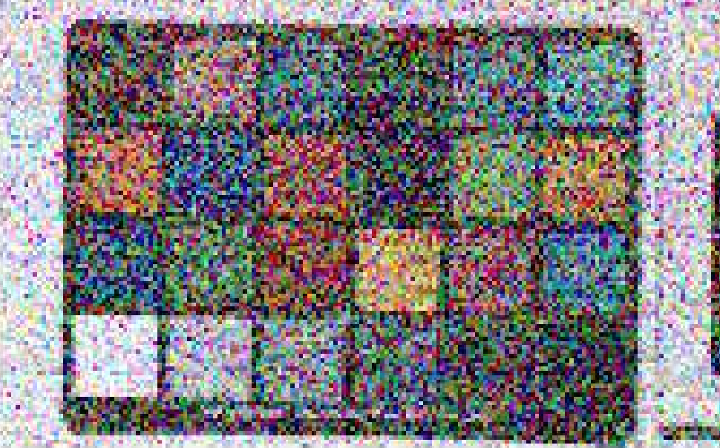
Noise sources in image sensors

Slide 7
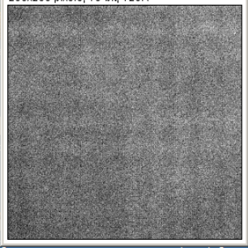
Two noise categories
1. Temporal noise
2. Fixed pattern noise
Temporal noise: random disturbance which changes every time a capture is taken
Fixed pattern noise: does NOT change with time (ie fixed pattern superimposed on the image)

Slide 8
Temporal noise example
Temporal noise changes randomly with time (ie for every capture)
Example pixel row profile:
Pixel value
Column position

Slide 9
Photon shot noise
Temporal noise that changes randomly from pixel to pixel and capture to capture (even if light level is constant)
Follows Poisson’s probability distribution:
p(x) = probability of x incidents (e.g. x photons detected in a pixel during T_{int}),
e = natural logarithm base (~2.72),
µ = mean value, i.e. statistical average of x, ie $\sum_{x}{x∙p(x)}$
$$p\left(x\right)=\frac{μ^{x}e^{−μ}}{x!}$$

Slide 10
Property of Poisson process: variance equals the mean (µ)
$$Mean(x)=\sum_{x=0}^{∞}{x∙p(x)=μ}$$
$$Var\left(x\right)=σ_{x}^{2}=\sum_{x=0}^{∞}{{\left(x−μ\right)}^{2}p(x)=μ}$$
Signal/Noise of ideal photon detector ($μ/σ$):
$$SNR=\frac{Mean(x)}{\sqrt{Var(x)}}=\frac{μ}{\sqrt{μ}}=\sqrt{μ}$$
Ex: if a pixel detects an average of 100photons, then S/N=10 (20dB)

Slide 11
Poisson distribution plots at various mean values (µ)
µ=1
µ=2
Probability of occurrance (no unit)
µ=10
Number of incidences (e.g. photons or electrons)

Slide 12
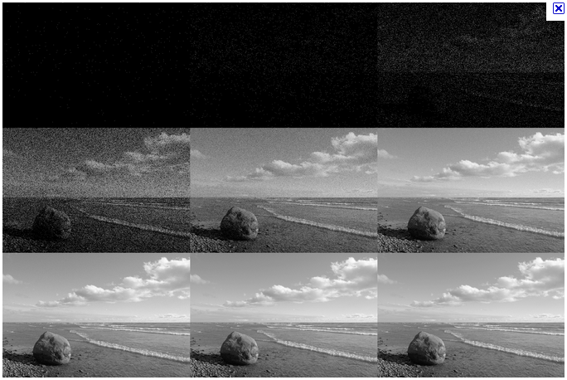
Photon shot noise examples
μ=0e-
μ=1e-
μ=2e-
μ=4e-
μ=10e-
μ=30e-
μ=100e-
μ=1000e-
μ=10000e-
Ref: Wikipedia

Slide 13
Fixed pattern noise (FPN)
FPN (also called nonuniformity) is the time invariant spatial variation in pixel output values under uniform illumination (incl total darkness) due to device and parameter variations (mismatches) across the sensor
Fixed for one sensor, but the nonuniformity pattern changes randomly from sensor to sensor. Hence, the ‘noise’ term.
E.g. vertical or horizontal stripes, white pixels, black pixels, shading, …

Slide 14
FPN compensation
FPN in pixels can be compensated digitally
For instance, dark FPN (ie FPN under zero illumination) can be removed by subtracting a dark image from regular captures
But FPN compensation too costly in commercial products. Instead, sensor must be designed for FPN to be invisible to human eye => 10x below temporal noise
A
B
A - B
Original picture
Dark image
After compensation

Slide 15
Dark current = both temporal noise and fixed noise (FPN)
Thermally generated electrons (or holes) in the pixel. Adds to the photo-generated signal charge and thus creates a pedestal offset.
Problem is that dark current is a random process (Poissonian, just like photons). Hence, it appears as noise in the picture or video at high temperatures and/or long integration times.
Mean value accross the array (N_{dark}) is a constant value and not defined as noise, since not random. In fact, it can be measured and subtracted from the pixel values (Black.
Standard deviation (σ_{dark}) is temporal noise

Slide 16
Thermal noise
Thermal agitations of electrons within a resistance (fundamental in all circuits)
Example row profile in darkness:
Random variation for every capture

Slide 17
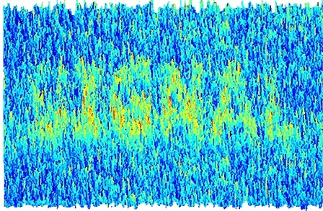
Signal/noise model

Slide 18
Introduction
Signal/noise ratio (S/N or SNR) is an essential quality performance parameter of any sensor
SNR quantifies how precise, accurate, reliable, trustworthy, .. the sensor output value is
Modelling SNR is important when making design desicions such as pixel size, circuit topology, ADC resolution, etc.
This section covers SNR modelling, incl correlated double sampling, and the impact of FPN

Slide 19
Outline
Define signal and noise for CMOS image sensors
Create model of S (from photons to bits)
Create model of N (shot noise, RN, ADC..)
Create model of CDS sampling process
Discuss how FPN influences SNR

Slide 20
Signal-to-noise ratio (SNR)
Sensor
Input signal
Output signal&noise
σ=rms noise=std.dev.
Output signal (a.u.)
$$SNR≝\frac{μ}{σ}$$
S/N in dB: 20log($\frac{μ}{σ}$)
µ
µ=mean sig
Input signal (a.u.)

Slide 21
Model of signal chain (multiple blocks)
G₁, σ₁
G₂, σ₂
G₃, σ₃
S_{in}/ σ_{in}
S_{out}/σ_{out}
S: signal
G_{i}: gain of module i
σ_{i}: rms noise added by i^{th} module (uncorrelated with the others)
$$S_{out}/σ_{out}=\frac{S_{in}G_{1}G_{2}G_{3}}{\sqrt{{σin}_{}^{2}{G1}_{}^{2}{G2}_{}^{2}{G3}_{}^{2}+{σ1}_{}^{2}{G2}_{}^{2}{G3}_{}^{2}+{σ2}_{}^{2}{G3}_{}^{2}+{σ3}_{}^{2}}}$$
NB! Noise sources added together. However, only in power (V²) domain, not in voltage domain due to the noise voltage (and/or noise current) being random with zero mean value.

Slide 22
Pixel+ADC model
Floating diffusion
Source follower
A/D converter
CG_{fd}, σ_{kTC}
G_{sf}, σ_{sf}
G_{adc}, σ_{adc}
S_{in}/ σ_{in}
S_{out}/σ_{out}
$$S_{out}/σ_{out}=\frac{S_{e−}CG_{fd}G_{sf}G_{adc}}{\sqrt{S_{e−}{CGfd}_{}^{2}{Gsf}_{}^{2}{Gadc}_{}^{2}+{σkTC}_{}^{2}{Gsf}_{}^{2}{Gadc}_{}^{2}+{σsf}_{}^{2}{Gadc}_{}^{2}+{σadc}_{}^{2}}}$$
Photon shot noise
Eliminated with
CDS
Readnoise, RN
S_{e-}: number of photo-electrons generated by photodiode
S_{out}: ADC output signal (DN or LSBs)
σ_{kTC}, σ_{sf}: rms noise voltage from FD and SF, respectively (V rms)
σ_{adc}: rms noise from ADC after gain (LSB rms)
G_{adc}: ADC conversion gain, (2^Nbits-1)/Vref_adc (LSB/V)
CG_{fd}: floating diffusion conversion gain (V/e-)

Slide 23
Calculating rms noise value (σ) from noise spectrum, N(f)
Integrate N(f) across all frequencies to get σ
N(f): noise spectrum (V²/Hz)
σ: rms noise voltage (V)

Slide 24
Frequency domain representation
S_{in}(f)
N_{in}(f)
H(f)N(f)
S_{out}(f)
N_{out}(f)
S_{in}(f): input signal spectrum (V²/Hz)
H(f): transfer function of any linear time-invariant system, e.g. pixel, amplifier, filter, ADC, CDS, ..
N(f): noise spectrum of additive noise source inside H(f), e.g. Johnson noise or 1/f-noise from resistors or transistors (V²/Hz)

Slide 25
Signal chain in frequency domain
S_{in}(f)
N_{in}(f)
H₁(f)N₁(f)
H₂(f)N₂(f)
H₃(f)N₃(f)
S_{out}(f)
N_{out}(f)
H(f): transfer function of any linear time-invariant system, e.g. pixel, amplifier, filter, ADC, CDS, ..
N₁(f), N₂(f), N₃(f): noise spectrum of noise sources (V²/Hz)

Slide 26
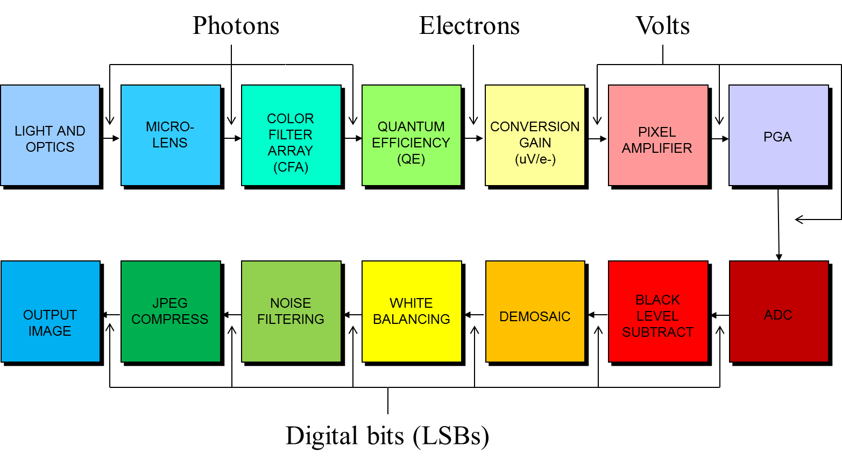
CIS signal chain from photons to bits
CCM
CIP
$$S_{ADCout}$$

Slide 27
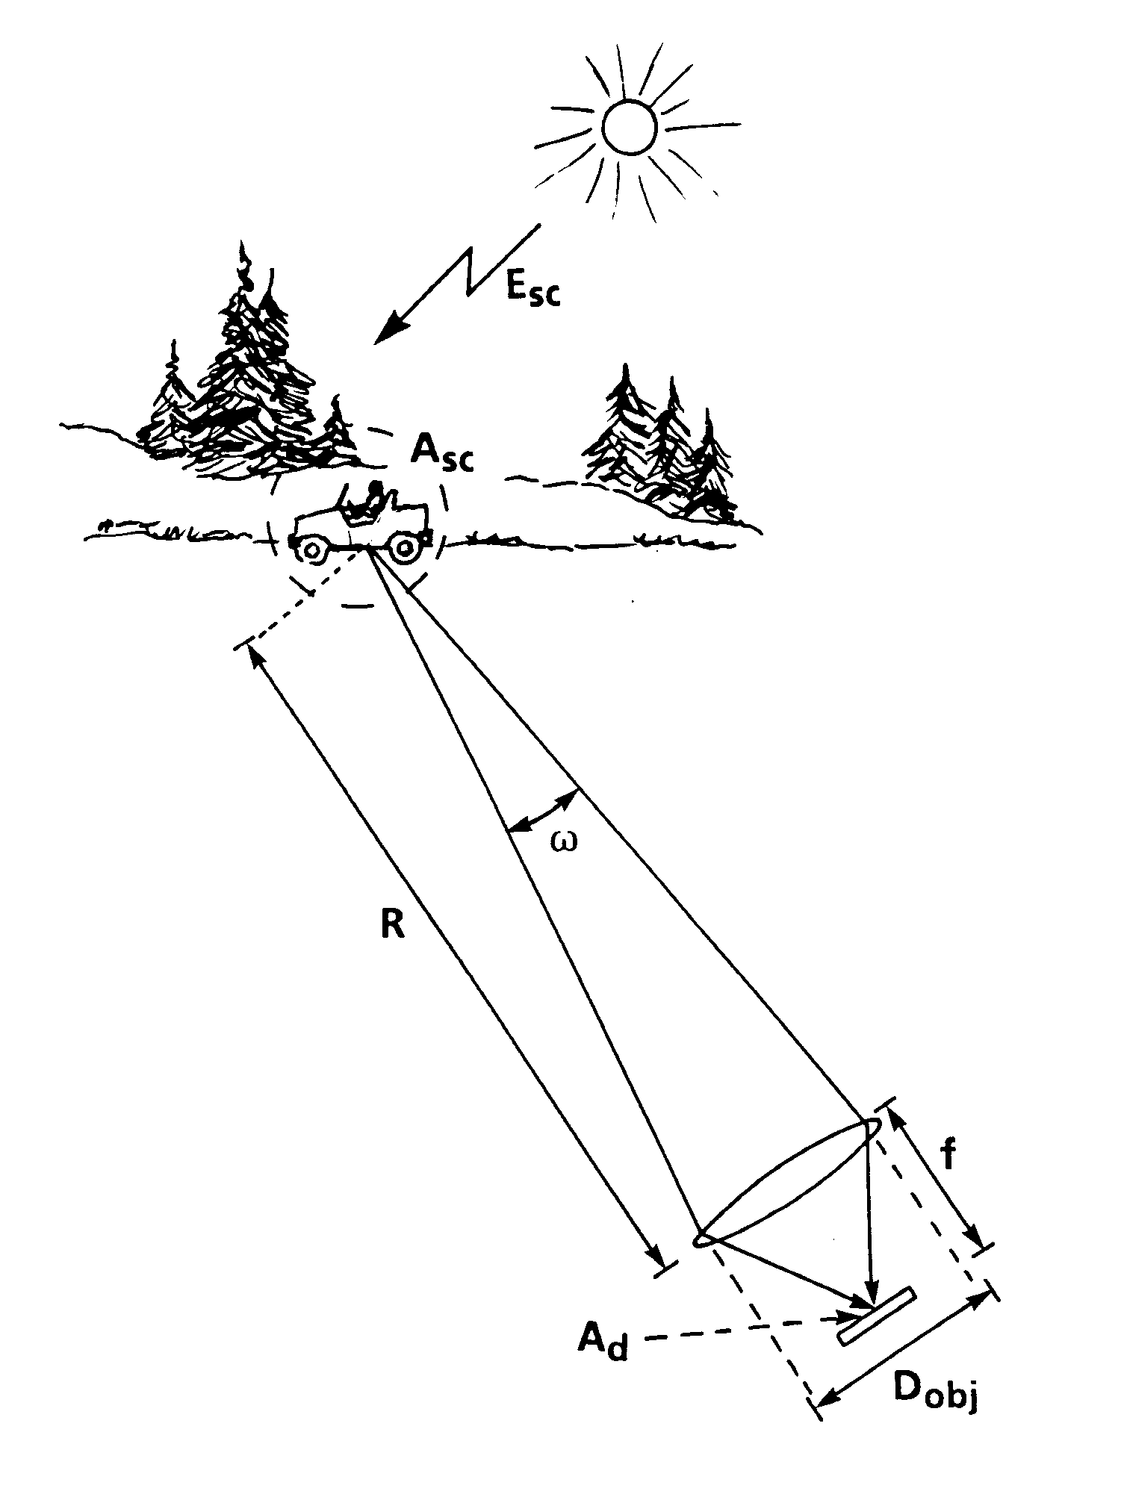
Pixel light flux for a given scene illumination
E_{sc}=scene irradiation (W/m/m²)
ρ_{sc}=scene reflectivity (no unit)
F=lense F-nummer (=f/D_{obj})
D_{obj}= lens aperture (m)
f = lens focal length (m)
A_{d}=detector area (m²)
λ=light wavelength (m)
E_{d}=detector irradiation (W/m/m²)

Slide 28
Calculation of pixel value after ADC
S_{ADCout}=output value (DN aka LSBs)
E_{sc}(λ)=spectral irradiation (W/m/m²)
ρ_{sc}(λ)=scene reflectivity (no unit)
T_{int}=camera exposure time (s)
F=lense F-nummer (=f/D_{obj})
h=Plancks constant (6.6x10⁻³⁴ J s)
c=speed of light (3x10⁸ m/s)
A_{pix}=detector area (m²)
λ=light spectral wavelength (m)
CG_{pix}=conversion gain (V/e-)
G_{sf}=source follower gain (no unit)
N_{bits}=ADC resolution (no unit)
V_{adc_ref}=ADC saturation level (V)

Slide 29
Temporal noise sources
Photon shot noise =>µ=S_{e-}, σ=sqrt(N_{ph})
N_{ph}: mean value of photons
Dark current noise =>µ=N_{dc}, σ=sqrt(N_{dc})
N_{dc}: mean value of dark current electrons
Read noise =>µ=0, σ=RN (V rms)
RN: temporal noise in darkness from pixel+ADC

Slide 30
Read noise sources
Temporal noise at zero illumination
Read noise =>µ=0, σ=RN
RN: rms noise floor in dark from pixel+ADC
Pixel source follower noise sources
White noise
1/f noise
ADC noise
White noise
1/f noise
Quantization noise =>µ=0, σ=1LSB/sqrt(12)

Slide 31
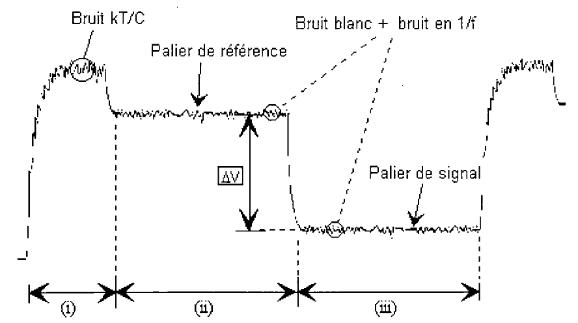
Example of 4T pixel output signal with noise
V_{pix}(t)
kT/C noise
White noise and 1/f noise, N_{pix}(f)
Reset level (Vrst)
Signal level (Vsig)
t
RST
TX

Slide 32
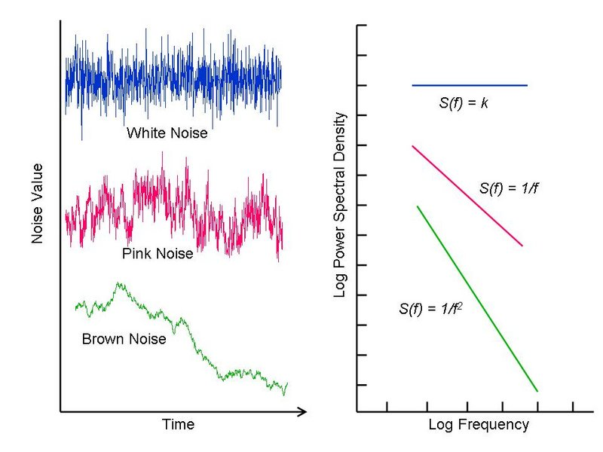
White noise and 1/f noise in transistors
N(f)
N(f)=k
N(f)=1/f
N(f)=1/f²

