Slide 1
INF5350 – CMOS image sensor design
Lecture 6 – Modelling S/N ratio
4-October-2019

Slide 2
Agenda
Project milestone status
Takeaways from previous lecture&exercises
Modelling S/N ratio

Slide 3
Project schedule
Task/milestone | Start | Finish
Chose topic/scope | 16-Sep | 20-Sep
Create project plan (tasks, milestones, schedule) | 20-Sep | 27-Sep
MS1 – project plan approved by Johannes | 30-Sep | 30-Sep
Study literature on the topic | 27-Sep | 4-Oct
Design/simulation | 4-Oct | 25-Oct
Write up prelim report (inc references, design, results) | 25-Oct | 29-Oct
MS2 – submit preliminary report to Johannes | 29-Oct | 29-Oct
Design/simulation | 29-Oct | 15-Nov
Write up final report (incl references, design, results) | 15-Nov | 22-Nov
MS3 – submit final report to Johannes & presentation | 22-Nov | 22-Nov
MS4 – grading (pass/fail) by Johannes & Tohid | 22-Nov | 22-Nov
Exam | 28-Nov 2019
✅
✅
✅
✅

Slide 4
Key takeaways from previous lecture
Temporal noise vs Fixed pattern noise
Photon flux and electron flux are random Poisson processes
Mean value (μ) = Variance (σ²) = (RMS value, σ)²
Independent noise sources can be summed quadratically
σ_{total} = sqrt(σ₁²+ σ₂² + σ₃² + ..)

Slide 5
SNR model based on σ for each block
Floating diffusion
Source follower
A/D converter
CG_{fd}, σ_{kTC}
G_{sf}, σ_{sf}
G_{adc}, σ_{adc}
S_{in}/ σ_{in}
S_{out}/σ_{out}
$$S_{out}/σ_{out}=\frac{S_{e−}CG_{fd}G_{sf}G_{adc}}{\sqrt{S_{e−}{CGfd}_{}^{2}{Gsf}_{}^{2}{Gadc}_{}^{2}+{σkTC}_{}^{2}{Gsf}_{}^{2}{Gadc}_{}^{2}+{σsf}_{}^{2}{Gadc}_{}^{2}+{σadc}_{}^{2}}}$$
How to model σ for pixels, gain amplifiers, filters, ADCs, etc?

Slide 6
Modelling noise in frequency domain
N_{in}(f): noise power density at input (V²/Hz)
N_{out}(f): noise power density at output (V²/Hz)
H(f): transfer function of a linear time-invariant system, e.g. pixel, amplifier, filter, ADC, CDS, ..
H(f)
N_{in}(f)
N_{out}(f) (V²/Hz)
(V rms)

Slide 7
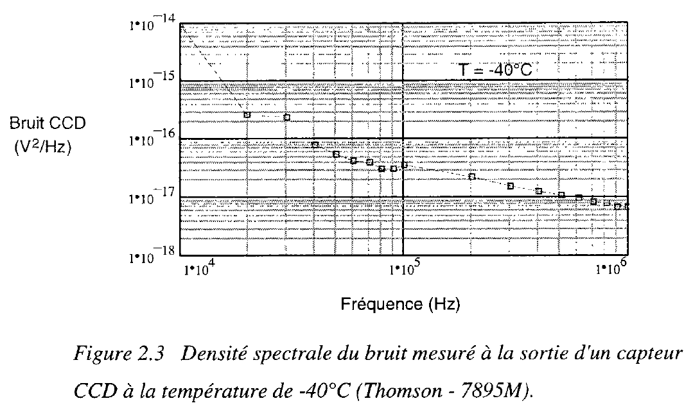
Noise spectral density at pixel SF output
N_{pix}(f) = k₁ + k₂/f + k₃/f² (V² / Hz)
N_{pix}(f)
Measured noise spectrum at the output of a CCD source follower at -40C. CMOS source followers look similar. White noise (k₁) dominates at high frequencies, typically above 1-10MHz.

Slide 8
Digital CDS model
Sample&Hold
V_{ref}
Low-pass filter
ALU
Signal, V_{pix}
Noise, N_{pix}
Signal, ΔV
Noise, σ
A/D
$$h\left(t\right)=1−e^{−t/{RC}}$$
$$h(t) = \frac{2^{N_{bit}}−1}{V_{ref}}\{δ\left(t\right)–δ\left(t−T_{CDS}\right)\}$$
δ(t) = delta-dirac function models the ADC input signal sampling
N_{bit} = number of ADC bits (typically 10b-12b)
V_{ref} = ADC reference voltage (typically 1V at 1x gain)
T_{CDS} = time interval between sampling of reset level and signal level

Slide 9
Fourier transfer of DCDS process
$h\left(t\right)= (δ\left(t\right)−δ(t−T_{CDS}$))
(i.e. Vrst-Vsig)
$$H\left(jω\right)= (1−e^{−jωT_{CDS}})$$
$$(ω=2πf)$$
$${\left|H\left(jω\right)\right|}^{2}=H\left(jω\right)∙H\left(−jω\right)$$
${\left|H\left(jω\right)\right|}^{2}= (1−e^{−jωT_{CDS}}$) $∙(1−e^{+jωT_{CDS}}\text{)}$
$${\left|H\left(jω\right)\right|}^{2}= (2−2∙\cos\left(ωT_{CDS}\right))=\text{4}∙\sin^{2}(\frac{ωT_{CDS}}{2}\text{)}$$

Slide 10
DCDS transfer function example
$${\left|H\left(jω\right)\right|}^{2}=\text{4}∙\sin^{2}(\frac{ωT_{CDS}}{2}\text{)}$$
Low frequency signals & noise attenuated

Slide 11
DCDS with LP filter for noise limitation
Low-pass filter
A/D and digital CDS
$$h\left(t\right)=1−e^{−t/{RC}}$$
$$h(t) = \frac{2^{N_{bit}}−1}{V_{ref}}\{δ(t) –δ(t−T_{CDS})\}$$
Input
Output
$${\left|H(f)\right|}^{2}=\frac{1}{1+{\left(f/f_{0}\right)}^{2}}$$
$${\left|H(f)\right|}^{2}=\text{4}∙\frac{2^{N}−1}{V_{ref}}∙\sin^{2}(\frac{ωT_{CDS}}{2}\text{)}$$

Slide 12
DCDS w/LP filter transfer function example
${\left|H\left(jω\right)\right|}^{2}=\text{4}∙\sin^{2}(\frac{ωT_{CDS}}{2}\text{)}$ $∙ \frac{1}{1+{\left(f/f_{0}\right)}^{2}}$
Roll-off due to low-pass filter

Slide 13
Output noise after digital CDS
$$σ^{2}=\int_{0}^{∞}{\frac{N_{pix}(f)}{1+{\left(\frac{f}{f_{c}}\right)}^{2}}∙{\left|H(f)\right|}^{2}∙df}$$
$$σ^{2}=\int_{0}^{∞}{\frac{N_{pix}(f)}{1+{\left(\frac{f}{f_{c}}\right)}^{2}}∙\frac{2^{N_{bit}}−1}{V_{ref}}∙\text{4}∙\sin^{2}(\frac{ωT_{CDS}}{2}\text{)}∙df}$$
$$σ^{2}=\text{4}∙\frac{2^{N_{bit}}−1}{V_{ref}}∙\int_{0}^{∞}{\frac{N_{pix}(f)}{1+{\left(\frac{f}{f_{c}}\right)}^{2}}∙\sin^{2}(\frac{ωT_{CDS}}{2}\text{)}∙df}$$
(LSB²)

Slide 14
Correlated Multi-Sampling (CMS)
Sample Vrst and Vsig twice and take average to reduce noise (need twice as fast ADCs)
A/D
Low-pass filter
ALU
$$h\left(t\right)=1−e^{−t/{RC}}$$
CDS
$h(t) = \frac{2^{N}−1}{V_{ref}}\{δ\left(t\right)+δ(t−τ)–δ(t−T_{CDS})–δ(t−τ−T_{CDS})\}$/2

Slide 15
CMS S/N model
$h(t) = \frac{2^{N}−1}{V_{ref}}\{δ\left(t\right)+δ(t−τ)–δ(t−T_{CDS})–δ(t−τ−T_{CDS})\}$/2
$$H\left(jω\right)=\frac{2^{N}−1}{2∙V_{ref}}\left(1+e^{−jωτ}−e^{−jωT_{CDS}}−e^{−jω{(τ+T}_{CDS})}\right)$$
${\left|H\left(jω\right)\right|}^{2}=\frac{2^{N}−1}{2∙V_{ref}}\{1+cos⁡(ωτ)\text{−}\text{cos}\text{(}ωT_{CDS}\text{)−}\frac{1}{2}∙cos\left(ω\left(T_{CDS}−τ\right)\right)\text{−}\frac{1}{2}∙cos\left(ω\left(T_{CDS}+τ\right)\right)$}
$$σ^{2}=\int_{0}^{∞}{\frac{N_{pix}(f)}{1+{\left(\frac{f}{f_{c}}\right)}^{2}}∙{\left|H(f)\right|}^{2}∙df}$$
(LSB²)

Slide 16
Example of Poisson distributed random values (e.g. photons and dark current)
Mean(A) = 2 => sigma(A) = 1.4
Mean(B) = 10 => sigma(B) = 3.2
Mean(A+B) = 12 => sigma(A+B) = 3.5

Slide 17
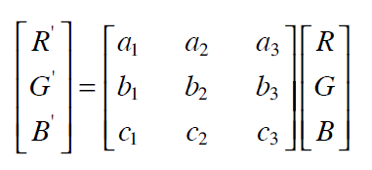
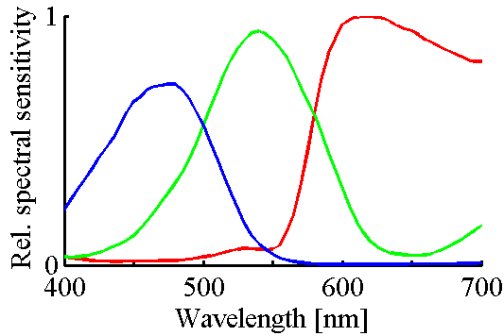
Noise from color crosstalk
Matrix ‘A’ = Color correction matrix (CCM)
3x3 matrix with fixed values stored in non-volatile memory
Blue to green crosstalk, b₃
Ref to green crosstalk, b₁
R’=a₁R+a₂G+a₃B e.g. 1.35R-0.2G-0.15B
G’=b₁R+b₂G+b₃B e.g. -0.05R+1.1G-0.05B
B’=c₁R+c₂G+c₃B e.g. -0.05R-0.15G+1.2B

Slide 18
Noise from color crosstalk (cont.)
Green signal, G’ = b₁R + b₂G + b₃B
Green noise, σ_{G’}² = b₁²σ_{R}² + b₂²σ_{G}² + b₃²σ_{B}²
Assuming R=G=B=S_{e-}>>RN (photon noise limited)
The larger the CCM values, the lower the SNR. (same for blue and red pixels.)
NB! Above assumes b₁+b₂+b₃=1 (unchanged brightness)

Slide 19
Photoresponse non-uniformity
Fixed pattern noise
Several potential root causes
Quantum efficiency variation due to manufacturing spread in the optical stack and/or in the PD implants
Conversion gain (CG) variation due to parasitic capacitance variation
Source follower gain variation due to Vth variation in active device
PRNU (in e- rms, V rms, or LSB rms) is proportional to the signal level
Therefore, it is usually quoted in terms of % rms of signal level
Let’s assume a signal level of 500e⁻ and 1% rms PRNU. Then,
$$σ_{PRNU}=500e^{−}∙0.01=5e^{−} rms$$

Slide 20
SNR model w/FPN sources
G_{asc}, σ_{asc}
S_{in}/ σ_{in}
S_{out}/σ_{out}
$$S_{out}/σ_{out}=\frac{S_{e}G_{asc}}{\sqrt{S_{e}{Gasc}_{}^{2}+{Se}_{}^{2}{σPRNU}_{}^{2}{Gasc}_{}^{2}+{σDSNU}_{}^{2}{Gasc}_{}^{2}+{σvfpn}_{}^{2}}}$$
If S_{e} >>1 => SNR=1/σ_{PRNU}
S_{e}: number of photo-electrons generated by photodiode
S_{out}: ADC output signal (DN or LSBs)
σ_{PRNU}: photoresponse non-uniformity (% rms)
σ_{DSNU}: dark signal non-uniformity (e- rms)
σ_{vfpn}: rms noise from vertical column FPN (LSB rms)
G_{asc}: conversion factor of analog signal chain, (LSB/e-)
CG_{fd}: floating diffusion conversion gain (V/e-)

Slide 21
Example noise curve
PRNU dominated
Photon shot noise dominated
RN=3e-

Slide 22
Example SNR plot
PRNU dominated
Photon shot noise dominated

Slide 23
PRNU dominates over photon shot noise at high signal levels
PRNU for most sensors is <1% rms
Negligible at small signal levels (small FW) but becomes dominant at high signal levels

Slide 24
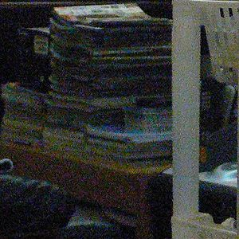
Example of picture with random noise
Possible noise sources in this picture:
Photon noise in ‘grey’ medium bright areas
Dark current (DC) in dark areas
Electronic circuit noise (read noise) in dark areas
Photoresponse-non-uniformity (PRNU) in bright areas

Slide 25
Vertical fixed pattern noise (VFPN)
Example of column FPN (vertical FPN)
When VFPN is randomly distributed across columns, it can be modelled similarly to temporal noise:

Slide 26
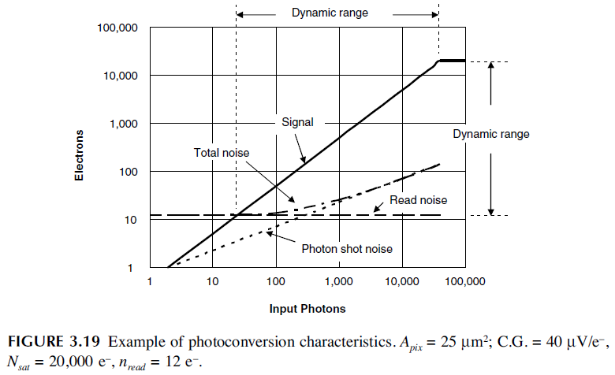
Signal, Noise and Dynamic Range
Source: Nakamura et.al.

Slide 27
Key takeaways
Noise sources added together in power domain or variance (ie V², I², or σ²)
CDS eliminates in-pixel kTC-noise and strongly attenuates low-frequency (1/f) noise
The larger the color correction matrix (CCM) values, the more shot noise is added to the pixel
FPN is calculated after removing (averaging) temporal noise. Thus, FPN relates to the image, not a single pixel.

Slide 28
appendix

Slide 29
Random variables
Discrete random variables modelled as probability mass function
x is integer (example: number of photons or electrons in a Poisson process)
A continuous random variable (x real, e.g. analogue voltage) modelled as probability density function
x is real (example: analogue voltage in a Gaussian process)
$$\sum_{x}{p\left(x\right)=1}$$
$$p\left(x\right)≥0$$
$$f\left(x\right)≥0, \int_{−∞}^{+∞}{f\left(x\right)dx=1}$$

Slide 30
Gaussian random variable
f(x)
$$f\left(x\right)=\frac{1}{\sqrt{2πσ^{2}}}e^{−\frac{{(x−μ)}^{2}}{2σ^{2}}}$$
σ

