Slide 1
INF5350 – CMOS image sensor design
Lecture 7 – High Dynamic Range CIS
11-October-2019

Slide 2
Agenda
Project milestone status
Takeaways from previous lecture&exercises
HDR image capture

Slide 3
Project schedule
Task/milestone | Start | Finish
Chose topic/scope | 16-Sep | 20-Sep
Create project plan (tasks, milestones, schedule) | 20-Sep | 27-Sep
MS1 – project plan approved by Johannes | 30-Sep | 30-Sep
Study literature on the topic | 27-Sep | 4-Oct
Design/simulation | 4-Oct | 25-Oct
Write up prelim report (inc references, design, results) | 25-Oct | 29-Oct
MS2 – submit preliminary report to Johannes | 29-Oct | 29-Oct
Design/simulation | 29-Oct | 15-Nov
Write up final report (incl references, design, results) | 15-Nov | 22-Nov
MS3 – submit final report to Johannes & presentation | 22-Nov | 22-Nov
MS4 – grading (pass/fail) by Johannes & Tohid | 22-Nov | 22-Nov
Exam | 28-Nov 2019
✅
✅
✅
✅

Slide 4
Lecture 7 – High dynamic range capture techniques overview
Motivation
Define DR
Dual exposure HDR
Skimming HDR (a.k.a. Lateral-Overflow HDR)
Down sampling HDR
Split-diode pixel HDR
Dual conversion gain HDR (a.k.a. DCG HDR)

Slide 5
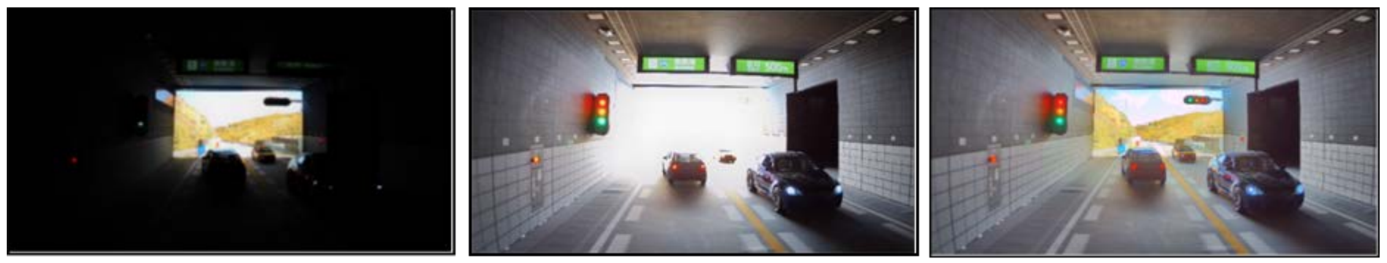
HDR in automotive
Imaging terminology
  Linear sensor: 8b to 12b output from single capture
  HDR sensor: up to 24b output from multiple captures
Linear (Tint short)
Linear (Tint long)
HDR capture
Source: Sony, IISW’19

Slide 6
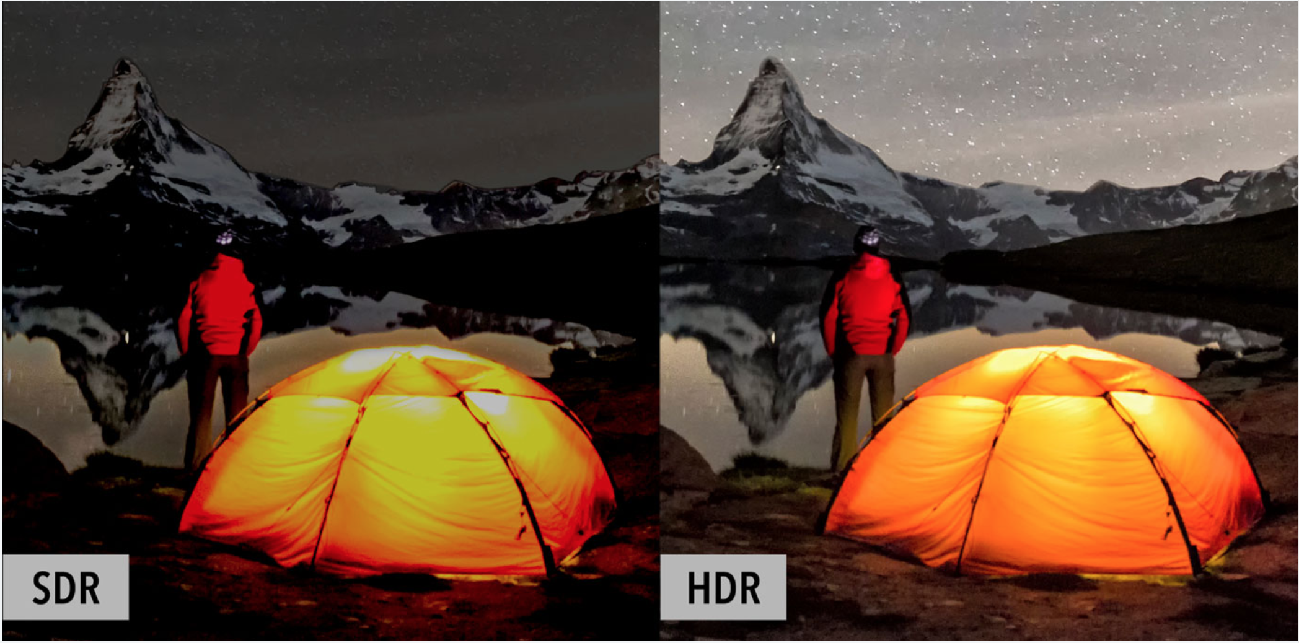

Slide 7
Linear sensor
8b to 12b output from single capture
2^{Nbits}-1
Dark night setting
1
Daylight
setting
2
Pixel value (LSBs)
Light level (a.u.)
Poor S/N

Slide 8
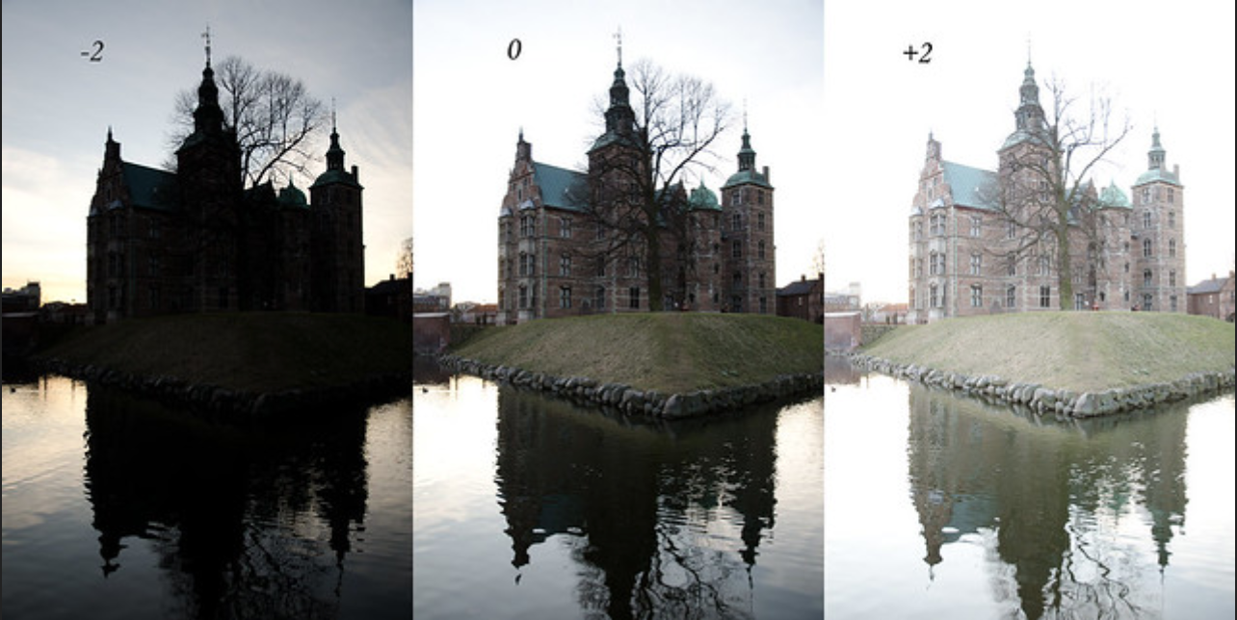
Linear sensor
3
2
1

Slide 9
HDR sensor
Up to 24b output from multiple captures combined
2^{Nbits}-1
3
2
Pixel value (a.u.)
1
Light level (a.u.)

Slide 10

HDR sensor after combine&processing

Slide 11
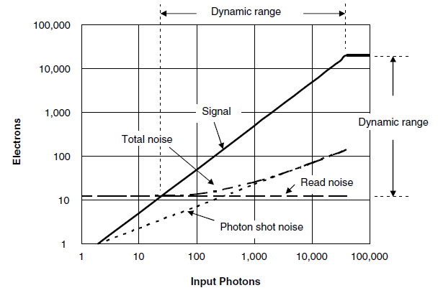
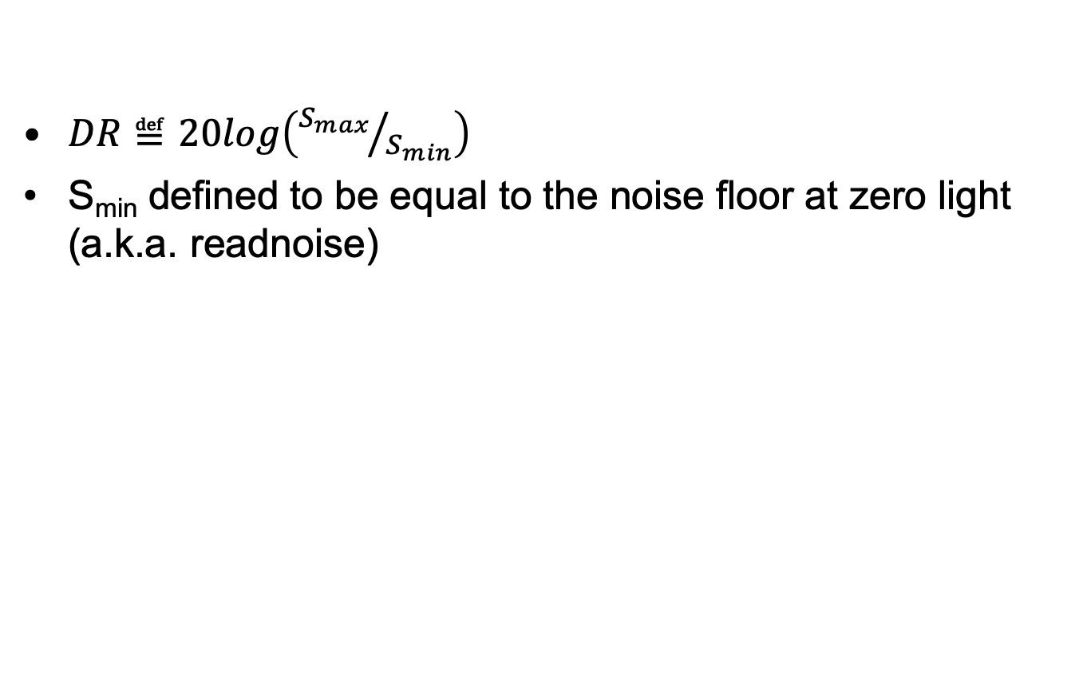
Dynamic Range for Image Sensors
$DR≝20log\left({S_{max}}/{S_{min}}\right)$
S_{min} defined to be equal to the noise floor at zero light (a.k.a. readnoise)
S_{min}
S_{max}
S_{max}
S_{min}

Slide 12
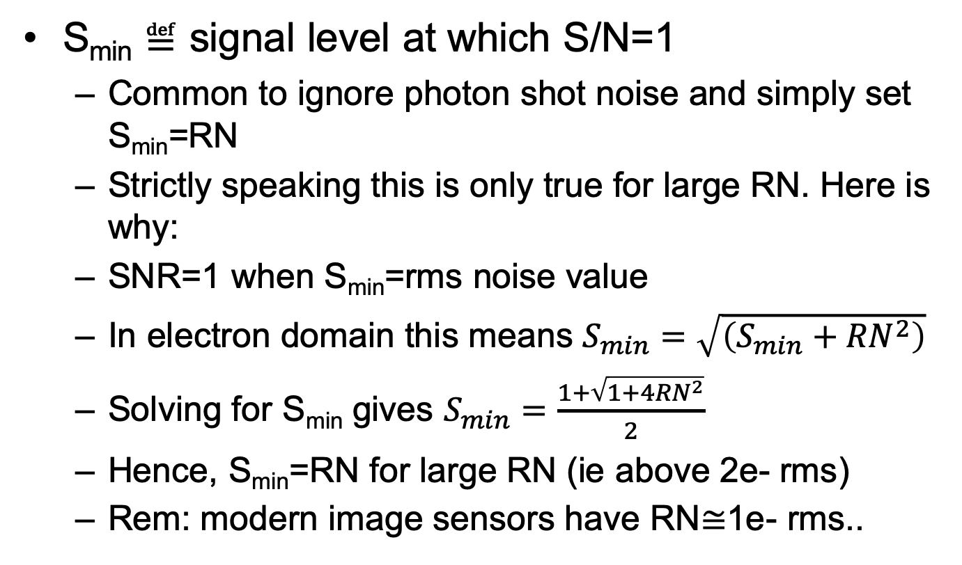
Remark about DR for image sensors
S_{min} ≝ signal level at which S/N=1
  Common to ignore photon shot noise and simply set S_{min}=RN
  Strictly speaking this is only true for large RN. Here is why:
  SNR=1 when S_{min}=rms noise value
  In electron domain this means $S_{min}=\sqrt{\left(S_{min}+{RN}^{2}\right)}$
  Solving for S_{min} gives $S_{min}=\frac{1+\sqrt{1+4{RN}^{2}}}{2}$
  Hence, S_{min}=RN for large RN (ie above 2e- rms)
  Rem: modern image sensors have RN≅1e- rms..

Slide 13
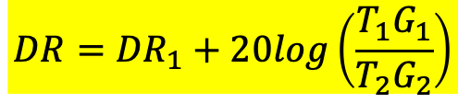
Dual exposure HDR concept
HDR combine function maps exp-2 pixel values along exp-1 curve to get linear output response
Pixel value (a.u.)
PD saturation
1
2
Light level (a.u.)
DR₁
$$DR={DR}_{1}+20log\left(\frac{T_{1}G_{1}}{T_{2}G_{2}}\right)$$
T₁, T₂: integration time (T₁ is long, T₂ is short)
G₁, G₂: total gain in readout chain (LSBs per electron)

Slide 14
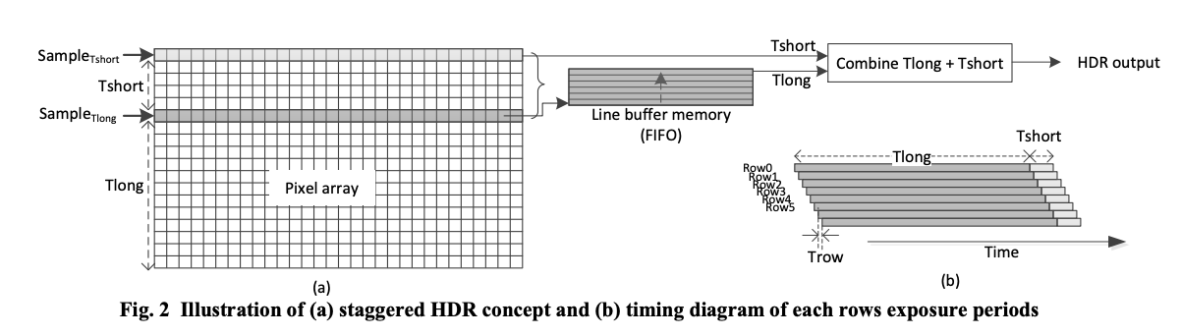
Dual exposure with Staggered readout
Two readout pointers running in parallel (Tlong and Tshort)
Line memory used as FIFO to delay processing of Tlong pixel values until they can be combined with Tshort values from same pixel row and produce linear HDR value
Delay between Tlong and Tshort => motion artifacts
  More details here: Solhusvik, IISW’13

Slide 15
Staggered dual exposure remarks
If analogue gain is applied in the readout chain, then the full DR of the photodiode is not utilized
For instance, 8x analog gain reduces full-well capacity (FWC) by 8x
Therefore, Tshort capture is usually with 1x gain and Tlong with 2x-16x depending on application
Significant SNR drop at the Tlong/Tshort transition point (a.k.a. knee-point), especially at large exposure ratios

Slide 16
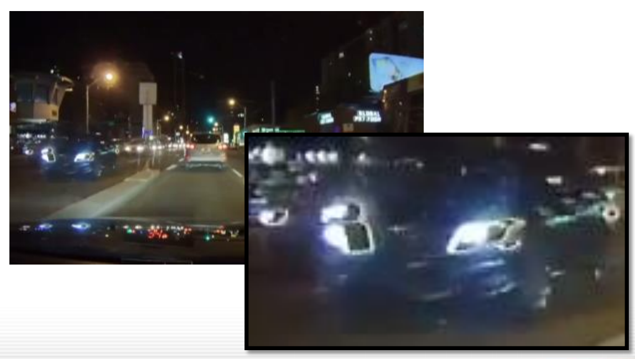
HDR motion artefact
Time-multiplexed staggered HDR scheme introduces motion artifacts (“ghosting”) due to motion in scene, as objects are in different position for each capture

Slide 17
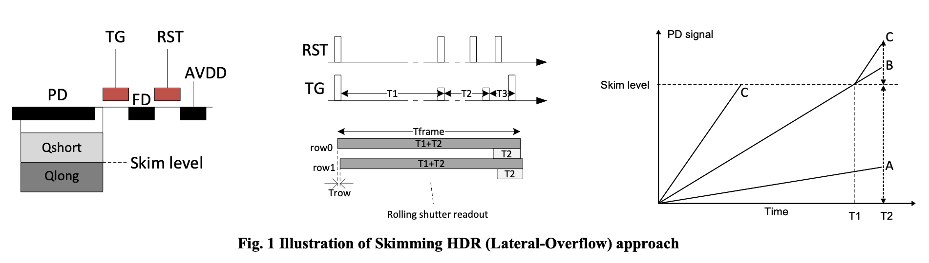
Skimming (lateral overflow) HDR concept
T2
T1+T2
At T1, TG is pulsed with reduced amplitude to ‘skim’ (remove) any charge above 50% of FWC
DR = DR₁ + 20log((T1+T2)/T2), where DR₁ is for capture A
  Assumes same gain in both captures
No need for line memory (smaller chip, lower power)
  More details here: Solhusvik, IISW’13

Slide 18
Skimming (Lateral-Ovflw) HDR remarks
Sensitive to Vth variations on TG device
  Leads to pixel-to-pixel variations of skimming level (source of FPN)
  Possible to measure and compensate for Vth spread by ‘flushing’ PD with electrons, then skimming pulse, then reading out the remaining charge which equals the skimming level

Slide 19
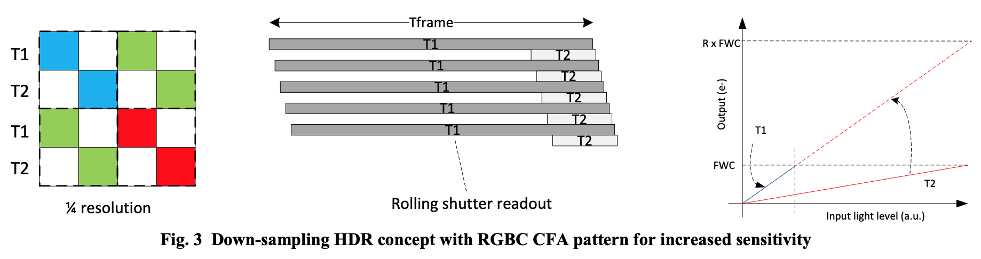
Down sampling HDR
Trade off optical (array) resolution to achieve HDR
Combine neighbouring pixels with different Tint
  T1/T2 represent long/short integration times
Above example uses RGBC CFA for improved sensitivity
  RGBC is not unique for down-sampling HDR sensors
  Equally applicable to other sensors for improved sensitivity

Slide 20

Down sampling HDR remarks
Similar to staggered HDR, but only requires one line buffer (small chip size, low power)
Trade off on resolution often not observable since even HDTV monitors (2Mpixels) have much lower resolution than most consumer imagers (8-80Mpixels)
Possible to further increase DR with for instance T1, T2, T3, T4 of four neighbouring pixels

Slide 21
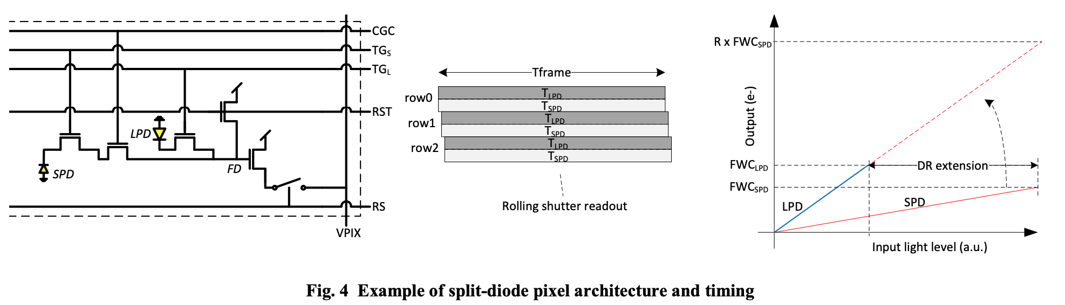
Split-diode pixel HDR
One small PD (SPD) and one large PD (LPD) in each pixel
SPD used to capture bright parts of the scene
If T_{LPD}=T_{SPD} then motion artefacts if mitigated (ref: the other HDR methods)

Slide 22

Split-diode HDR remarks
Trades off pixel sensitivity to get HDR with minimum motion artifacts
Complex architecture, difficult to scale below say 2um
Challenging to obtain identical QE curve for both LPD and SPD
Alternative approach, use 2x2 pixel cluster and reduce sensitivity of one of them, and combine the other there together into one large PD

Slide 23
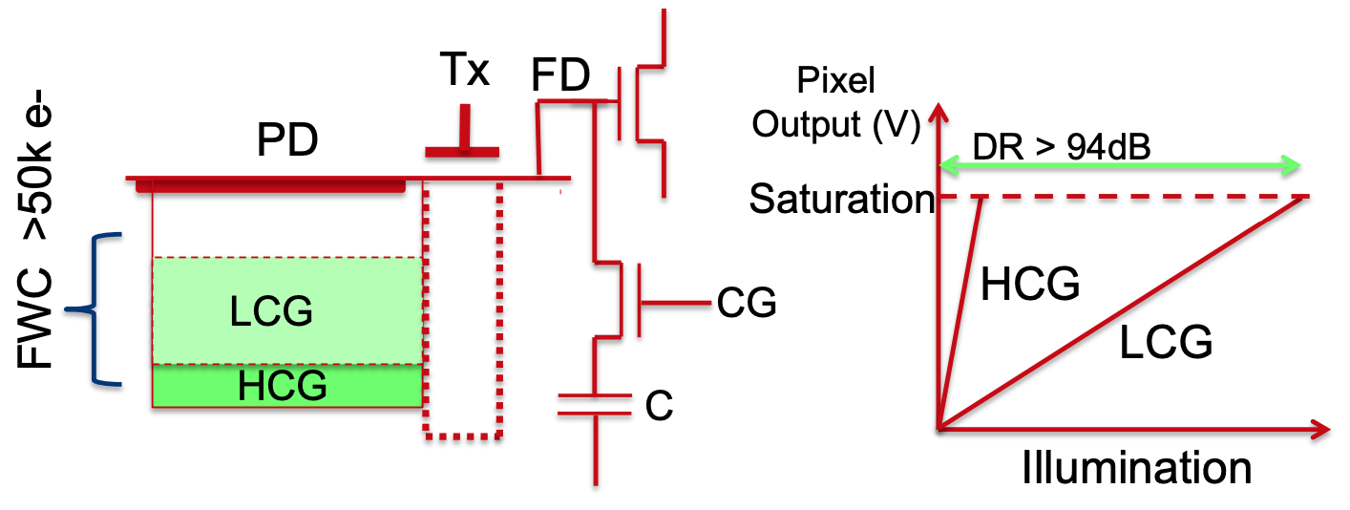
Dual conversion gain HDR
One single capture (Tint). Read out PD charge with high CG (low light) and low CG (high light).
DR = 20log(FWC_{LCG} / RN_{HCG})

Slide 24
DCG HDR remarks
One single integration => no motion artifacts
DR limited to about 96dB (60ke-/1e-) which is smaller than Tlong/Tshort HDR schemes
Often combined with other HDR schemes such as split-diode, multi-exposure, etc
Requires pixels with large FWC which is challenging w.r.t. dark current and charge lag from PD to FD node

Slide 25
Thanks!

