Slide 1
IN5350 – CMOS Image Sensor Design
Lecture 8 – Characterization

Slide 2
Contents
Measurement tools
QE – Quantum efficiency
CG – Conversion gain
RN - Readnoise
DC – Dark current
DSNU – Dark signal non-uniformity
PRNU – Photoresponse non-uniformity
VFPN – Vertical fixed pattern noise
HFPN – Horizontal fixed pattern noise

Slide 3
Recommended reading
EMVA 1288 Standard for image sensor characterization
https://www.emva.org/wp-content/uploads/EMVA1288-3.1a.pdf
SPIE book by Jim Janesick: Photon Transfer
Available at UiO
PhD thesis on CIS characterization
file:///Users/eier/Downloads/Utsav_jain_thesis_report.pdf
SPIE paper on Raspberry Pi based camera characterization
https://www.spiedigitallibrary.org/journalArticle/Download?fullDOI=10.1117%2F1.JEI.26.1.013014

Slide 4
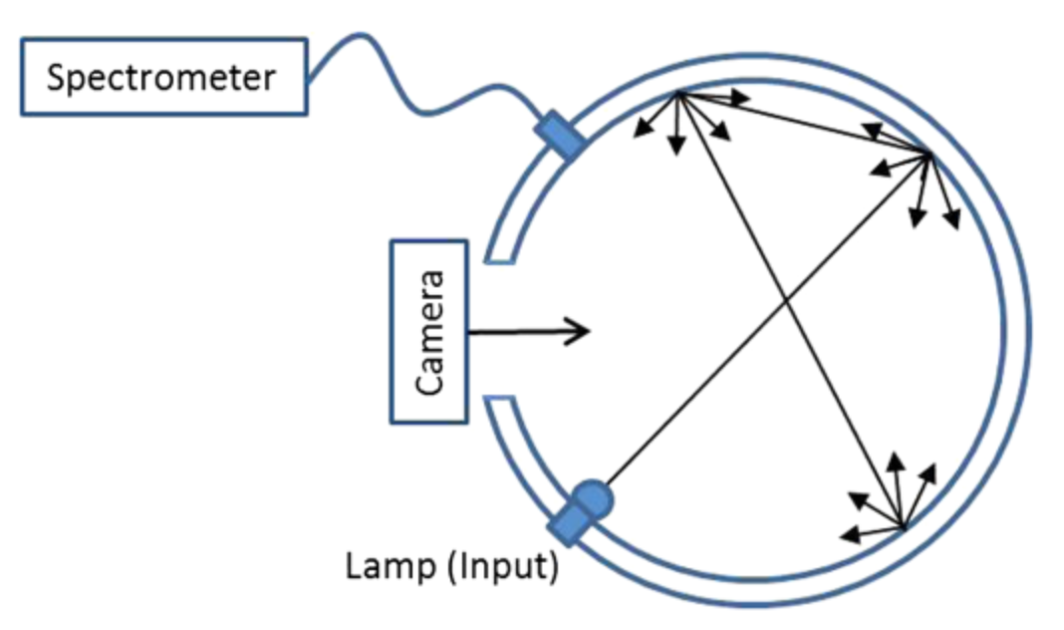
Integrating sphere
Illuminating a sensor uniformly on all pixels
Can be combined with a filter to select specific wavelength(s)

Slide 5
Optoliner
Integrating sphere + filters + optics
Illumination w/test pattern

Slide 6
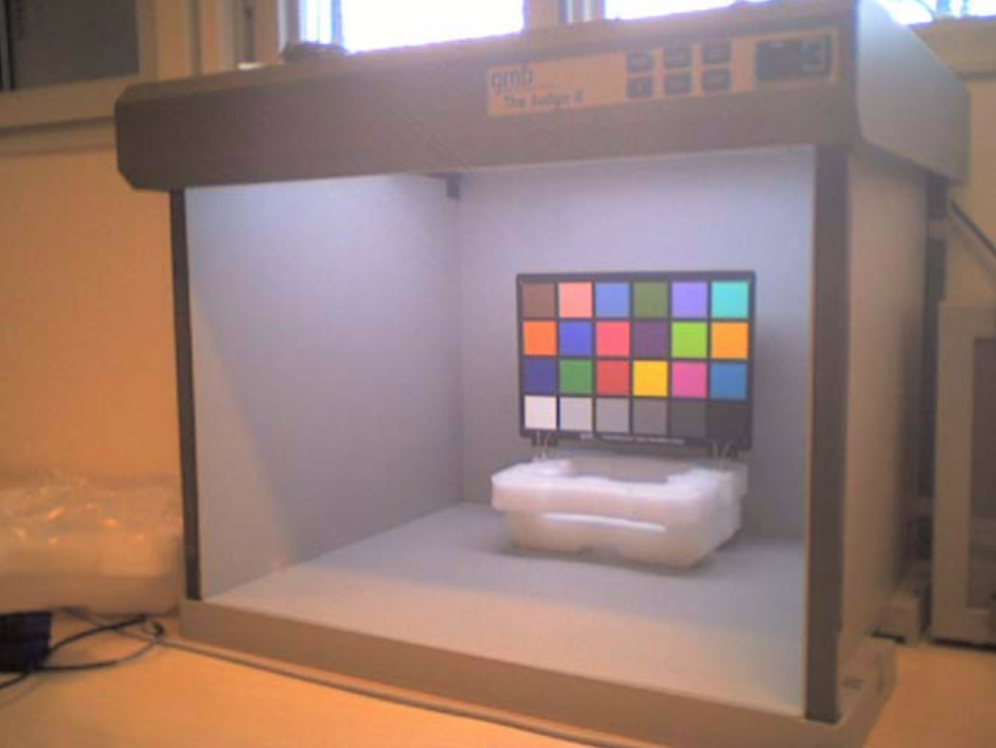
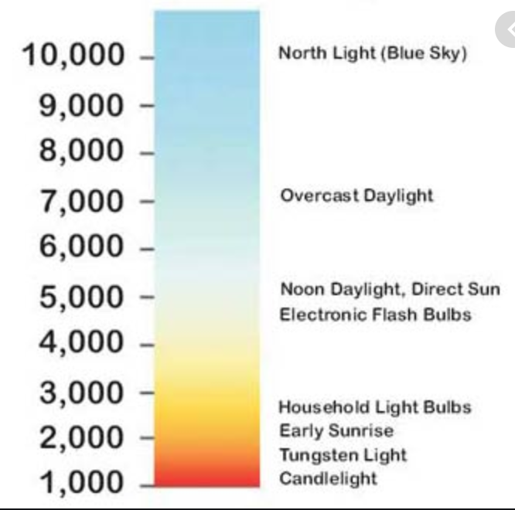
Light box with Macbeth colour checker chart
Illumination w/colour temperature settings
Ref: RGB coordinates of Macbeth colours

Slide 7
Monochromator
Narrowband wavelength selection
Spectral response measurement (QE)
Reference detector
DUT
Monochromator principles: (i) prism, (ii) grating

Slide 8
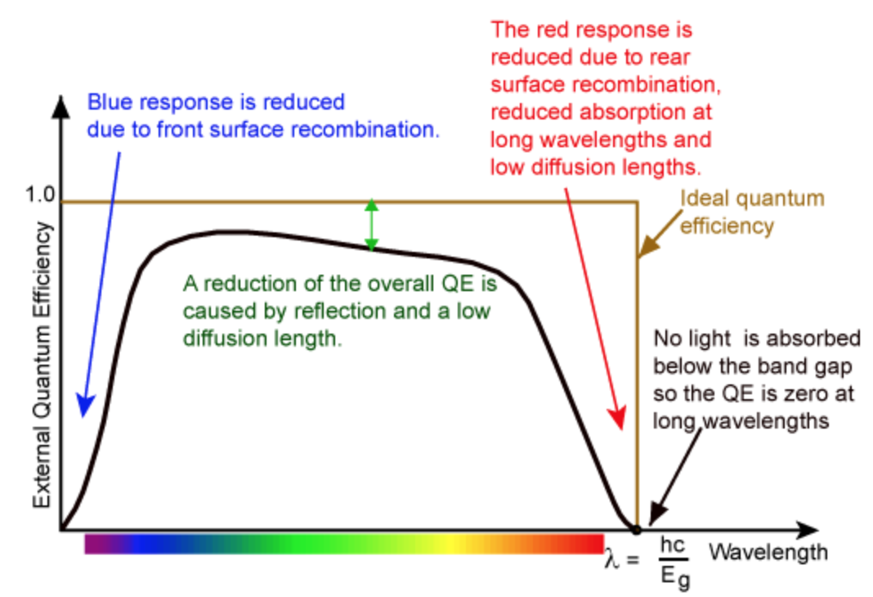
Quantum efficiency
Definition: Probability of a pixel detecting a photon of a given wavelength (spectral sensitivity)
Method: With a monochromator, step through each wavelength and measure average output pixel value, calculate back to #electrons captured, divide by #photons incident on the pixel

Slide 9
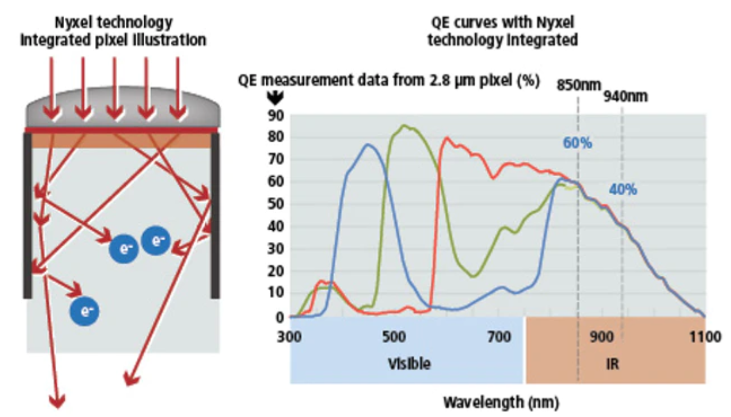
QE remarks
QE influenced by angle of incidence
Wide angle => more crosstalk to neighbour pixels
Using small array in the centre minimizes crosstalk
Interference oscillations from optical stack
Latest innovation to boost QE in NIR

Slide 10
Photon Transfer Curve (PTC)
PTC: plot of variance vs mean (in DNs, Volts, or electrons)
Curve bends due to clipping near saturation
Slope = CG (in DN/e-)
2^{Nbit}-1
.
Convert from DN/e- to uV/e- by multiplying with:
$σ_{tot}^{2}$ (DN²)
. . . . . . . .
.
$$Vref/2^{Nbit}∙1/Asf$$
Readnoise
...
0
.
0
Mean pixel value, (DN)

Slide 11
Photon Transfer Curve
Let
$$S_{out}=α∙N_{elec}+β$$
(1)
, where
$S_{out}$= output pixel value (DN)
$α$ = conversion factor (DN/e-)
$N_{elec}$= number of electrons captured (e-)
$β$ = black level offset (DN)
From (1), the noise output variance ($σ_{out}^{2}$) can be expressed by
$$σ_{out}^{2}=σ_{elec}^{2}+σ_{RN}^{2}=α^{2}N_{elec}+σ_{RN}^{2}$$
(2)
, where
$σ_{elec}^{2}$ = electron shot noise (DN²)
$σ_{RN}^{2}$ = readnoise floor at zero illumination (DN²)

Slide 12
Photon Transfer Curve (cont.)
From (1) we have
$$S_{out}−β=α∙N_{elec}$$
(3)
Replacing into (2) gives
$$σ_{out}^{2}=α\left(S_{out}−β\right)+σ_{RN}^{2}$$
(4)
Deriving (4) with respect to S_{out} gives
$$\frac{dσ_{out}^{2}}{dS_{out}}=α$$
(5)
(DN/e-)
Conclusion: Conversion gain (in DN/e-) is slope of output variance versus mean curve. Can be referred back to FD node by dividing by ADC gain and SF gain.

Slide 13
PTC remarks
Vary light level by changing integration time
High precision from crystal oscillator
Tint=0 gives readnoise value (RN)
To measure mean value (x-axis), prudent to capture dark frame (black level) for each setting
To measure variance (y-axis), convenient to use difference between two subsequent captures
Removes black level and fixed pattern noise
Remember to divide by 2 since noise variance is additive
Pixel values start to clip near saturation (measurement error)
For extra precision calculate variance for each pixel independently, i.e. by capturing 100-1000 pictures for each light level setting
Avoids the influence of PRNU at high signal levels

Slide 14
PTC example

Slide 15
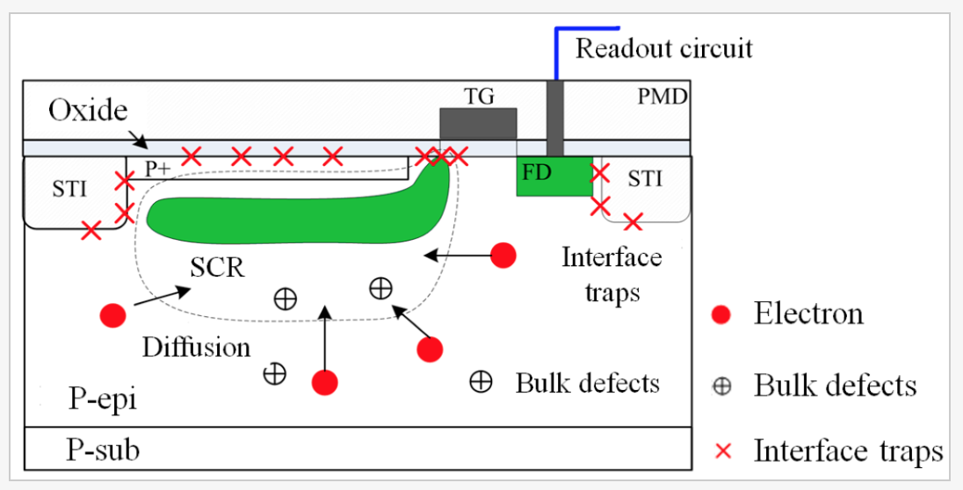
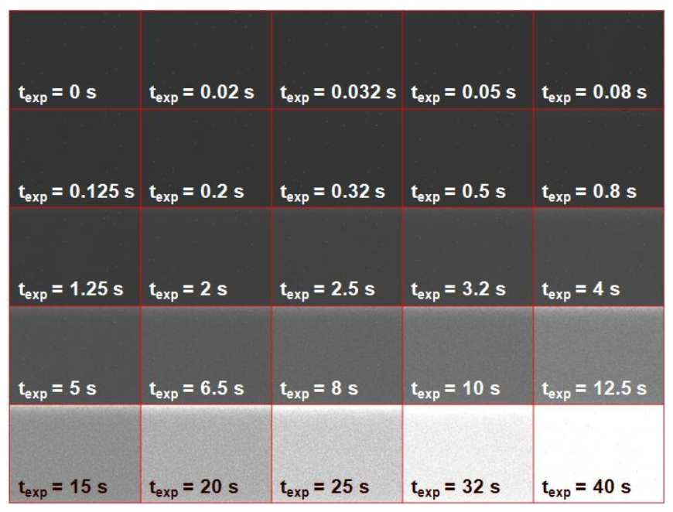
Dark current (DC) measurement
Sources of DC
Slope=DC (DN/s or e-/s)
μ,_{pix} (DN)
@T=60C
Tint (s)
DC captures at constant temp.
Example of bright pixels
Source: Harvest Imaging blog

Slide 16
Dark current measurement remarks
Ensure sensor has reached a stable temperature since DC is highly temperature dependent (DC doubles every 6-8℃)
Avoid light exposure (sometimes challenging)
Beware of DC shading. Could be due to non-uniform doping or contaminant levels and/or heat glow from circuits nearby (e.g. high power voltage driver)
Plot DC vs Tint. Slope gives DC in e-/sec.
DC can be calculated as average per frame OR individually for each pixel and then averaged
In the latter case, you can calculate the RMS variation of the DC. This is called the DSNU (dark signal non uniformity).
DSNU sometimes artificially large due to ’outliers’ in the DC distribution (ie bright pixels or black pixels). Could be filtered out.

Slide 17
Photoresponse non-uniformity (PRNU)
As the name suggests, PRNU is a measure of the variation in responsivity from pixel to pixel
It’s definition varies in the literature, but the most common is as follows
Where σ_{50%} is the rms variation of pixel mean values across the frame at 50% saturation (i.e. all the temporal noise is removed by averaging multiple frames, e.g. 100-1000 frames)
$$PRNU=\frac{\sqrt{σ_{50\%}^{2}−{DSNU}^{2}}}{\left(μ_{50\%}−μ_{dark}\right)}$$
(% rms)

Slide 18
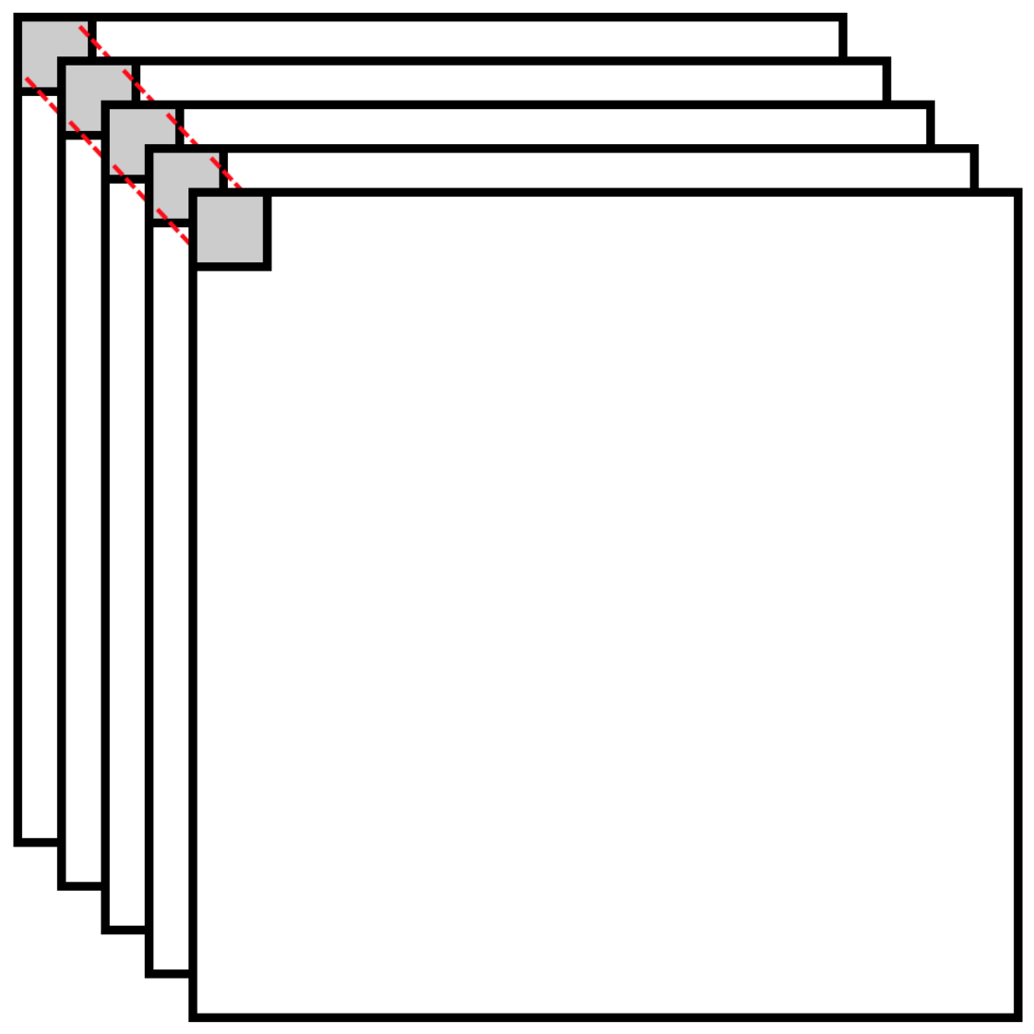
PRNU remarks
Convenient to re-use data from PTC measurements (assuming 100-1000 frames were captured for each integration time)
Remove temporal noise by calculating mean (μ) for each pixel position. Use it to calculate PRNU which is spatial and fixed noise.
Stack of captures each with identical setting (values vary due to temporal noise, only)

Slide 19
Vertical Fixed Pattern Noise (VFPN)
VFPN induced by col-to-col variations in Vth and parasitic couplings causing signal DC offset variations
Measured by (i) capturing dark frame, (ii) averaging all rows to form one single row without temporal noise, (iii) calculate rms value of row
VFPN value should be 10x smaller than RN to be invisible in image

Slide 20
Hnoise (rownoise)
Temporal noise on all pixels along one row induced by spikes on array signals or on VDD or GND during CDS readout (same noise spike on all pixels along one row)
Hnoise measured similarly to VFPN, ie average all columns to remove temporal noise, then calculate rms value

