Slide 1

IN5350 – CMOS Image Sensor Design
Lecture 9 – CIS communication interfaces
25-October-2019

Slide 2
Project schedule
Task/milestone | Start | Finish
Chose topic/scope | 16-Sep | 20-Sep
Create project plan (tasks, milestones, schedule) | 20-Sep | 27-Sep
MS1 – project plan approved by Johannes | 30-Sep | 30-Sep
Study literature on the topic | 27-Sep | 4-Oct
Design/simulation | 4-Oct | 25-Oct
Write prelim report (2-3pages, inc references, goals, design, prelim results) | 25-Oct | 29-Oct
MS2 – submit preliminary report to Johannes | 29-Oct | 29-Oct
Design/simulation | 29-Oct | 15-Nov
Write up final report (incl references, design, results) | 15-Nov | 22-Nov
MS3 – submit final report to Johannes & presentation | 22-Nov | 22-Nov
MS4 – grading (pass/fail) by Johannes & Tohid | 22-Nov | 22-Nov
Exam | 28-Nov 2019
✅
✅
✅
✅
✅

Slide 3
Goal for this lecture
Learn how the image sensor chip communciates with host CPU using industry standard interfaces
Learn how I2C is used to write commands to the CMOS image sensor and to read register contents
Learn about pros and cons of outputing pixel data with parallel and serial interfaces

Slide 4
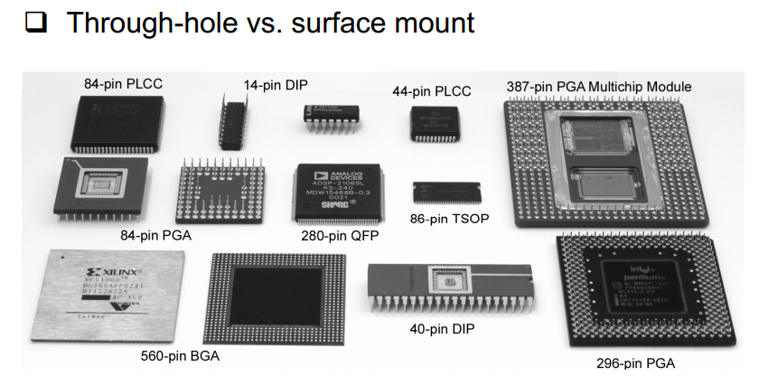
Package types
Ref: Harris et al, CMOS VLSI Design, 4th Ed.

Slide 5
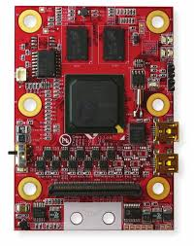
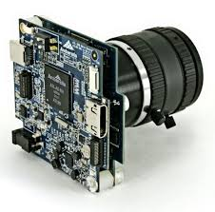
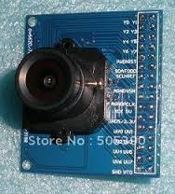
Camera HW examples
Sensor eval board
DSLR camera
FPGA + USB board

Slide 6
Sensor eval board example
Example
CIS chip

Slide 7
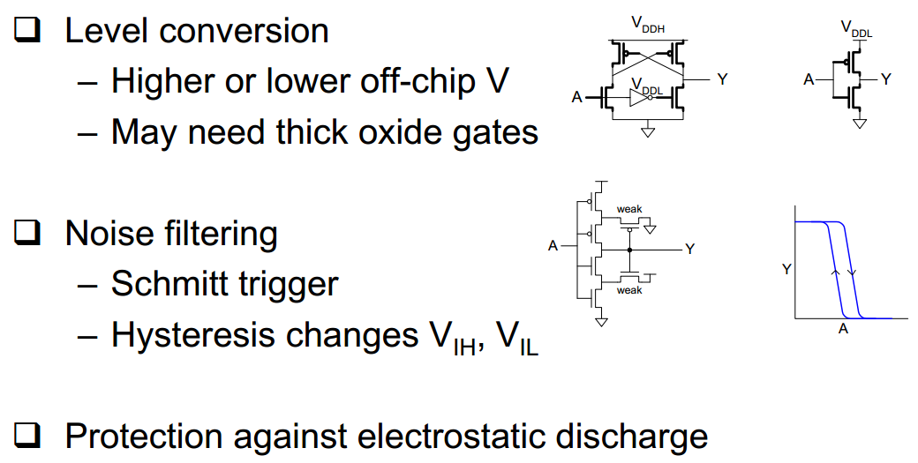
Digital input pads
(next slide)
Ref: Harris et al, CMOS VLSI Design, 4th Ed.

Slide 8
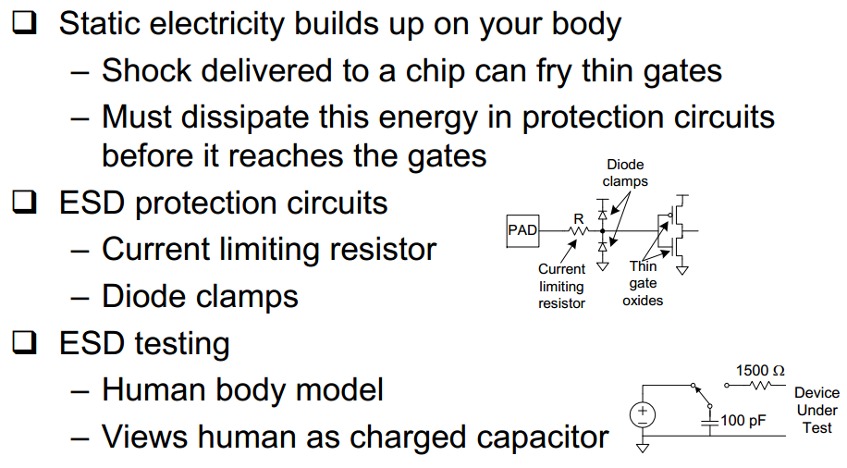
ESD protection
Ref: Harris et al, CMOS VLSI Design, 4th Ed.

Slide 9
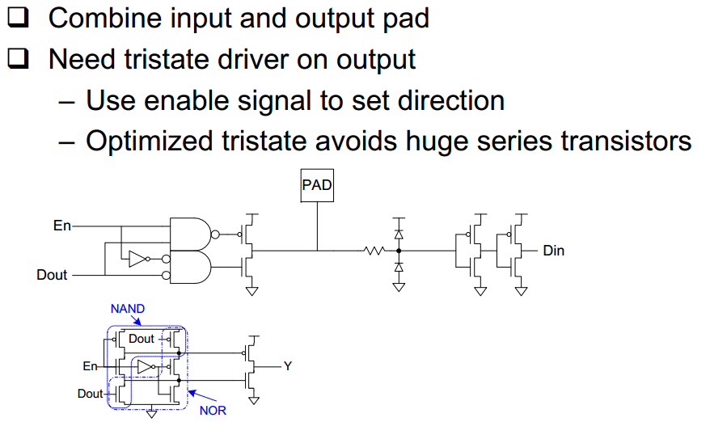
Bidirectional pads
Ref: Harris et al, CMOS VLSI Design, 4th Ed.

Slide 10
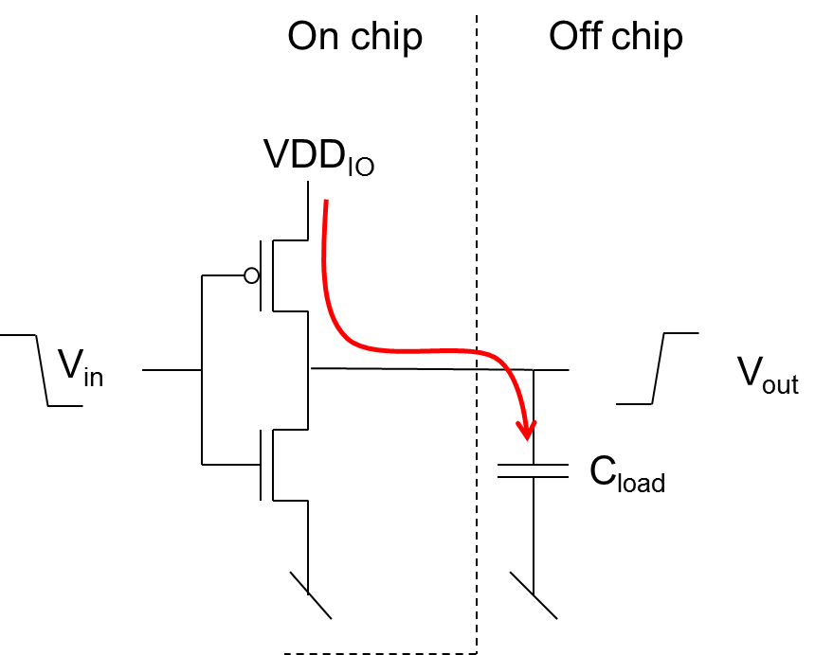
VDDIO power dissipation
Energy per transition (delivered by VDD_{IO}):
E_{IO} = C_{load} x VDD_{IO}²
Power delivered to output clock pin:
P_{CLK} = C_{load} x VDD_{IO}² x f_{CLK}
Power delivered to output pins:
P_{IOpin} = C_{load} x VDD_{IO}² x f_{CLK}/2
Total power:
P_{IO} = C_{load} x VDD_{IO}² x f_{CLK} x (1 + N_{DVP}/2)
Example: P_{IO}=20pF (3.3V)² 100MHz (1+12/2) = 152mW(!)

Slide 11
Noise concern when DVP data toggles
Current in I/O pins during LOW to HIGH transition
  I_{VDDIO} = C_{load} dV_{VDDIO}/dT
  Typical pin load: C_{load} = 15pF
  HDTV (720p60) output clock frequency: f_{CLK} = 74.25MHz (74.25Mpix/sec), i.e. Cycle time of 13.5ns
  Assume VDD_{IO}=1.8V and rise time of ¼ cycle time
  I_{VDDIO} = 15pF 1.8V/(13.5ns/4) = 8mA
  Assuming 0 to 1 transition on 12bit pixel value + clk
    8mA/pin x (12+1)pins = 104mA (large current spikes on VDD_{IO}!)

Slide 12
Industry trend from parallel to serial output
Driven by the megapixel raze
  E.g. 8MP 30fps => 240Mpix/sec
    CMOS DVP i/os limited to approx 100MHz
    Adding multiple DVPs could increase die size (cost)
Driven by power and noise concerns
  Current spikes in I/Os inducing supply and gnd noise
Driven by EMC requirements
  Reduced EM radiation from serial interfaces w/differential signalling

Slide 13
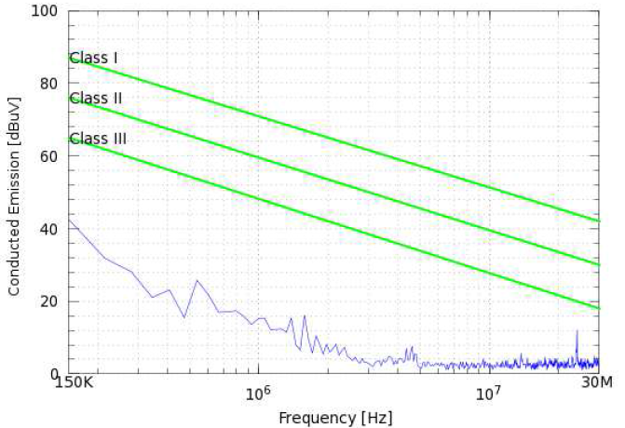
Example EMC test of digital VDD supply

Slide 14
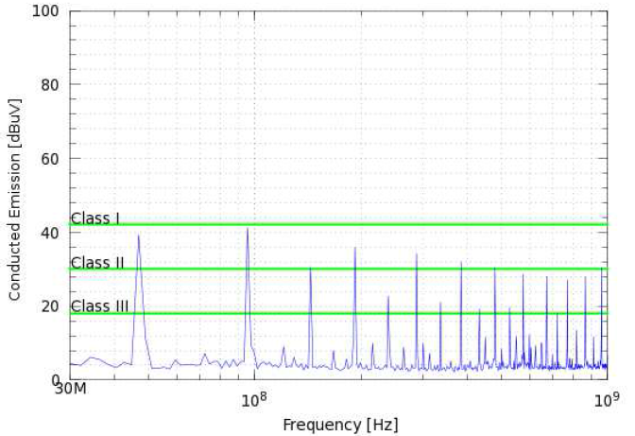
Example EMC test of digital VDD supply

Slide 15
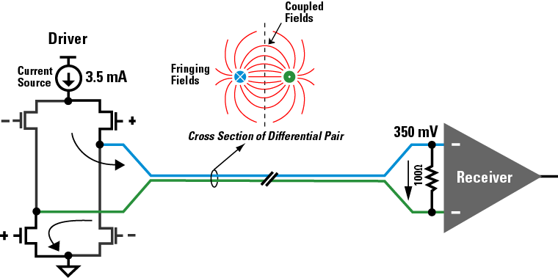
Low Voltage Differential Signaling
Ref: National Semiconductor, LVDS owners manual.

Slide 16
LVDS remarks
Data rate >5Gbps per lane (1Gbps is typical)
Unaffected by common mode noise thanks to differential signalling
At 2.5V supply voltage the power to drive 3.5 mA becomes 8.75 mW per lane
Variations of LVDS for reduced power
  sub-LVDS (introduced by Nokia in 2004) uses 0.9V typical common mode voltage
  SLVS-400 specified in JEDEC where the power supply can be 800 mV and common mode voltage 400mV
  MIPI D-PHY uses 200mV differential signalling

Slide 17
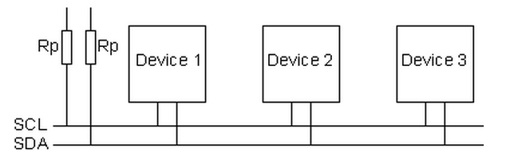
I2C Inter-Integrated Circuit
VDD_{IO}
Master
Slave
Slave
One device is Master, the others are Slaves (max 127)
Only the Master drives the clock line (SCL)
Pull-up resistors, R_{p}, typically 1.8kohms to 10kohms
Speed grades: 100kHz, 400kHz, 1MHz, 3.3MHz

Slide 18
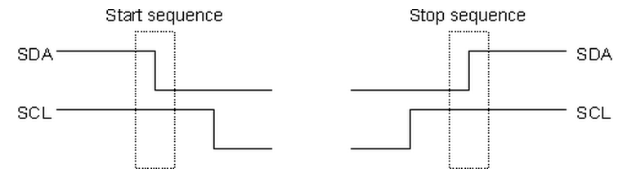
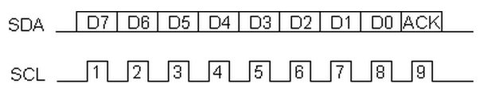
Start and stop sequence and data transmission
Data transmission: 8b data followed by 1b acknowledge from slave (i.e. SDA is pulled down by the slave device)

Slide 19
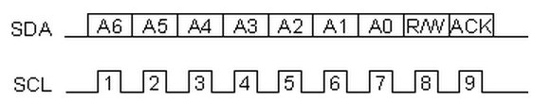
Addresssing an I2C device
7-bit device address, i.e. max 127 devices can be connected to the bus
R/W bit informs slave that master wants to Read (‘1’) or Write (‘0’)

Slide 20
Write sequence
Send a start sequence
Send the I2C address of the slave with the R/W bit low (even address)
Send the internal register number you want to write to
Send the data byte
[Optionally, send any further data bytes]
Send the stop sequence.

Slide 21
Read sequence
Send a start sequence
Send 0x<device address>
Send 0x<register address>
Send a start sequence again (repeated start)
Send 0x<device address>
Read data byte from device
Send the stop sequence

Slide 22
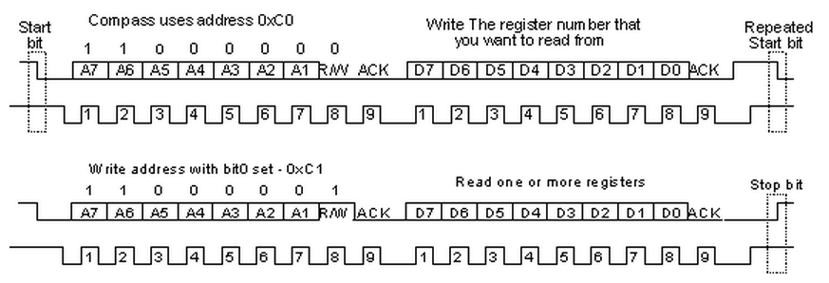
Example read sequence
NB. If slave is not ready for register read it can hold the SCL line low. This is called clock stretching. The master issues the first clock pulse of the read by making SCL high and then checks to see if it really has gone high. If its still low then it waits until it goes high before continuing.
Example code: http://www.robot-electronics.co.uk/acatalog/I2C_Tutorial.html

Slide 23
Key takeaways
Digital I/O pads with level shifting and ESD protection
Parallel outputs can be power hungry
  P_{IO} = C_{load} x VDD_{IO}² x f_{CLK} x (1 + N_{DVP}/2)
Industry trend from parallel to serial output (e.g. LVDS) due to higher datarates and lower EMC
I2C: industry strandard protocol used to read/write 8b values to CMOS sensor (e.g. Integration time, gain, etc)

Slide 24
Thanks!

