Slide 1
ICTs and Global health
Ernst Kristian Rødland, MD PhD
Senior medical offiser, the Norwegian Institute of Public Health
ernstkristian.rodland@fhi.no

Slide 2
Topics
Global health challenges
ICT in Global Health
Two specific examples of epidemics/pandemics
Antimicrobial resistance (AMR)
Covid-19

Slide 3
Top ten threaths to Global health
Notes:
6 out of 10 are in field of infectious diseases

Slide 4
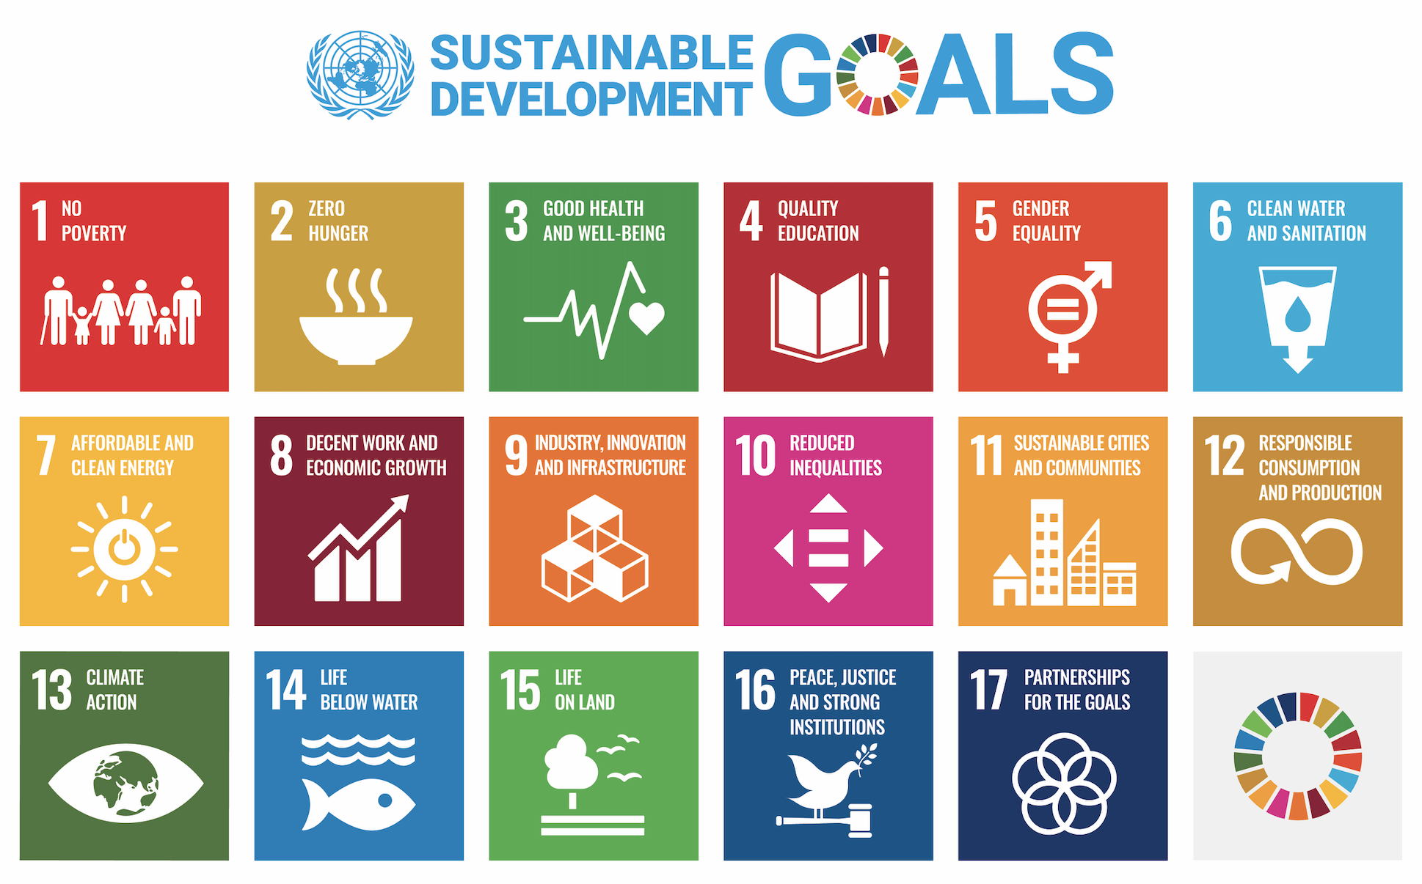

Slide 5
ICT relevant for Global Health
Internet of things, virtual care, remote monitoring, AI, big data analytics, smart wearables, platforms, data exchange and storage etc.
To enhance health outcomes by improving
medical diagnosis
data- based treatment decisions
digital therapeutics
clinical trials and self-management of care
supporting health workforce

Slide 6
ICT and SDG3
Improve health for everyone, everywhere through development of digital solutions
To prevent, detect and respond to epidemics/pandemics
Improve use of health data
Promote health and wellbeing

Slide 7
How can ICT improve health in LMICs
Improve spread of public health information
Enable distant consultations, diagnosis and treatment
Facilitate teamwork among health workers
Improve health research
Monitoring and responding to public health threats
Improve administrative systems

Slide 8
Barriers to application of ICT in the health sector in LMICs
Connectivity
Electricity, internett, hardware
Capacity
Culturally appropiate information
Content
Language, locally relevant information

Slide 9
AMR, a global challenge
AMR is the strategies microorganisms have to survive being exposed to antimicrobials
AMR is a global challenge₍₁₎
Estimation by 2050₍₂₎
10 million deaths/yr globally
Costs: 100 trillion USD/yr
(1) WHO, 2015
(2) Jim O`Neill et.al 2016
Notes:
500 x norwegian fiscal budget (state budget)

Slide 10
WHO Global action plan
Strenghten knowledge through surveillance and research

Slide 11
AMR Developement and spread
Improper use of antimicrobials
Lack of microbiological diagnostic services
Poor sanitation and shortage of clean water
Crowding – interpersonal spread
Migration
Resource limited countries (RLCs)

Slide 12
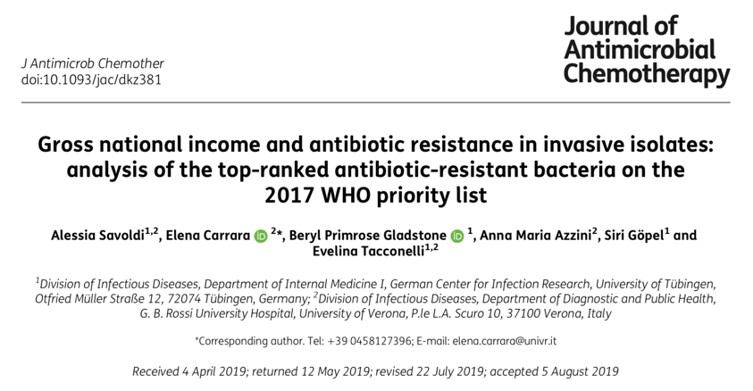

Slide 13
Results
AMR data from 22 surveillance systems
67 countries
HICs 57%, 38 countries
UMICs 24%, 16 countries
LMICs 16%, 11 countries
LICs 3%, 2 countries

Slide 14
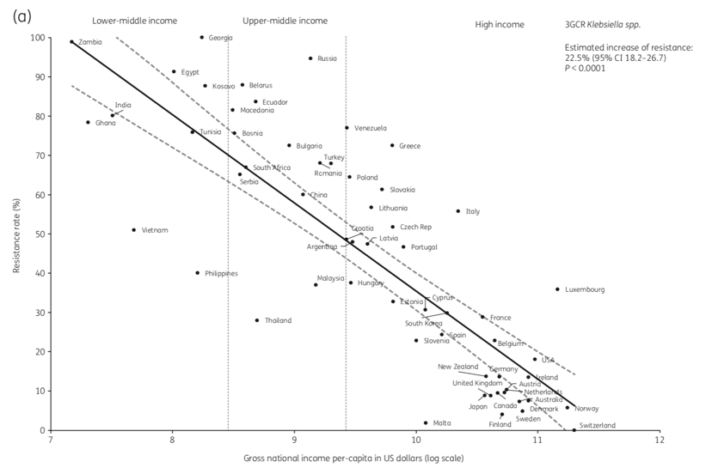

Slide 15
Global antibiotic consumption
Klein et al. PNAS, 2018

Slide 16
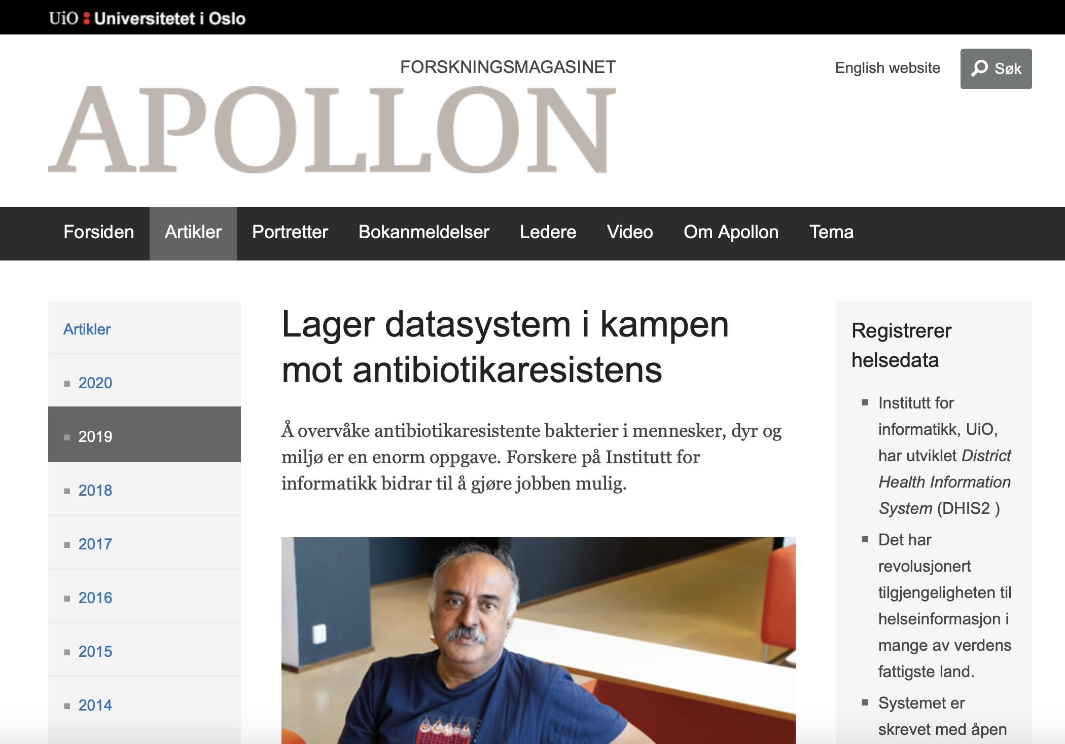

Slide 17
DHIS2 AMR surveillance platform
Why?
Challenges
Digital Global public good
Data is needed to/for:
Develope guidelines
Local, regional, national and global surveillance
Evaluate efforts to fight the problem
Big data
Usage and sharing of data
Attract the interest of relevant stakeholders

Slide 18
Covid-19 surveillance

Slide 19
Covid-19 surveillance in Norway
System developed in a low-income setting proved of great value in a high income setting like Norway
All countries are developing countries

