Slide 1
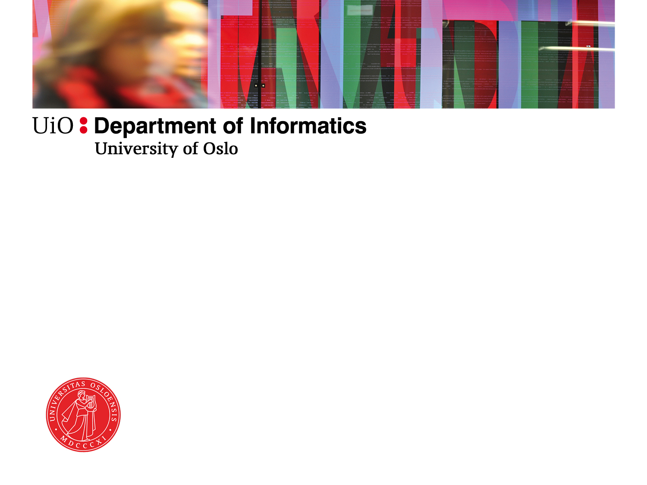
Alternative conceptualization of “better”: Sen and Castells
Sundeep Sahay

Slide 2
Alternative conceptualization of «better»
Alternative to an «economic growth» based perspective on development
Amartya Sen – Perspective on human development – Capability Approach
Manuel Castells – Perspective on exclusion-inclusion – the Network Society

Slide 3
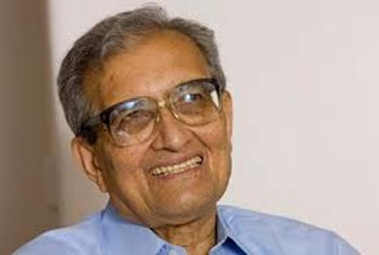
Amartya Sen’s capability approach
Development can be seen as a process of expanding the real freedoms that people enjoy. […] Focusing particularly on people’s capability to choose the lives they have reason to value
(Sen 1999)
Freedom has both intrinsic value and instrumental value

Slide 4
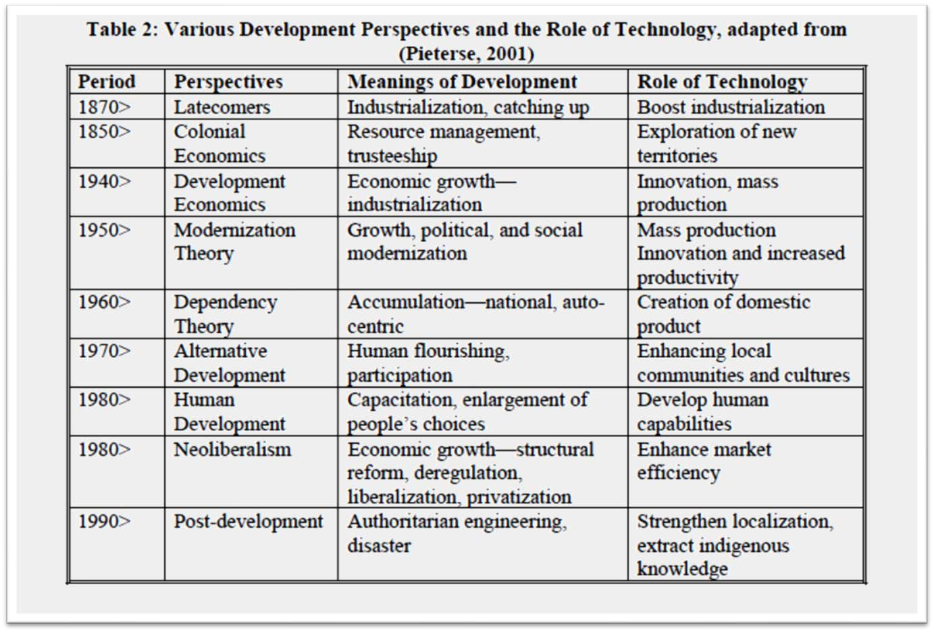
3
Thapa, D. and Saebø, Ø. (2014), “Exploring the link between ICT and development in the context of developing countries: a literature review”, The Electronic Journal of Information Systems in Developing Countries, Vol. 64,

Slide 5
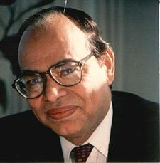
Human Development Index
With Mahbub ul Haq – integration into development measurement and development of the HDI from 1990
Three key parameters
  Education – level of literacy
  Health - life expectancy
  Income distribution – parities of income

Slide 6
Functionings and Capabilities
“A functioning is an achievement, whereas a capability is the ability to achieve. Functionings are, in a sense, more directly related to living conditions, since they are different aspects of living conditions.
Capabilities, in contrast, are notions of freedom, in the positive sense: what real opportunities you have regarding the life you may lead”.
(Sen, 1987, p. 36).

Slide 7
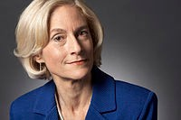
Martha Nussbaum’s Capability Approach
Developed independently from Sen’s
Identifies central human capabilities
  Life
  Bodily Health
  Bodily Integrity
  Senses, Imagination, and Thought
  Emotions
  Practical Reason
  Affiliation
  Other Species
  Play
  Control over one's Environment.
Notes:
Presenter
2019-09-24 23:56:38
--------------------------------------------
Life. Being able to live to the end of a human life of normal length; not dying prematurely, or before one's life is so reduced as to be not worth living. Bodily Health. Being able to have good health, including reproductive health; to be adequately nourished; to have adequate shelter.
Bodily Integrity. Being able to move freely from place to place; to be secure against violent assault, including sexual assault and domestic violence; having opportunities for sexual satisfaction and for choice in matters of reproduction.
Senses, Imagination, and Thought. Being able to use the senses, to imagine, think, and reason—and to do these things in a "truly human" way, a way informed and cultivated by an adequate education, including, but by no means limited to, literacy and basic mathematical and scientific training. Being able to use imagination and thought in connection with experiencing and producing works and events of one's own choice, religious, literary, musical, and so forth. Being able to use one's mind in ways protected by guarantees of freedom of expression with respect to both political and artistic speech, and freedom of religious exercise. Being able to have pleasurable experiences and to avoid non-beneficial pain. Emotions. Being able to have attachments to things and people outside ourselves; to love those who love and care for us, to grieve at their absence; in general, to love, to grieve, to experience longing, gratitude, and justified anger. Not having one's emotional development blighted by fear and anxiety. (Supporting this capability means supporting forms of human association that can be shown to be crucial in their development.)
Practical Reason. Being able to form a conception of the good and to engage in critical reflection about the planning of one's life. (This entails protection for the liberty of conscience and religious observance.) Affiliation.
Being able to live with and toward others, to recognize and show concern for other humans, to engage in various forms of social interaction; to be able to imagine the situation of another. (Protecting this capability means protecting institutions that constitute and nourish such forms of affiliation, and also protecting the freedom of assembly and political speech.) Having the social bases of self-respect and non-humiliation; being able to be treated as a dignified being whose worth is equal to that of others. This entails provisions of non-discrimination on the basis of race, sex, sexual orientation, ethnicity, caste, religion, national origin and species.
Other Species. Being able to live with concern for and in relation to animals, plants, and the world of nature. Play. Being able to laugh, to play, to enjoy recreational activities.
Control over one's Environment.
Political. Being able to participate effectively in political choices that govern one's life; having the right of political participation, protections of free speech and association.
Material. Being able to hold property (both land and movable goods), and having property rights on an equal basis with others; having the right to seek employment on an equal basis with others; having the freedom from unwarranted search and seizure. In work, being able to work as a human, exercising practical reason and entering into meaningful relationships of mutual recognition with other workers.

Slide 8
From patient to agent
A person is thus viewed as an “agent”, as opposed to a “patient” whose well-being or the absence of well-being is the only concern (Robeyns, 2005).
Concern for:
  Participation
  Public debate in the public sphere
  Democratic practice
  Empowerment
Notes:
Presenter
2019-09-24 23:56:33
--------------------------------------------
The aspect of “agency freedom”, which is a critical appeal of the CA, has not been very well developed partly because it is particularly difficult to operationalize (Gasper, 2007). Most development approaches have concentrated on the well-being aspect, such as income, education, and healthcare. Even in the Human Development Reports which adopt the capability approach as a conceptual framework, the focus has been on the well-being aspect of human development and the agency aspect has been much less appreciated.

Slide 9
Example
Measuring gender equity in terms of women’s agency
Growth-oriented approaches measures women’s deprivation in terms of income gaps
  Women’s welfare as instrumental to the wellbeing of others and economic growth
Sen focuses on the deprivation of capabilities
  E.g. access to healthcare, education, autonomy
Notes:
Presenter
2019-09-24 23:56:33
--------------------------------------------
For example, Fukuda-Parr (2003a) compares gender inequality seen from growth-oriented perspectives and from the capability approach. Growth-oriented approaches measure women’s deprivation in terms of income gaps between female-headed and male-headed households, and perceives promoting the welfare of women as instrumental to the well-being of others and economic growth. The capability approach focuses not on the level of income but deprivation of capabilities, e.g. access to healthcare, education, participating in economic life and the autonomy in decision making. In other words, it “measures gender equity in women’s agency” (ibid., p.314).

Slide 10



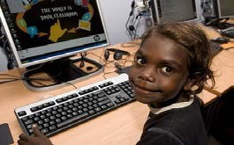
From Digital Divide to Multiple Inequalities
The Digital Divide
A
technological divide
An economic divide
A
socio-cultural divide
A Gender Divide

Slide 11
Conversion Factors, Choice, Outcome
Personal Preference, social pressure and other decision- making mechanisms
Achieved functionings
Commodities
(Characteristics of Technologies)
Personal, social and environmental conversion factors
Capabilities
=
Effective Opportunities
Choice
Means to Achieve
Freedom to Achieve
Achievement
Applying the Capabilities Approach to ICT4D

Slide 12
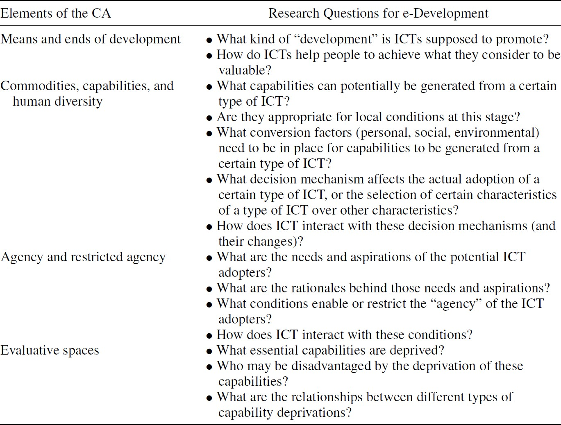
Research Questions

Slide 13
Critique on Sen
Insufficient theorization on structure and power
  Unable to address “entrenched power and the politics of conflict or social mobilization” (Navarro 2000)
  a need to distinguish the type of structures favorable for individual agency (Stewart and Deneulin 2002)
Focuses on individual agency rather than collective mobilization (Fukuda-Parr 2002);
  The CA sees individuals as active agents of change;
  The need for collective action to influence public policy (Stewart and Deneulin 2002)
15

Slide 14
Manuel Castells – the network society
Develops a “grand narrative of the present” where the entire planet is capitalist
Volume I - The Network society - outlines basic tenets of a “network society”
Volume II - The Power of Identity - outlines various processes of social change
Volume III - End of Millennium - processes of historical transformation

Slide 15
Key thesis
Relation between IT-Globalization-Social Development
Two key trends in the information age
  New capitalism - global and informational
Challenged by social movements based on cultural singularity - affirming identity
Dialectical opposition of “self and the net”

Slide 16
Understanding network society
Network basic form of social structure
Social interactions occur with a “networking logic”
Example stock exchange
Not restricted to financial systems, example peace networks, “black lives matter”, “MeToo” etc
Networks not new, informational basis and its global nature is what is new

Slide 17
Network society and ICTs
Information - raw material and also outcome
ICTs are pervasive - all aspects of life
ITs foster a networking logic because it allows to deal with complexity, which in itself is increased by IT
Specific ITs converge into highly integrated systems

Slide 18
Key characteristics
Represents a structural transformation (production, power and experience)
Social processes organized around networks
Studying the logic of these networks
Logic of the “power of flows” dominate “flows of power” (“flow society”)
Social morphology dominates social action - pace of flows defined by timeless time and placeless space

Slide 19
Network society and power
Not rooted in institutions as before – the power of the church or the family
Located in networks
Lies in codes of information
Three kinds of dichotomies are inherent
  net and the self
  timeless time and placeless self
  inclusion and exclusion

Slide 20
Relevant to us with respect to understanding «better»
The notion of «counter networks»
Castells’ thesis is that «if you are not in the network society, you will be excluded and further systematically marginalized»
«in the past, colonization was exercised by going there, but in the network society, colonization is exercised by not going there»
For marginalized, to enter the network society, you have to create «counter networks»
Only when information is visible, can we act

Slide 21
Counter network
Why «counter»?
  Historically excluded
  Capacities deficencies
  Infrastructure inadequacies
So, it is not about plug and play in the network
But it takes extra, time and innovative approaches to build counter networks

Slide 22
Counter «peace» networks
North Kenya, plagued by inter-ethnic conflict – around 2008 elections
Building over time, communities affected by the voilence, and mobilize them as peace networks
SMS based reporting was a tool used to make potential voilence solutions visible
Based on this information, conflict mitigation efforts were initiated

Slide 23
Counter «health» networks
Strengthening health equities within a deprived region in north Mozambique
Electronic systems can help them make their health problems visible to the authorities as a basis to strengthen advocacy efforts
But given their historical deprivations, challenging for them to join the network
Long term, sustained effort, based on innovative efforts to include them in the network – the counter health network

Slide 24
Concluding: alternative views on better
Sen – gives us the notion of better through the «human development» perspective
Castells – gives us the notion of better through the inclusion/exclusion perspective framed within network society thinking

