Slide 1
Topic of the day:
Notes:
Reference graphic: https://evandientrading.com/wp-content/uploads/2018/01/Bitcoin-Mining-Final.png

Slide 3
Brief Introduction
Name: Radoslaw Krzeski
Occupation: Digital Project Manager
Interested in Blockchains as a tool for economic efficiency in the media industry

Slide 4
Bitcoin mining
The authors warn of a goldrush race
To join, we connect to other nodes and perform six tasks:
Listen for transactions
Maintain block chains and listen for new blocks (valid nonce)
Assemble a candidate block
Find a nonce that makes your block valid (hitting target)
Hope your block is accepted
= Profit
Notes:
1- Listen for transactions and validate them by checking that signatures are correct and outputs being spent haven`t been spent before.
2- Maintain block chain. Start by asking nodes for historical blocks before you joined. Listen for new ones, by validating the transaction and valid nonce.
3- You have an update to date block – begin building by grouping transaction you`ve heard about, that extends the latest block – each transaction must be valid.
4- Requires the most work
5 – Hope that others accept your block on the consesus chain, instead of others.
6- Your profit if its accepted. Transaction fees, if applies, given to miners on 1% scale.
Two categoires that miners must do: validating transactions and blocks, and the race to find blocks and profit. The so called incentive to keep it as a currency.

Slide 5
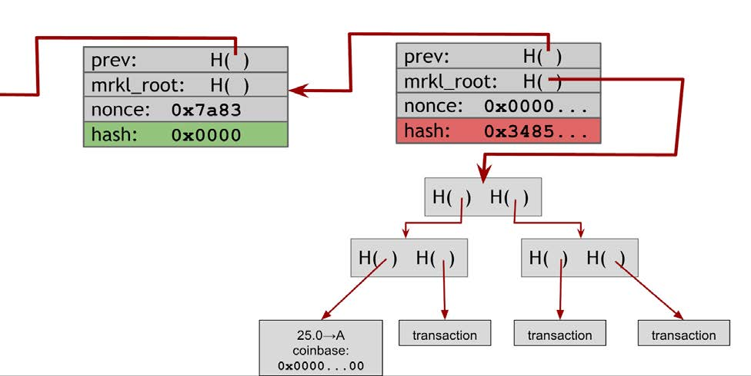
Finding the Valid Block
Notes:
Compile valid transactions pool into a Merkle tree, up the the limit of the total size of the block. Header points to previous block. Header «nonce field» is tried to find a nonce that cause the block hash to be under target- > required number of zeroes and that validates to the 32 bit value the hash can have,
If none is valid, change nonce, if not by header, then by transaction nonce. And then back to the header nonce in succinct order.
If done, then the whole merkle tree changes upwards, producing a more expensve operation than looking in the header operation.
When a combination finally hits , you announce and hope for profit.
Image is taken from the book.

Slide 6
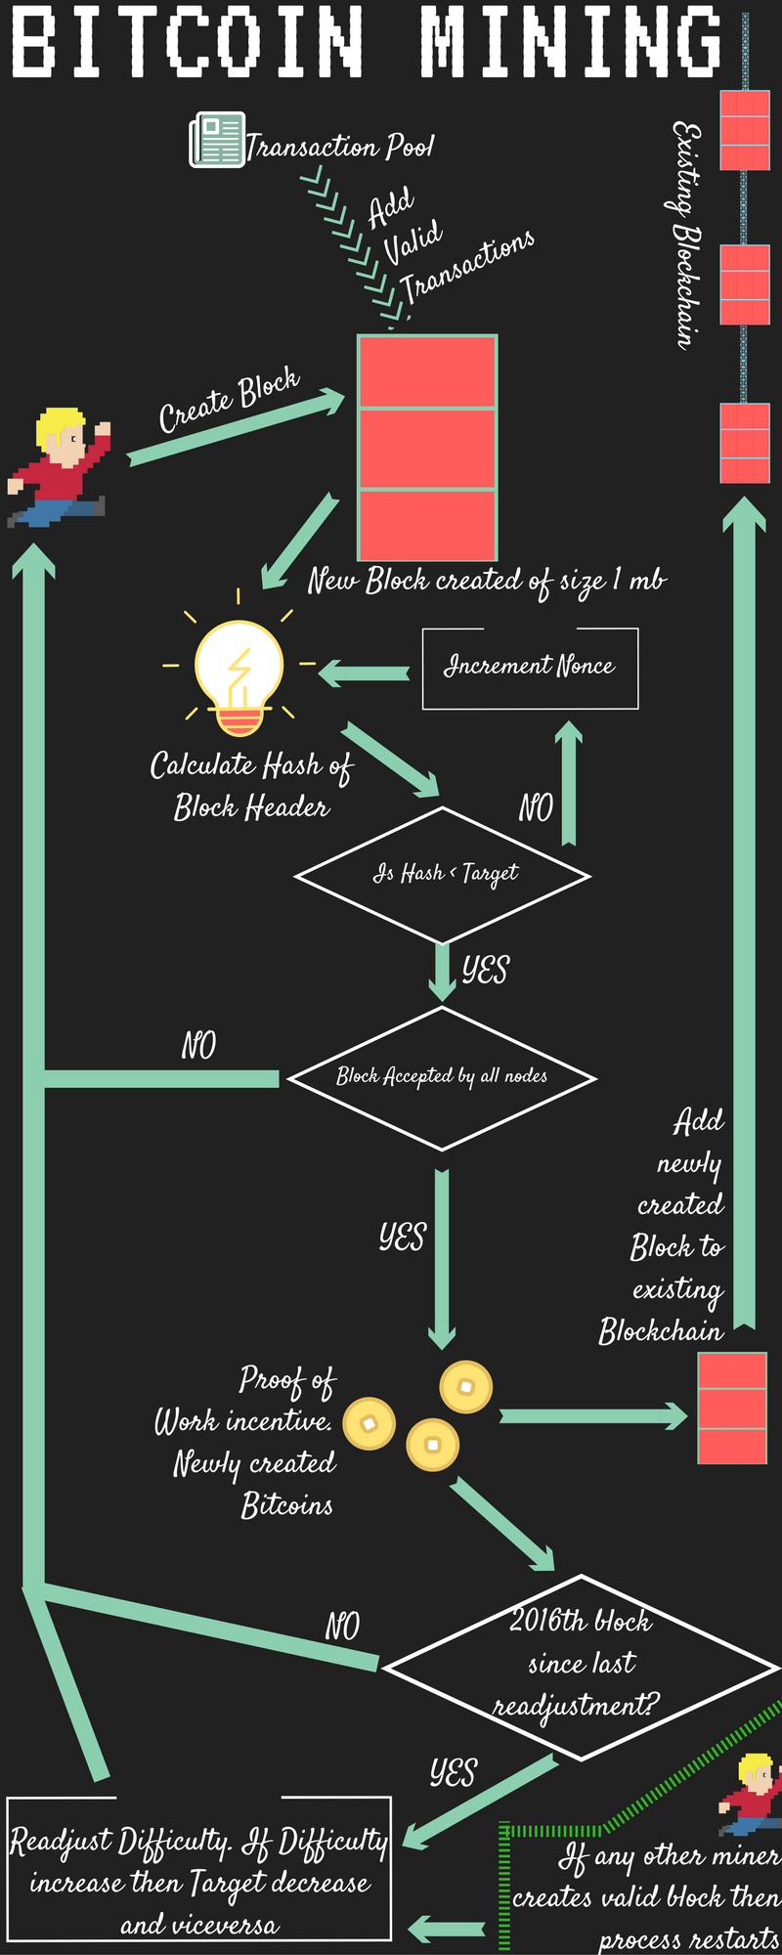
Determining Difficulty
Changes roughly every two weeks
Changes at every 2016 blocks
Difficulty fluctuates based on given time to mine
Miners on the same block have the same difficulty
Allows consesus

Slide 7
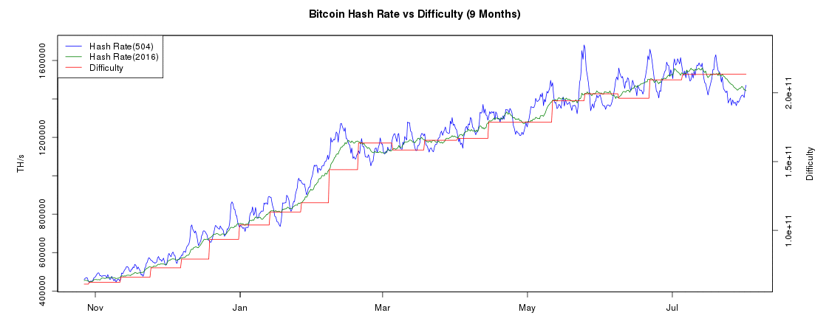
Side Question; What is a death spiral?
Notes:
Mining difficulty is dependant on, amount of miners and the effictivieness of hardware, and the exchange rate of the coins is always increased so it takes roughly ten minutes to find a block.
Hexadecimal value that needs to be below and the calculation is about 267 nonces (as of the writing of the book)
Death Spiral - which a dropping exchange rate makes mining unprofitable for some miners, causing an
exodus, in turn causing the price to drop further
Image source: https://img04.rl0.ru/9c4532ea1558c74a2e891ae94c9b2cb2/c1122x439/lh3.googleusercontent.com/zceV_44RR_MRdJH1tzUwjHX4NCSP8bTOxH9fcLufkhN1UgU5M8yS7zNsMbYr4fdWeeuemvGUeqc4yz5NC3j3MWuNwXpMrHngWTljSDJGcBxdxz7vZ-ltgFCdxXzD1-l0ZCkhE4G2CRk-FREv5w

Slide 8
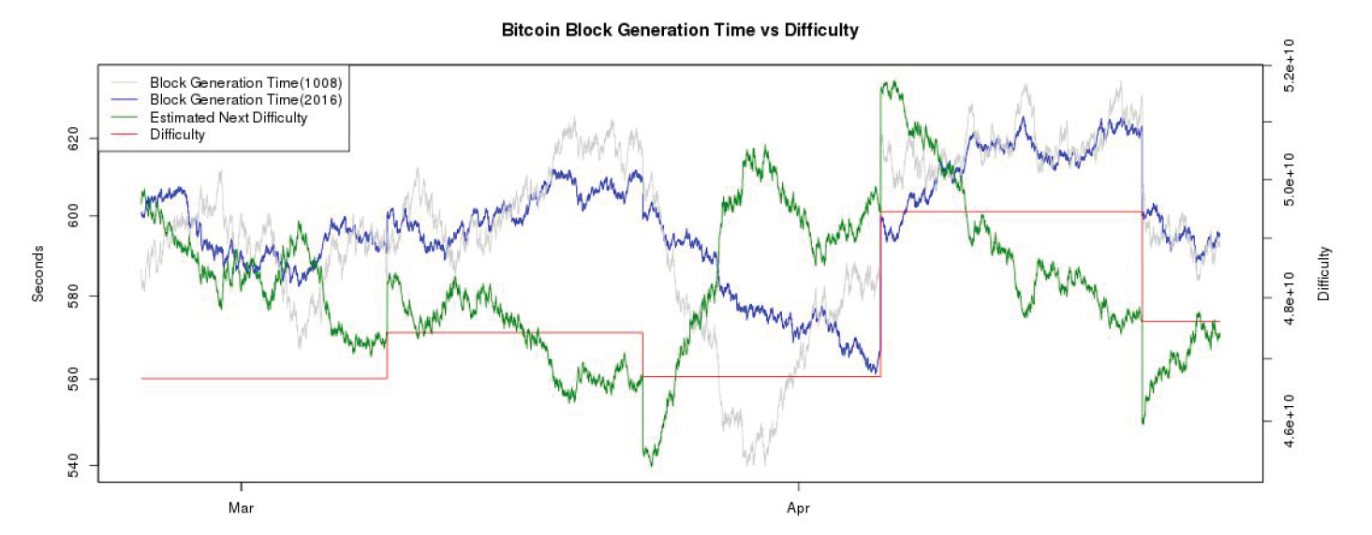
Notes:
540 second block discoveryup and down
On occasion the mining power was rising by 25% percent every two weeks.
Image source is book.

Slide 9
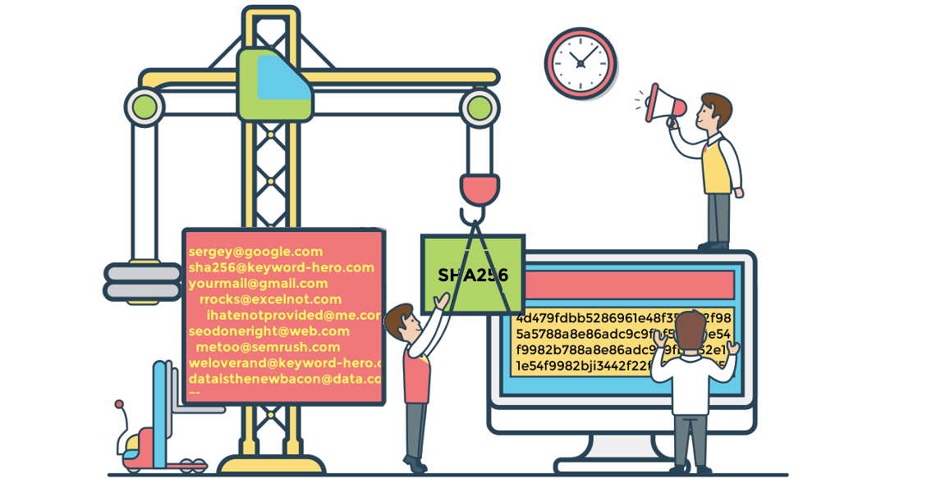
Mining Hardware
Why are hashes non-reversible?
SHA-256 Hash function
Applied twice to a bitcoin block
Impossible for normal computers
CPU/GPU mining (2010 OpenCL)
Arithmetic Logic Units (ALUs)
Field Programmable Gate Arrays
Application –Specific Integrated Circuits
Notes:
Secure Hash Alorithm developed in 2001 – reasonable choice when bitcoin was designed
On a high‐end desktop PC you might expect to
compute about 20 million hashes per second (MH/s). At that speed, it would take you several
hundred thousand years on average at the early‐2015 difficulty level (2 67 ) to find a valid block.
Arithmetic Logic Units (ALUs) used for parallel or simultaneous computation – overclocking
Disadvantages – spesific hardware , power and heat
FPGA allows to configure in the field, better performanace, cooling, use all transistors
Asic come in various forms and drive by bitcoin buggy in the beginning,obsolete within six months
Image from:
https://keyword-hero.com/wp-content/uploads/2017/05/sha256-1.png

Slide 10
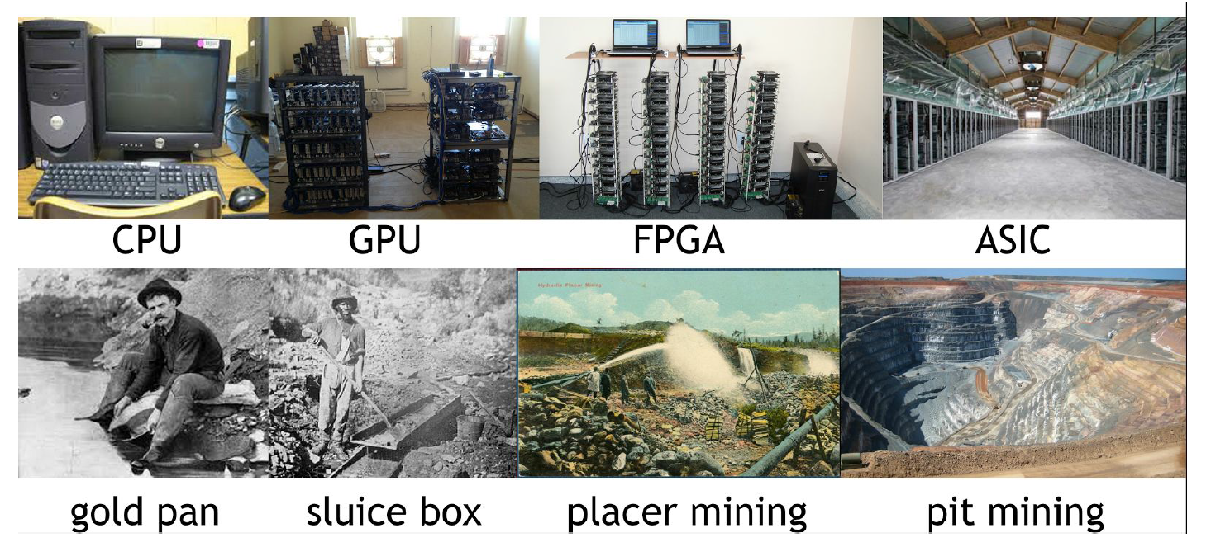
Professional mining
Notes:
Few centres disclose their details, although there are interesting stories out there from China, Island and other remote parts not famous for any infrastructure
Considerations are climate , cost of electricity and network speed

Slide 11
Energy consumption
Laundauer`s Principle
(every time you flip a bit there is a minimum amount of energy required
Three steps to bitcoin`s usage of energy
Embodied energy
Pure Electrity
Cooling
Two ways to calculate: Top-down/Bottom-up
0.21%
Notes:
The principle is optimali, the actual output of energy is far greater.
Emobided, physical, raw
Top Down - Calculated based on amount of bitcoins mined and the value of them
Bottom up – based on numbers of hashes and and estimated power consumpiton of these

Slide 12
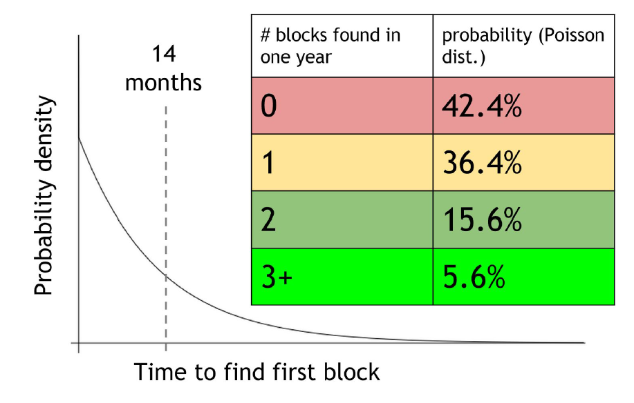
Mining Pools
Small chance of finding blocks
Many miners, one pool manager
Calculating mining shares by reporting near valid hashes and actual valid blocks
Pay-per share
Propotional
Pool hopping
Communication API`s
Notes:
Pay per share – even if block are not found, high fees- prone to attacks – discarding valid pools
Proptioanl- every time a valid block is found, fee is paid based on work done.
Pool hopping- jumping ships between two modesl when they are most valuable

Slide 13
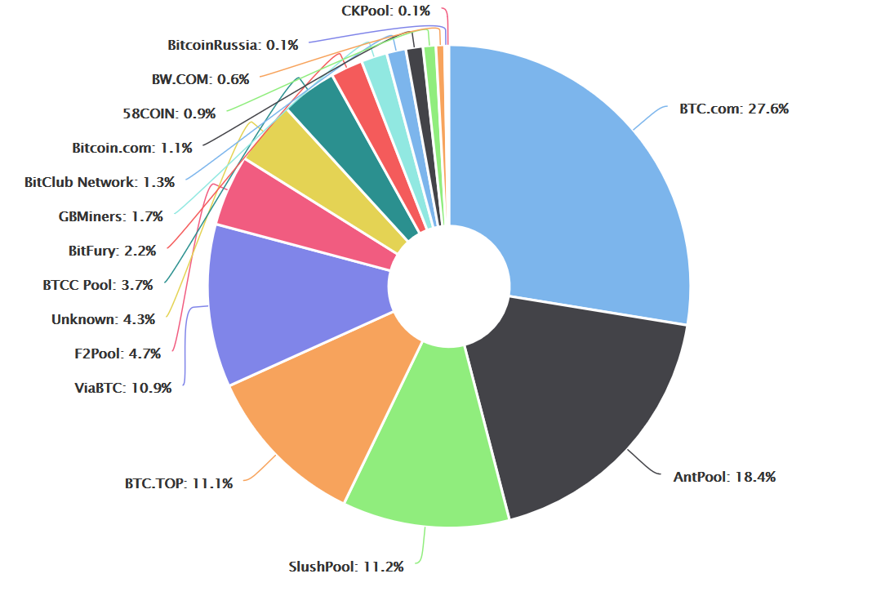
Mining Pools cont.
51%?
Notes:
51% Ghash – laundering hashes –true mining power
Positive for smaller miners, easier to upgrade the network with controlling pool manager, updating software
Disadvantege is a centralization of power
Miners need to choose which transactions to include, any above certain limit
Which block to mine, usually the longest valid known chain
Block of same height – chose the fork that came first
Announcing block- usually straight away
New strategies and combinatiosn are being researched
Image source:
https://blockchain.info/pools

Slide 14
Mining Risks
Forking attack
Goldfinger attack
Forking via bribery
Temporary block-withholding attacks
Blacklisting / Punitive Forking
Notes:
Forking attack- essentially paying a transaction and then mining on a different block to invalidate a recent transaction – if attacher has majority of hash power – can be countermeasured?
Goldfinger – crash it in order to gain a different currency up?
Bribrery- bribery- mining pools at loss- or be the biggst tipper
With holding blocks- finding more blocks on top and then delcaring longest chain –theoretical
All relative to hash power

Slide 15
Alternative Mining puzzles
Why do we have mining puzzles?
A few basic requirements:
Quick to verify
Adjustable difficulty
Progress-freenes
Memoryless process
What is a different word for «Bitcoin Puzzle»?
Notes:
Mining puzzles are at the very core of Bitcoin because their difficulty limits the ability of any one party
to control the consensus process. Might skip and focus on network-related optimization if not designed correctly
Adjusting difficiuly- whn user and increasing hash power comes along’
partial hash‐preimage puzzle – find preimages for a partially specified hash output
Progress freenes : the chance of winning a puzzle
solution in any unit of time should be roughly proportional to the hash power used
Make it ASIC-resistant?

Slide 16
ASIC-resistant?
«One-CPU-one-vote»
Memory-hard puzzles
Memory-bound puzzles
Scrypt – although resitant, what happened?
DASH(x11)
Changing/Moving puzzles
Notes:
Hard - puzzles that require a large amount of memory to compute, instead of,
or in addition to, a lot of CPU time.
A similar but different concept is memory‐bound puzzles in which
the time to access memory dominates the total computation time – used to restrain and limit output.
Scrypt- used for Litecoin – memory hard function – hard to brute force- filling up a large buffer in RAM- updating in pseudorandom order, required that the entire buffer is store in RAM – low value of N ended up being broken 128kb
Even though x11 is not widely broken og having ASIC implemented, the market share of coins is low

Slide 17
Last Notes
Proof-of-Useful-Work
Nonoutsourceable Puzzles
Virtual Mining
Notes:
VM – where viirtual ming give the coins voting power and assumes that we do whats best for the coin to increase value of given coin. – proof of stake and proof of deposit

Slide 18
Discussion
What constitutes the luck element, what is involved in the block creation to be accepted by the consensus chain?
Is there a chance that two miners are mining the same block/puzzle?
At one point the book mentions : «If the period were much higher, the network’s hash power might get too far out of balance with the difficulty.» - What happens then?
What happens when we go from derived value from the mining to the transaction fees? How will miners change their behaviour?
ASIC mining and the development of professional mining centers violate the original vision of Bitcoin which was to have a completely decentralized system in which every individual in the network mined on his or her own computer. Is it a violation of Satoshi Nakamoto’s original vision in terms of the mining or did he foresee it?

Slide 19
What happens when we go from derived value from the mining to the transaction fees? How will miners change their behaviour?

