Slide 1
Applications BC
Carl Petter Boehlke

Slide 2
Articles
Blockchains and Smart Contracts for the Internet of Things Konstantinos Christidis and Michael Devetsikiotis
LSB: A Lightweight Scalable BlockChain for IoT Security and Privacy Ali Dorri, Salil S. Kanhere, Raja Jurdak, Praveen Gauravaram
Providing Privacy, Safety, and Security in IoT-Based Transactive Energy Systems using Distributed Ledgers Aron Laszka, Abhishek Dubey, Michael Walker, Douglas Schmidt

Slide 3
Notes:
How this all begun, interest in learning and finding uses,

Slide 4
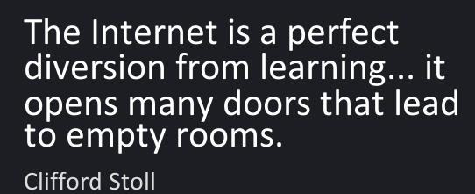
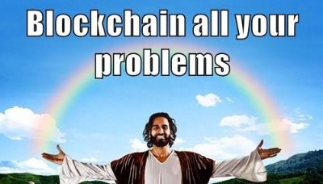
Internet (‘94) vs BC (‘18)
Notes:
Useful or religion

Slide 5
Notes:
Evolution… or weird scheme

Slide 6
Challenge
BC $3.1 trillion 2030(1)
BC is disrupting 20 industries
IoT market $2.99 trillion(2014) → $8.9 trillion by 2020(2)
IoT security
Devices, data and supply chain partners → vunerable
IoT devices lack authentication standards to ensure data security
Notes:
BC will $3.1 trillion by 2030
BC is disrupting around 20 industries
IoT market $2.99 trillion(2014) → $8.9 trillion by 2020
IoT security primari concern
Devices, data and supply chain partners → vunerable
IoT devices lack authentication standards to ensure data security

Slide 7
IOT Devices, data and supply chain partners → vunerable
October 2016 DDos attack
https://www.iotforall.com/5-worst-iot-hacking-vulnerabilities/
Notes:
his IoT botnet was made possible by malware called Mirai. Once infected with Mirai, computers continually search the internet for vulnerable IoT devices and then use known default usernames and passwords to login, infecting them with malware. These devices were things like digital cameras and DVR players.

Slide 8
IOT Devices Hackable Cardiac Devices
https://www.iotforall.com/5-worst-iot-hacking-vulnerabilities/
Notes:
“The FDA confirmed that St. Jude Medical’s implantable cardiac devices have vulnerabilities that could allow a hacker to access a device. Once in, they could deplete the battery or administer incorrect pacing or shocks, the FDA said.
The vulnerability occurred in the transmitter that reads the device’s data and remotely shares it with physicians

Slide 9
IOT Devices Owlet WiFi Baby Heart Monitor
https://www.iotforall.com/5-worst-iot-hacking-vulnerabilities/
Notes:
The connectivity element makes them exploitable and if manufacturers and developers don’t consider this and take extra steps to secure devices at the hardware layer, these are stories that we will, unfortunately, keep hearing.”

Slide 10
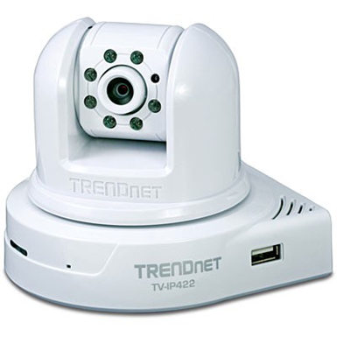
IOT Devices TRENDnet Webcam Hack
https://www.iotforall.com/5-worst-iot-hacking-vulnerabilities/
Notes:
April 2010 [until about January 2012], TRENDnet transmitted user login credentials in clear, readable text over the Internet, and its mobile apps for the cameras stored consumers’ login information in clear, readable text on their mobile devices, the FTC said.

Slide 11
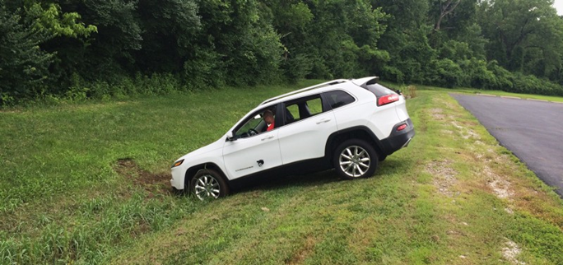
IOT Devices Jeep Hack
https://www.iotforall.com/5-worst-iot-hacking-vulnerabilities/
Notes:
exploiting a firmware update vulnerability, they hijacked the vehicle over the Sprint cellular network and discovered they could make it speed up, slow down .
While companies often ignore the security of peripheral devices or networks, the consequences can be disastrous.”

Slide 12
Iot security lessons
Devices that cannot have their software, passwords, or firmware updated should never be implemented.
Changing the default username and password should be mandatory for the installation of any device on the Internet.
Passwords for IoT devices should be unique per device, especially when they are connected to the Internet.
Always patch IoT devices with the latest software and firmware updates to mitigate vulnerabilities
-pcmagazine
Notes:
Ability to change passwords and firmware
Changing default username and password, mandatory
Passwords unique
Patch with latest software and firmware

Slide 13
Notes:
Start talking about BC and Iot and what the problem is. Next slide get some cool image of a hack

Slide 14
BC benefits
Maintains distributed ledger of transactions distributed
Decentralized (non-trusting) interact in certain manner
trustless consensus
Computation resources required, protecting against malicions mining of blocks
Puzzle solving introduces randomness
Encrypted communication, protecting agains eavesdropping
Use of changeable PK that prevents from being tracked, privacy
Tagging different pieces of info belonging to different participants

Slide 15
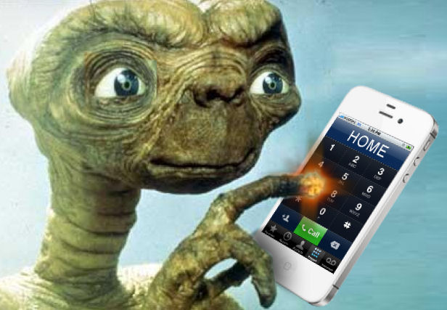
iot
Limited resources (bandwith, computation, memory)
Ecosystems rely centralized brokered communications models, all devices are identified, autenticated and connected through cloud servers
Lack of privacy: apps require users to reveal precise data to SP to receive personalized services
Updates are centralized
Users are non heavy
Lack of trust phone home devices
Notes:
Limited resources incompatible with complex security
Cetralization: unlikely to scale with bilions of devices, cloud servers will remain a bottleneck and point of failure
several IoT
applications require users to reveal precise data to
the Service Providers (SP) to receive personalized
services.

Slide 16
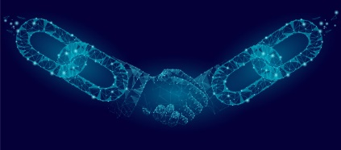
Challenge with BC for Iot
For some applications IoT , there are high limitations
Complex consensus (PoW or PoS)
Scalability and overheads (typical all blocks are broadcasted to and verified by all nodes) Iot devices have limited bandwidth connections (LPWAN)
Latency: in bitcoin 30 min for confirming a transaction. IoT requires shorter delays
Security overheads: some compu-intesive security mechanisms in BC are ment for protecting from double spending, appropiate for cryptocurrency not directly for IoT

Slide 17
LSB lightweight scalable Bc
Application agnostic
2 main tiers: Smart Home and Overlay
Transaction is basic comunication primitive for exchanging information among entities.
IL (local primitive imutable ledger), like a BC but centralized
Symmetric encryption to encript transactions here.
Overlay Tier: capable nodes (SP servers), manage the public bc, to store overlay transactions.
Overlay organiza as clusters where CH(cluster heads res for managing public BC.
LSB: tunable concensus period for
number of generated blocks by the CH

Slide 18
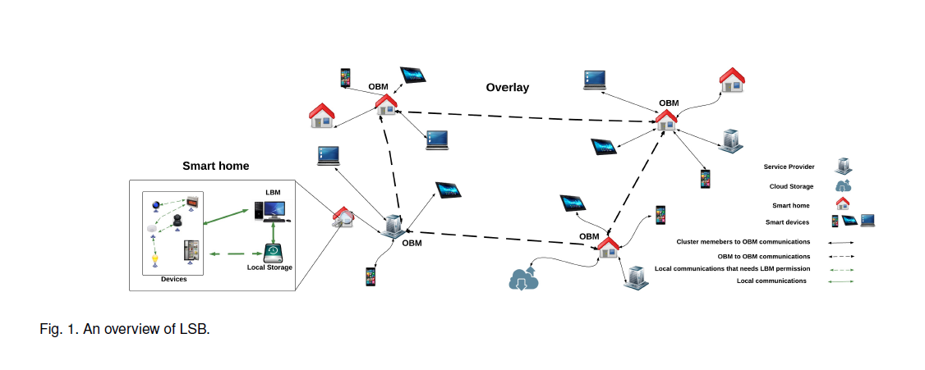
LSB OVERLAY & Smart home
Notes:
Overlay: async encription
Smat home: symetric encryption

Slide 19
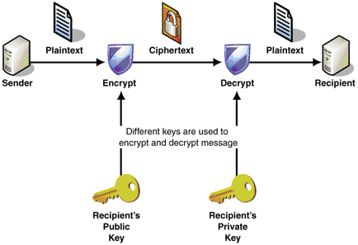
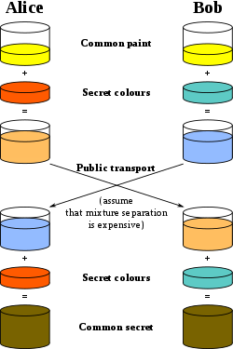
LSB Encryption
Symmetric encryption
asymmetric encryption

Slide 20
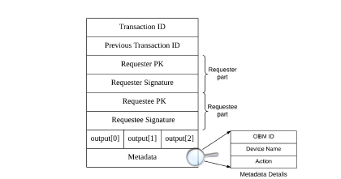
LSB OVERLAY & Smart home
Multisig transaction

Slide 21
LSB OVERLAY & Smart home
Trust table

Slide 22
LSB How
Distriubuted trust algorithm
Each CH acumulates evidence about other CH, and the validity of the new blocks they generate.
DTM: dynamically adjust throughput to public BC.
Network is selfscaling

Slide 23
LSB flow of data
To and from IoT devices: seperate from transaction flow
Transactions are broadcasted among overlay nodes
Data packets are routed toward their destinations.

Slide 24
Local smart home tier
IL: local immutable ledger of local transactions similar to BC but managed centrally
Symmetric encription is used to encrypt transactions in this tier
Process local transactions and overlay transactions generated to and from SH
Notes:
Iot Devices : resource constrained
Symetric encryption
LBM manages local IL(inmutable ledger)= similar to BC

Slide 25
Local SH : IL
LBM requestee: IL records: block header :hash to previous block
Policy header: access control list rules for processing local and overlay transactions
Notes:
Bh:hash to previous block
Ph: acl:
1.id: if multisig its pk of the requestee
-local trans: specific IoT Device
2.permited actions
3. Targer device

Slide 26
Overlay tier
Distributed trust algorithm
Nodes are grouped into clusters, where a CH is elected
CHs process incoming and outgoing transactions generated to or form their cluster members
Each CH accumulates evidence about other CHs based on the validity of the new nodes that they generate
CHs more trust, less verification needed in transactions for a new block
DTM: adjust some system parameters to ensure throughput to the public BC (tps appended to BC)
DTM ensures network is self scalling.
Notes:
CH keep evidence of trustworthiness of other CH. New CHs need full verificatino, but well know is CHs verification is reduced. Recommender systems

Slide 27
LSB OVERLAY Consensus
Direct Evidence
Indirect Evidence
Notes:
To reduce computancy demand
Build evidence
-direct evidence: OBM a has DE that OBM b prevously has verified at least one block generated by B
-indirect evidence: OBM a does not have direct evidence of OBM b, bot other has confirmed that the block generated by B is valid.

Slide 28
Overlay tier
Capable nodes, SP servers, collaborativel manage a public BC which stores overlay transactions
Scalability assured, overlay nodes are organized as clusters and only the Cluster Heads (CH) are responsible of managing the public BC
Proposed a lightweight consensus algorithm that limits the number of new blocks generated by the CHs within a tunable consensus period
Asymetric encription (sha256) (single signature and multisig)

Slide 29
Overlay tier
Each node is known by PK
Fresh PKs to generate new transaction
Entities: overlay nodes: smart home(LBM), mobile devices, Service Providers (SP) servers, cloud storage (where smart homes store data)
Notes:
CH keep evidence of trustworthiness of other CH. New CHs need full verificatino, but well know is CHs verification is reduced. Recommender systems

Slide 30
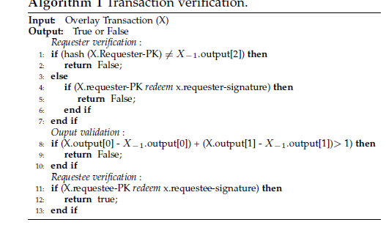
LSB OVERLAY Consensus
Notes:
Time based : periodicity fir an OBM: period an OBM can generate blocks
DTM:adjust the consensus period
1. Validate signature
2. Verify each transaction in the block
3. Calid if all transactions are valid

Slide 31
LSB OVERLAY Consensus
DTM: calculate utilization ratio:
Total number of new transactions generated
total number of transactions added to BC.

Slide 32
LBS security
Confidentiality: Encryption
Integrity: transaction includes a hash of all other fields contained in th transaction
Availability:LBM procesees
Authentication: LBM creates shared key, overlay store genesis block
Non-repudiation
Notes:
Availability:LBM processes all incoming transactions and controls access to all smart home devices, thus protecting them from
malicious requests, 2) An OBM sends a transaction to its cluster members only if a key contained in the transaction
matches one of the entries in its keylist (Section 2.1). This ensures that the cluster members only receive transactions
from authorized nodes.
Authentication: In the smart home, the LBM creates a shared key between two communicating devices which is also used for
authentication (Section 2.2). In the overlay, each node should have a stored genesis transaction in the BC to be
authenticated. As transactions are chained to the genesis transaction, a node is authenticated when it has the private
key corresponding to the output PK of a transaction stored in the BC (Section 2.1). The cloud storage uses standard
authentication protocols.

Slide 33
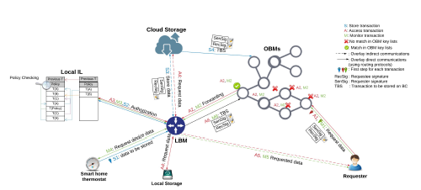
LBS Storage
Notes:
Cloud storage example

Slide 34
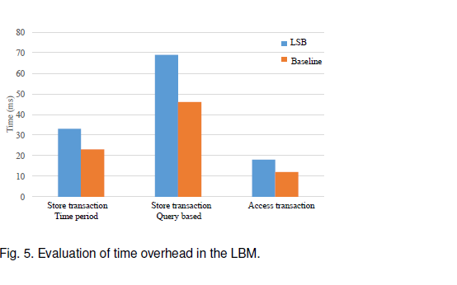
LBS TIME Performance
Notes:
Baselin: IPv6 over low power wireless personal area networks vs LSB encryption, hashing and local IL

Slide 35
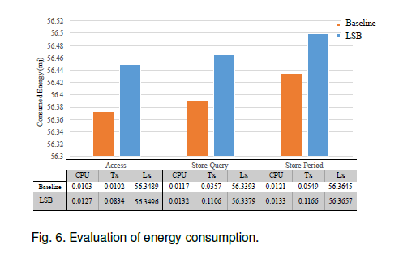
LBS Energy Performance
Notes:
Energy consumption for the 3 core taskts: CPU , transmission (Tx), listening (Lx)
Increase due to encryption and hashing

Slide 36
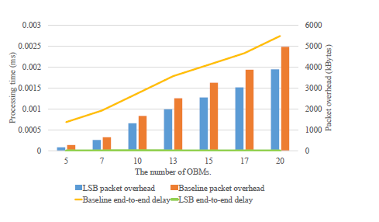
LBS transaction and data flow Performance
Notes:
Separation in LSB helps, end to end is not affected by amount of OBMS, packet overhead is linear,
OBM gain on packets since they are broadcasted among all OBMS, not routed using the best path.
Will this continue to be linear?

Slide 37
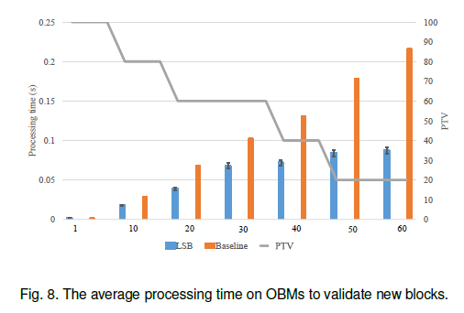
LBS processing time
Notes:
Distributred trust algorithm
Baseline similar to classical BC
LSB: trusted OBMS
PVT: % verified transactions grows in baseline while not in LSB

Slide 38
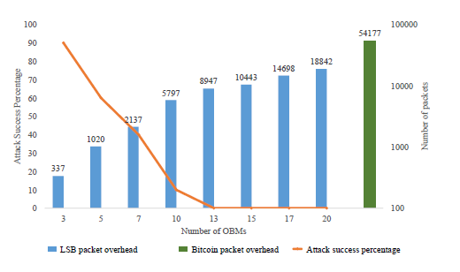
LBS impact # of OBMS on security and packet overhead
Notes:
Baseline: overlay structured as Bitcoin

Slide 39
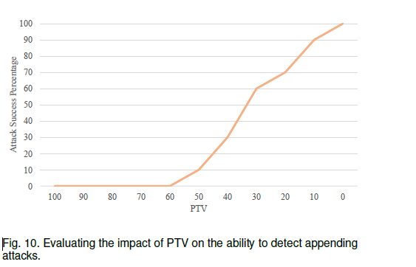
LBS PVT ability vs append attacks
Notes:
More verifications, less probability of append attacks

Slide 40
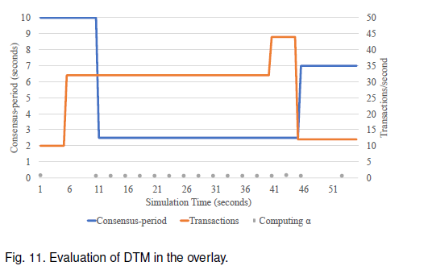
LBS PVT ability vs append attacks
Notes:
DTM mechanism, for adjusting the network utilization based on total load, number generated transactions.

Slide 41
LBS back to
OBMS have to find match
Overlay threshold
OBM keylists
LBM authorization before sending
SH shared key communication
Device injection attack, limited by LBM shared key, requiring Home approval
Notes:
--Ddos
Overlay threshold: maximum rate transactions received from overlay
Obm keylists
LBM auth before sending
Overlay transactions not valid within the smart home
SH , communication only if shared key establishe between them bia LBM
--medical
Device injection attack, limited by LBM shared key, requiring Home approval

Slide 42
LBS back to
Encrypted communication between device and Mobile
Linking attack: overlay unique PK for each transaction in the Overlay
LBM shared key needed, and PK address on the overlay.
Encrypted transactions
Notes:
Encrypted communication between device and Mobile via LBM, shared key
Now just the ip of the camera is not enough.

Slide 43
IOT Devices Jeep Hack
Firmware can only be updated from listed OBM
Trusted sharing
Smart contracts for secure updates
https://www.iotforall.com/5-worst-iot-hacking-vulnerabilities/
Notes:
Storage can be shared, trusted system to not depend only on the manufacturer

Slide 44
Iot security lessons with BC
Devices that cannot have their software, passwords, or firmware updated should never be implemented. LBM , and smart contracts
Changing the default username and password should be mandatory for the installation of any device on the Internet. Smart Contracts, LBM
Passwords for IoT devices should be unique per device, especially when they are connected to the Internet. Shared keys, PKs
Always patch IoT devices with the latest software and firmware updates to mitigate vulnerabilities. Smart contracts Overlay trusted lists, and async encryption
-pcmagazine
Notes:
Start talking about BC and Iot and what the problem is. Next slide get some cool image of a hack

Slide 45
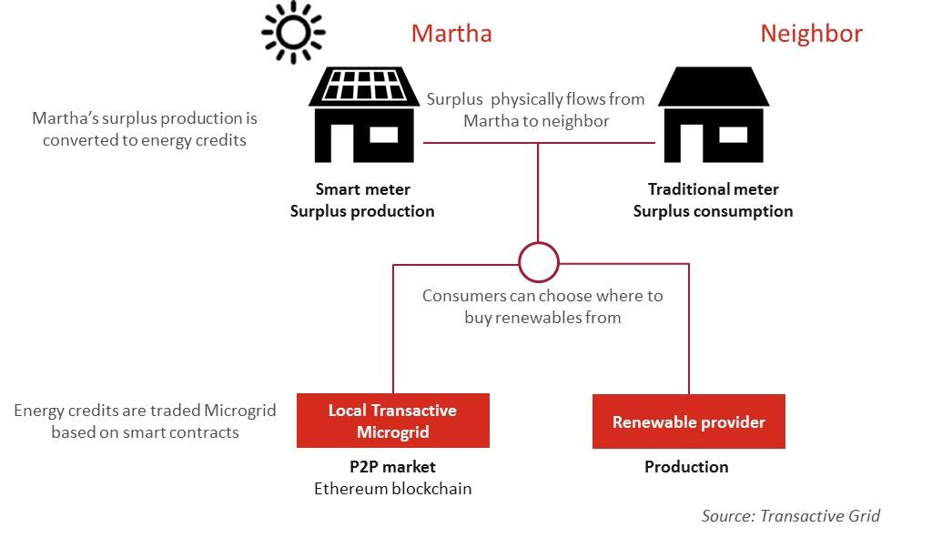
Transactive microgrid
Prosumers
Smooth load on
main grid usage
4%(2015)
29% (2040)
5% lost energy (3)
Decentralized power system control problem
Distributed market problem
DSOs
Storage
Notes:
Prosumers can trade energy wiht each other, smoothing the load on main grid using local supply
Problems: security, safety, privacy in decentralized and transactive energy system.
This system requires of a distributed infraestructure comprising, smart meters, feeders,smart inverters, utility substation, the utility central offices,and the transportation system operator, provind the computational fabric to support the interplay between the energy control and fiscal market challenges.
5% of energy in the US is lost in the transfer with big traditional grids

Slide 46
IOT based transactive Energy Systems & DL
Prosumers (consumers with energy generation and storage capabilities)
Trade with each other to sooth load on the main grid with local supply
Difficult to provide security, safety, and privacy in a Decentralized transactive system.
Protected from careless and malicious trading which could destabilize the entire grid.
Notes:
Prosumers can trade energy wiht each other, smoothing the load on main grid using local supply
Problems: security, safety, privacy in decentralized and transactive energy system.

Slide 47
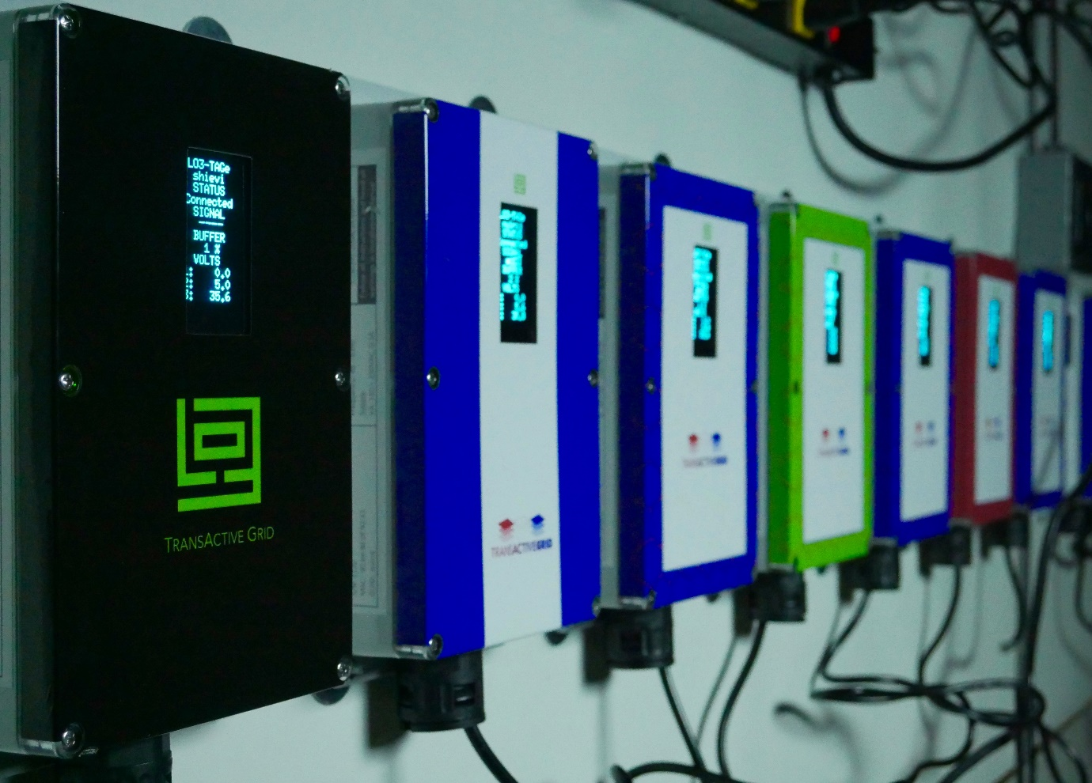
Transactive microgrid challenges
Security
Safety
Privacy
Careless
Malicious trading
Notes:
Prosumers can trade energy wiht each other, smoothing the load on main grid using local supply
Problems: security, safety, privacy in decentralized and transactive energy system.

Slide 48
Transactive microgrid challenges
Leakage of user patterns
Future states
Personally identifiable information
Notes:
The prosumer usage patterns in the current Iot might be leaked to others,
Future states might be leak, giving information about times the family will be home
Infer personal information, such as risk propensity and financial standing

Slide 49
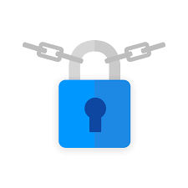
Petra solution
Privacy prevailing Energy Transactions
Major changes in power grids
Current systems for smart grids and others have forgotten about privacy?
Secure and safe solution for transactive microgrids enabling consumers to trade energy without sacrifing privacy
Notes:
Current systems for smart grids and others have forgotten about privacy? Focus on the computation and distribution of information, and not handle the require privacy challenges that arise from information exchange.

Slide 50
Transactive microgrid Petra
PETra : privacy preseving energy transactions
DL such as Blockchains
Provides anonimity for communication, bidding and trading
1. enables trading in a secure and verifiable manner
2. preserves prosumer privacy
3. enables DSOs to regulate trading and enforce some safety rules
Notes:
Solution that enables consumers to trade energy without sacrifying their privacy

Slide 51
Architecture with Petra
Notes:
Blue are basic elements in decentralized transactive microgrid
Red: added or extended by petra
DL: for security and safety offfers inmutability , trades, changes in regulatory policies for microgrid. Distributed to provide fault tolerance
Reach consensus, quickly and reliable, even in presence of faulty or malicious ledger nodes.
Bid storage: where prosumers to find trade partners. Can be implemented in a distrubuted manner. Prosumers only communicate with this service to discover trade partners.
Microgrid controller:DSO level, predicts the load based on: 1. bids and ask in the bid storage, 2. outstanding energy trades in the ledger. Based on this info the controller, increases or decreases load, also updates the price policy, to influence energy production and consumption. Assume secondary controllers that balances voltage and frequency in the microgrid.
Smart meter: measure the prosumer, energy production and consumption, tamper resistant, after measured amount of energy consumed in some time interval, info send to DSO for billing purposes

Slide 52
Requirements security
Prosumers are billed correctly
Prosumers or outside attackers cannot change policies set by DSO
Prosumers cannot back ouot of trades unilaterally, and tamper with others trading and bidding
Financial and physical impact of compromised or faulty nodes is limited and nodes can be banned by the DSO

Slide 53
Requirements safety
To avoid oversell of futures
Amount of net amount of energy sold or bought by prosume is upperbounded by DSO
Notes:
Net amount of energy sold is the difference of the and bought and sold, adn amount of bought energy is defined analogously

Slide 54
Requirements privacy
Only corresponding smartmeter and DSO may gain information regarding the amount of energy produced, consumed, bought or sold by a prosumer
Only the prosumer knows which bids and asks it has posted, no one can know who traded energy with whom
Notes:
Net amount of energy sold is the difference of the and bought and sold, adn amount of bought energy is defined analogously

Slide 55
Trading workflow
Notes:
Mixing service: conishuffle or Xim
To post an ask: prosumer needs to prove to storage service, that it owns a production asset in an anonymous address, which prevents spamming.
-then the prosumer can post the energy ask, with an anonymous communication identifier, a price, and a reference to the production asset.
-if another prosumer , seeking to buy energy , find the ask acceptable, it can contact the seller using the comunication identifier included in the ask
Seller and uyer can execute the trade by creating a financial transaction together, and recording it to the ledger.
Financial asset: certain amount of money
Comsumption asset: permission to buy a certain amount of energy.

Slide 56
transactions
Timing
Assets (EPA, ECA, FA) :
Energy and financial transactions:used as proof, to hide identity, deposit asset
Conditions: non spent, signatured are valid, sum of input and output are equal
Smart meter transactions: used to withdraw energy and financial assets
Regulatory transactions
Notes:
Timing: when energy trades take place, microgrid load, when will it be produced or consumed. Fixed lenght intervals
Energy production accet, energy consumption asset (power,start, end), financial asset
Smart meter transaction is valid: smart meter identified has been authorized (not banned) by DSO, smart meter signature is valid.
Regulatory transactions: (1) manage the set of authorized meters, (2) to change the price policy. Timestep should not be in the past.

Slide 57
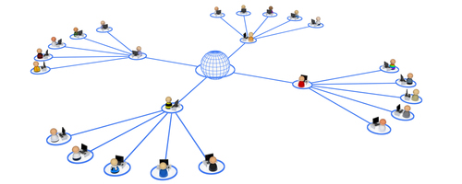
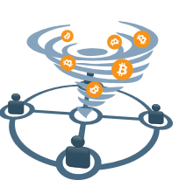
services
Communication anonymity
Transaction anonymity
Bidding anonymity
Smart-Meter based billing
Notes:
Communication anonymity: without this layer the bids, asks, transactions could be easily deanonymized, by ip or mac address. Onion ring (smart meters, prosumers, and other devices act as routers)
Transaction anonymity: DL allow users to generate new address at random, then use of mixing services
Bidding anonymity: must first proof he owns the assets, but uses an anonymous communication identifier (Tor hidden service) Publik key, proof means knowing the PK
Smart-meter: measures amount of energy actually consumed (or produced) by prosumer, using physical sensors. Compute prosumers bill for timeslot t, consumptions assets are not used directlyfor billing but only to enforce security and safety.

Slide 58
Contribution
Overview of the microgrids problems,
Presents an idea of a Solution
Feasable , practical?
Any real deployment? Or all simulated?
Privacy can be achieved by mix transactions like CoinShuffle or Xim
It is important the transactions also go through even if you have none

Slide 59
Personal view
Good description of requirements
Lacks some why we need the privacy
For transactive grids , consensus is an important isssue
Still interesting to see the LSB application

Slide 60
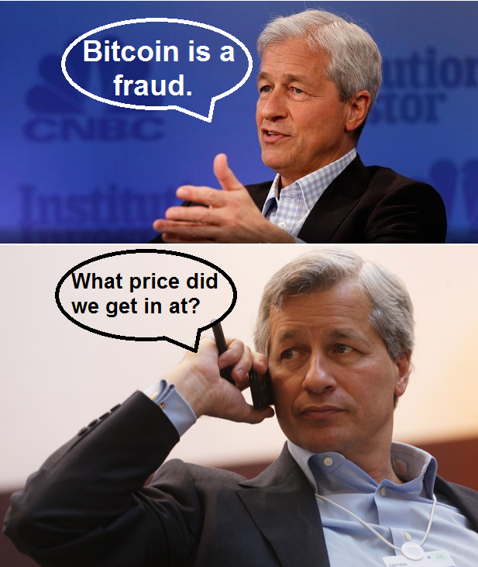
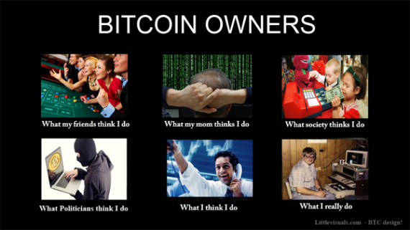
To take away cryptocurrencies
IOT might need incentives
Could be a billing layer
Paves way for marketplace between devices

Slide 61
To take away
Microgrids can be one of the clearest applications of distributed ledgers.
It does need to keep safety, privacy and security, since damage can be done
In that sense distributed ledgers working with it might require some sort of permisioned based DL
For microgrids the DSOs will have the central info so they will be like a central point, and therefore security measures have to be good.
BC can surely benefit IoT

Slide 62
questions
Alice
Bob
Notes:
Who has more money Alice or Bob?

Slide 63
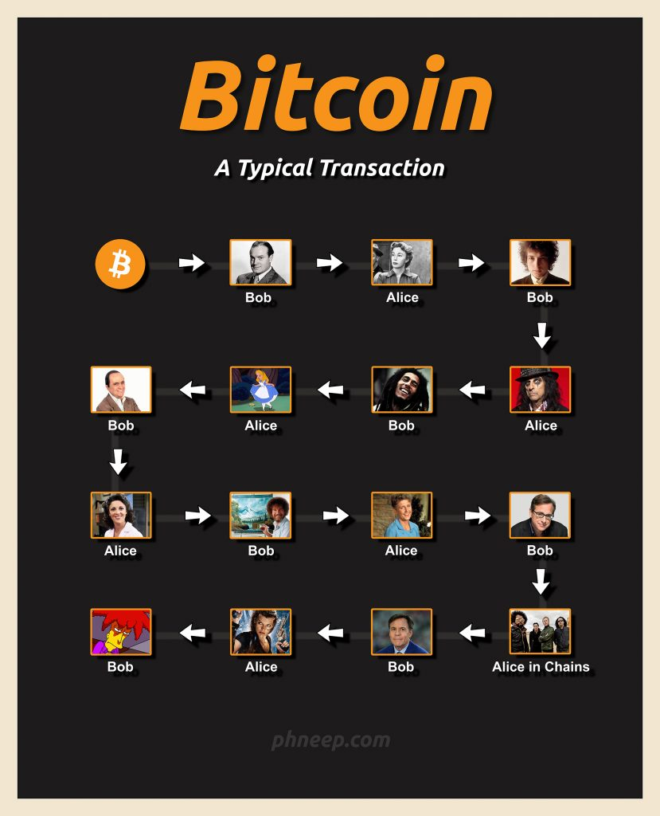
Questions discussion
How secure is LSB, against bizantine nodes?
Incentives with cryptocurrencies?
Incentives for manufacturers?
BC is about decentralization, non-trust, IoT uses more centralized OBMs, DSO, trust lists?
Incentives for firmware storage
projects:
brooklin microgrid
Power Ledger
catastrophees
Notes:
Regulators to decide if one could buy and sell credits? So its just an exchange

Slide 64
references
(1) https://www.trisent.com/blockchain-technology-value-to-exceed-3-1-trillion-by-2030/
(2) https://www.forbes.com/sites/louiscolumbus/2017/12/10/2017-roundup-of-internet-of-things-forecasts/#2e95f0461480
(3) https://www.power-technology.com/features/featurethe-brooklyn-microgrid-blockchain-enabled-community-power-5783564/
Notes:
Who has more money Alice or Bob?

