Slide 1
IN5430 IT and Management
Introduction
16th January 2019
Ole Hanseth (Ole.Hanseth@ifi.uio.no)
Kristoffer Fossum (kristofo@ifi.uio.no)
Alexander Moltubakk Kempton (alexansk@ifi.uio.no)

Slide 2
About the course
Practicalities
  Course overview (format, important dates etc)
  About the project: seminar Tuesday 22nd January
Changed from INF5890 to IN5430
  Revised course description
  New exam form: oral exam
Course content
  “IT and management” at what level?
  Sociotechnical complexity
    How readings (book + articles) and activities (lectures, seminars and project work) contribute to understanding complexity
  More focus on platforms

Slide 3
What is the course about?
Course content
  In this course you learn about managerial challenges related to development, implementation and management of IT solutions in organizations. A specific focus is on the challenges posed by socio-technical, complex, large-scale and interconnected IT solutions. The lectures and readings in the course present approaches, models and frameworks found in practice, and offer a research-based view on the topics. You will participate in a project where you apply this knowledge to an empirical study within a real-world organization.
Learning outcome
  After you have completed the course you:
  describe common approaches, models and frameworks for IT management and governance, project management and enterprise architectures in organizations.
  describe theoretical perspectives on the opportunities and challenges associated with IT governance, project management and enterprise architectures.
  discuss the challenges of inter-organizational and sector-wide IT governance.
  describe the connection between governance models and enterprise architectures.
  can plan, organize, and report from a project where you collect and analyze data to document and assess the IT governance model of an organization.
  utilize your practical and theoretical basis for critical reflection on how IT is managed in organizations.

Slide 4
Activities and evaluation
Oral exam (individual): Grades A-F
Mandatory project has to be passed to take exam (not graded).
  Groups (3-4 participants) identify case organizations
  3 deliverables (2 group + 1 individual)
More in seminar Tuesday 22nd Jan

Slide 5
IT: level of detail – time perspective
Level of detail
Low
OPERATIONAL
STRATEGIC
TECHNICAL
TACTICAL
High
Short term
Long term
Time perspective

Slide 6
IT: levels of complexity
Application (accounting system, word processor)
Portfolio of applications in organizations
Platforms and platform ecosystems (iPhone/iOs + apps, Airbnb, ..)
Information infrastructures (Internet, national e-health solutions, Pan-European e-Governemnt solutions, programmatic advertising infrastructure, ..)

Slide 7
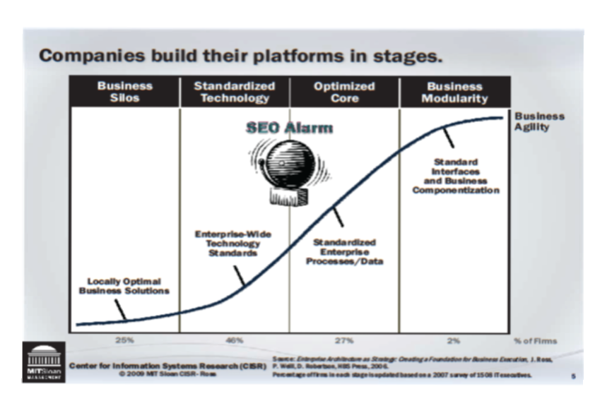

Slide 8
Platforms
Definitions:
  Extensible codebase (ex: Android)
  Marketplace (ex: Uber, Airbnb)
Categories (overlapping)
  Consumer platforms
  Software platforms (Android, SAP, ..)
  Date sharing platforms
  Shared platforms, platform co-operatives
“everything” is becoming a platform?

Slide 9
Industry platforms
Internet of Things, machine learning, information sharing, ..
https://www.veracity.com
https://www.kognifai.com
https://www.cognite.com
https://www.ge.com/digital/iiot-platform
https://new.abb.com/abb-ability
https://www.siemens.com/global/en/home/products/software/mindsphere.html

Slide 10
Platforms and platform ecosystems
Complexity – networks
Network effects – increasing returns
Self-reinforcing processes
Multi-sided markets

Slide 11
From platforms to infrastructures
Internet
National e-health infrastructures
Supply chain support
E-Government solutions
Pan-European e-Government infrastructures
Programmatic advertising
..

Slide 12
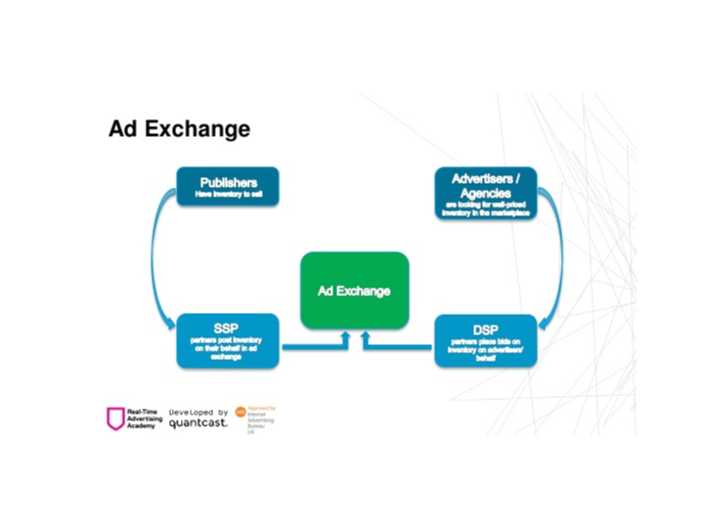
Example: Programatic advertizing

Slide 14
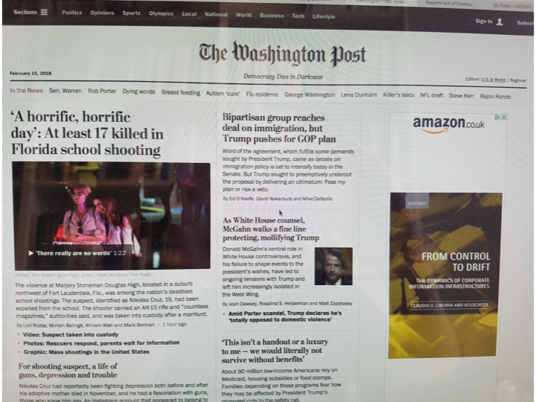

Slide 15
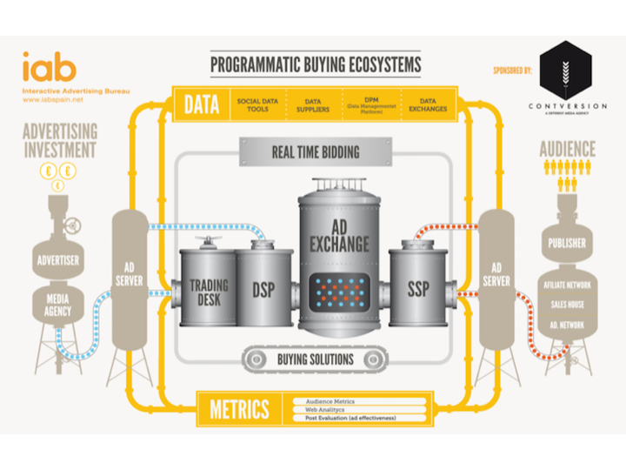

Slide 17
Projects
Deliverable 1 (Group) (March 12th)
  Find a platform. The description should include:
  A description of the platform in terms of its
    Functionality
    Use and user groups,
    Origin and historical evolution
  You should also identify systems the platform is connected to (is it a part of a larger infrastructure?).

Slide 18
Deliverable 2 (Group) (April 8th)
  Apply theory on platforms and platform governance and address the following questions:
  What kind of platform is it?
  What are the relations and dependencies between user groups?
  How is the platform (ecosystem) governed?
  Could platform theory contribute to the further development of the platform?
  This part is an addition to deliverable 1. In total the document should now be maximum 30 pages. Hand in by April 9th by email. Prepare to present in the seminar on the same day. The presentation should not exceed 10 minutes and PowerPoint slides should be used.
Deliverable 3 (Individual) (May 22nd)
  To be announced.

Slide 19
Course Overview
Lectures |  | Reading | Seminars | Project Deliverables
16.01 22.01 | Introduction Platforms: Examples and basic issues. Network economics | -
23.01 | IT governance in organizations (Bendik Bygstad)
30.01 | Project management (Knut Rolland)
06.02 | IT strategy and Enterprise Architecture (BB)
13.02 | Lightweight IT and platformization (BB)
19.02 | Platform launch strategies
20.02 | Managing multi-sided markets
06.03 | Governance of consumer platforms
12.03 | Governance og software platforms |  |  | 12.03
20.03 27.03 | (goverannce of shared platforms & platform co-operatives) Infrastrucutre governance: Heath care
02.04 | Network governance, orchestrtion, adaptive co-mamagement
03.04 | Infrastructure governance: the role of architecture |  |  | 08.04
10.04 | Adaptive infrastructure governance
24.04 | Critical perspectives |  |  | 30.04
08.05 | Summary of lectures
(Starting 22.1)
Discuss:
Readings
Project Work
Present:
Group Project Deliverables
Coordinated by
Mikael + Kristoffer
As per reading list
(matching literature to lectures)

