Slide 1
A User Organization Perspective on Digital Platforms
Knut H. Rolland
University of Oslo and SINTEF Digital

Slide 2
Agenda
What is a digital platform?
Why platforms?
Different kinds of platforms and ecosystems
Overview of basic concepts and theories
A user organization perspective
Case study of a digital platform in a large media company

Slide 3
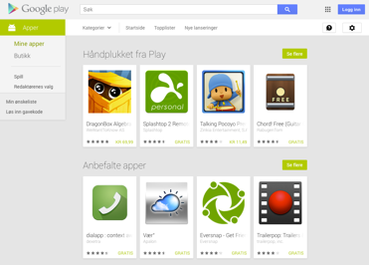
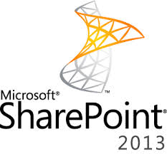
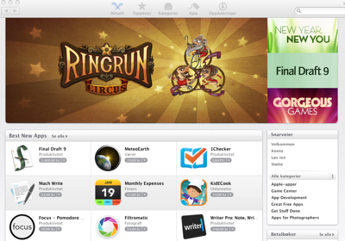
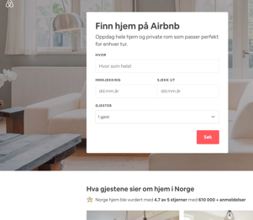

Slide 4
But, what is a platform?
An operating system?
A layered software architecture?
A multi-sided market?
A distributed innovation system?
A transaction system?
Apps and digital services?
A data platform?
Can implicate all of the above, and more!

Slide 5
Platform as a metaphor
“The term platform has a rich history and many uses. Plat, meaning flat or level, and forme, meaning shape or arrangement of parts – together imply a flat, possibly raised, surface onto which something can be placed” (Tilson et al., 2013: p. 2)

Slide 6
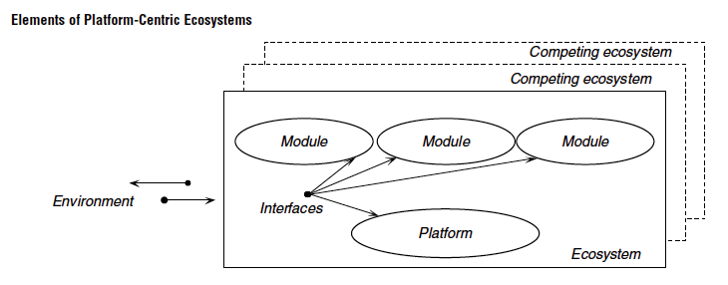
Platform as layered modular architecture
A software platform is “the extensible codebase of a software-based system that provides core functionality shared by the modules that interoperate with it and the interfaces through which they interoperate” and modules as “an add-on software subsystem that connects to the platform to add functionality to it” (Tiwana et al., 2010: p. 675).

Slide 7
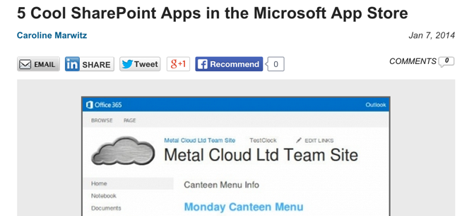
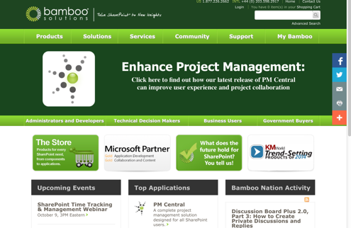
Example: Microsoft SharePoint

Slide 8
Platform as a multi-sided market
n service consumers
n service providers
Platform owner:
mediating transactions between provider and consumer
«Bring together (or match) distinct groups, whereas the value for one group increases as the number of participants from the other group increases» (de Reuver et al., 2017, p 4)

Slide 9
Example: nabobil.no

Slide 10
Modualarization and standardized interfaces
Rapidly evolving and numerous alternatives
App
App
App
App
Standardized interfaces
Platform core – shared resources
Relatively stable core

Slide 11
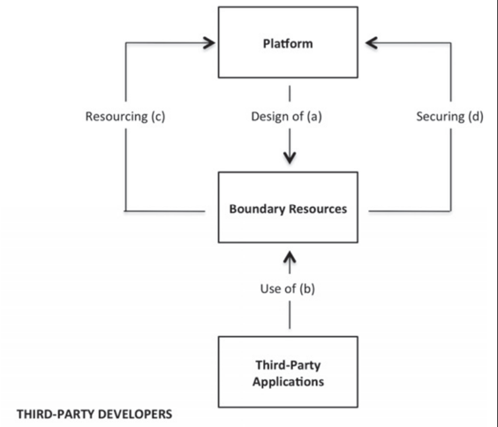
«Boundary resources»
«The software tools and regulations that serve as the interface for the arm'slength relationship between the platform owner and the application developer» (Ghazawneh & Henfridsson, 2012: p. 20)
«Boundary resources» are important for both innovation and control

Slide 12
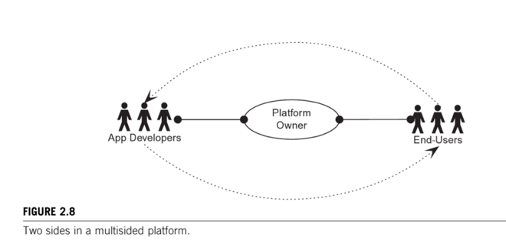
Multi-sidedness of platforms
Tiwana (2013) argues that a primary characteristic of ‘real’ platforms are their multi-sidedness and the interactions between different sides through the core platform as a mediator.
Tiwana (2013: p. 32)

Slide 13
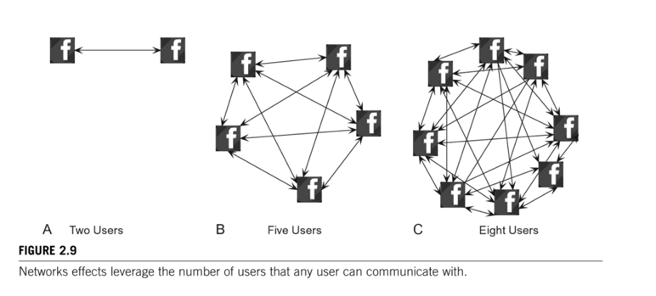
Network effects in platform ecosystems I
Tiwana (2013: p. 34)

Slide 14
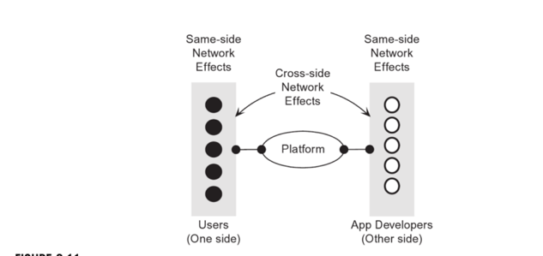
Same-side and cross-side network effects
Positive and negative network externalities
Negative externalities: too many different user groups or Apps make it too complex to participate?
Cross-side: adding new App which increases value for users on the other side
Same side: adding a new developer that makes the platform more attractive to other developers
(Tiwana, 2013: p. 35)

Slide 15
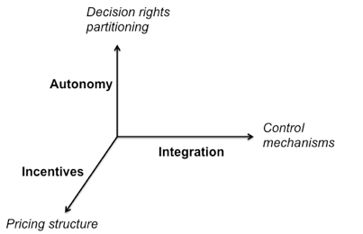
Aligning Architecture and Governance (Tiwana, 2013: p. 204-5)
Platform architecture
Co-evoution of architecture and governance
App Micro-architecture

Slide 16
How to identify platform opportunities? (according to Tiwana)
Product or service
Lens #1: Two distinct sides exist?
Lens #2: Unexploited long-tails?
Lens #3: One side on board?
Lens #4: Cross-side network effects potential exist?
Future platform opportunity

Slide 17
Why platforms?
Platforms are a more cost efficient and effective way of facilitating transactions between consumers and suppliers (Ex.: Uber)
Platforms as “layered modular architecture” and ”open standardized interfaces” are likely to produce more innovation (Ex.: Google Android)
Platforms inside organizations enable more flexible infrastructures that reduces complexity and increases innovation speed (Ex. NAV)

Slide 18
Many different kinds of platforms?
Transaction platforms –Platform owner facilitates consumer-producer relationship (Case: Finn.no)
Innovation platforms – Platform owner favilitetes third-party devlopers and complemenatry products and services (Case: Microsoft SharePoint)
External industry platforms – platforms owner or consortium of companies facilitates industry-wide standardizations and transactions (Case: News platform)
Development platforms (Amazon Web Services (AWS), Microsoft Azure, Google cloud platform)

Slide 19
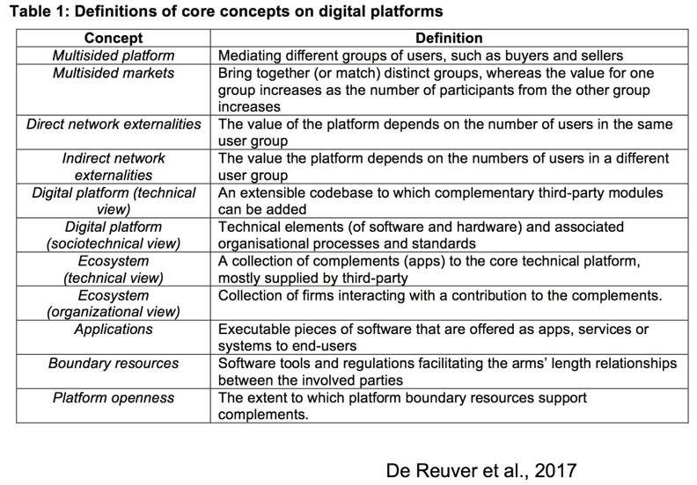
Summary of definitions according to de Reuver et al. (2017)

Slide 20
A User Organization Perspective
Current literature is too narrow in terms of cases, types of platforms, and context of use
Current literature over-empathizes unbounded generativity and
A digital platform can produce new options as well as new challenges for managing the IT infrastructure
Tensions between existing solutions and new options provided by the new platform ecosystem
User organizations can take on many roles
Customer, user, collaborator with platform owner, APP developer, take part in standardization processes etc.
User organization becomes part of a larger ecosystem

Slide 21
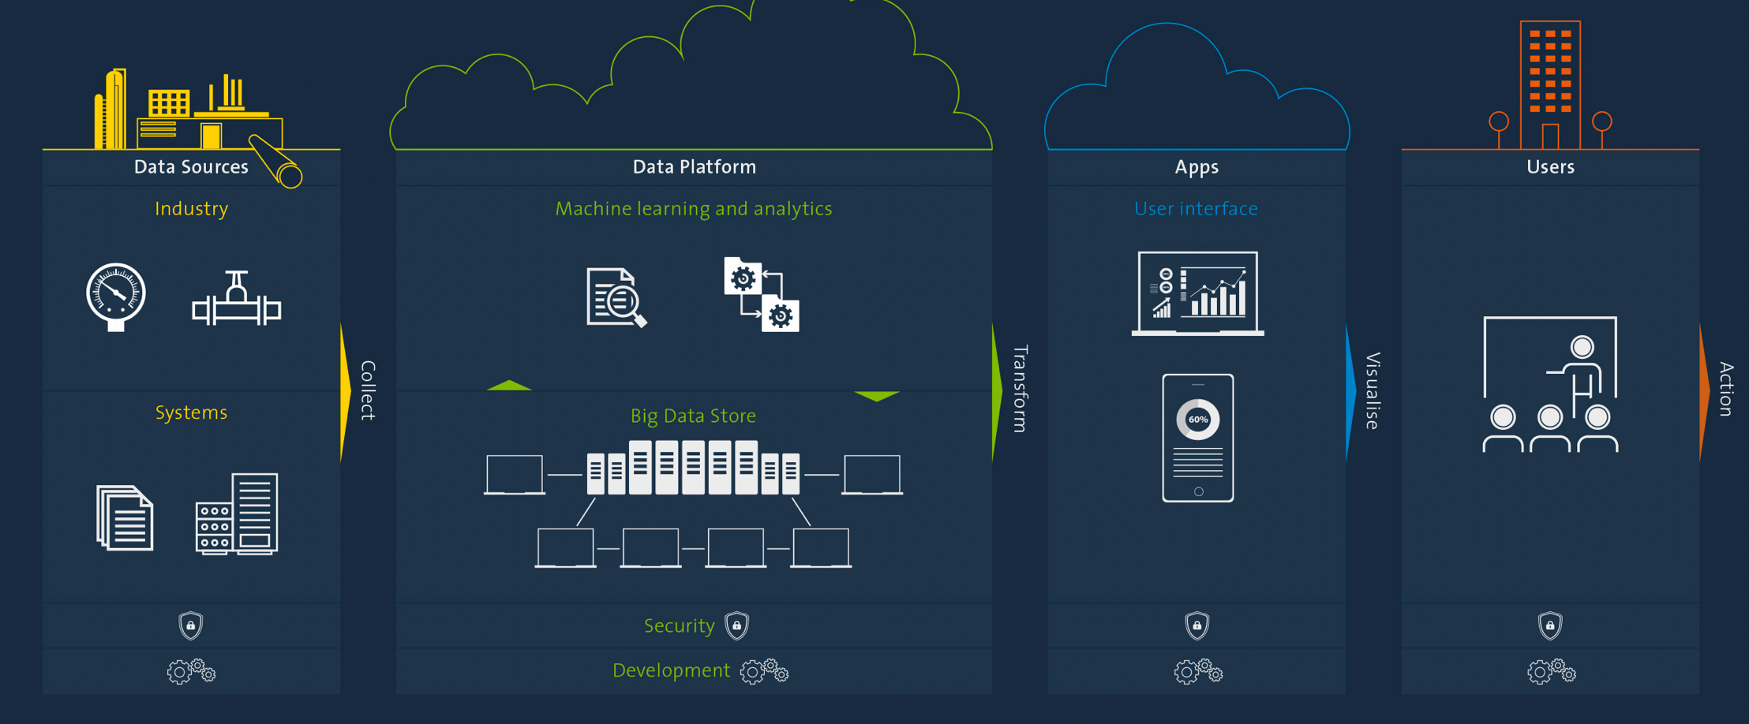
Towards platform-centric infrastructures?
Source: Leif Heggø
Notes:
Metadata taxonomies
Structure of digital content
SharePoint -> requires a more ‘project’ oriented organization
Different versions of the SharePoint platform has different hardware and network requirements (e.g. Citrix), change of domains is difficult

Slide 22
Infrastructure -> platform
Existing infrastructure can be a hinderance for utilizing new platform features
Digital debt: "A buildup of technical and informational obligations related to platform maintenance and evolvability that represent performance risks in an organization’s work processes” (Rolland et al., 2018: p. 425)

Slide 23
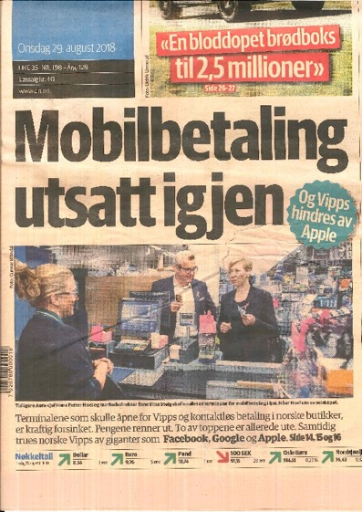
Existing infrastructure as barrier for change
Digital debt related to existing customer programmes and their infrastructures
«...dagligvarehandelen har vært motvillig til å godta kontaktløse kort foreløpig, både på grunn av pris og utfordringer knyttet til hvordan man kobler mobilbetaling opp mot kunde- og bonuskort.»
Source: https://e24.no/digital/bank/mobilbetaling-er-bare-foerste-steg-foer-mange-nye-banktjenester/24399212

Slide 24
Platform->infrastructure
Platforms and their ecosystems can give new possibilities and increase the design space of current infrastructure
Digital Options: “An opportunity to invest in new technical and informational features that will increase the platform’s value proposition for an organization’s work processes”

Slide 25
Platform as mechanism for change: NAV case
Moved development to the NAIS (NAV application infrastructure service) platform and thereby breaking current path trajectory
The NAIS platform developed based on Kubernetes (see link)
The NAIS platform provides a wide-range of “options” for the development process:
Monitoring and automating deployment
NAIS platform affords continuous deployment (everyday 12 O'clock)
Toggling functionality affords evolutionary organizational implementation
Source: https://kubernetes.io/docs/concepts/overview/what-is-kubernetes/

Slide 26
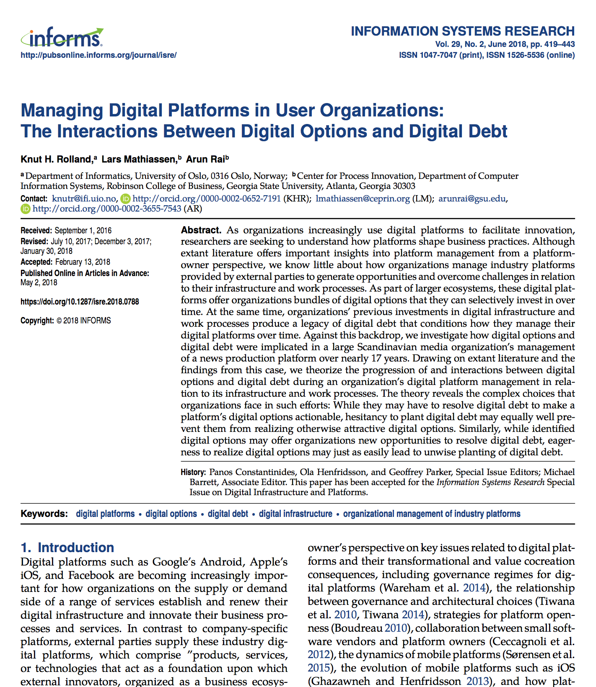
A User Organization Perspective
Develops a new vocabulary for understanding platforms in organizational contexts
Organizations can play multiple roles in a platform ecosystem
Both digital debt and digital options are essential for managing platforms
Understanding how digital options and digital debt mutually influence each other
Platforms become a central component in evolution of the Enterprise IT Architecture, and for innovation of new services and products

Slide 27
Case organization
Media Company is a large Scandinavian broadcaster
Located on more than 50 geographical sites
3500 employees
Adopted a «News Platform» in the late 1990s, that is now part of a ‘generative’ platform ecosystem
See Rolland et al. (2018) for details

Slide 28
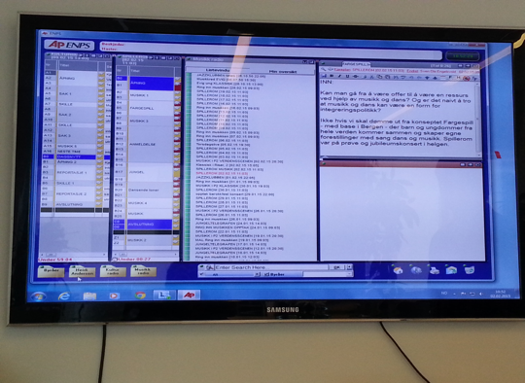
The News Platform
Used by journalists and producers
Different types news rooms are using it
Developed by a platform owner: 60,000 users, 700 news rooms, 60 countries
App developers are both media companies, platform owner and third-party developers
Involved in standards development within the media industry

Slide 29
Case timeline

Slide 30
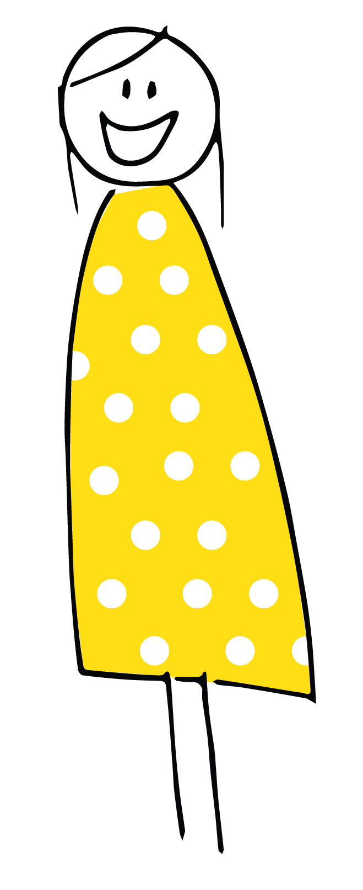
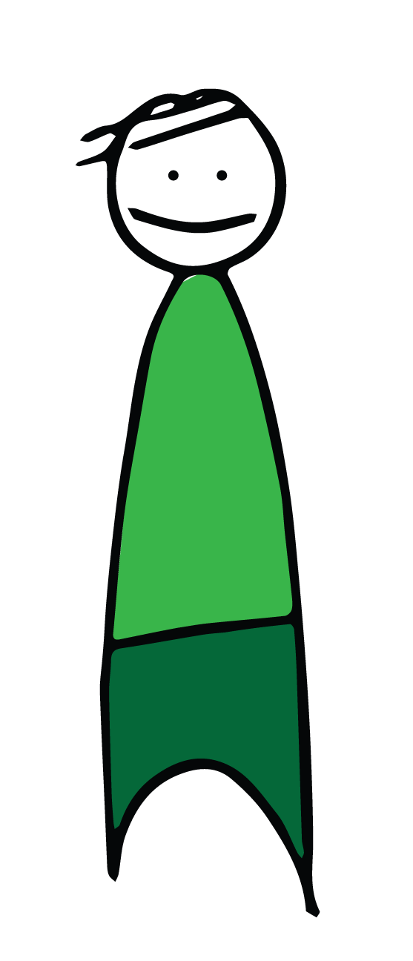
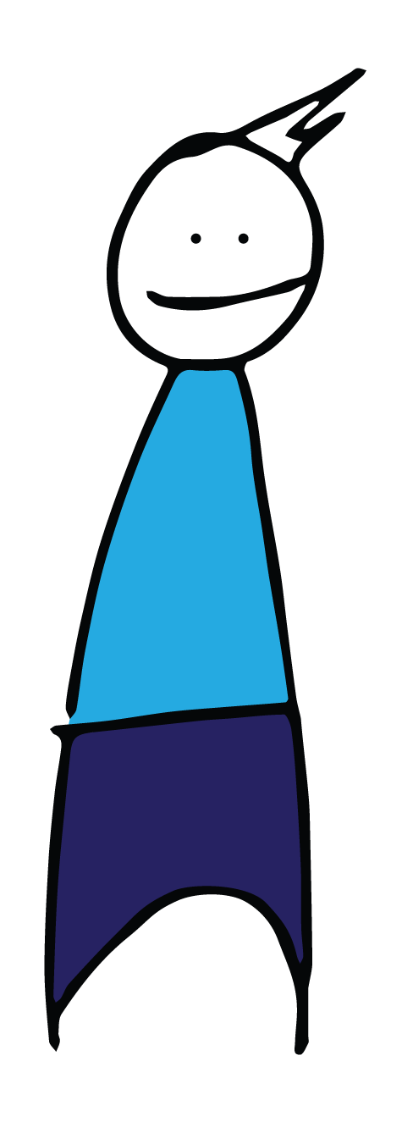
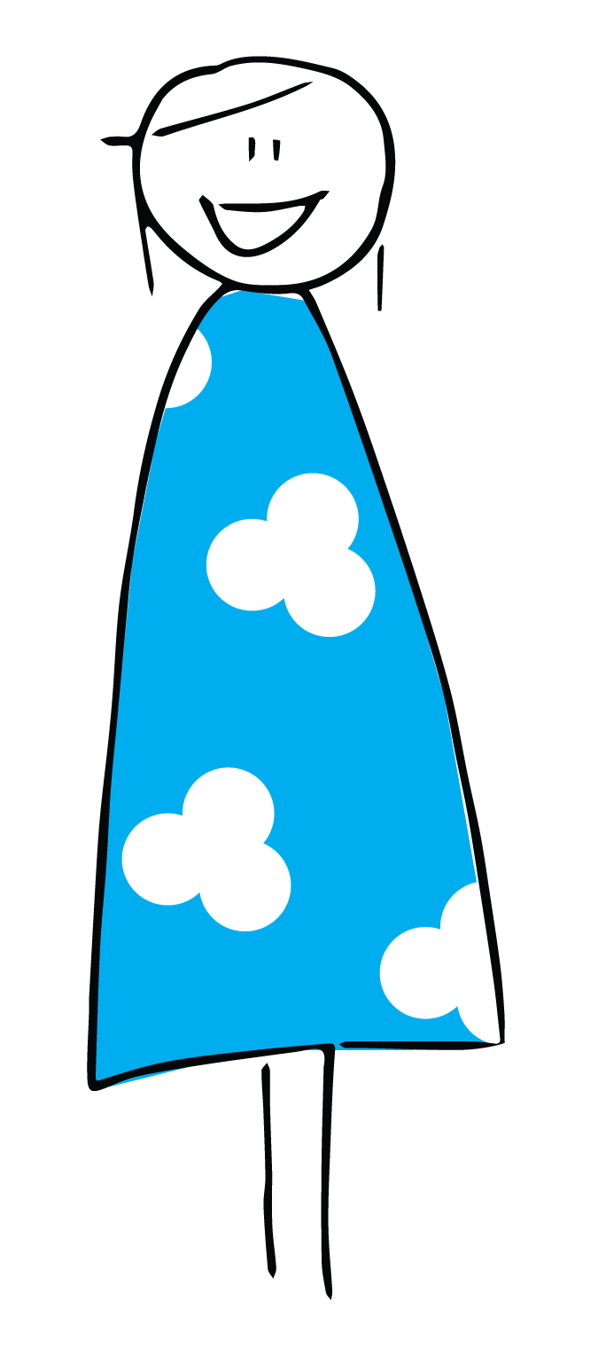
Platform ecosystem and multiple roles of the user organization
Consultant services provided by platform owner
Inhouse developed Apps
Apps developed by third-party
Consortium of media companies developing common standards
Complementary software products
“Boundary resources”
APIs, consulting serivces, standards, code libraries
Software development companies
Core functionality and transaction handling
Other platform ecosystems (Google, Microsoft…)
On premise database
On premise database
On premises databases
Corporate IT infrastructure

Slide 31
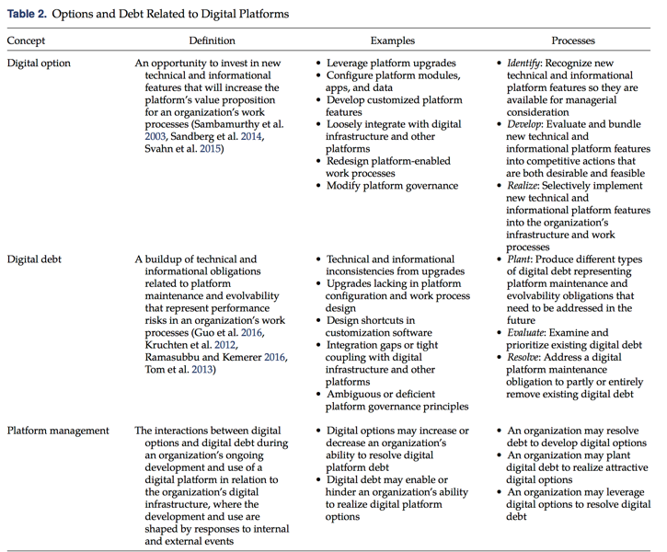

Slide 32
Considerable «switching costs»
«[We] were running out of time. We did double shifts delivering a training program everywhere. The plan was not of this earth—but we made it. But, the old plat- form had an internal hierarchical structure that made it hard to switch to the new platform. In the new platform there are a lot of folders, which gives you access to the different servers—for example, the main news program has its server—and you need to know where to navigate.»
(Stakeholder 2, project participant)

Slide 33
Not all features were ‘realized’
«We tried to use a feature that gave users a notification on their mobile to use when they were offline [journal- ists sometimes leave the office to do interviewing and reporting in the field], but it never took off. These fea- tures are still available, but not used. There are many features that we are not using. They are developed for commercial TV stations—a comprehensive module for American elections, for instance, and the commercial break line. This particular feature we use for a different purpose than initially intended.
(Stakeholder 10, IT Department)

Slide 34
New features provided new options, which in turn planted new debt
«[I] use the module called the “Thomas module” as it was developed by Thomas. The program transfers suprainformation, intros, and all metadata describing who made video clips, produced them, and everything else. All these metadata are then [automatically] con- nected to the actual video clip aired and all related clips. They are then transferred to something called “Program Bank” and then to the big archive. «

Slide 35
Increasing complexity over time - but no ‘lock-in’
«[But] as more systems get integrated, the amount of configuration increases. And as long as more and more systems are integrated with [News Platform], there are more systems you have to take into the account when doing the actual configuring»
(Stakeholder 2, project participant)

Slide 36
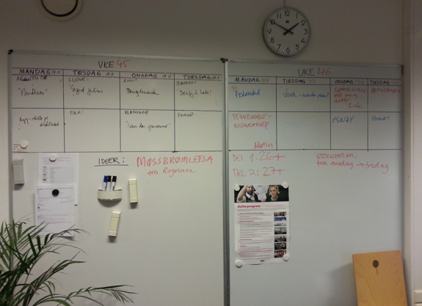
User organizations utilize multiple platforms
Google docs and Microsoft 365 to compensate for lacking features
Provided new options

Slide 37
Managing platforms in user organizations
News platform ecosystem
Continuous innovation of «digital options»
...
Media Company recognizing, developing and realizing some of the «digital options»
Media Company managing the local instantiation of News platform
Media Company planting, evaluating, and resolving “digital debt” reducing or increasing the number of possible options
v

Slide 38
Analysis of case
Developing digital options provided new ways of resolving digital debt
Realizing digital options intentionally and unintentionally planted digital debt
Developing and realizing digital options led to unwise planting of digital debt
Resolving digital debt facilitated developing and realizing digital options

Slide 39
Concluding remarks
Platforms in user organizations have different dynamics and user organizations play multiple roles simultaneously
A weakness that current literature is focused on platform owners and consumers – not user organizations
Platform ecosystems provides both sources for digital options as well as digital debt
Using several – fragmented platforms adds flexibility, but can also increase complexity
Generative platform ecosystems may not be generative in specific contexts – and contextual characteristics may make them more generative

