Slide 1
IN5430
Seminar 26.3.19
Tensions in architecture and governance, platforms

Slide 2
Exercise 1 (5+5)
Repetition: discuss and define architecture and governance

Slide 3
 | Stability | Change
Architecture | Integration (efficiency) Uniformity, standardization Centralized | Modularization (flex) Variation Decentralized
Governance (strategy, organizing) | Consolidation Long term focus Planned change Centralized control | Local optimization (adapt.), innovation Short term focus Emergent change Distributed control
Exercise 2 (15+10)
Choose four tensions, two from each domain
Discuss, explain and give examples of why they are tensions
How are the tensions in the two domains related?
Provide and discuss examples

Slide 4
Exercise 3 (15+10)
How can a platform architecture deal with the tensions?
Discuss and provide examples
Relate to models in Hanseth and Bygstad, Platformization

Slide 5
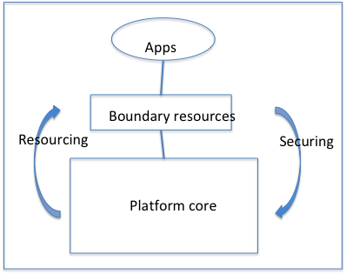
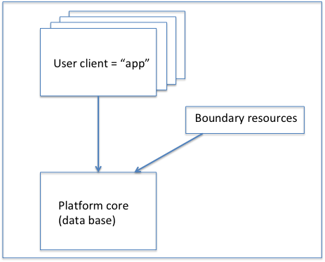
Platforms and infrastructures (Hanseth & Bygstad)

Slide 6
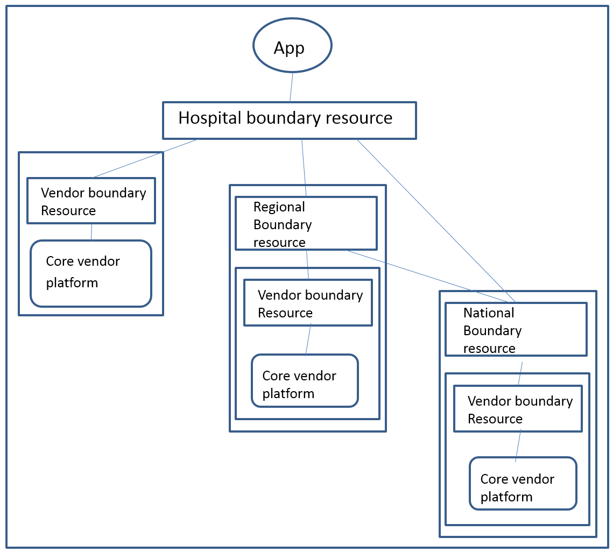
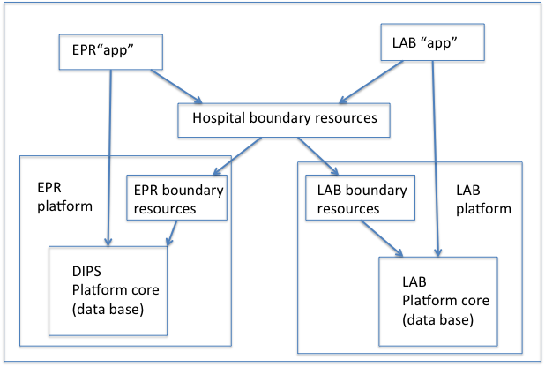
Platforms and infrastructures

Slide 7
Exercise 4
In your group’s case: what is infrastructure and what is platform?
Why?

Slide 8
Exercise 5
How is the infrastructure enabling the platforms’ business operations and goals?

