Slide 1
IN5430 - Seminar
IT Governance

Slide 2
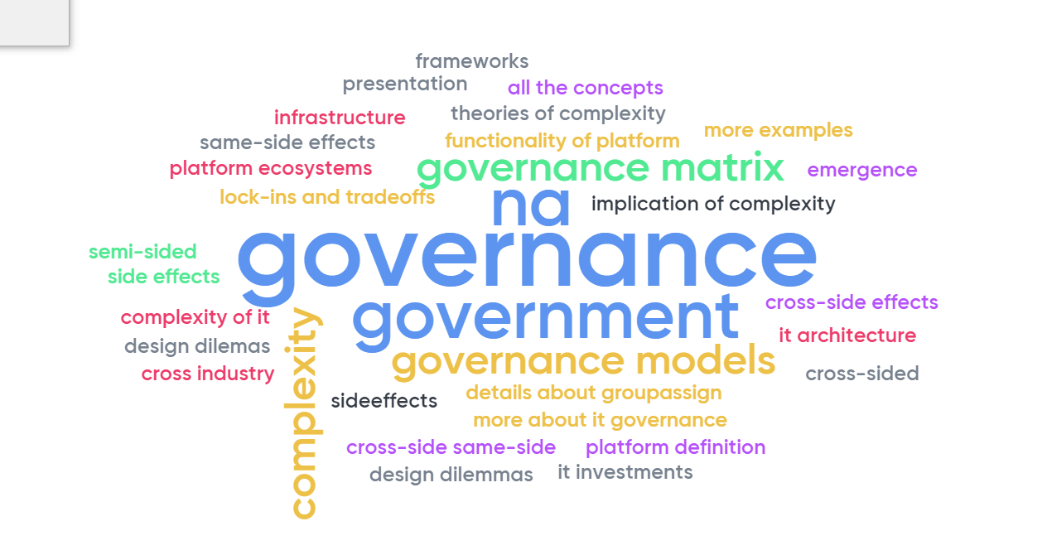
Feedback last week

Slide 3
Agenda
IT governance concepts
Case analyse

Slide 4
Group task (3-5p (5+5min)):
Discuss the differences between governance and management
Discuss lecture themes so far in regards to:
Size of what you govern/manage
Have they been presented as governance and/or management challenges?
Why?

Slide 5
Governance and Management
IT Governance: Specifying the desicion rights and accountability framework to encourage desirable behaviour in the use of IT
Decision rights
Accountability
Management: The process of implementing the decisions
Making
Implementing
Weill & Ross (2004)

Slide 6
Weill & Ross (2004) 5 min
Discuss:
What is the governance arrangement matrix?
What do the different elements in the governance matrix mean?
Notes:
What is IT gov?
the distribution of decision rights (input rights) and accountability frameworks for encouraging desirable behaviour in the use of IT
A desired behaviour is one that is consistent with the organization’s mission and strategy (e.g. innovation)
IT gov. not about making specific decisions but assigning who makes decisions and who has input to decisions and these people are held accountable
Why is IT governance important?
To get value from IT investments (e.g. innovation, operational efficiency, service quality, customer intimacy)
Improved profit, customer intimacy, improved performance
Beyond risk management and compliance
How to we gain value from governing IT?
Clarifying business strategy & role of IT in achieving them
Measuring and managing investment & output
Assigning accountability
Learning from each implementation

Slide 7
 | IT Principles |  | IT Architecture |  | IT Infrastructure |  | Business Application Needs |  | IT Investment & Prioritization
 | Input | Output | Input | Output | Input | Output | Input | Output | Input | Output
Business Monarchy
IT Monarchy
Feudal
Federal
IT Duopoly
Anarchy

Slide 8
Case
Catalan ePrescription Project
Paper: Digital Infrastructure Innovation and Evolution: The Co-Functioning of Architecture, Governance and Process Strategy (Rodon & Hanseth)

Slide 9
Individually:
Read the case (15-20 min)
In groups of 3-5 (20 min):
Complete the IT governance arrangements matrix
Answer the following questions based on the case:
What were the main governance mechanisms (structures and processes) used?
Compare figure 2 and 3. How does configuration 2 challenge the business principles of the pharmacists? And does configuration 3 solve this?
What are the pros and cons of applying the matrix in this context?
Present your findings (5 min)
Notes:
Pros:
a process enabling visualization of decision making structures among related actors in their complex world.
Cons:
By reducing the complexity of reality, you may loose important details

Slide 10
 | IT Principles |  | IT Architecture |  | IT Infrastructure |  | Business Application Needs |  | IT Investment & Prioritization
 | Input | Output | Input | Output | Input | Output | Input | Output | Input | Output
Business Monarchy
IT Monarchy
Feudal
Federal
IT Duopoly
Anarchy

Slide 11
Find your mobile phones!
We want your feedback about us and what we discuss!
Please help us to improve, and answer the following questions at menti.com
Code: 993243

