Slide 1
Group Session 4
26.02.19

Slide 2
Case
Lightweight IT in Oslo Municipality

Slide 3
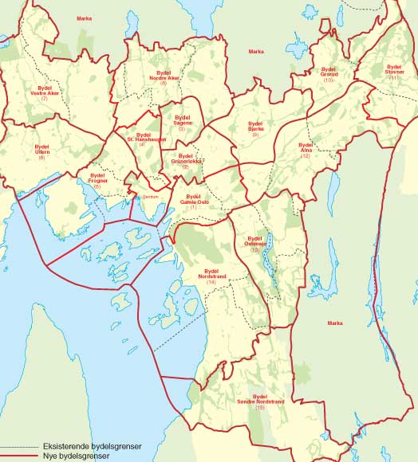
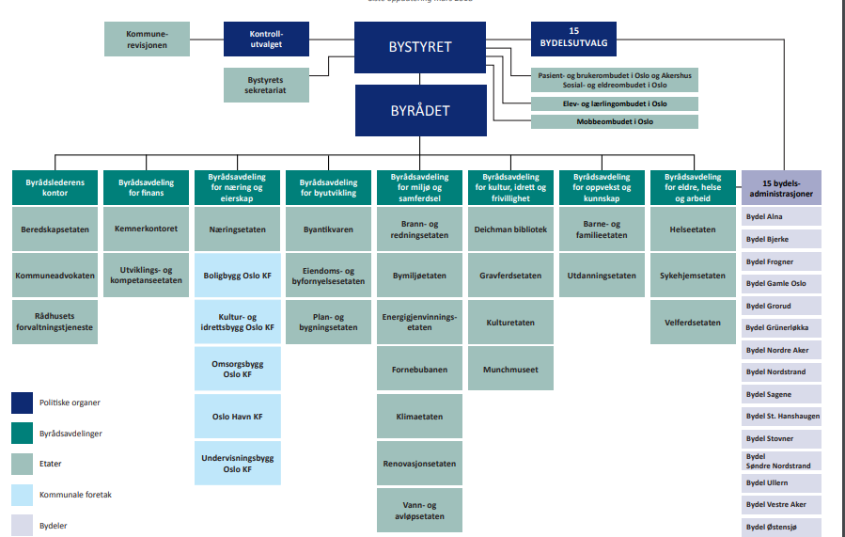

Slide 4
Home services
St. Hanshaugen
Sagene
Grunerløkka
Bydel …

Slide 5
Helseetaten
(IT)
Electronic Patient Records
Home services
St. Hanshaugen
Documentation
Task management
Sagene
Grunerløkka
Bydel …

Slide 6
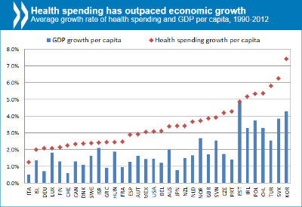

Slide 7
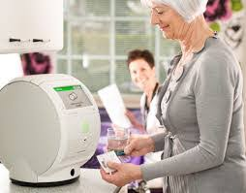
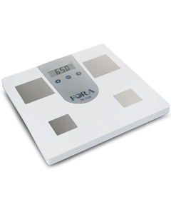
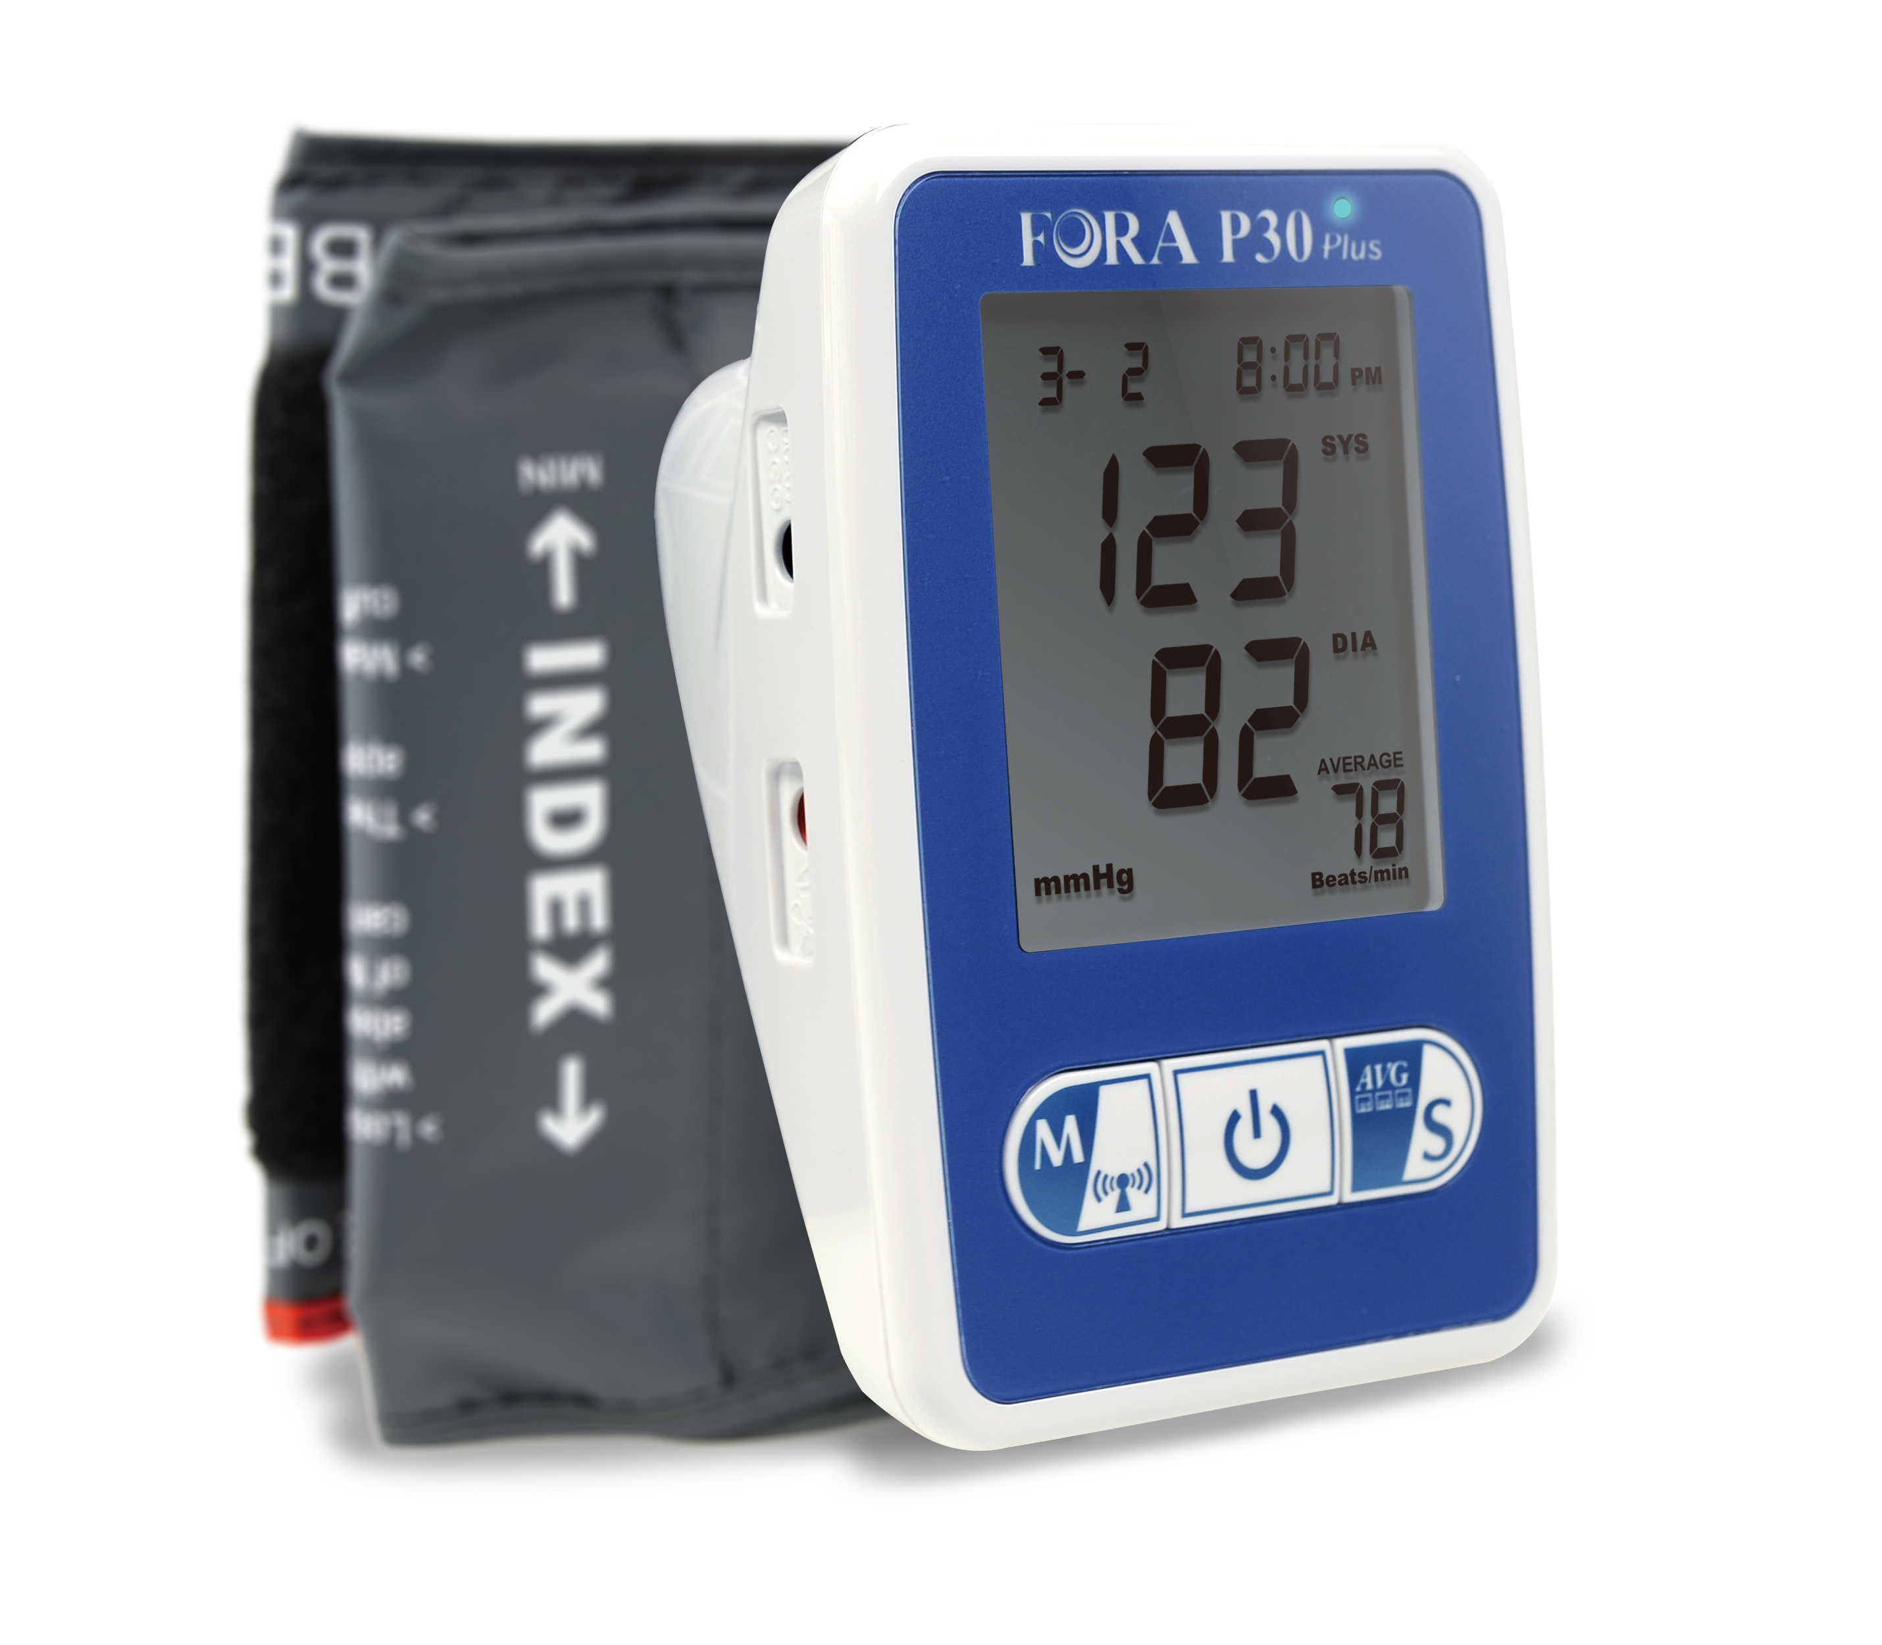
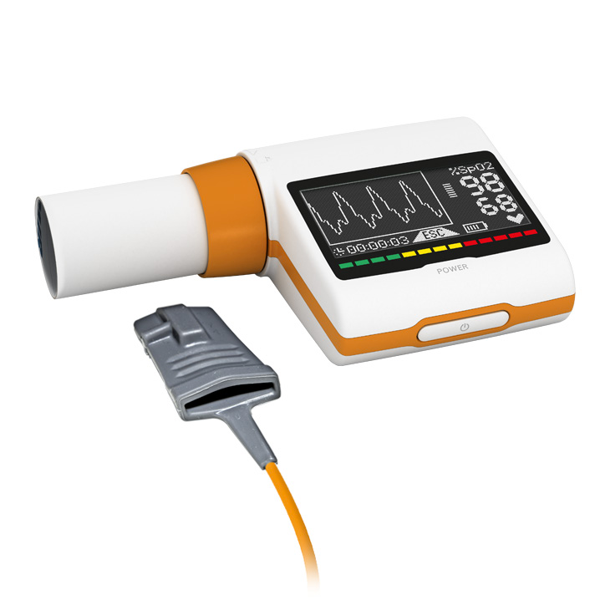
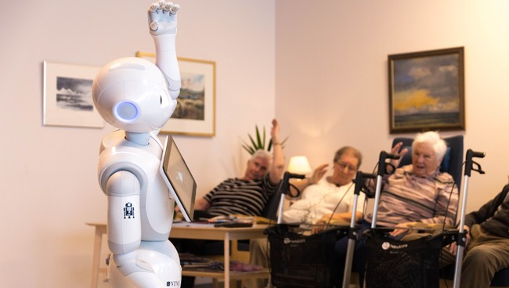
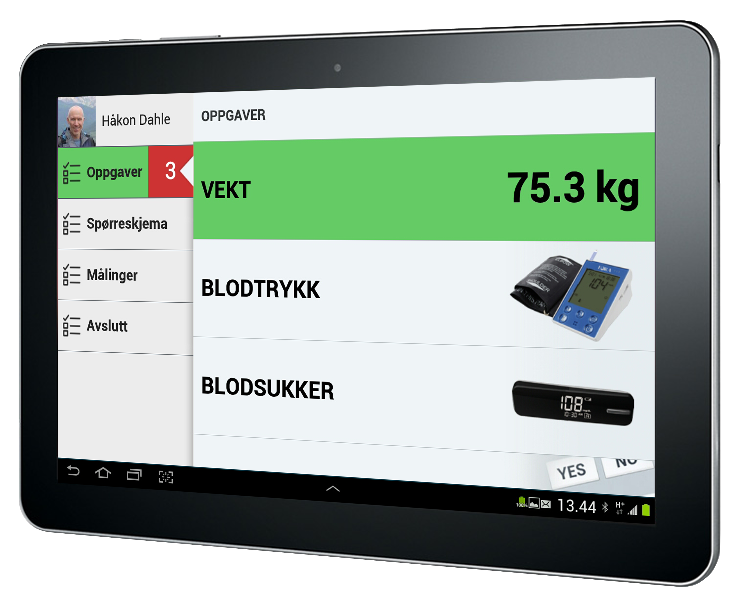

Slide 8
Helseetaten
(IT)
Device
Device
Electronic Patient Records
Home services
Device
St. Hanshaugen
Device
Device
Home services
Device
Sagene
Device
Device
Home services
Device
Grunerløkka
Device
Device
Home services
Device
Bydel …

Slide 9
Exercise 1 (5 + 5 min)
Why does Bygstad and Iden characterize the new IT as “lightweight”?

Slide 10
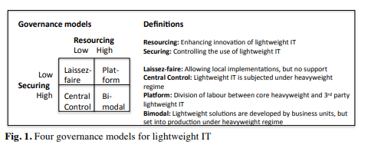

Slide 11
Exercise 2 (20 + 10 )
Use the governance models from Bygstad and Iden
Suggest four governance structures for the new services in Oslo Municipality, according to each of the four models
  Argue from lecture slides and syllabus

Slide 12
Exercise 3 (5 + 5)
Define these generative mechanisms:
  Adoption
  Scaling
  Innovation

Slide 13
Exercise 4 (10 + 10)
Evaluate the four structures by the criteria of scaling, adoption, innovation
What other criteria could be used in evaluating them?

