Slide 1
IN5430 IT and Management
Introduction
13th January 2020
Ole Hanseth (Ole.Hanseth@ifi.uio.no)
Kristoffer Fossum (kristofo@ifi.uio.no)
Ivar Hukkelberg (ivarhuk@ifi.uio.no)

Slide 2
About the course
Practicalities
  Course overview (format, important dates etc)
  About the project: seminar Tuesday 22nd January
Changed from INF5890 to IN5430
  Revised course description
  New exam form: oral exam
Course content
  “IT and management” at what level?
  Sociotechnical complexity
    How readings (book + articles) and activities (lectures, seminars and project work) contribute to understanding complexity
  More focus on platforms

Slide 3
What is the course about?
Course content
  In this course you learn about managerial challenges related to development, implementation and management of IT solutions in organizations. A specific focus is on the challenges posed by socio-technical, complex, large-scale and interconnected IT solutions. The lectures and readings in the course present approaches, models and frameworks found in practice, and offer a research-based view on the topics. You will participate in a project where you apply this knowledge to an empirical study within a real-world organization.
Learning outcome
  After you have completed the course you:
  describe common approaches, models and frameworks for IT management and governance, project management and enterprise architectures in organizations.
  describe theoretical perspectives on the opportunities and challenges associated with IT governance, project management and enterprise architectures.
  discuss the challenges of inter-organizational and sector-wide IT governance.
  describe the connection between governance models and enterprise architectures.
  can plan, organize, and report from a project where you collect and analyze data to document and assess the IT governance model of an organization.
  utilize your practical and theoretical basis for critical reflection on how IT is managed in organizations.

Slide 4
Activities and evaluation
Oral exam (individual – 60%): Grades A-F
Mandatory project has to be passed to take exam (not graded).
  Groups (3-4 participants) identify case organizations
  2 deliverables
Individual assignment (deliverable 3) (40%): Grades A-F
More in seminar Wednesday 22nd Jan

Slide 5
IT: level of detail – time perspective
Level of detail
Low
OPERATIONAL
STRATEGIC
TECHNICAL
TACTICAL
High
Short term
Long term
Time perspective

Slide 6
IT: levels of complexity
Application (accounting system, word processor)
Portfolio of applications in organizations
Platforms and platform ecosystems (iPhone/iOs + apps, Airbnb, ..)
Information infrastructures (Internet, national e-health solutions, Pan-European e-Governemnt solutions, programmatic advertising infrastructure, ..)

Slide 7
Information infrastructure
management
Platform
(ecosystem) management
EA
Project
management

Slide 8
Trends
From
  In-house development of solutions for in-house users
To
  Community extension and modification of solutions for communities

Slide 9
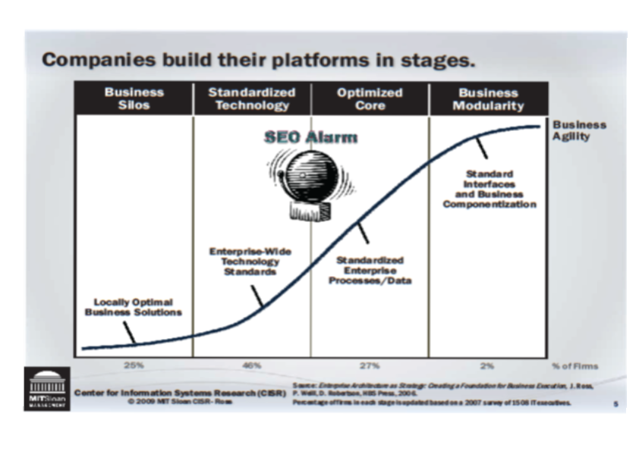

Slide 10
Platforms
Definitions:
  Extensible codebase (ex: Android)
  Marketplace (ex: Uber, Airbnb)
Categories (overlapping)
  Consumer platforms
  Software platforms (Android, SAP, ..)
  Date sharing platforms
  Shared platforms, platform co-operatives
“everything” is becoming a platform?

Slide 11
Industry platforms
Internet of Things, machine learning, information sharing, ..
https://www.veracity.com
https://www.kognifai.com
https://www.cognite.com
https://www.ge.com/digital/iiot-platform
https://new.abb.com/abb-ability
https://www.siemens.com/global/en/home/products/software/mindsphere.html

Slide 12
Platforms and platform ecosystems
Complexity – networks
Network effects – increasing returns
Self-reinforcing processes
Multi-sided markets

Slide 13
From platforms to infrastructures
Internet
National e-health infrastructures
Supply chain support
E-Government solutions
Pan-European e-Government infrastructures
Programmatic advertising
..

Slide 14
Blurred boundaries (physically and conceptually)
Literature operates with clear cut boundaries
Connected and /or overlapping
  Applications
  Platforms
  Platform ecosystems
  Infrastructures
Infrastructure or platform?
  Platform: business model/organizing strategy
  Infrastructure: shared services for a community or society

Slide 15
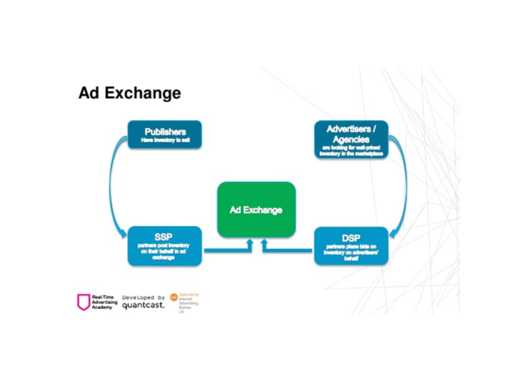
Example: Programatic advertizing

Slide 17
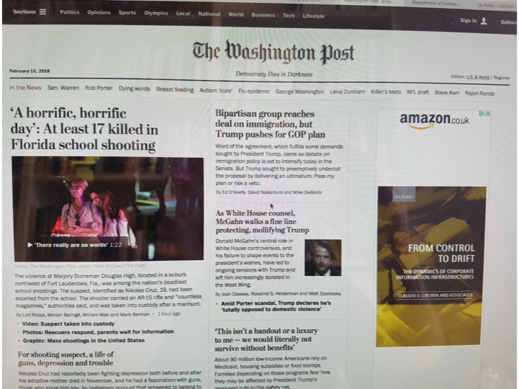

Slide 18
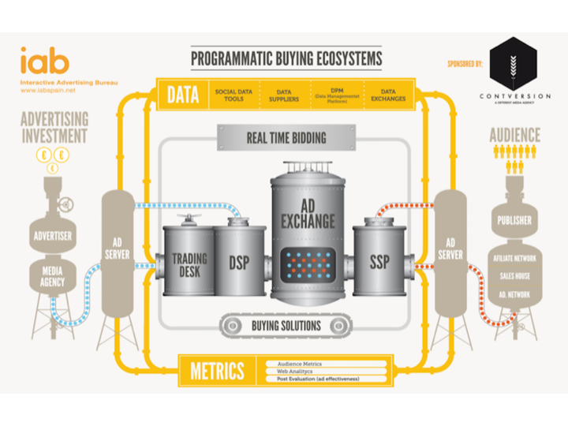

Slide 20
Key Dates – Group Work
Items | Date
Deadline for group formation | Jan. 29
Deadline for securing organization | Feb. 12
Deliverable 1 - group | March 10
Deliverable 2 - group | April 21
Deliverable 3 – individual home exam | May 27
Notes:
All students must participate in a project assignment
There will be 2 group deliverables and 1 individual assignment.

Slide 21
Projects
Deliverable 1 (Group) (March 10th)
  Find a platform. The description should include:
  A description of the platform in terms of its
    Functionality
    Use and user groups,
    Origin and historical evolution
  You should also identify systems the platform is connected to (is it a part of a larger infrastructure?).

Slide 22
Deliverable 2 (Group) (April 21th)
Apply theory on platforms and platform governance and address the following questions:
What kind of platform is it?
What are the relations and dependencies between user groups?
How is the platform (ecosystem) governed?
Could platform theory contribute to the further development of the platform?
This part is an addition to deliverable 1. In total the document should now be maximum 30 pages. Hand in by April 21th by email. Prepare to present in the seminar on the same day. The presentation should not exceed 10 minutes and PowerPoint slides should be used.

Slide 23
Deliverable 3
Individual assignment
  Graded (A-F) 40%
  Must pass to take oral exam and pass course
  Content to be announced, but will be directly related to group deliverables
  Maximum 2000 words
  Submission by email before midnight (May 27)
Notes:
What do we gain by this taxonomy?
What are the risks of this taxonomy?

Slide 24
Typical Challenges
Finding an organization
  The elusive informant
  Finding the right informant
Leaving it too late
Doing assignment without reading/understanding course material and/or assignment requirments
Group dynamics (dealing with «free riders,» stragglers, dominant members)
Division of labour – finding proper balance

Slide 25
Cont’d
At least 1 interview mandatory (recommend 2)
  Needs to be documented
15-20 pages
Short method section
  data sources
References
  in-text citation, source for figures/diagrams
Submission by email before midnight March 10
  Group PPT presentation (10 min)
Oral feedback provided (1 week later)
Notes:
the sources of information that are drawn on, how that information is sampled, and the types of instruments that are used in data collection.

Slide 26
Cont’d
Deliverable 2 should be added to Deliverable 1
  maximum 30 pages (strict)
Submission by email before midnight (April 21.)
  Group PPT presentation (10 min)

Slide 27
Questions?

