Slide 1
Platform governance Managing tensions

Slide 2
Governance, management models
Hierarchy or market
Network
Platform ecosystem: one kind of network
Information infrastructure: another

Slide 3
Main issues
Managing platform ecosystems
Network effects – multi-sided markets
Tensions
Architectures

Slide 4
Variety of platform ecosystems
Consumer platforms: Android, iPhone, Vipps, finn.no, Uber, Airbnb, …
Industry platforms : Veracity, Cognite, Kognifai, ….
https://www.veracity.com
Platform ecosystems in user organizations: NRK, Helse SørØst, …
Governance model evolves as platform ecosystem evolves
Platforms and cloud symbioses
Integration of platforms: information infrastructures

Slide 5
Choosing strategy - criteria
Novelty, uncertainty
 | Low | High
Low | ”Anything goes” | Agile, extreme programming
High | Centralized control, Waterfall | ???
Complexity,
scale

Slide 6
Two examples
Programmatic advertizing
AKSON, “one citizen – one medical record” – primary care
Waterfall?
Platform ecosystem?

Slide 7
Tensions
Paradox: opposites, present at the same time
Trade-off: balance
Dualism: either or, balance
Ambidexterity
Duality: opposites & mutually enabling, presupposing each other
Dialectics: conflict, opposing “forces”
..
Duality and dialectics: dynamics

Slide 8
 | Stability | Change
Architecture | Integration (efficiency) Uniformity, standardization Centralized | Modularization (flex) Variation Decentralized
Governance (strategy, organizing) | Consolidation Long term focus Planned change Centralized control | Local optimization (adapt.), innovation Short term focus Emergent change Distributed control

Slide 9
Duality
Complex machine/system
Adapt to changing environment (technologies, user requirements, ..)
All components cannot be change at the same time
To keep some stable, others must change
To change some, others must stay stable

Slide 10
Platform ecosystems
 | Stability | Change
Architecture | Stable core Centralized Integrated Uniform | Dynamic periphery Decentralized Modularized Variety
Governance (strategy, organizing) | Platform owner/controller | Autonomous app developers

Slide 11
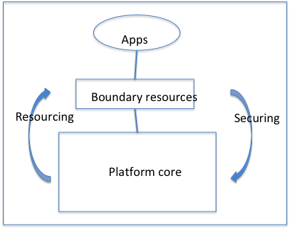

Slide 12
Tensions
Changes over time, dynamic
No users
No apps
Changing environment
Competition
…

Slide 13
Tensions
Generativity – control
Exaptive bootstrapping
Duality/reflexivity: stable platform -> many apps -> new ideas, requirements -> platform change (ex: Facebook)
Stabilization – de-stabilization
ERP case:
Standard – variety
Control – autonomy
Collective - individual
Bank case: stability & control – change
SW case: co-created value – governance costs

Slide 14
Governance mechanisms
Rules: who gets access to what
Prices
Support/collaboration
“Distributed tuning”

Slide 15
Consumer platforms
Uber, Airbnb, vipps, finn.no
User accout
Personal data
Credit card
Taxi drivers, ..
Certification rules

Slide 16
Software platforms
Platform wide or dyadic governance
Partner levels
Certification
Technical barriers/control. Ex: iPhone
Governance costs
Variety among platform types (consumer, industry, user organizations)

Slide 17
More specific governance ”parameters”
Governance structure
Resources and documentation
Accessibility and control
Trust and perceived risks
Pricing
External relationships

Slide 18
“Governing through technology”
Boundary resources
Ex: iPhone
Download apps from iTunes
Certificates

