Slide 1
Platforms in user organizations
& platform-oriented infrastructures

Slide 2
Platforms in user organizations
Case
  Large bank
  Pressure due to consumerization of IT
    Tension: securing - resourcing
  Restructuring applications into platform
  +apps
  + «glue»
  Change: functional ->platform-based governance

Slide 3
IT governance
 | Focuntional (=EA) | Platform based
Focus (what) | Proprietary and sourced IT resources | Re-combination
Scope (who) | IT function | Autonomous cross-functional teams
Patterns (how) | Structural arrangements, formal processes, relational mechanisms | Platform standards, automated processes, multilayered architecture

Slide 4
From platforms to infrastructures
Infrastructures: multiplicity of connected platforms/platform ecosystems
Platform: business model
Infrastructure: shared resources for a community or society
Platforms as infrastructures?
Infrastructures as platforms?

Slide 7
 | Stability | Change
Architecture | Integration (efficiency) Uniformity, standardization Centralized | Modularization (flex) Variation Decentralized
Governance (strategy, organizing) | Consolidation Long term focus Planned change Centralized control | Local optimization (adapt.), innovation Short term focus Emergent change Distributed control

Slide 8
Case
“Digital Renewal” – IT programme (2012) of the South East Health Authority in Norway
75-80.000 employees
11 hospital trusts (40-50 hospitals)
5.700 applications
  Fragmentation
  Costs
MTUs (25.000 at OUS) & IoT, mobile apps,..

Slide 9
Evolution of IIs in Helse Sør-Øst
Started in the 70-ies, stand-alone applications
Growth in no of applications
Communication technology, integration
Standardization:
  1990: Messages
  2003: regional application standards, national architecture
  2012: “consolidation of applications”

Slide 10
Digital Renewal
Consolidation – one regional solution/installation
  EPR: DIPS at OUS, consolidation
  Lab: new solution, pilot - rollout
  Radiology: new solution, pilot - rollout
  Collaboration
  Management support
  Infrastructure: Outsourcing
2 BNOK/year

Slide 11
Outcomes: EPR
DIPS at OUS.
Running Oct. 2014
80 M Euros
Integration with 55 applications
Phase 2: 60 additional applications
Standardizing databases ++
Planning consolidation: 130 – 200 M Euros
700-1000 integrations
Converting to new version: 90 M Euros
??

Slide 12
Integration - history
Ad-hoc
Standardize messages – plug and play: failed!!
Hospital ESBs (BizTalk)
Regional control of ESBs
  Integration Factory
Integration Platform: BizTalk & Internet Integration Server

Slide 13
Outcomes
Reorganization: RKL (RCS), CMS, CTS, ..
DIPS consolidation: 1.2 – 1.8 BMNOK
  Stepwise, limited strategy
LAB and Rad: troubled
Infrastructure: stopped
Østfold: Outside DR, successful
Others: Imatis (whiteboards), MediCLoud, ..
Evolution of the Integration Platform

Slide 14
Lessons learned
Failure of “Application Theory”
Positive: Emerging (generative) platform-oriented infrastructure

Slide 15
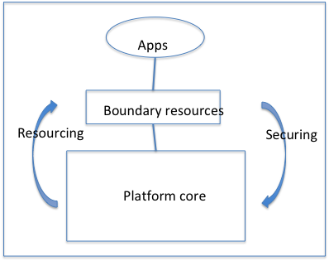
Platforms

Slide 16
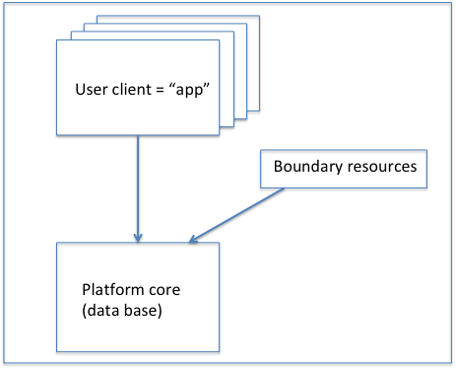
Applications (silos) as Platform ecosystem

Slide 17
Multi-platform infrastructure

Slide 18
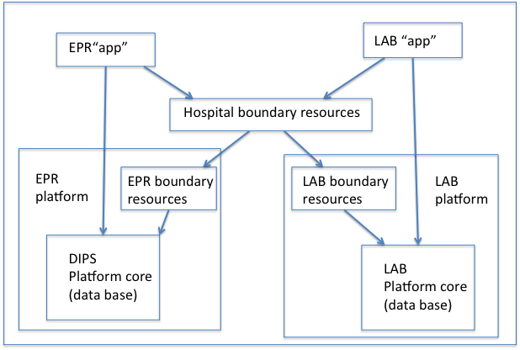

Slide 19
App1
App n
institutional boundary resource level x
Vendor boundary
Resource 1
Institutional
boundary resource
level x+1
Vendor
Platform
2
Vendor
Platform
n
Core vendor
platform 1
Vendor boundary
Resource 1
Vendor
platform n
Core vendor
platform 1

Slide 20
App
Hospital boundary resource
Vendor boundary
Resource
Regional
Boundary
resource
Core vendor
platform
Vendor boundary
Resource
National
Boundary
resource
Core vendor
platform
Vendor boundary
Resource
Core vendor
platform

