Slide 1
IN5430
Seminar class
22.01.2020
Ivar Hukkelberg and Kristoffer Fossum

Slide 2
Introduction to seminar classes
Who are we?
Ivar Hukkelberg
Kristoffer Fossum
Who are you?
Studies?
Work experience?
Expectations to the seminar classes?

Slide 3
Introduction to seminar classes
Seminar classes as an environment for learning
Type:
High student activity
Group and class discussions based on small assignments
Cooperation between you and us
Content:
Themes and concepts from from lectures
Connecting themes and concepts from previous lectures to get the «big picture»
Feedback
We want that the seminar classes are useful for your learning – please give feedback (ivarhuk@ifi.uio.no)
We will make it easy for you by using mentimeter also

Slide 4
Group discussion From IT applications to Information infrastructures
Form groups of 3-5 persons and discuss the following (10min):
- IT artefacts (systems) may be categorized according to how complex they are, and how complex they are to manage/govern.
Mention the main categories as shown in a previous lecture
Provide concrete examples of IT systems from each category
Discuss differences between the categories
What do you think are main governance challenges in each category?

Slide 5
Information infrastructure
management
Platform
(ecosystem) management
Enterprise
Architecture
Complexity
Project
management

Slide 6
Group project assignment
Items | Date
Deadline for group formation | Jan. 29
Deadline for securing organization/platform | Feb. 12
Deliverable 1 – group work | March 10
Presentation of del. 1 in class* | March 11
Feedback per group | March 18
Deliverable 2 – group work | April 21
Presentation of del. 2 in class* | April 22
Feedback per group work | April 29
Deliverable 3 – home exam | May 27
Oral exam | Week 24 (10th 11th June)
Assignment text
*Each group member has to present at least once. You can decide how to distribute it.

Slide 7
Typical Challenges in group work
Finding an organization
The elusive informant
Finding the right informant
Leaving it for too late
Doing assignment without reading/understanding course material and/or assignment requirments
Group dynamics (dealing with stragglers)

Slide 8
Break!
….but only for those of you who have found a group…
The rest of you stay to find groups!
Remember to send email to ivarhuk@ifi.uio.no with group memebers

Slide 9
Group discussion Central concepts this far
Write on your own for two minutes:
What is a platform? «A platform is…»
There are two main types of platforms (that we mainly cover in this course), which?
2. Find the one sitting next to you, and discuss:
Find examples and discuss
2+3+5 min
Notes:
Mainly two types of platforms:
innovation platforms / extetnsible codebase (android, ios, SAP etc), Cognite and other industry platforms
Transaction platforms / marketplace (Uber, AirBnB, Vipps, Spotify, etc)
Optional: Data sharing platforms (Cognite, Veracity, Kognifai, Altinn
Trans: facilitates interaction between participants in a market or network
Innov: facilitates innovation by enabling efficient use and reorganization of resoures by a large audience

Slide 10
Group discussion Central concepts this far
Make groups of 3 – 5, and discuss:
What do we mean by «multi sided»?
How is this related to platforms? Discuss examples from the real world
5+5 min

Slide 11
Group discussion Central concepts this far
Stay in your groups, and:
Find the drawing about network effects in Parker Ch.2. page 31 (link on lecture web-site)
Which types of network effects are described in the drawing
Explain and discuss why, and what it actually means for Uber
12 + 13 min

Slide 12
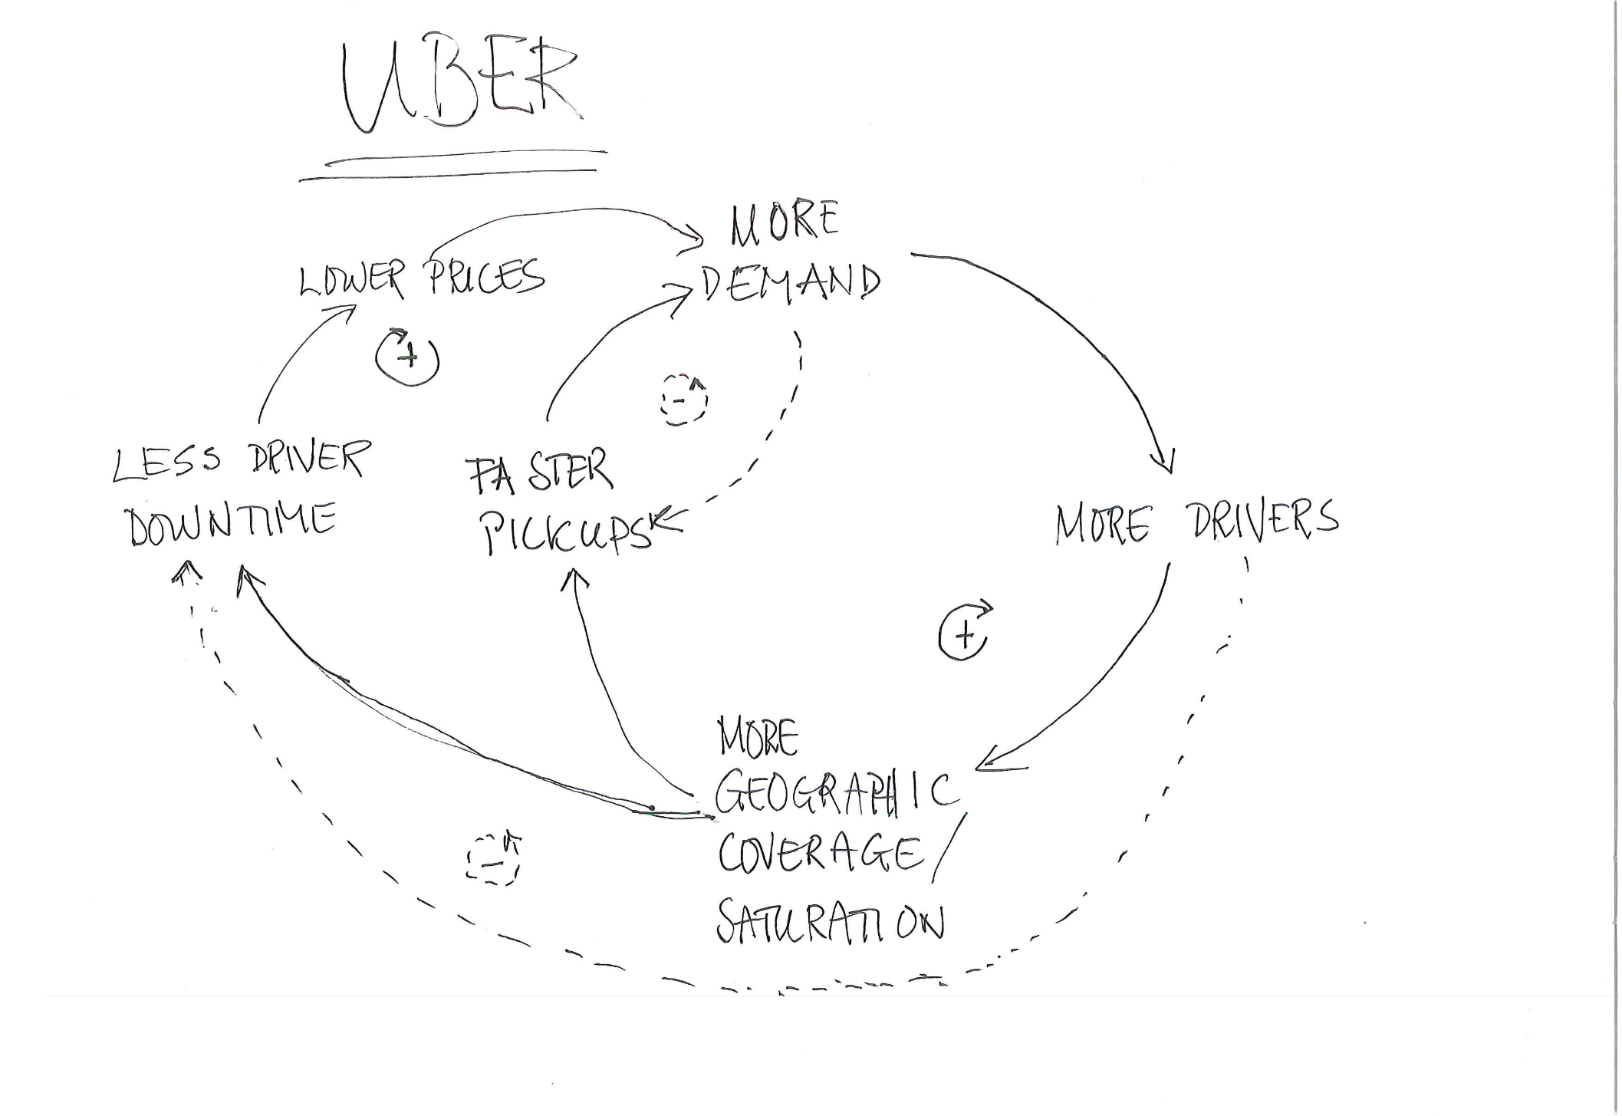

Slide 13
More Demand
Lower Prices
Less Driver Downtime
Faster Pickups
More Drivers
More Geographical coverage / Saturation

Slide 14
Demand
Prices
More Driver Downtime
Slower Pickups
More Drivers
Geographical coverage
/ Saturation

Slide 15
Demand
Prices
Driver Downtime
Pickup time
More Drivers
Geographical coverage
/ Saturation

Slide 16
Find your mobile phones (finally)!
We want your feedback about us and what we discuss!
Please help us to improve, and answer the following questions at menti.com
Code: 192592

