Slide 1
IN5430
Seminar 29.1.20
Network effects
Tensions in architecture and governance
Platform solution to tensions

Slide 2
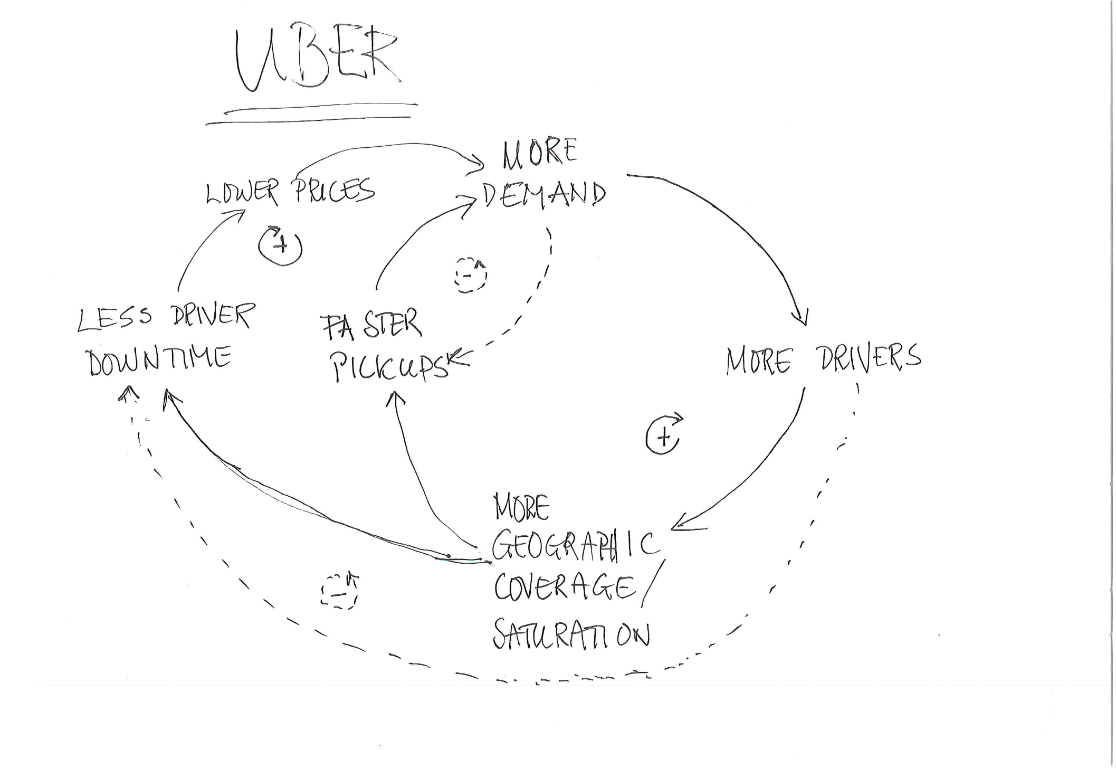
Recap: Network effects
Positive – negative
Same side – cross side
Not only about enrollment of new users,
but how to make people stick
Governing without full control
Balancing incentives

Slide 3
Exercise 1 (15+10)
Make a similar drawing for Apple iOS/Google Android
Find positive and negative, same-side and cross-side, effects
(which distinct user groups are there, and what are their relations regarding network effects. What is the platform owner’s role in this)

Slide 4
Example of network effects for iOS/Android
More ad income
More users
Less users per app
More app developers
More advertisement per app
More functional diversity

Slide 5
Exercise 2 (5+5)
Use your drawing to explain why the Microsoft mobile platform failed
Use your drawing to explain why Nokia, previously the world´s largest mobile distributor, disappeared

Slide 6
Break!

Slide 7
 | Stability | Change
Architecture | Integration (efficiency) Uniformity, standardization Centralized | Modularization (flex) Variation Decentralized
Governance (strategy, organizing) | Consolidation Long term focus Planned change Centralized control | Local optimization (adapt.), Innovation Short term focus Emergent change Distributed control
Exercise 3 (15+10)
Choose four tensions, two from each domain
Discuss, explain and give examples of why they are tensions
How are the tensions in the two domains related?
Provide and discuss examples

Slide 8
Exercise 4 (5+8)
How can a software platform architecture and governance deal with the tensions?
Discuss and provide examples

Slide 9
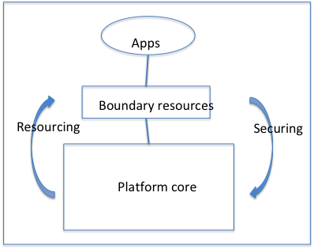
Platforms

Slide 10
Find your mobile phones (finally)!
We want your feedback about us and what we discuss!
Please help us to improve, and answer the following questions at menti.com
Code: 192592

