Slide 1
IN5430
Seminar 19.2.20
Information Infrastructure
Network Governance

Slide 2
Exercise 1 (7min+8min)
What is the difference between an information infrastructure and a platform?
Discuss and provide examples
Is Google and Facebook platforms or infrastructures?
Example of an infrastructure
Source: Introduction to Digital infrastructures and platforms - Knut H. Rolland (2018)
Notes:
Platforms may become infrastructures (Google, Facebook, etc.)
Platform: business model/strategy/organizing principle
Platform ecosystems have a lot in common with infrastructures (Tilson et al. 2010). Involve large number of technological and organizational elements, they evolve and grow over long time. They both focus on how evolution is driven by tensions..
What sets them apart/make them different is that platforms are based on a specific architecture/governance config. (stable core, platform, that is controlled by a single organization, and a dynamic periphery consisting of a large number of «apps»).
Platform research focus only on single platforms, in isolation from other platforms.
If traditional IT solution at trad.organizations want to change to platform, we will get huge number of platforms integrated with each other.
Co-evolution of a multiplicity of platforms within an orgnaization → platform oriented corporate II.

Slide 3
Case: Large public organization (30min)
The public organization, known as Public Data Gov, want to integrate machine learning (ML) capabilities into their services and products (ML is currently the most used method when working with AI). They have established a small team to work with it.
A key feature with ML methods is the need for extensive amount of data, in order to make accurate and precise decisions.
Discuss the following:
1) In terms of what we have recently discussed - what challenges may they face when trying to integrate ML?

Slide 4
Discuss: What challenges do you think Public Data Gov meet when trying to integrate ML into their services?
Notes:
Photo: https://www.kisspng.com/png-brain-machine-learning-artificial-intelligence-dee-1641682/preview.html
Bruk før

Slide 5
Common challenges of integrating machine learning into organizations
Data source
Data quality
Privacy and GDPR
Lack of ML/AI knowledge
Organizing
User adoption
Notes:
Photo: https://www.kisspng.com/png-brain-machine-learning-artificial-intelligence-dee-1641682/preview.html
How is II theory connected to this:
Data infrastructure → existing installed base. Gives data friction
Legal structures → installed base and adaptability problem
Centralized to decentralized organized.
Bootstrapping problem (bootstrapping data)
Why do we want to see it through an II lens? → Analyze why adoption and adaption is so hard for ML

Slide 6
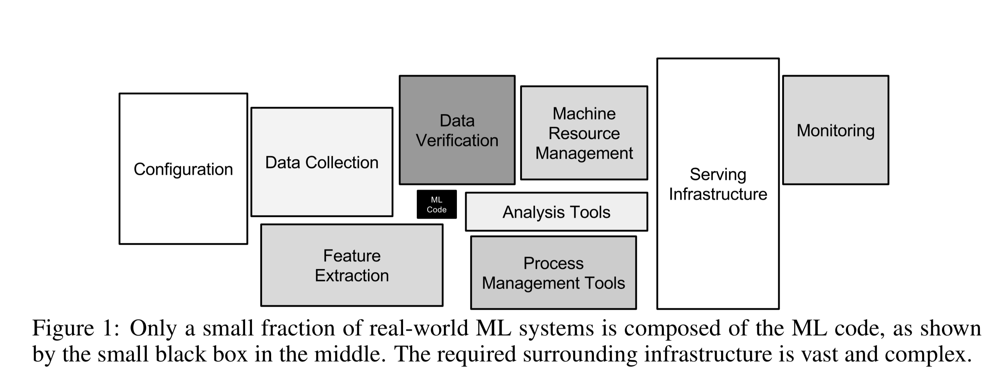
ML is only a small piece of the larger information infrastructure
What?! Seriously...
(Scully et al., 2015)
Notes:
Need so much more to run a data driven org.
Maintenance problems → how to keep the data updated when you have a ML sol´n running
How to find and collect data?
How to verify data quality?
Pipeline jungles

Slide 7
Break!

Slide 8
Case: Large public organization, part 2
Oh well, this doesn't look good.
2) How can platform and platform governance be of help

Slide 9
Data platforms can help to create order in an organization´s legacy systems
Example:
Overview of an organization´s systems. Not the easiest place to find the data you´re after, or keep maintenance of your model…
“… silos make data sharing and discovery, data lineage and provenance tracking, version control, and access control difficult, if not impossible.” (Agrawal et al., 2019)
Don´t panic!
Where is the data I need?!!!!!!
Source: Knut H. Rolland (2018)
Notes:
Try to maintain your ML models here!
Silos are a problem for data access and consistency
Keep track of ownership of data
Furthermore, in large organizations, we observed various teams solving similar ML problems, often without knowledge of each other. A central data management system will enable these teams to discover and share relevant data and to foster new collaborations between teams.

Slide 10
Privacy, GDPR and data platforms
GDPR - General Data Protection Regulation
Benefits of having a data platform
... Is the most important change in data privacy regulation in 20 years. (www.EUgdpr.no)
Sets clear restrictions on what a company / organization can do with personal data
We, as users gets more control over our personal data through a set of rights
Manage data access
Overview of GDPR verified data
Hey! This GDPR thing looks like it will be a big hassle when we do ML…
Now everything must go through me first, hehe…
Legal officer
ML developer
Notes:
Personal data must be verified and approved before we can use them for ML
Needs a lot of discussion with legal.
Privacy Impact Assessment.
Legal team can easily use it

Slide 11
Source: https://www.nrk.no/norge/nav-sliter-med-gamle-datasystemer-i-jakten-pa-trygdetabber-_-har-ikke-statistikk-1.14769965
Notes:
work assessment allowance (AAP), sickness benefit
Travel to another EU/EEA countryhttps://www.nrk.no/norge/nav-sliter-med-gamle-datasystemer-i-jakten-pa-trygdetabber-_-har-ikke-statistikk-1.14769965

Slide 12
Network Governance

Slide 13
Exercise 3 (3min+5min)
What is the difference between the following: Management vs Governance vs Regulation
Explain by using specific examples
Management: projects, corporations (closed hierarchical organizations)
Example: IT project at NAV
Governance: larger domains, less strict
Example: IT governance model at Telia.
Regulations: communities, law centered
Example: Market regulations (try and control demand/supply of goods)
Notes:
Management: act of getting people together to accomplish desired goals and objectives using available resources efficeniently and effectively
Typical example: IT project. Project tools (Kanban, waterfall method, ++)
Governance: Consistent management, cohesive policies, guidance, processes and decision rights for a given area of respons.
Regulation:

Slide 14
Exercise 4: (3min+5min)
Explain the difference between traditional governance and network governance
Traditional
Focus on the role of boards of directors. Protecting the interest of shareholders
Monitor and control the behavior of management
Bureaucratic structure
Rigid and formal relationships (contracts, etc.)
Network
Often not legal entities
Interfirm coordination
Interdependent actors who interact with each other to produce an outcome
Goal-directed organizational networks with a distinct identity
Notes:
Network gov: interfirm coordination. Organic or informal social system. Access
Traditional gov: bureaucratic structures, rigid, formal relationships
Traditional project: Waterfall, contracts with suppliers, ISO standards, architecture mirror org.structure
Distingusih themselves in three ways:
Involve a large number of interdependent actors who interact with each other to produce an outcome
Decisions based on negotiation rationality as opposed to substantial rationality that governs state rule etc.
Compliance is ensured through trust and political obligation, which over time becomes sustained by self-constituted rules and norms
Historical network governance: trading Merchants. English and Dutch East India Companies. Cooperation between merchants.
Advantage with network governance: enhanced learning, more efficient use of resources, increased capacity to plan for and address complex problems, greater competitivenesss, better services for clients and customers.

