Slide 1
Collaging
Practice in working creatively with users

Slide 2
Why collage?
Not all things are easy to put into words
Enabling users to explore the future through visual imagery
Adaptable to any context
Individuals, groups and pairing
Change imagery with physical artefacts: lego? Wood? Clay? Paint? Limitless possibilities!
Incredibly specific or very broad
Easily combined with other methods, tools and techniques
Opens up telling, making and enacting
Used as a guide for design, or user-design

Slide 3
Plan
Make Collage - 10 min
Talk -10 min
Make Collage - 10 min
Talk - 10 min
Adaptation of the workshop
Discussion

Slide 4
Introduce imagery!

Slide 5
MAKE
Use your group work as starting point
Outline the context of your target group using the imagery and post-its.
Things like:
What do users go through?
What is the current situation like?
Who are your users?
What are the possibilities you see?
10~ MIN

Slide 6
TALK
1 minute to tell the others on your class about your collage
After each: discuss! Say what you liked, ideas you might have, information that is nice to know, etc..
10~ MIN

Slide 7
MAKE
Make a collage / drawing using the material to express an ideal situation / experience for your users.
10-20 MIN

Slide 8
Talk
2-3 minute to tell the others on your group about your collage
After each: discuss! Say what you liked, ideas you might have, information that is nice to know, etc..
10-20 MIN

Slide 9
HOW WOULD YOU ADAPT THE WORKSHOP?

Slide 10
DISCUSS
What does your images or material need to reflect?
People, age, race, gender, emotions, interaction, technology, fantasy, imagination, nature, holidays, thoughts, feelings, materials, positive vs negative, aesthetic vs simplicity, subject specific, stylization, diversity, words?
Are your participants used to telling stories?
Are your participants used to working by mapping process?
What engages your participants effectively?
What is the essence of what you want to explore?
user experiences is rarely about doing the thing itself, but the feeling a routine or activity foster: brushing teeth, checking Facebook, shaving, taking the buss…

Slide 11
WHAT’S NEXT`?
Make the designs of the user
Have the user make their designs
If they have developed an understanding of their routine of brushing teeth: use a workshop to continue exploring new designs.

Slide 12
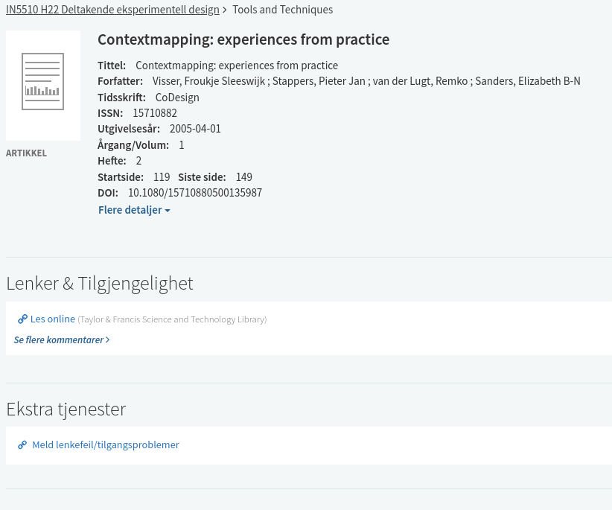
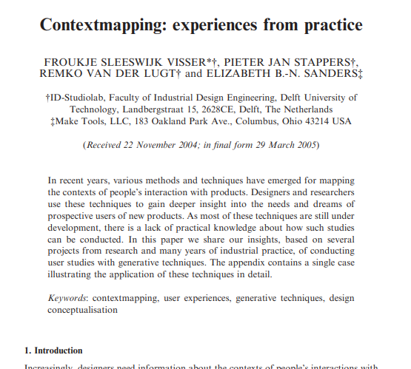
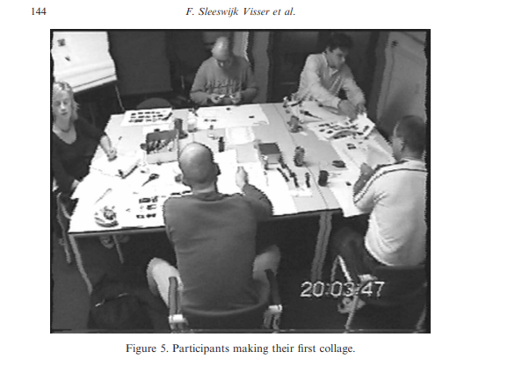
Collaging Exercise:
Visser et al. (2005) (How-to-guide)

Slide 13
Why do you think we had this class?
Pro tips with Johannes
Questions after class?
Next wednesday: Feedback on project proposal

Slide 14
Student pain points with assignment:
“I don't remember everything my subject covered”
“Citations are a hazzel”
“Every time i write an assignment i have to start from scratch”
“I think I remember a fact, but I can’t remember what the source was”

