Slide 1
Project Minesweeper
Andreas, Evy, Martin, Rebekka and Siripong

Slide 2
Possibility to reserve a group room

Slide 3
From this
Anarchy

Slide 4
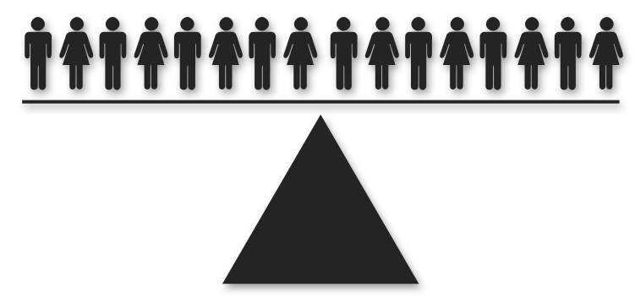
To this
Democracy

Slide 5
Could we change the way students interact with the library?

Slide 6
Transcending the traditional
role of the library

Slide 7
User-centered design
Initial Research
Surveys
Observations
Collaboration with Users
Focus Group
Workshop
Design
Low-Fidelity
High-Fidelity

Slide 8
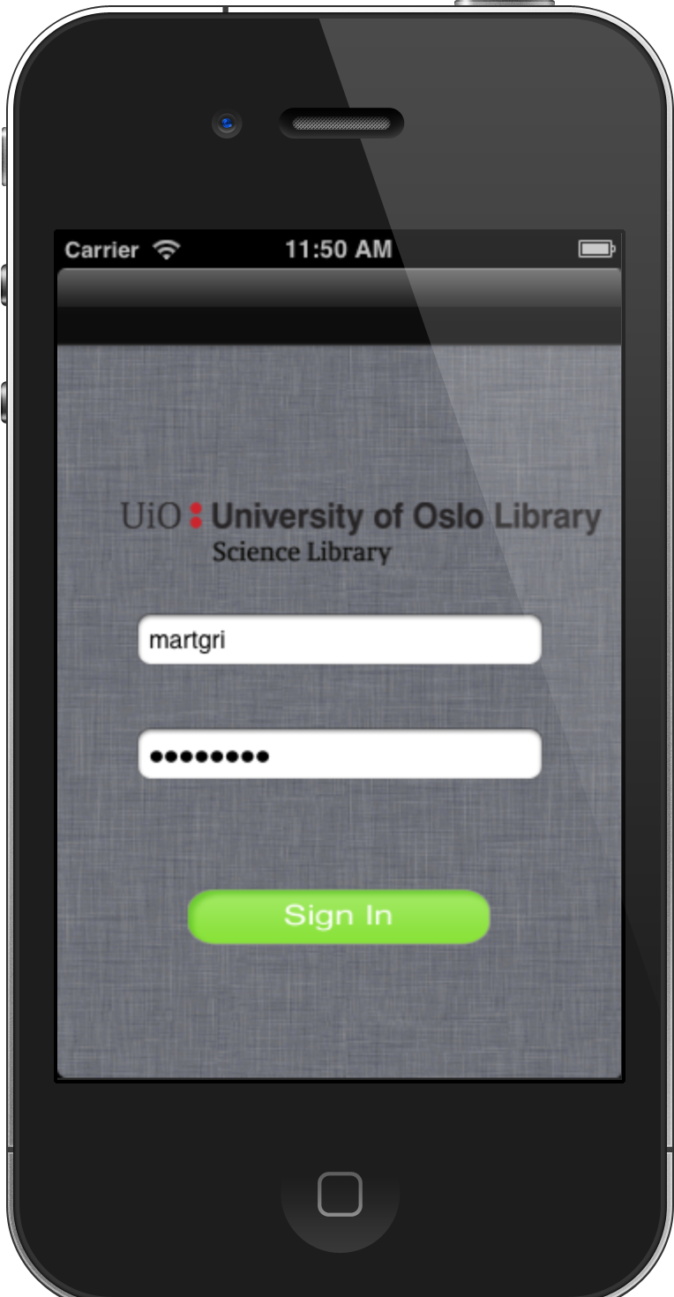
Prototype Presentation

