Slide 1
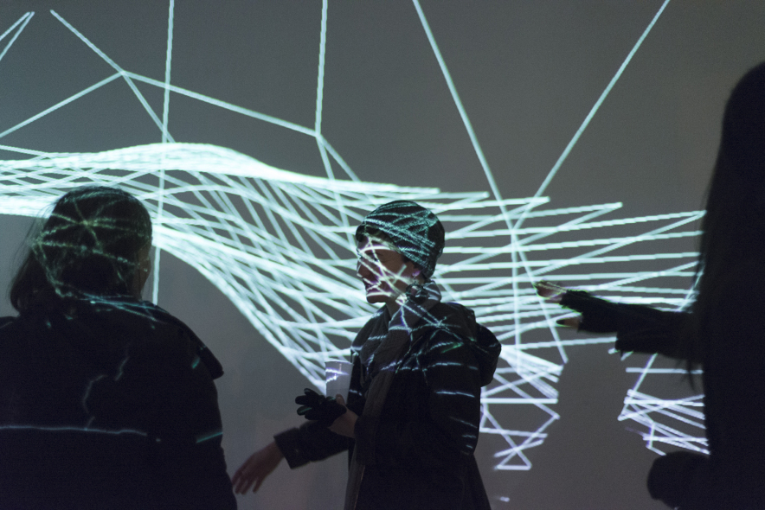
Emigrating to Axzaylia?
Mihai-Cristian Patea
Masa Zivkovic
Borisa Barisa
Notes:
Our brief was related to participation in culture, through the EU project the people's smart sculpture

Slide 2
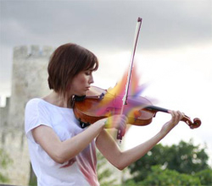
Ideation
We came up with many ideas for the project:
1) InterViolin
2) Interactive Art
3) Assimilation
4) Tagging
5) Urban Design
Used voting based evaluation
Assimilation and InterVioline were favorites
Technical feasibility and time requirement’s evaluation next → Assimilation
Notes:
Starting with open brief that has to do with participation in culture, we have ideated broadly, from interactive violin and art to civic engagement.

Slide 3
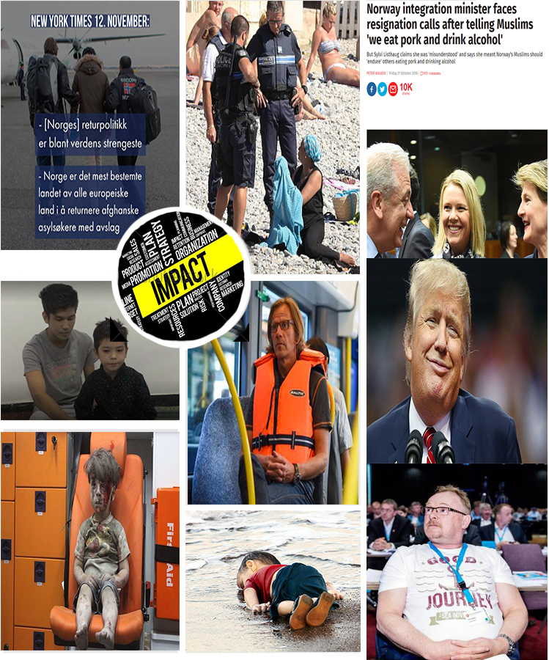
Moodboarding Assimilation
Due to some of these events which marked us, we chose evermore to take up this assignment and try to make an impact further on.
Notes:
Civic engagement motivated us the most. We wanted to rise some critical questions around immigration.

Slide 4
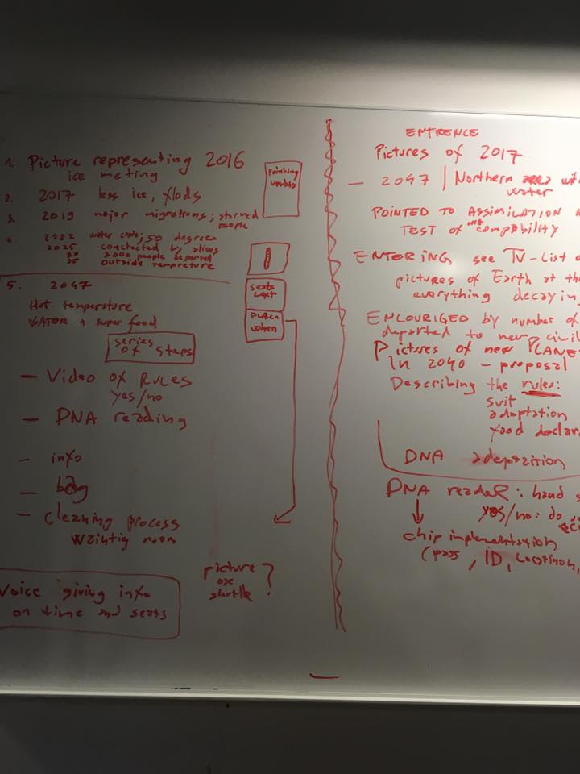
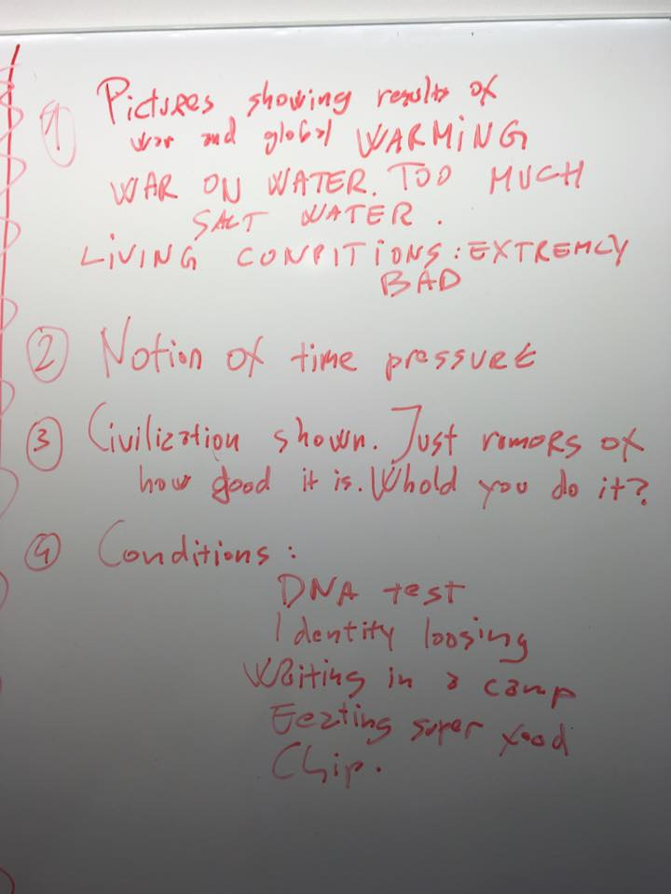
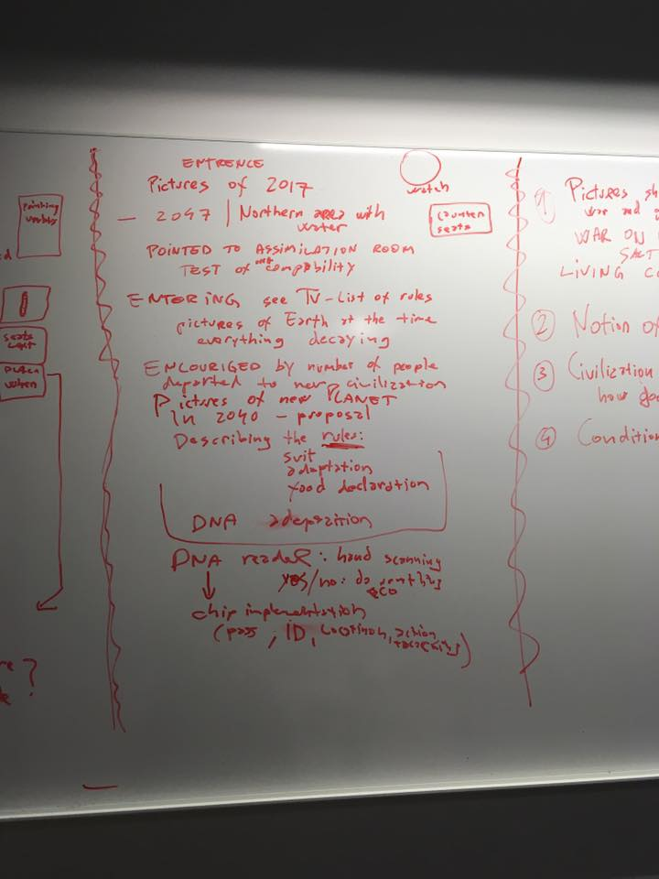
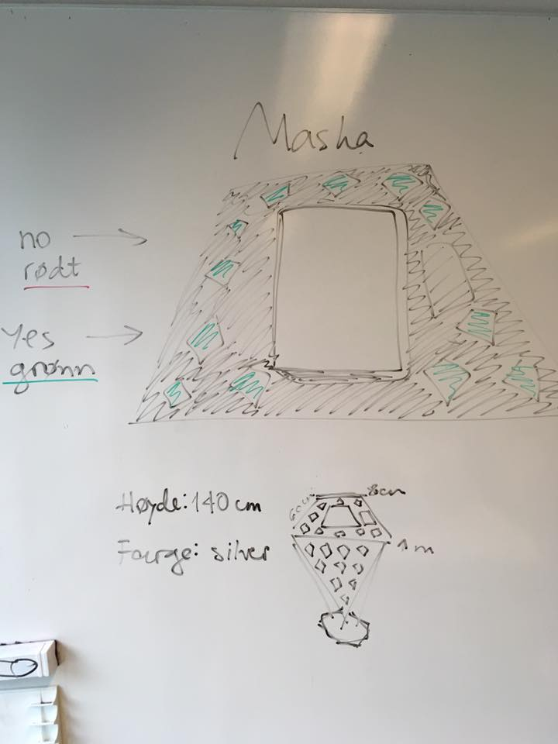
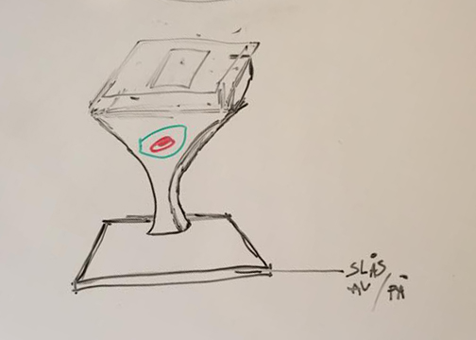
Sketching ideas
We wanted to explore the question “How can we make the experience of being an immigrant readily available for everyone?”, but also to do it through design.

Slide 5
What is Research through Design?
Research through design is a process of design, for researchers, which gives an opportunity to gain new knowledge. Research through design is a relatively new methodology with 3 new lines of practice: -the Lab
-the Field
-the Showroom
The Showroom approach allows us to make use of both critical and speculative design.
“The research involves a process of problem selection, exploration through the generation of many possible forms, and iterative refinement of a final form that approaches showroom quality.” Zimmerman and Forlizzi , “Research through design in HCI”
Notes:
The methodological approach that allowed us to explore critical and speculative design was research through design, and in particular, the showroom approach.

Slide 6
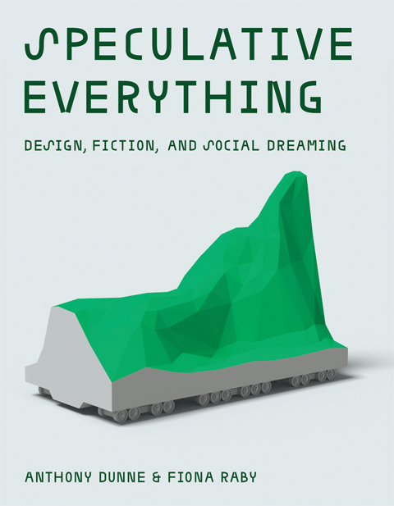
“We believe that by speculating more, at all levels of society, and exploring alternative scenarios, reality will become more malleable and, although the future cannot be predicted, we can help set in place today factors that will increase the probability of more desirable futures happening.”
- F. Raby, Speculative Everything 2013

Slide 7
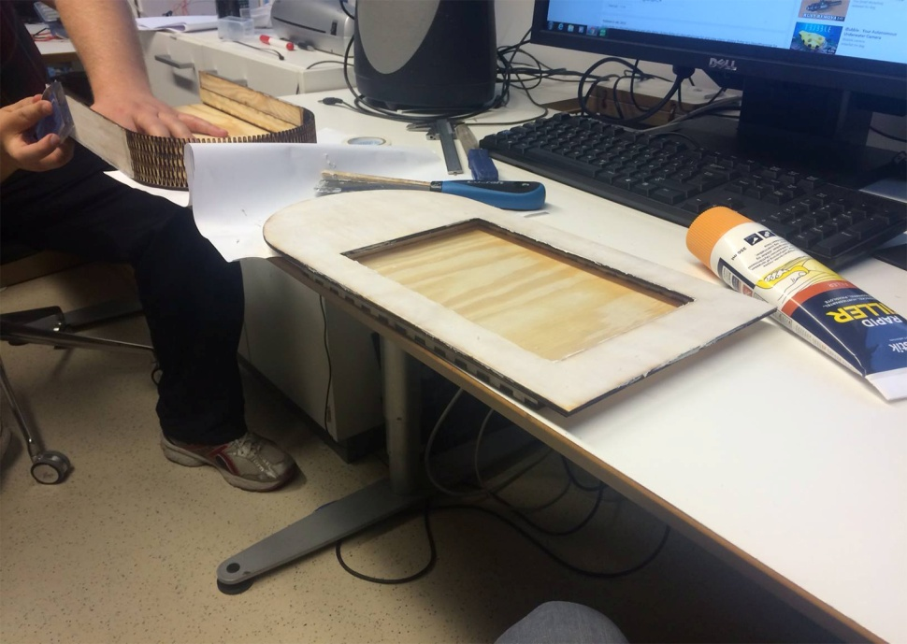
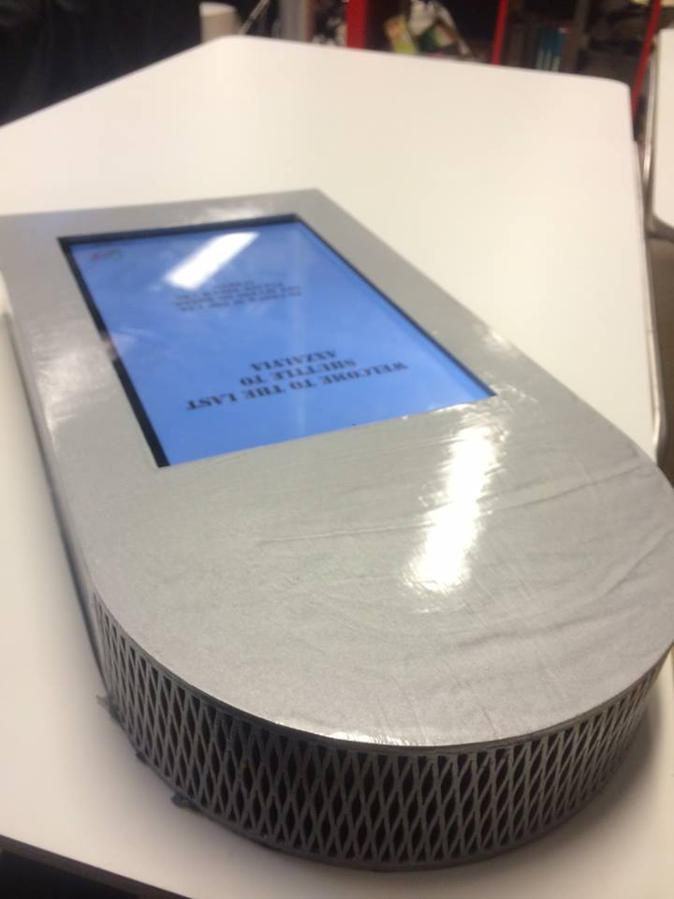
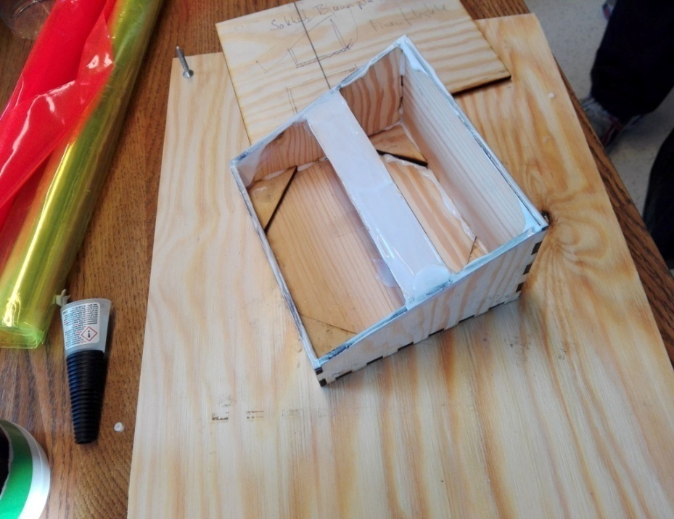
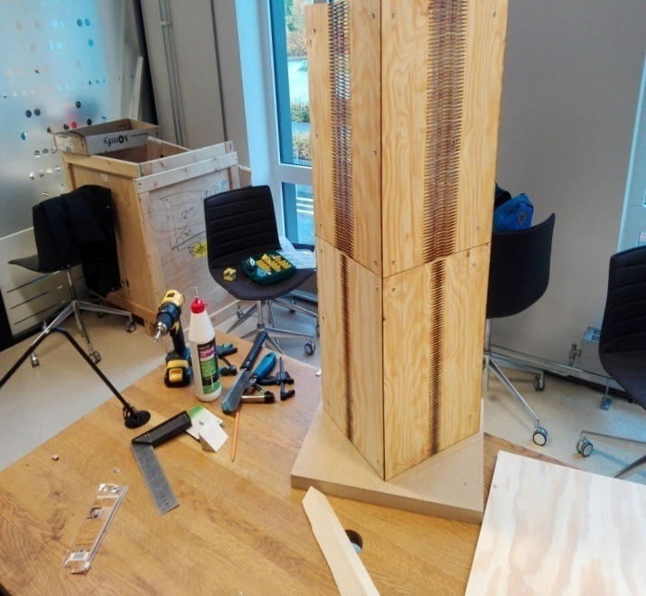
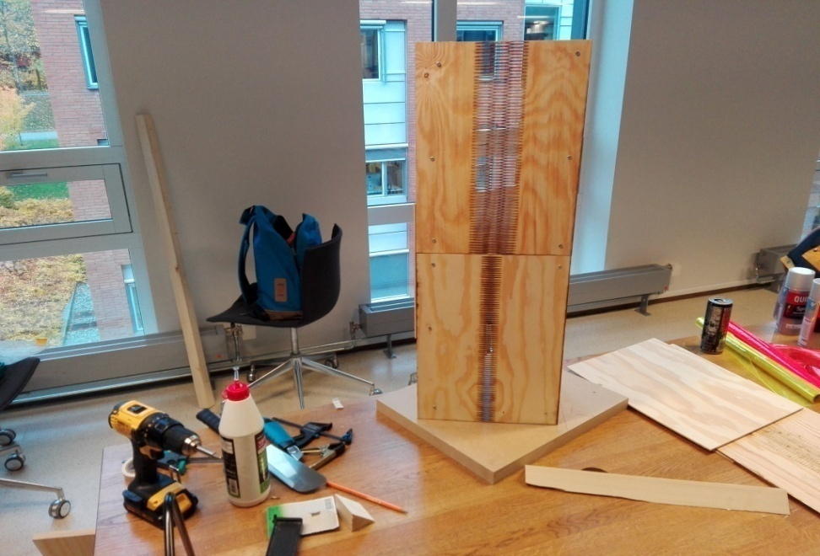
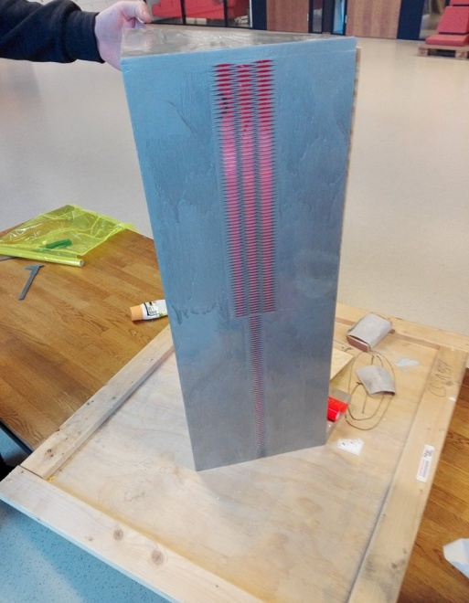
Building the device

Slide 8
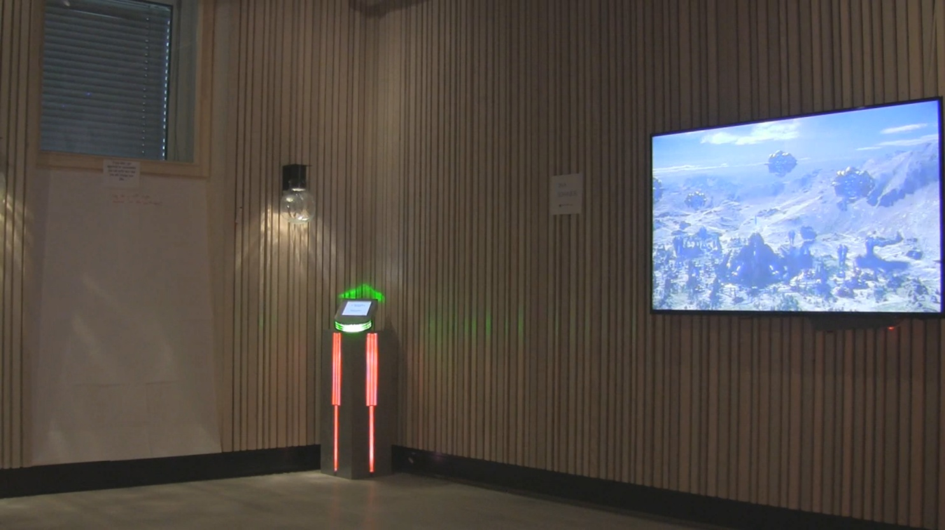
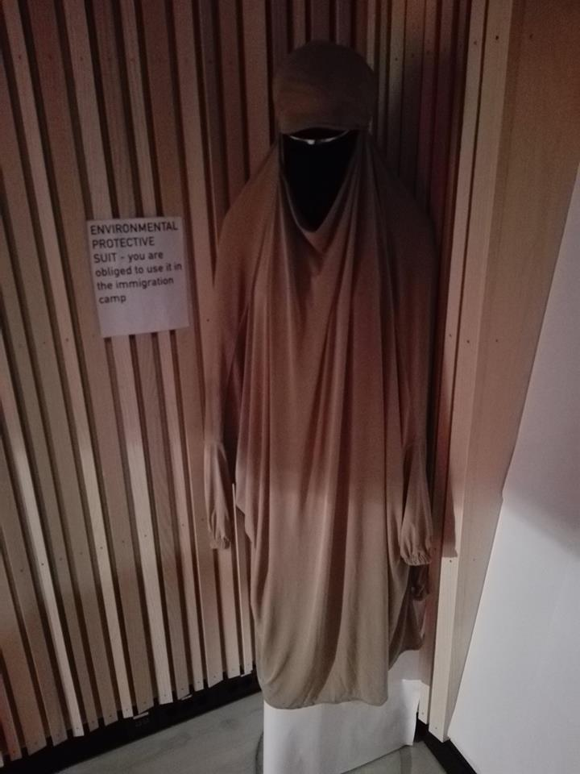
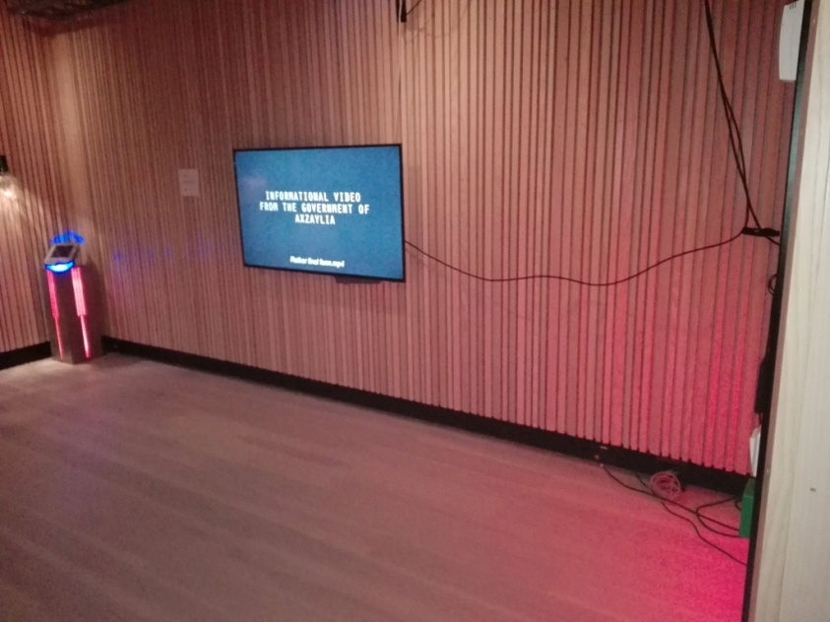
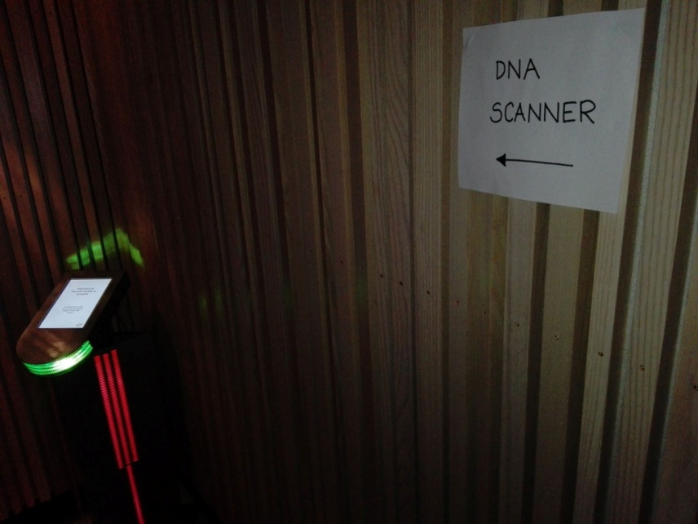
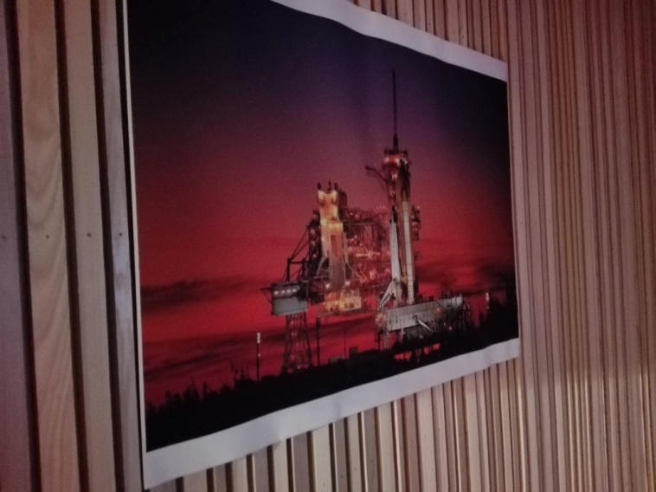
Designing the showroom

Slide 9
Findings
General feedback: "Cool system". "Easy to use". "Well presented, very convincing. In the right direction. Cool video." "Great music.". “It’s very good that you are using technology to make us think about this matter!”
Emotional response: When rejected, a woman began crying. Kids got worried about their sibling who was rejected. They do not want to split their family.
All in all, people enjoyed the flow of the system, but they also started pondering the matter and to question whether or not they have done the right thing if they voted for The Progress Party after seeing what they are doing to immigrants, as part of their Immigration Policy.
We will make stronger, more critical focus, exhibit in the spring! This is needed!!!!!
Notes:
Small samples of reactions

Slide 10
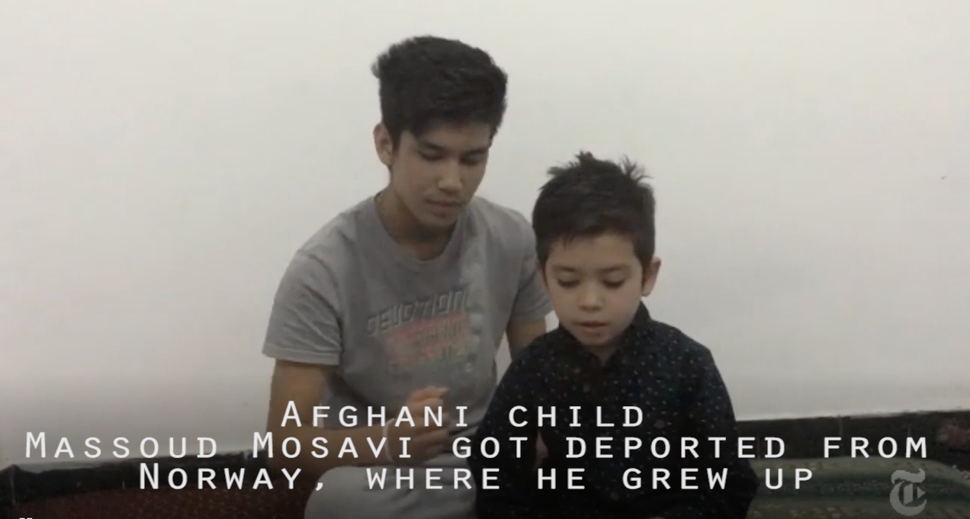

Slide 11
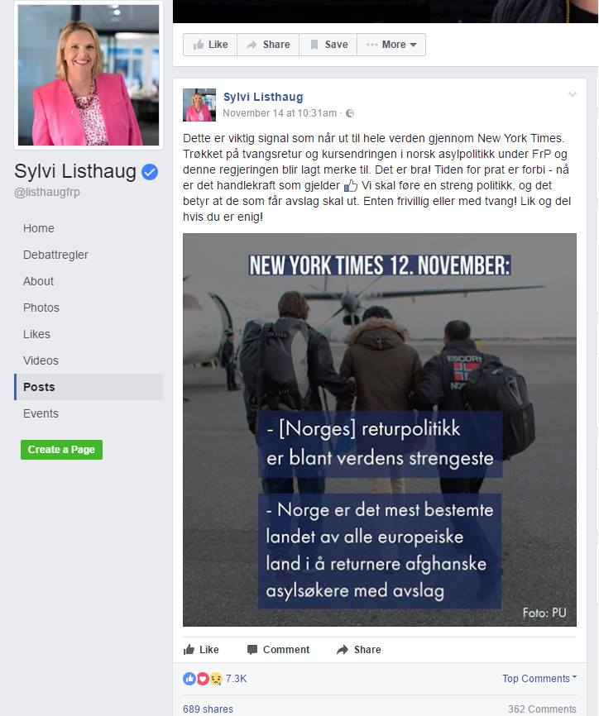

Slide 12
THANK YOU!

