Slide 1
Active on Wheels
Brage Braaten - bragewb@uio
Kaitlyn Hua - yingh@uio
Mona Andresen - monandr@uio
Stian Jessen - stianjes@uio

Slide 2
Stakeholders
Sunnaas Sykehus HF
Matthijs Wouda (project owner)
Physiotherapist, Head of Clinical Physiological Laboratory, PhD-Student
Users
Wheelchair-bound people with Spinal Cord Injury
UiO-IFI
Hani Murad (supervisor)
Project Group
Brage Braaten
Kaitlyn Hua
Mona Andresen
Stian Jessen

Slide 3
Activity & Exercise apps
Already exists many many exercise apps, for able bodied people
Typically measure/calculate (estimate)
Pulse
Steps
Time
Expenditure (energy/Kcal used)
Distance
Not very useful for those in wheelchairs
Calculations and information given is way off
That’s why we’re working with Matthijs to create a design for his

Slide 4
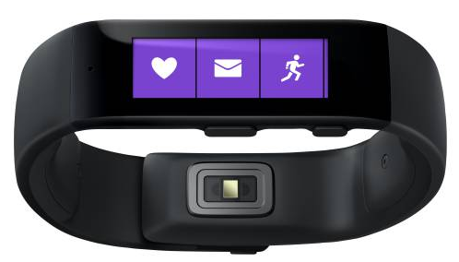
Activity and exercise app for Wheelchair users
Combines three devices by Bluetooth
Android Smartphone
Microsoft Band
POLAR Heart rate monitor
Makes it possible to
Accurately estimates energy expenditure and workout intensity
Provide accurate information during and after workout
Track progression and goal achievements over time
Tailor motivational affordances (e.g. feedback )

Slide 5
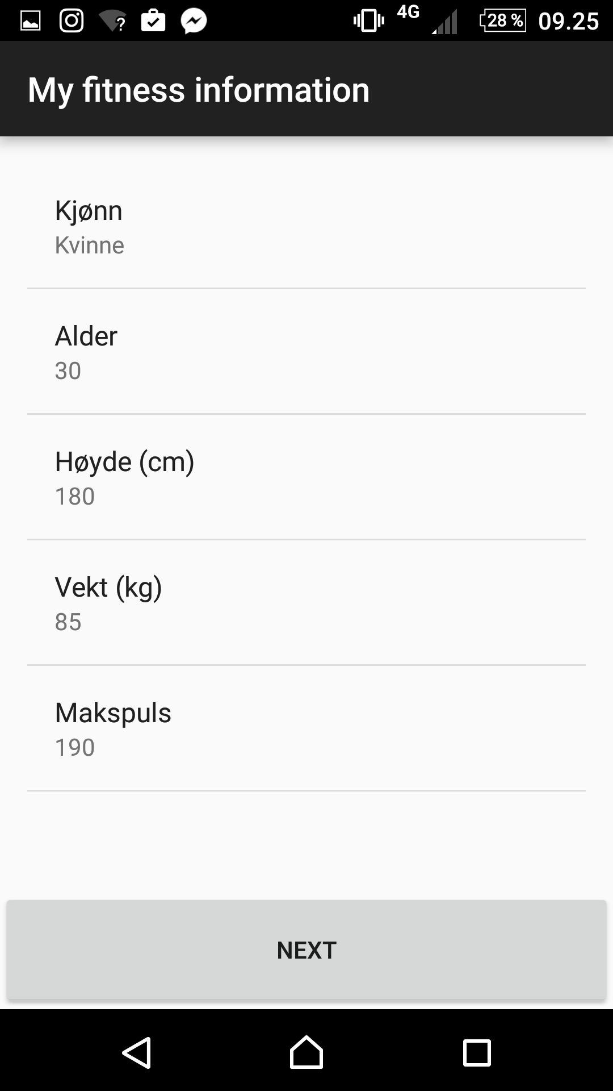
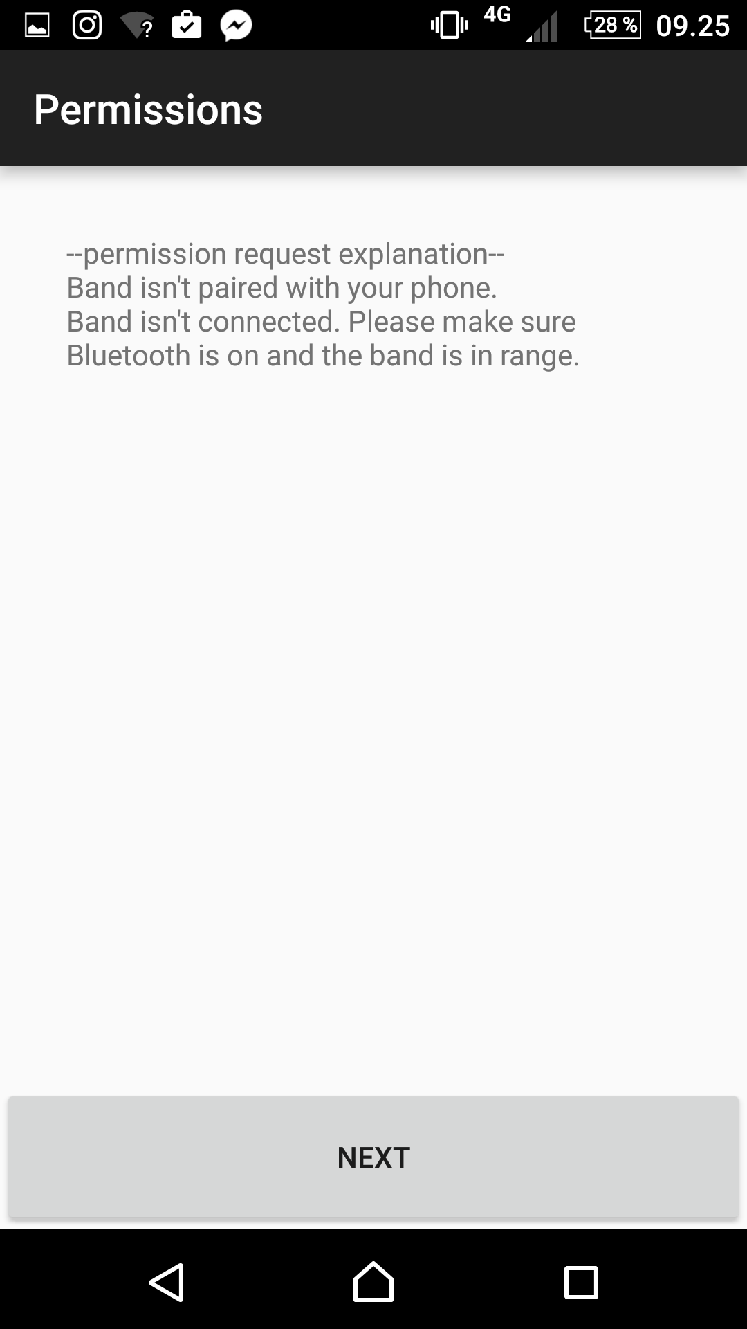
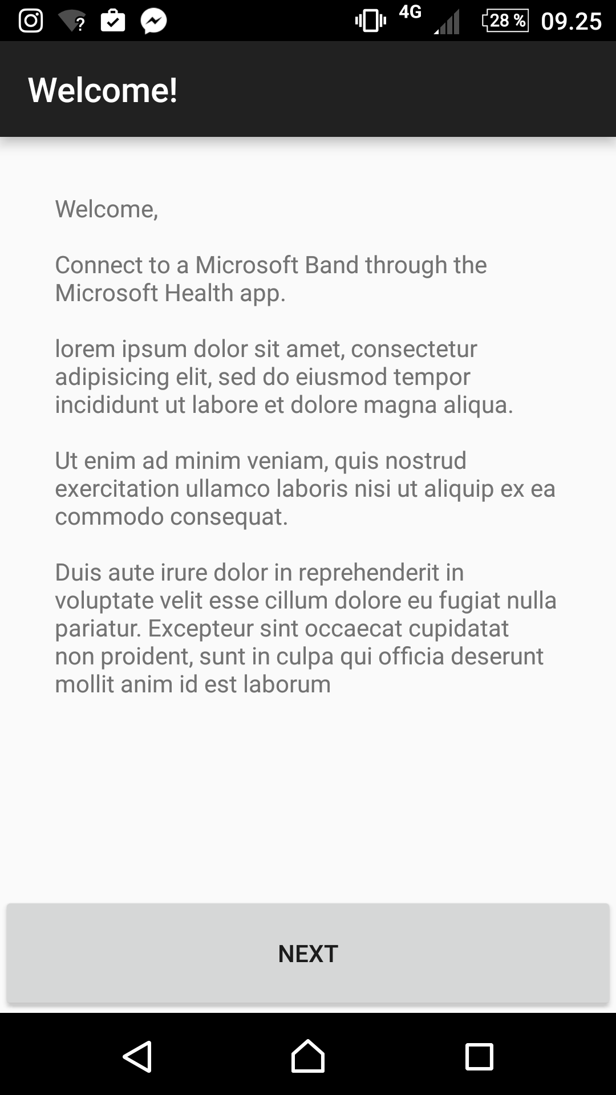
What are we doing?
Today the app looks like this
Not really that interesting or cool
We are changing that by creating a totally new fun, motivating and immersive design for the app

Slide 6
How are we doing this?
User-Centered approach to design
Data
Interviews/evaluations with users
Literature findings
Universal Design / Design for disabled
Experiences from clinical work at Sunnaas
Design
Fun, immersive, and motivating interface for the Active on Wheels app
Data
Notes:
UD logo: https://www.nr.no/en/research-area/e-inclusion

Slide 7
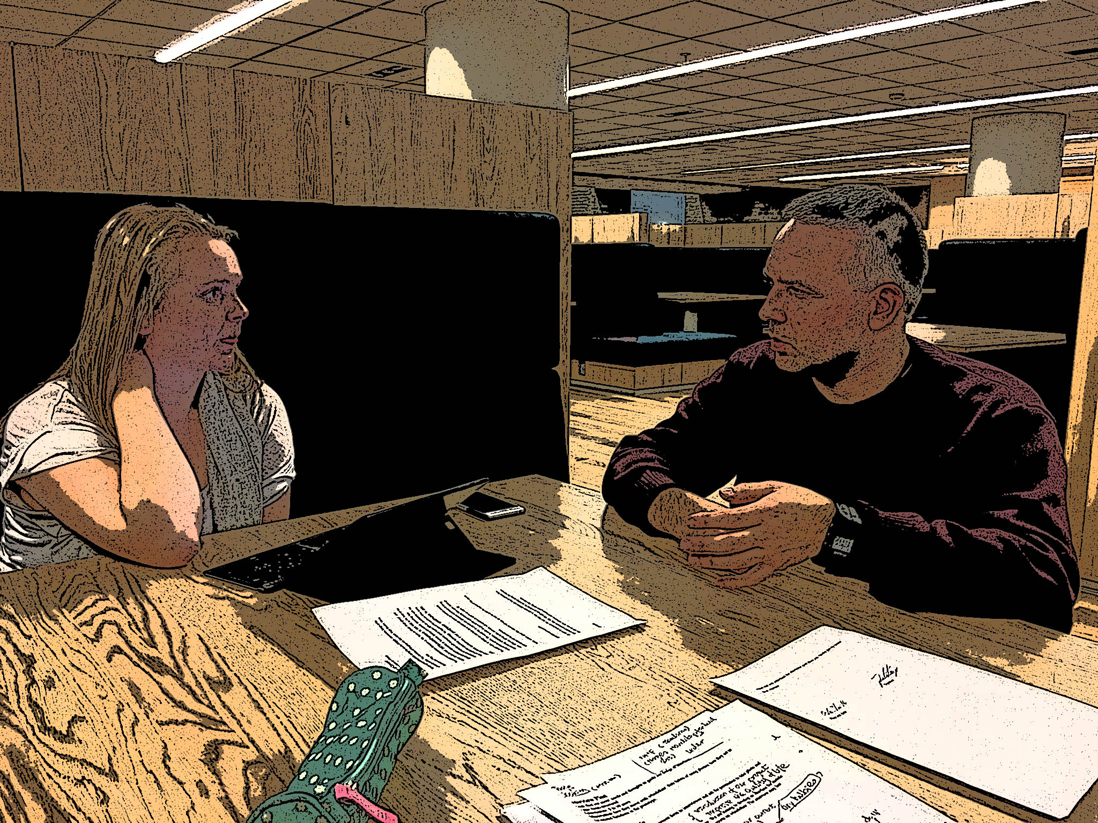
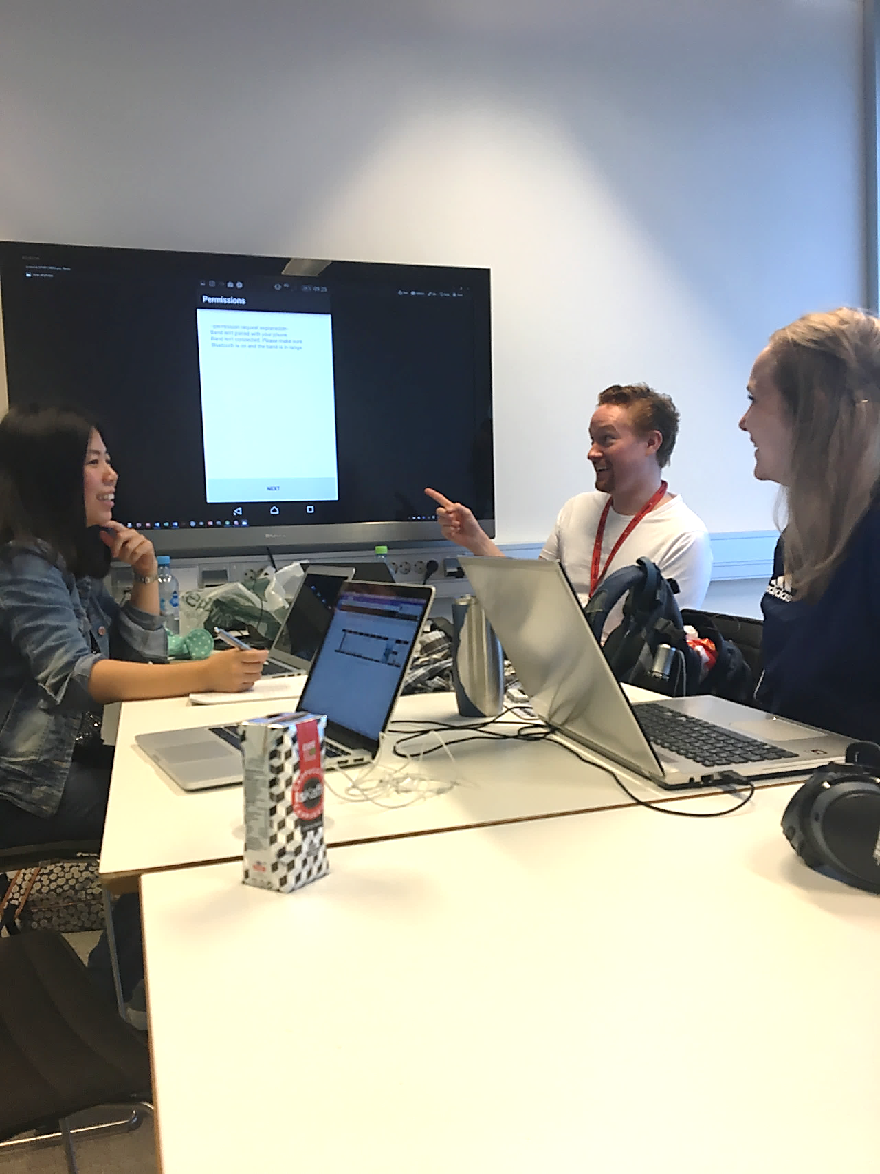
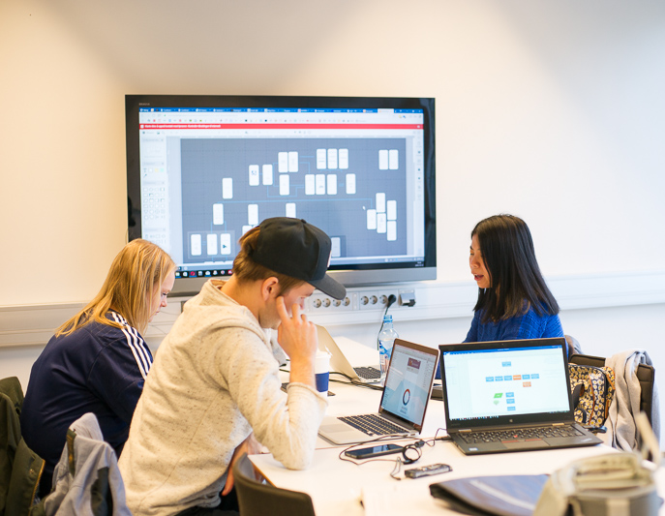
What has been done so far
Idea-generating meetings with Matthijs (client)
We have free reigns..
User Interviews
Need and requirements
Contexts of use
Reviewing literature
Design for, and working with, disabled people.
Gamification & motivation theories and ideas
Design meetings,
Brainstorming
Sketching
Mapping the app
Connecting different data
Interviews, literature findings, ideas, previous experiences etc.

Slide 8
The way ahead
Phase 1
Informing the design
User Interviews
Phase 2
Doing the design
Phase 3
Evaluating the design
Literature review
Clinical experiences
Users feedback on Lo-Fi Prototypes
User evaluations of Hi-Fi prototype
Design meetings
Weeks 37-42
Weeks 42-45
Weeks 46-48
Panic-writing:-)
Right now we’re between 1 and 2
Delayed by slow recruiting
Working more on design the next weeks
Adjust it as we do more interviews with users
Set up user evaluations of prototype for late October/early November

Slide 9
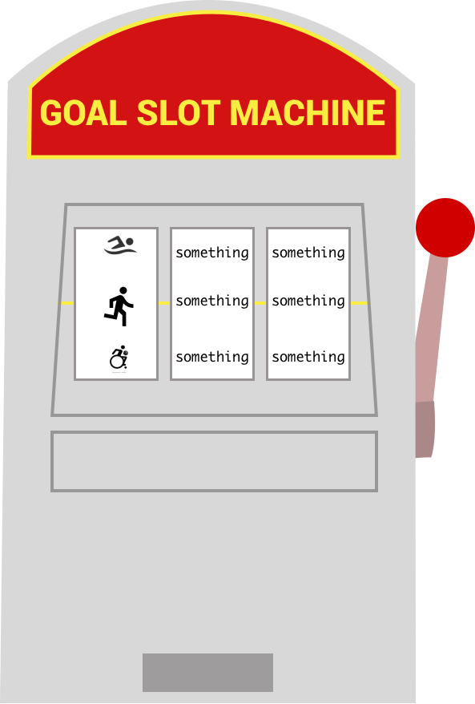
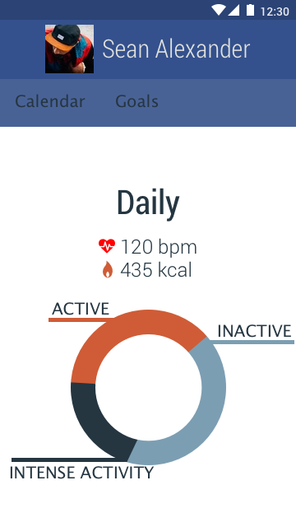
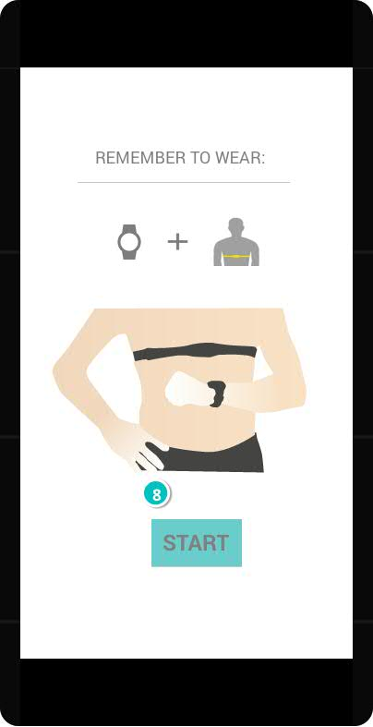
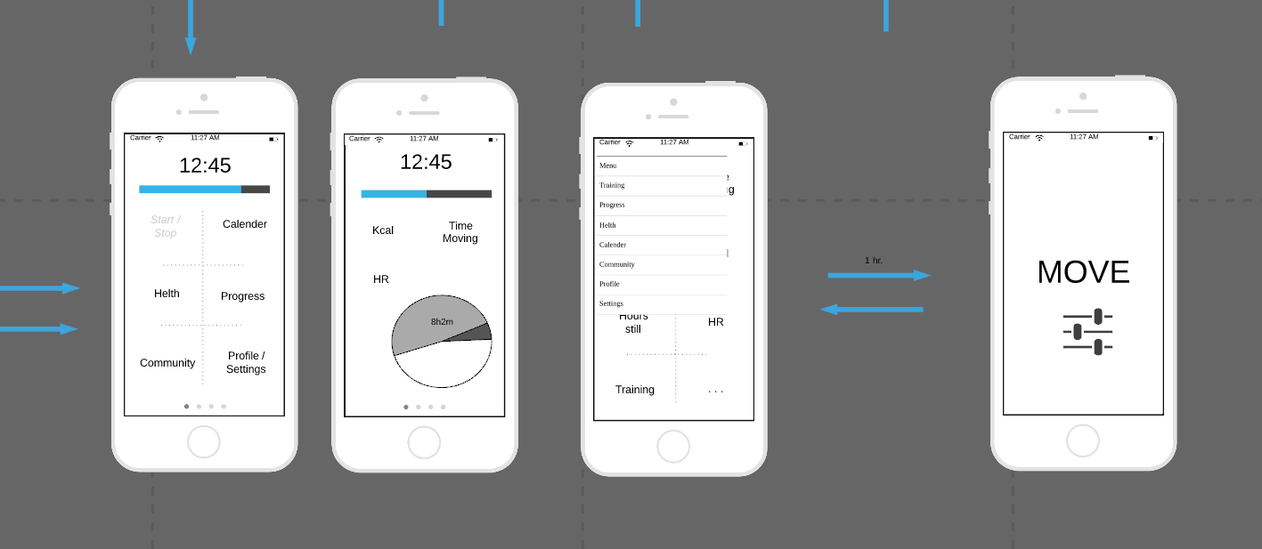
Our designs so far
Many sketches and ides for implementations of gamified components
Variations on themes
Mapped out most of the app

Slide 10
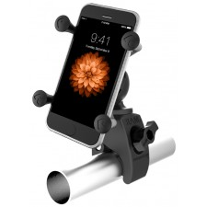
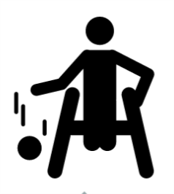
Challenges
Already defined target group
Wheelchair users with incomplete spinal cord injuries
Hard to find/recruit users
Sample Bias
How to use the app?
Chair often requires two hands to operate!
Design
Designing for users with varying dexterity/abilities
How to compete when no one are a like?
Ethics
Working with a vulnerable group

Slide 11
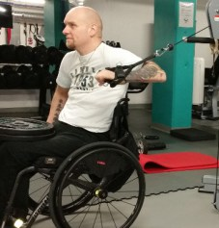
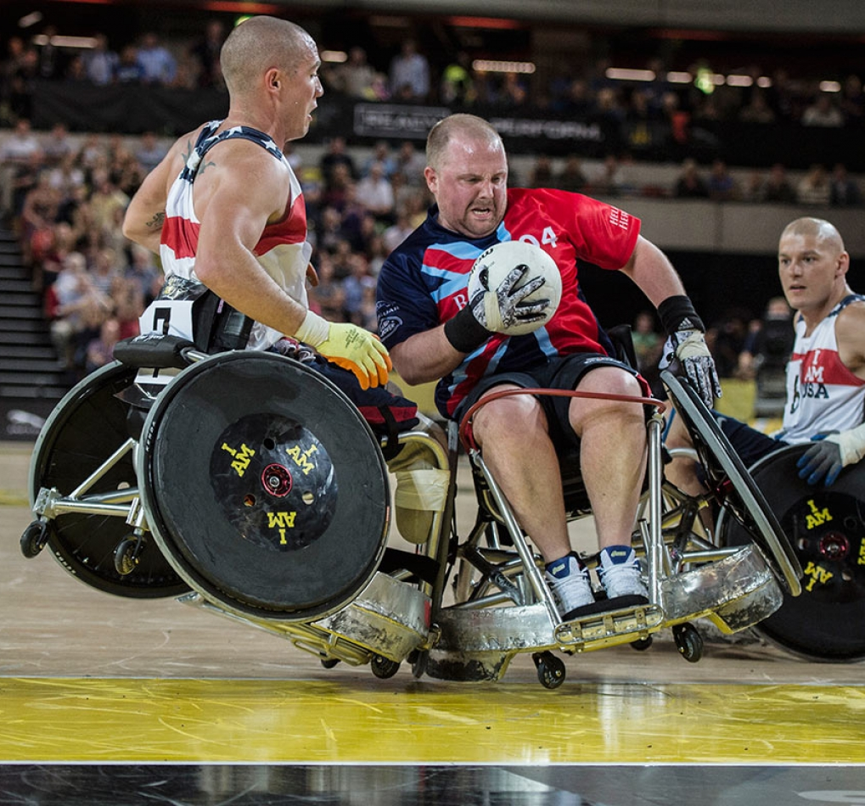
Ideally though
A more participatory design approach
Larger User group
E.g. work with interest group/organization
More heterogenous sample
Several workshops
(Much) more time

Slide 12
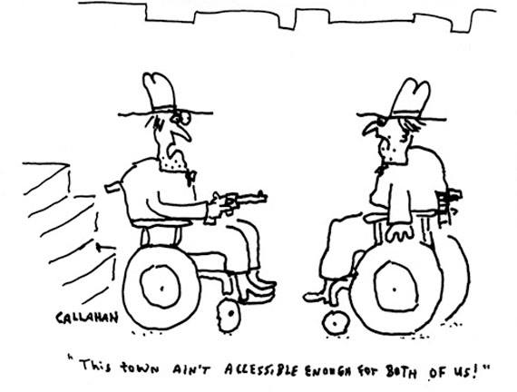
Thank You!

