Slide 1
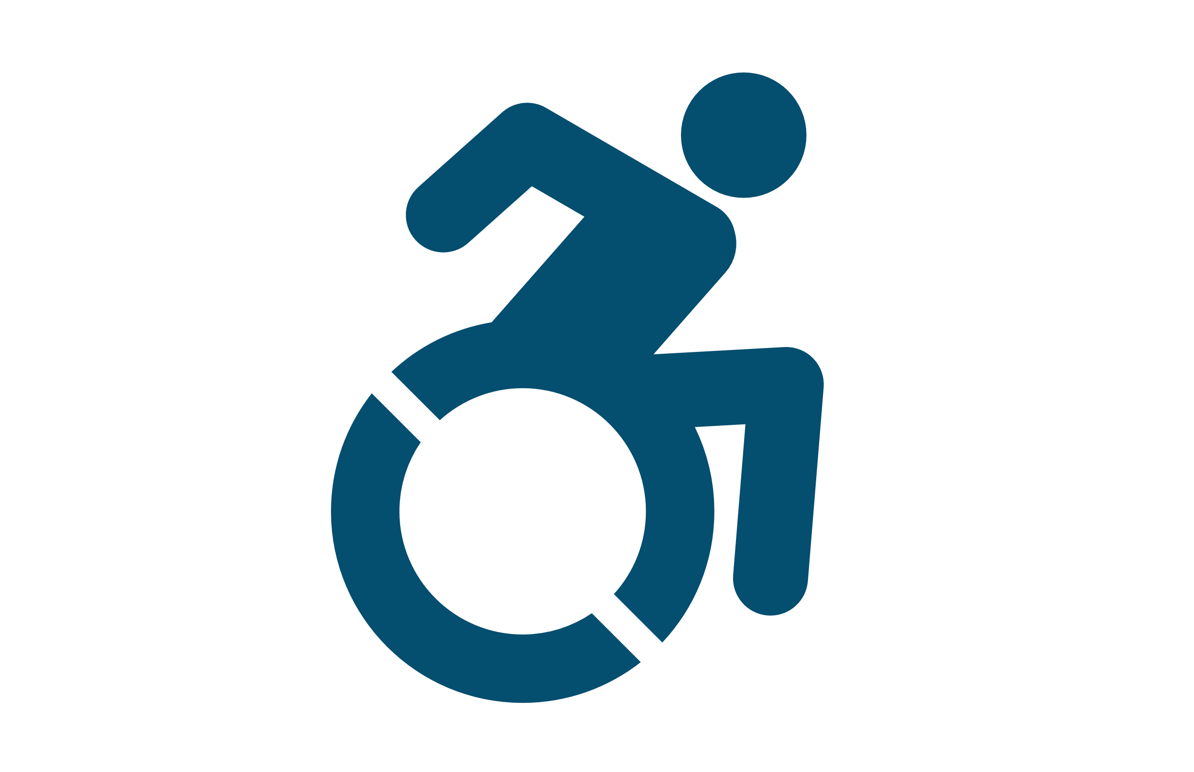
Active n wheels
- An exercise app for wheelchair users -

Slide 2
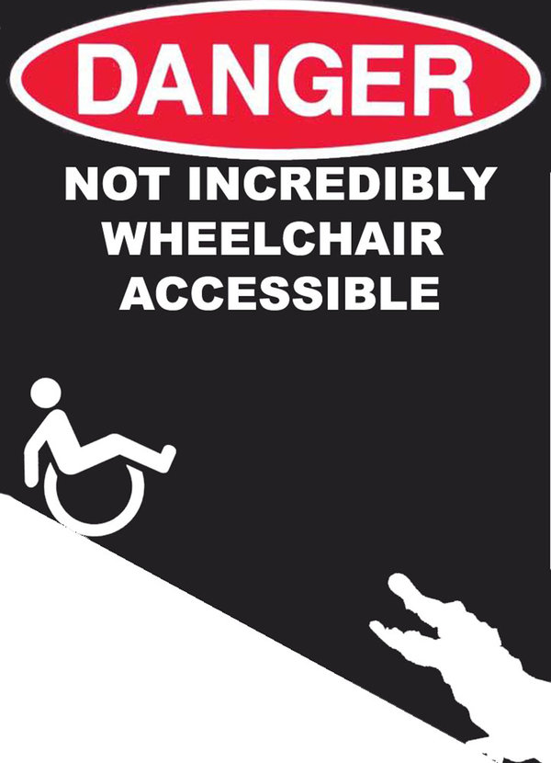
Lack of Exercise equality today
Recreational/exercise activities or tools are not designed for people in wheelchairs
Gyms
Apps
People still need to exercise and be active
Particularly wheelchair users
Notes:
Our solution makes it possible for people bound to a wheelchair to keep track of their exercises and energy expanditure.

Slide 3
We are changing that
Designing an interface that support wheelchair users to:
Exercise and be more active
Maintain or improve fitness
Avoid secondary illnesses (diabetes, ,obesity cardiovascular problems)
Notes:
Our solution makes it possible for people bound to a wheelchair to keep track of their exercises and energy expanditure.

Slide 4
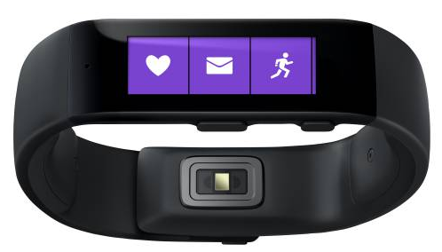
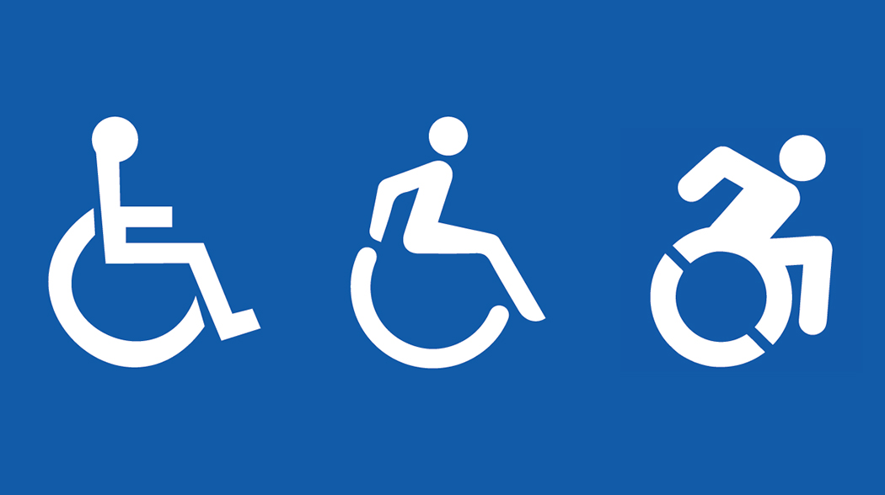
Exercise app for Wheelchair users
Combines
Phone, Pulse belt, Activity Band
Estimates energy expenditure and workout intensity
Provide accurate information during and after workout
Notes:
Our solution makes it possible for people bound to a wheelchair to keep track of their exercises and energy expanditure.

Slide 5
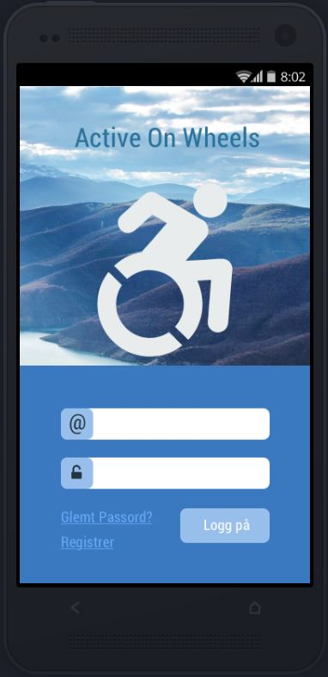
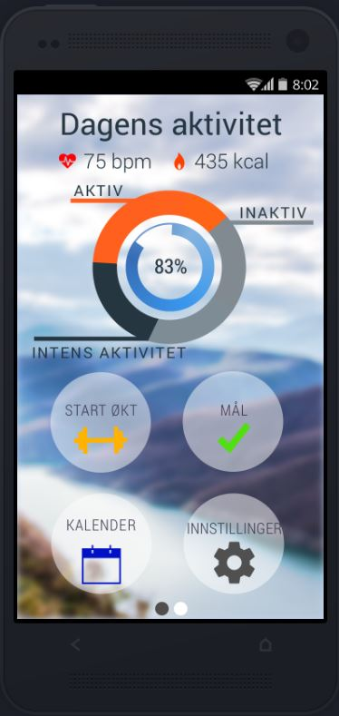
How is it done?
Literature studies
Clinical experiences
Working with the users
Notes:
Our solution makes it possible for people bound to a wheelchair to keep track of their exercises and energy expanditure.

Slide 6
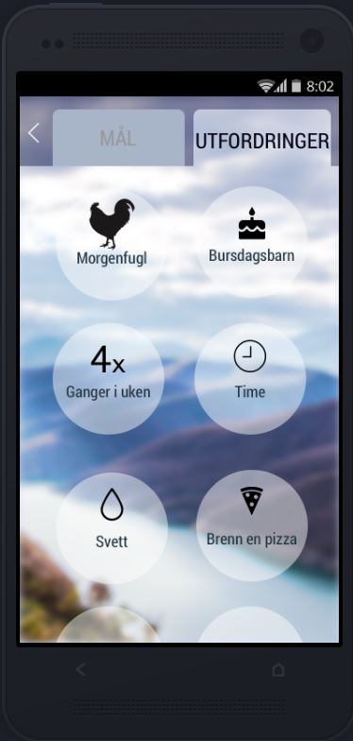
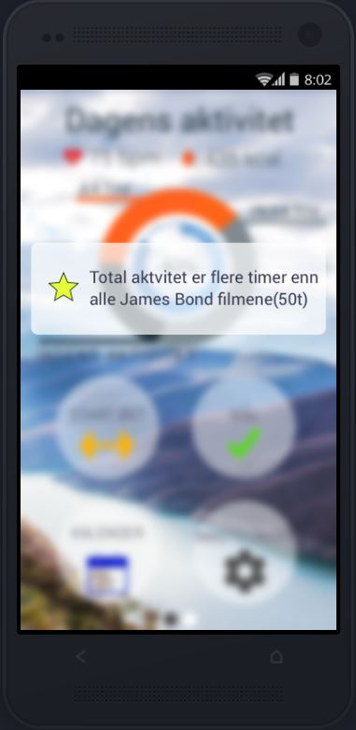
use
Smartphone app
Game elements to motivate
Three types of goals
My goals (mål)
Challenges (utfordringer)
“random” rewards
Notes:
Our solution makes it possible for people bound to a wheelchair to keep track of their exercises and energy expanditure.

Slide 7
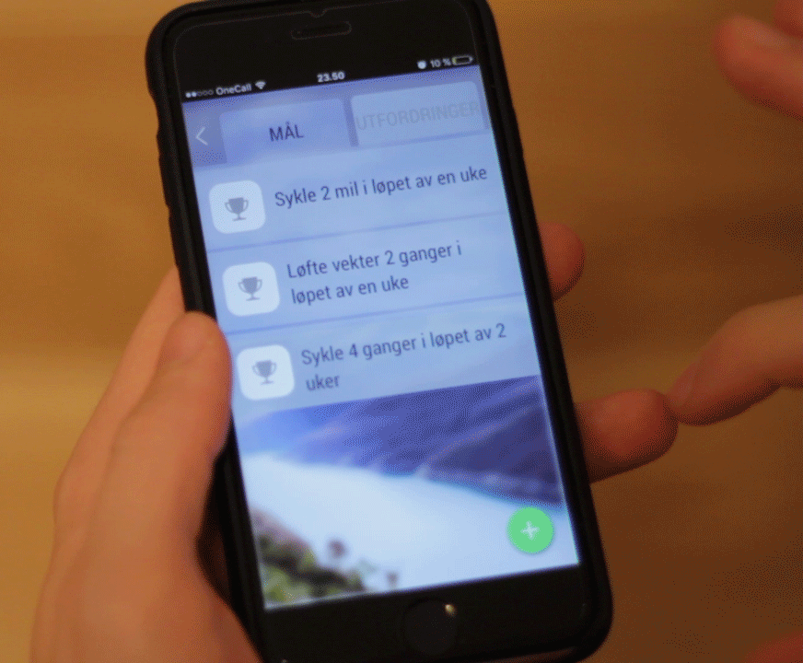
use
Smartphone app
Game elements to motivate
Three types of goals
My goals (mål)
Challenges (utfordringer)
“random” rewards
Notes:
Our solution makes it possible for people bound to a wheelchair to keep track of their exercises and energy expanditure.

Slide 8
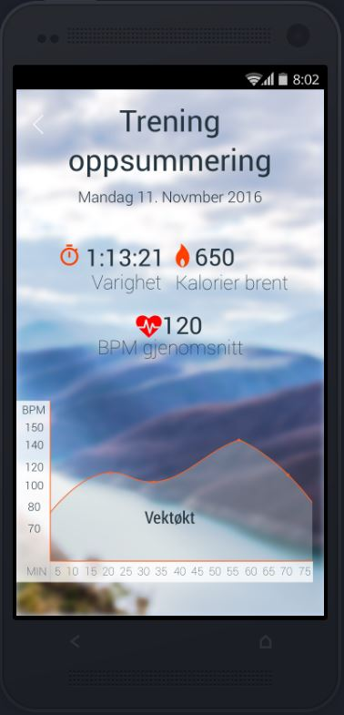
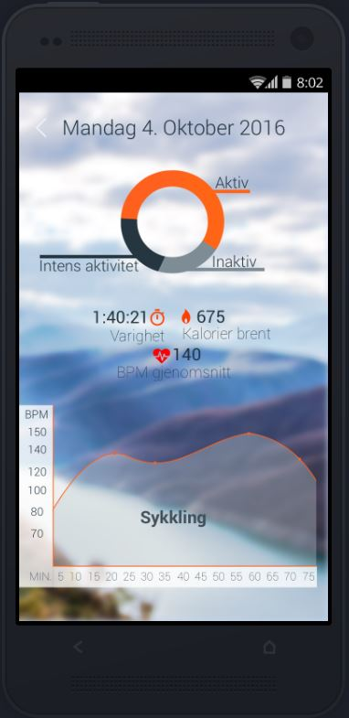
Validation
User reviews / interviews
Expert reviews
Literature and user/expert input agrees
Notes:
Our solution makes it possible for people bound to a wheelchair to keep track of their exercises and energy expanditure.

Slide 9
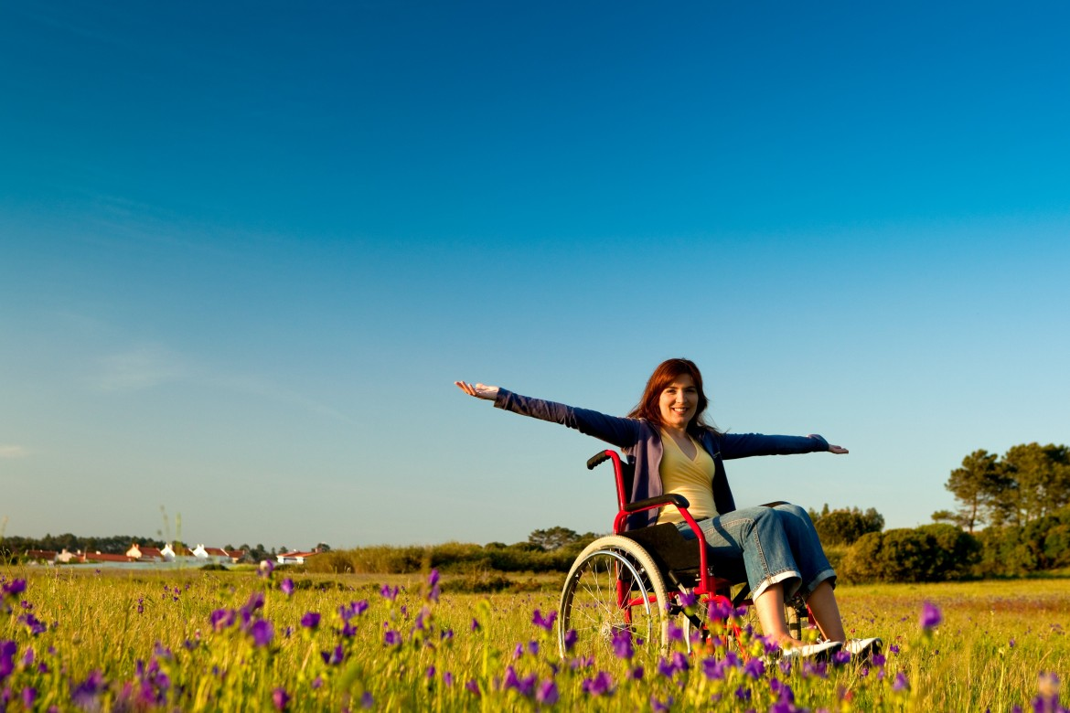
impact
Active n wheels
Healthier, happier, and fitter users
Less secondary diseases
Diabetes
Cardiovascular
Obesity
Exercise equality
Cheaper and better healthcare
Notes:
Our solution makes it possible for people bound to a wheelchair to keep track of their exercises and energy expanditure.

