Slide 1
Deadlocks, Message Passing Brief refresh from last week
Tore Larsen
Oct. 2010

Slide 2
Deadlocks
Formal definition :
A set of processes is deadlocked if each process in the set is waiting for an event that only another process in the set can cause
Usually the event is release of a currently held resource
None of the processes can …
Run
Release resources
Be awakened
Notes:
Event - hendelse

Slide 3
Four Conditions for Deadlock
Mutual exclusion condition
Each resource is either assigned to one process or it is available
Hold and wait condition
Process holding resources may request more resources
No preemption condition
Previously granted resources cannot be taken away by force
Circular wait condition
Must be at least one circular chain involving two or more processes
Each is waiting for resource held by next member of the chain
Notes:
Gjensidig utelukkelse
Hold og vent
Ingen

Slide 4
Deadlocks: Strategies
Ignore the problem
It is user’s fault
Detection and recovery
Fix the problem afterwards
Dynamic avoidance
Careful allocation
Prevention
Negate one of the four conditions
Notes:
Avoid – unngaa
Prevent - forhindre

Slide 5
Which is your favorite?
Ignore the problem
It’s the user’s fault
Detection and recovery
Fix the problem afterwards
Dynamic avoidance
Careful allocation
Prevention (Negate one of four conditions)
Avoid mutual exclusion Spool everything
Avoid hold and wait Request all resources initially
No preemption Forcefully reclaim resources
No circular wait Order resources numerically

Slide 6
Big Picture
race conditions
critical regions
mutal exclusion
monitors
shared memory
mutexes
sleep and wakeup
semaphores
message passing
communication?

Slide 7
Asynchronous vs. Synchronous
msg
operation,
unblock thread
Synchronous (blocking):
thread is blocked until message primitive has been performed
may be blocked for a very long time
msg operation
block thread, execute msg operation in another thread/kernel
time

Slide 8
Asynchronous vs. Synchronous
Asynchronous (non-blocking):
thread gets control back immediately
thread can run in parallel other activities
thread cannot reuse buffer for message before message is received
how to know when to start if blocked on full/empty buffer?
poll
interrupts/signals
…
msg operation,
resume immediately
execute msg operation in another thread/kernel
time

Slide 9
Asynchronous vs. Synchronous
Send semantic:
Synchronous
Will not return until data is out of its source memory
Block on full buffer
Asynchronous
Return as soon as initiating its hardware
Completion
Require application to check status
Notify or signal the application
Block on full buffer
Receive semantic:
Synchronous
Return data if there is a message
Block on empty buffer
Asynchronous
Return data if there is a message
Return null if there is no message

Slide 10
Buffering
No buffering
synchronous
Sender must wait until the receiver receives the message
Rendezvous on each message
Buffering
asynchronous or synchronous
Bounded buffer
Finite size
Sender blocks when the buffer is full
Use mesa-monitor to solve the problem?
Unbounded buffer
“Infinite” size
Sender never blocks

Slide 11
Direct Communication
Must explicitly name the sender/receiver (“dest” and “src”) processes
A buffer at the receiver
More than one process may send messages to the receiver
To receive from a specific sender, it requires searching through the whole buffer
A buffer at each sender
A sender may send messages to multiple receivers

Slide 12
Indirect Communication
“dest” and “src” are a shared (unique) mailbox
Use a mailbox to allow many-to-many communication
Requires open/close a mailbox before using it
Where should the buffer be?
A buffer and its mutex and conditions should be at the mailbox

Slide 13
Linux: Mailboxes vs. Pipes
Are there any differences between a mailbox and a pipe?
Message types
mailboxes may have messages of different types
pipes do not have different types
Buffer
pipes – one or more pages storing messages contiguously
mailboxes – linked list of messages of different types
Termination
pipes exists only as long as some have open the file descriptors
mailboxes must often be closed
More than two processes
a pipe often (not in Linux) implies one sender and one receiver
many can use a mailbox

Slide 14
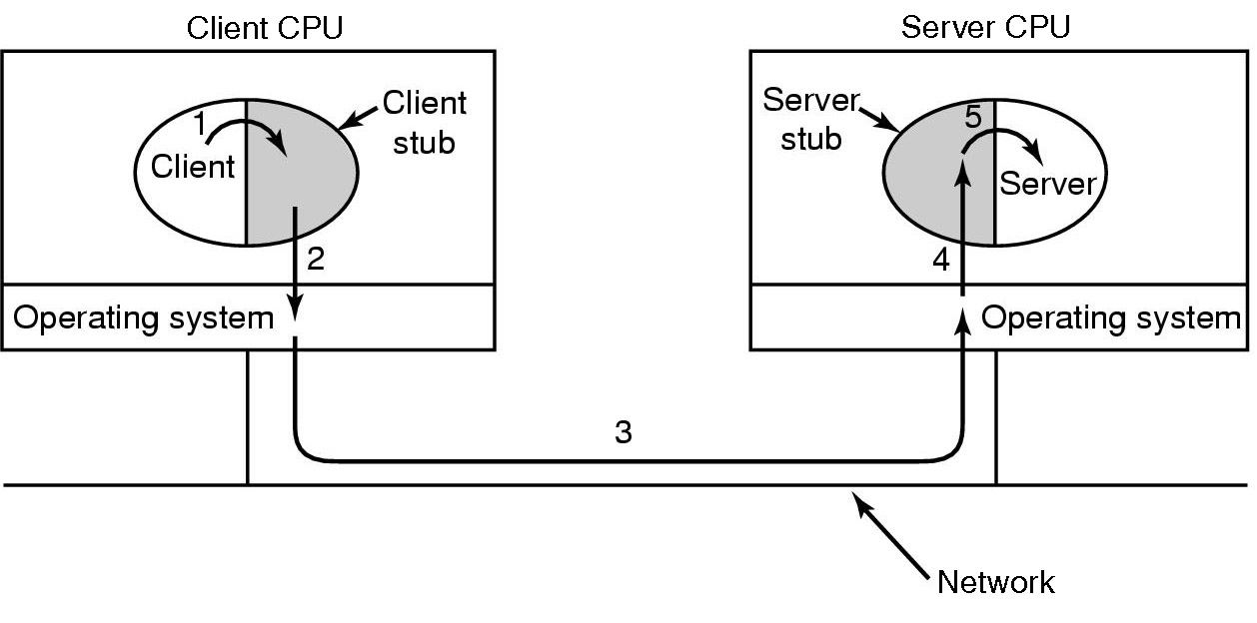
Remote Procedure Call
Message passing uses I/O
Idea of RPC is to make function calls
Small libraries (stubs) and OS take care of communication

Slide 15
Publish – Subscribe Subject for later course
Decoupled
Asynchronous
Anonymous
Filtering

