Slide 1
Threads and Critical Sections
Thomas Plagemann
Slides from Otto J. Anshus, Tore Larsen (University of Tromsø), Kai Li (Princeton University)

Slide 2
Overview
Intro to threads
Concurrency
Race conditions & critical regions
Too much milk problem
-> mutual exclusion …..

Slide 3
Thread and Address Space
Thread
A sequential execution stream within a process (also called lightweight process)
Address space
All the state needed to run a program
Provide illusion that program is running on its own machine (protection)
There can be more than one thread per address space

Slide 4
Typical Thread API
Difficult to use
Not good: Combines specification of concurrency (Fork) with synchronization (Join)
Creation
Fork, Join
Mutual exclusion
Acquire (lock), Release (unlock)
Condition variables
Wait, Signal, Broadcast
Alert
Alert, AlertWait, TestAlert

Slide 5
Fork/Join
Executes concurrently
P1:
….
FORK T1;
….
JOIN T1;
….
T1:
….
END;
T1:
….
END;
P1 must WAIT until T1 finishes
P1:
….
FORK T1;
FORK T2;
FORK T3;
….
JOIN;
….
T2:
….
END;
T3:
….
END;
JOIN whom??

Slide 6
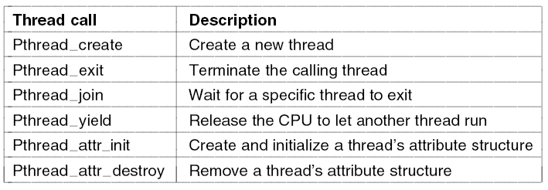
POSIX Threads (1)
Figure 2-14. Some of the Pthreads function calls.

Slide 7
POSIX Threads (2)
Figure 2-15. An example program using threads.
. . .

Slide 8
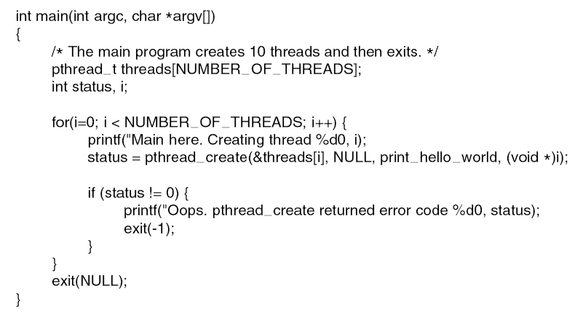
POSIX Threads (3)
. . .
Figure 2-15. An example program using threads.

Slide 9
User vs. Kernel-Level Threads
Question
What is the difference between user-level and kernel-level threads?
Discussions
When a user-level thread is blocked on an I/O event, the whole process is blocked
A context switch of kernel-threads is expensive
A smart scheduler (two-level) can avoid both drawbacks

Slide 10
User vs. Kernel Threads
Threads
Threads
Thread Package
Process “Package”
Thread Package
KERNEL

Slide 11
Recall last week: PCB resp. PT
Which information has to be stored/saved for a process?

Slide 12
Thread Control Block
Shared information
Processor info: parent process, time, etc
Memory: segments, page table, and stats, etc
I/O and file: comm ports, directories and file descriptors, etc
Private state
State (ready, running and blocked)
Registers
Program counter
Execution stack

Slide 13
System Stack for Kernel Threads
Each kernel thread has
a user stack
a private kernel stack
Pros
concurrent accesses to system services
works on a multiprocessor
Cons
More memory
Each kernel thread has
a user stack
a shared kernel stack with other threads in the same address space
Pros
less memory
Cons
serial access to system services
Typical for all shared resources

Slide 14
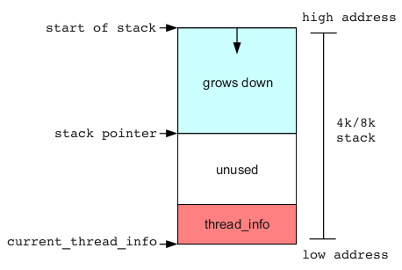
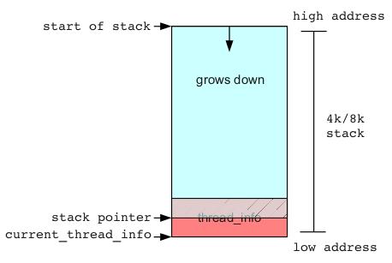
System Stack for Kernel Threads in Linux
http://jon.oberheide.org/blog/2010/11/29/exploiting-stack-overflows-in-the-linux-kernel/

Slide 15
Concurrency and Threads
I/O devices
Overlap I/Os with I/Os and computation (modern OS approach)
Human users
Doing multiple things to the machine: Web browser
Distributed systems
Client/server computing: NFS file server
Multiprocessors and multi cores
Multiple CPUs sharing the same memory: parallel program

Slide 16
Why is concurrency tricky
We use threads or processes as powerful concept to keep threads of control apart, looking at sequential processes instead of arbitrarily interleaved thread of execution
Yet, in reality interleaved, any process may be interrupted at any time
Subtle, hard-to-identify, programming errors including race-conditions are introduced

Slide 17
Example: NASA Pathfinder spacecraft
Total system resets in Mars Pathfinder
An overrun of a data collection task →
a priority inversion in mutex semaphore →
a failure of a communication task →
a system reset.
Took 18 hours to reproduce the failure
in a lab replica → the problem became
obvious and a fix was installed
Errors rooted in the interaction of multiple concurrent operations/threads and are based on timing dependencies.
Easy to identify the errors and fix them once the failing sequences are reproduced (or observed).
Source: Yann–Hang Lee, Gerald Gannod, and Karam Chatha, Arizona State University
W. Eric Wong, University of Texas

Slide 18
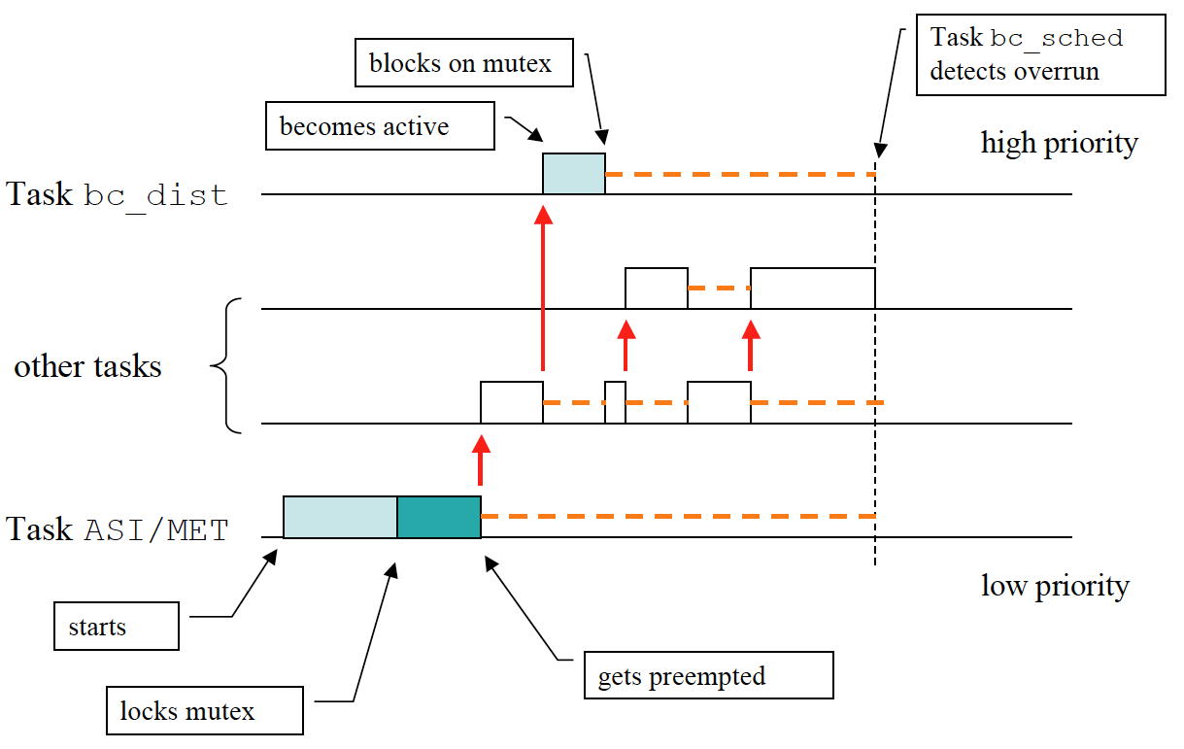
Priority Inversion on Mars Pathfinder
Source: http://www.cse.nd.edu/~cpoellab/teaching/cse40463/slides6.pdf

Slide 19
Temporal Dependence
Predicting and controlling timing and responses are based on event occurrences
Timing relationship: (can you guarantee it?)
Predictable actions in response to external stimuli
if event E₁ occurs at time t₁, will an action A₁ be triggered at time t₂
Deadline (absolute or relative), and jitter
Program execution
If event E₁ occurs at time t₁+Δ, will the same action A₁ be triggered at time t₂ +Δ ?
Will the program execution be identical ?
Should this case be tested ?
Source: Yann–Hang Lee, Gerald Gannod, and Karam Chatha, Arizona State University
W. Eric Wong, University of Texas

Slide 20
Concurrency: Double buffering
Specifies concurrent execution
/* Fill s and empty t concurrently */
s
Get(s,f);
Repeat
Copy;
cobegin
Put(t,g);
Get(s,f);
coend;
until completed;
Get (s,f)
Input sequence f
/* Copy */ t := s;
t
Output sequence g
(Threads)
Put (t,g)
Put and Get are disjunct
… but not with regards to Copy!

Slide 21
Concurrency: Time Dependent Errors
Mini assignment: are both solutions correct? What can happen?
Repeat
Copy;
cobegin
Put(t,g);
Get(s,f);
coend;
until completed;
Repeat
cobegin
Copy;
Put(t,g);
Get(s,f);
coend;
until completed;
The rightmost (incorrect) solution can be executed in 6 ways:
C-P-G
C-G-P
P-C-G
P-G-C
G-C-P
G-P-C
In the correct solution we solved the problem of sharing of the buffers between Copy and Put/Get by designing an algorithm avoiding problems
Interleaving!

Slide 22
Race Conditions
A
B
C
Necessary conditions:
Concurrent operations
At least one is “update”
No mechanism to guarantee any specific order
3 operations – A, B, & C
A race condition occurs when two threads manipulate a shared data structure simultaneously without synchronization and the result depends on who runs precisely when.
Race conditions are common errors in multi-threaded programs; Since they are timing-dependent, they are notoriously hard to catch during testing
Possible consequences:
inconsistent data
unexpected (non-deterministic) execution sequence (order of actions)
B
A
C
C
B
A
Source: Yann–Hang Lee, Gerald Gannod, and Karam Chatha, Arizona State University
W. Eric Wong, University of Texas

Slide 23
Critical Region
Mutual exclusion
The part of the program where the shared memory (or something else) is accessed is called a critical section
Four conditions for a good solution for mutual exclusion:
Not two processes simultaneously in their critical regions
No assumptions may be made about speed and number of CPUs
No process running outside its critical region may block another process
No process should have to wait forever to enter its critical region

Slide 24
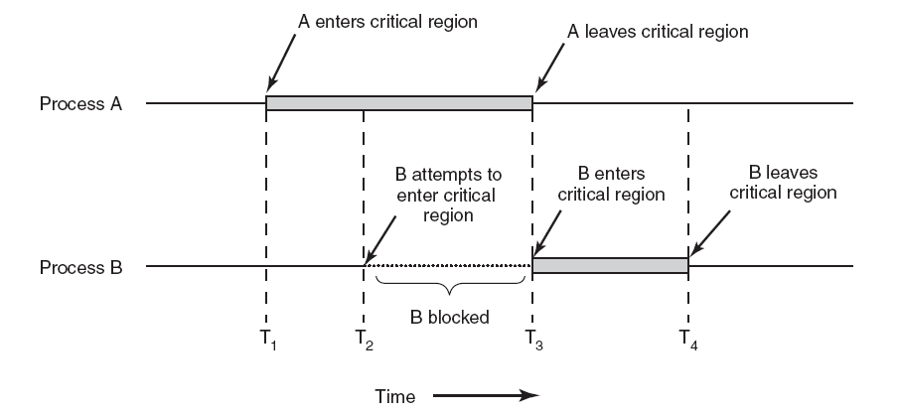
Critical Regions (2)
Figure 2-22. Mutual exclusion using critical regions.

Slide 25
“Too Much Milk” Problem
Person A
Person B
Look in fridge: out of milk
Leave for Rema1000
Arrive at Rema1000
Buy milk
Arrive home
Look in fridge: out of milk
Leave for Rema1000
Arrive at Rema1000
Buy milk
Arrive home
Don’t buy too much milk
Any person can be distracted at any point

Slide 26
A Possible Solution?
A:
B:
if ( noMilk ) {
if (noNote) {
leave note;
buy milk;
remove note;
}
}
if ( noMilk ) {
if (noNote) {
leave note;
buy milk;
remove note;
}
}

Slide 27
A Possible Solution?
A:
B:
if ( noMilk ) {
if (noNote) {
leave note;
buy milk;
remove note;
}
}
if ( noMilk ) {
if (noNote) {
leave note;
buy milk;
remove note;
}
}
Ping!!!: and B starts executing until finished, and then A starts again
The ENTRY is flawed
And both A and B buys milk.
(But B will “see” A by the fridge?: That is what we are trying to achieve.)

Slide 28
Another Possible Solution?
Thread A
Thread B
leave noteA
if (noNoteB) {
if (noMilk) {
buy milk
}
}
remove noteA
leave noteB
if (noNoteA) {
if (noMilk) {
buy milk
}
}
remove noteB

Slide 29
Another Possible Solution?
Thread A
Thread B
leave noteA
if (noNoteB) {
if (noMilk) {
buy milk
}
}
remove noteA
leave noteB
if (noNoteA) {
if (noMilk) {
buy milk
}
}
remove noteB
Ping!! And B starts
“Milk starvation” possible, but perhaps not a problem in practice!
Ping!! And A starts
WHY?

Slide 30
Yet Another Possible Solution?
Thread A
Thread B
leave noteA
while (noteB)
do nothing;
if (noMilk)
buy milk;
remove noteA
leave noteB
if (noNoteA) {
if (noMilk) {
buy milk
}
}
remove noteB

Slide 31
Yet Another Possible Solution?
Thread A
Thread B
leave noteA
while (noteB)
do nothing;
if (noMilk)
buy milk;
remove noteA
leave noteB
if (noNoteA) {
if (noMilk) {
buy milk
}
}
remove noteB
Safe to buy
If the other buys, quit
Not symmetric solution
Busy wait!

Slide 32
Remarks
The last solution works, but
Life is too complicated
A’s code is different from B’s
Busy waiting is a waste
Peterson’s solution is also complex
What we want is:
Acquire(lock);
if (noMilk)
buy milk;
Release(lock);
Critical section a.k.a. Critical region a.k.a. Mutual Exclusion (Mutex)

Slide 33
Entry and Exit Protocols
ENTRY;
<Critical region>;
EXIT;

Slide 34
Entry and Exit Protocols
Threads blocked waiting to get access
What will happen if they don’t?
ENTRY;
<Critical region>;
All threads must conform to the structure:
ENTRY;
<use resources reserved>
EXIT;
EXIT;
Will release no. 1 in queue so it can enter CR

Slide 35
Characteristics of a realistic solution for Mutual Exclusion
Mutex: Only one process can be inside a critical region
Non-preemptive scheduling of the resource: A thread having the resource must release it after a finite time
No one waits forever: When the resource is requested by several threads concurrently, it must be given to one of them after a finite time
No busy wait (?)
Processes outside of critical section should not block other processes
No assumption about relative speeds of each thread (time independence)
Works for multiprocessors

Slide 36
Summary
Concurrency
Threads first intro
Too much milk problem → mutual execution!
Entry & exit
Tomorrow: mutual exclusion with HW support

