Slide 1
INF3190 – Application Layer
DNS, Web, Mail
Carsten Griwodz
Email: griff@ifi.uio.no

Slide 2
Application layer in the TCP/IP stack
Introduction

Slide 3
What is it?
Internet view
everything above the socket interface is application layer function
=> all functions of OSI layers 5 and 6 are Internet application layer
We still need (many of) those OSI functions
long-term session maintenance, reconnections, session migration
protocol translation
today’s Internet world has protocols for this
(official standards (de jure) and de facto)
  SMTP + (POP3 or IMAP)
  HTTP, SHTTP, QUIC
  (RTSP or SIP) + RTP/RTCP
  MPEG DASH, Apple HLS, Microsoft Smooth Streaming
  DCE / CORBA
Notes:
E.g. RTP realizes some such functions; is part of the Java JDK…
Basically no limits to the functionality of applications => lower-layer functionality can be built on top of the socket interface too (networks on top of networks…)
Perhaps most obvious for real-time multimedia transmission
Upper-layer functionality can be separated in more and more layers…
What follows: some things to keep in mind when developing an application-layer protocol; some example protocols (SMTP, HTTP)

Slide 4


Client-Server
Traditional communication model, easily comprehensible abstraction
  Clients request service (initiate connection)
  Servers provide service (answer requests)
Examples: Web Client/Server, Mail Client/Server, FTP Client/Server

Slide 5
Peer-to-Peer
Recognized application-layer
paradigm since 2000s
First clearly visible application: Napster
file sharing (mostly for music)
ruled illegal
followed by others: Gnutella, Kazaa, BitTorrent, Freenet
later picked up by research: CAN, Chord, Tapestry, Kademlia, Pastry
idea: avoid control and/or censorship
Famous services
video streaming: PPTV, P2PTV
distributed computing: SETI@home
Old tech. that is like P2P but not recognized:
  Telephony
  Usenet news
  IP Routing
Actually, P2P = original Internet model
all nodes are equal
all nodes can address each other
ownership is distributed

Slide 6
The presentation problem
Q: Does perfect memory-to-memory copy solve “the communication problem”?
A: Not always!
struct Test
{
char code;
int x;
}
Test test;
test.x = 273;
test.code=‘a’
test.code
test.x
00600000
00000000
00000011
00000001
test.code
test.x
00600000
00010000
0011
host 2 format
e.g. Intel DOS
not packed
little endian
host 2 format
e.g. ARM Linux
packed
big endian
Problem: Different data format, storage conventions

Slide 7
Solving the presentation problem
1. Translate local-host format to host-independent format
2. Transmit data in host-independent format
3. Translate host-independent format to remote-host format
Old Style
cross-platform standardized binary encoding of data structures
  OSI host-independent format: “Abstract Syntax Notation One” (ASN.1) defines “Basic Encoding Rules” (BER)
  XDR: „external data representation“, belonged to NFS (Network File System)
Current Style
encoding everything as text
  XML: „extensible markup language“
  REST: „representational state transfer”
compensate for platform
differences
assume single data
interpretation
space-saving
convey data in
platform-independent
manner
local styling and
interpretation
readable and debuggable
Notes:
More recent option: send host-local format with hints, translate if necessary on reception

Slide 8
XDR example
bool_t xdr_datarate(XDR* xdrs,
datarate *gp)
{
if (xdr_long(xdrs, &gp->data) &&
xdr_long(xdrs, &gp->seconds))
return(TRUE);
return(FALSE);
}
struct datarate {
long data;
long seconds;
};
XDR compiler
program(int socket) {
datarate R = { 1000, 1 };
XDR* p;
xdrmem_create( p, buf, 16,
XDR_ENCODE);
xdr_datarate( p, &R );
write( socket, buf, 16 );
}}
C compiler
C compiler
Linker
OS/platform-specific XDR library
OS/platform-specific
program

Slide 9
REST example
struct datarate {
long data;
long seconds;
};
void sendfunction( int socket, datarate* gp ) {
char buf[1000];
sprintf(buf, “POST https://peer.nowhere.com”
“/1/classes/datarate HTTP/1.1\n”
...
“’{\”data\":\”%d\”,\”seconds\":\”%d\”}’/n”
“https://peer.nowhere.com/1/classes”
“/datarate”,
gp->data, gp->seconds );
}
C compiler
Linker
POST https://peer.nowhere.com/1/classes/datarate HTTP/1.1
...
X-Parse-Application-Id: Datarate-Setter
X-Parse-REST-API-Key: JASD3476D
Content-Type: application/json
’{”data":1000,”seconds":”1”}’
https://peer.nowhere.com/1/classes/datarate
sent over the network at
run-time:

Slide 10
Application layer in the TCP/IP stack
DNS
Domain Name System

Slide 11
How to connect to a remote computer?
Connect to <hostname,port>
e.g. telnet 127.0.0.1 23
talking to my own machine
obviously: used all the time, esp. since DHCP screws up your other addresses
or wget http://173.194.39.31:80/
talking to one of Google’s machines
possible to remember
or ssh 9.228.93.3
trying to talk to a desktop that had this address in 1995
impossible to remember unless you’ve typed it 100 times a day
If you want short names, write them into /etc/hosts
originally globally maintained by SRI, changes re-distributed by email
and ftp (no more, ancient history)
Notes:
SRI / SRI International - Stanford Research Institute

Slide 12
How to connect to a remote computer?
Use “reasonable” names
e.g.
ssh login.ifi.uio.no
wget www.google.com
not only easier to remember
reflects also organisation structures
although the hierarchical structure may not fulfill all purposes
somewhat related to physical network structure, at least locally
  Domain Name System (DNS)

Slide 13
DNS at a High-Level
Domain Name System
Hierarchical namespace
  As opposed to original, flat namespace
  e.g. .com → google.com → mail.google.com
Distributed database
Simple client/server architecture
  UDP or TCP port 53
  servers must use TCP nowadays
  clients using TCP are mostly rejected
    reduces server load
    is a security problem

Slide 14
Naming Hierarchy
root servers
TLDs – top level domains
Root
net
edu
com
gov
mil
org
uk
no
etc.
uio
hioa
Each Domain Name is a subtree
.no → uio.no → ifi.uio.no → www.ifi.uio.no
Other regions could have other “uio”s
ifi
smtp
imap
www
login

Slide 15
Hierarchical Administration
ICANN
Root
UNINETT
net
edu
com
gov
mil
org
uk
no
etc.
UIO
uio
hioa
ifi
smtp
imap
Tree is divided into zones
Each zone has an administrator
Responsible for the part of the hierarchy
Can delegate sub-tress to others
www
login
Notes:
ICANN – US dept commerce has decided !!!!!

Slide 16
Server Hierarchy
Functions of each DNS server
Authority over a portion of the hierarchy
  No need to store all DNS names
Store all the records for hosts/domains in its zone
  Must be replicated for robustness (at least 2 servers)
Know the addresses of the root servers
  Resolve queries for unknown names
Root servers know about all TLDs

Slide 17
Root Name Servers
Responsible for the Root Zone File
Lists the TLDs and who controls them
com. 172800 IN NS a.gtld-servers.net.
com. 172800 IN NS b.gtld-servers.net.
com. 172800 IN NS c.gtld-servers.net.
Administered by ICANN
13 root servers, labeled A→M
6 are anycasted, i.e. they are globally replicated
Contacted when names cannot be resolved
In practice, most systems cache this information
DDoS attacks designed to reach root
infrastructure bugs (e.g. old Telenor modems converted IPv6 lookup into broken IPv4 lookup)

Slide 18
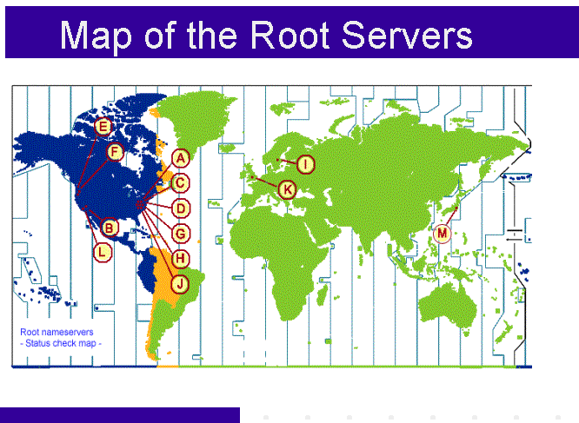
ICANN
from: http://www.icann.org/en/news/correspondence/roberts-testimony-14feb01-en.htm

Slide 19
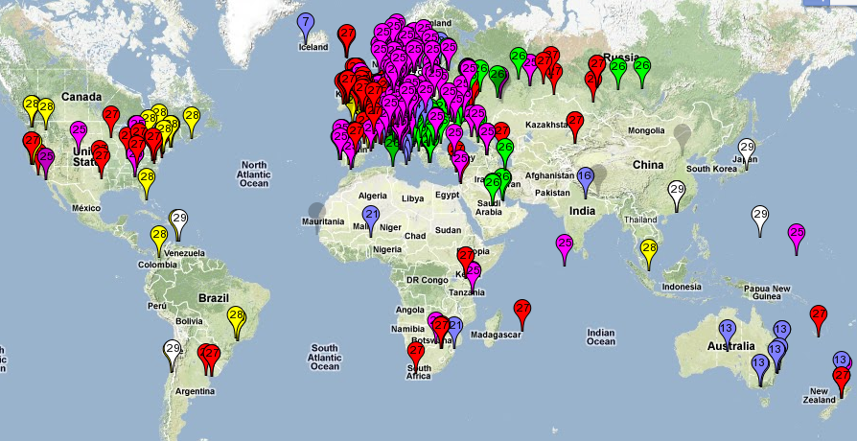
Map of the Roots
k-root (Europe) is an anycast root node
This is RIPE’s map of probing which of the 6 k-root copies get accessed
from https://labs.ripe.net/Members/kistel/dns-measurements-with-ripe-atlas-data

Slide 20
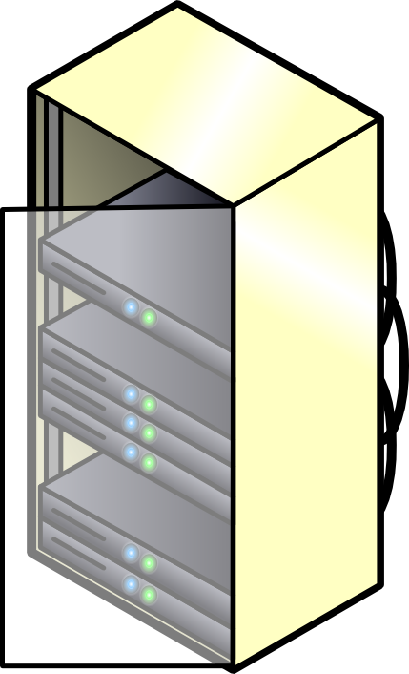

Recursive DNS Query
Classical approach
Must keep state for every request in a server until answered
Allows every node along the path to cache results
Concentrates the data flow at the central servers
Keeps a lot of state on central servers
k.root-server.net
com
huldra.uio.no
ns1.google.com
get www.google.com
www.google.com

Slide 21
Iterated DNS Query
Newer approach
Redirects request
Keep state only at local server (or some servers) until answered
Allows few nodes to cache results
Halves number of requests at central servers
Avoids state on central servers entirely
k.root-server.net
com
huldra.uio.no
ns1.google.com
get www.google.com
www.google.com

Slide 22
Caching vs. Freshness
Caching reduces DNS resolution latency
Caching reduces server load
Caching delays updates
lookup
mpg.ndlab.net
Cached Root Zone File
Cached .com Zone File
Cached .net Zone File
Etc.
ns.ifi.uio.no
Root
net
Information is cached between 5 minutes and 72 hours
update
mpg.ndlab.net
domainnameshop.com
Notes:
CORRECT THIS !!!!!!

Slide 23
DNS as Indirection Service
DNS gives us very powerful capabilities
  Not only easier for humans to reference machines!
Changing the IPs of machines becomes trivial
  e.g. you want to move your web server to a new host
  Just change the DNS record!
  Dynamic DNS
  Zoned DNS

Slide 24
Aliasing and Load Balancing
One machine can have many aliases
mpg.ndlab.net
drammen.ndlab.net
records.sigmm.org
simula080.simula.no
One domain can map to multiple machines
www.google.com
That includes k.root-server.net
and
login.ifi.uio.no

Slide 25



Content Delivery Networks
DNS allows zoning
e.g. Netflix (and Google) addresses depend
on the origin of your connection
geography, ISP, ...
addresses can also depend on server load
minimal 5-minutes allows Netflix
to direct people to other servers every 5 minutes

Slide 26
Content Delivery Networks
DNS allows zoning
e.g. Netflix (and Google) addresses depend
on the origin of your connection
geography, ISP, ...
“Small problem” with this technique
modern to use external resolvers
e.g. ALL Chrome DNS lookups seem to originate from 8.8.8.8
(an address owned by Google)
Consequences
user stays more anonymous
Netflix and others make wrong decisions
addresses can also depend on server load
minimal 5-minutes allows Netflix
to direct people to other servers every 5 minutes

Slide 27
DNS Record
hostname
admin email
record serial number
refresh time
retry time
expiry time
min TTL
start of authority record
@ IN SOA rh7login.ifi.uio.no. hostmaster.ifi.uio.no. 201703291 1800 900 960000 86400
@ NS nn.uninett.no.
@ NS ns1.uio.no.
@ NS ifi.uio.no.
@ A 129.240.65.60
@ A 129.240.65.61
@ A 129.240.65.62
@ A 129.240.65.63
@ MX 50 smtp.uio.no.
login.ifi.uio.no CNAME rh7login.ifi.uio.no
CNAME: an alias (another name)
A: an IPv4 address, several means the name has multiple interfaces, perhaps hosts, AAAA for IPv6
NS: a responsible
name server
MX: mail server’s name
Notes:
2017030312 – serial number by date
refresh time
retry time (time to wait after zone file fetch failure)
expiration time
min TTL
CNAME: canonical name (an alias)

Slide 28
mDNS
A way of discovering services by announcing them with IP multicast
RFC 6762 (2013): multicast DNS
records announce services (as well as link-local hostnames that are invisible outside the current multicast domain, like mymac.local)
records are never authoritative and mDNS can never redirect or recurse
name of the service
domain where the service is located
priority
port
name of the server
protocol
weight
_service._protocol.example.com SRV 10 0 5060 service.example.com
Example from my machine:
_ssh._tcp.example.com SRV 10 0 22 1x-193-157-212-9.uio.no

Slide 29
add-ons
is DNS essential: not really
resolver: internal and external
DNS prefetcher
DNS resolve latency
alternatives to DNS – P2P

Slide 30
Application layer in the TCP/IP stack
HTTP
Hypertext Transfer Protocol

Slide 31
The Web: the HTTP protocol
HTTP: hypertext transfer protocol
Web’s application layer protocol
client/server model
  client: browser that requests, receives, “displays” Web objects
  server: Web server sends objects in response to requests
Three major versions
HTTP/1.0 (1990)
HTTP/1.1 (1999)
HTTP/2 (2015)
Host running
a browser
HTTP request
HTTP response
HTTP request
Server
Running
A web
server
HTTP response
Host running
a browser

Slide 32
The HTTP protocol
HTTP: TCP transport service:
client initiates TCP connection (creates socket) to server, port 80
server accepts TCP connection from client
HTTP messages (application-layer protocol messages) exchanged between browser (HTTP client) and Web server (HTTP server)
TCP connection closed
HTTP is “stateless”
server maintains no information about past client requests
aside
Protocols that maintain “state” are complex!
past history (state) must be maintained
if server/client crashes, their views of “state” may be inconsistent, must be reconciled

Slide 33
HTTP example
Suppose user enters URL www.mn.uio.no/ifi/index.html
1a. HTTP client initiates TCP connection to HTTP server (process) at www.mn.uio.no. Port 80 is default for HTTP server.
1b. HTTP server at host www.mn.uio.no waiting for TCP connection at port 80. “accepts” connection, notifying client
2. HTTP client sends HTTP request message (containing URL) into TCP connection socket
3. HTTP server receives request message, forms response message containing requested object (ifi/index.html), sends message into socket
time
(now let’s say index.html contains text, references to 10 JPEG images)

Slide 34
HTTP example (cont.)
5. HTTP client receives response message containing HTML file, displays HTML. Parsing HTML file, finds 10 referenced JPEG objects
4. HTTP server closes TCP connection.
time
6. Steps 1-5 repeated for each of 10 jpeg objects

Slide 35
Non-persistent, persistent connections
Non-persistent
HTTP/1.0: server parses request, responds, closes TCP connection
2 RTTs to fetch object
  TCP connection
  object request/transfer
each transfer suffers from TCP’s initially slow sending rate
many browsers open multiple parallel connections
Persistent
default for HTTP/1.1
on same TCP connection: server, parses request, responds, parses new request,..
client sends requests for all referenced objects as soon as it receives base HTML
fewer RTTs, less slow start
Persistent with pipelining
request multiple objects in one go (even fewer RTTs)
answers arrive one after each other in order of requests
Notes:
persistent: varig / bestandig

Slide 36
HTTP/1.x message format: request
two types of HTTP messages: request, response
HTTP request message:
  ASCII (human-readable format)
request line
(GET, POST,
HEAD commands)
GET /ifi/index.html HTTP/1.0
User-agent: Mozilla/4.0
Accept: text/html, image/gif,image/jpeg
Accept-language:no
(extra carriage return, line feed)
header
lines
Carriage return,
line feed
indicates end
of message

Slide 37
HTTP/1.x message format: response
status line
(protocol
status code
status phrase)
HTTP/1.0 200 OK
Date: Thu, 06 Aug 1998 12:00:15 GMT
Server: Apache/1.3.0 (Unix)
Last-Modified: Mon, 22 Jun 1998 …...
Content-Length: 6821
Content-Type: text/html
data data data data data ...
header
lines
data, e.g.,
requested
html file

Slide 38
HTTP/1.x response status code examples
200 OK
  request succeeded, requested object later in this message
301 Moved Permanently
  requested object moved, new location specified later in this message (Location:)
400 Bad Request
  request message not understood by server
404 Not Found
  requested document not found on this server
505 HTTP Version Not Supported

Slide 39
Trying out HTTP/1.x (client side) for yourself
1. Telnet to your favorite Web server:
telnet www.aftenposten.no 80
Opens TCP connection to port 80
(default HTTP server port) at www.aftenposten.no.
Anything typed in will be sent via this connection.
By typing this in (hit carriage
return once), you send
this minimal (but complete)
GET request for the root document
to the HTTP server
2. Type in a GET request:
GET / HTTP/1.1
Servers can be multi-homed (multiple
different web sites on physical server),
and so the client must specify which
host it wants. Else, a server would
often return an error message.
3. Quickly: type in the host header:
Host: www.aftenposten.no
4. Hit carriage return twice and see the result

Slide 40
Cookies: keeping “state”
server-generated # , server-remembered #, later used for:
  authentication
  remembering user preferences, previous choices
server sends “cookie” to client in response msg
  Set-cookie: 1678453
client presents cookie in later requests
  cookie: 1678453
client
server
usual http request msg
usual http response +
Set-cookie: #
usual http request msg
cookie: #
cookie-
spectific
action
usual http response msg
usual http request msg
cookie: #
cookie-
spectific
action
usual http response msg

Slide 41
Conditional GET: client-side caching
Goal: don’t send object if client has up-to-date cached version
client: specify date of cached copy in http request
  If-modified-since: <date>
server: response contains no object if cached copy is up-to-date:
  HTTP/1.0 304 Not Modified
client
server
http request msg
If-modified-since: <date>
object
not
modified
http response
HTTP/1.0
304 Not Modified
http request msg
If-modified-since: <date>
object
modified
http response
HTTP/1.1 200 OK
<data>

Slide 42
Web Caches (proxy server)
Goal: satisfy client request without involving origin server
user sets browser: Web accesses via web cache
client sends all HTTP requests to web cache
  object in web cache: web cache returns object
  else web cache requests object from origin server, then returns object to client
origin
server
Proxy
server
HTTP request
HTTP request
client
HTTP response
HTTP response
HTTP request
HTTP response
client
origin
server
Assumption: cache is closer to client (e.g. same network) => faster, less “long-distance” traffic

Slide 43
Big changes in HTTP/2
textual protocol → binary protocol
supports header compression
ordered and blocking → multiplexed
  can therefore use one connection for parallelism
client pull only -> client pull and server push

Slide 44
Changes in HTTP/2
textual protocol
can be written manually
can be read when intercepted
easy to add (and ignore) proprietary extensions
very talkative
binary protocol
saves space
less data to write and parse
exactly specified
hard to extend
uncompressed header
required in 1.0
avoidance eases transition to 1.1
compressed header
adds a lookup table
may save space
info like: cookies, referer, stream dependencies, weighting, priorities, client identification, ...

Slide 45
Changes in HTTP/2
ordered and blocking
speed-up by using several parallel TCP connections (1.x)
speed-up by using pipelining (1.1)
multiplexed
send all requests at once
server chooses order (e.g. send advertising inlays first) and can mix messages
GET “body”
get “body”
GET “img”
get “img”
GET “img”
get “img”
GET “css”
get “css”
app-layer flow control per subflow

Slide 46
Changes in HTTP/2
client pull
assumption: server is stateless
client pull + server push
assumption: server knows best
pipeline
multiplex
server push

Slide 47
Application layer in the TCP/IP stack
SMTP and MIME
Simple mail transfer protocol
Multipurpose Internet mail extensions

Slide 48
Electronic Mail
Major components
  “mail clients”
  Message User Agents (MUAs)
  “mail servers”
  Message Submission / Transfer / Delivery Agents (MSA, MTA, MDA)
    often realized as one component called
    Message Handling Service (MHS)
MUA
  a.k.a. “mail reader”
  composing, editing, reading mail messages
  outgoing, incoming messages stored on server

Slide 49
Electronic Mail: mail servers
outgoing
message queue
Mail Servers
mailbox contains incoming messages (yet to be read) for user
message queue of outgoing (to be sent) mail messages
Simple Mail Transfer Protocol (SMTP)
between mail servers to send email messages
client: sending mail server
server: receiving mail server
mail
server
user mailbox
POP3
mail
server
SMTP
SMTP
SMTP
mail
server
user agents
SMTP

Slide 50
Electronic Mail: SMTP
uses TCP to reliably transfer email message from client to server, port 25
direct transfer: sending server to receiving server
three phases of transfer
  handshaking (greeting)
  transfer of messages
  closure
command/response interaction
  commands: ASCII text
  response: status code and phrase
messages must be in 7-bit ASCII

Slide 51
Sample SMTP interaction
S: 220 hamburger.edu
C: HELO crepes.fr
S: 250 Hello crepes.fr, pleased to meet you
C: MAIL FROM: <alice@crepes.fr>
S: 250 alice@crepes.fr... Sender ok
C: RCPT TO: <bob@hamburger.edu>
S: 250 bob@hamburger.edu ... Recipient ok
C: DATA
S: 354 Enter mail, end with "." on a line by itself
C: Do you like ketchup?
C: How about pickles?
C: .
S: 250 Message accepted for delivery
C: QUIT
S: 221 hamburger.edu closing connection

Slide 52
Handmade SMTP
telnet servername 25
see 220 reply from server
enter HELO, MAIL FROM, RCPT TO, DATA, QUIT commands
above lets you send email without using email client (reader)

Slide 53
SMTP: final words
SMTP uses persistent connections
SMTP requires message (header & body) to be in 7-bit ASCII
Certain character strings not permitted in msg (e.g., CRLF.CRLF). Thus msg has to be encoded (usually into either base-64 or quoted printable)
SMTP server uses CRLF.CRLF to determine end of message (no length header)
Comparison with HTTP/1.x:
HTTP: pull
STMP: push
  until final server!
  until recently: reading mails on final server itself using NFS
both have ASCII command/response interaction, status codes
HTTP
  each object encapsulated in its own response msg
SMTP
  originally the same
  now: multiple objects sent in multipart msg

Slide 54
Mail message format
SMTP: protocol for exchanging email msgs
Standard for text message format:
header lines, e.g.,
  To:
  From:
  Subject:
  different from SMTP commands!
body
  the “message”, ASCII characters only
header
blank
line
body

Slide 55
Message format: multimedia extensions
MIME: multipurpose Internet mail extension
additional lines in msg header declare MIME content type
From: alice@crepes.fr
To: bob@hamburger.edu
Subject: Picture of yummy crepe.
MIME-Version: 1.0
Content-Transfer-Encoding: base64
Content-Type: image/jpeg
base64 encoded data .....
.........................
......base64 encoded data
MIME version
method used
to encode data
multimedia data
type, subtype,
parameter declaration
encoded data
“classical” mail may indicate:
Content-type: text/ascii
but 7-bit ASCII text is still the default

Slide 56
MIME types
Content-Type: type/subtype; parameters
Text
example subtypes: plain, html
Image
example subtypes: jpeg, gif
Audio
example subtypes: basic
(8-bit mu-law encoded),
32kadpcm (32 kbps coding)
Video
example subtypes: mpeg, quicktime
Application
other data that must be processed by reader before “viewable”
example subtypes: msword, octet-stream

Slide 57
Multipart Type
From: alice@crepes.fr
To: bob@hamburger.edu
Subject: Picture of yummy crepe.
MIME-Version: 1.0
Content-Type: multipart/mixed; boundary=98766789
--98766789
Content-Transfer-Encoding: quoted-printable
Content-Type: text/plain
Dear Bob,
Please find a picture of a crepe.
--98766789
Content-Transfer-Encoding: base64
Content-Type: image/jpeg
base64 encoded data .....
.........................
......base64 encoded data
--98766789--
SMTP header
MIME header
SMTP body
MIME body

Slide 58


Mail access protocols
SMTP
SMTP
POP3 or
IMAP
user
agent
user
agent
sender’s mail
server
receiver’s mail
server
SMTP: delivery/storage to receiver’s server
Mail access protocol: retrieval from server
  POP: Post Office Protocol
    authorization (agent <==> server) and download
  IMAP: Internet Mail Access Protocol (Interim➔Interactive➔Internet)
    more features (more complex)
    manipulation of stored messages on server
  HTTP: Hotmail , Yahoo! Mail, etc.

Slide 59
POP3 protocol
S: +OK POP3 server ready
C: user alice
S: +OK
C: pass hungry
S: +OK user successfully logged on
authorization phase
client commands:
  user: declare username
  pass: password
  (plain text!)
server responses
  +OK
  -ERR
transaction phase, client:
list: list message numbers
retr: retrieve message by number
dele: delete
quit
C: list
S: 1 498
S: 2 912
S: .
C: retr 1
S: <message 1 contents>
S: .
C: dele 1
C: retr 2
S: <message 1 contents>
S: .
C: dele 2
C: quit
S: +OK POP3 server signing off

Slide 60
IMAP protocol example (from RFC3501)
C: <open connection>
S: * OK IMAP4rev1 Service Ready
C: a001 login mrc secret
S: a001 OK LOGIN completed
C: a002 select inbox
S: * 18 EXISTS
S: * FLAGS (\Answered \Flagged \Deleted \Seen \Draft)
S: * 2 RECENT
S: * OK [UNSEEN 17] Message 17 is the first unseen message
S: * OK [UIDVALIDITY 3857529045] UIDs valid
S: a002 OK [READ-WRITE] SELECT completed
C: a003 fetch 12 full
S: * 12 FETCH (FLAGS (\Seen) INTERNALDATE "17-Jul-1996 02:44:25 -0700"
RFC822.SIZE 4286 ENVELOPE ("Wed, 17 Jul 1996 02:23:25 -0700 (PDT)"
"IMAP4rev1 WG mtg summary and minutes"
(("Terry Gray" NIL "gray" "cac.washington.edu"))
(("Terry Gray" NIL "gray" "cac.washington.edu"))
(("Terry Gray" NIL "gray" "cac.washington.edu"))
((NIL NIL "imap" "cac.washington.edu"))
((NIL NIL "minutes" "CNRI.Reston.VA.US")
("John Klensin" NIL "KLENSIN" "MIT.EDU")) NIL NIL
"<B27397-0100000@cac.washington.edu>")
BODY ("TEXT" "PLAIN" ("CHARSET" "US-ASCII") NIL NIL "7BIT" 3028
92))
S: a003 OK FETCH completed
C: a004 fetch 12 body[header]
S: * 12 FETCH (BODY[HEADER] {342}
S: Date: Wed, 17 Jul 1996 02:23:25 -0700 (PDT)
S: From: Terry Gray <gray@cac.washington.edu>
S: Subject: IMAP4rev1 WG mtg summary and minutes
S: To: imap@cac.washington.edu
S: cc: minutes@CNRI.Reston.VA.US, John Klensin <KLENSIN@MIT.EDU>
S: Message-Id: <B27397-0100000@cac.washington.edu>
S: MIME-Version: 1.0
S: Content-Type: TEXT/PLAIN; CHARSET=US-ASCII
S:
S: )
S: a004 OK FETCH completed
C a005 store 12 +flags \deleted
S: * 12 FETCH (FLAGS (\Seen \Deleted))
S: a005 OK +FLAGS completed
C: a006 logout
S: * BYE IMAP4rev1 server terminating connection
S: a006 OK LOGOUT completed

Slide 61
IMAP can do more
IMAP capabilities
  create, delete, rename mail folders
  check for new messages, remove messages, set and clear flags
  parse, search, selective fetch
  search WITHIN messages
  STORE and conditional STORE
  CATENATE (to concatenate)
often used for:
  TODOs
  Notes with or without Mime elements
but: replace “message” with “file” and you have a quite complete file system

Slide 62
Summary
First peek at structure of distributed applications
Presentation Layer functions
Domain Name Systems
  with note on CDNs
HTTP
SMTP
  and an example for POP3 and IMAP

