Slide 1
INF5063 – GPU & CUDA
Håkon Kvale Stensland
Simula Research Laboratory

Slide 2
PC Graphics Timeline
Challenges:
Render infinitely complex scenes
And extremely high resolution
In 1/60th of one second (60 frames per second)
Graphics hardware has evolved from a simple hardwired pipeline to a highly programmable multiword processor
DirectX 6
DirectX 7
DirectX 8
DirectX 9
DirectX 9.0c
DirectX 9.0c
DirectX 10
DirectX 5
Multitexturing
T&L TextureStageState
SM 1.x
SM 2.0
SM 3.0
SM 3.0
SM 4.0
Riva 128
Riva TNT
GeForce 256
GeForce 3
Cg
GeForceFX
GeForce 6
GeForce 7
GeForce 8
1998
1999
2000
2001
2002
2003
2004
2005
2006
Notes:
Spill driver markedet

Slide 3
Basic 3D Graphics Pipeline
Application
Host
Scene Management
Geometry
Rasterization
Frame
Buffer
Memory
GPU
Pixel Processing
ROP/FBI/Display
Notes:
Geometry = Setter opp vertexer (kanter i triangler), og lager triangler
Rasterization = Finne ut hvilke pixler som hører hjemme i trianglet
Pixel = Manipulere, gjøre effekter med pixler
ROP = Render Out Put = Siste ”touch” på triangler, eller på AA, osv. Finner også ut om vi trenger pixlen (er den synlig (Hidden Surface Removal))

Slide 4
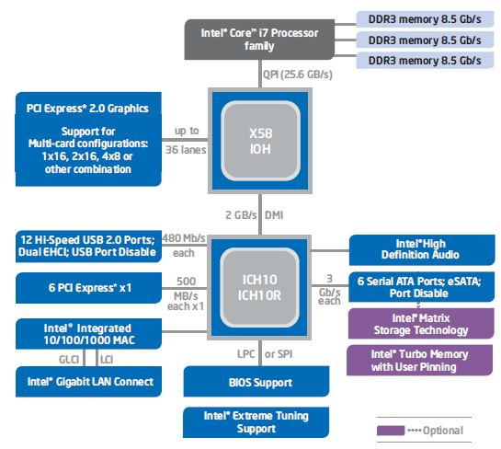
Graphics in the PC Architecture
QuickPath (QPI) between processor and Northbridge (X58)
Memory Control in CPU
Northbridge (IOH) handles PCI Express
PCIe 2.0 x16 bandwidth at 16 GB/s (8 GB in each direction)
Southbridge (ICH10) handles all other peripherals
Notes:
PCI Express = Seriel bus, flere kanaler…. 0,5 GB/sec hver vei
Mer strøm!
Snart PCI Express 3.0

Slide 5
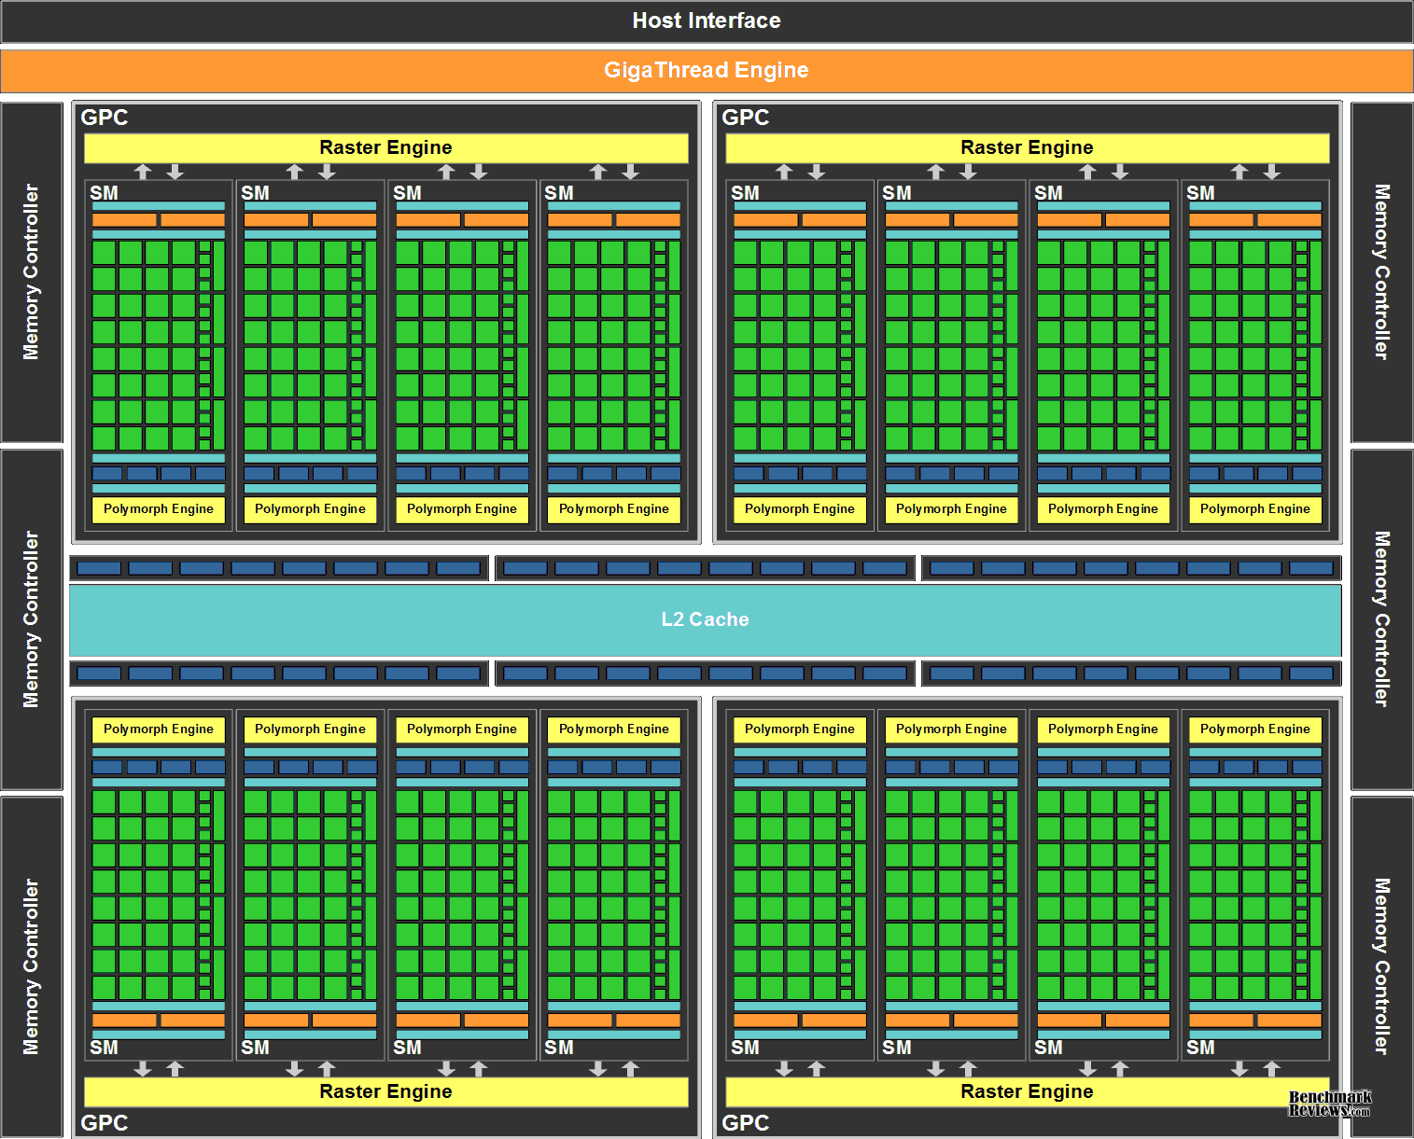
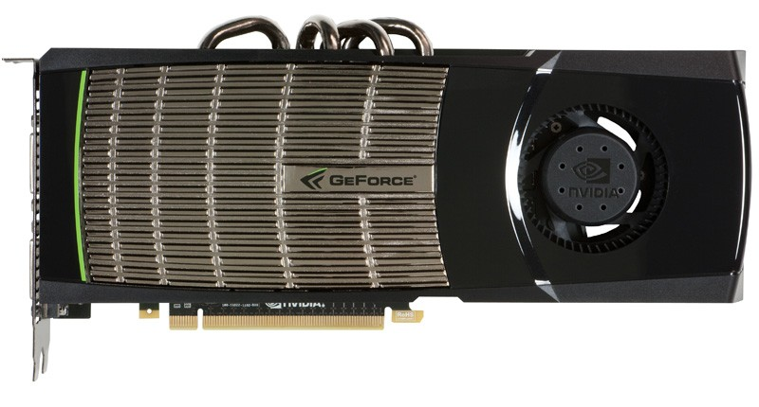
High-end Hardware
nVIDIA Fermi Architecture
The latest generation GPU, codenamed GF100
3,1 billion transistors
512 Processing cores (SP)
IEEE 754-2008 Capable
Shared coherent L2 cache
Full C++ Support
Up to 16 concurrent kernels
Notes:
40nm største hos TSMC

Slide 6
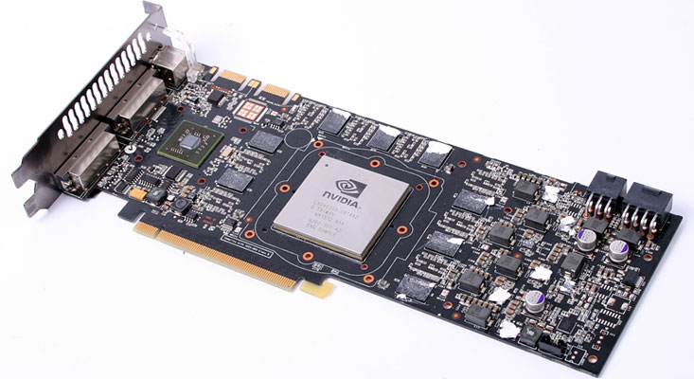
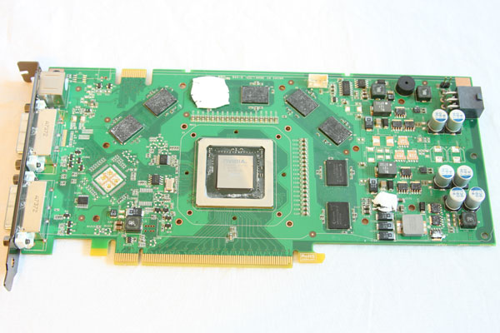
Lab Hardware
nVidia GeForce GTX 280
Based on the GT200 chip
1400 million transistors
240 Processing cores (SP) at 1476MHz
1024 MB Memory with 159 GB/sec bandwidth
nVidia GeForce 8800GT
Based on the G92 chip
754 million transistors
112 Processing cores (SP) at 1500MHz
256 MB Memory with 57.6GB/sec bandwidth
Notes:
Begge er Compute 1.1
En maskin med 8800GTX – Compute 1.0

Slide 7
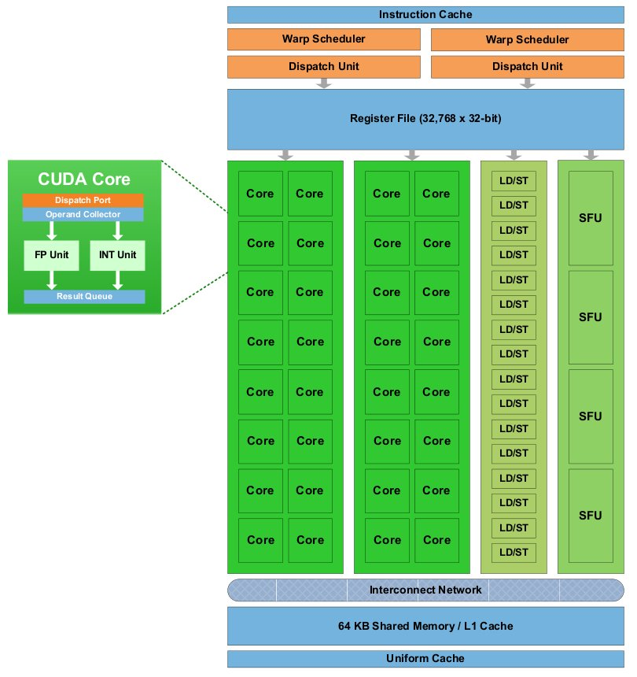
GeForce GF100 Architecture
Notes:
A ”mile-high” overview

Slide 8
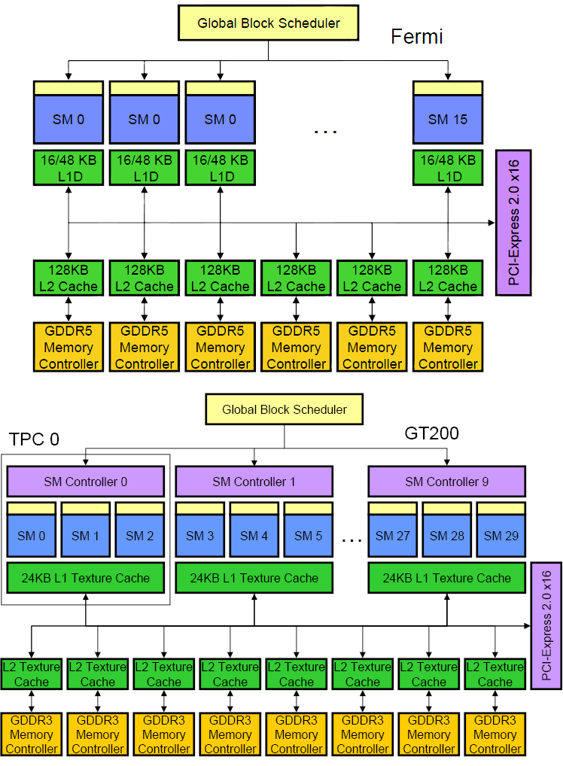
nVIDIA GF100 vs. GT200 Architecture
Notes:
TPC = Texture Processor Cluster
SM = Streaming Multiprocessor
SP = Stream Processor (Oppererer med Scalar-verdier)
SFU = Special Function Unit
TEX = Texturing Unit

Slide 9
TPC… SM… SP… Some more details…
TPC
Texture Processing Cluster
SM
Streaming Multiprocessor
In CUDA: Multiprocessor, and fundamental unit for a thread block
TEX
Texture Unit
SP
Stream Processor
Scalar ALU for single CUDA thread
SFU
Super Function Unit
TPC
TPC
TPC
TPC
TPC
TPC
TPC
TPC
Texture Processor Cluster
Streaming Multiprocessor
Instruction L1
Data L1
SM
SM
Instruction Fetch/Dispatch
Shared Memory
TEX
SM
SP
SP
SP
SP
SM
SFU
SFU
SP
SP
SP
SP

Slide 10
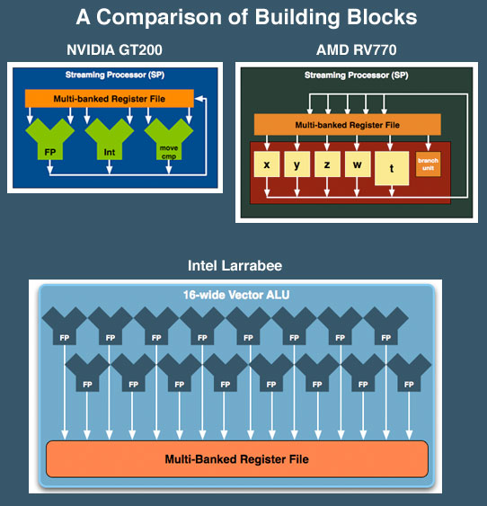
SP: The basic processing block
The nVIDIA Approach:
A Stream Processor works on a single operation
AMD GPU’s work on up to five operations
Now, let’s take a step back for a closer look!

Slide 11
Streaming Multiprocessor (SM)
Streaming Multiprocessor (SM)
8 Streaming Processors (SP)
2 Super Function Units (SFU)
Multi-threaded instruction dispatch
1 to 1024 threads active
Try to Cover latency of texture/memory loads
Local register file (RF)
16 KB shared memory
DRAM texture and memory access
Streaming Multiprocessor
(
SM
)
Instruction Fetch
Instruction L
1
Cache
L
1
Fill
Thread
/
Instruction Dispatch
Work
Shared Memory
Control
SP
0
RF
0
RF
4
SP
4
Results
S
SP
1
RF
1
RF
5
SP
5
S
F
F
U
SP
2
RF
2
RF
6
SP
6
U
SP
3
RF
3
RF
7
SP
7
Load Texture
Constant L
1
Cache
L
1
Fill
Load from Memory
Store to
Store to Memory
Foils adapted from nVIDIA

Slide 12
SM Register File
Register File (RF)
32 KB
Provides 4 operands/clock
TEX pipe can also read/write Register File
3 SMs share 1 TEX
Load/Store pipe can also read/write Register File
I
$
L
1
Multithreaded
Instruction Buffer
R
C
$
Shared
F
L
1
Mem
Operand Select
MAD
SFU
Notes:
TEX er mer viktig for grafikk

Slide 13
Constants
Immediate address constants
Indexed address constants
Constants stored in memory, and cached on chip
L1 cache is per Streaming Multiprocessor
I
$
L
1
Multithreaded
Instruction Buffer
R
C
$
Shared
F
L
1
Mem
Operand Select
MAD
SFU

Slide 14
Shared Memory
Each Stream Multiprocessor has 16KB of Shared Memory
16 banks of 32bit words
CUDA uses Shared Memory as shared storage visible to all threads in a thread block
Read and Write access
I
$
L
1
Multithreaded
Instruction Buffer
R
C
$
Shared
F
L
1
Mem
Operand Select
MAD
SFU

Slide 15
Execution Pipes
Scalar MAD pipe
Float Multiply, Add, etc.
Integer ops,
Conversions
Only one instruction per clock
Scalar SFU pipe
Special functions like Sin, Cos, Log, etc.
Only one operation per four clocks
TEX pipe (external to SM, shared by all SM’s in a TPC)
Load/Store pipe
CUDA has both global and local memory access through Load/Store
I
$
L
1
Multithreaded
Instruction Buffer
R
C
$
Shared
F
L
1
Mem
Operand Select
MAD
SFU
Notes:
FMUL = Floating point multipler, FADD = Floating point add,
Hot clock/shader clock

Slide 16
GPGPU
Foils adapted from nVIDIA

Slide 17
What is really GPGPU?
General Purpose computation using GPU in other applications than 3D graphics
GPU can accelerate parts of an application
Parallel data algorithms using the GPUs properties
Large data arrays, streaming throughput
Fine-grain SIMD parallelism
Fast floating point (FP) operations
Applications for GPGPU
Game effects (physics) nVIDIA PhysX
Image processing (Photoshop CS4)
Video Encoding/Transcoding (Elemental RapidHD)
Distributed processing (Stanford Folding@Home)
RAID6, AES, MatLab, etc.
Notes:
Mark Harris, of Nvidia, runs the gpgpu.org website

Slide 18
Previous GPGPU use, and limitations
Working with a Graphics API
Special cases with an API like Microsoft Direct3D or OpenGL
Addressing modes
Limited by texture size
Shader capabilities
Limited outputs of the available shader programs
Instruction sets
No integer or bit operations
Communication is limited
Between pixels
per thread
per Shader
per Context
Input Registers
Fragment Program
Texture
Constants
Temp Registers
Output Registers
FB Memory

Slide 19
nVIDIA CUDA
“Compute Unified Device Architecture”
General purpose programming model
User starts several batches of threads on a GPU
GPU is in this case a dedicated super-threaded, massively data parallel co-processor
Software Stack
Graphics driver, language compilers (Toolkit), and tools (SDK)
Graphics driver loads programs into GPU
All drivers from nVIDIA now support CUDA
Interface is designed for computing (no graphics ☺)
“Guaranteed” maximum download & readback speeds
Explicit GPU memory management

Slide 20
Outline
The CUDA Programming Model
Basic concepts and data types
The CUDA Application Programming Interface
Basic functionality
An example application:
The good old Motion JPEG implementation!
Notes:
I dag skal skjelettet frem…. Om to uker blir det mer kjøtt på bena

Slide 21
The CUDA Programming Model
The GPU is viewed as a compute device that:
Is a coprocessor to the CPU, referred to as the host
Has its own DRAM called device memory
Runs many threads in parallel
Data-parallel parts of an application are executed on the device as kernels, which run in parallel on many threads
Differences between GPU and CPU threads
GPU threads are extremely lightweight
Very little creation overhead
GPU needs 1000s of threads for full efficiency
Multi-core CPU needs only a few

Slide 22
Thread Batching: Grids and Blocks
A kernel is executed as a grid of thread blocks
All threads share data memory space
A thread block is a batch of threads that can cooperate with each other by:
Synchronizing their execution
Non synchronous execution is very bad for performance!
Efficiently sharing data through a low latency shared memory
Two threads from two different blocks cannot cooperate
Host
Device
Grid 1
Kernel 1
Block
(0, 0)
Block
(1, 0)
Block
(2, 0)
Block
(0, 1)
Block
(1, 1)
Block
(2, 1)
Grid 2
Kernel 2
Block (1, 1)
Thread
(0, 0)
Thread
(1, 0)
Thread
(2, 0)
Thread
(3, 0)
Thread
(4, 0)
Thread
(0, 1)
Thread
(1, 1)
Thread
(2, 1)
Thread
(3, 1)
Thread
(4, 1)
Thread
(0, 2)
Thread
(1, 2)
Thread
(2, 2)
Thread
(3, 2)
Thread
(4, 2)
Notes:
1 kernel eksekverer 1 grid…
1 block kjører på 1 SM (Multiprosessor)

Slide 23
CUDA Device Memory Space Overview
Each thread can:
R/W per-thread registers
R/W per-thread local memory
R/W per-block shared memory
R/W per-grid global memory
Read only per-grid constant memory
Read only per-grid texture memory
The host can R/W global, constant, and texture memories
(Device) Grid
Block (0, 0)
Block (1, 0)
Shared Memory
Shared Memory
Registers
Registers
Registers
Registers
Thread (0, 0)
Thread (1, 0)
Thread (0, 0)
Thread (1, 0)
Local
Memory
Local
Memory
Local
Memory
Local
Memory
Host
Global
Memory
Constant
Memory
Texture
Memory
Notes:
Global, constant, and texture memory spaces are persistent across kernels called by the same application.

Slide 24
Global, Constant, and Texture Memories
Global memory:
Main means of communicating R/W Data between host and device
Contents visible to all threads
Texture and Constant Memories:
Constants initialized by host
Contents visible to all threads
(Device) Grid
Block (0, 0)
Block (1, 0)
Shared Memory
Shared Memory
Registers
Registers
Registers
Registers
Thread (0, 0)
Thread (1, 0)
Thread (0, 0)
Thread (1, 0)
Local
Memory
Local
Memory
Local
Memory
Local
Memory
Host
Global
Memory
Constant
Memory
Texture
Memory

Slide 25
Terminology Recap
device = GPU = Set of multiprocessors
Multiprocessor = Set of processors & shared memory
Kernel = Program running on the GPU
Grid = Array of thread blocks that execute a kernel
Thread block = Group of SIMD threads that execute a kernel and can communicate via shared memory
Memory | Location | Cached | Access | Who
Local | Off-chip | No | Read/write | One thread
Shared | On-chip | N/A - resident | Read/write | All threads in a block
Global | Off-chip | No | Read/write | All threads + host
Constant | Off-chip | Yes | Read | All threads + host
Texture | Off-chip | Yes | Read | All threads + host

Slide 26
Access Times
Register – Dedicated HW – Single cycle
Shared Memory – Dedicated HW – Single cycle
Local Memory – DRAM, no cache – “Slow”
Global Memory – DRAM, no cache – “Slow”
Constant Memory – DRAM, cached, 1…10s…100s of cycles, depending on cache locality
Texture Memory – DRAM, cached, 1…10s…100s of cycles, depending on cache locality

Slide 27
CUDA – API

Slide 28
CUDA Highlights
The API is an extension to the ANSI C programming language
Low learning curve than OpenGL/Direct3D
The hardware is designed to enable lightweight runtime and driver
High performance

Slide 29
CUDA Device Memory Allocation
cudaMalloc()
Allocates object in the device Global Memory
Requires two parameters
Address of a pointer to the allocated object
Size of allocated object
cudaFree()
Frees object from device Global Memory
Pointer to the object
(Device) Grid
Block (0, 0)
Block (1, 0)
Shared Memory
Shared Memory
Registers
Registers
Registers
Registers
Thread (0, 0)
Thread (1, 0)
Thread (0, 0)
Thread (1, 0)
Local
Memory
Local
Memory
Local
Memory
Local
Memory
Host
Global
Memory
Constant
Memory
Texture
Memory

Slide 30
CUDA Device Memory Allocation
Code example:
Allocate a 64 * 64 single precision float array
Attach the allocated storage to Md.elements
“d” is often used to indicate a device data structure
BLOCK_SIZE = 64;
Matrix Md
int size = BLOCK_SIZE * BLOCK_SIZE * sizeof(float);
cudaMalloc((void**)&Md.elements, size);
cudaFree(Md.elements);

Slide 31
CUDA Host-Device Data Transfer
cudaMemcpy()
memory data transfer
Requires four parameters
Pointer to source
Pointer to destination
Number of bytes copied
Type of transfer
Host to Host
Host to Device
Device to Host
Device to Device
Asynchronous operations available (Streams)
(Device) Grid
Block (0, 0)
Block (1, 0)
Shared Memory
Shared Memory
Registers
Registers
Registers
Registers
Thread (0, 0)
Thread (1, 0)
Thread (0, 0)
Thread (1, 0)
Local
Memory
Local
Memory
Local
Memory
Local
Memory
Host
Global
Memory
Constant
Memory
Texture
Memory

Slide 32
CUDA Host-Device Data Transfer
Code example:
Transfer a 64 * 64 single precision float array
M is in host memory and Md is in device memory
cudaMemcpyHostToDevice and cudaMemcpyDeviceToHost are symbolic constants
cudaMemcpy(Md.elements, M.elements, size, cudaMemcpyHostToDevice);
cudaMemcpy(M.elements, Md.elements, size, cudaMemcpyDeviceToHost);

Slide 33
CUDA Function Declarations
 | Executed on the: | Only callable from the:
__device__ float DeviceFunc() | device | device
__global__ void KernelFunc() | device | host
__host__ float HostFunc() | host | host
__global__ defines a kernel function
Must return void
__device__ and __host__ can be used together

Slide 34
CUDA Function Declarations
__device__ functions cannot have their address taken
Limitations for functions executed on the device:
No recursion
No static variable declarations inside the function
No variable number of arguments

Slide 35
Some Information on the Toolkit

Slide 36
Compilation
Any source file containing CUDA language extensions must be compiled with nvcc
nvcc is a compiler driver
Works by invoking all the necessary tools and compilers like cudacc, g++, etc.
nvcc can output:
Either C code
That must then be compiled with the rest of the application using another tool
Or object code directly

Slide 37
Linking & Profiling
Any executable with CUDA code requires two dynamic libraries:
The CUDA runtime library (cudart)
The CUDA core library (cuda)
Several tools are available to optimize your application
nVIDIA CUDA Visual Profiler
nVIDIA Occupancy Calculator
Windows users: NVIDIA Parallel Nsight for Visual Studio

Slide 38
Debugging Using Device Emulation
An executable compiled in device emulation mode (nvcc -deviceemu):
No need of any device and CUDA driver
When running in device emulation mode, one can:
Use host native debug support (breakpoints, inspection, etc.)
Call any host function from device code
Detect deadlock situations caused by improper usage of __syncthreads
nVIDIA CUDA GDB
printf is now available on the device! (cuPrintf)

Slide 39
Before you start…
Four lines have to be added to your group users .bash_profile or .bashrc file
PATH=$PATH:/usr/local/cuda/bin
LD_LIBRARY_PATH=$LD_LIBRARY_PATH:/usr/local/cuda/lib
export PATH
export LD_LIBRARY_PATH
SDK is downloaded in the /opt/ folder
Copy and build in your users home directory

Slide 40
Some usefull resources
nVIDIA CUDA Programming Guide 3.2
http://developer.download.nvidia.com/compute/cuda/3_2/toolkit/docs/CUDA_C_Programming_Guide.pdf
nVIDIA CUDA C Programming Best Practices Guide http://developer.download.nvidia.com/compute/cuda/3_2/toolkit/docs/CUDA_C_Best_Practices_Guide.pdf
nVIDIA CUDA Reference Manual 3.2
http://developer.download.nvidia.com/compute/cuda/3_2/toolkit/docs/CUDA_Toolkit_Reference_Manual.pdf

Slide 41
Example:
Motion JPEG Encoding

Slide 42
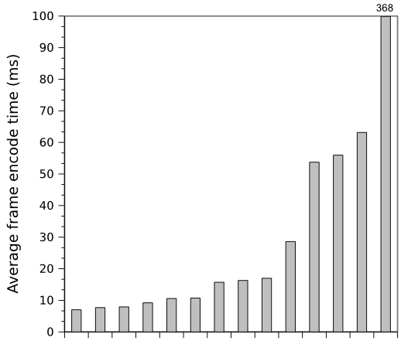
14 different MJPEG encoders on GPU
Nvidia GeForce GPU
Problems:
Only used global memory
To much synchronization between threads
Host part of the code not optimized
Notes:
Results from the course INF5063: Advanced course in programming heterogeneous architectures
Two assignments (home exams) on MJPEG (on Cell and GPU)
Y axis IS NOT at the SAME SCALE
one assignment “I/O bound” on the Cell
Looks like it was easy to get better performance on Nvidia GPU (more about this later)

Slide 43
Profiling a Motion JPEG encoder on x86
A small selection of DCT algorithms:
2D-Plain: Standard forward 2D DCT
1D-Plain: Two consecutive 1D transformations with transpose in between and after
1D-AAN: Optimized version of 1D-Plain
2D-Matrix: 2D-Plain implemented with matrix multiplication
Single threaded application profiled on a Intel Core i5 750

Slide 44
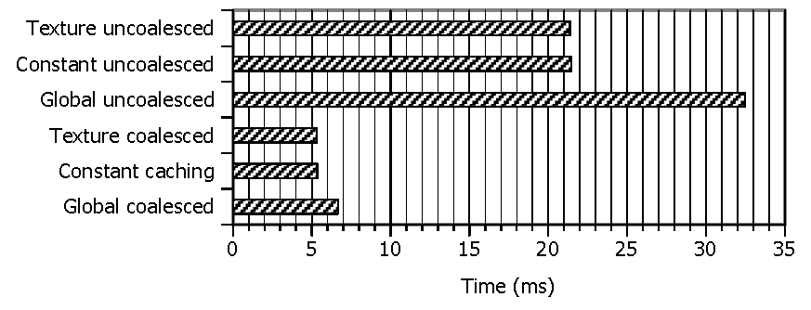
Optimizing for GPU, use the memory correctly!!
Several different types of memory on GPU:
Global memory
Constant memory
Texture memory
Shared memory
First Commandment when using the GPUs:
Select the correct memory space, AND use it correctly!

Slide 45
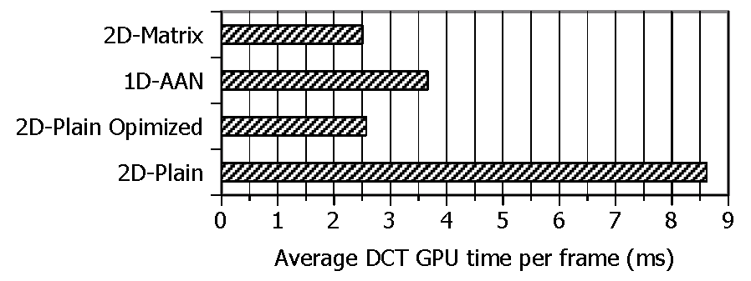
How about using a better algorithm??
Used CUDA Visual Profiler to isolate DCT performance
2D-Plain Optimized is optimized for GPU:
Shared memory
Coalesced memory access
Loop unrolling
Branch prevention
Asynchronous transfers
Second Commandment when using the GPUs:
Choose an algorithm suited for the architecture!

Slide 46
Effect of offloading VLC to the GPU
VLC (Variable Length Coding) can also be offloaded:
One thread per macro block
CPU does bitstream merge
Even though algorithm is not perfectly suited for the architecture, offloading effect is still important!

