Slide 1
Vector processing: x86, SSE
INF5063: Programming heterogeneous multi-core processors
September 11, 2012

Slide 2
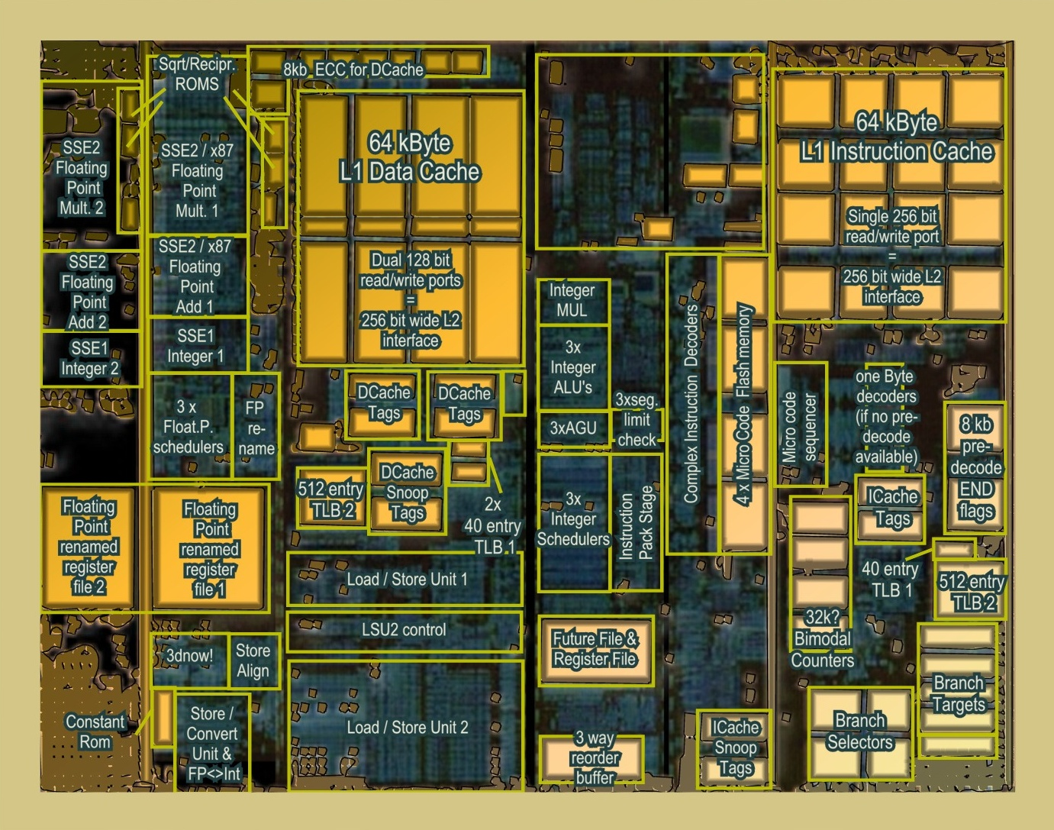
AMD K8

Slide 3
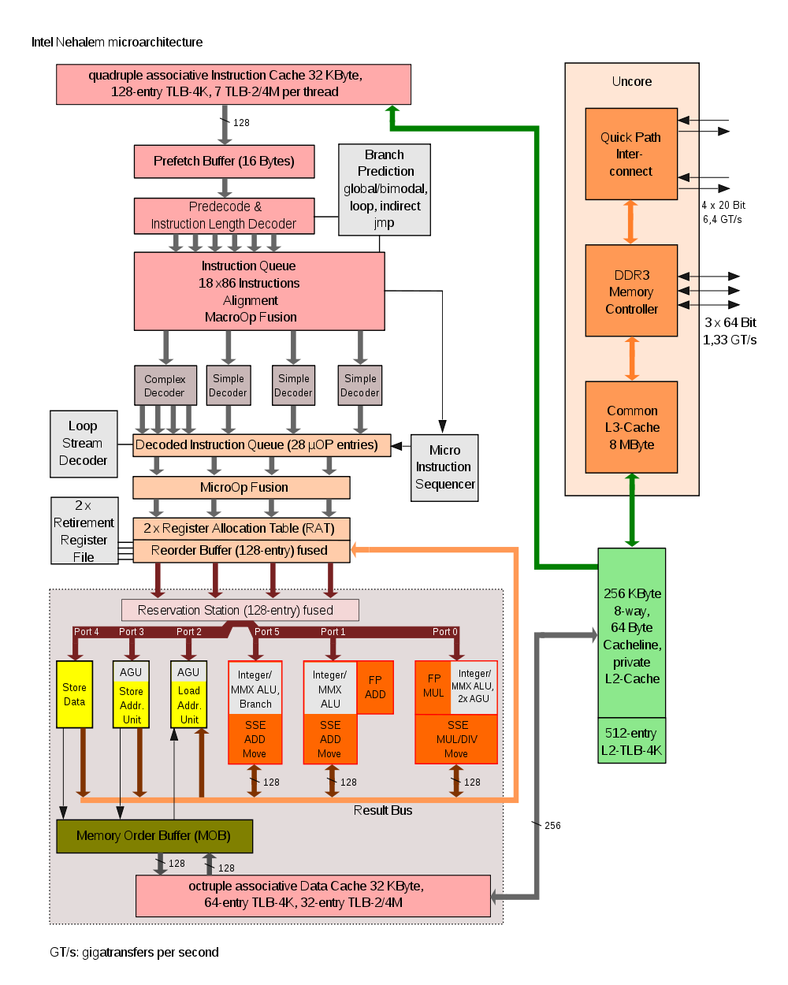
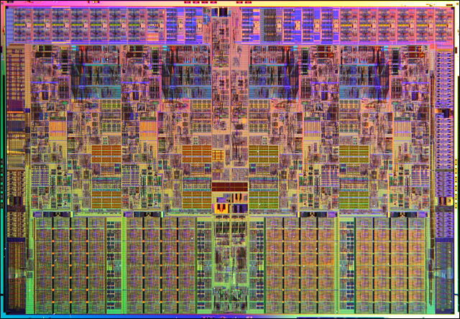
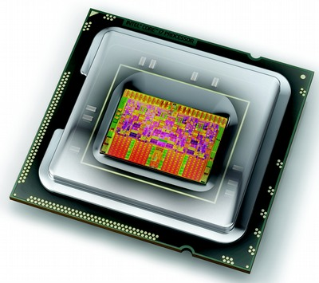
Intel Nehalem
Nehalem

Slide 4
Intel Nehalem

Slide 5
Overview
Types of parallel computations
Vector processors
SSE examples
Home exam 1
(Thursday: "Can we SSE-parallelize MJPEG?")

Slide 6
Types of Parallel Processing/Computing?
Bit-level parallelism
4-bit → 8-bit → 16-bit → 32-bit → 64-bit → …
Instruction level parallelism
(fetch, decode, execute, memory, write back)
IF | ID | EX | MEM | WB
IF | ID | EX | MEM | WB
IF | ID | EX | MEM | WB
IF | ID | EX | MEM | WB
IF | ID | EX | MEM | WB

Slide 7
Types of Parallel Processing/Computing?
Task parallelism
different operations are performed concurrently
task parallelism is achieved when the processors execute different threads (or processes) on the same or different data
examples?

Slide 8
Types of Parallel Processing/Computing?
Data parallelism
distribution of data across different parallel computing nodes
data parallelism is achieved when each processor performs the same task on different pieces of the data
examples?
when should we not use data parallelism?
for each element a
perform the same (set of) instruction(s) on a
end

Slide 9
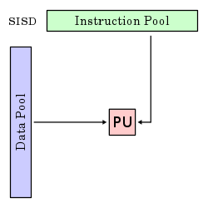
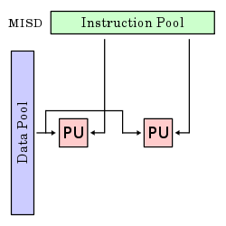
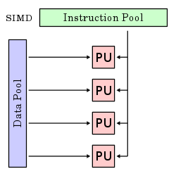
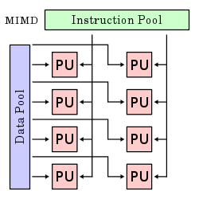
Flynn's taxonomy
 | Single instruction | Multiple instruction
Single data
Multiple data
Notes:
SISD
A sequential computer which exploits no parallelism in either the instruction or data streams. i.e. one operation at a -- traditional uniprocessor machines (PC) or old mainframes.
SIMD A computer which exploits multiple data streams against a single instruction stream to perform operations which may be naturally parallelized. Example: array processor
MISD
Multiple instructions operate on a single data stream. Uncommon architecture which is generally used for fault tolerance. Heterogeneous systems operate on the same data stream and must agree on the result. Example: Space Shuttle flight control computer.
MIMD Multiple autonomous processors simultaneously executing different instructions on different data. Distributed systems are generally recognized to be MIMD architectures; either exploiting a single shared memory space or a distributed memory space. A multi-core superscalar processor is an MIMD processor.

Slide 10
Vector processors
A vector processor (or array processor)
CPU that implements an instruction set containing instructions that operate on one-dimensional arrays (vectors)
example systems?
Cray-1 (1976)
4096 bits registers (64x64-bit floats)
IBM
POWER with ViVA (Virtual Vector Architecture) 128 bits registers
Cell – SPE 128 bit registers
SUN
UltraSPARC with VIS 64-bit registers
NEC
SX-6/SX-9 (2008) - Earth simulator 1/2 with 4096 bit registers (used different ways)
up to 512 nodes of 8/16? cores (8192 cores)
each core
has 6 parallel instruction units
shares 72 4096-bit registers

Slide 11
Vector processors
People use vector processing in many areas…
Scientific computing
Multimedia Processing (compression, graphics, image processing, …)
Standard benchmark kernels (Matrix Multiply, FFT, Convolution, Sort)
Lossy Compression (JPEG, MPEG video and audio)
Lossless Compression (Zero removal, RLE, Differencing, LZW)
Cryptography (RSA, DES/IDEA, SHA/MD5)
Speech and handwriting recognition
Operating systems (memcpy, memset, parity, …)
Networking (checksum, …)
Databases (hash/join, data mining, updates)
…

Slide 12
Vector processors
Instruction sets?
MMX
SSEx (several extensions)
AltiVec
AVX
3DNow!
VIS
MDMX
FMA
…

Slide 13
Special instructions…
MMX
MMX is officially a meaningless initialism trademarked by Intel; unofficially,
MultiMedia eXtension
Multiple Math eXtension
Matrix Math eXtension
SIMD (Single Instruction, Multiple Data) computation processes multiple data in parallel with a single instruction, resulting in significant performance improvement; MMX gives 2 32-bit computations at once.
MMX defined 8 “new” 64-bit integer registers (mm0 ~ mm7), which were aliases for the existing x87 FPU registers – reusing 64 (out of 80) bits in the floating point registers.

Slide 14
Special instructions…
SSE
Streaming SIMD Extensions (SSE)
SIMD; 4 computations at once.
SSE defines 8 new 128-bit registers (xmm0 ~ xmm7) for single-precision floating-point computations. Since each register is128-bit long, we can store total 4 of 32-bit floating-point numbers (1-bit sign, 8-bit exponent, 23-bit mantissa/fraction).
Single or packed scalar operations: __SS vs __PS

Slide 15
Matrix multiplication using SSE

Slide 16
Example: Matrix Multiplication
1 | 1 | 1 | 1
2 | 2 | 2 | 2
3 | 3 | 3 | 3
4 | 4 | 4 | 4
1
2
3
4
1
2
3
4
10
2
4
6
8
20
3
6
9
12
30
4
8
12
16
40

Slide 17
Example: Matrix Multiplication - C
#include <stdio.h>
float elts[4][4] = {1,1,1,1,2,2,2,2,3,3,3,3,4,4,4,4};
float vin[4] = {1,2,3,4};
float vout[4];
void main(void)
{
vout[0] = elts[0][0] * vin[0] + elts[0][1] * vin[1] +
elts[0][2] * vin[2] + elts[0][3] * vin[3];
vout[1] = elts[1][0] * vin[0] + elts[1][1] * vin[1] +
elts[1][2] * vin[2] + elts[1][3] * vin[3];
vout[2] = elts[2][0] * vin[0] + elts[2][1] * vin[1] +
elts[2][2] * vin[2] + elts[2][3] * vin[3];
vout[3] = elts[3][0] * vin[0] + elts[3][1] * vin[1] +
elts[3][2] * vin[2] + elts[3][3] * vin[3];
printf("%f %f %f %f\n", vout[0], vout[1], vout[2], vout[3]);
}

Slide 18
Example: Matrix Multiplication – SSE
#include <stdio.h>
float elts[4][4] = {1,1,1,1,2,2,2,2,3,3,3,3,4,4,4,4};
float vin[4] = {1,2,3,4};
float vout[4];
void main(void)
{
vout[0] = elts[0][0] * vin[0] + elts[0][1] * vin[1] +
elts[0][2] * vin[2] + elts[0][3] * vin[3];
vout[1] = elts[1][0] * vin[0] + elts[1][1] * vin[1] +
elts[1][2] * vin[2] + elts[1][3] * vin[3];
vout[2] = elts[2][0] * vin[0] + elts[2][1] * vin[1] +
elts[2][2] * vin[2] + elts[2][3] * vin[3];
vout[3] = elts[3][0] * vin[0] + elts[3][1] * vin[1] +
elts[3][2] * vin[2] + elts[3][3] * vin[3];
printf("%f %f %f %f\n", vout[0], vout[1], vout[2], vout[3]);
}
Assuming elts in a COLUMN-MAJOR order:
a | b | c | d
e | f | g | h
i | j | k | l
m | n | o | p
a | e | i | n | b | f | j | n | c | g | k | o | d | h | l | p
1 | 1 | 1 | 1
2 | 2 | 2 | 2
3 | 3 | 3 | 3
4 | 4 | 4 | 4
1
2
3
4
1
2
3
4
10
2
4
6
8
20
3
6
9
12
30
4
8
12
16
40

Slide 19
Example: Matrix Multiplication – SSE
__asm {
mov esi, VIN
mov edi, VOUT
// load columns of matrix into xmm4-7
mov edx, ELTS
movups xmm4, [edx]
movups xmm5, [edx + 0x10]
movups xmm6, [edx + 0x20]
movups xmm7, [edx + 0x30]
// load v into xmm0.
movups xmm0, [esi]
// we'll store the final result in xmm2; initialize it
// to zero
xorps xmm2, xmm2
// broadcast x into xmm1, multiply it by the first
// column of the matrix (xmm4), and add it to the total
movups xmm1, xmm0
shufps xmm1, xmm1, 0x00
mulps xmm1, xmm4
addps xmm2, xmm1
// repeat the process for y, z and w
movups xmm1, xmm0
shufps xmm1, xmm1, 0x55
mulps xmm1, xmm5
addps xmm2, xmm1
movups xmm1, xmm0
shufps xmm1, xmm1, 0xAA
mulps xmm1, xmm6
addps xmm2, xmm1
movups xmm1, xmm0
shufps xmm1, xmm1, 0xFF
mulps xmm1, xmm7
addps xmm2, xmm1
// write the results to vout
movups [edi], xmm2
}
Assuming elts in a COLUMN-MAJOR order:
a | b | c | d
e | f | g | h
i | j | k | l
m | n | o | p
a | e | i | n | b | f | j | n | c | g | k | o | d | h | l | p

Slide 20
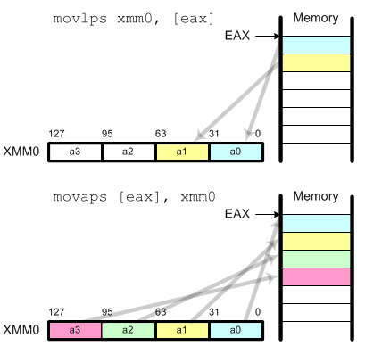
Example: Matrix Multiplication – SSE
__asm {
mov esi, VIN
mov edi, VOUT
// load columns of matrix into xmm4-7
mov edx, ELTS
movups xmm4, [edx]
movups xmm5, [edx + 0x10]
movups xmm6, [edx + 0x20]
movups xmm7, [edx + 0x30]
// load v into xmm0.
movups xmm0, [esi]
// we'll store the final result in xmm2; initialize it
// to zero
xorps xmm2, xmm2
// broadcast x into xmm1, multiply it by the first
// column of the matrix (xmm4), and add it to the total
movups xmm1, xmm0
shufps xmm1, xmm1, 0x00
mulps xmm1, xmm4
addps xmm2, xmm1
// repeat the process for y, z and w
movups xmm1, xmm0
shufps xmm1, xmm1, 0x55
mulps xmm1, xmm5
addps xmm2, xmm1
movups xmm1, xmm0
shufps xmm1, xmm1, 0xAA
mulps xmm1, xmm6
addps xmm2, xmm1
movups xmm1, xmm0
shufps xmm1, xmm1, 0xFF
mulps xmm1, xmm7
addps xmm2, xmm1
// write the results to vout
movups [edi], xmm2
}
Notes:
movss: copy a single floating-point data movlps: copy 2 floating-point data (low packed) movhps: copy 2 floating-point data (high packed) movaps: copy aligned 4 floating-point data (fast) movups: copy unaligned 4 floating-point data (slow) movhlps: copy 2 high elements to low position movlhps: copy 2 low elements to high position
movaps requires that the data in memory must be aligned 16 byte boundary for better performance.

Slide 21
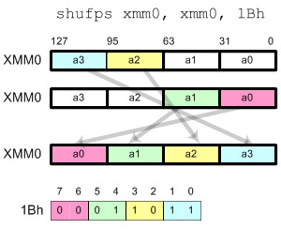
Example: Matrix Multiplication – SSE
__asm {
mov esi, VIN
mov edi, VOUT
// load columns of matrix into xmm4-7
mov edx, ELTS
movups xmm4, [edx]
movups xmm5, [edx + 0x10]
movups xmm6, [edx + 0x20]
movups xmm7, [edx + 0x30]
// load v into xmm0.
movups xmm0, [esi]
// we'll store the final result in xmm2; initialize it
// to zero
xorps xmm2, xmm2
// broadcast x into xmm1, multiply it by the first
// column of the matrix (xmm4), and add it to the total
movups xmm1, xmm0
shufps xmm1, xmm1, 0x00
mulps xmm1, xmm4
addps xmm2, xmm1
// repeat the process for y, z and w
movups xmm1, xmm0
shufps xmm1, xmm1, 0x55
mulps xmm1, xmm5
addps xmm2, xmm1
movups xmm1, xmm0
shufps xmm1, xmm1, 0xAA
mulps xmm1, xmm6
addps xmm2, xmm1
movups xmm1, xmm0
shufps xmm1, xmm1, 0xFF
mulps xmm1, xmm7
addps xmm2, xmm1
// write the results to vout
movups [edi], xmm2
}
Notes:
Shuffle Instruction
shufps requires 2 operands and 1 mask. shufps selects 2 elements from each operand (register) based on the mask. 2 elements from the first operand are copied to the lower 2 elements in destination register and 2 elements from the second operand are copied to the higher 2 elements in the destination register.Using shufps instruction, you can shuffle any 4 data elements with any order. The frequent usages of shufps are broadcast, swap and rotate.BroadcastIt copies all 4 fields with a single data element. The possible masks are
00h: Broadcast the least significant data element 55h: Broadcast the second data element AAh: Broadcast the third data element FFh: Broadcast the most significant data element

Slide 22
Example: Matrix Multiplication – SSE
__asm {
mov esi, VIN
mov edi, VOUT
// load columns of matrix into xmm4-7
mov edx, ELTS
movups xmm4, [edx]
movups xmm5, [edx + 0x10]
movups xmm6, [edx + 0x20]
movups xmm7, [edx + 0x30]
// load v into xmm0.
movups xmm0, [esi]
// we'll store the final result in xmm2; initialize it
// to zero
xorps xmm2, xmm2
// broadcast x into xmm1, multiply it by the first
// column of the matrix (xmm4), and add it to the total
movups xmm1, xmm0
shufps xmm1, xmm1, 0x00
mulps xmm1, xmm4
addps xmm2, xmm1
// repeat the process for y, z and w
movups xmm1, xmm0
shufps xmm1, xmm1, 0x55
mulps xmm1, xmm5
addps xmm2, xmm1
movups xmm1, xmm0
shufps xmm1, xmm1, 0xAA
mulps xmm1, xmm6
addps xmm2, xmm1
movups xmm1, xmm0
shufps xmm1, xmm1, 0xFF
mulps xmm1, xmm7
addps xmm2, xmm1
// write the results to vout
movups [edi], xmm2
}
1 | 1 | 1 | 1
1 | 2 | 3 | 4
1 | 2 | 3 | 4

Slide 23
Example: Matrix Multiplication – SSE
__asm {
mov esi, VIN
mov edi, VOUT
// load columns of matrix into xmm4-7
mov edx, ELTS
movups xmm4, [edx]
movups xmm5, [edx + 0x10]
movups xmm6, [edx + 0x20]
movups xmm7, [edx + 0x30]
// load v into xmm0.
movups xmm0, [esi]
// we'll store the final result in xmm2; initialize it
// to zero
xorps xmm2, xmm2
// broadcast x into xmm1, multiply it by the first
// column of the matrix (xmm4), and add it to the total
movups xmm1, xmm0
shufps xmm1, xmm1, 0x00
mulps xmm1, xmm4
addps xmm2, xmm1
// repeat the process for y, z and w
movups xmm1, xmm0
shufps xmm1, xmm1, 0x55
mulps xmm1, xmm5
addps xmm2, xmm1
movups xmm1, xmm0
shufps xmm1, xmm1, 0xAA
mulps xmm1, xmm6
addps xmm2, xmm1
movups xmm1, xmm0
shufps xmm1, xmm1, 0xFF
mulps xmm1, xmm7
addps xmm2, xmm1
// write the results to vout
movups [edi], xmm2
}
1 | 2 | 3 | 4
0 | 0 | 0 | 0
1 | 2 | 3 | 4

Slide 24
Example: Matrix Multiplication – SSE
xmm0:
__asm {
mov esi, VIN
mov edi, VOUT
// load columns of matrix into xmm4-7
mov edx, ELTS
movups xmm4, [edx]
movups xmm5, [edx + 0x10]
movups xmm6, [edx + 0x20]
movups xmm7, [edx + 0x30]
// load v into xmm0.
movups xmm0, [esi]
// we'll store the final result in xmm2; initialize it
// to zero
xorps xmm2, xmm2
// broadcast x into xmm1, multiply it by the first
// column of the matrix (xmm4), and add it to the total
movups xmm1, xmm0
shufps xmm1, xmm1, 0x00
mulps xmm1, xmm4
addps xmm2, xmm1
// repeat the process for y, z and w
movups xmm1, xmm0
shufps xmm1, xmm1, 0x55
mulps xmm1, xmm5
addps xmm2, xmm1
movups xmm1, xmm0
shufps xmm1, xmm1, 0xAA
mulps xmm1, xmm6
addps xmm2, xmm1
movups xmm1, xmm0
shufps xmm1, xmm1, 0xFF
mulps xmm1, xmm7
addps xmm2, xmm1
// write the results to vout
movups [edi], xmm2
}
4 | 3 | 2 | 1
xmm1:
1 | 1 | 1 | 1
2 | 2 | 2 | 2
3 | 3 | 3 | 3
4 | 4 | 4 | 4
1
2
3
4
4 | 3 | 2 | 1
1 | 1 | 1 | 1
4 | 3 | 2 | 1
4 | 3 | 2 | 1
2 | 2 | 2 | 2
8 | 6 | 4 | 2
4 | 3 | 2 | 1
3 | 3 | 3 | 3
12 | 9 | 6 | 3
4 | 3 | 2 | 1
4 | 4 | 4 | 4
16 | 12 | 8 | 4
xmm2:
0 | 0 | 0 | 0
4 | 3 | 2 | 1
12 | 9 | 6 | 3
24 | 18 | 12 | 6
40 | 30 | 20 | 10
xmm4:
4 | 3 | 2 | 1
xmm5:
4 | 3 | 2 | 1
xmm6:
4 | 3 | 2 | 1
xmm7:
4 | 3 | 2 | 1

Slide 25
Intrinsic SSE functions
Intrinsic SSE instructions exist, e.g., for gcc on Intel Linux:
src1 = _mm_mul_ps(src1, src2) → mulps src1, src2
src1 = _mm_add_ps(src1, src2) → addps src1, src2
…which can be used without any (large/noticeable) performance loss

Slide 26
Changing picture brightness using SSE

Slide 27
Brightness
make_brighter
Make a simple program that change the brightness of a picture by adding a brightness value between -128 and 127 to each pixel. A positive value makes the picture brighter, a negative value darker.
Assume it is a one byte pixel in gray scale, or a YUV picture where you operate on the Y-part only.

Slide 28
Brightness – main
<.. includes ..>
int main (int argc, char *argv[])
{
< ... more variables ... >
unsigned char *bw_image;
int image_len, bright_value;
< open input and output files >
bright_value = atoi( argv[???] ); /* a value between -128 and 127 */
image_len = atoi( argv[???] ) * atoi( argv[???] ); /* picture width * picture height */
bw_image = (unsigned char *) malloc(image_len + 15); /* +15 to allow 16-byte alignment */
if ((((long)bw_image) % 16) != 0) bw_image += 16 - ((long)bw_image % 16); /* align */
< read picture to into memory with first pixel at "bw_image" >
if (bright_value !=0 ) brightness( bw_image, image_len, bright_value );
< write picture back to file >
< free memory, close descriptors >
}

Slide 29
Brightness – Naïve C
void brightness (unsigned char *buffer, int len, int v)
{
int t, new_pixel_value;
if (v > 0) {
for (t = 0; t < len; t++) { /* make brighter */
new_pixel_value = buffer[t] + v;
if (new_pixel_value > 255) new_pixel_value = 255;
buffer[t] = new_pixel_value;
}
} else {
for (t = 0; t < len; t++) { /* make darker */
new_pixel_value = buffer[t] + v;
if (new_pixel_value < 0) new_pixel_value = 0;
buffer[t] = new_pixel_value;
}
}
}

Slide 30
Brightness – SSE ASM
; void brightness_sse_asm(unsigned char *image, int len, int v)
brightness_sse_asm:
pushall
mov ebp, esp
mov edi, [ebp+12] ; unsigned char *image
mov ecx, [ebp+16] ; int len
mov eax, [ebp+20] ; int v in [-128, 127]
test eax, 0x80000000 ; check if v is negative
jz bright_not_neg
xor al, 255 ; make al abs(v)
inc al ; add 1
bright_not_neg:
shr ecx, 4 ; len = len / 16 (shift right 4)
mov ah, al ; xmm1=(v,v,v,v,v,v,v,v,v,v,v,v,v,v,v,v)
pinsrw xmm1, ax, 0 ; Packed Insert Word
pinsrw xmm1, ax, 1
pinsrw xmm1, ax, 2
pinsrw xmm1, ax, 3
pinsrw xmm1, ax, 4
pinsrw xmm1, ax, 5
pinsrw xmm1, ax, 6
pinsrw xmm1, ax, 7
test eax, 0xff000000 ; if v was negative,
jnz dark_loop ; make darker
bright_loop:
movdqa xmm0, [edi] ; move aligned double quadword
paddusb xmm0, xmm1 ; packed add unsigned
movdqa [edi], xmm0
add edi, 16 ; ptr = ptr + 16
loop bright_loop ; while (count>0)
jmp exit
dark_loop:
movdqa xmm0, [edi]
psubusb xmm0, xmm1
movdqa [edi], xmm0
add edi, 16 ; ptr=ptr+16
loop dark_loop ; while (count>0)
exit:
popall
ret
;; Less instructions ALTERNATIVE ;; using shufps
move ah, al
pinsrw xmm1, ax, 0
pinsrw xmm1, ax, 1
shufps xmm1, xmm1, 0x00
PINSRW (Packed Insert Word) moves the lower word in a 32-bit integer register or 16-bit word from memory into one of the 4/8word locations in destination MMX/SSE register. The insertion is done in such a way that the 3/7 other words from the destination register are left untouched.
MOVDQA (move aligned double) Moves a double quadword from the source operand (second operand) to the destination operand (first operand).
PSUBUSB (Packed Subtract Unsigned with Saturation) instruction subtracts packed unsigned byte integers. When an individual byte result is less than zero (a negative value), the saturated value of 0x00 is written to the destination operand.
PADDUSB (Packed Add Unsigned with Saturation) instruction adds packed unsigned byte integers. When an individual byte result is beyond the range of an unsigned byte integer (that is, greater than 0xFF), the saturated value of 0xFF is written to the destination operand.

Slide 31
Brightness – SSE Intrinsics
void brightness_sse_xscale (unsigned char *buffer, int len, int v)
{
__m128 pixel_vector;
__m128 value_vector;
int t;
if (v > 0) {
< make v char >
value_vector = _mm_set1_epi8( v ); /* PINSRW, SHUFPS, etc..*/
for (t = 0; t < len; t += 16) {
pixel_vector = (__int128 *)(buffer+t); /* MOVDQA */
pixel_vector = _mm_adds_epi8(pixel_vector, value_vector); /* PADDUSB */
*((__m128 *)(buffer+t)) = pixel_vector; /* MOVDQA */
}
} else { % (v <= 0)
v=-v;
< make v char >
value_vector = _mm_set1_epi8(v);
for (t = 0; t < len; t += 16) {
pixel_vector = (__int128 *)(buffer+t); /* MOVDQA */
pixel_vector = _mm_subs_epi8(pixel_vector, value_vector); /* PSUBUSB */
*((__m128 *)(buffer+t)) = pixel_vector; /* MOVDQA */
}
}
}

Slide 32
(M-) JPEG
The very short, turbo fast introduction

Slide 33
High data volumes: Need for compression
PAL video sequence
25 images per second
3 bytes per pixel
RGB (red-green-blue values)
YUV (luminance + 2 chrominance values), usually often a compression already
Uncompressed data rate depending on resolution:
VGA: 640 * 480 * 3 Byte * 25/s = 23.040.000 byte/s = ~ 22 MByte/s
HD 720p: 1280 * 720 * 3 Byte * 25/s = 69.120.000 byte/s = ~ 66 Mbyte/s
HD 1080p: 1920 * 1080 * 3 Byte * 25/s = 155.520.000 byte/s = ~ 148 Mbyte/s
Network rates
5 Mbps ADSL: 4% of 1 HD1080p
1 Gbps Ethernet: 84% of 1 HD1080p
add 1000s of concurrent users
Need for compression

Slide 34
Basic Encoding Steps

Slide 35
JPEG
“JPEG”: Joint Photographic Expert Group
International Standard:
For digital compression and coding of continuous-tone still images
Gray-scale and color
Compression rate of 1:10 yields reasonable results
Lossless mode: reasonable compression rate approx. 1:1.6
Independence of
Image resolution
Image and pixel aspect ratio
Color representation
Image complexity and statistical characteristics

Slide 36
1 - Color conversion: RGB to YCbCr
The 24-bit RGB (red, green, blue) value is often converted to YCbCr consisting of
one luma component (Y) representing brightness:
two chroma components representing color (Cb-BlueDifference and Cr-RedDifference), or of the Pb and Pr:
Kb and Kr are ordinarily derived from the definition of the corresponding RGB space, e.g., Kb = 0.114 and Kr = 0.299 defined for standard-definition television
the prime (') symbols mean gamma correction is being used - resulting luma (Y) value will then have a nominal range from 0 to 1, and the chroma (Cb and Cr) values will have a nominal range from -0.5 to +0.5
in digital form, the results are scaled and rounded, and offsets are typically added

Slide 37
1 - Color conversion: RGB to YCbCr
JPEG File Interchange Format (JFIF) allows Y'CbCr where Y', Cb and Cr have the full 256 values:
Y' = + 0.299 * R’ + 0.587 * G’ + 0.114 * B’
Cb = 128 - 0.168736 * R’ - 0.331264 * G’ + 0.5 * B’
Cr = 128 + 0.5 * R’ - 0.418688 * G’ - 0.081312 * B’
… allowing values [0, 255]
Downsampling (first compression step)
humans can see considerably more fine detail in the brightness, i.e., can reduce the spatial resolution of the Cb and Cr components
4:4:4 (no downsampling)
4:2:2 (reduce by factor of 2 in horizontal direction)
4:2:0 (reduce by factor of 2 in horizontal and vertical directions)
resolution of croma is usually reduced by a factor of 2 (24-bit to 16-bit in total)

Slide 38
1 - Color conversion: RGB to YCbCr
Y image is essentially a greyscale copy of the main image;
the white snow is represented as a middle value in both Cr and Cb;
the brown barn is represented by weak Cb and strong Cr;
the green grass is represented by weak Cb and weak Cr;
the blue sky is represented by strong Cb and weak Cr.
RGB
YCbCr
R
Y
G
Cb
B
Cr

Slide 39
2 - Split each picture in 8x8 blocks
Each Y, Cb and Cr picture is divided into 8x8 blocks, number depends on resolution

Slide 40
3 - Discrete cosine transform (DCT)
Each 8×8 block (Y, Cb, Cr) is converted to a frequency-domain representation, using a normalized, two-dimensional DCT

Slide 41
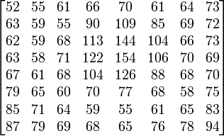
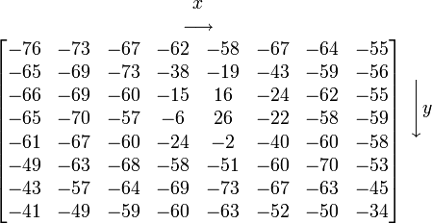
3 - Discrete cosine transform (DCT)
Each 8×8 block (Y, Cb, Cr) is converted to a frequency-domain representation, using a normalized, two-dimensional DCT
each pixel is represented by a [0, 255]-value
each pixel is transformed to a [-128, 127]-value

Slide 42
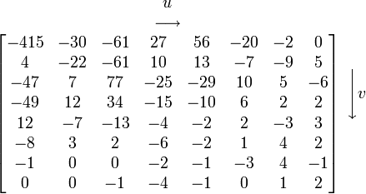
3 - Discrete cosine transform (DCT)
Each 8×8 block (Y, Cb, Cr) is converted to a frequency-domain representation, using a normalized, two-dimensional DCT
two-dimensional DCT:
G_{u,v} is the DCT at coordinates (u,v)
u is the horizontal spatial frequency [0,8>
v is the vertical spatial frequency [0,8>
g_{x,y} is the pixel value at coordinates (x,y)
α is a normalizing function:
Note the rather large value of the top-left corner (DC coefficient). The remaining 63 are AC coefficients. The advantage of the DCT is its tendency to aggregate most of the signal in one corner of the result, as may be seen above.
Compression possible: the following quantization step accentuates this effect while simultaneously reducing the overall size of the DCT coefficients

Slide 43
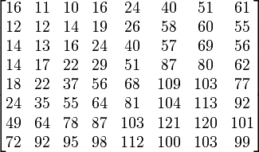
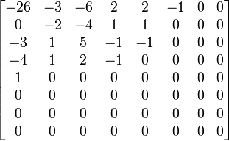
4 - Quantization
The human eye
is good at seeing small differences in brightness over a large area
not so good at distinguishing the exact strength of a high frequency brightness variation
can reduce the amount of information in the high frequency components
simply dividing each component in the frequency domain by a known constant for that component, and then rounding to the nearest integer:
where Q_{j,k} is a quantization matrix, e.g., for JPEG
G_{0,0} = -415
= -25.9375000000 ≈ -26
Q_{0,0} = 16

Slide 44
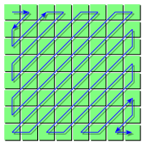
5 - Lossless compression
The resulting data for all 8×8 blocks is further compressed with a loss-less algorithm:
organizing numbers in a zigzag pattern: -26, -3, 0, -3, -2, -6, 2, -4, 1, -4, 1, 1, 5, 1, 2, -1, 1, -1, 2, 0, 0, 0, 0, 0, -1, -1, 0 , 0, 0, 0, 0, 0, 0, 0, 0, …., 0, 0
run-length (RLE)
Huffman coding – own table of symbols

Slide 45
Huffman Coding
Assumption
Some symbols are more frequent than others
Example
Given: A, B, C, D, E
Probability to occur: p(A)=0.3, p(B)=0.3, p(C)=0.1, p(D)=0.15, p(E)=0.15

Slide 46
JPEG – Baseline Mode: Quantization
Use of quantization tables for the DCT-coefficients
Map interval of real numbers to one integer number
Allows to use different granularity for each coefficient

Slide 47
Motion JPEG
Use series of JPEG frames to encode video
Pro
Lossless mode – editing advantage
Frame-accurate seeking – editing advantage
Arbitrary frame rates – playback advantage
Arbitrary frame skipping – playback advantage
Scaling through progressive mode – distribution advantage
Min transmission delay = 1/framerate – conferencing advantage
Supported by popular frame grabbers
Contra
Series of JPEG-compressed images
No standard, no specification
Worse, several competing quasi-standards
No relation to audio
No inter-frame compression

