Slide 1
Information Infrastructure

Slide 2
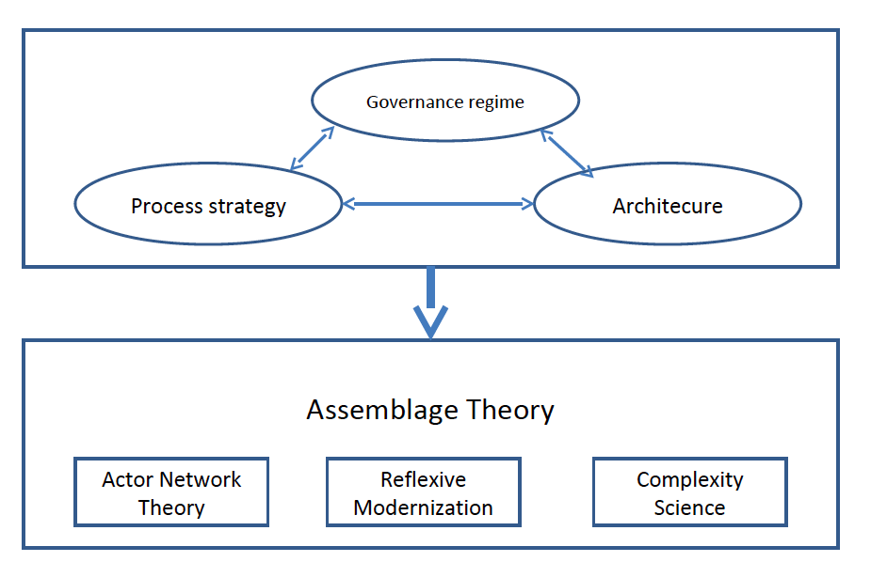

Slide 3
Definition
Information infrastructure is defined as a:
shared
evolving
open
heterogeneous
Installed base
No life cycle
(Hanseth - From Control to Drift - Cha 4. p 60)

Slide 4
The characteristics used in this definition:
▫ ENABLING - a range of different activities (that run simultaneously over the same infrastructure)
▫ SHARED - an infrastructure is shared by multiple parties who use, develop and manage it at the same time
▫ OPEN - no limit to the number of users, stakeholders, vendors, nodes, components etc
▫ HETEROGENEOUS - they are social technical networks consisting of technical, human, organisational, institutional components
▫ INSTALLED BASE - consisting of existing users, who may be tied to older versions of the infrastructure

Slide 5
Are these IIs?
Android
Studentweb
Internet
YouTube
Patient medical record: EPJ

Slide 6
Project related
Look at your case, or the cases you are considering.
Discuss II using the definition.
Prepare a few words for the rest of us.

