Slide 1
Empirical research in Information systems in Developing countries
Topics:
Empirical research & Action research
Example Action Research in Indonesia
Example evaluation of HISP and DHIS2 implementations in countries with the aim to improve data use -> trying to make into systematic action research

Slide 2
Empirical research in Information systems in Developing countries
What is a Global South perspective – or aims?
IT for development!
  Learning to master technology and its design
  apply IT to improve local /country development
  Local innovation
  Entrpenaurship
  Local institutions, universities, NGOs, companies
The researcher enters a real-world situation and aims both to improve it and to acquire knowledge

Slide 3
Research method
The research method: A strategy of enquiry
A way of finding empirical data about the world
Each research method build on a set of underlying philosphical assumptions, the choice of method influence the way researchers collect the data.
Specific research methods imply different set of skills and practices.

Slide 4
 | Positivist Paradigm | Phenomenological Paradigm ‘Qualitative’
Basic beliefs | The world is external and objective Observer is independent Science is value free | The world is socialy constructed and subjective Observer is part of what observed Science is driven by human interest
Researcher should | Focus on facts Look forcausalities and fundamental laws Reduse phenomena to simples elements Formulate hypothesis and then test them | Focus on meanings Try to understand what is happening Look at the totality of each situation Developideas from induction of data
Preferred methods include | Operatinalising consepts so that they can be measured Large samples | Using multiple methods to establish diferent views of phenomena Small samples invest-igeted in depth over time

Slide 5
Approaches to study ‘systems’:
Depending on how embedded they are in social context
‘Mathematical models’ vs ‘Social models’
The more ‘connections’ vs less – ‘standalone’
Stand alone – No dependencies
Less
Complexities
Context sensitive
Social system
models
Context free
Descrete entity
models
More
Complexities
Multiple connections,
networks & dependencies

Slide 6
Health information system = SOCIAL SYSTEM
DHIS2 – dependent on CONTEXT
Outsource, or
Generic SW?
A district:
District management team
Local
Government
District
manager
District hospital
Manager
Environmental
Health
district
database
Register
report
Information
officer
Information
officer
Immunisation
program (EPI)
Nurse
report
Information
responsible
Nurse
Patients
Health centre/
Clinic
NGO
School
Health
Register
‘Action’
Clinic
Manager
‘Action’
Patients
‘Community’
‘Community’

Slide 7
Qualitative research (when you go to the field and do empirical work)
Qualitative research allows the researchers to see and understand the context within which decissions and actions take place. It is the context that helps explain why someone acted as they did. And this context (or multiple context) is best understood by talking to people.

Slide 8
Action research
With an aim to ‘improve’
Action research aims to solve current practical problems while expanding scientific knowledge (articles, theses, masters, phd)
The action resercher is concerned to create organizational change and simultaneously to study the process.
The researcher enters a real-world situation and aims both to improve it and to acquire knowledge

Slide 9
The history of Action Research in IS
The Tavistock Institute of Human Relations 1950’s
  Automatisation but less productive
Socio technical approach Enid Mumford
  Autonomous groups
  Concensus
Scandinavian tradition
  Critical perspectiv: Workplace Democracy
  Iron & Metal union project Kristen Nygaard
  «Data avtalen»
  Tool perspective: support work expertice, mutual learning
Participatory Design
  Etnografic studies: Thick descriptions -> focus on work practices
Computer Supported Collaborative Work (CSCW)
  Work practice + Collaboration
  Individual & collective
HISP – Network of Action
  Improve Health & local Health Information Systems
  Local knowledge

Slide 10
3 components of the HISP ‘Network of Action’
Health Information Systems
Integration, standards, architecture
Use of information for action
Health management
Free & Open Source Software
Distributed DHIS development
– Sharing across the world
knowledge & support
Mozambique
Building Capacity,
Academies, Education, Research
Training of health workers
Graduate courses, Masters, PhD
Sharing teaching /courses
South Africa
Vietnam
Burkina Faso
Norway
Nigeria
India
Kenya
Indonesia
Rwanda
Bangladesh
Ghana
Phillipines
Sierra Leone
others
Laos

Slide 11
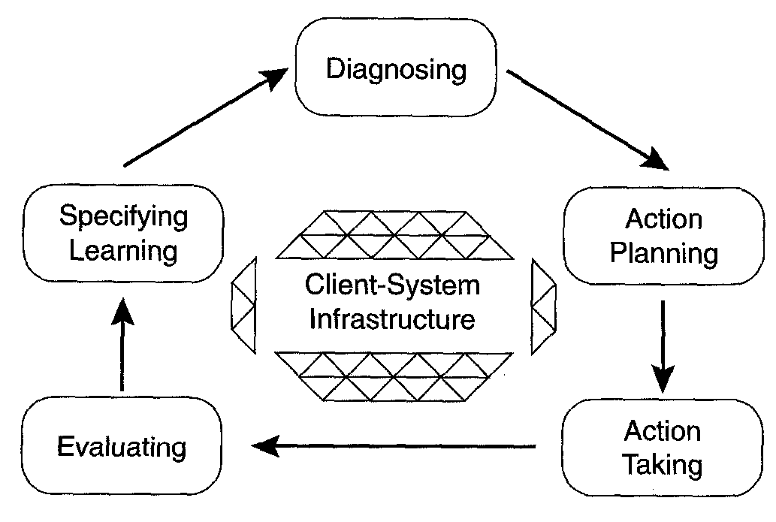
The Action Research Cycle
Aiming to change a social context which is in continuous flux – ever changing
- like a river; never the same, but similar and changing

Slide 12
The Action Research Cycle
Cycle 1
Cycle 2
Cycle 3
Share among local
Participants & ‘critical’
friends
Share with directly
linked organisations
& structures
Share with official
structures & other
researchers
For results and sustainability: the cycles getting ‘wider’
and including more Actors: - ‘Networks of Action’
organisational levels, ‘’governement’, NGOs, other projects etc.

Slide 13
HISP : Cycles of action research – the reality …
International
HISP spans 20 years +
Cycles are ‘long’ &
‘short’
– many are never
Completed
- Opportunities lost!
Cycles: many types
- PHD & Masters
- Development &
- implementation
National
local
TIME

Slide 14
HISP Action Research & Development
HISP as a long-term, large scale Action research project
  Consisting of multiple projects more or less tied together in networks:
    System development
    Development projects in countries
    Software development
    & Research projects – PhD students
Have been difficult to integrate research and development
  ‘PhD students & various researchers do research – others are ‘implementers’
  Project staff and multiple groups do implementation work
  + abig Open Source Software development project
New: HISP documentation, evaluation & Action research programme: Effort to better integrate research and development

Slide 15
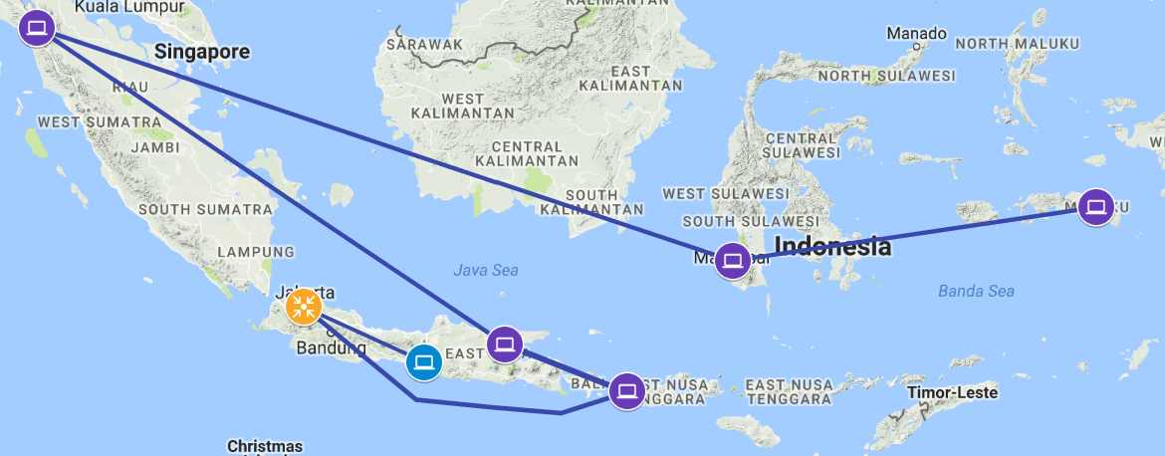

Example Indonesia
10 districts in 5 provinces
Repeted Cycles of
- Evaluation and Problem identification
- Efforts to solve the problems
Legend
Phase 0 : 2012/2013
Phase 1 : 2014/2015
Phase 2 : 2016/2017

Slide 16
Action research Methodology: 10 districts multiple cycles
Province level
District 1 & 2
Parallel & continous Activities
Focus group discussion with Province level programme and system people
Map Province Health System structures, Data Flows, existing datasets & IS and bottlenecks
Discussion on way forward
Focus group discussion with District programme and system people
Map District health system structures
Identify and assess Data Flows, existing IS and bottlenecks
Discussing action plan
Day 1
Data Analysis and System Design
Analyze Data Flows and identify bottlenecks
Assessing data collected
Rationalization and standardization of data flows
Data Importations
DHIS2 configuration
Dashboard Design and configuration
Field Visit Province Hospital
- Assesssystems
- Collect data and collection tools
- Discussions
Training on prototype with local data
- Dashboard configuration
- Data use
Field Visit Health centre & community l
- Assess data and systems
- Discussion
Training on prototype with local data
Dashboard
Data analysis
Data use
Day 2
Day 3
Multiple sector Advocacy Session
- Prov. Government offices, Statistics, education, insurance, etc.
DHIS2 Dashboard Presentation
Advocacy and action planning
Action planning
Multiple sector Advocacy Session
District government, statistics, education, etc.
DHIS2 Dashboard Presentation
Advocacy and action planning
Action planning
2 Weeks: Province level (3 days), District 1 & 2, 3 days each

Slide 17
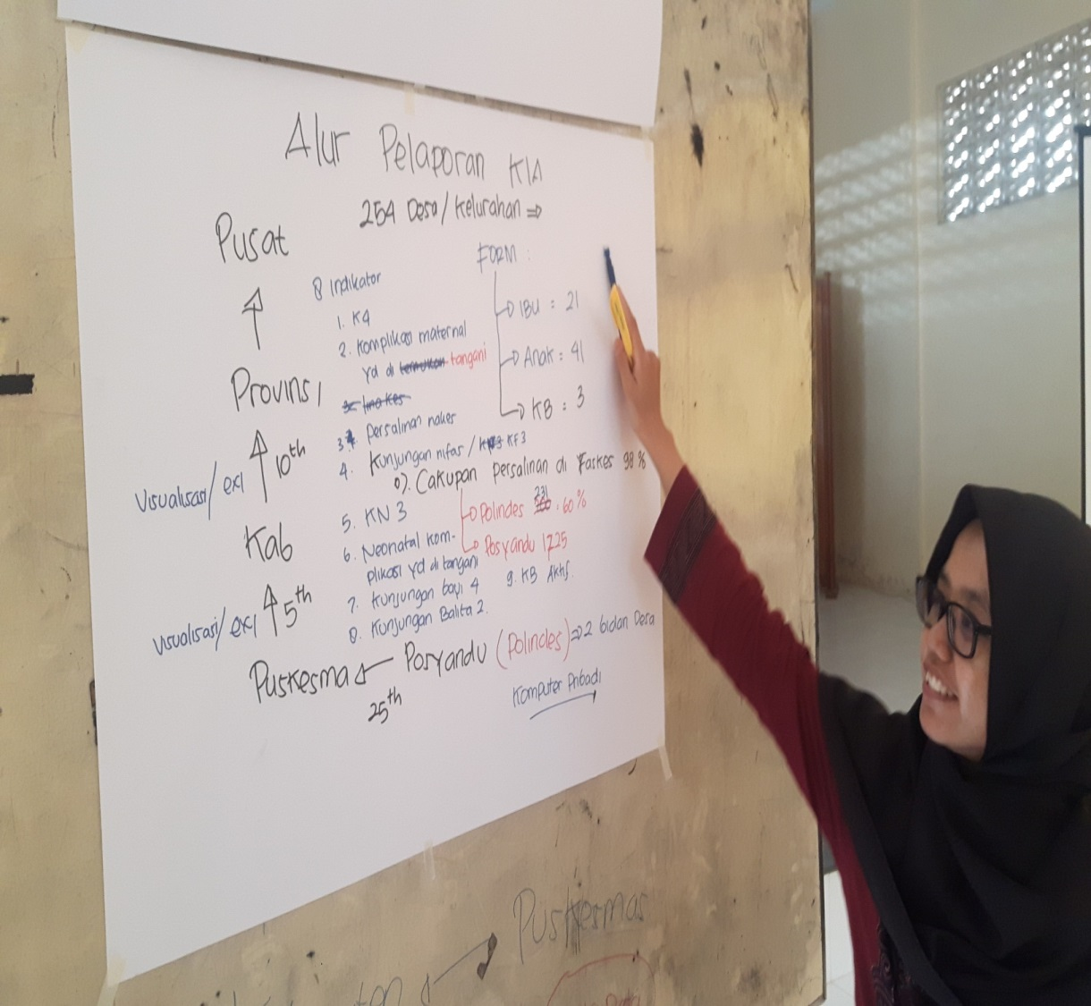
Empirical research: Evaluating Systems & Mapping Data
- diferent practices in districts and provinces
Analyzing
  Duplication of data collection points
  Variations of data elements disaggregation
  Understanding the gaps between the local and national guidelines.
    Data Elements
    Indicators
    Organisationunits
    Submitted values

Slide 18
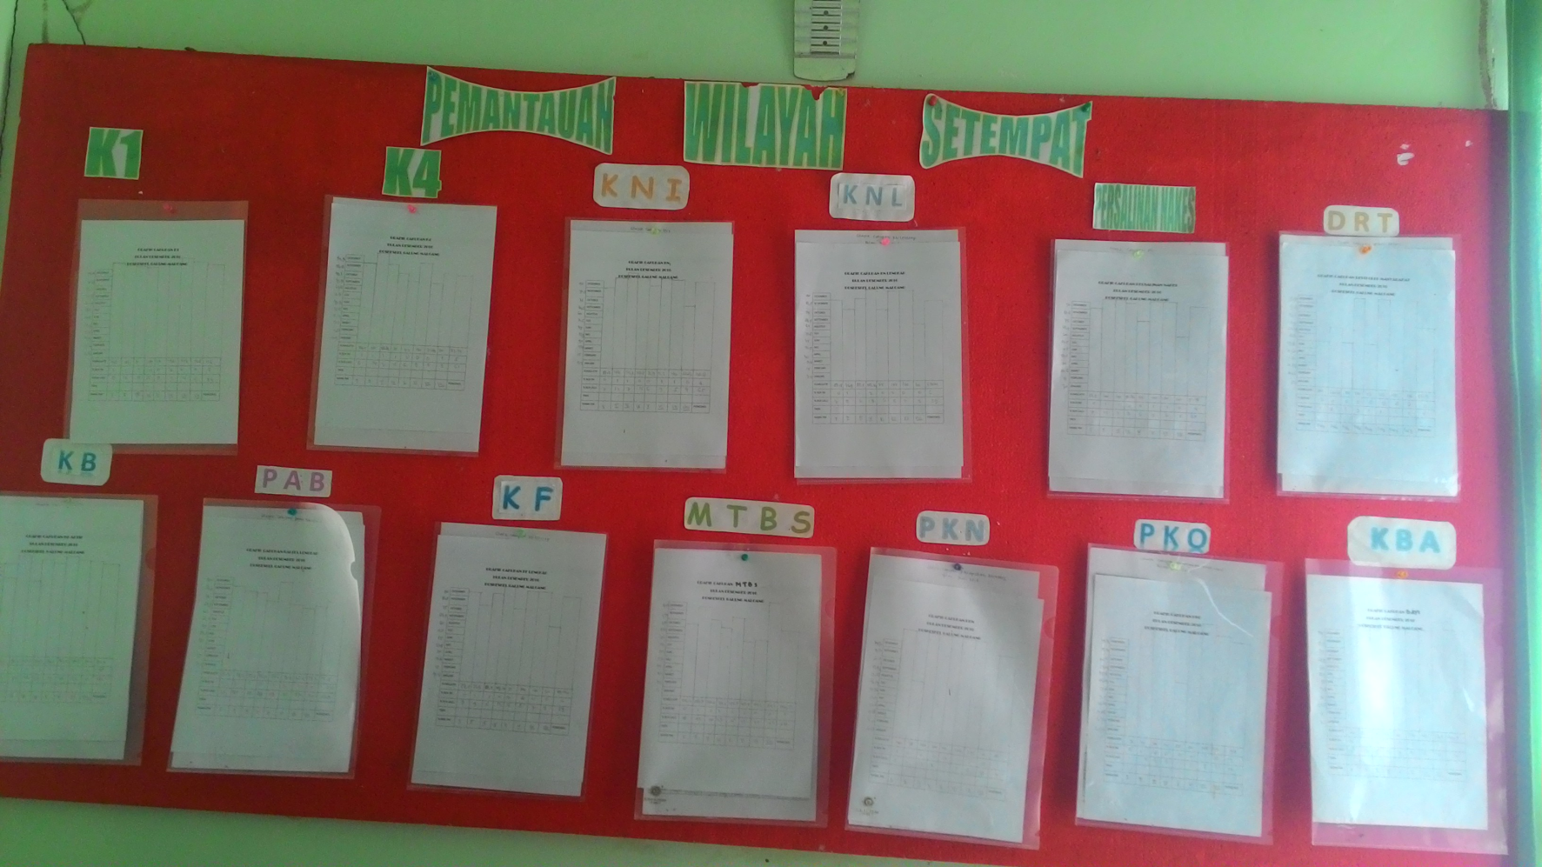
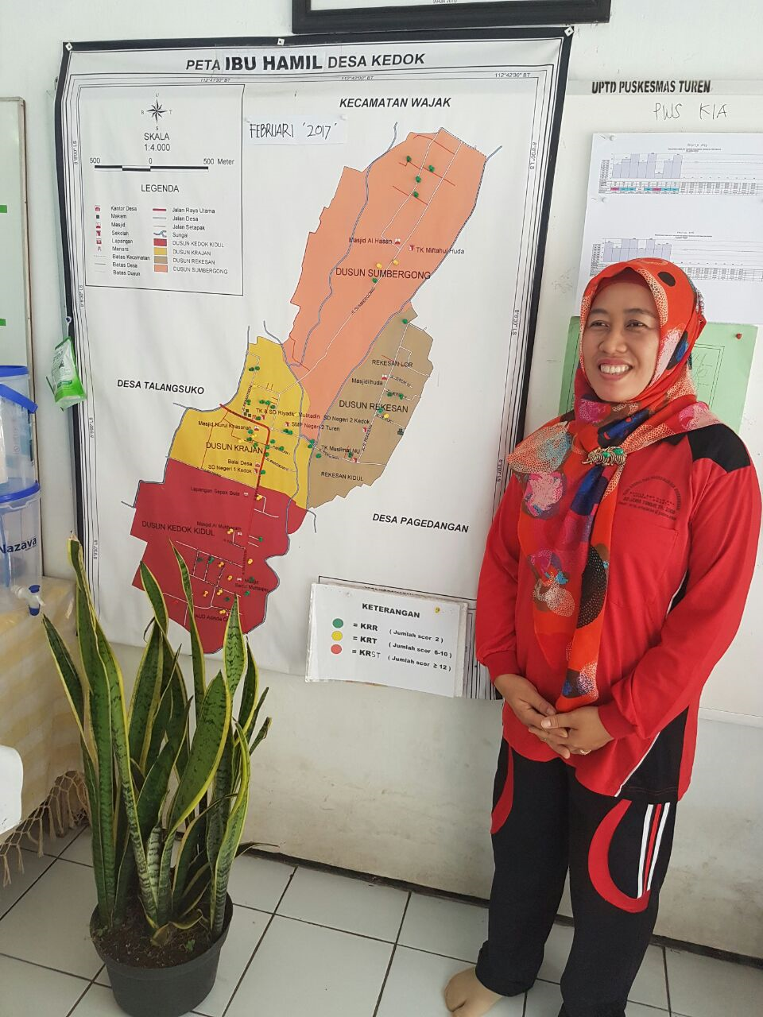
Data at community level
Pregnant women cohort
children under five cohort
Immunization cohort
Puskesmas – PHC Centre
Pregnant women monitoring and report
K4 coverage
Immunization coverage
Poskesdes
Midwife + Nurse
Pustu
Nurses
Polindes
Midwife
Posyandu cadres
Notes:
PHC collect data from Poskesdes, Pustu, Polindes.
18

Slide 19
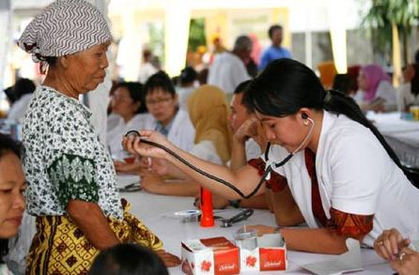
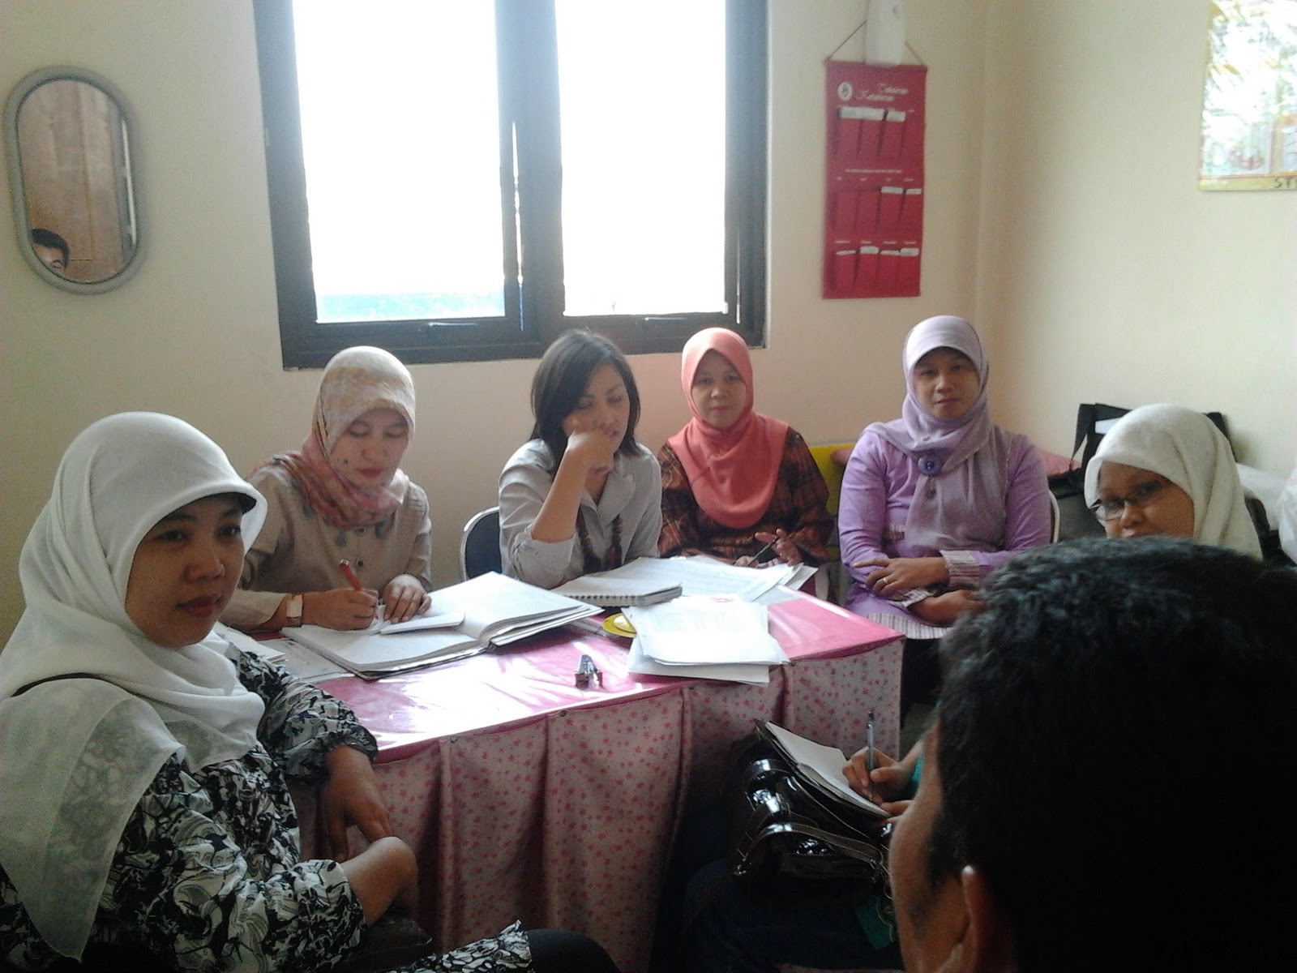
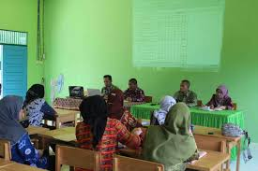
Data collection and data use at Puskesmas - PHC Centre
Village midwife
Midwife in PHC
Nurse in Pustu
Nurse in PHC
service and data recording
Coordinator midwife (MCH)
Pre Lokmin : program manager collect data from healthworkers
Nutrition program manager
Immunization program manager
LOKMIN (lokakarya mini) monthly meeting, data based evaluation

Slide 20
Fagmented reporting, district aggregates
District & higher level:
- Generally poor data
quality
- Fragmented data
- Data aggregated by district (not facility)
Data integrated
‘one place’ at
Puskesmas level
Data fragmented
at higher levels
District
Subdistrict
Puskesmas
Health Centre
Community level:
- Good routine data use
- Reasonably good data
quality
- Data are integrated:
in one place, one nurse
Malnutrition children report
Pregnan women get Fe supplementation
Postpartum women and children get Vit. A
Kelurahan/Desa (urban /rural village )
Poskesdes
Midwife+Nurse
Pustu
Nurses
Polindes
Midwife
cadre
cadre
cadre
Posyandu
Posyandu
Posyandu

Slide 21
‘Bottom-up’ dashboard & data integration project
Expansion to 50 more districts
Including Universities; 9 National Centres of Excellence
Regional training of trainers
Online training
Objective:
all districts
National Dashboard project: Extract data from national databases
by Facility & by district
Pilot in Yogyakarta
2012-2014
2016-
2018
2018-
2020
2022
2014-
2016
Roll out in 10 districts & 5 Provinces
Cyclic approach to evaluation & improvements
Including Universities; 3 National Centres of Excellence
Preparing for scaling up nationally
Pilot project Yogyakarta
Province
Integrating data from different systems in districts
Notes:
Formal and informal education and training
Student and participants come form different district and province
Research
Implementation research collaboration with health office and MoH
Community service
Part of university responsibility to implement theory into practice in collaboration with partners (district health office, MoH, PHO)

Slide 22
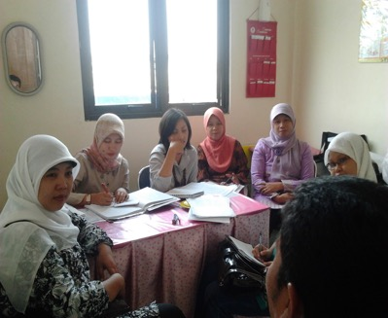
Finding: Fairly good data use & Regular meetings in all health centres (puskesmas) (also) discussing data
Strategy & design:
Using Regular meetings
as ‘vehicle’ for promoting
data use
Design Health centre
dashboards
!! Note:
Need local MCH data
Challenge: Mostly Xcel
Health services: data recording &
collection
Pre Lokmin : Checking data quality
LOKMIN (lokakarya mini) monthly meeting, data based evaluation

Slide 23
Policy
Processes
One/Satu Data Indonesia
Presidential Regulation
National
Policy level,
WHO, UNICEF, ..
Managers/
Province politics level
Cycle of
Action
Research
MoH
PHO and DHO data officer
Center of Excellence (CoE)
Cycle of
Action
Research
Users/
Project
level
Cycle of
Action
Research
Repeated Bottom-up cycles of Action Research Engaging increasingly wider & higher level groups of stakeholders
- until converging with national policy processes

Slide 24
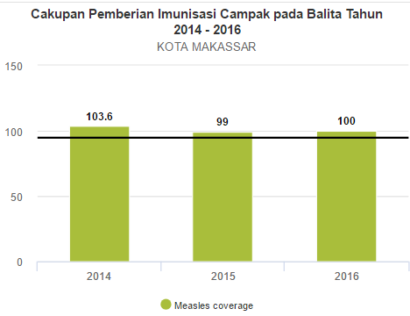
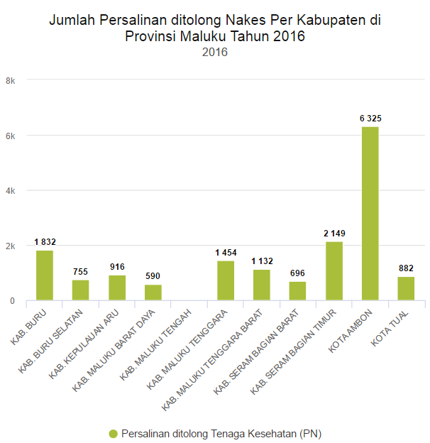
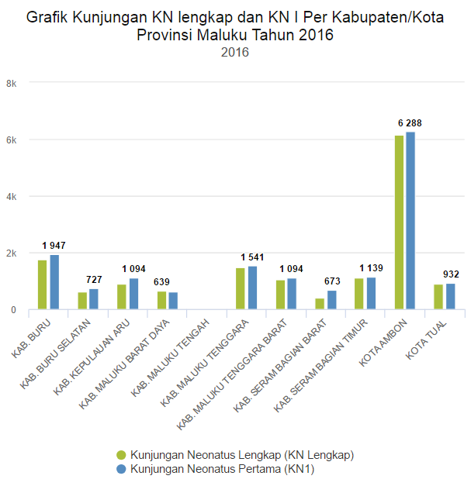
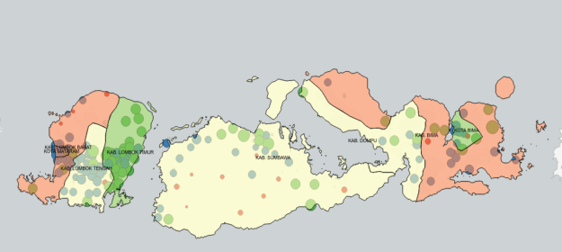
Example Project to improve data use and DHIS2
Concurrent evaluation,
interventions and improvement
In countries
BKKBN
BPJS
BPS
SITT
SIHA
DHIS2
Komdat
eSismal
eLog
SIKDA Generik
Nutrition
MCH
Immunization

Slide 25
How to ensure quality DHIS2 implementations?
Combining evaluation & action research
- Evaluation
- refining design, plans
- action, implementation
Research: Conceptualise new knowledge, write up, publish
In a cyclic process oriented approach
‘Text book’ approach to information systems development
But complicated due to ‘short’ funding & planning cycles
Often, identified problems are not being addressed
Long time horizon needed

Slide 26
Method & Objectives for
‘concurrent evaluation, intervention, & improvement project’
Objectives: Prioritise country requirements to Improve DHIS2 to better support & improve data use practices and workflow – focus on district & facility levels
Method & approach:
- dentify & analyse routine procedures of data use (monthly meetings, planning, budgetting, reports, etc)
- How is data used? & How is DHIS2 used?
- What are the shortcommings
- How could data be used better & use DHIS2 better
How to improve DHIS2 use
  New features / core development
  Improve design & configuration of country instance

Slide 27
Focus on Routine data use meetings & procedures
Routine ‘data use’ meetings in all countries - opportunities for institutionalising data use – Often depending on partner funding
Example Rwanda – part of government budget:
Hospitals and Health Centres:
  Data validation; before 5th each months
  Monthly: ‘Quality assurance’ meetings, addressing poor performance indicators (e.g. 4th ANC)
  Monthly ‘Staff meetings’, all performance indicators
Districts:
  Monthly coordination meetings, data manager and Heads from all health centres participate + district hospital manager, M&E and data manager + programs;
    each facility present indicators helped prepare by district data manger
  Quarterly, DHMT meeting. Headed by deputy major for social welfare; presenting performance indicators
  Giseny: monthly data manager meeting – local initiative – becoming national

Slide 28
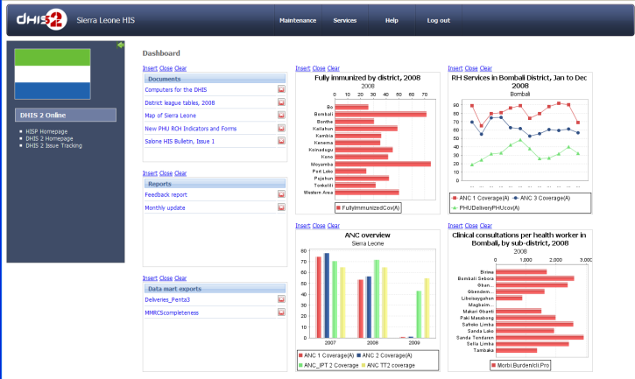
Empirical work: mapping use of information in Mozambique
‘Community’
Collation / aggregation
Data
Registration
report
Reporting
‘Health Facility’
Ecosystem of Data
Handling & Use
‘District’
Aggregate Data capture
Validation
Action &
Implementation
Information Products;
Reports, presentations, charts, dashboards, …
Routine meetings
Decision
making
Analysis
Planning
Evaluation
Monitoring
Conversation about data
Informating
Service delivery & Practices

Slide 29
How to understand information use?
- Or how information systems are useful. Or contribute to development
Informating is a term from the book In the Age of the Smart Machine (Zuboff, 1988)
the process that translates ‘digital’ descriptions and measurements of activities, events and objects into information and thereby making them visible to the organization
Enable information to be pushed to lower level of the organisation
Enable informed decisionmaking & conversation around information

Slide 30
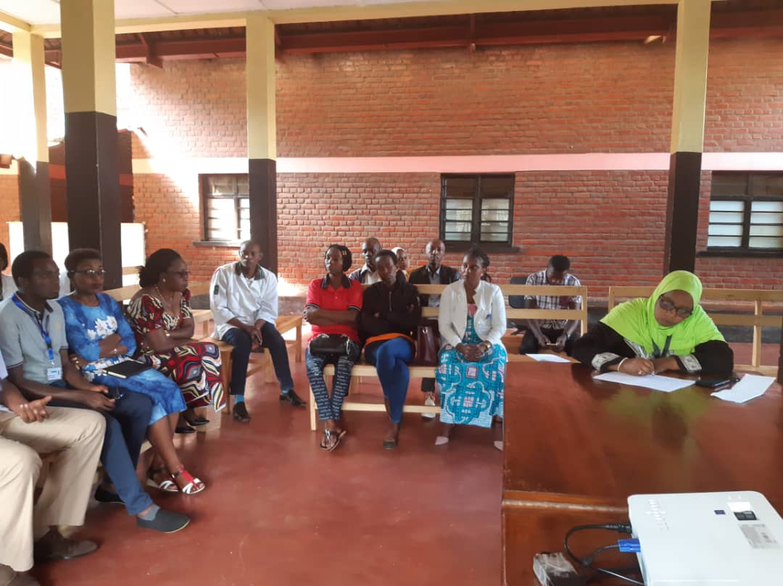
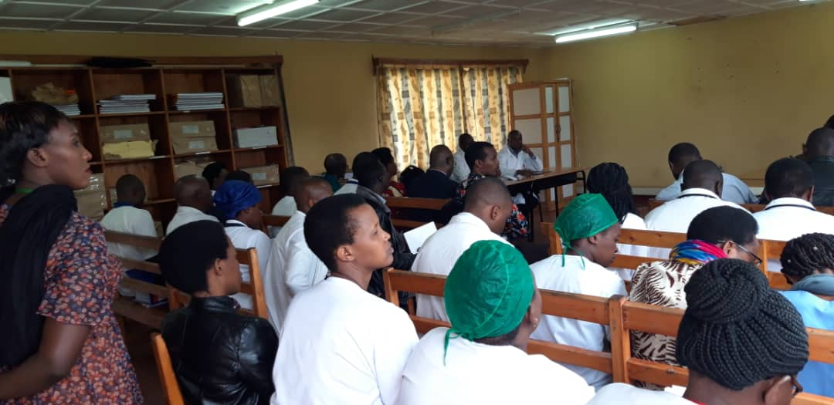
Routine data validation
Routines for data validation in all countries – BUT carried out before monthly DHIS2 data entry – Paperbased ‘Tradition’
Of course ‘good’ - But DHIS2 and validation rules not part of routine data handling
Data validation
Giseny hospital
4th October 2019 (!)
Wards & services control
data variables together
with data manager

Slide 31
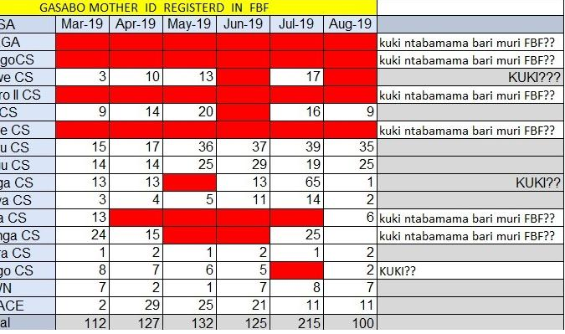
Improve DHIS2 to better support data use
Tables with data reported from facilities much used in meetings
Example from data manager: ‘Why I use Excel and not DHIS2’
Need to mix text and charts and add colours in tables
Requires improved DHIS2 analytics

Slide 32
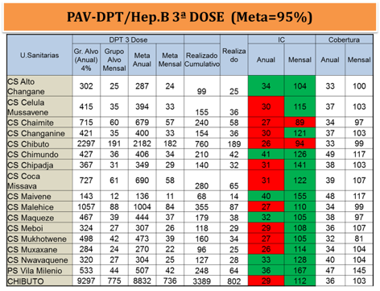
Mozambique: Monthly meeting using ‘scorecard’ table to check achievement ‘face to face’ with each facility
Data is copied downloaded from DHIS2 and pasted into excel template
-> Why not dashboard in DHIS2?

Slide 33
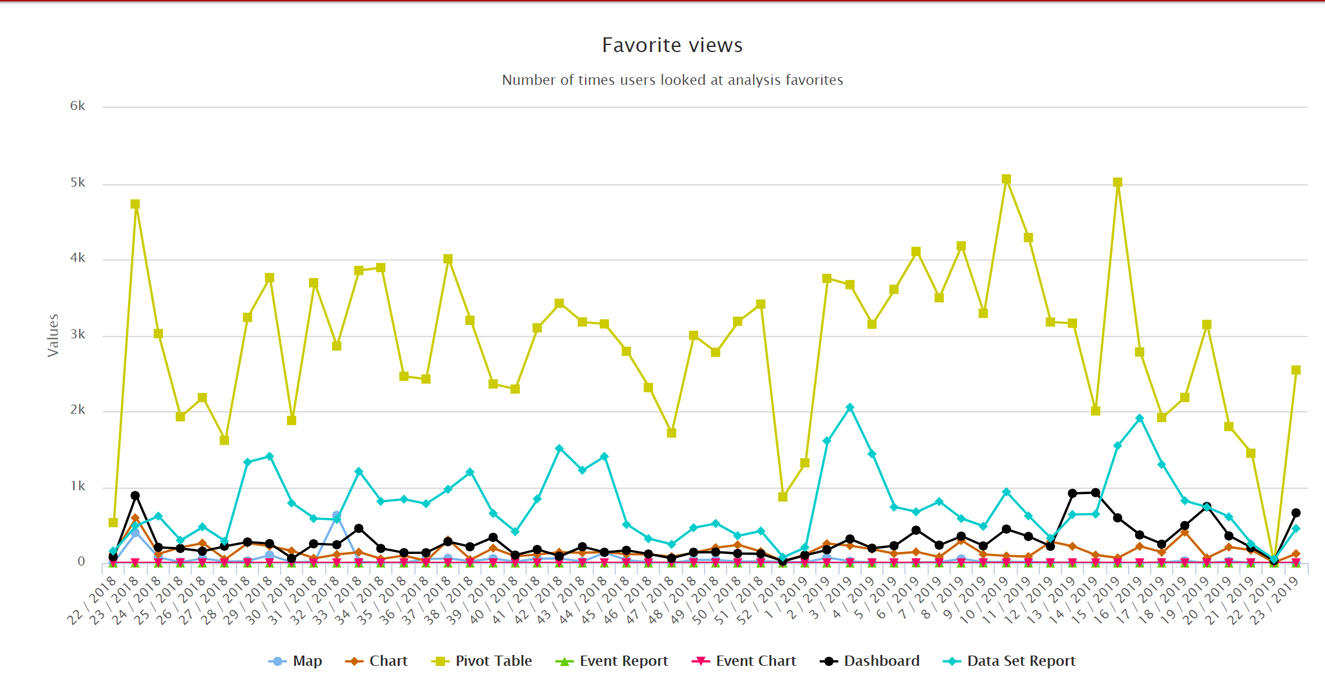
Rwanda - Most Used Analytics Features

Slide 34
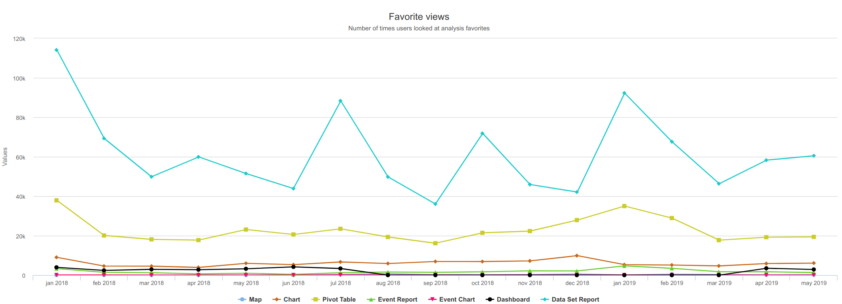
Tanzania: Most used analytics efatures
Notes:
High level of dataset,
Quarterly basis spark for quarterly reports.
Pivot table coming up now. But can be more on downloading data to excel.

Slide 35
DHIS2 implemention not well embedded in Data use practices & workflow
DHIS2 Not fully part of data use and data review /validation processes
‘Participatory Design’ – needs to be re-invented
‘Social system’ perspective on information systems needed -
The whole work flow & ‘human activity system’ need to be targeted for design process & implementation – ‘Change management’
Implementation is not only a technical effort

Slide 36
DHIS2 – Continuum of challenges: core features, better configurations, capacity
Core features & development
  Some country requirements need core development
  Some should be apps maintained outside core – by HISP?
  Some requirements depend on ‘deep coding’ – most not
Better local configuration & design
  Meta data management
  Indicators
  Org unit Hierarchy
Capacity (linked to above)
  Country core teams
  Disticts & facilities
Most problems and requirements can be solved by configuration /design & governance – but not all ..

Slide 37
Finished
Next slides only an extra case – lao, in case

Slide 38
Cycles of action research:
Example Lao PDR
Repeated cycles 2016-2019
Processes from identifying problems to fixing them includes;
  Stakeholder agreement and buy-in
  Changing recording & work routines
  Software development
  Paper forms development
  Pilot Implementation
  Modifying scaling strategies based on pilot
  Implementation ..
……… take time

Slide 39
Lao evaluation 2016/17:
EPI – problems identified:
differences between Excel reports and DHIS2
Problem with population denominator data
Mutliple log books and reporting forms make data aggregation difficult and prone to errors
Difficult to calculate coverage because location is not included in hospital reports
Many immunised in (province) hospitals: coming from many different areas – cannot calculate area coverage

Slide 40
Lao evaluation and redesign
EPI & ANC, two identified problems with similar solutions
Problem 1: Immunisation data: poor data on coverage
  Many do vaccination in hospitals , missing ‘village’
  implement tracker event: both area and facility coverage
Problem 2: ANC reporting
  Poor data on: 3 Zones with increasing risk (poor, travel distance), ANC before 12 weeks, mother s<19 years, TT vaccination
  Zones linked to villages, which also has population data
  Solution / action: Implement (only) ANC first visit event register including village & zone; addresses all data quality issues

Slide 41
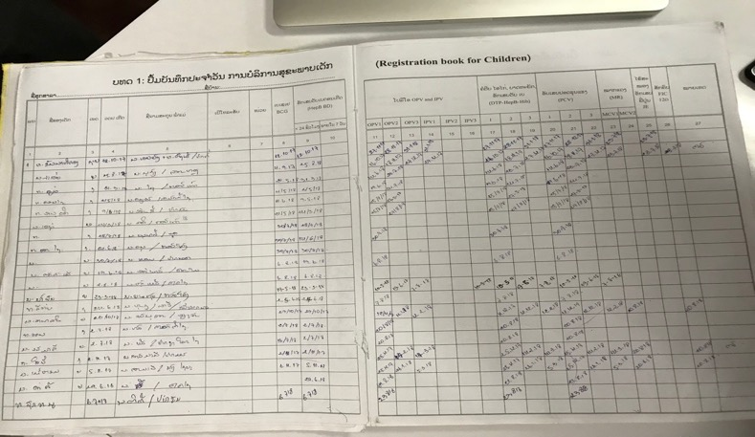
EPI Register – One line per Child – DH Difficult for event capture; Xiengnuen

Slide 42
Lao: Actions based on evaluation
Developed offline event capture
Introduced case based event data capture
  Simplified data collection & automatic aggregation
Each case linked to village - Village list standardised;
Villages linked to facilities
  Enable correct area based coverage indicators

Slide 43
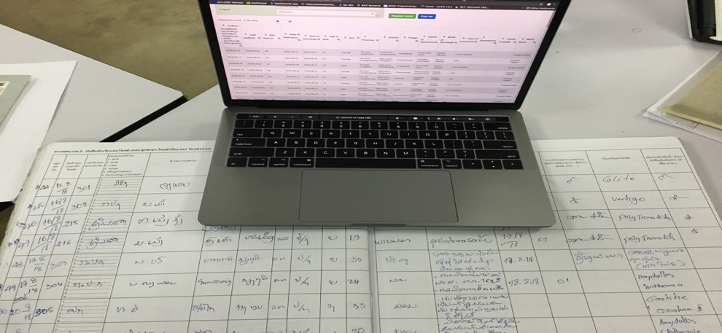
Easy to cross check with register to event capture
But event capture requires event based registration
DH Xiengnguen

Slide 44
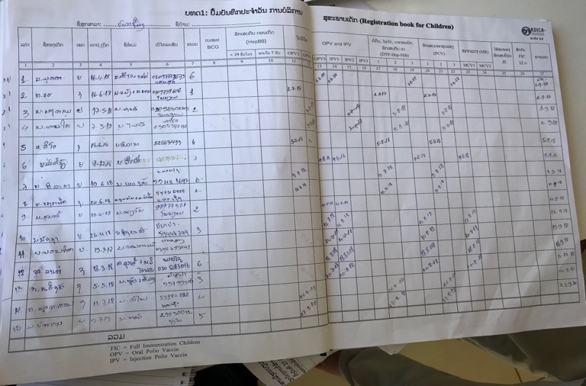
EPI register- One line per visit – HC Needed for ‘event capture’; Pakxueang
Challenge: Need to change paper registers also

Slide 45
Results
Offline event capture working - But need to modify data procedures
  ‘One line per visit’ registries
  Focus on province hospitals
  Prepare for full child immunistaion record – need id
EPI reluctant – MOH not (‘politics’)
All other programs work well
‘Ideal’ action research implementation takes time!

