Slide 1
Platforms for Development
Brian Nicholson

Slide 2
Learning outcomes
Students will be able to:
Define the term digital platform
Identify, describe and contrast the types of digital platforms
Critically analyse some implications for development

Slide 3
What is a platform? What is a digital platform?

Slide 4
definition
“Plat, meaning flat or level, and forme, meaning shape or arrangement of parts – together imply a flat, possibly raised, surface onto which something can be placed.” Tilson, Sorensen and Lyytinen 2013
Tilson, Sorensen and Lyytinen (2013) Platform Complexity: Lessons from the Music Industry 46th Hawaii International Conference on System Sciences

Slide 8
The Business View of Platforms
A platform is a business based on enabling value-creating interactions between external producers and consumers.
The platform provides an open participative infrastructure for these interactions and sets governance conditions for them
The platforms overarching purpose : to consummate matches among users, facilitate exchange of goods services or social currency thereby enabling value creation (Parker et al 2016)

Slide 9
Kari Koskinen, Carla Bonina & Ben Eaton (2018) Digital Platforms in the Global South: Foundations and Research Agenda available at: https://diode.network/publications/

Slide 11
Some platforms are not for profit
Transaction
Homeexchange.com
Freecycle.com
Couchsurfing.com
Innovation
Linux
DHIS2
Any others?

Slide 12
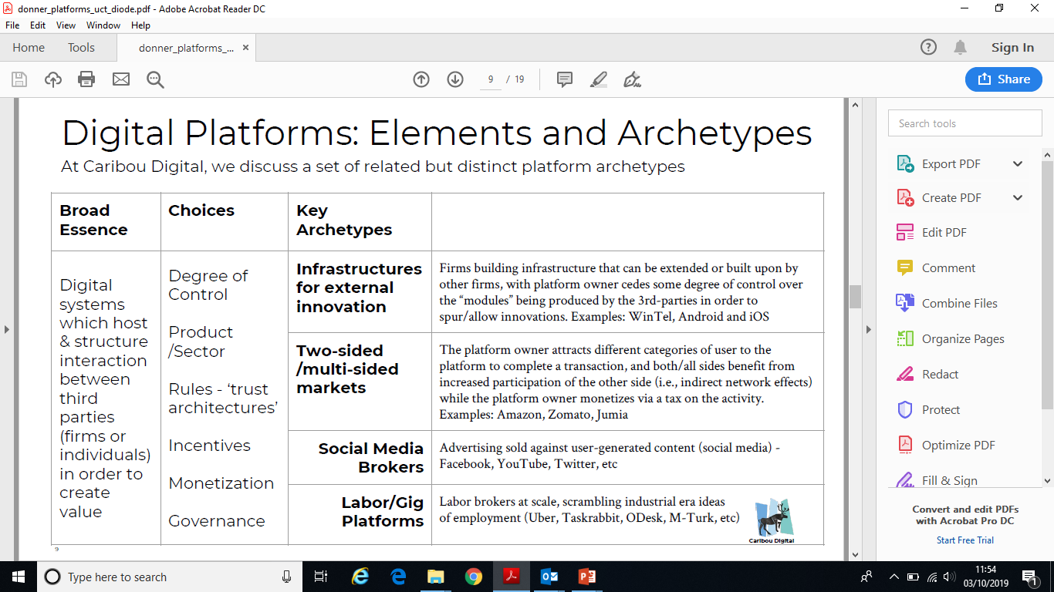

Slide 13
“In 2015, Uber, the world’s largest taxi company owns no vehicles, Facebook the world’s most popular media owner creates no content, Alibaba the most valuable retailer has no inventory, and Airbnb the world’s largest hotelier owns no real estate.”
Tom Goodwin, Sr. VP of Strategy Havas Media

Slide 16
Positive and negative feedback loops - Uber

Slide 17
2 sided network has positive and negative effects

Slide 20
platforms are embedded in creating an unbalanced world
is there a causal link between imbalance and inequality ?

Slide 21
Source: Geoffrey Parker (2016) Platform Revolution

Slide 24
An unequal game - perverse effects of platformisation
“The frightful 5 platforms”: Amazon, Apple, Facebook, Microsoft and Alphabet
Network effect benefits the biggest players
Acquisitions : facebook buy whatsapp, Instagram etc.
R&D : Apple app store dominated by western developers
Lobbying : massive spend on lobbying by Uber fuelled by venture capital
Tax : Amazon is able to shift jurisdictions and pay minimal tax
Surveillance and privacy implications

Slide 25
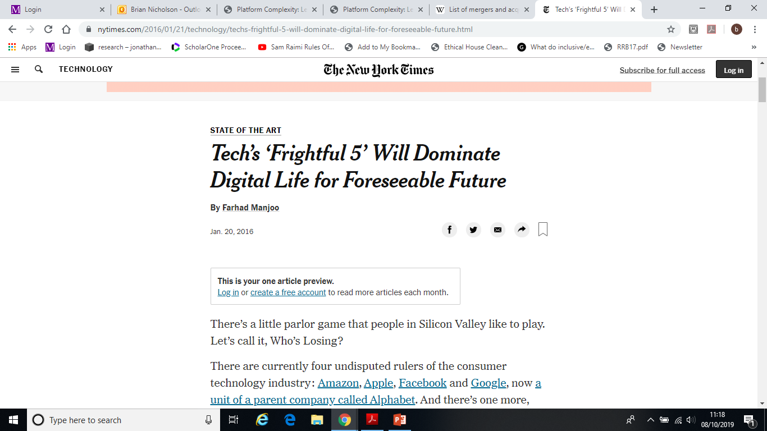
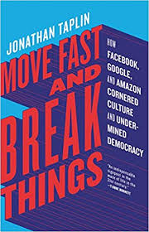

Slide 26
Examples
Objective: Illustrate the perverse effects with case studies, a mixture of the positive effects and the not-so-positive ones.

Slide 27
Platforms & development EXAMPLE 1 Transactional: digital freelancing platforms
https://papers.ssrn.com/sol3/papers.cfm?abstract_id=3427264

Slide 28
CSP logos
Notes:
Upwork and Freelancer – are estimated to have 4.5 and 7.5 million workers worldwide [8]. It is predicted that, by 2020, the OO sector overall will be worth US$15-25bn [15].
two main types of platforms including microwork such as Amazon Mechanical Turk and online freelancing such as Upwork, Freelancer, Guru, Fiverr etc. each targeting different segments of workers and employers. Estimates vary on the number of OO platforms and the marketplace is dynamic but we know there are hundreds of examples that incorporate a wide range of tasks including data entry and transcription; data analytics; web, mobile apps, and software development; legal and accounting services; engineering and architecture services; translation; administrative support; customer service; and sales and marketing. The World Bank estimated OO annual revenues of $4.8 billion in 2016 and between $15-$25 billion by 2020 [15].
Table circa 2009: Prominent Online Marketplaces for Services
• Guru.com: Guru.com, a Pennsylvania based company, seems to be the largest marketplace
with more than 625,000 registered vendors and freelance professionals and with more than 60
percent of these coming from low-wage countries. Guru follows a "closed auction" model of
bidding and hence the vendors cannot see each other bids. Usually, after a project is
completed, the final work-product is sent to Guru’s "Workroom," which is only accessible to
the contracted parties. To reduce their risk, the clients can use a “SafePay Escrow” service
that protects the interests of both the client and the vendor during the execution of the project;
this is clearly very important since these two parties are likely to be located in two different
countries.
• Elance.com: Elance.com, a California based marketplace, is known for its outsourcing
solutions supporting medium to large enterprises and has approximately 80,000 registered
vendors and free-lance professionals. Of these, approximately 50 percent are from low-wage
countries. Unlike Guru.com, Elance has an "open auction" bidding system, which implies that
each vendor can adjust its bid after seeing competitors' bids. Elance does not have an escrow
service but the buyers and vendors are somewhat protected by a third-party arbitration service
called "Square Trade."
• RentACoder.com: This is a Florida based marketplace that has more than 175,000
registered freelancers who only do coding of software programs. One of its main attractions
is its escrow and arbitration service. More than 80% of these programmers are from low-wage
countries. Its bidding model is a “closed auction” model and the client awards the project
based upon the freelancer’s or vendor’s price, qualifications, references and schedule.
3
• GetAFreelancer.com: This marketplace is owned by a Sweden based company, Innovate it.
Most of its freelancers are also IT programmers from low-wage countries. On this
marketplace, the buyers decide whether to allow closed or open auction bidding and the

Slide 29
Digital freelancing development policy interventions
Pakistan: KP Youth Employment Program: Khyber Pakhtunkhwa province. Target 40,000 unemployed and under-employed youth with freelancing.
NaijaCloud initiative in Nigeria
Malaysia: eRezeki Started in 2011 as Microwork for the B40
Notes:
Donor agencies such as the World Bank and national policy makers in developing countries, for instance, the Philippines, Malaysia and Pakistan have all seen potential for OO to create livelihoods for marginalised groups: women, youth and those on lowest incomes. OO initiatives involving government- and donor agency-funded training programmes for economic empowerment of these groups are therefore already underway.

Slide 30
Research questions
What drives those in marginalised groups to engage in digital freelancing platforms?
What are infrastructural and institutional ecosystems required, particularly addressing barriers to digital freelancing for marginalised groups?
What are the short- and longer-term impacts of digital freelancing platforms?
Notes:
The knowledge gaps include issues of incentives and motivation, infrastructural requirements, financial and non-financial impacts, and impact on longer-term career trajectories [23]

Slide 31
Sustainable Livelihoods Framework
H
Vulnerability
Context
S
N
Policies
Institutions
Processes
Livelihood
Strategies
Livelihood
Outcomes
influence
P
F
Notes:
• Human capital: “the skills, knowledge, ability to labour and good health that together enable people to pursue different livelihood strategies and achieve their livelihood objectives” [7, p.7].
• Social capital: “the social resources upon which people draw in pursuit of their livelihood objectives” [7, p.9].
• Physical capital: “the basic infrastructure and producer goods needed to support livelihoods” [7, p.13].
• Financial capital: “the financial resources that people use to achieve their livelihood objectives” [7, p.15]

Slide 32
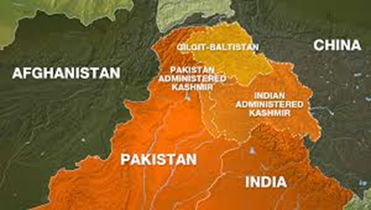

Slide 33
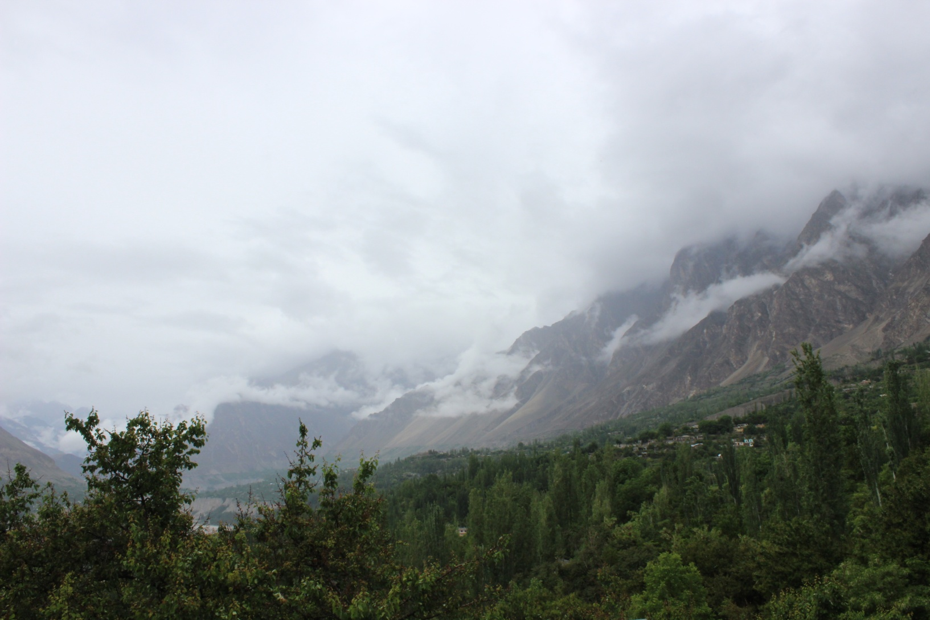
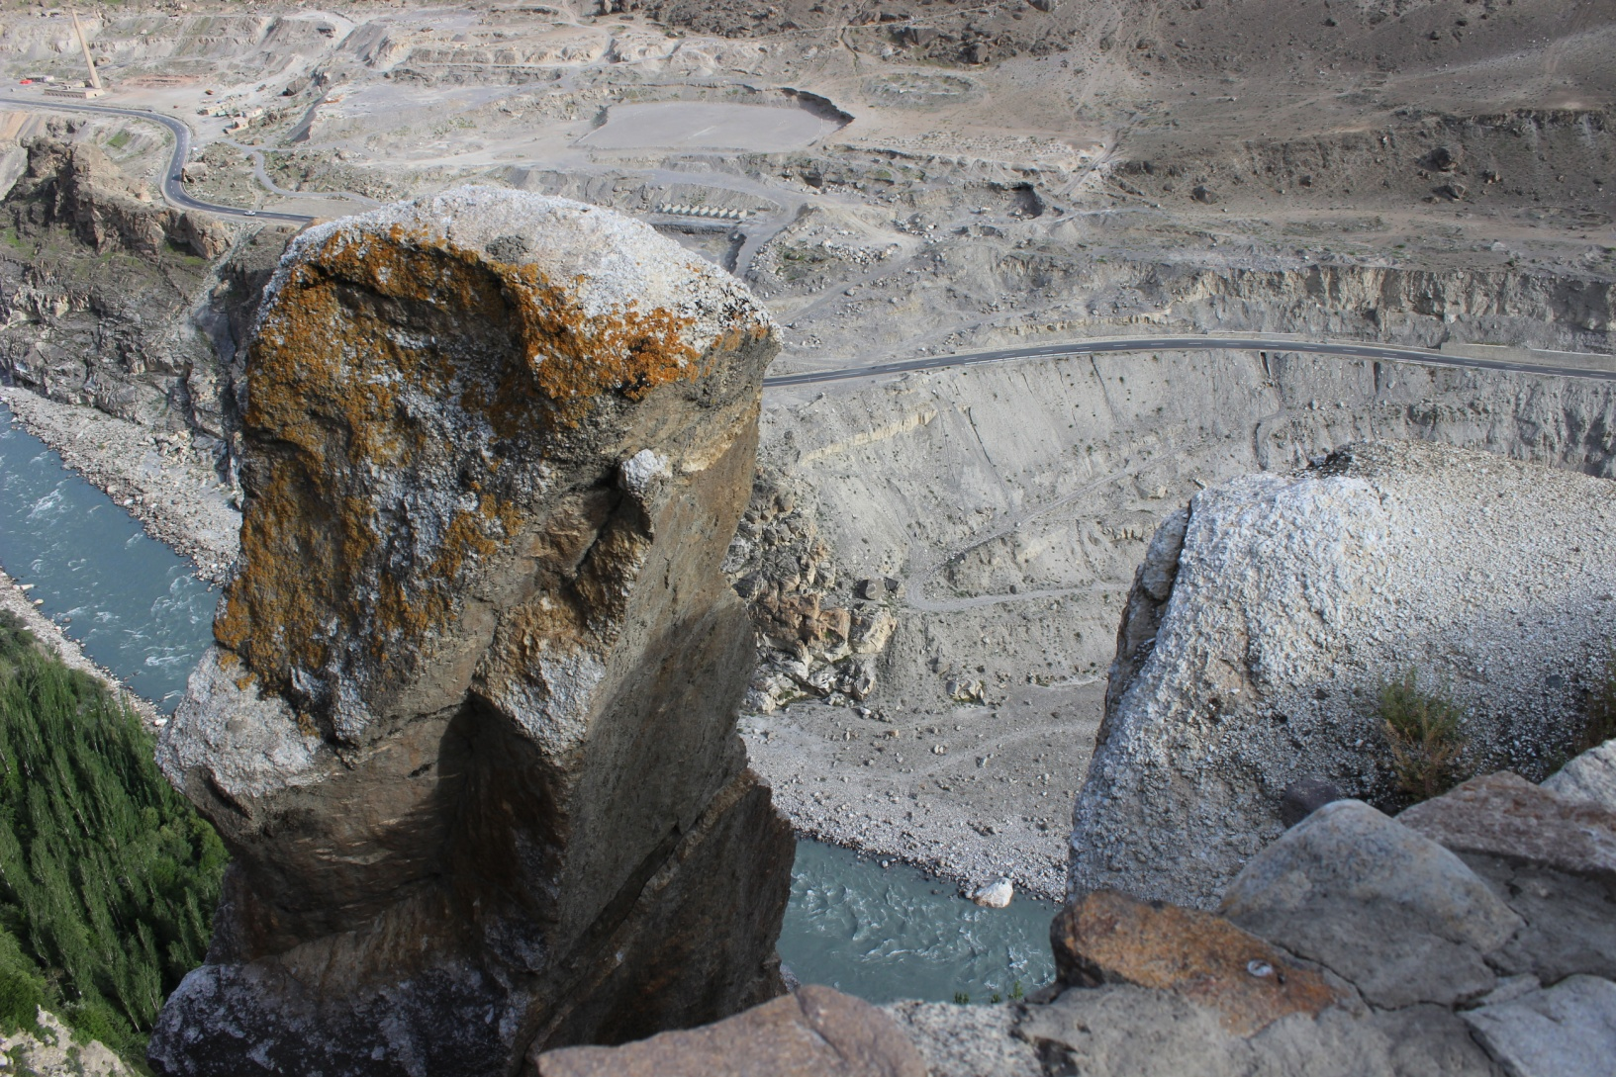

Slide 37
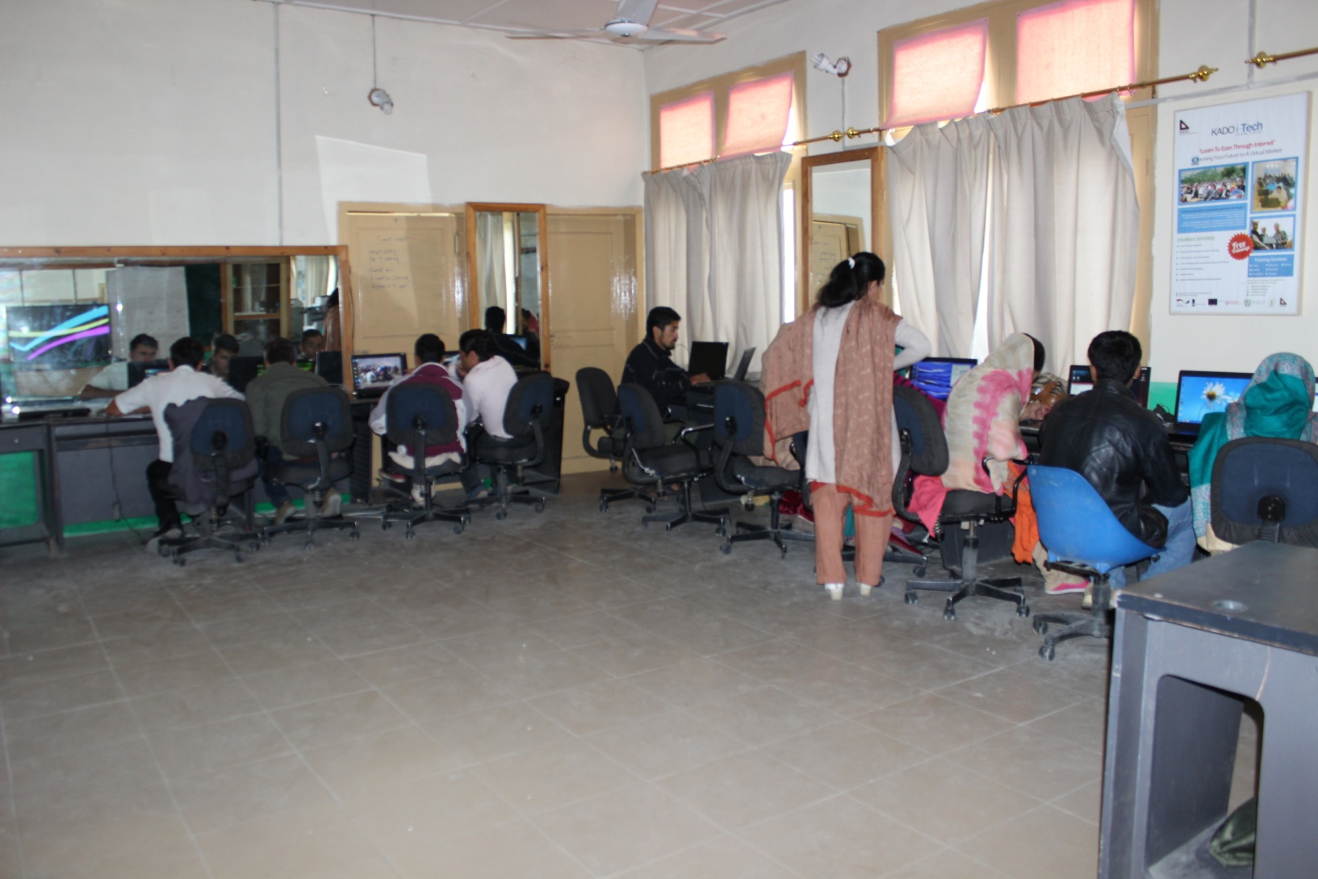
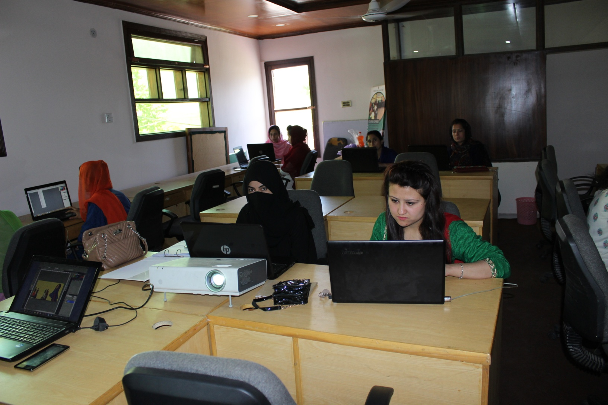

Slide 38
“…..the problem here is that our job market is very poor. We do not have industries here” (RE – Project Coordinator, KADO)
“The problem is that we live in GB; which is itself a conflicted area. That is why the government is not doing much investment for prosperity here”( EJ-Project Manager KADO)
“The reason is it’s the front line of extremism. The next biggest issue is unemployment. Both of these issues are interrelated because when there is unemployment the chances of frustrated youth to be involved in terrorist activities would be higher.”(SK–Project Manager, EP)

Slide 39
Vulnerability Context
“..RA (a famous blogger in the region) tells once about his freelancing experience. He opened his account and showed it to us. At that time, his earning was twelve to fifteen lakh Pakistani rupees per month (c.US$12,000-15,000).” (HU – Trainee, KADO).
“We don’t have high speed Internet and full time electricity in this area. So we don’t have basic things for freelancing.” (SA – Trainer, KADO);
“My parents are uneducated. So, they won’t understand freelancing. They just want that their son to go to the office, use a big car and work on some important government position, and people can praise them how successful is their son.” (HU – Trainee, KADO)
Notes:
. Firstly, GB is located in the disputed region of Kashmir the result of which is that it is a separate state in Pakistan but without status of a province to be eligible to independent provincial government, legislation and budget. GB is not integrated with any of the other provinces of Pakistan

Slide 40
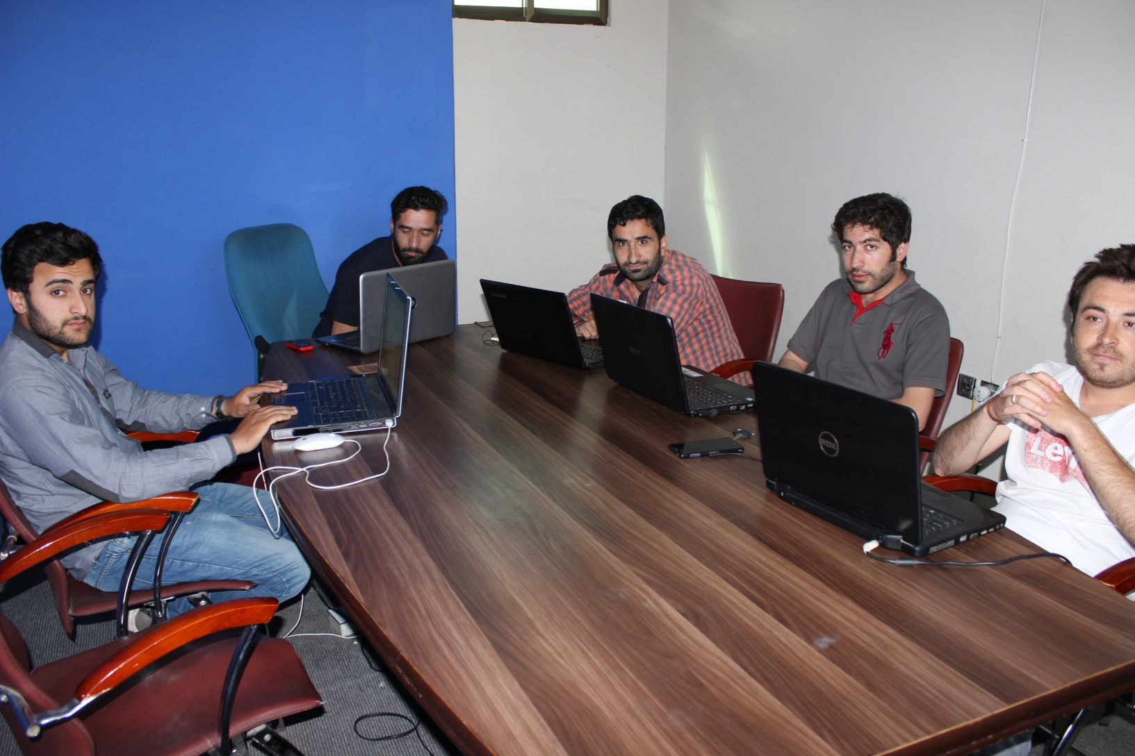

Slide 42
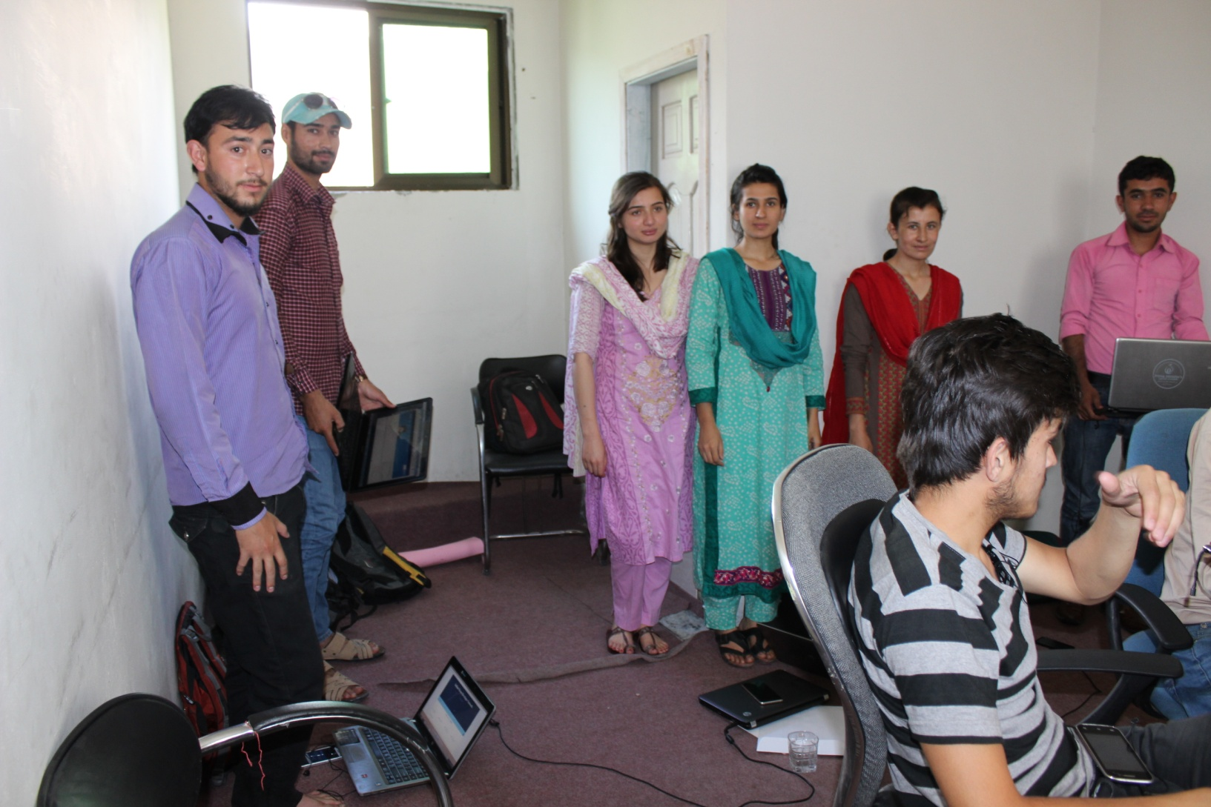
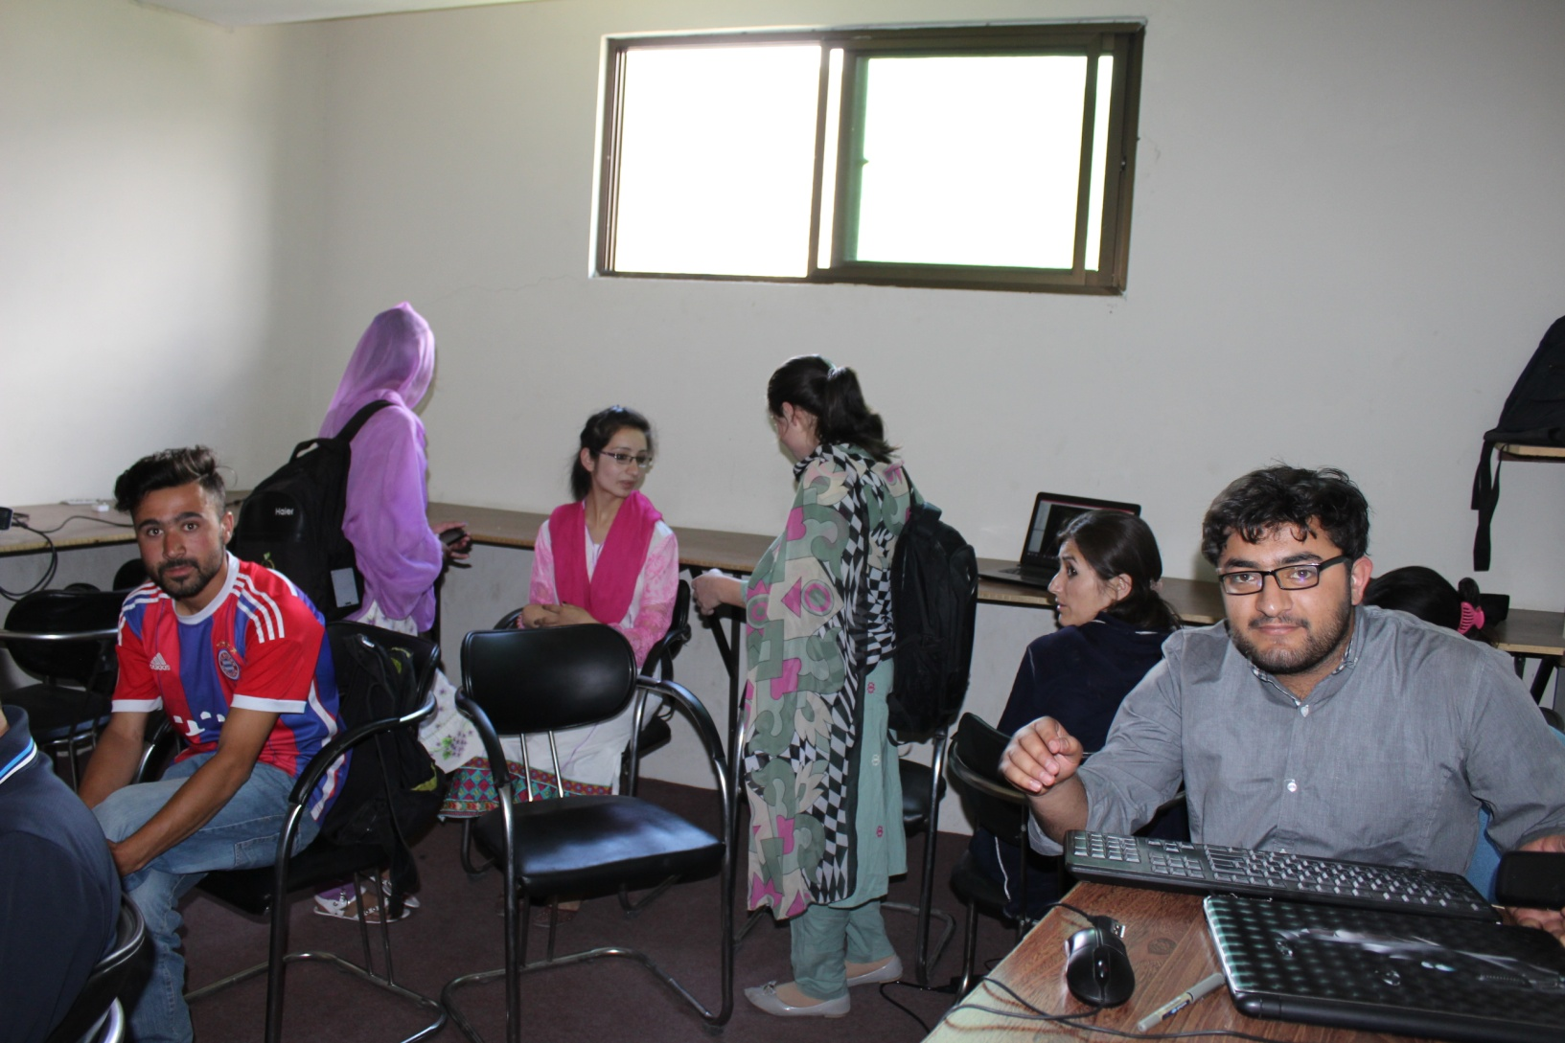

Slide 43
Mediation Effect of Institutions
“I think the system of Freelancer and Upwork is very tough. ... I cannot work on that level. I made an account on Upwork but we have some difficulties there. We had some problem in creating a profile there. I cannot do work in English correctly. Sometimes, they cancel the jobs. We do not understand what they are talking about. Sometimes, they give us poor rating. That is also a dead block.” (WA – Trainee, KADO)
“The freelancing marketplaces are improving their processes. They are blocking accounts for any violation of their terms and conditions. They have introduced different matrix like job success rather than relying on customers’ reviews.” (SK – Project Manager, EP)
Free market vs. “Walled Gardens”
“I completed my first online outsourcing project with the help of one or two of my friends.” (MU – Trainee, KADO)and “I have recently guided my cousin about freelancing.” (NU – Trainee, KADO)

Slide 44
Capital Assets and Livelihood Outcomes
Sinking, Struggling, Surviving and Swimming
“the technical skills for freelancing such as e-marketing, blogging, search engine optimization, graphic and web-designing”
“There is a friend of mine ... When he did not get any order for six months so his family members were also irritated. They said to him to leave this freelancing and work in a factory. He went to the factory as a Data entry operator” (AZ – Trainee, EP)
“When a person is healthy, he can do this work. If he gets ill, so he will be unable to work and there would be no chances for any money.” (WA – Trainee, KADO)

Slide 45
Conclusions
Q1. Main driving force is necessity of earning a living and absence of other livelihood strategies.
Q2. Physical and human capitals were especially lacking and there were also institutional barriers, for example around payment systems, gender roles, and cultural constructions of what constituted meaningful work.
Q3. many trainees “failed to launch” while others struggled to make minor amounts, was limited evidence on impacts on social and physical capital.

Slide 46
Example 2 Innovation Platform DHIS2
https://www.researchgate.net/publication/332658689_Exploring_Tensions_of_Global_Public_Good_Platforms_for_Development_The_Case_of_DHIS2

Slide 48
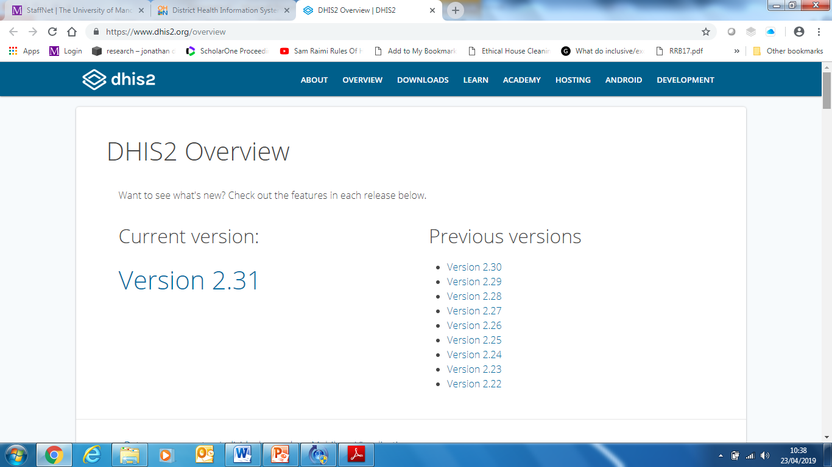
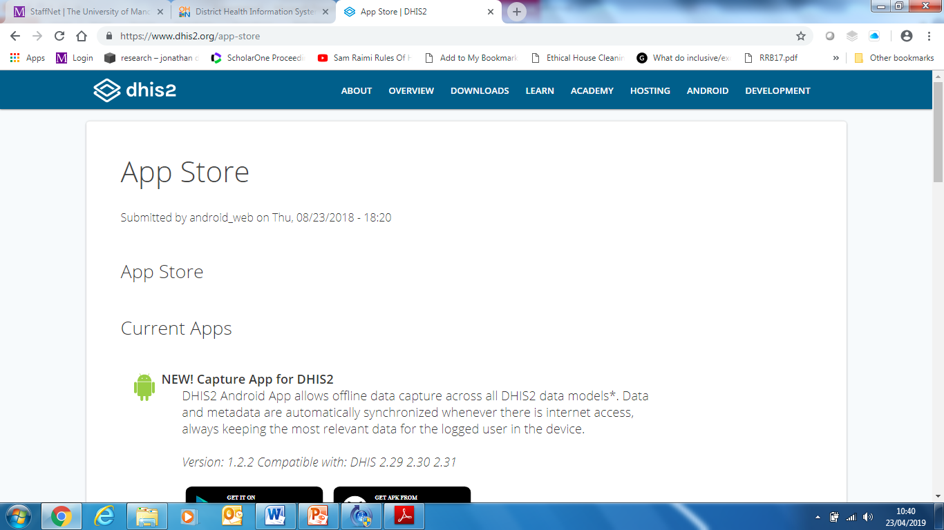

Slide 49
Tension between serving those that can pay for functionality and those that cannot

Slide 50
Tension between DHIS2 as a generic software and an “appliance”

Slide 51
Tension between supporting the platform core and supporting innovation in the fringes

Slide 52
Tension between global and local accountability

Slide 53
Conclusion
Developing countries in an unequal game
Dominance of frightful 5
Some potential in digital entrepreneurship : identify local particularities & protection: Uber does not dominate in Russia or China, Google does not dominate in China
Many African countries : Enduring institutional conditions: access to finance, expertise

