Slide 1
The technology transfer debate
Monday 25/9 2017

Slide 2
Technology transfer outline
How to approach the readings
Background; why is this important
Historical models explaining technology diffusion
Understanding it better:
Technology translation and other variants
Success and failures. Challenges of design-actuality gaps. Design from nowhere
Translations go both ways: the case of DHIS2

Slide 3
Guide to the readings
Main narrative is from Nhampossa’s thesis
Chapter 2 nicely summarize discourses around technology transfer and translation
Chapter 6 presents more in-depth on translation, strategies to manage it etc.
Heeks: Presents a reasonable framework to understand aspects of sustainability. Design-actuality gaps
Recommended readings
Suchman: technology use is re-contextualization of technologies “designed from nowhere”
Laet and Mol: very nicely written! Shows translations (assembling of networks) through the concept of fluidity. Also relevant for “frugal technologies” session
Braa et al: technology learning. No tech transfer without knowledge transfer, and knowledge creation
Sahay et al: circulating translations. Deals with technology translations between multiple locales. Relevant for understanding DHIS2 and implementations in countries

Slide 4
Background
Technology transfer, in a wide sense, means transferring technology from originator/group, to wider dissemination. Can be from universities to private sector, from large businesses to small ones, from government to business, across borders, etc.
In our case, it is usually in addition seen as transferring from ”developed” country to ”developing”.
International development has been, and continues to be, focused on «moving/developing technology from one context to another»
From early days of international development
Agricultural machinery. Some industrialization (perhaps more in the Soviet camp?)
A very common theme also in ICT4D, almost by definition
ICT (from developed country) 4 D (in developing country)

Slide 5
Why transfer of ICTs from developed to developing countries (summary in Heeks)
Economics of innovation: domination of industrialized countries research and development
Economics of business: industrialized-country businesses able to invest more and earlier in ICT
Economics and politics of aid: flow of resources and artefacts from developed to developing
Belief in superiority of imported items
All of the above enabled and strengthened by globalization: carried ideas and systems from developed to developing

Slide 6
Billions of $ going into ”technology transfer”, led by development agencies
http://www.who.int/phi/programme_technology_transfer/en/
http://www.worldbank.org/projects/P101928/health-sector-technology-transfer-institutional-reform?lang=en&tab=overview
https://www.usaid.gov/ghana/news-information/press-releases/official-launch-feed-future-usaid-agriculture-technology
IT is seen as a key tool in achieving [economic growth], and becomes part of a technically rational and technologically determinist agenda that focuses on the digital divide, on “eDevelopment,” and on IT infrastructure (Wilson & Heeks, 2000).
Question 1: How is this seen from the various perspectives on development (from lecture 1)?
Question 2: How do we transfer technology?

Slide 7
Historical models
Rogers’ Diffusion of Technology
TAM
Critiques, and the realization that better explanations are needed

Slide 8
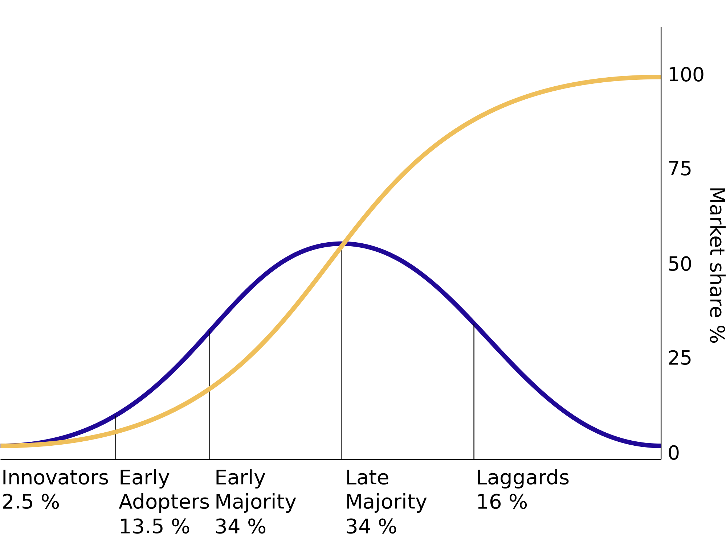
Diffusion of technology Rogers (1983)
Focus on individuals (”early adopters”, ”laggards”)
Does not deal with social systems in which the diffusion takes place
Critiqued for failing to account for complex technological innovation (ICTs). Technology as material object

Slide 9
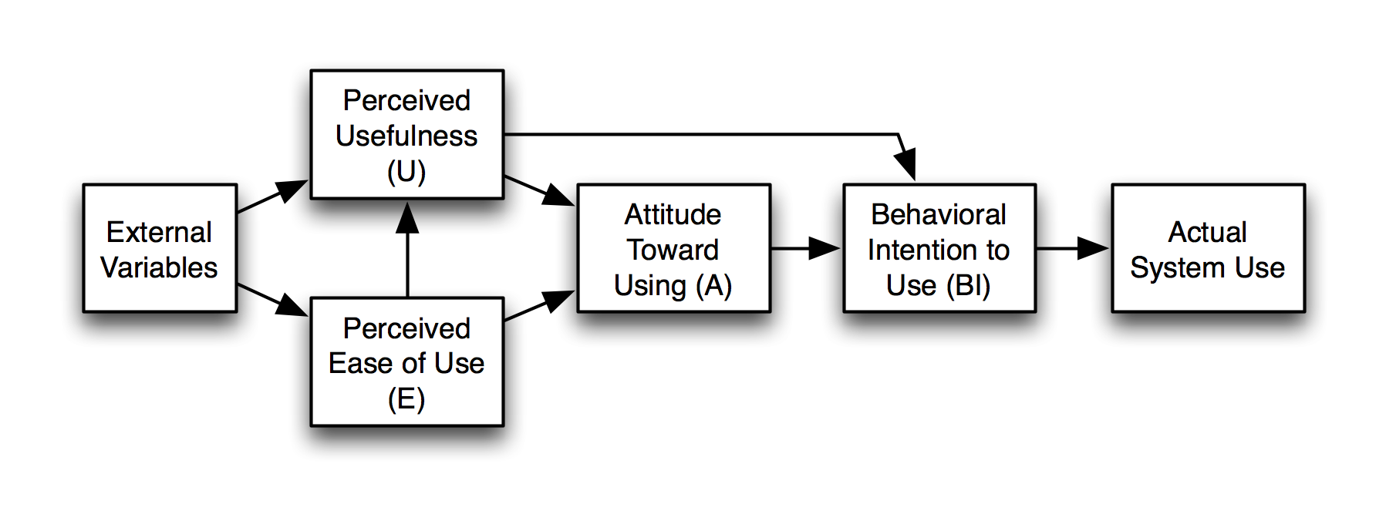
Technology Acceptance Model (TAM) (Davis et al 1989)
Builds on the ideas of, among others, Rogers
Tailored to the context of ICT, designed to predicts ICT acceptance
Perceived usefulness
Perceived ease of use

Slide 10
Limitations of the models
Diffusion of technology model and TAM would work well for facebook
Suggested extension of the models (indicate they are not very precise)
Endorsement of top management
Technological culturation
Accessibility
Exposure to ICT (computer literacy)
Perceived socio economic prospects
++

Slide 11
Critique of TAM (summarized by Nhampossa)
Considering the characteristics of the technology itself
Technology is black-boxed. Are they all the same?
TAMs applicability to large, complex and interconnected systems remains questionable
Socio-technical mismatch
All the suggestions in previous slide really say that context matter
When context/culture is considered, it is reduced to a limited set of variables, that are assumed measurable and standardized.
A focus on voluntary use situations
Perhaps useful for individuals
Ignore the socio-political realities of organizations
(UiO and microsoft exchange…, MS Outlook for email)
Snapshot instead of process perspective
ICT adoption is not phenomena easily understood in snapshots
Process perspectives needed (why did Johan adopted Outlook just recently?)

Slide 12
Introducing Technology Translation
Need a broader view of technology
Socio-technical
Culture
Organizations, institutions
Language
In short, context matters
Originally from ANT, the concept of translation has seen wide use in terms of explaining how, why, and what happens when technology is ”transferred”

Slide 13
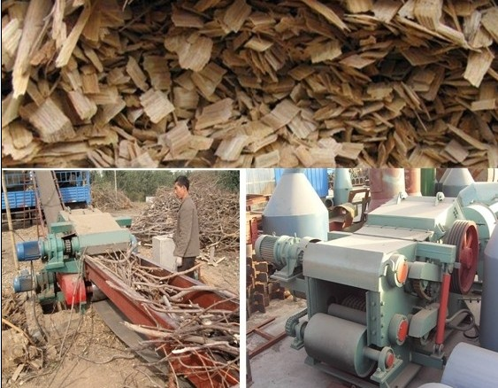
Akrich’s example (1992): There is no such thing as technology transfer
A wood waste machine is ”transferred” from Sweden to Nicaragua
The social and technical relations (actor networks) around it are different, and start to change:
Little wood in Nicaragua, forests held by rebels. Can’t use rice waste. But cotton waste works! How to collect it? Machine from Sudan works ok. Another machine is built to harvest also waste under ground. But cotton waste only available a short period each year. Warehouses built! Then, Amphiserus Cornutu! The Sudanese machine have to be modified to compact the waste more. And so on…..
The network in Nicaragua is different from the one in Sweden. Technology is passed from hand to hand: a series of small translations. Also the technology is translated.

Slide 14
Technology Translation
Clarification: In ANT, technology also has agency (the power to act, to influence, to impose, to play a role). Think of how facebook rule you all
Technology transfer should be seen as an outcome of how actors translate the interests of others so that they become aligned in the complex heterogeneous network of human and non-human actors (Nhampossa)
What does he mean?
With this perspective, effectiveness of technology transfer process is dependent on how the actor network is created and strengthened over time

Slide 15
How the translation perspective addresses some of the critiques of TAM
Technology treated as black box
Characteristics of technology important, how they shape and are shaped by socio-technical networks
Technology transfer is one big step from North to South
Technology translation focus on small incremental steps of co-adaptation between actors (”users and technology”)
Socio-technical mismatch
Translation perspective emphasize the socio-technical nature of any system. Translation processes include technology, politics, culture, institutions, history etc.
Diffusion of technology is measured in terms of rate of adoption
Translation perspective instead focus on stability of network, and alignment of interests. Individuals are treated as part of the network
Diffusion perspective ignores challenges of scaling and sustaining over time
In translation perspective, scaling and sustainability are core concerns.

Slide 16
Cultivating sustainable networks
Means what?
Examples of sustainable networks?
HISP Uganda?

Slide 17
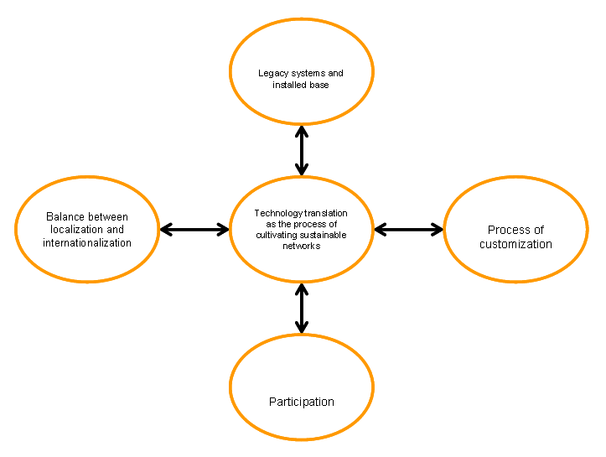
Nhampossa’s view of technology translation

Slide 18
Heeks (2002)
Looks at reasons for failures of information systems in developing countries
Partial failure, total failure, etc..
Sustainability failure, particularly affecting DC
Initially succeeding, but then falling apart
End of funding
When key staff quit
When senior-level champions move on
1/5 to ¼ IS projects in developed countries are total failures
1/3 to 3/5 fall in the partial failure category
Failure rates in DC might be (considerably) higher

Slide 19
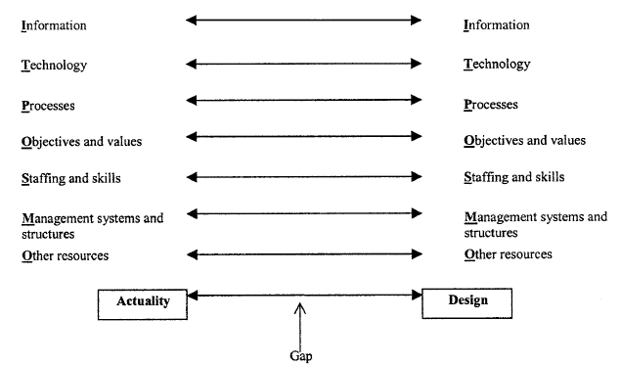
Design-actuality gaps

Slide 20
Design-actuality gaps
With technology transfer, the gaps are typically large
Extreme cases when technology is designed within and for an industrialized country setting, and transferred to a developing country context
Example: introduction of field health information system in Philippines, designed according to an American model assuming the presence of skilled programmers, skilled project managers, a sound technological infrastructure, and a need for outputs like those in an American health-care organization
Even when efforts to develop an information system specifically for a developing country organization, there can be similar problems. Industrialized country consultants, IT vendords, aid donors etc. «If it works for us, it will work for you». Even if they try, their poor understanding of the DC conditions will lead to gaps

Slide 21
How to limit gaps
Actuality improvisation: changing the local actuality to make it closer to the IS design
Design improvisation: changing the (often imported) IS design to make it closer to DC user actuality
These improvisations should be locally situated
How does this compare with translations?

Slide 22
Complementing views
Fluidity as concept to understand attachment and detachment
The need for learning
Designer/user relationships. Design from nowhere, detached intimacy, located accountability
Non-linearity of transfer and translation; circulating translations

Slide 23
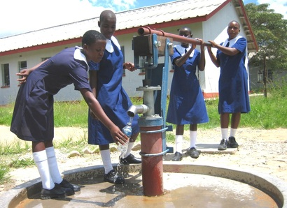
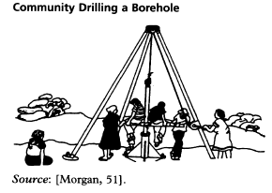
The Zimbabwe Bush Pump type ‘B’
Introduce Fluidity instead of networks: «an object that isn’t too rigorously bounded, that doesn’t impose itself but tries to serve, that is adaptable, flexible and responsive – in short, a fluid object – may well prove to be stronger than one which is firm»
High interpretive flexibility
Heeks’ point about local improvisation?
How does this relate to translation?
Steel and wood. Locally replacable parts

Slide 24
Technology learning (Braa et al)
Not only «will have to learn» to use the technology, but «must learn» to be able to catch up with the industrialized countries
Additional point: ICT development should be sheltered from international competition. Need to develop capacity themselves
Heeks’ point about developing in and for DC: who will develop this? The people who know the context and assumptions

Slide 25
Suchman’s Located acountabilities in technology production
Pointing to three contrasting positions for design:
Design from nowhere:
A view that designers can make commodified technologies detached from any context
Led to a rise of intermediaries (trying to make the system fit)
Detached intimacy
A cadre of developers turn back towards themselves.
You can make a career only engaging with likeminded
Located accountability
We see the world from our own (limited) location
We are responsible for creating collective knowledge about localities of both development and use
What are the implications for ”technology transfer”?

Slide 26
Pointing to some possible implications for technology production
Understanding technology use as recontextualization of technologies designed another place (similar to translation)
Accepting the limited power of any actors or artifacts to control technology production/use (fluidity, networks)

Slide 27
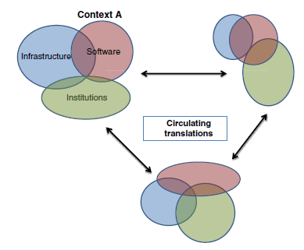
Circulating translations
Stresses the need for learning and local adaptations, or translations.
Translations also affect what is transferred (software)
With digital artefacts (software, written documents), these translations can easily travel further, leading to further translations in other contexts.
The global and the local mutually reinforce each other
What would DHIS2 be like if it had only been implemented in one country?
Design from nowhere? Design from everywhere?

Slide 28
Nhampossa’s view of technology translation revisited
Flexibility
Design improvisation
Fluidity
Design-actuality gaps
Circulating translations
Technology learning
Creating networks, aligning interests

Slide 29
Take-away points
Transfer as translation
Focus on the process; small-step incremental cultivation of networks. Transferred technologies change their new context, and are changed themselves.
Flexible, improvisable, fluid, technologies make design-actuality gaps less dangerous. Allow easier recontextualization
Learning the technology, and how to develop it, is important
Translations circulate. We live in a global world, it influences us

