Slide 1
INF 5860 Machine learning for image classification
Lecture 11: Recurrent neural networks
April 11 , 2018

Slide 2
Outline
Overview (Feed forward and convolution neural networks)
Vanilla Recurrent Neural Network (RNN)
Input-output structure of RNN’s
Training Recurrent Neural Networks
Simple examples
Advanced models
Advanced examples

Slide 3
About today
Goals:
Understand how to build a recurrent neural network
Understand why long range dependencies is a challenge for recurrent neural networks

Slide 4
Readings
Video:
cs231n: Lecture 10 | Recurrent Neural Networks
cs231n (2016): Lecture 14: First part “ConNet for Video” to slide 38
Read:
The Unreasonable Effectiveness of Recurrent Neural Networks
Optional:
Video: cs224d L8: Recurrent Neural Networks and Language Models
Video: cs224d L9: Machine Translation and Advanced Recurrent LSTMs and GRUs
Read: Deep Learning book: CH10 (10.1-10.2)

Slide 5
Progress
Overview (Feed forward and convolution neural networks)
Vanilla Recurrent Neural Network (RNN)
Input-output structure of RNN’s
Training Recurrent Neural Networks
Simple examples
Advanced models
Advanced examples

Slide 6
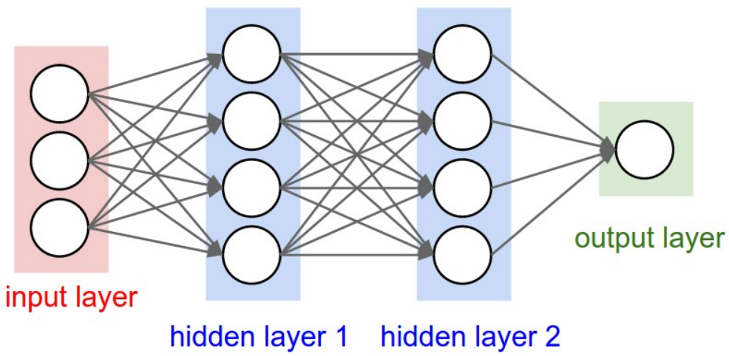
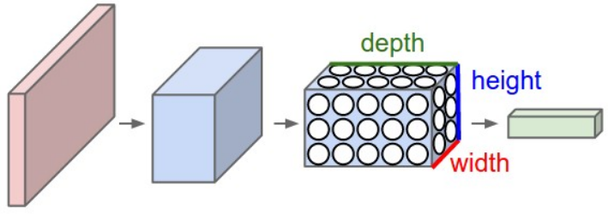
Overview
What have we learnt so far?
Fully connected neural network
Convolutional neural network
What worked well with these?
Fully connected neural network works well when the input data is structured
Convolutional neural network works well for imaging tasks
What does not work well?
Processing data with unknown length
Notes:
Both are feed forward neural networks.
Dilated convolutions can be used to increase the receptive field in CNN’s.
CNN will always have a final receptive field.

Slide 7
Progress
Overview (Feed forward and convolution neural networks)
Vanilla Recurrent Neural Network (RNN)
Input-output structure of RNN’s
Training Recurrent Neural Networks
Simple examples
Advanced models
Advanced examples

Slide 8
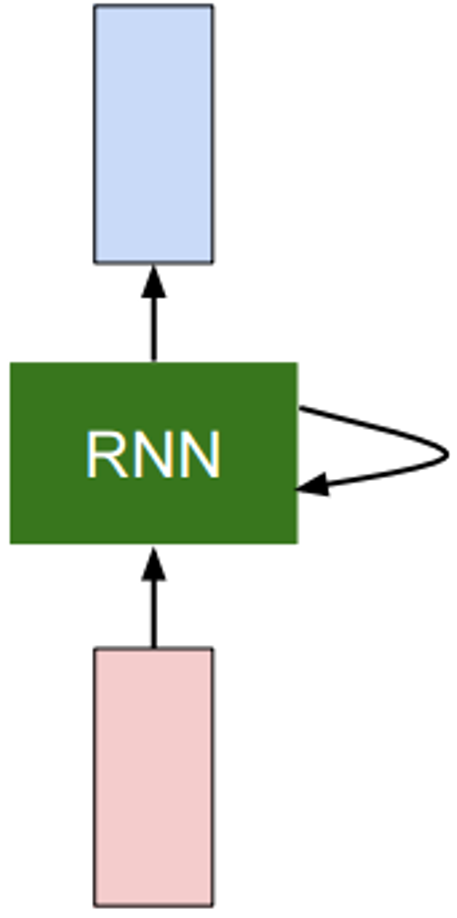
Recurrent Neural Network (RNN)
Takes a new input
Manipulate the state
Reuse weights
Gives a new output
$$y_{t}$$
$$x_{t}$$

Slide 9
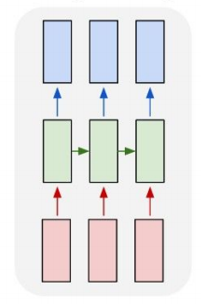
Recurrent Neural Network (RNN)
Unrolled view
$x_{t}$: The input vector:
$h_{t}$: The hidden state of the RNN
$y_{t}$: The output vector:
$$y_{t}$$
$$y_{1}$$
$$y_{2}$$
$$y_{3}$$
$$h_{1}$$
$$h_{2}$$
$$h_{3}$$
$$x_{t}$$
$$x_{1}$$
$$x_{2}$$
$$x_{3}$$

Slide 10
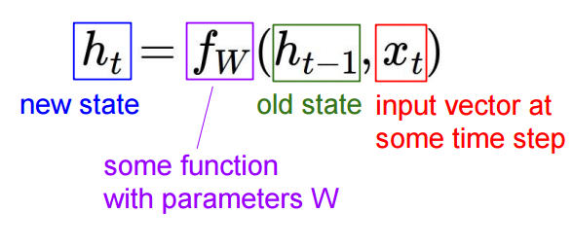
Recurrent Neural Network (RNN)
Recurrence formula:
Input vector: $x_{t}$
Hidden state vector: $h_{t}$
$$y_{t}$$
$$x_{t}$$
Note: We use the same function and parameters for very “time” step

Slide 11
(Vanilla) Recurrent Neural Network
Input vector: $x_{t}$
Hidden state vector: $h_{t}$
Output vector: $y_{t}$
Weight matrices: $W_{hh}$, $W_{hx}, W_{hy}$
General form:
$$h_{t}=f_{w}\left(h_{t−1},x_{t}\right)$$
Vanilla RNN:
$$h_{t}=\tanh\left(W_{hh}h_{t−1}+W_{hx}x_{t}+b\right)$$
$$y_{t}=W_{hy}h_{t}$$
$$y_{t}$$
$$x_{t}$$

Slide 12
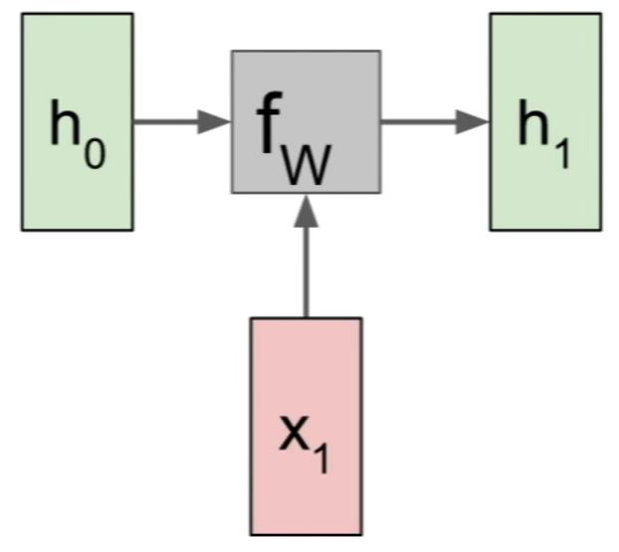
RNN: Computational Graph
Notes:
H_0: Often initialized to zeros

Slide 13
RNN: Computational Graph

Slide 14
RNN: Computational Graph

Slide 15
RNN: Computational Graph

Slide 16
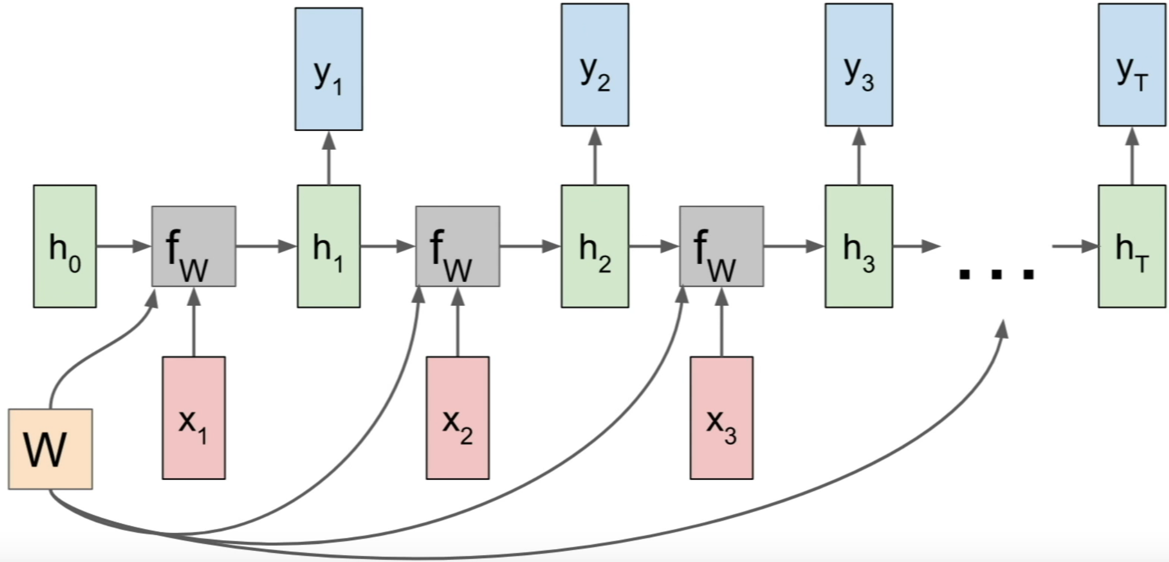
RNN: Computational Graph

Slide 17
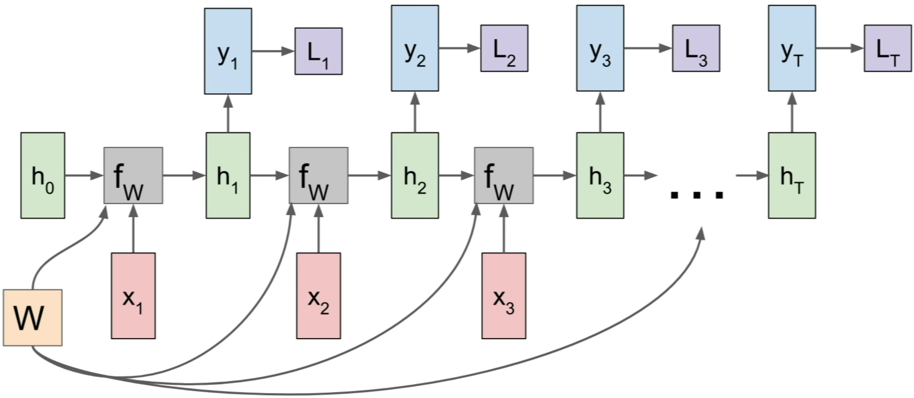
RNN: Computational Graph

Slide 18
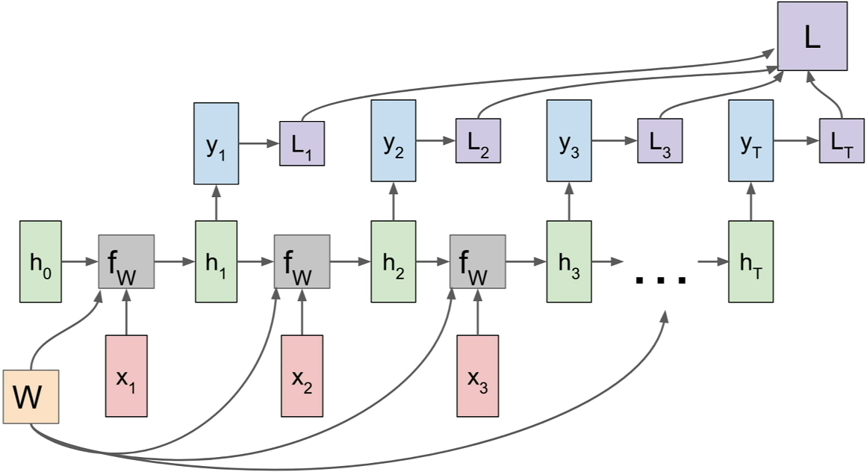
RNN: Computational Graph

Slide 19
Example: Language model
Task: Predicting the next character
Training sequence: “hello”
Vocabulary:
[h, e, l, o]
Encoding: Onehot
Notes:
- Input the softmax: Different then what the model saw during training. For word model, the input vector can be very large and spare vector operations are often used.
The characters are categorical
L is not more H then E…

Slide 20
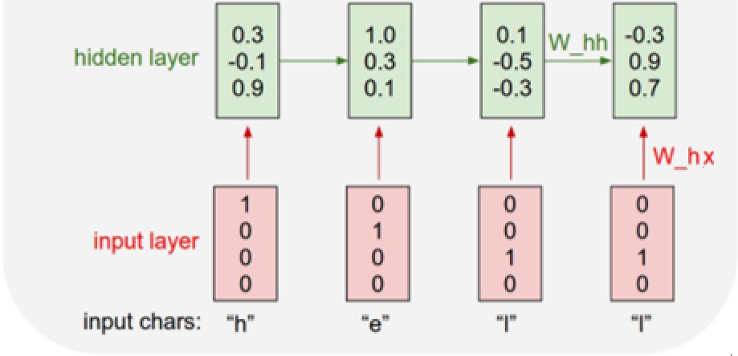
RNN: Predicting the next character
Task: Predicting the next character
Training sequence: “hello”
Vocabulary:
[h, e, l, o]
Encoding: Onehot
Model:
$$h_{t}=\tanh\left(W_{hh}h_{t−1}+W_{hx}x_{t}\right)$$

Slide 21
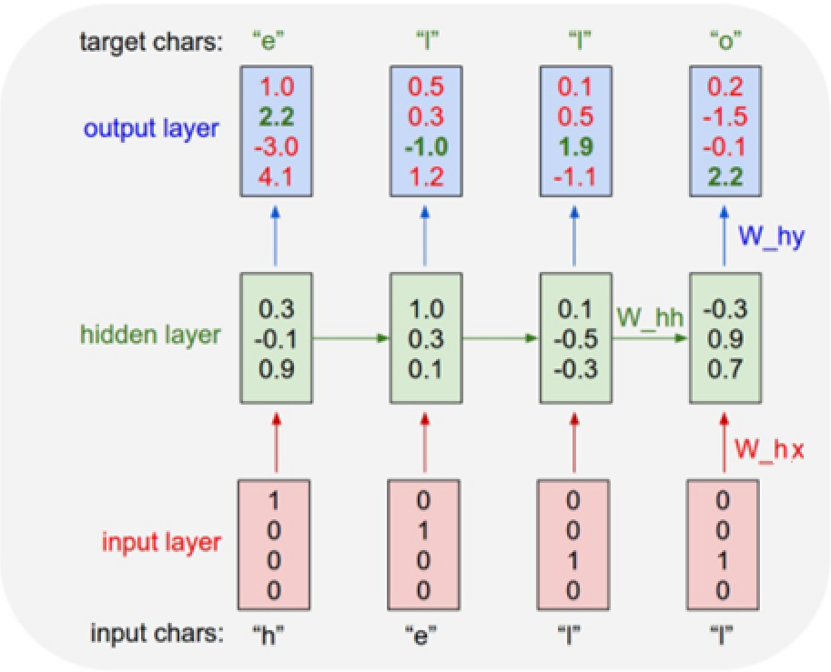
RNN: Predicting the next character
Task: Predicting the next character
Training sequence: “hello”
Vocabulary:
[h, e, l, o]
Encoding: Onehot
Model:
$$h_{t}=\tanh\left(W_{hh}h_{t−1}+W_{hx}x_{t}+b\right)$$
$$y_{t}=W_{hy}h_{t}$$

Slide 22
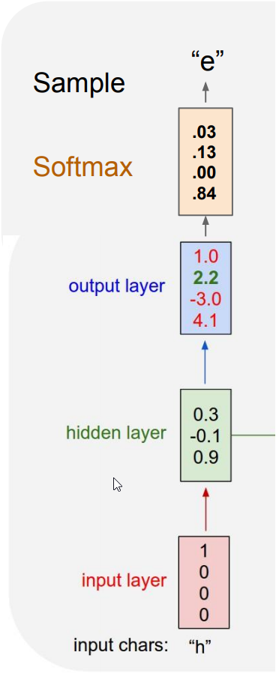
RNN: Predicting the next character
Vocabulary:
[h, e, l, o]
At test time, we can sample from the model to synthesis new text.

Slide 23
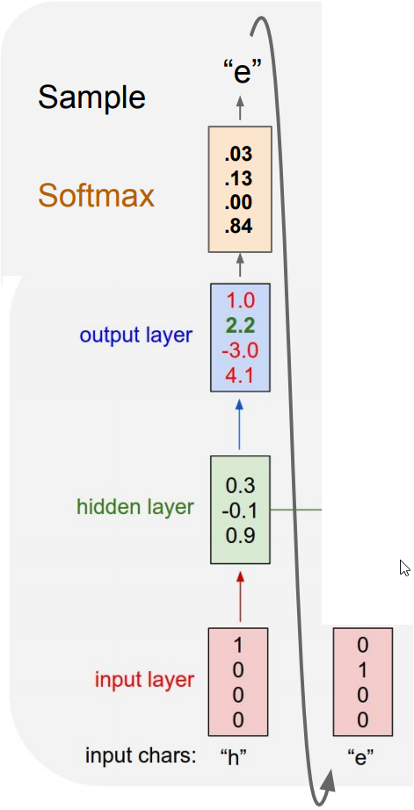
RNN: Predicting the next character
Vocabulary:
[h, e, l, o]
At test time, we can sample from the model to synthesis new text.

Slide 24
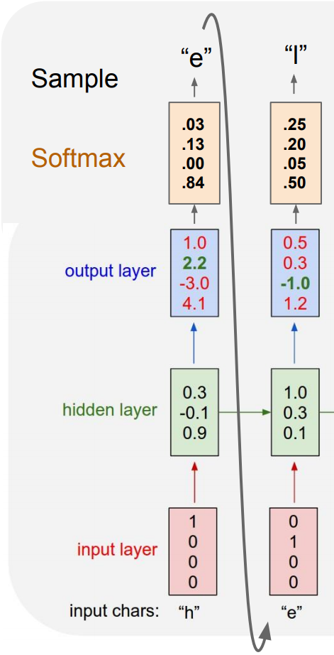
RNN: Predicting the next character
Vocabulary:
[h, e, l, o]
At test time, we can sample from the model to synthesis new text.

Slide 25
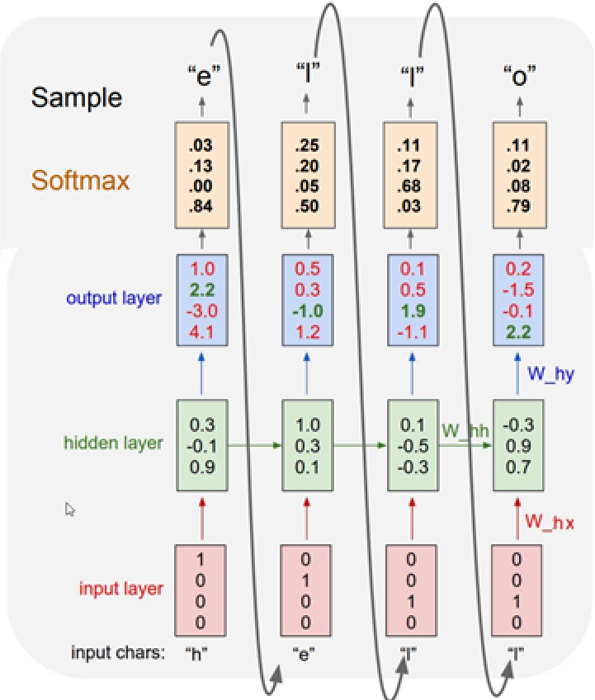
RNN: Predicting the next character
Vocabulary:
[h, e, l, o]
At test time, we can sample from the model to synthesis new text.

Slide 26
Progress
Overview (Feed forward and convolution neural networks)
Vanilla Recurrent Neural Network (RNN)
Input-output structure of RNN’s
Training Recurrent Neural Networks
Simple examples
Advanced models
Advanced examples

Slide 27
Input-output structure of RNN’s
One-to-one
one-to-many
many-to-one
Many-to-many
many-to-many (encoder-decoder)

Slide 28
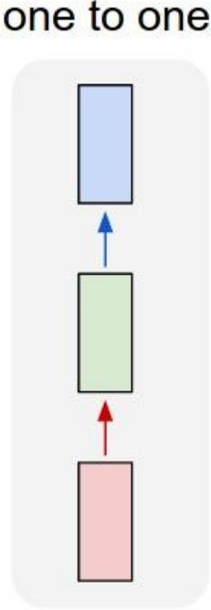
RNN: One-to-one
Normal feed forward neural network

Slide 29
RNN: One-to-many
Task:
Image Captioning
(Image Sequence of words)

Slide 30
RNN: Many-to-one
Tasks:
Sentiment classification
Video classification

Slide 31
RNN: Many-to-many
Task:
Video classification on frame level

Slide 32
RNN: Many-to-many (encoder-decoder)
Task:
Machine Translation
(English French)

Slide 33
Progress
Overview (Feed forward and convolution neural networks)
Vanilla Recurrent Neural Network (RNN)
Input-output structure of RNN’s
Training Recurrent Neural Networks
Simple examples
Advanced models
Advanced examples

Slide 34
Training Recurrent Neural Networks
The challenge in training a recurrent neural network is to preserve long range dependencies.
Vanilla recurrent neural network
$h_{t}=f\left(W_{hh}h_{t−1}+W_{hx}x_{t}+b\right)$
$f=tanh⁡()$ can easily cause vanishing gradients, difficult to remember more than $\sim$7 steps.
$f=relu()$ can easily cause exploding values and/or gradients
Finite memory available

Slide 35
Exploding or vanishing gradients
$tanh⁡()$ solves the exploding value problem
$tanh⁡()$does NOT solve the exploding gradient problem, think of a scalar input and a scalar hidden state.
$$h_{t}=\tanh\left(W_{hh}h_{t−1}+W_{hx}x_{t}+b\right)$$
$$\frac{∂h_{t}}{∂h_{t−1}}=\left[1−\tanh^{2}{(W_{hh}h_{t−1}+W_{hx}x_{t}+b)}\right]{⋅W}_{hh}$$
The gradient can explode/vanish exponentially in time (steps)
If ${|W}_{hh}|<1$, vanishing gradients
If ${|W}_{hh}|>1$, exploding gradients

Slide 36
Exploding or vanishing gradients
Conditions for vanishing and exploding gradients for the weight matrix, $W_{hh}$:
If largest singular value > 1: Exploding gradients
If largest singular value < 1: Vanishing gradients
“On the difficulty of training Recurrent Neural Networks, Pascanu et al. 2013

Slide 37
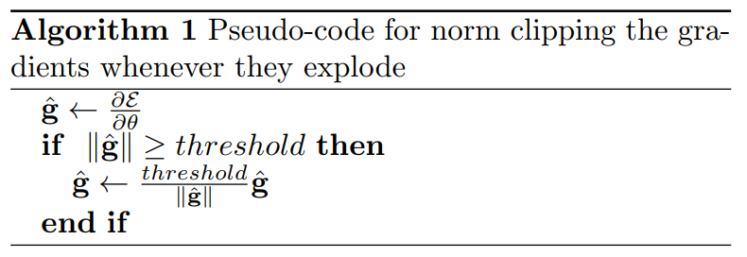
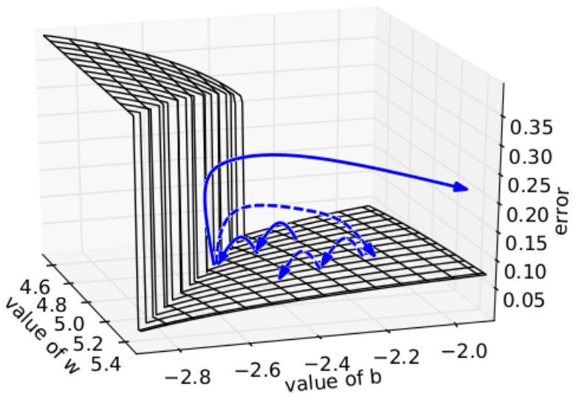
Gradient clipping
To avoid exploding gradients, a simple trick is to set a threshold of the norm of the gradient matrix, $\frac{∂h_{t}}{∂h_{t−1}}$.
Error surface of a single hidden unit RNN
High curvature walls
Solid lines: Standard gradient descent trajectories
Dashed lines gradient rescaled to fixes size
“On the difficulty of training Recurrent Neural Networks, Pascanu et al. 2013

Slide 38
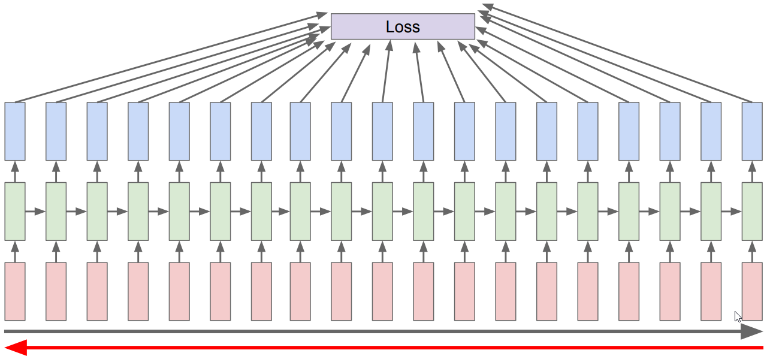
Vanishing gradients - “less of a problem”
In contrast to feed-forward networks, RNNs will not stop learning in spite of vanishing gradients.
The network gets “fresh” inputs each step, so the weights will be updated.
The challenge is to learning long range dependencies. This can be improved using more advanced architectures.
Outputs at time step t is mostly effected by the close previous state.

Slide 39
Initialization of the weights
Xavier initialization: ${Var[W}_{l}]= \frac{2}{n_{l} + n_{l+1}}$
Variance scaling: ${ Var[W}_{l}]= \frac{1}{n_{l} }$
Transition matrix, $W_{hh}$, $W_{hx}$, $W_{hy}$:
Xavier initialization
Variance scaling
Initial state, $h_{0}$:
Initialize to zeros
Note: We can learn the initial state by backpropagate into it.

Slide 40
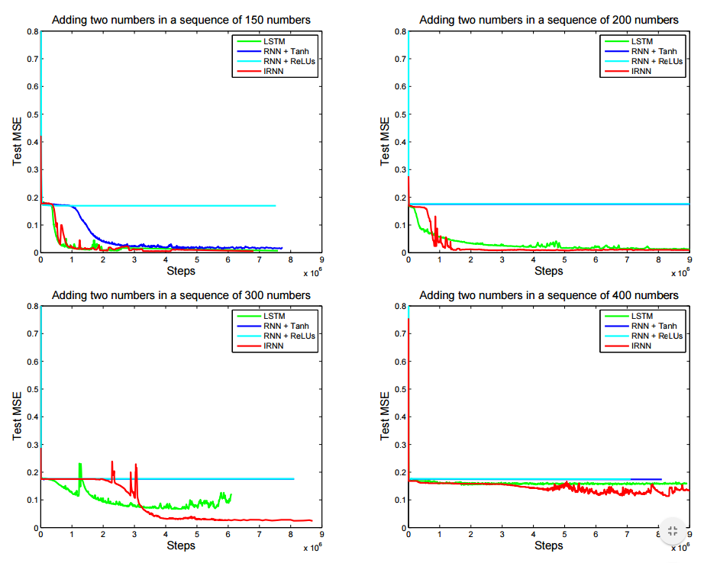
Some initialization schemes can help RNNs
Identity initialization of state transition matrix, $W_{hh}$:
Initially no state change can be a good start
Avoid exploding/vanishing gradients
May be able to use ReLu
A Simple Way to Initialize Recurrent Networks of Rectified Linear Units
Notes:
Adding two numbers in a sequence:
LSTM
RNN +tanh (normal rnn with tanh and gaussian initialization)
RNN +relu (normal rnn with relu and gaussian initialization)
IRNN +tanh (normal rnn with relu and identity initialization)
The output should be the sum of the two values which have “mask” value of 1.

Slide 41
Backpropagation through time (BPTT)
Training of a recurrent neural network is done using backpropagation and gradient descent algorithms
To calculate gradients you have to keep your inputs in memory until you get the backpropagating gradient
Then what if you are reading a book of 100 million characters?

Slide 42
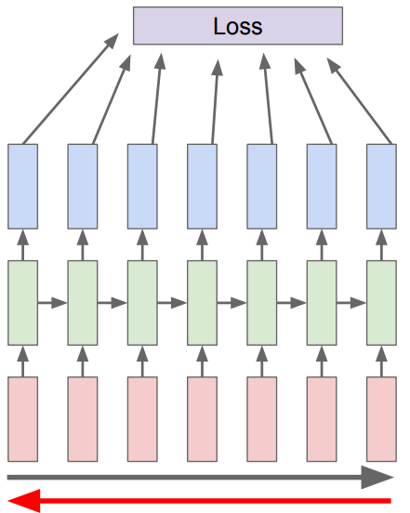
Truncated Backpropagation thought time
The solution is that you stop at some point and update the weight as if you were done.

Slide 43
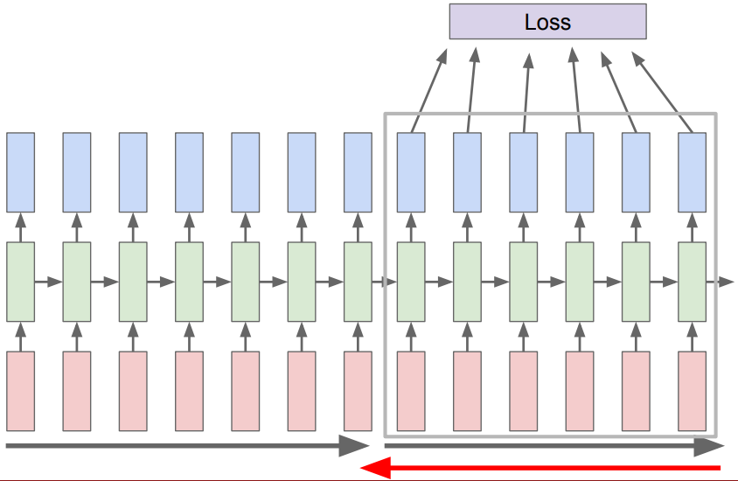
Truncated Backpropagation thought time
The solution is that you stop at some point and update the weight as if you were done.

Slide 44
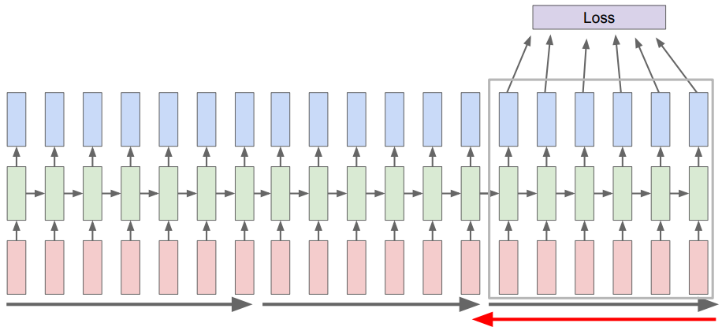
Truncated Backpropagation thought time
The solution is that you stop at some point and update the weight as if you were done.

Slide 45
Truncated Backpropagation thought time
Advantages:
Reducing the memory requirement
Faster parameter updates
Disadvantage:
Not able to capture longer dependencies then the truncated length.
Notes:
Faster parameter updates -> similar to batch gradient descent

Slide 46
What effect do you get from stopping the gradients?
You are not guarantied to remember interactions longer than the number of steps.
Say a text call a person Anna then much later refer to her as “she”
A model with a lot of steps could directly learn to remember Anna.
RNNs can in test time remember longer than the number of steps:
You may have learned from earlier cases where “name” and “he/she” were much closer
The model knows that it should save gender of the name

Slide 47
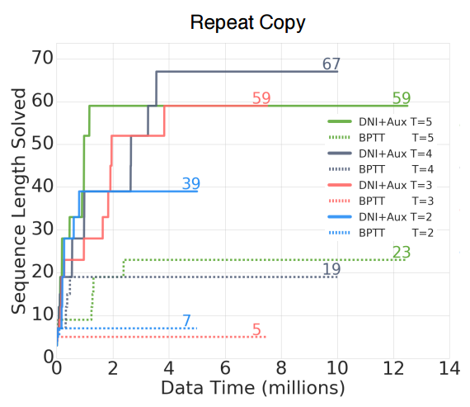
A fun fix! Synthetic gradients
Train a network to predict the gradients you would get if all steps were connected
You can learn that if you see Anna in the state, you should expect gradients “asking for Anna” later
This is of course not perfect since you don’t have all the coming information
Decoupled Neural Interfaces using Synthetic Gradients
Notes:
Decoupled Neural Interface (DNI)
- All rnn models were LSTMs
“modelling error gradients with a neural network”
“T” is the step size before backprop
Reported: “maximum sequence length that was successfully modelled”
Task: “Repeat Copy ” Repeat Copy must also read a sequence of N characters, but after the stop character, reads the number, R, which indicates the number of times it is required to copy the sequence, before outputting a final stop character
N: Sequence length
R: number of copies
Truncated BPTT: T ∈ {2, 3, 4, 5}
auxiliary task (AUX) -> predict future synthetic gradient
X-axis: training data consumed.
Y-axis: e maximum sequence length in N*R

Slide 48
Progress
Overview (Feed forward and convolution neural networks)
Vanilla Recurrent Neural Network (RNN)
Input-output structure of RNN’s
Training Recurrent Neural Networks
Simple examples
Advanced models
Advanced examples

Slide 49
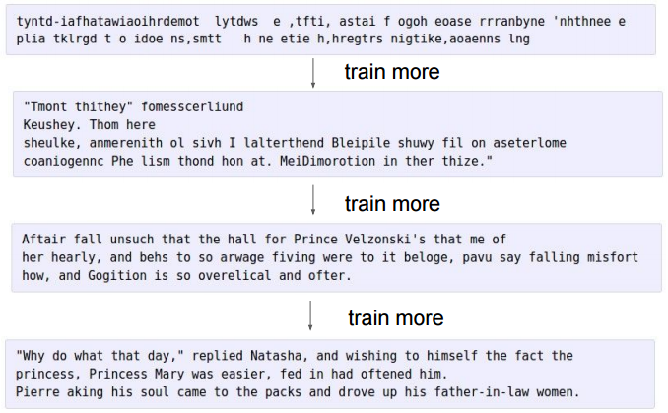
Inputting Shakespeare
Input a lot of text
Try to predict the next character
Learning spelling, quotes and punctuation.
https://gist.github.com/karpathy/d4dee566867f8291f086

Slide 50
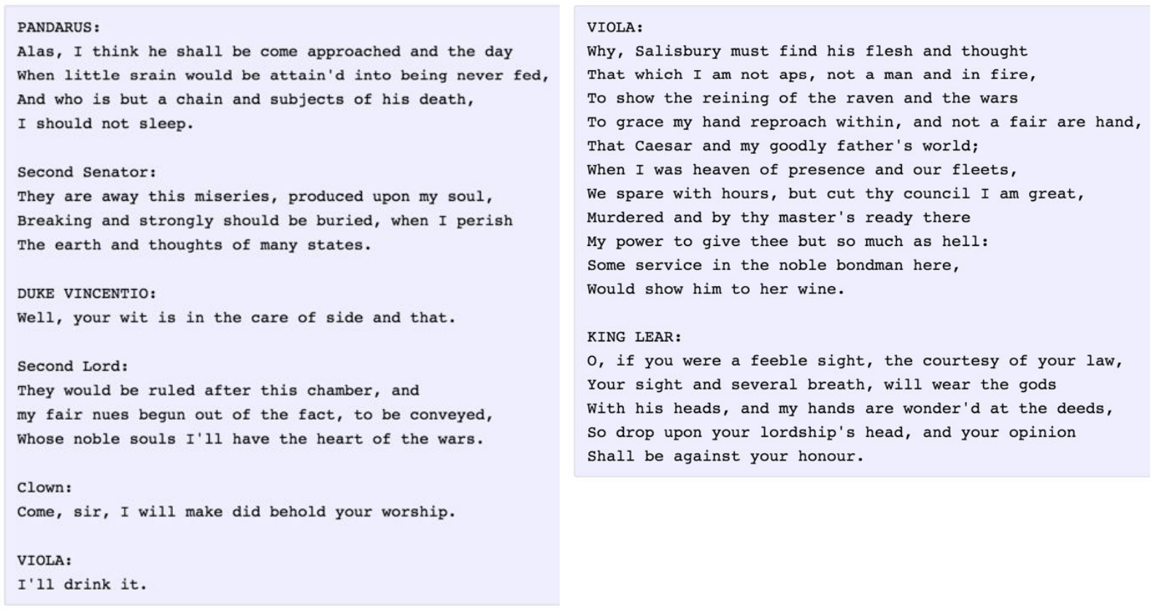
Inputting Shakespeare
https://gist.github.com/karpathy/d4dee566867f8291f086

Slide 51
Inputting latex

Slide 52
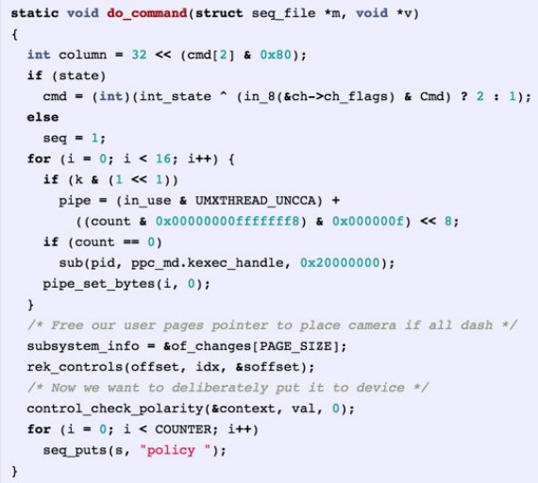
Inputting C code (linux kernel)

Slide 53
Interpreting cell activations
Semantic meaning of the hidden state vector
Visualizing and Understanding Recurrent Networks

Slide 54
Interpreting cell activations
Visualizing and Understanding Recurrent Networks

Slide 55
Interpreting cell activations
Visualizing and Understanding Recurrent Networks

Slide 56
Interpreting cell activations
Visualizing and Understanding Recurrent Networks

Slide 57
Interpreting cell activations
Visualizing and Understanding Recurrent Networks

Slide 58
Progress
Overview (Feed forward and convolution neural networks)
Vanilla Recurrent Neural Network (RNN)
Input-output structure of RNN’s
Training Recurrent Neural Networks
Simple examples
Advanced models
Advanced examples

Slide 59
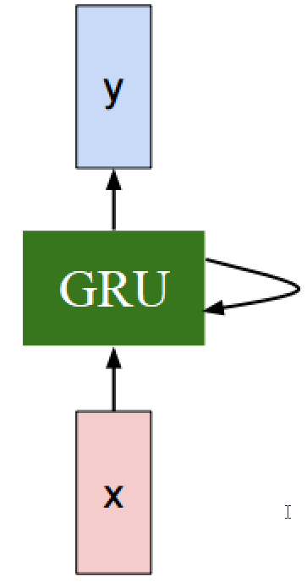
Gated Recurrent Unit (GRU)
A more advanced recurrent unit
Uses gates to control information flow
Used to improve long term dependencies

Slide 60
Gated Recurrent Unit (GRU)
GRU is adding or removing to the state, not “transforming the state”
Vanilla RNN
Cell state | $$h_{t}=tanh({W^{hx}x}_{t}+W^{hh}h_{t−1}+b)$$
GRU
Update gate | $$Γ^{u}= σ({W^{u}x}_{t}+{U^{u}h}_{t−1}+b^{u})$$
Reset gate | $$Γ^{r}= σ({W^{r}x}_{t}+{U^{r}h}_{t−1}+b^{r})$$
Candidate cell state | $${\tilde{h}}_{t} =tanh\left({Wx}_{t}+{U{(Γ}^{r}∘h}_{t−1}\right)+b)$$
Final cell state | $h_{t}= Γ^{u}∘h_{t−1}+\left(1−Γ^{u}\right)∘{\tilde{h}}_{t}$
With $Γ^{r}$ as ones and $Γ^{u}$ as zeros, GRU Vanilla RNN
Notes:
The gates can be sees as continuous “binary” gates. They are between 0 and 1
The Reset gate have the opportunity to remove all old information.
The cell memory contains values between -1 and 1.
The update gate chooses how much of the new memory content that should be considered.
Why does GRU work

Slide 61
Gated Recurrent Unit (GRU)
Text example:
“I visualize a time when we will be to robots what dogs are to humans, and I’m rooting for the machines.”
Update gate | $$Γ^{u}= σ({W^{u}x}_{t}+{U^{u}h}_{t−1}+b^{u})$$
Reset gate | $$Γ^{r}= σ({W^{r}x}_{t}+{U^{r}h}_{t−1}+b^{r})$$
Candidate cell state | $${\tilde{h}}_{t} =tanh\left({Wx}_{t}+{U{(Γ}^{r}∘h}_{t−1}\right)+b)$$
Final cell state | $h_{t}= Γ^{u}∘h_{t−1}+\left(1−Γ^{u}\right)∘{\tilde{h}}_{t}$
Notes:
The update gate $,Γ^{u}$, can easily be very close to 1 due to the use of sigmoid activation function.
In a standard rnn, we are multiplying the weight matrix with the input regardless of how useless the input is.

Slide 62
Long Short Term Memory (LSTM)
GRU |  | LSTM
Update gate | $$Γ^{u}= σ({W^{u}x}_{t}+{U^{u}h}_{t−1}+b^{u})$$ | Forget gate | $$Γ^{f}= σ({W^{f}x}_{t}+{U^{f} h}_{t−1}+b^{f})$$
Reset gate | $$Γ^{r}= σ({W^{r}x}_{t}+{U^{r}h}_{t−1}+b^{r})$$ | Input gate | $$Γ^{i}= σ({W^{i}x}_{t} +{U^{i }h}_{t−1} +b^{i})$$
 |  | Output gate | $$Γ^{o}= σ({W^{o}x}_{t}+{U^{o}h}_{t−1}+b^{o})$$
Candidate cell state | $${\tilde{h}}_{t} =tanh\left({Wx}_{t}+{U{(Γ}^{r}∘h}_{t−1}\right)+b)$$ | Potential cell memory | $${\tilde{c}}_{t}=tanh({W^{c}x}_{t}+{U^{c} h}_{t−1}+b^{c})$$
Final cell state | $h_{t}= Γ^{u}∘h_{t−1}+\left(1−Γ^{u}\right)∘{\tilde{h}}_{t}$ | Final cell memory | $$c_{t}=Γ^{f}∘c_{t−1}+Γ^{i}∘{\tilde{c}}_{t}$$
 |  | Final cell state | $h_{t}=Γ^{o}∘tanh⁡(c_{t})$
LSTM training
One can initialize the biases of the forget gate such that the values in the forget gate are close to one.

Slide 63
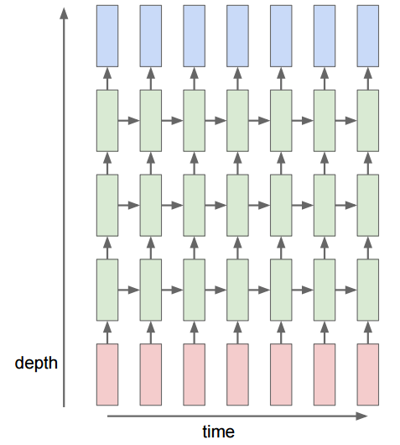
Multi-layer Recurrent Neural Networks
Multi-layer RNN can be used to enhance model complexity
Similar as for feed forward neural networks, stacking layers creates higher level feature representation
Normally, 2 or 3 layer deep, not as deep as conv nets
More complex relationships in time

Slide 64
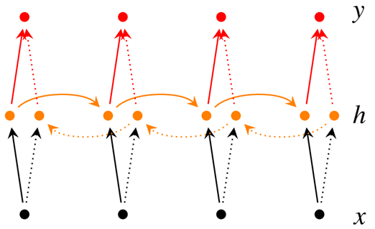
Bidirectional recurrent neural network
The blocks can be vanilla, LSTM and GRU recurrent units
Real time vs post processing
$${\vec{h}}_{t}=f\left({\vec{W}}_{hx}x_{t}+{\vec{W}}_{hh}{\vec{h}}_{t−1}\right)$$
$${\overset{⃖}{h}}_{t}=f\left({\overset{⃖}{W}}_{hx}x_{t}+{\overset{⃖}{W}}_{hh}{\overset{⃖}{h}}_{t+1}\right)$$
$$y_{t}=g(W_{hy} \left[{\vec{h}}_{t},{\overset{⃖}{h}}_{t}\right]+b)$$

Slide 65
Bidirectional recurrent neural network
Example:
Task: Is the word part of a person’s name?
Text 1: He said, “Teddy bear are on sale!”
Text 2: He said, “Teddy Roosevelt was a great President!”
$${\vec{h}}_{t}=f\left({\vec{W}}_{hx}x_{t}+{\vec{W}}_{hh}{\vec{h}}_{t−1}\right)$$
$${\overset{⃖}{h}}_{t}=f\left({\overset{⃖}{W}}_{hx}x_{t}+{\overset{⃖}{W}}_{hh}{\overset{⃖}{h}}_{t+1}\right)$$
$$y_{t}=g(W_{hy} \left[{\vec{h}}_{t},{\overset{⃖}{h}}_{t}\right]+b)$$

Slide 66
Progress
Overview (Feed forward and convolution neural networks)
Vanilla Recurrent Neural Network (RNN)
Input-output structure of RNN’s
Training Recurrent Neural Networks
Simple examples
Advanced models
Advanced examples

Slide 67
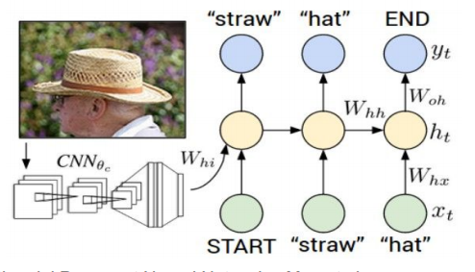
Image Captioning
Combining text RNN with image CNN
Learning RNN to interpret top features from CNN
Deep Visual-Semantic Alignments for Generating Image Descriptions
Notes:
Microsoft COCO dataset
Can be trained in a fully manner

Slide 68
Image Captioning

Slide 69
Image Captioning

Slide 70
Image Captioning

Slide 71
Image Captioning

Slide 72
Image Captioning

Slide 73
Image Captioning

Slide 74
Image Captioning

Slide 75
Image Captioning: Results
NeuralTalk2

Slide 76
Image Captioning: Failures
NeuralTalk2

Slide 77
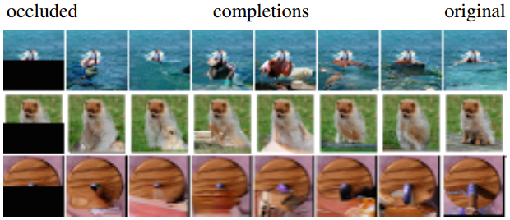
Generating images
Input top and left pixel to predict a new pixel.
Fill in holes.

Slide 78
Machine translation
Example:
German to English:
“Echt dicke Kiste” to “Awesome sauce”
Tokenize each word/character, e.g. as a onehot vector.
<EOS> token
Can use softmax loss for every timestep
Character model vs vocabulary model:
Pros character model :
Much smaller class size (input/ouput vector length)
You don’t need to worry about unknown words
Pros vocabulary model
Shorter sequences, easier to capture long term dependencies
Less computationally expensive to train

Slide 79
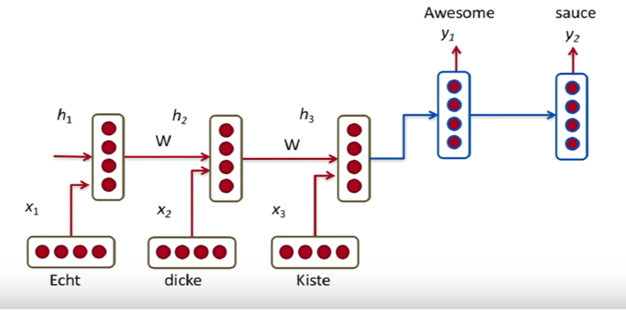
Machine translation
RNN: Many-to-many (encoder-decoder)
Tips which may help:
Different $W$ for the encoder and the decoder
Concatenate the last hidden state of the encoder to all hidden state in the decoder
In the decoder, pass in $y_{n}$ as $x_{n+1}$
Reverse the order:
ABC XY
CBA XY
Encoder
Decoder
Notes:
- At runtime, synthesize the next character from the probability distribution (after softmax). Creates diversity.
- We want the state to capture all information about the previous states

Slide 80
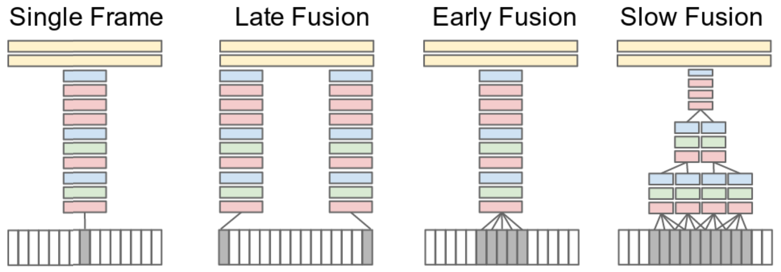
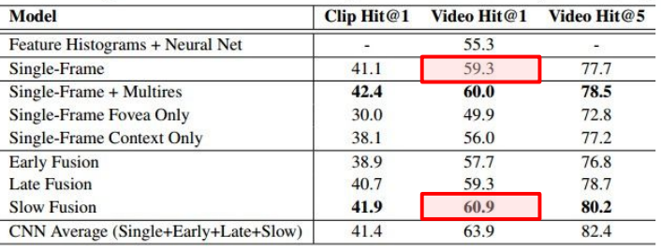
Deep learning for videos
Simply use frames as different input channels
For the sports-1m dataset extra data gave little effect. (This may be the nature of the task)
Large-scale Video Classification with Convolutional Neural Networks
Notes:
Early fusion: Stacking frames in depth
Slow fustion: Computes convolutions with a sub set of the temporal length and combined the output in channels.

Slide 81
But what about longer time-scales

Slide 82
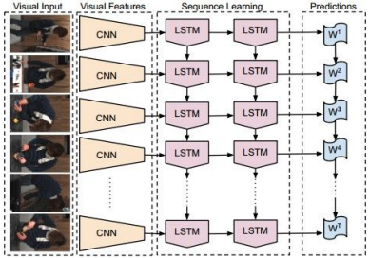
Better results by using RNN
With RNN on top of CNN features, you capture a larger time horizon
Long-term Recurrent Convolutional Networks for Visual Recognition and Description

Slide 83
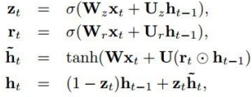
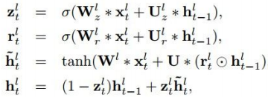
A network can be both convolutional and recurrent
By simply changing the matrix multiplications to convolutions
Learning Video Object Segmentation with Visual Memory

Slide 84
3D convolutions, convolutions in time+space
3D convolutions can work well
Obviously restricted time horizon
R-C3D: Region Convolutional 3D Network for Temporal Activity Detection

