Slide 1
INF 5860 Machine learning for image classification
Lecture 5 : Introduction to TensorFlow
Tollef Jahren
February 14, 2018

Slide 2
OUTLINE
Deep learning frameworks
TensorFlow
TensorFlow graphs
TensorFlow session
TensorFlow constants
TensorFlow variables
TensorFlow feeding data to the graph
Tensorboard
TensorFlow save/restore models
TensorFlow example

Slide 3
ABOUT TODAY
You will get an introduction to one of the most widely used deep learning frameworks
The goal is for you to be familiar with TensorFlow’s computational graph
Understand how to use basic tensors and operator
TensorFlow version: 1.4
Python: 3.6

Slide 4
Readings
https://www.tensorflow.org/
https://web.stanford.edu/class/cs20si/2017/syllabus.html [lecture notes/slides 1-5]
https://www.youtube.com/channel/UCMq6IdbXar_KtYixMS_wHcQ/videos

Slide 5
Progress
Deep learning frameworks
TensorFlow
TensorFlow graphs
TensorFlow session
TensorFlow constants
TensorFlow variables
TensorFlow feeding data to the graph
Tensorboard
TensorFlow save/restore models
TensorFlow example

Slide 6
Popularity

Slide 7
Why do we need Deep learning frameworks?
Speed:
Fast GPU/CPU implementation of matrix multiplication, convolutions and backpropagation
Automatic differentiations:
Pre-implementation of the most common functions and it’s gradients.
Reuse:
Easy to reuse other people’s models
Less error prone:
The more code you write yourself, the more errors

Slide 8
Deep learning frameworks
Deep learning frameworks does a lot of the complicated computation, remember last week….

Slide 9
Progress
Deep learning frameworks
TensorFlow
TensorFlow graphs
TensorFlow session
TensorFlow constants
TensorFlow variables
TensorFlow feeding data to the graph
Tensorboard
TensorFlow Save/restore models
TensorFlow example

Slide 10
Why TensorFlow
Python API
Can use CPU, GPU
Supports many platforms:
Raspberry Pi, Android, Windows, iOS, Linux
Companies using TensorFlow:
Nvidia, Uber, ebay, snapchat, google, Airbnb, twitter and many more

Slide 11
Progress
Deep learning frameworks
TensorFlow
TensorFlow graphs
TensorFlow session
TensorFlow constants
TensorFlow variables
TensorFlow feeding data to the graph
Tensorboard
TensorFlow Save/restore models
TensorFlow example

Slide 12
What is a computational graph?

Slide 13
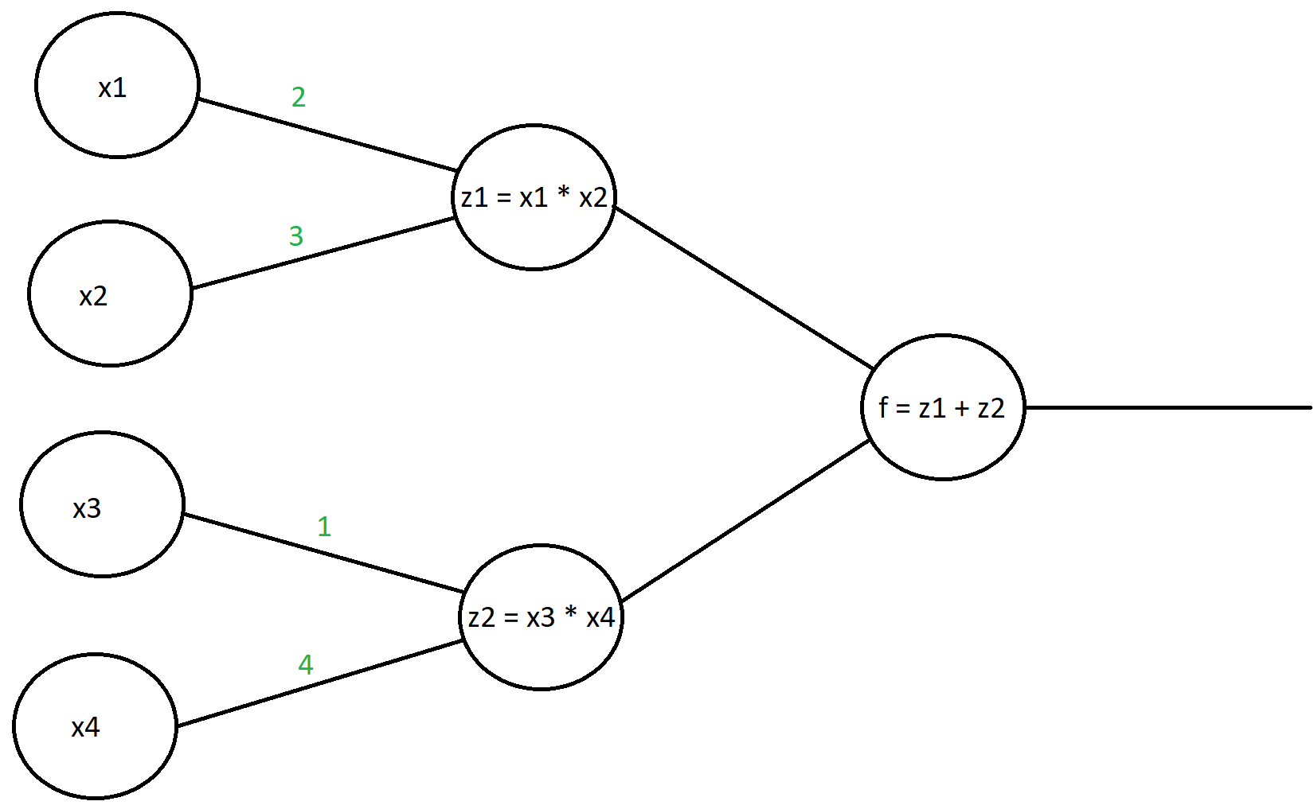
Forward propagation

Slide 14
Forward propagation

Slide 15
Forward propagation

Slide 16
Backward propagation
What if we want to get the derivative of f with respect to the different x values?

Slide 17
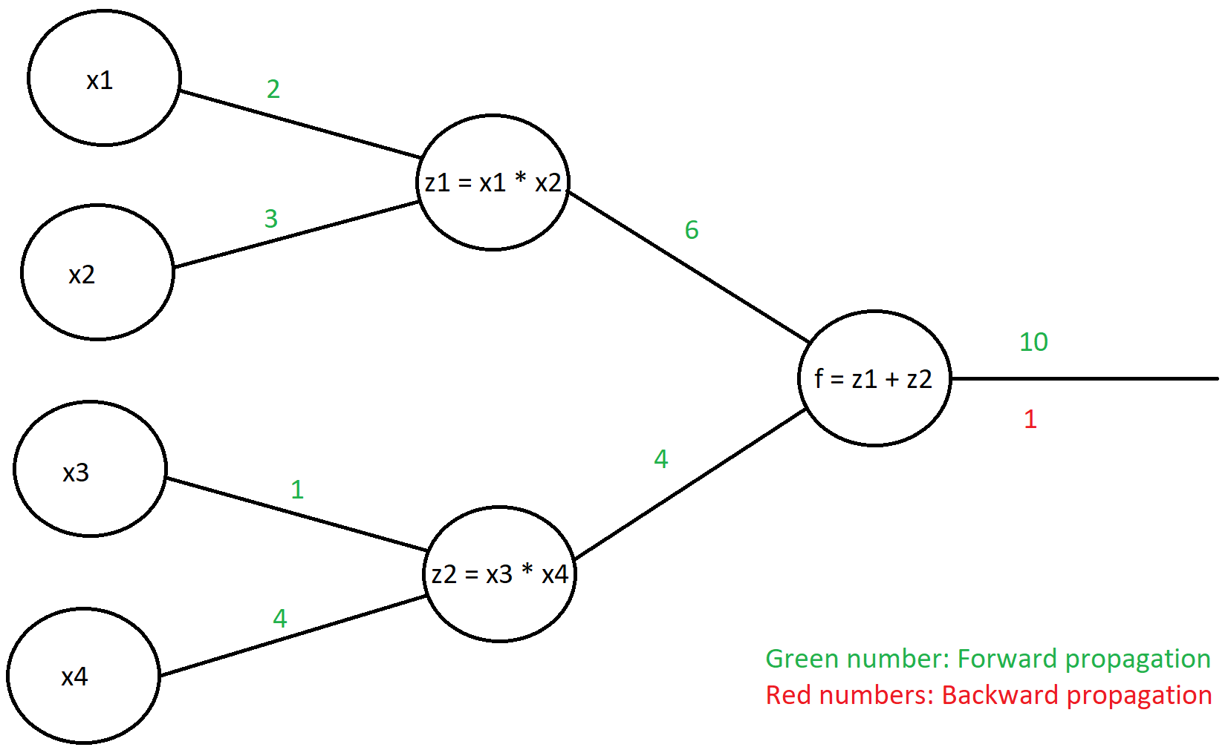
Backward propagation
Lets take the derivative of f with respect to x1

Slide 18
Backward propagation

Slide 19
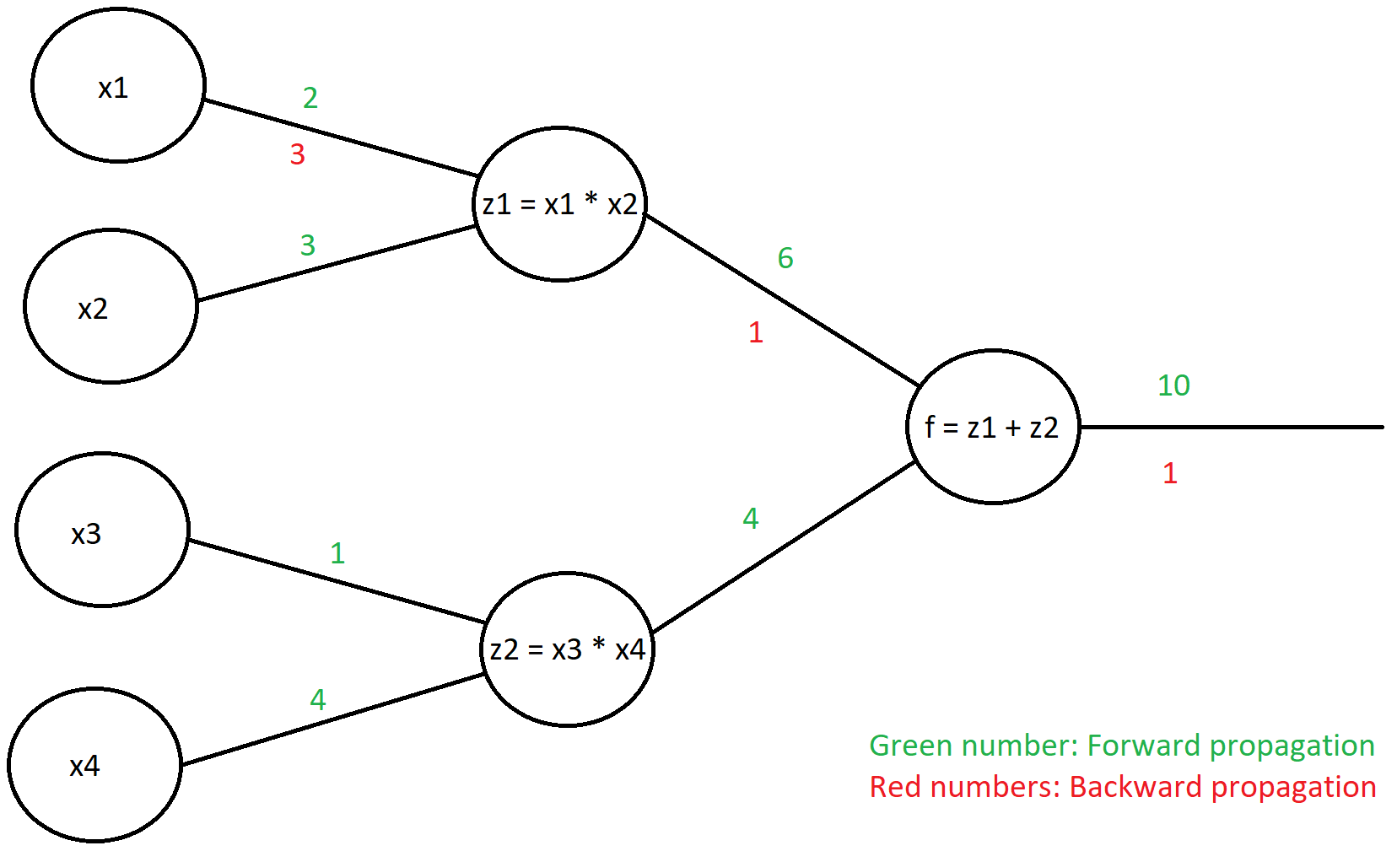
Backward propagation

Slide 20
Backward propagation

Slide 21
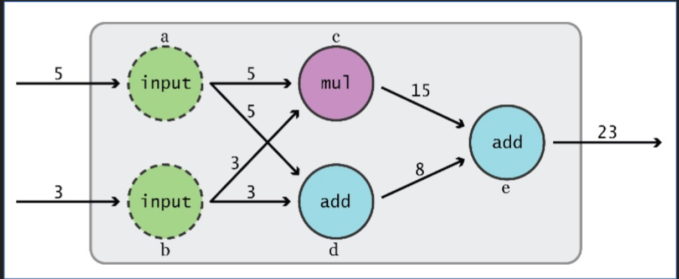
TensorFlow: Computational graph
You need to define the computational graph before you can use it.
Notes:
In tensorflow we are building the computational graphs we want to execute. Before we can execute and computation, we need to define our graph.
The graphs are executed using a Session
The graph is static
Eager
Why is graph efficient:
- Machine learning libraries like tensorflow are needed to do large numerical computations efficiently.These computations are not optimised in python and need to be carried out in a well optimised language outside python.Thus, there can be a lot of overhead from switching back to Python after every computation. This overhead is especially bad if you want to run computations on GPUs or in a distributed manner, where there can be a high cost to transferring data.

Slide 22
What is a TensorFlow Tensor
An n-dimensional array
0-D: A scalar
1-D: An array (vector)
2-D: A matrix

Slide 23
Defining a tensor in TensorFlow
The main types of tensors are:
tf.Variable / tf.get_variable
tf.constant
tf.placeholder
Attributes (some of them):
Shape
dtype
name
Notes:
Tf.Variable -> often use a the weight matrix
Tf.constant -> a constant
Tf.placeholder -> use for feeding traning data and labels into the graphs

Slide 24
Example of a tensors

Slide 25
Tensors need unique names
Every tensor defined within a graph needs to have a unique name
TensorFlow will automatically add an index to the name which will increment if more tensors with the “same” name gets defined.

Slide 26
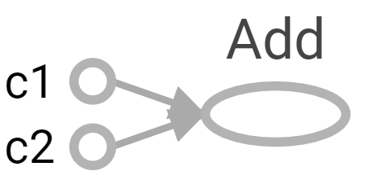
Defining an Operator in TensorFlow
If no name is given, TensorFlow will automatically give the node a name.

Slide 27
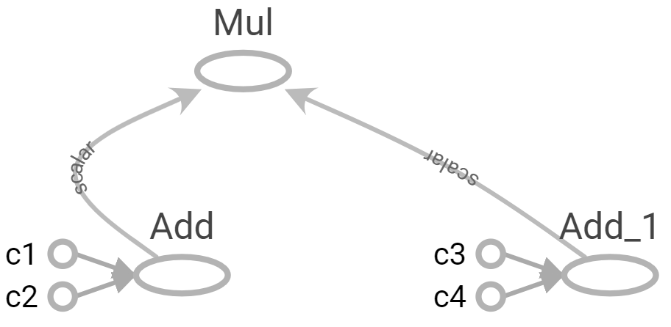
The graph
The TensorFlow graph is a definition, not any computation.
The computational graph is a series of TensorFlow operations arranged into a graph. The graph is composed of two types of objects:
Operation: Nodes in the graph
Tensors: The edges in the graph

Slide 28
The graph
Operation (“ops”): Nodes in the graph
Tensors: The edges in the graph
Tensors
Tensors
Operations

Slide 29
The graph
The tf.Graph holds two types of information:
Graph structure
Graph collection: Meta data
Examples of Meta data
Global variables
Trainable variable
Regularization loss
Moving average variables
Summaries

Slide 30
Multiple graphs
It is possible to create multiple graph, but we don’t do it!
Each graph will require it’s own session
To pass data between the graphs, we need to pass them through Python/NumPy
Working with one graph is easier, and its better to have disconnected subgraphs.

Slide 31
Progress
Deep learning frameworks
TensorFlow
TensorFlow graphs
TensorFlow session
TensorFlow constants
TensorFlow variables
TensorFlow feeding data to the graph
Tensorboard
TensorFlow Save/restore models
TensorFlow example

Slide 32
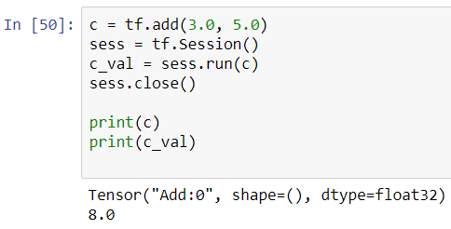
Executing the tf.Graph: tf.Session
We have seen that variables and constants are handles to elements in the computational graph only.
We execute the graph using a tf.Session

Slide 33
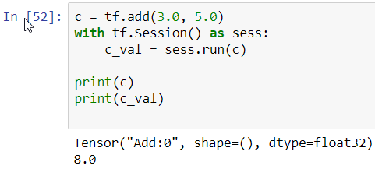
Two ways to use tf.Session

Slide 34
tf.Session
When a tf.Session is created, the required resources are allocated.
The tf.Session object can be configured:

Slide 35
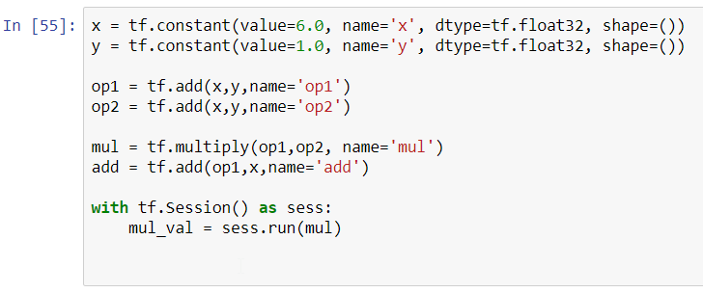
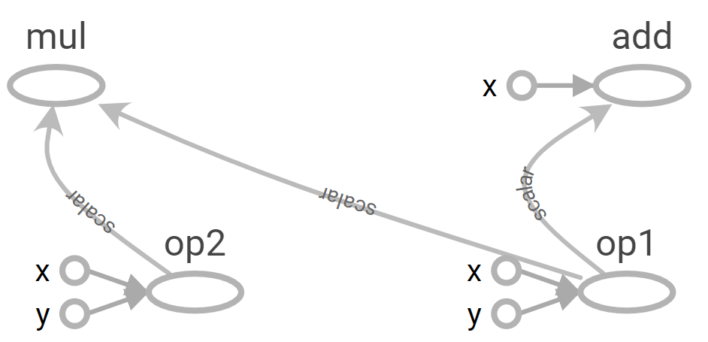
Run parts of the graph only

Slide 36
Run the whole graph

Slide 37
Why graphs
Save computation, run subgraphs that lead to the values you want to fetch only
Break computation into small, differential pieces to facilitate auto-differentiation
Facilitate distributed computation, spread the work across multiple CPUs, GPUs, TPUs, or other devices

Slide 38
Progress
Deep learning frameworks
TensorFlow
TensorFlow graphs
TensorFlow session
TensorFlow constants
TensorFlow variables
TensorFlow feeding data to the graph
Tensorboard
TensorFlow Save/restore models
TensorFlow example

Slide 39
tf.constant

Slide 40
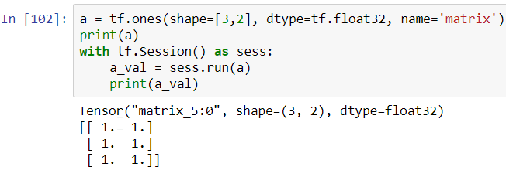
Useful constants

Slide 41
Constants as sequences

Slide 42
Randomly Generated Constants
tf.set_random_seed(seed)

Slide 43
Operations

Slide 44
Arithmetic Operations

Slide 45
TensorFlow Data Types

Slide 46
What is wrong with constants?
Constants are constants and not good for e.g. being a weight matrix
The data contained in constants are stored in the TensorFlow graph definition.

Slide 47
Constants: The values can be stored in the TensorFlow graph definition

Slide 48
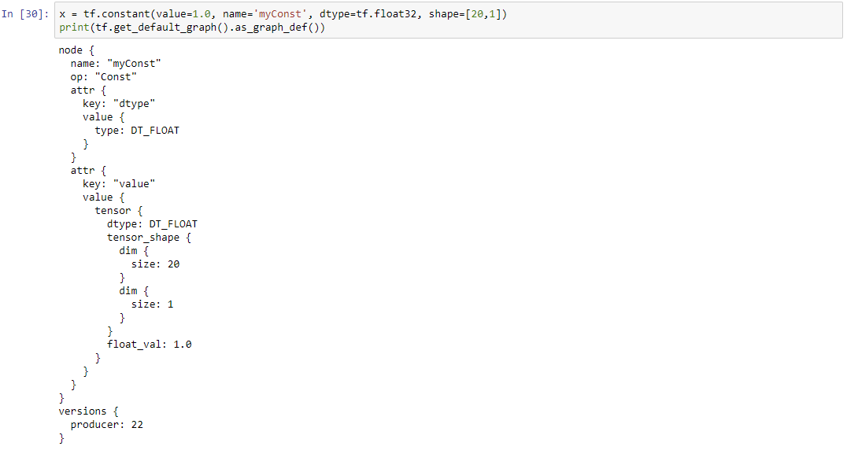
Constants: The values can be stored in the TensorFlow graph definition

Slide 49
Progress
Deep learning frameworks
TensorFlow
TensorFlow graphs
TensorFlow session
TensorFlow constants
Tensorflow variables
TensorFlow feeding data to the graph
Tensorboard
TensorFlow Save/restore models
TensorFlow example

Slide 50
Variables
Operation vs Classes
tf.constant is written with lowercase and is an operation (op)
tf.Variable is written with uppercase and is a class
The tf.Variable class have many operations (ops)

Slide 51
Creating variables
We can define variables two ways:
preferred

Slide 52
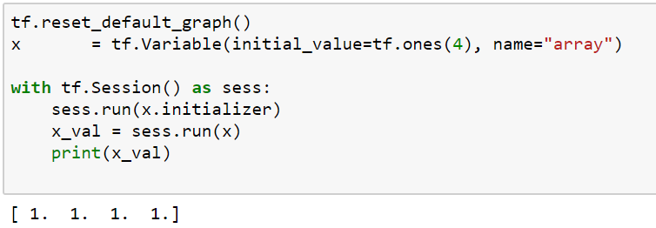
Initializing variables
The variables to be used in the graph have to be either:
Initialized
Restored

Slide 53
If variables are not initialized

Slide 54
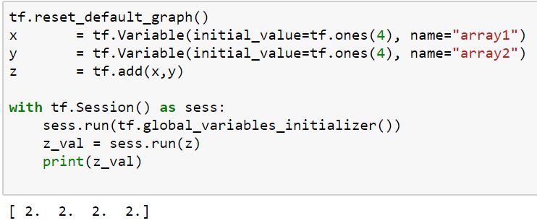
Initializing all or some variables

Slide 55
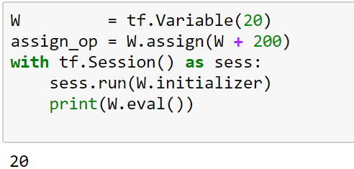
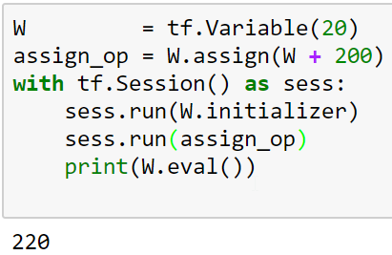
tf.Variable.assign()
The assign operator is handy if you want to update the values in a variable

Slide 56
tf.get_variable()
Why is tf.get_variable preferred over tf.Variable?
tf.get_variable makes reusing (sharing) variables easy

Slide 57
tf.variable_scope()
tf.variable_scope is used to give a specific prefix to variables names, it is analogous to directory structure.

Slide 58
Reusing variables
If we try to define two variables with the same name, a valueError is raised.

Slide 59
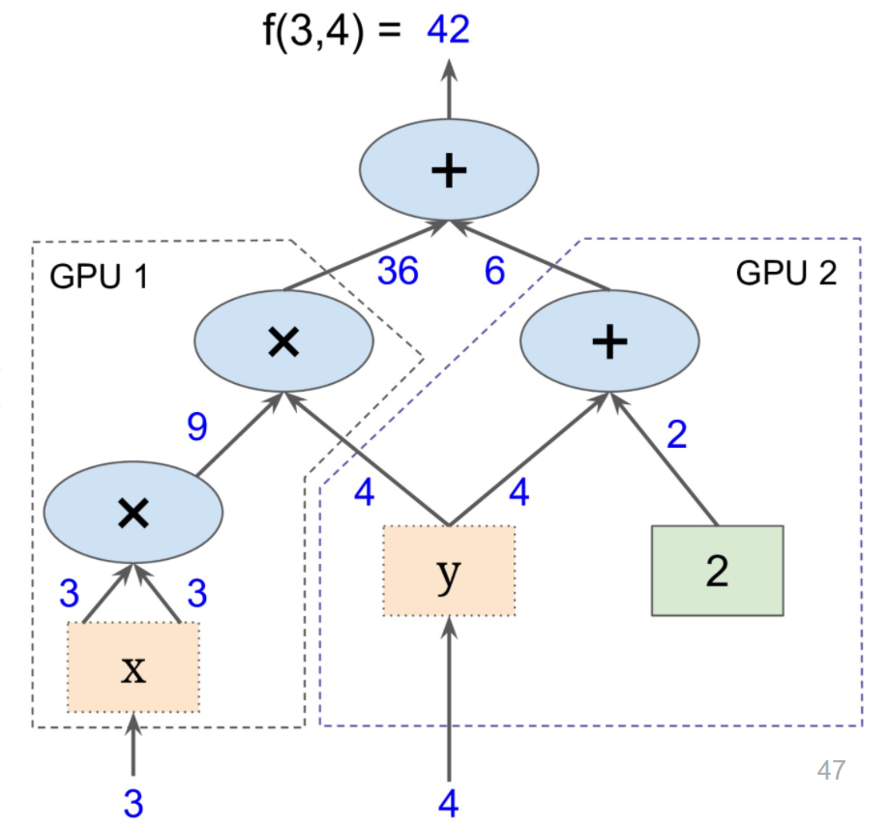
Distributed computation (multiple GPU’s)
Graph from Hands-On Machine Learning with Scikit-Learn and TensorFlow

Slide 60
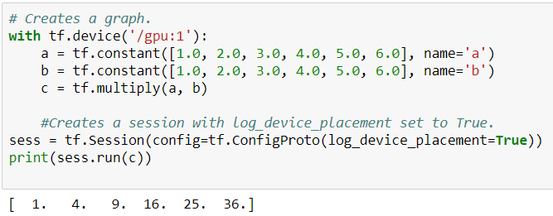
Distributed Computation
tf.device() can be used to put part of the graph to the cpu or gpus
Notes:
Often a good idea to do preprocessing on the CPU

Slide 61
Progress
Deep learning frameworks
TensorFlow
TensorFlow graphs
TensorFlow session
TensorFlow constants
TensorFlow variables
Tensorflow feeding data to the graph
Tensorboard
TensorFlow Save/restore models
TensorFlow example

Slide 62
How to feed data into the graph
Often we want to feed data into the graph after it has been defined. For example during training of a neural network, we feed training data and labels into the graphs repeatedly.
Two methods are recommended:
tf.placeholder
tf.data.Dataset (we will not go though dataset and iterators)

Slide 63
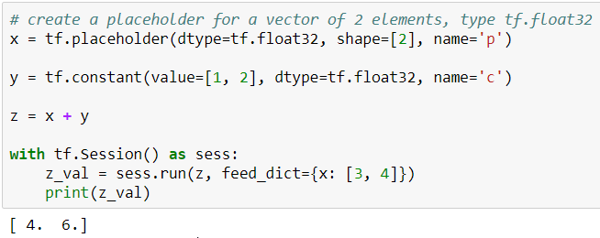
tf.placeholder

Slide 64
Progress
Deep learning frameworks
TensorFlow
TensorFlow graphs
TensorFlow session
TensorFlow constants
TensorFlow variables
TensorFlow feeding data to the graph
Tensorboard
TensorFlow Save/restore models
TensorFlow example

Slide 65
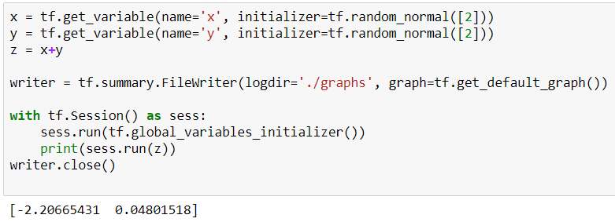
Tensorboard: Visualizing graph
In terminal:
$ tensorboard --logdir="./graphs" --port 6006
In web browser:
http://localhost:6006/

Slide 68
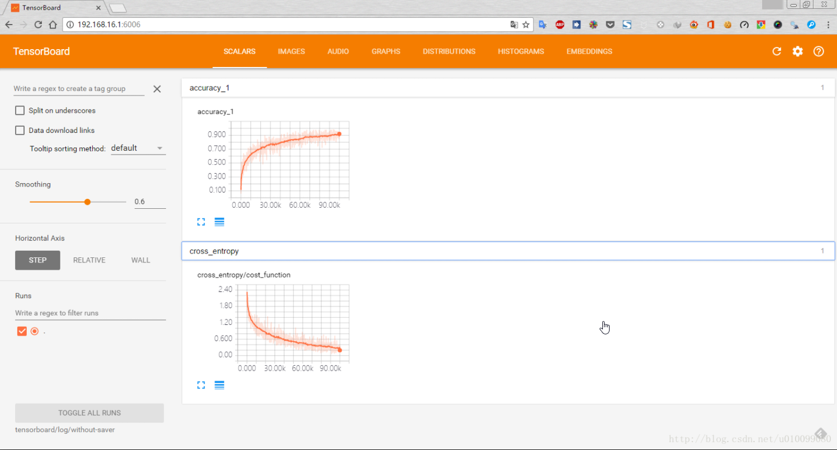
Tensorboard: Visualizing learning

Slide 69
Tensorboard: Visualizing learning

Slide 70
Progress
Deep learning frameworks
TensorFlow
TensorFlow graphs
TensorFlow session
TensorFlow constants
TensorFlow variables
TensorFlow feeding data to the graph
Tensorboard
TensorFlow Save/restore models
TensorfFow example

Slide 71
Save/restore models
We often want to be able to save and store our models.
Unexpected power shoot down
Reuse of the already trained network weights
Sharing our work e.g. github

Slide 72
tf.train.saver.save()
How to save our model every 1000 iteration.

Slide 73
tf.train.saver.restore()
How to restore a model.

Slide 74
Progress
Deep learning frameworks
TensorFlow
TensorFlow graphs
TensorFlow session
TensorFlow constants
TensorFlow variables
TensorFlow feeding data to the graph
Tensorboard
TensorFlow Save/restore models
TensorFlow Cifar10 example

Slide 75
TensorFlow example: Cifar10
Define a “dataClass”
Define a structure of the network (graph)
Define a loss function
Define an optimizer
Train the neural network

Slide 76
Define a “dataClass”
Properties of "dataClass“:
Read in the cifar10 images
Perform preprocessing
Have a "next_training_batch" function
have a "get_test_data" function

Slide 77
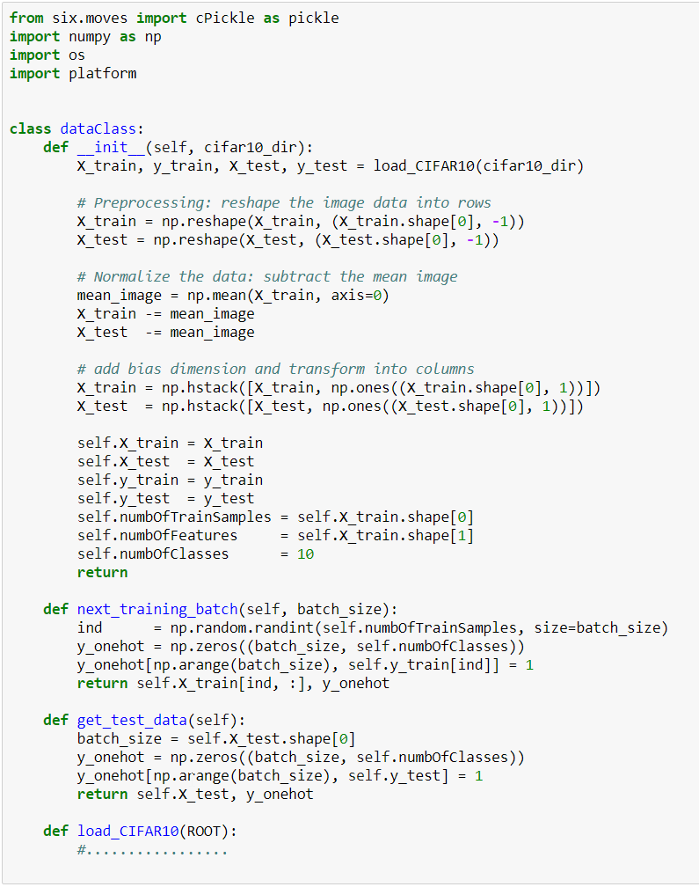

Slide 78
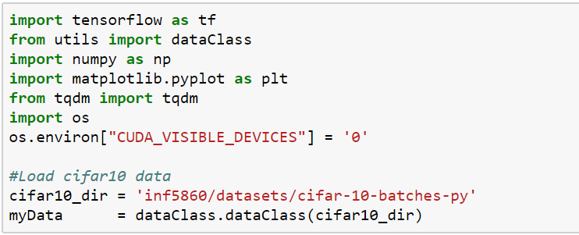
Import

Slide 79
Define placeholder’s

Slide 80
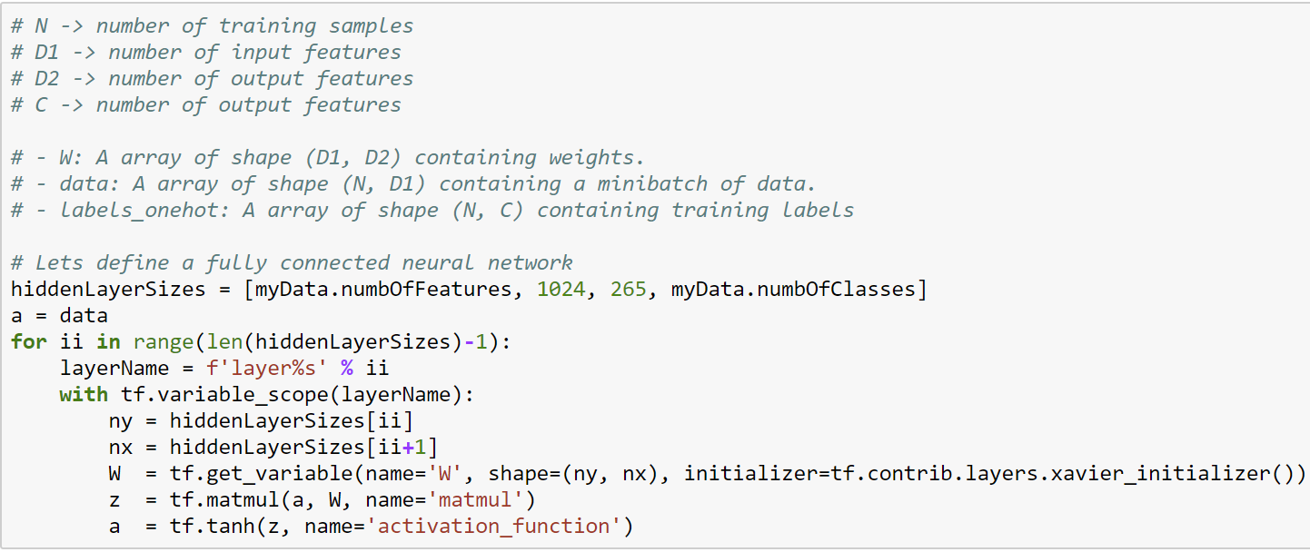
Define the network structure (graph)

Slide 81
Define the loss

Slide 82
Define an optimizer

Slide 83
Define an accuracy measure

Slide 84
Train the network

Slide 85
Result

Slide 86
TensorFlow integrates well with NumPy
tf.int32 == np.int32 ⇒ True
tf.ones([2, 2], np.float32)
The output of a tf.Session.run(ops) ⇒ will be a n-D NumPy array if “ops” is a n-D tensor
But use tf datatypes if possible

Slide 87
Higher level of abstraction wrappers
Open source software libraries for numerical computation using data flow graphs:
High level wrappers
Kears
TF-Slim
Tf-layers
Pretty Tensor
TFLearn
We will use TensorFlow “core” as it is the fundamental library and it is then easier to learn the higher level wrappers

Slide 88
Next week
Convolutional neural networks

