Slide 1
INF 5860 Machine learning for image classification
Lecture 6 : Convolutional neural networks
Tollef Jahren
February 21, 2017

Slide 2
OUTLINE
Challenges with image classification
Benchmark: ImageNet
Fully connected neural network on images
Convolutional layer
Convolutional layer hyperparameters
Convolutional layer example
Receptive field (Field of View)
Dilated convolutions
Pooling
Visualizing and Understanding CNN
Applications were CNN are used
Alternative to ConvNet

Slide 3
ABOUT TODAY
Name convention: Convolutional neural network, ConvNet, CNN
What is a convolutional neural network?
The required computation in a convolutional neural network
Considerations when designing an convolution neural network architecture

Slide 4
Readings
Text:
http://cs231n.github.io/convolutional-networks/
Video:
https://www.youtube.com/watch?v=bNb2fEVKeEo&index=5&list=PLC1qU-LWwrF64f4QKQT-Vg5Wr4qEE1Zxk
Optional text:
Receptive field: http://www.cs.toronto.edu/~wenjie/papers/nips16/top.pdf
Visualizing and Understanding CNN: https://cs.nyu.edu/~fergus/papers/zeilerECCV2014.pdf
Dilated convolutions: https://arxiv.org/abs/1511.07122
Optional videos:
https://www.youtube.com/watch?v=ghEmQSxT6tw
https://www.youtube.com/watch?v=SQ67NBCLV98

Slide 5
Progress
Challenges with image classification
Benchmark: ImageNet
Fully connected neural network on images
Convolutional layer
Convolutional layer hyperparameters
Convolutional layer example
Receptive field (Field of View)
Dilated convolutions
Pooling
Visualizing and Understanding CNN
Applications were CNN are used
Alternative to ConvNet
Notes:
Cifar10 NN vs CNN show be added
Global average pooling
Depth separable convolutions

Slide 6
Challenges with image classification
Build invariance:
Translation
Occlusion
Illumination
View angle variations
Deformation
Background Clutter
Interclass variation

Slide 7
Building invariance
Translation
Occlusion
Illumination

Slide 8
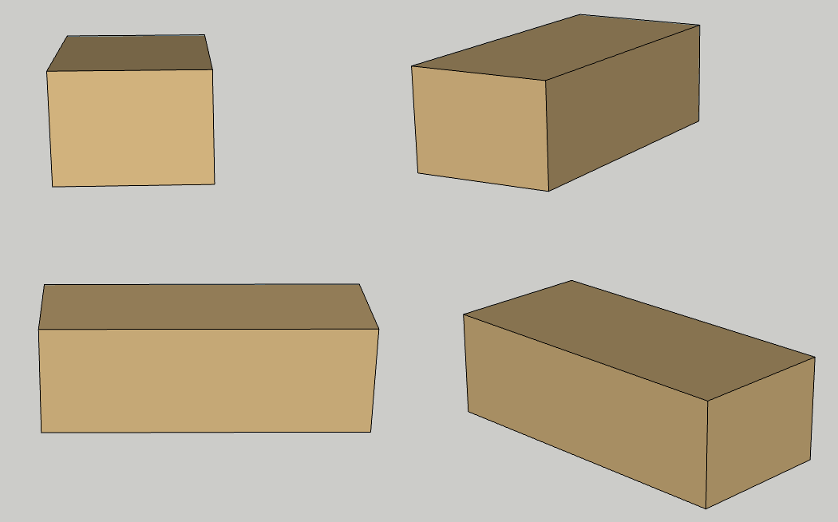
Building invariance
View angle variations

Slide 9
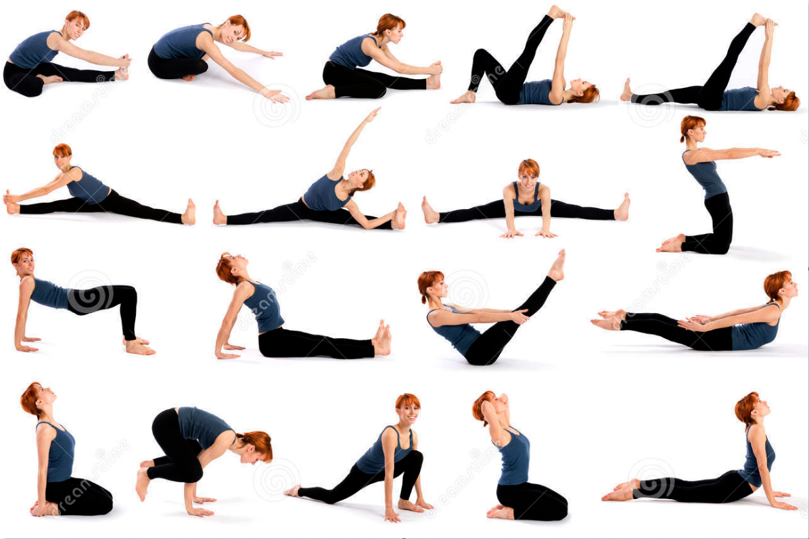
Building invariance
Deformation

Slide 10
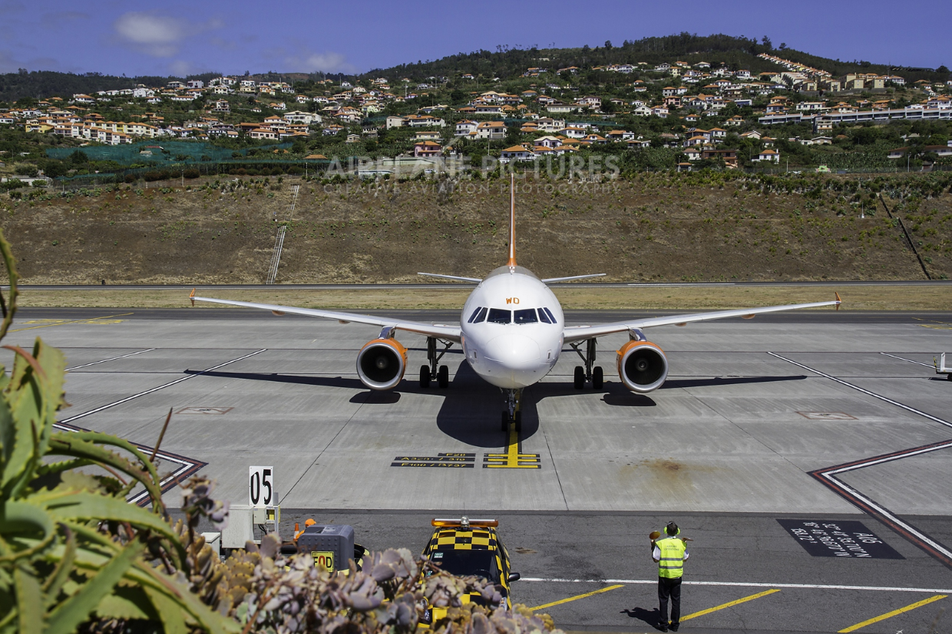
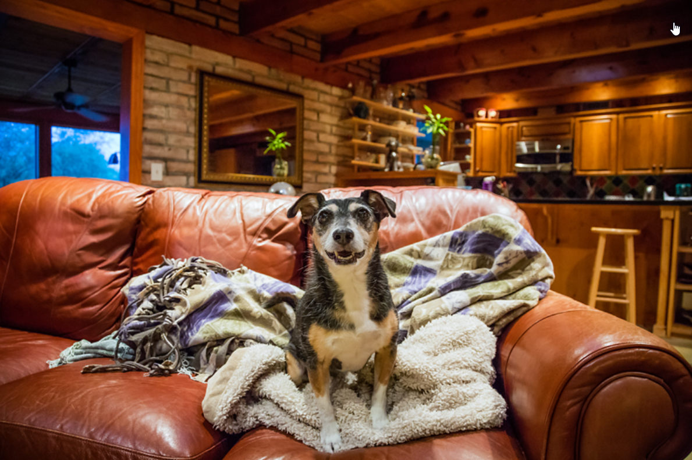
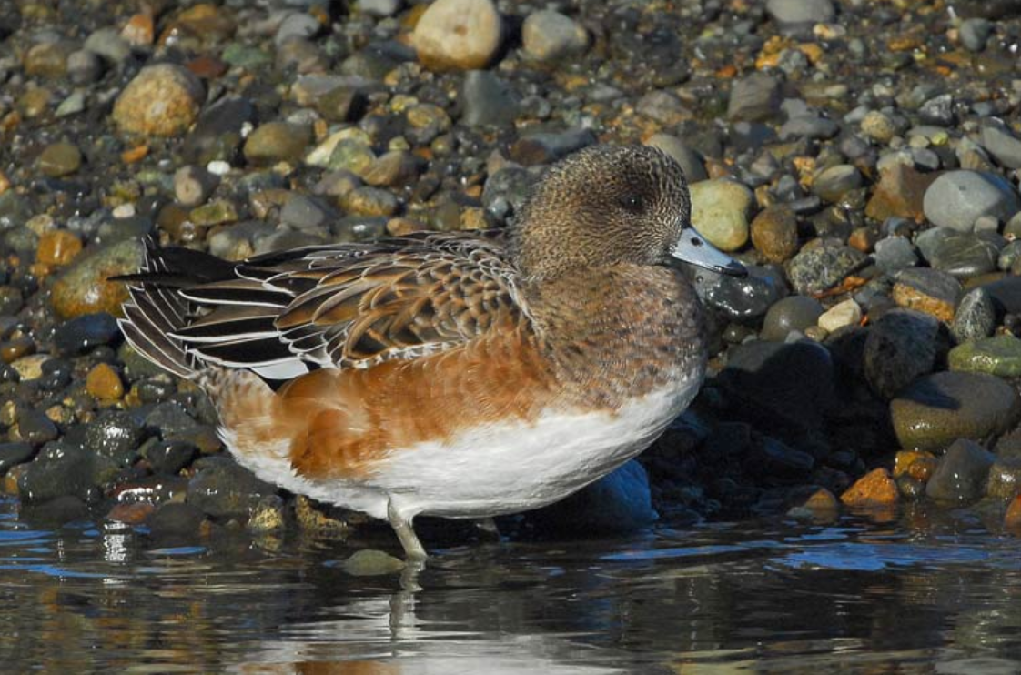
Building invariance
Background Clutter

Slide 11
Building invariance
Interclass variation

Slide 12
Progress
Challenges with image classification
Benchmark: ImageNet
Fully connected neural network on images
Convolutional layer
Convolutional layer hyperparameters
Convolutional layer example
Receptive field (Field of View)
Dilated convolutions
Pooling
Visualizing and Understanding CNN
Applications were CNN are used
Alternative to ConvNet
Notes:
Cifar10 NN vs CNN show be added
Global average pooling
Depth separable convolutions

Slide 13
The ImageNet challenge
The images classification challenge
Dataset
1,431,167 images
1,000 classes

Slide 14
Progress
Challenges with image classification
Benchmark: ImageNet
Fully connected neural network on images
Convolutional layer
Convolutional layer hyperparameters
Convolutional layer example
Receptive field (Field of View)
Dilated convolutions
Pooling
Visualizing and Understanding CNN
Applications were CNN are used
Alternative to ConvNet
Notes:
Cifar10 NN vs CNN show be added
Global average pooling
Depth separable convolutions

Slide 15
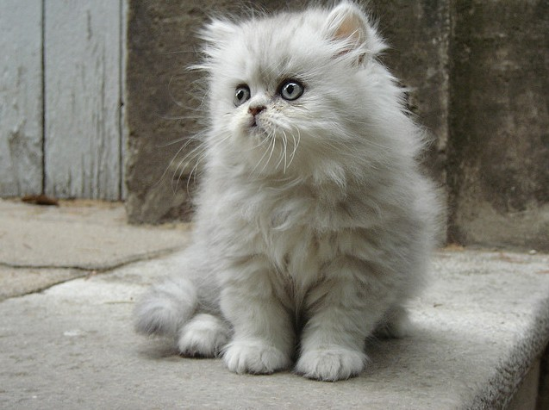
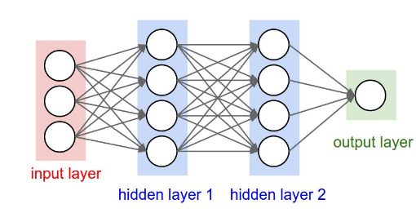
Fully connected neural network on images
Most image applications are absolute position invariant.
A fully connected network will have too many parameters and not able to scale to normal size images and generalize
$$z^{1}=W^{T}x$$
$$a^{1}=g(z^{1})$$

Slide 16
Progress
Challenges with image classification
Benchmark: ImageNet
Fully connected neural network on images
Convolutional layer
Convolutional layer hyperparameters
Convolutional layer example
Receptive field (Field of View)
Dilated convolutions
Pooling
Visualizing and Understanding CNN
Applications were CNN are used
Alternative to ConvNet
Notes:
Cifar10 NN vs CNN show be added
Global average pooling
Depth separable convolutions

Slide 17
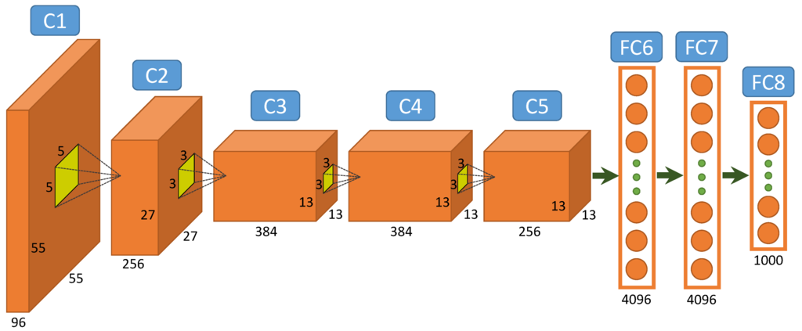
A peak of the full network architecture
Often fully-connected layers are used at the end of the network
Same softmax and loss as before

Slide 18
Convolutional neural networks (CNNs / ConvNets)

Slide 19
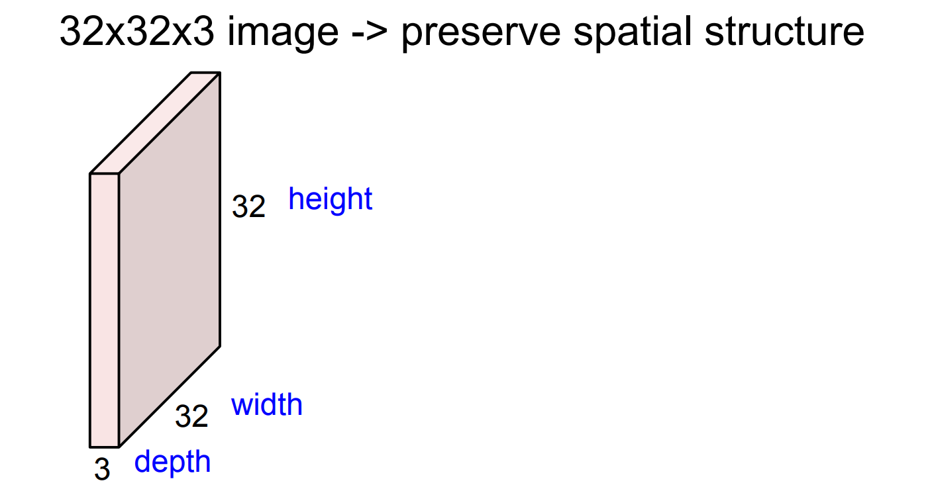
Convolutional layer
Notes:
No flattening of the input image

Slide 20
Convolutional layer
We are convolving /sliding the filter spatially across the input image and computing the dot product.

Slide 21
Convolutional layer
The input volume and the filer has always the same depth (blue value).

Slide 22
Convolutional layer
The activation from a local region is computed:
$$z=w^{T}x+b$$

Slide 23
Convolutional layer

Slide 24
Convolutional layer

Slide 25
Convolutional layer
If we filter the input volume 6 times using a 5x5x3 filter, we get a output volume with 6 channels (depth)

Slide 26
Activations
We use an activation function separately on all elements of the output volume

Slide 27
Progress
Challenges with image classification
Benchmark: ImageNet
Fully connected neural network on images
Convolutional layer
Convolutional layer hyperparameters
Convolutional layer example
Receptive field (Field of View)
Dilated convolutions
Pooling
Visualizing and Understanding CNN
Applications were CNN are used
Alternative to ConvNet
Notes:
Cifar10 NN vs CNN show be added
Global average pooling
Depth separable convolutions

Slide 28
Convolution neural network hyper-parameters
Stride
Padding
Kernel (filter) size

Slide 29
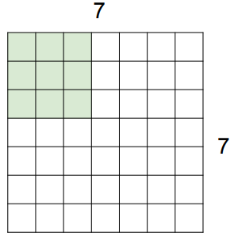
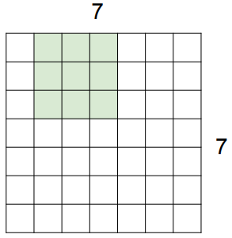
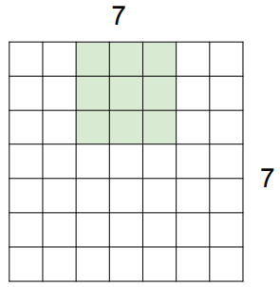
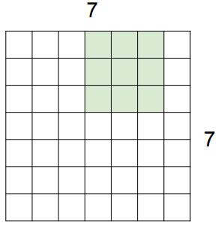
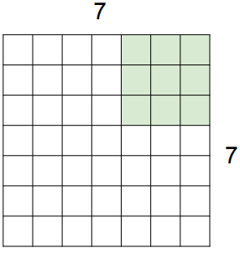
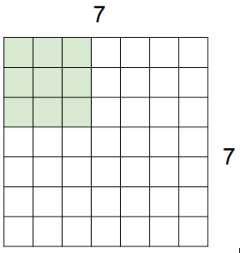
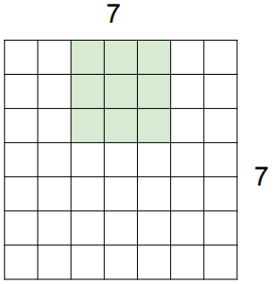
Stride
Stride is the spatial step length in the convolution operation.
Example: Input volume 7x7x1, kernel (filter) size 3x3x1
The stride is an important parameter for determining the spatial size of the output volume
Stride 1
Stride 2

Slide 30
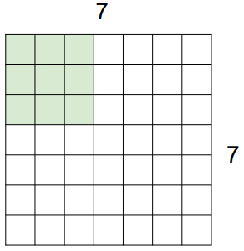
Stride
What about stride equal to 3?
Using a 3x3x1 filter on the 7x7x1 volume with stride 3 does not fit!
Stride 3

Slide 31
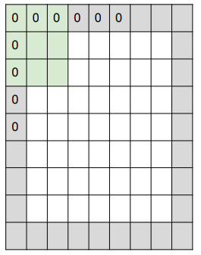
Padding
The output volume can get a lower spatial resolution compared to the input volume. We can solve this by padding the input volume. Common to use zero padding
Abbreviations: Stride ($S$), filter size ($F$), input size ${(N}^{0})$, output size ${(N}^{1})$ and padding $(P)$
For $S=1$, we can achieve $N^{0}=N^{1}$ selecting $P$ equal to:
$P=\frac{\left(F−1\right)}{2}$
Calculation of the spatial output size:
$$N^{1}=\frac{N^{0}−F+2P}{S}+1$$

Slide 32
Padding examples
Remember: $N^{1}=\frac{N^{0}−f+2P}{S}+1$
Parameters:
$N^{0}=7$
$P=0$
$F=3$
Stride $1 \underset{→}{ } \frac{7−3}{1}+1=5$
Stride $2 \underset{→}{ } \frac{7−3}{2}+1=3$
Stride $3 \underset{→}{ } \frac{7−3}{3}+1=2.33$

Slide 33
Padding examples
Remember, to keep $N^{0}=N^{1}$ with $S =1$use:
$$P=\frac{\left(F−1\right)}{2}$$
$F=3 \underset{→}{ }$ zero pad with $1$
$F=5 \underset{→}{ }$ zero pad with $2$
$F=7 \underset{→}{ }$ zero pad with $3$

Slide 34
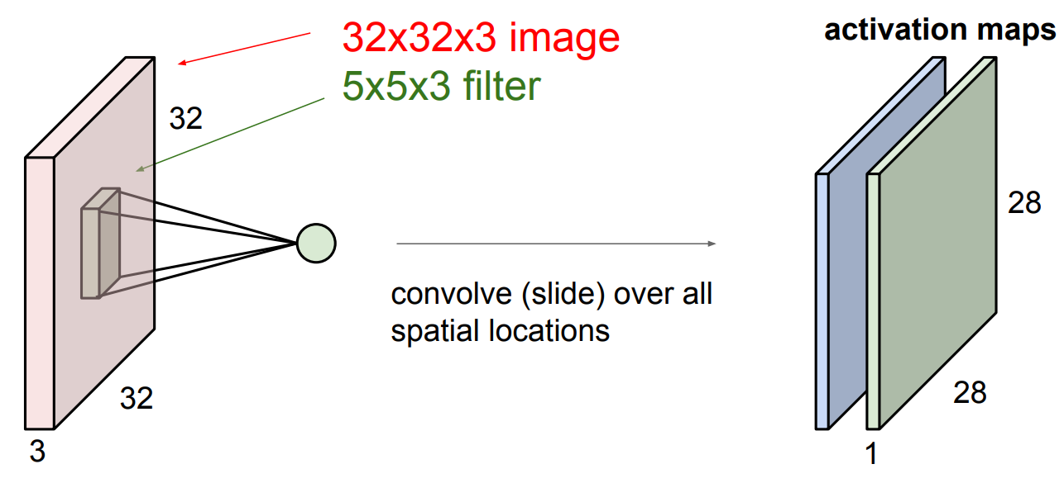
Kernel size (filter bank)
Each filter has a size of $f_{1}$x $f_{2}$x $c^{0}$ e.g. 5x5x3
Multiple filters ($c^{1}$) can be applied at each layer and the filter bank are represented by a 4-D tensor
[$f_{1},$ $f_{2},$ $c^{0}$, $c^{1}$]
$c^{1}$ corresponds to the depth of the next layer
This is a practical representation and used by many deep learning frameworks.

Slide 35
Progress
Challenges with image classification
Benchmark: ImageNet
Fully connected neural network on images
Convolutional layer
Convolutional layer hyperparameters
Convolutional layer example
Receptive field (Field of View)
Dilated convolutions
Pooling
Visualizing and Understanding CNN
Applications were CNN are used
Alternative to ConvNet
Notes:
Cifar10 NN vs CNN show be added
Global average pooling
Depth separable convolutions

Slide 36
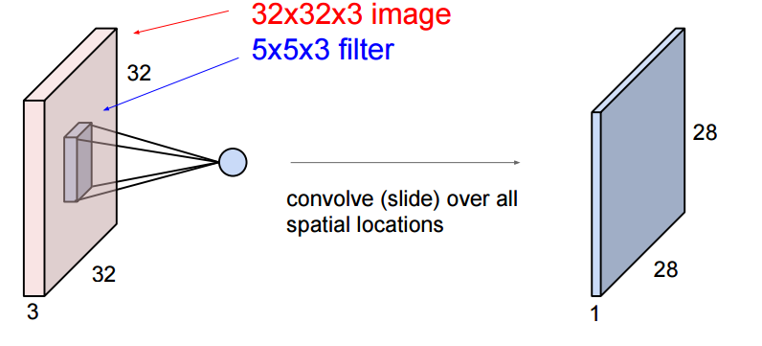
A one-layer, two-filter network

Slide 37
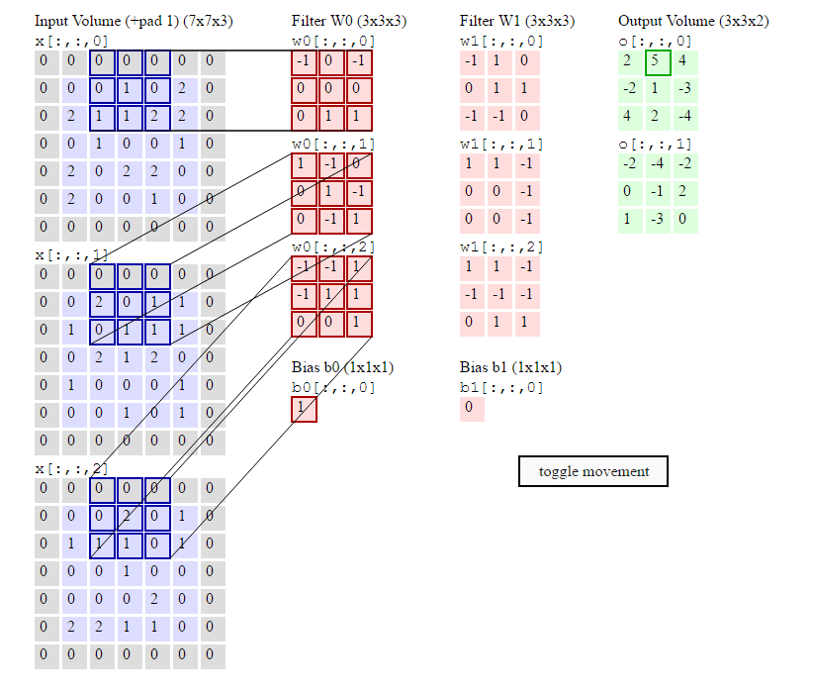
A one-layer, two-filter network

Slide 38
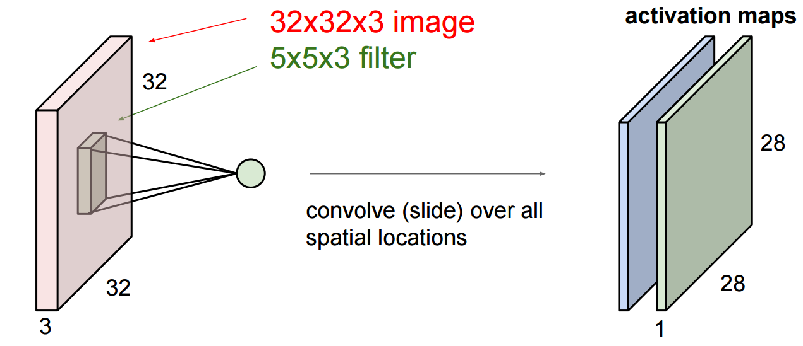
A one-layer, two-filter network

Slide 39
A one-layer, two-filter network

Slide 40
Progress
Challenges with image classification
Benchmark: ImageNet
Fully connected neural network on images
Convolutional layer
Convolutional layer hyperparameters
Convolutional layer example
Receptive field (Field of View)
Dilated convolutions
Pooling
Visualizing and Understanding CNN
Applications were CNN are used
Alternative to ConvNet
Notes:
Cifar10 NN vs CNN show be added
Global average pooling
Depth separable convolutions

Slide 41
Receptive field (Field of View)
How much of the input image available for a particular neuron?

Slide 42
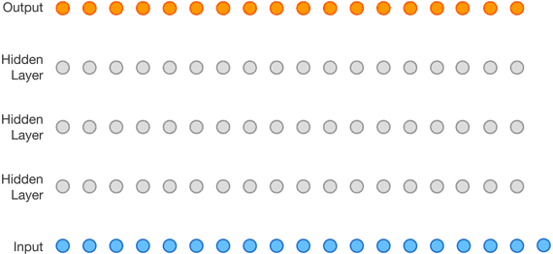
How large area influence the end result?
With a convolutional network the receptive field increase with each layer
3 inputs influence each node in the first hidden layer

Slide 43
How large area influence the end result?
With a convolutional network the receptive field increase with each layer
3 inputs influence each node in the first hidden layer
5 influence the next

Slide 44
How large area influence the end result?
With a convolutional network the receptive field increase with each layer
3 inputs influence each node in the first hidden layer
5 influence the next
7 influence the next

Slide 45
The receptive field grow with k-1 for each layer
Two 3x3 filters give equal receptive field as one 5x5 filer
Should we use 3x3 or 5x5?

Slide 46
Parameter efficiency
Two 3x3 filters give equal receptive field as one 5x5 filter
Should we use 3x3 or 5x5 filters?
Assumption:
The filter count in all layers are C, and we don’t account for biases.
Number of parameters:
3x3 filter $\underset{→}{ } (3⋅3⋅C)⋅C+(3⋅3⋅C)⋅C={18C}^{2}$
5x5 filter $\underset{→}{ } (5⋅5⋅C)⋅C={25C}^{2}$
Note: Many 3x3 filters will lead to a larger memory footprint during training as the system must store the values for backpropagation.

Slide 47
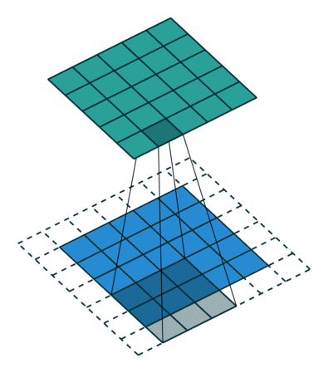
Smaller spatial filter size is more parameter efficient
A network with many parameters generally need more training data and computation time
A larger receptive field per parameter is good
More layers can give more reuse

Slide 48
Increasing the receptive field more efficiently
Low level features also need spatial context
Large networks are expensive in computation time and memory

Slide 49
Strided convolutions
By skipping positions we can cover a larger area with less computation
The effect of the receptive field for the next layer is important

Slide 50
The effect of strided convolutions
We still cover the whole input
We have increased the receptive field from 5 7 in hidden layer 2

Slide 51
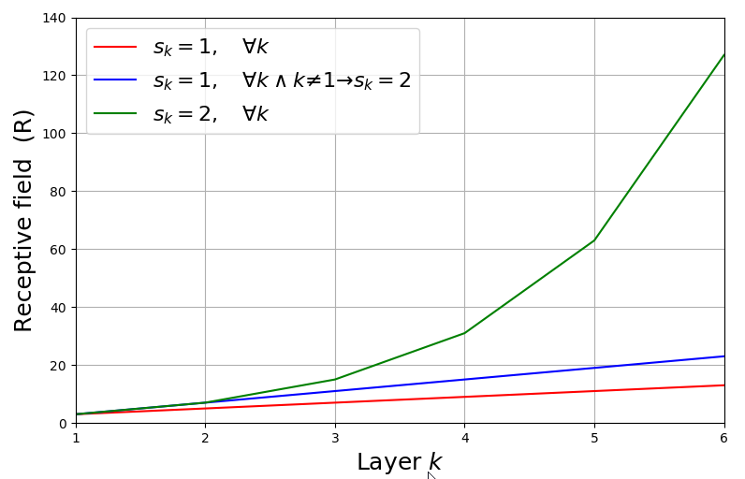
The effect of strided convolutions
Receptive field : $R$
Filter size: $F$
Stride: $s$
Layer index: $k$
$$R_{k}=R_{k−1}+\left[\left(F_{k}−1\right)⋅\prod_{i=1}^{k−1}{s_{i}} \right]$$
Essentially all the following layers will have a receptive field multiplied by $s_{k}$

Slide 52
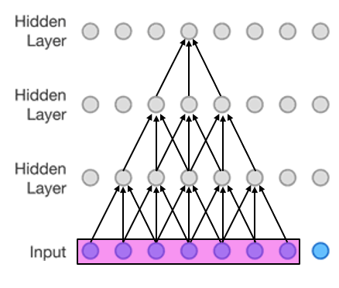
Theoretical vs effective receptive field
“Effective receptive field only takes up a fraction of the full theoretical receptive field”

Slide 53
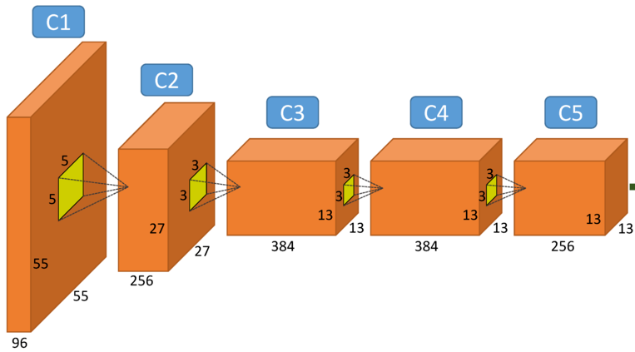
With strides, spatial dimensions will become smaller
Usually some of the of the network capacity is preserved through an increasing number of channels

Slide 54
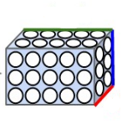
Can the network still remember positions?
Yes, the network can still encode positional information in the depth dimension
A network can pass positional information (right, left etc.) to different channels

Slide 55
Progress
Challenges with image classification
Benchmark: ImageNet
Fully connected neural network on images
Convolutional layer
Convolutional layer hyperparameters
Convolutional layer example
Receptive field (Field of View)
Dilated convolutions
Pooling
Visualizing and Understanding CNN
Applications were CNN are used
Alternative to ConvNet
Notes:
Cifar10 NN vs CNN show be added
Global average pooling
Depth separable convolutions

Slide 56
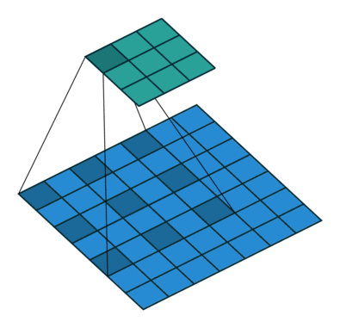
Dilated convolutions
Larger receptive field, without reducing spatial dimension or increasing the parameters

Slide 57
Dilated convolutions
Skipping values in the kernel
Same as filling the kernel with every other value as zero
Still cover all inputs
Larger kernel with no extra parameters

Slide 58
A growing dilation factor can give similar effect as stride
With a constant dilation factor you get the similar effect as using a larger kernel
With growing dilation you can get an even larger receptive field, while still covering all inputs
Fisher Yu, Vladlen Koltun (2016) Multi-scale Context Aggregation by Dilated Convolutions

Slide 59
Growing dilation factor
1-D example:
Filter size: $s=3$
Layer:$\text{k} \text{∈} \left\{1,2,3,…,n\right\}$
Field of view: $F_{k}=2^{k+1}−1$
Dilation factor: $l=2^{k−1}$
$$k=3$$
$$k=2$$
$$k=1$$

Slide 60
Progress
Challenges with image classification
Benchmark: ImageNet
Fully connected neural network on images
Convolutional layer
Convolutional layer hyperparameters
Convolutional layer example
Receptive field (Field of View)
Dilated convolutions
Pooling
Visualizing and Understanding CNN
Applications were CNN are used
Alternative to ConvNet
Notes:
Cifar10 NN vs CNN show be added
Global average pooling
Depth separable convolutions

Slide 61
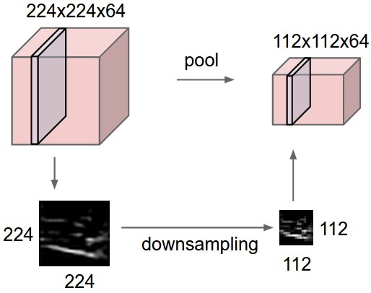
Pooling
Spatial reduction and forcing invariance
Operates over each activation map independently
No learnable weights
Two methods:
Max pooling
Average pooling

Slide 62
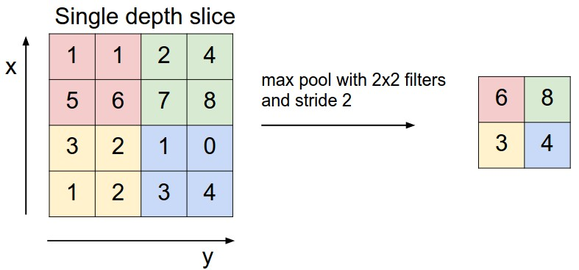
Max pooling
A strided maximum filtering
Choosing the maximum value inside the kernel
Notes:
Very large pooling filters will remove too much information.
Backprop: we need to store the index of the max activation to rout the gradient.

Slide 63
Max-pooling: invariance built-in
With max-pooling you explicitly remove some spatial information
This can help both position and rotation invariance

Slide 64
Max-pooling have some important problems
Even if we want our final results to be positional invariant, we may need positional information in the earlier representations
Only a small part of the network is updated with gradients each step (learning slower)
We calculate a lot of values that is not “used”

Slide 65
Progress
Challenges with image classification
Benchmark: ImageNet
Fully connected neural network on images
Convolutional layer
Convolutional layer hyperparameters
Convolutional layer example
Receptive field (Field of View)
Dilated convolutions
Pooling
Visualizing and Understanding CNN
Applications were CNN are used
Alternative to ConvNet
Notes:
Cifar10 NN vs CNN show be added
Global average pooling
Depth separable convolutions

Slide 66
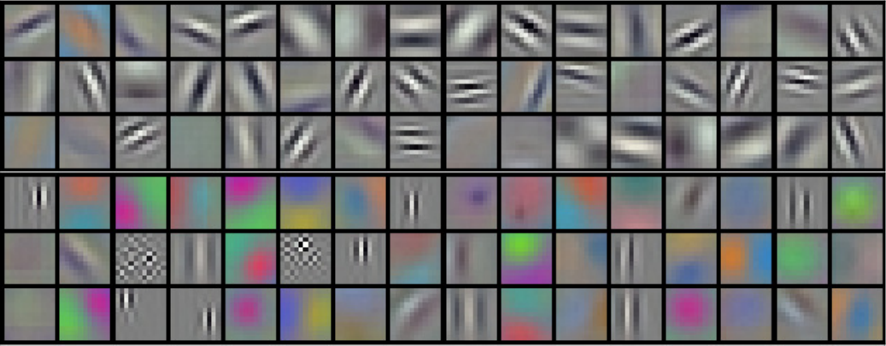
Visualizing and Understanding ConvNets
AlexNet, the winner of the ImageNet classification challenge 2012.
Filter bank of size (11x11x3)x96 for the first convolutional layer:
Visualizing the learnt weights
Notes:
The filters/kernels get the most excited when they see an image patch equal to their weights (dot product)

Slide 67
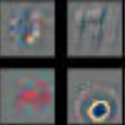
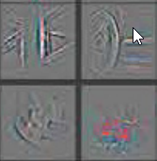
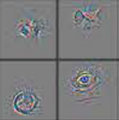
Visualizing and Understanding deeper layers
Looking at the filer coefficient directly at deeper layer is not meaningful.
Visualization with Deconvnet
Layer 1
Layer 2
Layer 3
Layer 4
Layer 5
Zeiler M.D., Fergus R. (2014) Visualizing and Understanding Convolutional Networks

Slide 68
Hierarchical learning
A convolution neural network is built up as a hierarchy were the complexity (abstraction) is increased by depth.
A hierarchical structure is parameter efficient

Slide 69
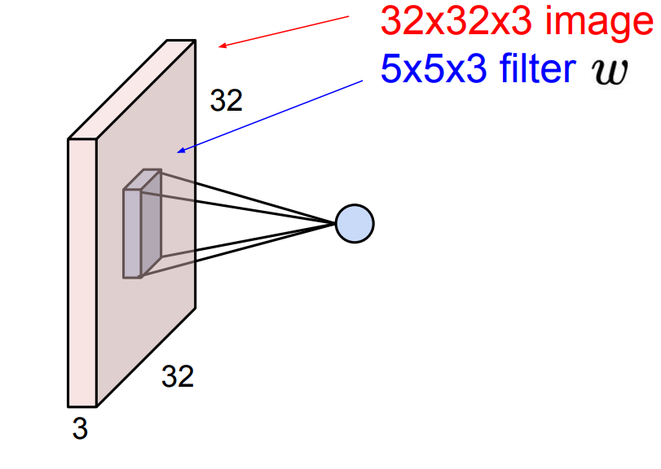
Reuse of features
Each filter kernel is applied at all spatial positions
Features are reused:
edges, fur, eye, grass
Reuse instead of retraining many times over

Slide 70
Data driven
A convolutional neural network still “remembers” shapes, rotation, size.
No fundamental understanding of the concept “cat”

Slide 71
Progress
Challenges with image classification
Benchmark: ImageNet
Fully connected neural network on images
Convolutional layer
Convolutional layer hyperparameters
Convolutional layer example
Receptive field (Field of View)
Dilated convolutions
Pooling
Visualizing and Understanding CNN
Applications were CNN are used
Alternative to ConvNet
Notes:
Cifar10 NN vs CNN show be added
Global average pooling
Depth separable convolutions

Slide 72
Application of convolutional neural network
Classification
Detection
Segmentation
Reinforcement learning (game playing)
Image captioning

Slide 73
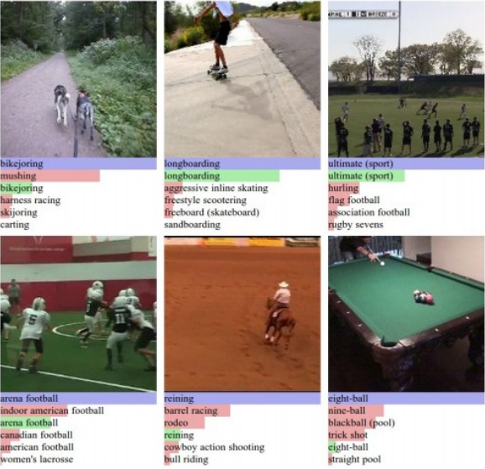
Classification
Images for ImageNet

Slide 74
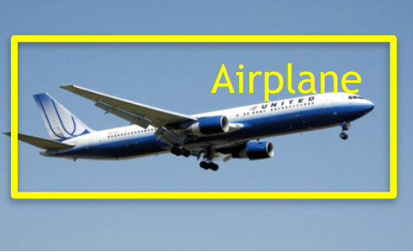
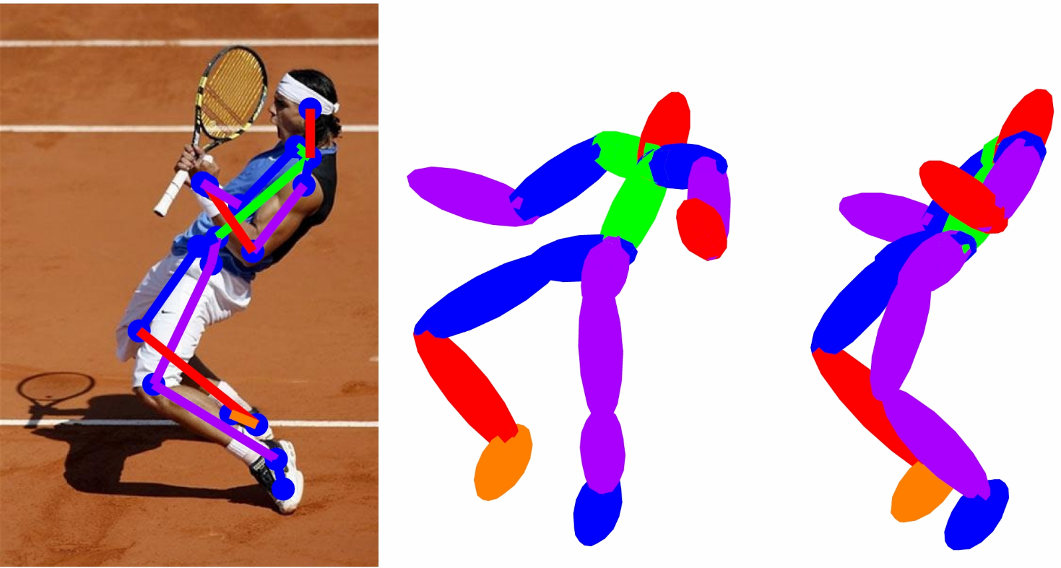
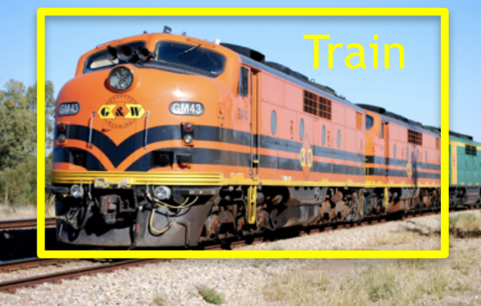
Detection

Slide 75
Segmentation

Slide 76
Reinforcement learning (game playing)

Slide 77
Image captioning

Slide 78
Progress
Challenges with image classification
Benchmark: ImageNet
Fully connected neural network on images
Convolutional layer
Convolutional layer hyperparameters
Convolutional layer example
Receptive field (Field of View)
Dilated convolutions
Pooling
Visualizing and Understanding CNN
Applications were CNN are used
Alternative to ConvNet
Notes:
Cifar10 NN vs CNN show be added
Global average pooling
Depth separable convolutions

Slide 79
Alternative to ConvNet
Note: Not part of curriculum
Rotation equivariant vector field networks
https://arxiv.org/abs/1612.09346
Capsule Network
https://arxiv.org/abs/1710.09829

Slide 80
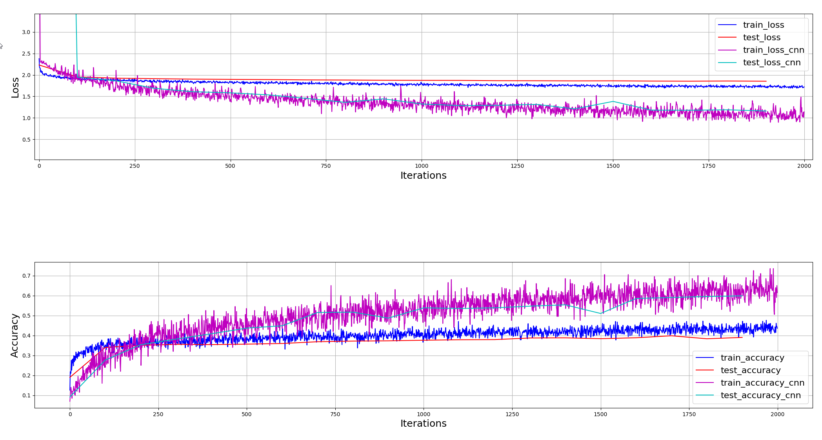
CNN vs dense net on cifar10

