Slide 1
INF 5860 Machine learning for image classification
Lecture 8: Generalization
Tollef Jahren
March 7 , 2018

Slide 2
Outline
Is learning feasible?
Model complexity
Overfitting
Evaluating performance
Learning from small datasets
Rethinking generalization
Capacity of dense neural networks

Slide 3
About today
Part1: Learning theory
Part2: Practical aspects of learning

Slide 4
Readings
Learning theory (caltech course):
https://work.caltech.edu/lectures.html
Lecture (Videos): 2,5,6,7,8,11
Read: CS231n: section “Dropouts”
http://cs231n.github.io/neural-networks-2/
Optional:
Read: The Curse of Dimensionality in classification
http://www.visiondummy.com/2014/04/curse-dimensionality-affect-classification/
Read: Rethinking generalization
https://arxiv.org/pdf/1611.03530.pdf

Slide 5
Progress
Is learning feasible?
Model complexity
Overfitting
Evaluating performance
Learning from small datasets
Rethinking generalization
Capacity of dense neural networks

Slide 6
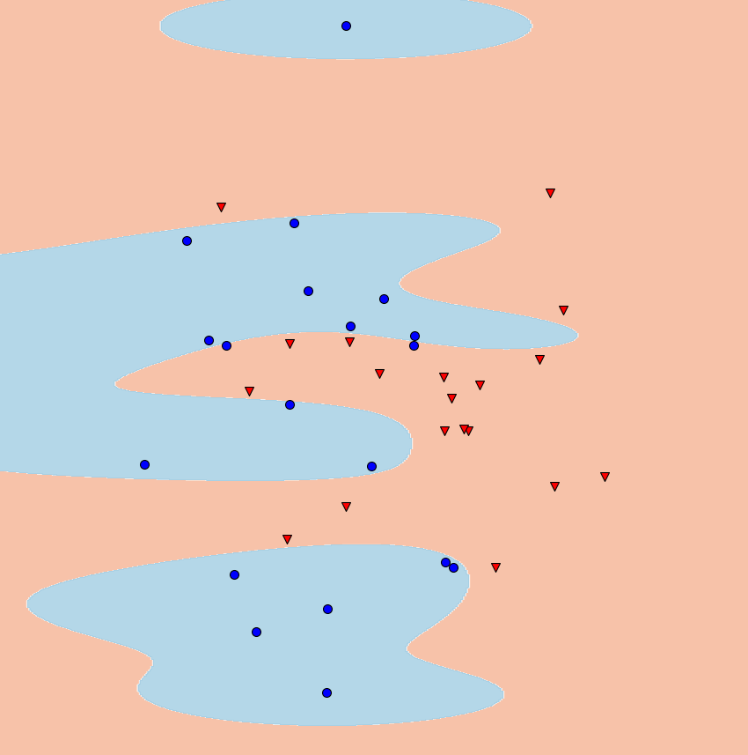
Is learning feasible?
Classification is to find the decision boundary
But is it learning?

Slide 7
Notation
Formalization supervised learning:
Input: $x$
Output: $y$
Target function: $f :𝒳\overset{→}{ } 𝒴$
Data: $\left(x_{1},y_{1}\right), \left(x_{2},y_{2}\right)⋅⋅⋅ ,\left(x_{N},y_{N}\right)$
Hypothesis: $h :𝒳\overset{→}{ } 𝒴$
Example:
Hypothesis set: $y=w_{1}x+w_{0}$
A hypothesis: $y=2x+1$

Slide 8
More notation
In-sample (colored): Training data available to find your solution.
Out-of-sample (gray): Data from the real world, the hypothesis will be used for.
Final hypothesis:
Target hypothesis:
Generalization: Difference between the in-sample error and the out-of-sample error
Notes:
In-sample. The training data you have available to find a good hypothesis

Slide 9
Learning diagram
The Hypothesis Set
$$ℋ=\left\{h\right\} \text{g} \text{∈} ℋ$$
The Learning Algorithm
e.g. Gradient$\text{descent}$
The hypothesis set and the learning algorithm are referred to as the Learning model
Notes:
Hypothesis set: neural network, linear model, gaussian classifier etc.
Learning algorithm: e.g. gradient descent

Slide 10
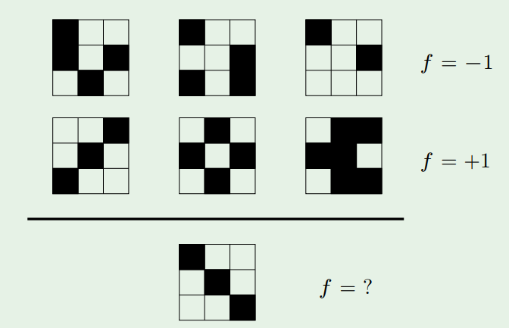
Learning puzzle
Notes:
F=-1 if the hypothesis is the top left corner
F=1 if the hypothesis is symmetry
Multiple possible hypothesis that could be used as the target function is unknown. We always have a finite set of data points. If the goal were to memories, we would not learn anything. Learning is to understand the pattern.

Slide 11
The target function is UNKNOWN
We cannot know what we have not seen!
What can save us?
Answer: Probability
Notes:
Example: training data has black cats only, you never know if the next cat is white….

Slide 12
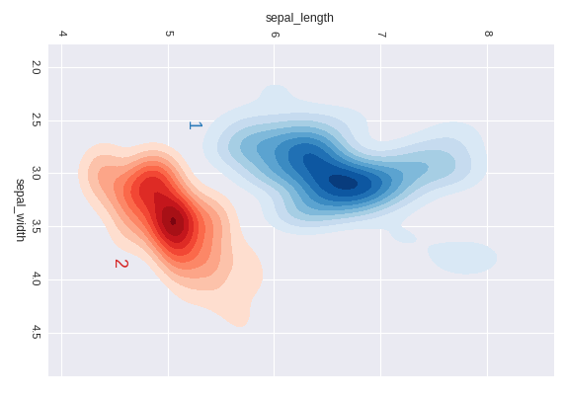
Drawing from the same distribution
Requirement:
The in-sample and out-of-sample data must be drawn from the same distribution (process)

Slide 13
What is the expected out-of-sample error?
For a randomly selected hypothesis
The closest error approximation is the in-sample error

Slide 14
What is training?
A general view of training:
Training is a search through possible hypothesis
Use in-sample data to find the best hypothesis
$$h_{1}$$
$$h_{2}$$
$$h_{3}$$

Slide 15
What is the effect of choosing the best hypothesis?
Smaller in-sample error
Increasing the probability that the result is a coincidence
The expected out-of-sample error is greater or equal to the in-sample error
$$h_{1}$$
$$h_{2}$$
$$h_{3}$$

Slide 16
Searching through all possibilities
The extreme case search through all possibilities
Then you are guaranteed 0% in-sample error rate
No information about the out-of-sample error

Slide 17
Progress
Is learning feasible?
Model complexity
Overfitting
Evaluating performance
Learning from small datasets
Rethinking generalization
Capacity of dense neural networks

Slide 18
Capacity of the model (hypothesis set)
The model restrict the number of hypothesis you can find
Model capacity is a reference to how many possible hypothesis you have
A linear model has a set of all linear functions as its hypothesis

Slide 19
Measuring capacity
Vapnik-Chervonenkis (VC) dimension
Denoted: $d_{VC}(ℋ)$
Definition:
The maximum number of points that can be arrange such that $ℋ$ can shatter them.

Slide 20
Example VC dimension
(2D) Linear model
Configuration ($N=$3)
$$x_{2}$$
$$x_{1}$$

Slide 21
Example VC dimension
(2D) Linear model
Configuration ($N=$3)
$$x_{2}$$
$$x_{1}$$

Slide 22
Example VC dimension
(2D) Linear model
Configuration ($N=$3)
$$x_{2}$$
$$x_{1}$$

Slide 23
Example VC dimension
(2D) Linear model
Configuration ($N=$3)
$$x_{2}$$
$$x_{1}$$

Slide 24
Example VC dimension
(2D) Linear model
Configuration ($N=$3)
$$x_{2}$$
$$x_{1}$$

Slide 25
Example VC dimension
(2D) Linear model
Configuration ($N=$3)
$$x_{2}$$
$$x_{1}$$

Slide 26
Example VC dimension
(2D) Linear model
Configuration ($N=4$)
$$x_{2}$$
$$x_{1}$$

Slide 27
Example VC dimension
(2D) Linear model
Configuration ($N=4$)
$$x_{2}$$
$$x_{1}$$

Slide 28
Example VC dimension
(2D) Linear model
Configuration ($N=4$)
$$x_{2}$$
$$x_{1}$$

Slide 29
Example VC dimension
(2D) Linear model
Configuration ($N=4$)
$$x_{2}$$
$$x_{1}$$

Slide 30
Example VC dimension
(2D) Linear model
Configuration ($N=4$)
$$x_{2}$$
$$x_{1}$$

Slide 31
Example VC dimension
(2D) Linear model
Configuration ($N=4$)
$$x_{2}$$
$$x_{1}$$

Slide 32
Example VC dimension
(2D) Linear model
Configuration ($N=4$)
$$x_{2}$$
$$x_{1}$$

Slide 33
Example VC dimension
(2D) Linear model
Configuration ($N=4$)
$$x_{2}$$
$$x_{1}$$

Slide 34
Example VC dimension
(2D) Linear model
Configuration ($N=4$)
$$x_{2}$$
No separating line
$$x_{1}$$

Slide 35
VC dimension
Definition
The maximum number of points that can be arrange such that $ℋ$ can shatter them.
The VC dimension of a linear model in dimension $d$ is:
$d_{VC}\left(ℋ_{lin}\right)=d+1$
Capacity increases with the number of effective parameters

Slide 36
Growth function
The growth function is a measure of the capacity of the hypothesis set.
Given a set of N samples and an unrestricted hypothesis set, the value of the growth function is:
$m_{ℋ}\left(N\right)=2^{N}$
For a restricted (limited) hypothesis set the growth function is bounded by:
$$m_{ℋ}\left(N\right)≤\sum_{i=0}^{d_{VC}}{\left({N \atop i}\right)}$$
Maximum power is $N^{d_{VC}}$
Notes:
Binomialkoeffisienten

Slide 37
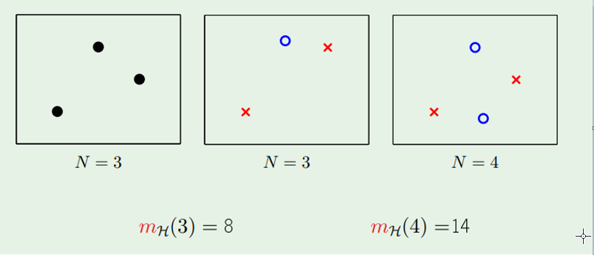
Growth function for linear model

Slide 38
Generalization error
Error measure binary classification:
$$e\left(g\left(x_{n}\right), f\left(x_{n}\right)\right)= \left\{\begin{aligned}0, if g\left(x_{n}\right)=f\left(x_{n}\right) \\ 1, if g\left(x_{n}\right)≠f\left(x_{n}\right)\end{aligned}\right.$$
In-sample error:
$$E_{in}\left(g\right)= \frac{1}{N}\sum_{n=1 }^{N}{e\left(g\left(x_{n}\right), f\left(x_{n}\right)\right)}$$
Out-of-sample error:
$$E_{out}\left(g\right)=Ε_{x}\left[e\left(g\left(x\right), f\left(x\right)\right)\right]$$
Generalization error:
$$G(g)=E_{in}\left(g\right)−E_{out}\left(g\right)$$

Slide 39
Upper generalization bound
Number of In-sample samples, $N$
Generalization threshold, $ε$
Growth function: $m_{ℋ}()$
The Vapnik-Chervonenkis Inequality
$$P \left[\begin{matrix} \\ \left|E_{in}\left(g\right)−E_{out}\left(g\right)\right|> ε \\ \end{matrix}\right] ≤4 m_{ℋ}\left(2N\right) e^{−\frac{1}{8}ε^{2}N}$$
Maximum power is $N^{d_{VC}}$
Notes:
The growth function is a count of the possible hypothesis given different spilt of the in-sample data.

Slide 40
What makes learning feasible?
Restricting the capacity of the hypothesis set!
But are we satisfied?
No!
The overall goal is to have a small $E_{out}\left(g\right)$

Slide 41
T$he goal is small E_{out}\left(g\right)$
$$P \left[\begin{matrix} \\ \left|E_{in}−E_{out}\right|> ε \\ \end{matrix}\right] ≤4 m_{ℋ}\left(2N\right) e^{−\frac{1}{8}ε^{2}N}= δ$$
$$ε= \sqrt{\frac{8}{N}\ln{\frac{4m_{ℋ}(2N)}{δ}}} = Ω(N,ℋ,δ)$$
$$P \left[\begin{matrix} \\ \left|E_{in}−E_{out}\right|<Ω \\ \end{matrix}\right] >1− δ$$
With probability $> 1−δ:$
$$E_{out}<E_{in}+Ω$$

Slide 42
A model with wrong hypothesis will never be correct
All hypotheses
Hypotheses space
All hypotheses
Hypotheses space
correct
Cannot be found
correct

Slide 43
Progress
Is learning feasible?
Model complexity
Overfitting
Evaluating performance
Learning from small datasets
Rethinking generalization
Capacity of dense neural networks

Slide 44
Noise
The in-sample data will contain noise.
Origin of noise:
Measurement (sensor) noise
The in-sample data may not include all parameters
Our $ℋ$ has not the capacity to fit the target function

Slide 45
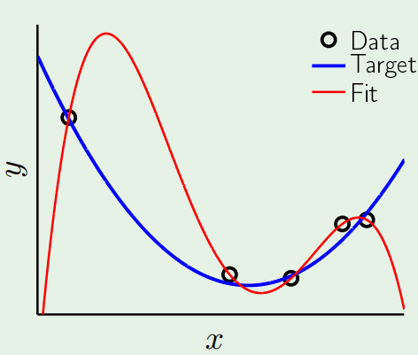
The role of noise
We want to fit our hypothesis to the target function, not the noise
Example:
Target function: second order polynomial
Noisy in-sample data
Hypothesis: Fourth order polynomial
Result: $E_{in}=0, E_{out} is huge$

Slide 46
Overfitting - Training to hard
Initially, the hypothesis is not selected from the data and $E_{in}$ and $E_{out}$ are similar.
While training, we are exploring more of the hypothesis space
The effective VC dimension is growing at the beginning, and defined by the number of free parameters at the end
Notes:
Initially, the hypothesis is not selected from the data and E_in and E_out are similar.
While training, we are exploring more of the hypothesis space
- Effective VC dimension is growing at the beginning, and defined by the number of free parameters at the end

Slide 47
Regularization
With a tiny weight penalty, we can reduce the effect of noise significantly.
Notes:
We can select the complexity of the model continuous

Slide 48
Progress
Is learning feasible?
Model complexity
Overfitting
Evaluating performance
Learning from small datasets
Rethinking generalization
Capacity of dense neural networks

Slide 49
Splitting of data
Training set (60%)
Used to train our model
Validation set (20%)
Used to select the best hypothesis
Test set (20%)
Used to get a representative out-of-sample error

Slide 50
Important! No peeking
Keep a dataset that you don’t look at until evaluation (test set)
The test set should be as different from your training set as you expect the real world to be

Slide 51
A typical scenario

Slide 52
Learning curves
Simple hypothesis
Complex hypothesis

Slide 53
Progress
Is learning feasible?
Model complexity
Overfitting
Evaluating performance
Learning from small datasets
Rethinking generalization
Capacity of dense neural networks

Slide 54
Learning from a small datasets
Regularization
Dropouts
Data augmentation
Transfer learning
Multitask learning

Slide 55
Dropouts
Regularization technique
Drop nodes with probability, $p$

Slide 56
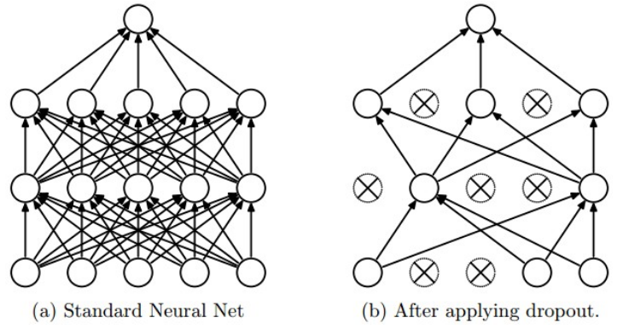
Dropouts
Force the network to make redundant representations
Stochastic in nature, difficult for the network to memories.
Remember to scale with $1/p$

Slide 57
Data augmentation
Increasing the dataset!
Examples:
Horizontal flips
Cropping and scaling
Contrast and brightness
Rotation
Shearing

Slide 58
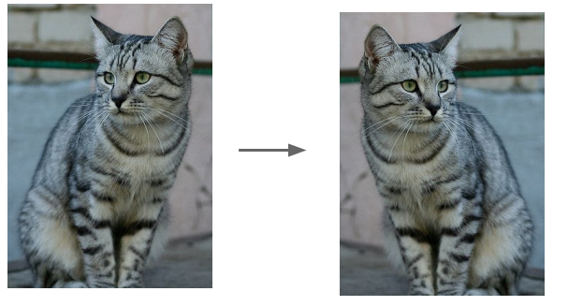
Data augmentation
Horizontal Flip

Slide 59
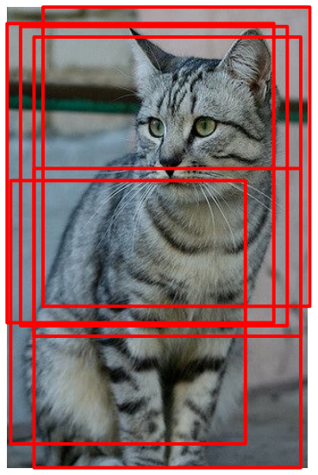
Data augmentation
Cropping and scaling

Slide 60
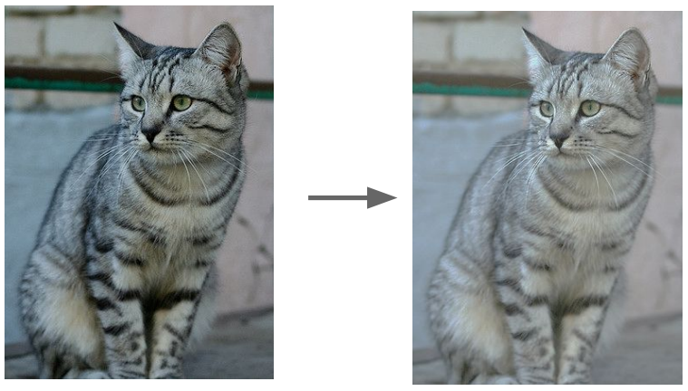
Data augmentation
Change Contrast and brightness

Slide 61
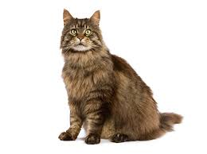
Transfer learning
Use a pre-trained network
Neural networks share representations across classes
You can reuse these features for many different applications
Depending on the amount of data, finetune:
the last layer only
the last couple of layers

Slide 62
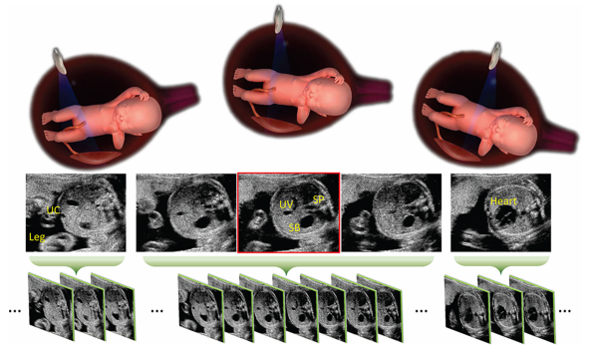
What can you transfer to?
Detecting special views in Ultrasound
Initially far from ImageNet
Benefit from fine-tuning imagenet features
Standard Plane Localization in Fetal Ultrasound via Domain Transferred Deep Neural Networks

Slide 63
Transfer learning from pretrained network
Since you have less parameters to train, you are less likely to overfit.
Need a lot less time to train.
OBS! Since networks trained on ImageNet have a lot of layers, it is still possible to overfit.

Slide 64
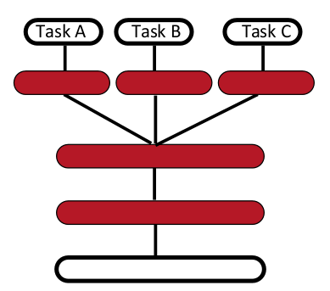
Multitask learning
Many small datasets
Different targets
Share base-representation

Slide 65
Progress
Is learning feasible?
Model complexity
Overfitting
Evaluating performance
Learning from small datasets
Rethinking generalization
Capacity of dense neural networks

Slide 66
Is traditional theory valid for deep neural networks?
“UNDERSTANDING DEEP LEARNING REQUIRES RETHINKING GENERALIZATION”
Experiment:
Deep neural networks have the capacity to memories many datasets
Deep neural networks show small generalization error
Notes:
Shuffling labels in the dataset -> No structure to be learned

Slide 67
Progress
Is learning feasible?
Model complexity
Overfitting
Evaluating performance
Learning from small datasets
Rethinking generalization
Capacity of dense neural networks

Slide 68
Have some fun
Capacity of dense neural networks
http://playground.tensorflow.org

Slide 69
Tips for small data
Try a pre-trained network
Get more data
1000 images with 10 mins per label is 20 working days…
Sounds like a lot, but you can spend a lot of time getting transfer learning to work
Do data-augmentation
Try other stuff (Domain-adaption, multitask learning, simulation, etc.)

