Slide 1
INF 5860 Machine learning for image classification
Lecture 14: Reinforcement learning
May 9 , 2018

Slide 2
Outline
Motivation
Introduction to reinforcement learning (RL)
Value function based methods (Q-learning)
Policy based methods (policy gradients)
Value function and policy based methods (Actor-Critic)
Miscellaneous

Slide 3
About today
Introduction to main concepts and terminology of reinforcement learning
The goal is for you to be familiar with policy gradients and Q-learning

Slide 4
Readings
Video:
CS231n: Lecture 14 | Deep Reinforcement Learning: https://www.youtube.com/watch?v=lvoHnicueoE&index=14&list=PLC1qU-LWwrF64f4QKQT-Vg5Wr4qEE1Zxk&t=3s
Text:
Karpathy blog: (Reinforcement learning/Policy learning) http://karpathy.github.io/2016/05/31/rl/
Optional:
RL Course by David Silver: https://www.youtube.com/watch?v=2pWv7GOvuf0&list=PL7-jPKtc4r78-wCZcQn5IqyuWhBZ8fOxT&index=0

Slide 5
Progress
Motivation
Introduction to reinforcement learning (RL)
Value function based methods (Q-learning)
Policy based methods (policy gradients)
Value function and policy based methods (Actor-Critic)
Miscellaneous

Slide 6
Branches of Machine Learning

Slide 7
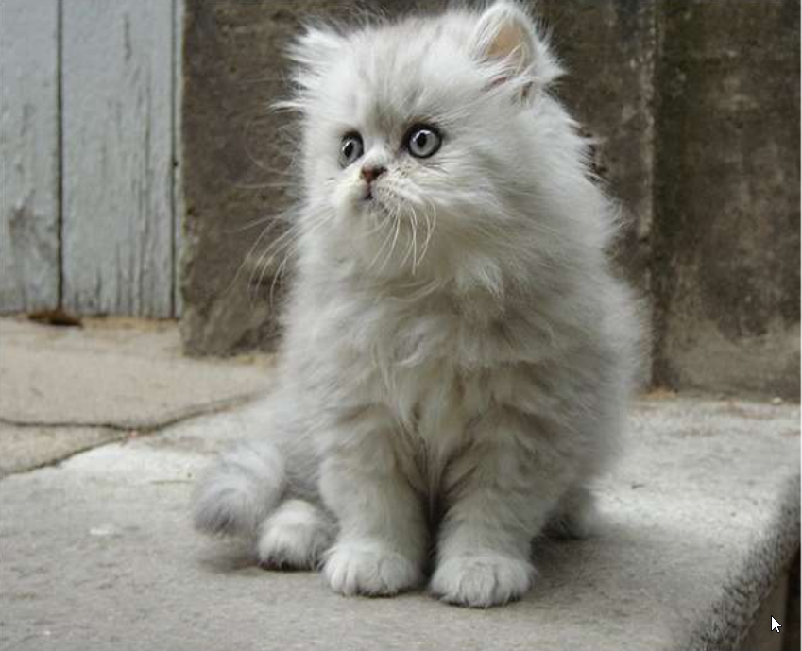
Supervised learning
Given a training set with input $x$ and desired output $y$:
$Ω_{train}=\left\{\left(x^{\left(1\right)},y^{\left(1\right)}\right),{ (x}^{\left(2\right)},y^{(2)}),…,{(x}^{\left(m\right)},y^{\left(m\right)})\right\}$
The goal is to create a function $f$ that “approximates” this mapping:
$f\left(x\right)≈y, \text{∀}\text{(}\text{x}\text{,}\text{y}\text{) }\text{∈}{ Ω}_{train}$
Hope that this generalizes well to unseen examples:
$f\left(x\right)=\hat{y}≈y, \text{∀}\text{(}\text{x}\text{,}\text{y}\text{) }\text{∈}{ Ω}_{test}$
Examples:
Classification, regression, object detection,
Segmentation, image captioning.

Slide 8
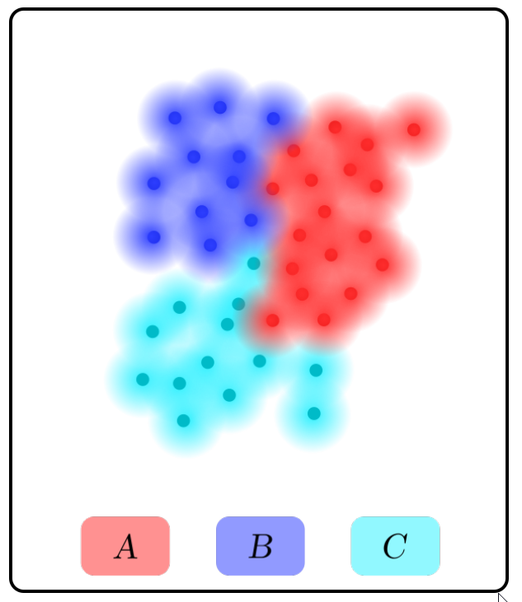
Unsupervised learning
Our training set consists of input $x$ only:
$Ω_{train}=\left\{x^{\left(1\right)},x^{\left(2\right)},…,x^{\left(m\right)}\right\}$
We do not have any labeled data. Our goal is to find an underlaying structure of the data.
Examples:
Data clustering
Anomality detection
Signal generation
Signal compression
Variational autoencoder (latent space $z$)

Slide 9
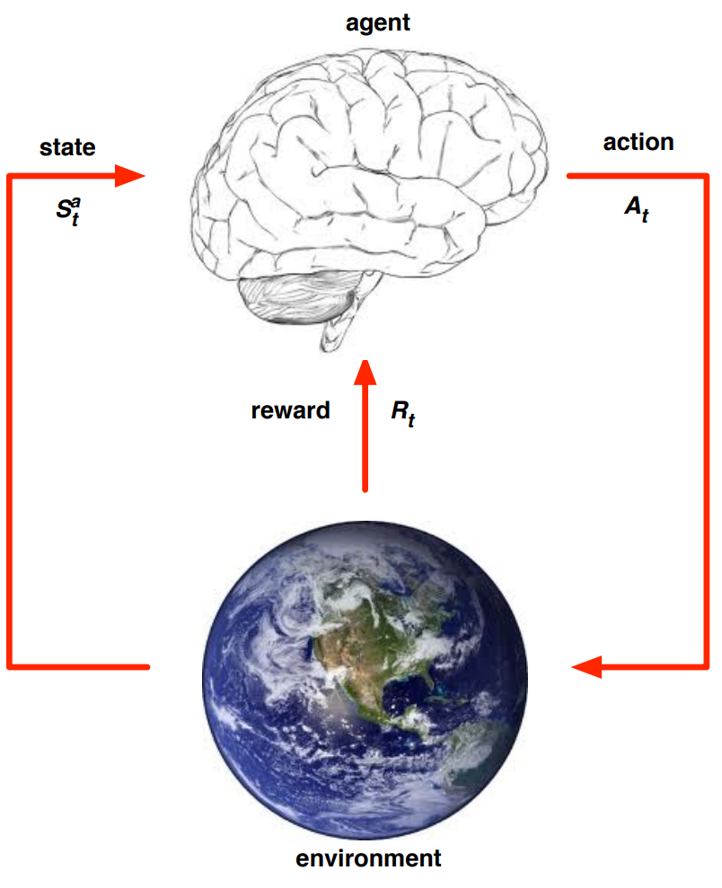
Reinforcement learning
Reinforcement Learning ~ Science of decision making
In RL an agent learns from the experiences it gains by interacting with the environment.
The goal is to maximize an accumulated reward given by the environment.
An agent interacts with the environment via states, actions and rewards.
RL Course by David Silver
Notes:
In Supervised Learning we cannot affect the environment.

Slide 10
Reinforcement learning
What makes reinforcement learning different from other machine learning paradigms?
There is no supervisor, only a reward signal
Feedback is delayed, not instantaneous
Time really matters (sequential, non i.i.d data)
Agent’s actions affect the subsequent data it receives

Slide 11
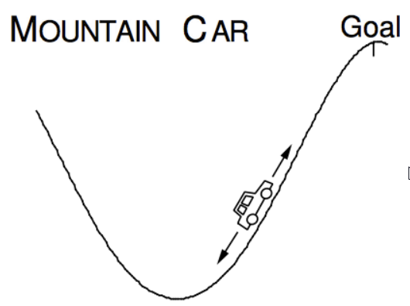
Mountain Car
Objective:
Get to the goal
State variables:
Position and velocity
Actions:
Motor: Left, Neutral, right
Reward:
(-1) for each time step

Slide 12
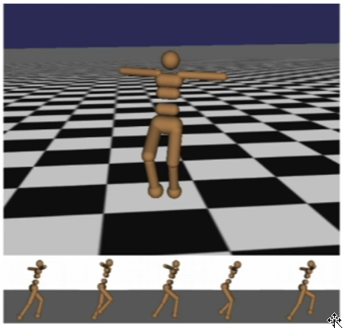
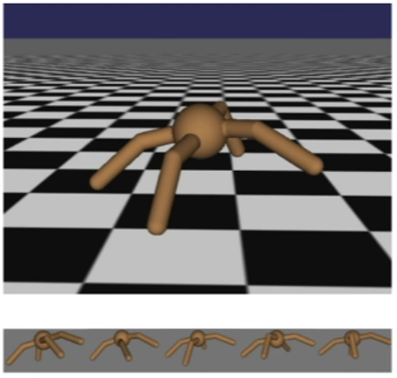
Robots
Objective:
Get the robot to move forward
State variables:
Angle and positions of the joints
Actions:
Torques applied on joints
Reward:
(+1) at each time step upright + forward movement

Slide 13
https://www.youtube.com/watch?v=rhNxt0VccsE

Slide 14
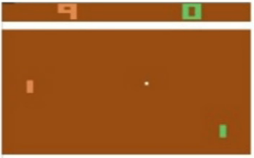
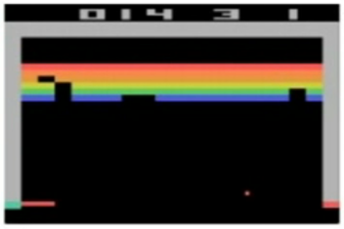
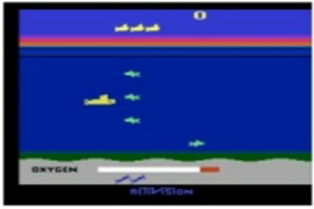
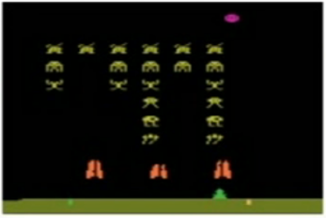
Atari games
Objective:
Complete the game with the highest score
State variables:
Raw pixel inputs of the game state
Actions:
Game controls, e.g. left, right, up, down, shoot.
Reward:
Score increases/decreases at each time step

Slide 15
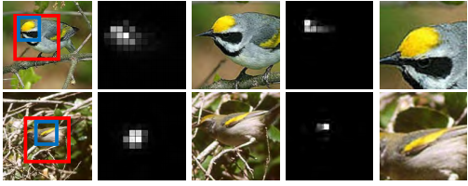
Distinguishing images with small differences
You have high resolution images
You separate classes based on small, but characteristic differences
Birds
Tumors
Brands
Notes:
Attention models in image classification, eye perception, we first look at the image in low res, and the focues onto smaller regions.

Slide 16
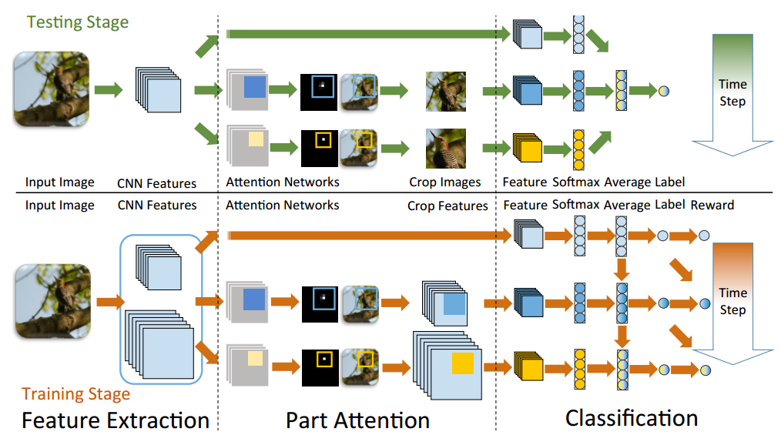
Distinguishing images with small differences
Pre-trained CNN features
Attention network output confidence map
Spatial softmax for finding probabilities of locations
Crop and resize image features
Fully Convolutional Attention Networks for Fine-Grained Recognition

Slide 17
Progress
Motivation
Introduction to reinforcement learning (RL)
Value function based methods (Q-learning)
Policy based methods (policy gradients)
Value function and policy based methods (Actor-Critic)
Miscellaneous

Slide 19
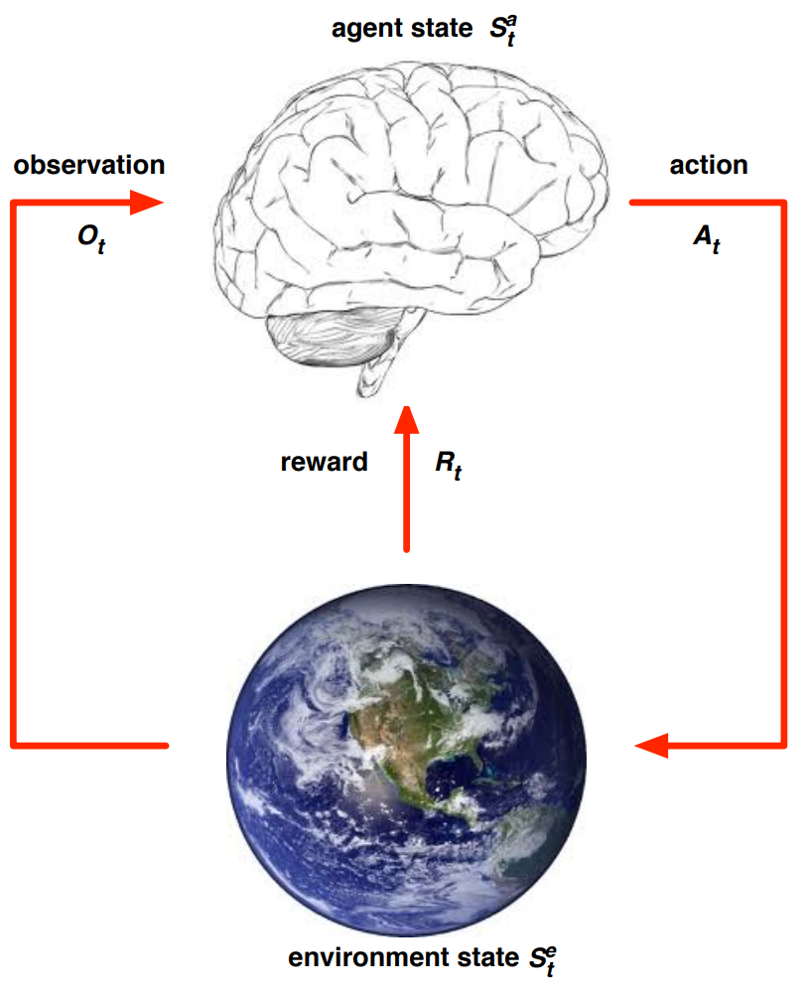
History (trajectory) and State
History / trajectory :
$H_{t}={τ_{t}= O}_{1}, A_{1}, R_{1}, O_{2}, A_{2}, R_{2},…, O_{t}, A_{t}, R_{t}$
Full observatory:
Agent direct observe the environment state.
$O_{t}= S_{t}^{e}=S_{t}^{a}$
State:
The state is a summary (of the actions and observations) that determines what happens next given an action.
$S_{t}=f(H_{t})$
Partially observability:
The agent indirectly observes the environment.
Robot with a camera

Slide 20
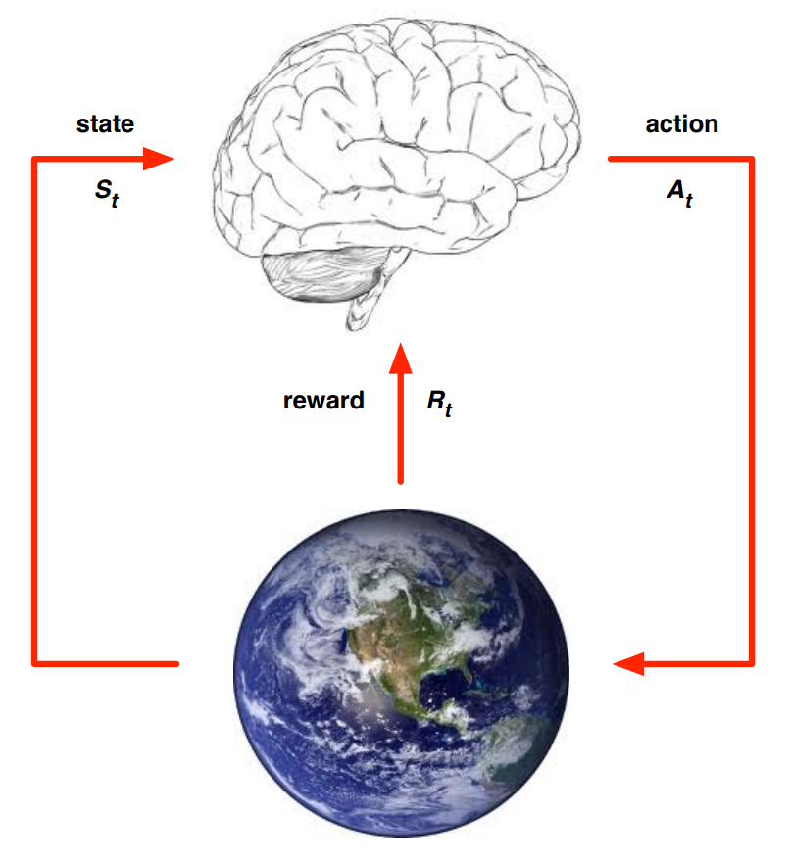
Markov Property
Definition:
A state $S_{t}$ is Markov if and only if:
$ℙ\left[S_{t+1} | S_{t}\right]=ℙ\left[S_{t+1} | {S_{1},{ S}_{2},…,S}_{t}\right]$
The state capture all relevant information from the history
The state is sufficient to describe the statistics of the future.

Slide 21
Policy
The agent’s policy defines it’s behavior.
A policy, $π,$ is a map from state to actions
Deterministic policy: $π(s_{t})$
Stochastic policy: $π\left(a_{t} | s_{t}\right)=ℙ(A_{t}=a_{t}|S_{t}=s_{t})$

Slide 22
Reward and Return
The reward, $R_{t}$, is a scalar value the agent receives for each step t.
The return, $G_{t}$, is the total discounted accumulated reward form a given time-step t.
$G_{t}=R_{t}+{γR}_{t+1}+…= \sum_{k=0}^{∞}{γ^{k}}R_{t+k}$
Discount factor:
We can apply a discord factor, $γ∈\left[0,1\right],$ to weight how we evaluate return.
The agent's goal is to maximize the return
Notes:
Why discount:
To avoid inf returns in cyclic process.
Uncertain of the future

Slide 23
Markov Decision Process (MDP)
The mathematical formulation of the reinforcement learning (RL) problem.
A Markov Decision Process is a tuple,$ℳ=\left\langle S, A, P, R, γ\right\rangle$, where every state has the Markov property.
S: A finite set of states
A: A finite set of actions
P: The transition probability matrix
$$P_{s_{t}s_{t+1}}^{a}=ℙ\left[S_{t+1}=s_{t+1} | S_{t}=s_{t}, A_{t}=a_{t}\right]$$
R: Reward function:
$R_{s}^{a}= 𝔼\left[S_{t}=s_{t}, A_{t}=a_{t}\right]$
$γ$: is a discount factor $γ\text{∈} \text{[}\text{0,1}\text{]}$
Notes:
$γ$ -> How much do we value reward coming soon comparred to at the end.

Slide 24
Markov Decision Process (timeline)
The environment samples an initial state, $s_{0},$ for time-step t=0.
For time-step, t, until termination:
Agent selects an action given a policy: $a_{t}= π\left(a_{t} | s_{t}\right)=ℙ(A_{t}=a_{t}|S_{t}=s_{t})$
Environment samples a reward: $r_{t}= ℙ\left[R_{t}=r_{t} | S_{t}=s_{t}, A_{t}=a_{t}\right]$
Environment samples next state: $s_{t+1}= ℙ\left[S_{t+1}=s_{t+1} | S_{t}=s_{t}, A_{t}=a_{t}\right]$
Agent receives the next state, $s_{t+1}$, and the reward, $r_{t}$.

Slide 25
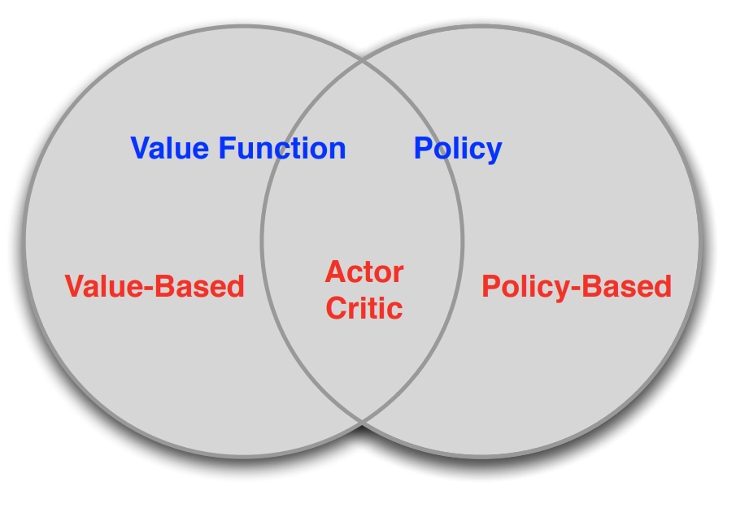
Objective
The objective in reinforcement learning (RL) is to find the optimal policy, $π_{∗}$, which maximize the expected accumulated reward.
Agent’s taxonomy to find the optimal policy in reinforcement learning

Slide 26
Progress
Motivation
Introduction to reinforcement learning (RL)
Value function based methods (Q-learning)
Policy based methods (policy gradients)
Value function and policy based methods (Actor-Critic)
Miscellaneous

Slide 27
Objective
Our goal is it find the policy which maximize the accumulated reward:
$G_{t}=R_{t}+{γR}_{t+1}+…= \sum_{k=0}^{∞}{γ^{k}}R_{t+k}$
Due to the randomness of the transition probability and the reward function, we use the expected value in the definition of the optimal policy.
$π_{∗}=\underset{π}{arg max}{𝔼}\left[G_{t}\right]$

Slide 28
State-value function and action-value function
While we follow our policy, we would like to know if we are not a good or bad state/position. Imagine trajectory: ${s_{0}, a}_{0}, r_{0}, s_{1}, a_{1}, r_{1},…$
Definition: a state-value function, $v_{π}\left(s\right)$, of an MDP is the expected return starting from state, s, and then following the policy $π.$ In general, how good is it to be in this state.
$v_{π}\left(s\right)= 𝔼_{π}\left[{ G}_{t} \right| S_{t}=s]$
Definition: an action-value (q-value) function, $q_{π}\left(s,a\right)$, is the expected return starting from state, s, taking action, a, and following policy, $π.$ In general, how good it is to take this action.
$q_{π}\left(s,a\right)= 𝔼_{π}\left[ G_{t} | A_{t}=a, S_{t}=s\right]$

Slide 29
State-value function and action-value function
Define: $π ≥ π^{′} if v_{π}\left(s\right)≥v_{π^{′}}\left(s\right), ∀s$
Definition: The optimal state-value function$v_{∗}\left(s\right)$, is the maximum value function over all policies:
$v_{∗}\left(s\right)= \max_{π}{v_{π}\left(s\right)}$
Definition: The optimal action-value function$q_{∗}\left(s,a\right)$, is the maximum action-value function over all policies:
$q_{∗}\left(s,a\right)= \max_{π}{q_{π}\left(s,a\right)}$
Note: If we knew $q_{∗}\left(s,a\right)$ the RL problem is solved.

Slide 30
Bellman (expectation) equation
The Bellman equation is a recursive equation which can decompose the value function into two part:
Immediate reward, $R_{t}$
Discounted value of successor state, $γv(S_{t+1})$
$v\left(s\right)=𝔼_{π} \left[{ G}_{t} \right| S_{t}=s]$
$=𝔼_{π} \left[R_{t}+{γR}_{t+1}+{γ^{2}R}_{t+2}{+γ^{3}R}_{t+3}+… \right| S_{t}=s]$
${=𝔼}_{π}\left[R_{t}+{γ(R}_{t+1}+{γ^{2}R}_{t+2}{+γ^{3}R}_{t+3}+…) \right| S_{t}=s]$
${=𝔼}_{π}\left[R_{t}+γG_{t+1}\right| S_{t}=s]$
$=𝔼_{π} \left[R_{t}+γv(S_{t+1})\right| S_{t}=s]$

Slide 31
How to find the best policy?
We will go though a simple example, Gridworld, to show how the Bellman equation can be used iteratively to evaluate a policy, $π.$ The Goal is to give an intuition of how the Bellman equation is used.
$${v\left(s\right) =𝔼}_{π} \left[R_{t}+γv\left(S_{t+1}\right) \right| { S}_{t}=s]$$

Slide 32
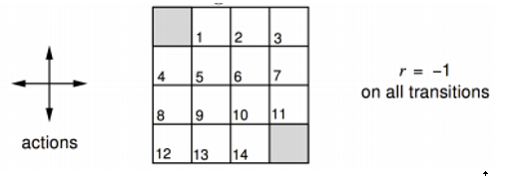
Evaluating a Random Policy in Gridworld using the Bellman eq.
Terminal states are shown as shaded
Actions leading out of the grid leave state unchanged
Reward is (-1) until a terminal state is reached
Agent follows uniform random policy
$π\left(n | ⋅\right)=π\left(s | ⋅\right)=π\left(e | ⋅\right)=π\left(w | ⋅\right)=0.25$

Slide 33
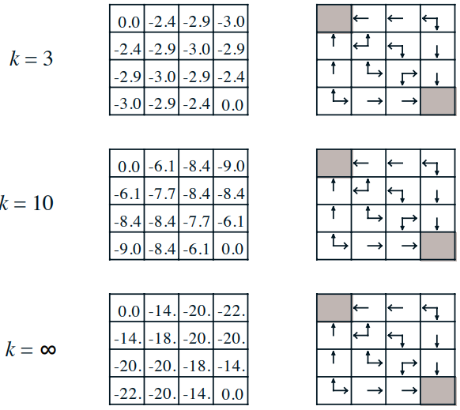
$${v_{k+1}\left(s\right) =𝔼}_{π} \left[R_{t}+γv_{k}\left(S_{t+1}\right) \right| { S}_{t}=s]$$

Slide 34
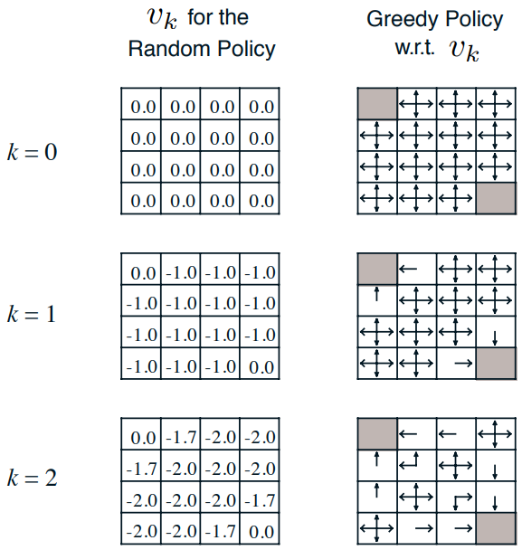
Policy evaluation
We can evaluate the policy $π$, by iteratively update the state-value function.
${v_{π}\left(s\right) =𝔼}_{π} \left[R_{t}+γv\left(S_{t+1}\right) \right| { S}_{t}=s]$
We can improve the policy by acting greedily with respect to $v_{π}$.
$π^{′}=greedy(v_{π})$
In our example, we found the optimal policy, $π^{′}$= $π^{∗}$, after one iteration only.
In general, iterating between policy evaluation and policy improvement is required before finding the optimal policy
This was an example with a known MDP, we knew the rewards and the transitions probabilities.

Slide 35
Bellman (optimality) equation
Lets define the optimal Q-value (action-value) function,$Q_{∗}$, to be the maximum expected reward given an state, action pair.
$$Q_{∗}\left(s_{t},a_{t}\right)= \max_{π}{𝔼_{π}\left[ G_{t} | A_{t}=a_{t}, S_{t}=s_{t}\right] }$$
The optimal Q-value function, $Q_{∗}$, satisfy the following form of the bellman equation:
$$Q_{∗}\left(s_{t},a_{t}\right)=𝔼\left[ R_{t}+γ\max_{a_{t+1}}{Q_{∗}\left(s_{t+1},a_{t+1}\right)}| A_{t}=a_{t}, S_{t}=s_{t}\right]$$
Note: The optimal policy, $π_{∗}$, is achieved by taking the action with the highest Q-value.
Note: We still need the expectation, as the randomness of the environment is unknown.

Slide 36
Solving for the optimal policy
The goal is to find a Q-value function which satisfy the Bellman (optimality) equation. An algorithm, value iteration, can be used to iteratively update our Q-value function.
$$Q_{i}\left(s_{t},a_{t}\right)=𝔼\left[ R_{t}+γ\max_{a_{t+1}}{Q_{i−1}\left(s_{t+1},a_{t+1}\right)}| A_{t}=a_{t}, S_{t}=s_{t}\right]$$
Notation: $i$, is the iteration update step, $t$, is the sequential time-step in an episode.
The Q-value, $Q_{i}$, will converge to $Q_{∗}$ under some mathematical conditions.
While solving for the optimal Q-value function, we normally encounter two challenges:
The “$max$” property while sampling new episodes can lead to suboptimal policy.
The state-action space is too large to store.

Slide 37
Exploration vs Exploitation
“The “$max$” property while sampling new episodes can lead to suboptimal policy”
Exploitation:
By selecting the action with the highest q-value while sampling new episodes, we can refine our policy efficiently from an already promising region in the state action space.
Exploration:
To find a new and maybe more promising region within the state action space, we do not want to limit our search in the state action space.
We introduce a randomness while sampling new episodes.
With a probability of $ε$ lets choose a random action:
$$π\left(a | s\right)=\left\{\begin{aligned}a_{∗}=\underset{a∈A}{argmax}{Q(s,a)}, with probabillity 1−ε \\ random action, with probabillity ε\end{aligned}\right.$$

Slide 38
Function approximation
In the Gridworld example, we stored the state-values for each state. What if the state-action space is too large to be stored e.g. continuous?
We approximate the Q-value using a parameterized function e.g. neural network.
$$\hat{Q}\left(s,a, θ\right)≈Q(s,a)$$
We want the function to generalize:
Similar states should get similar action-values, $\hat{Q}\left(s,a, θ\right)$ can also generalize to unseen states. A table version would just require to much data.
In supervised learning:
Building a function approximation vs memorizing all images (table).
Notes:
Typically, we want the parametric function to have less parameters than the values in the table.
Practical if $\hat{Q}\left(s,a, θ\right)$ is differentiable w.r.t theta

Slide 39
Solving for the optimal policy: Q-learning
Goal: Find a Q-function satisfying the Bellman (optimality) equation.
Idea: The Q-value at the last time step is bounded by the true Q-value, the correctness of the Q-value estimates increase with time-steps.
Init: Initialize the weights in the neural network e.g. randomly.
$$Q_{∗}\left(s_{t},a_{t},θ_{i}\right)=𝔼\left[ R_{t}+γ\max_{a_{t+1}}{Q_{∗}\left(s_{t+1},a_{t+1},θ_{i−1}\right)}| A_{t}=a_{t}, S_{t}=s_{t}\right]$$
Reference:
$$y_{i}= 𝔼\left[ R_{t}+γ\max_{a_{t+1}}{Q\left(s_{t+1},a_{t+1}, θ_{i−1}\right)}| A_{t}=a_{t}, S_{t}=s_{t}\right]$$
Loss:
$$L_{i}(θ_{i})=𝔼_{s_{t}, s_{t+1, }a_{t}, r_{t}\sim D_{i}}\left[{\left(y_{i}−Q\left(s_{t},a_{t}, θ_{i}\right)\right)}^{2}\right]$$
$D_{i}$ is your dataset with state action pairs $s_{t}, s_{t+1, }a_{t}, r_{t}$
Notes:
Initialize Q to be something, the weights in the function approximation.

Slide 40
Solving for the optimal policy: Q-learning
Loss:
$$L_{i}(θ_{i})=𝔼_{s_{t}, s_{t+1, }a_{t}, r_{t}\sim D_{i}}\left[{\left(y_{i}−Q\left(s_{t},a_{t}, θ_{i}\right)\right)}^{2}\right]$$
Compute gradients:
$${∇_{θ}}_{i}L_{i}(θ_{i}) =𝔼_{s_{t}, s_{t+1, }a_{t}, r_{t}\sim D_{i}}\left[2\left(y_{i}−Q\left(s_{t},a_{t}, θ_{i}\right)\right)⋅{∇_{θ}}_{i}Q\left(s_{t},a_{t}, θ_{i}\right)\right]$$
Update weights $θ$:
$θ_{i}=θ_{i−1}−α {∇_{θ}}_{i}L_{i}(θ_{i})$

Slide 41
Example: Deep Q-learning (Atari Games)
Objective:
Complete the game with the highest score
State variables:
Raw pixel inputs of the game state
Actions:
Game controls, e.g. left, right, up, down, shoot.
Reward:
Score increases/decreases at each time step

Slide 42
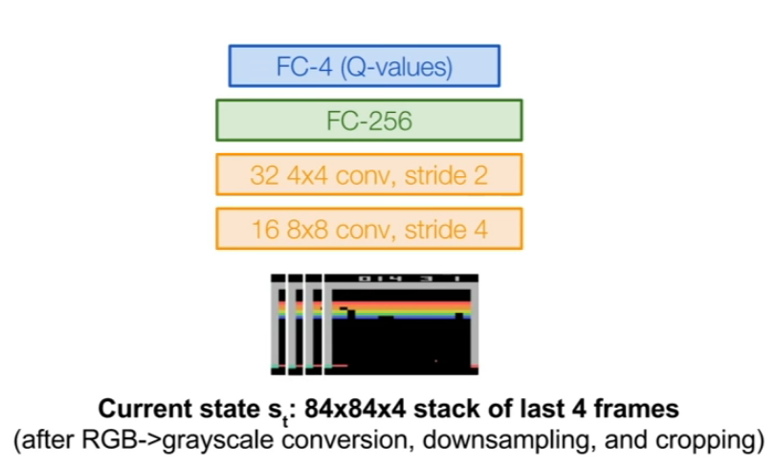
Deep Q-learning (Atari Games)
Example taken from: [Mnih er al. NIPS Workshop 2013; Nature 2015]
Q-network architecture:
FC-4 outputs Q values for all actions
A state, $s_{t}$, is a set pixels from stacked frames

Slide 43
Experience replay
Loss:
$$L_{i}\left(θ_{i}\right)=𝔼_{s_{t}, s_{t+1, }a_{t}, r_{t}\sim D_{i}}\left[{\left(y_{i}−Q\left(s_{t},a_{t}, θ_{i}\right)\right)}^{2}\right]$$
The loss function is defined by two state action pairs, $\left\langle s_{t}, r_{t}, a_{t}, s_{t+1}\right\rangle$. We can store a replay memory table form the episodes played. The table is updated when new episodes are available.
Normally, state action pairs from the same episode are used to update the network. However, we can select random mini batches for the replay memory. This breaks the correlation between the data used to update the network.
More data efficient as we can reuse the data.

Slide 53
https://www.youtube.com/watch?v=V1eYniJ0Rnk

Slide 54
Progress
Motivation
Introduction to reinforcement learning (RL)
Value function based methods (Q-learning)
Policy based methods (policy gradients)
Value function and policy based methods (Actor-Critic)
Miscellaneous

Slide 55
Policy based methods
Value function based methods:
Learning the expected future reward for a given action.
The policy was to act greedily or epsilon-greedily on the estimated values.
Policy based methods:
Learning the probability that an action is good directly.
Advantage of Policy based methods:
We might need a less complex function for approximating the best action compared to estimate the final reward.
Example: Think of Pong

Slide 56
Policy based methods
Goal:
The goal is to use experience/samples to try to make a policy better.
Idea:
If a trajectory achieves a high reward, the actions were good
If a trajectory achieves a low reward, the actions were bad
We will use gradients to enforce more of the good actions and less of the bad actions. Hence the method is called Policy Gradients.
Notes:
Example: Pong, it can be difficult to estimate the final score at a given state within the episode. However, I can be much simpler to estimate were to move to be able to hit the ball

Slide 57
Policy Gradients
Our policy, $π_{θ},$ is a parametric function of parameter $θ.$
We can define an objective function for a given policy as:
$𝒥\left(θ\right)=𝔼 \left[\sum_{t≥0}{γ^{t}r_{t}|π_{θ}}\right]$
Note:
$γ$ is the discord factor
$r_{t}$ is the reward at time-step t.
Assuming our policy is differentiable we can use gradient ascent to maximum $𝒥$ w.r.t to $θ$

Slide 58
REINFORCE algorithm (not curriculum)
Our environment and sampling of our action is stochastic. Lets define the return as the expected accumulated reward.
$𝒥\left(θ\right)=𝔼_{τ\sim p(τ,θ)}[r(τ)]$
$=\int_{τ}{r\left(τ\right)p\left(τ,θ\right)dτ}$
Note:
Trajectory: ${τ_{t}=s}_{0}, a_{0}, r_{0}, s_{1}, a_{1}, r_{1},…, s_{t}, a_{t}, r_{t}$
We need the gradient of the objective function to update the parameters, $θ$.
${ ∇}_{θ} 𝒥\left(θ\right) = \int_{τ}{r\left(τ\right){ ∇}_{θ}p\left(τ,θ\right)dτ}$

Slide 59
REINFORCE algorithm (not curriculum)
${ ∇}_{θ} 𝒥\left(θ\right) ={ ∇}_{θ}𝔼_{τ\sim p(τ,θ)}[r(τ)]$
$=\int_{τ}{r\left(τ\right){ ∇}_{θ}p\left(τ,θ\right)dτ}$
We can rewrite the equation to become an expectation of an gradient using the following trick:
${ ∇}_{θ}p\left(τ,θ\right)=p\left(τ,θ\right)\frac{{ ∇}_{θ}p\left(τ,θ\right)}{p\left(τ,θ\right)}=p\left(τ,θ\right){ ∇}_{θ}\log{p\left(τ,θ\right) }$
${ ∇}_{θ} 𝒥\left(θ\right)=\int_{τ}{p\left(τ,θ\right)\left(r\left(τ\right) { ∇}_{θ}\log{p\left(τ,θ\right)}\right) dτ}$
${= 𝔼}_{τ\sim p(τ,θ)}\left[r\left(τ\right) { ∇}_{θ}\log{p\left(τ,θ\right)}\right]$
Notes:
Can estimate ${=𝔼}_{τ\sim p(τ,θ)}\left[r\left(τ\right) { ∇}_{θ}\log{p\left(τ,θ\right)}\right]$ using Monte Carlo sampling

Slide 60
REINFORCE algorithm (not curriculum)
$${ ∇}_{θ} 𝒥\left(θ\right){= 𝔼}_{τ\sim p(τ,θ)}\left[r\left(τ\right) { ∇}_{θ}\log{p\left(τ,θ\right)}\right]$$
Expanding the probability of a trajectory based on the term, ${ ∇}_{θ}\log{p\left(τ,θ\right)}$:
$p\left(τ,θ\right)= \prod_{t≥0}{p\left(s_{t+1}|s_{t},a_{t}\right) π_{θ}(a_{t}|s_{t})}$
$\log{p\left(τ,θ\right)}= \sum_{t≥0}{\left(\log{p\left(s_{t+1}|s_{t},a_{t}\right)+\log{π_{θ}(a_{t}|s_{t})}}\right)}$
${ ∇}_{θ}\log{p\left(τ,θ\right)}=\sum_{t≥0}{{ ∇}_{θ }log{π_{θ}(a_{t}|s_{t})}}$
We can sample trajectories to get estimates of the gradient.
${ ∇}_{θ} 𝒥\left(θ\right)≈\sum_{t≥0}{{r\left(τ\right) ∇}_{θ }log{π_{θ}(a_{t}|s_{t})}}$

Slide 61
REINFORCE algorithm (Pseudocode) (not curriculum)
Update parameters by stochastic gradient ascent
Using $r_{t}$ as the return at time-step t.
$$Δθ_{t}= α{ ∇}_{θ }log{π_{θ}(a_{t}|s_{t})}r_{t}$$
function REINFORCE
Initialize $θ$ arbitrarily
for each episode {${τ_{t}=s}_{0}, a_{0}, r_{0}, s_{1}, a_{1}, r_{1},…, s_{t}, a_{t}, r_{t}$} $\sim π_{θ}$ do
for $t=1$ to $T−1$ do
$θ←θ+α{ ∇}_{θ }log{π_{θ}(a_{t}|s_{t})}r_{t}$
end
end
return $θ$
end function

Slide 62
Game of Pong

Slide 63
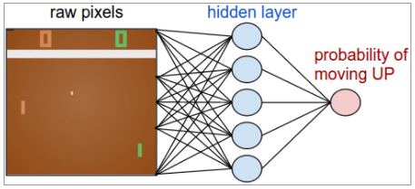
Policy learning: Pong
Policy learning
We take input images as states
Output probability of being good action
Choose an action
Observe: reward (/punishment)
Improve
The game:
Actions:
Up
Down
Reward:
Winning $=+1$
Losing $=−1$

Slide 64
Supervised learning vs Reinforcement learning
Imagine you play pong and the agent predicts:
Up $→\log{p=−1.2 (}$30%)
Down $→\log{p=−0.36 (}$70%)
correct action is “Up”
Supervised learning:
You choose the output with the highest probability
You get an immediate reward
Policy learning:
You sample an action with given the probability distribution
Wait until you get an reward to backprop (May be many steps)

Slide 65
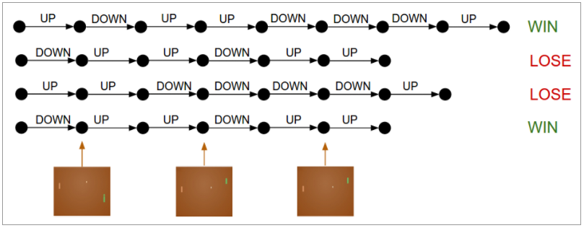
Playing games of Pong
Examples of games/episodes
You play a lot of actions and receive an reward at the end
You get a result, WIN! Great, but how do you know which action, caused the victory?
Well… you don’t

Slide 66
Which action caused the final results?
In a winning series there may be many non-optimal actions
In a losing series there may be good actions
The true effect is found by averaging out the noise, as winnings series tend to have more good action and visa versa

Slide 67
A chain of actions can cause large variations in performance
If we change one action early in the network, we can easily move into unchartered territory.
Imagine a self-driving car model that is used to driving on roads. If it happens to miss the road, it may have no idea what to do.
If one action in the chain changes, other earlier actions may go from WIN, WIN, WIN to LOSE, LOSE, LOSE
This high variance gradients make learning slow

Slide 68
Policy gradients: High variance

Slide 69
Policy gradients: High variance
42

Slide 70
Variance - all choices get the reward
42
42
42
42
42
42
42
42
42
42

Slide 71
Variance - other possible paths
42
42
42
42
42
42
42
42
42
42

Slide 72
Variance - high probability to chose some other path
42
42
42
42
42
42
42
42
42
42
-8

Slide 73
Variance - same actions for same state: now negative
-8
-8
-8
-8
-8
-8
-8
-8

Slide 74
Variance reduction
In pong and most other applications, the final actions leading up to the win relate more to the final result than other actions.

Slide 75
Variance reduction
Gradient estimator:
${ ∇}_{θ} 𝒥\left(θ\right)≈\sum_{t≥0}{{r\left(τ\right) ∇}_{θ }log{π_{θ}(a_{t}|s_{t})}}$
First idea: The return can be the accumulative reward from the state and to the end.
$${ ∇}_{θ} 𝒥\left(θ\right)≈\sum_{t≥0}{\left(\sum_{t′≥t}{r_{t′}}\right)}∇_{θ }log{π_{θ}(a_{t}|s_{t})}$$
Second idea: Add the discount factor, $γ$, to reduce the effect of delayed rewards
$${ ∇}_{θ} 𝒥\left(θ\right)≈\sum_{t≥0}{\left(\sum_{t′≥t}{{γ^{t^{′}−t}r}_{t′}}\right)}∇_{θ }log{π_{θ}(a_{t}|s_{t})}$$

Slide 76
Variance reduction: Baseline (not curriculum)
The accumulated discounted reward is not necessarily a reasonable value to be used for changing our probability distribution of the agent e.g. all reward are positive.
What we care about is whether an action is better or worse then expected. We can subtract an estimate of the goodness of the state (baseline).
$${ ∇}_{θ} 𝒥\left(θ\right)≈\sum_{t≥0}{\left(\sum_{t′≥t}{{γ^{t^{′}−t}r}_{t′}}−b(s_{t})\right)}∇_{θ }log{π_{θ}(a_{t}|s_{t})}$$
The most naive form of the baseline could be to use an moving average of the return experienced by all trajectories so far.

Slide 77
Variance reduction: Baseline (not curriculum)
Question: Can we find a better alternative?
$${ ∇}_{θ} 𝒥\left(θ\right)≈\sum_{t≥0}{\left(\sum_{t′≥t}{{γ^{t^{′}−t}r}_{t′}}−b(s_{t})\right)}∇_{θ }log{π_{θ}(a_{t}|s_{t})}$$
In general, we want to increase the probability of choosing an action if the action is better than the expected return from the particular state.
$${ ∇}_{θ} 𝒥\left(θ\right)≈\sum_{t≥0}{\left(Q\left(a_{t},s_{t}\right)−V(s_{t})\right)}∇_{θ }log{π_{θ}\left(a_{t} | s_{t}\right)}$$
$Q$: Is the q-value (action value) function
$V$: Is the state-value function

Slide 78
Q-learning vs Policy learning
Policy learning: More stabile The policy can be simpler to represent Imagine pong: It can be easy to find out that you have to move in one direction It can be hard to estimate the actual return for that step Effective: You get the policy directly “Built-in” stochastic polices | Q-learning Can converge faster Can be more flexible as you need state pair to learn only Experience replay Don’t need full episodes

Slide 79
Progress
Motivation
Introduction to reinforcement learning (RL)
Value function based methods (Q-learning)
Policy based methods (policy gradients)
Value function and policy based methods (Actor-Critic)
Miscellaneous

Slide 80
Actor-Critic Algorithm (not curriculum)
From policy gradients, we wanted to find values for $Q$ and $V$:
$${ ∇}_{θ} 𝒥\left(θ\right)≈\sum_{t≥0}{\left(Q\left(a_{t},s_{t}\right)−V(s_{t})\right)}∇_{θ }log{π_{θ}\left(a_{t} | s_{t}\right)}$$
Solution: We can use Q-learning to estimate $Q$ and $V$. The Actor-Critic algorithm is a combination of Policy gradients and Q-learning.
The actor (policy) is defined by Policy gradients
The critic is defined by Q-learning

Slide 81
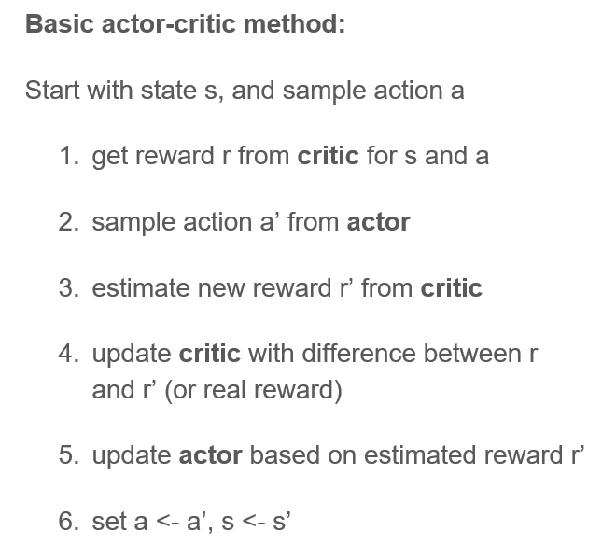
Actor-Critic Algorithm (not curriculum)
The actor (policy) decides which action to take, the critic reverts back with how good the action was compared to the average action.
We don’t get the same variance problem since we only learn transition between steps at a time.

Slide 82
Progress
Motivation
Introduction to reinforcement learning (RL)
Value function based methods (Q-learning)
Policy based methods (policy gradients)
Value function and policy based methods (Actor-Critic)
Miscellaneous

Slide 83
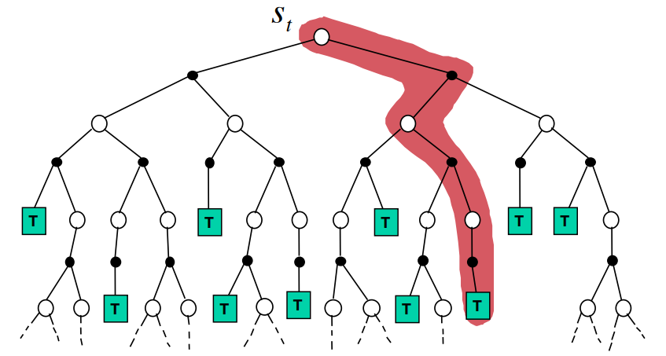
Model based RL
We can model the environment using e.g. a neural network. The network can be trained in a supervised way.
By modeling the environment, we can “look ahead” and use search trees for evaluating our action.
Important in e.g. games as chess and go where a single wrong action can make you loose.

