Slide 1

INF 5860 Machine learning for image classification
Summary
June 5, 2018

Slide 2
Progress
TensorFlow
Convolutional neural networks
Generalization
Recurrent neural networks
Deep reinforcement learning

Slide 3
Why do we need Deep learning frameworks?
Speed:
  Fast GPU/CPU implementation of matrix multiplication, convolutions and backpropagation
Automatic differentiations:
  Pre-implementation of the most common functions and it’s gradients.
Reuse:
  Easy to reuse other people’s models
Less error prone:
  The more code you write yourself, the more errors

Slide 4
TensorFlow
TensorFlow graphs
TensorFlow session
TensorFlow constants
TensorFlow variables
TensorFlow feeding data to the graph
Tensorboard
TensorFlow save/restore models
TensorFlow example

Slide 5

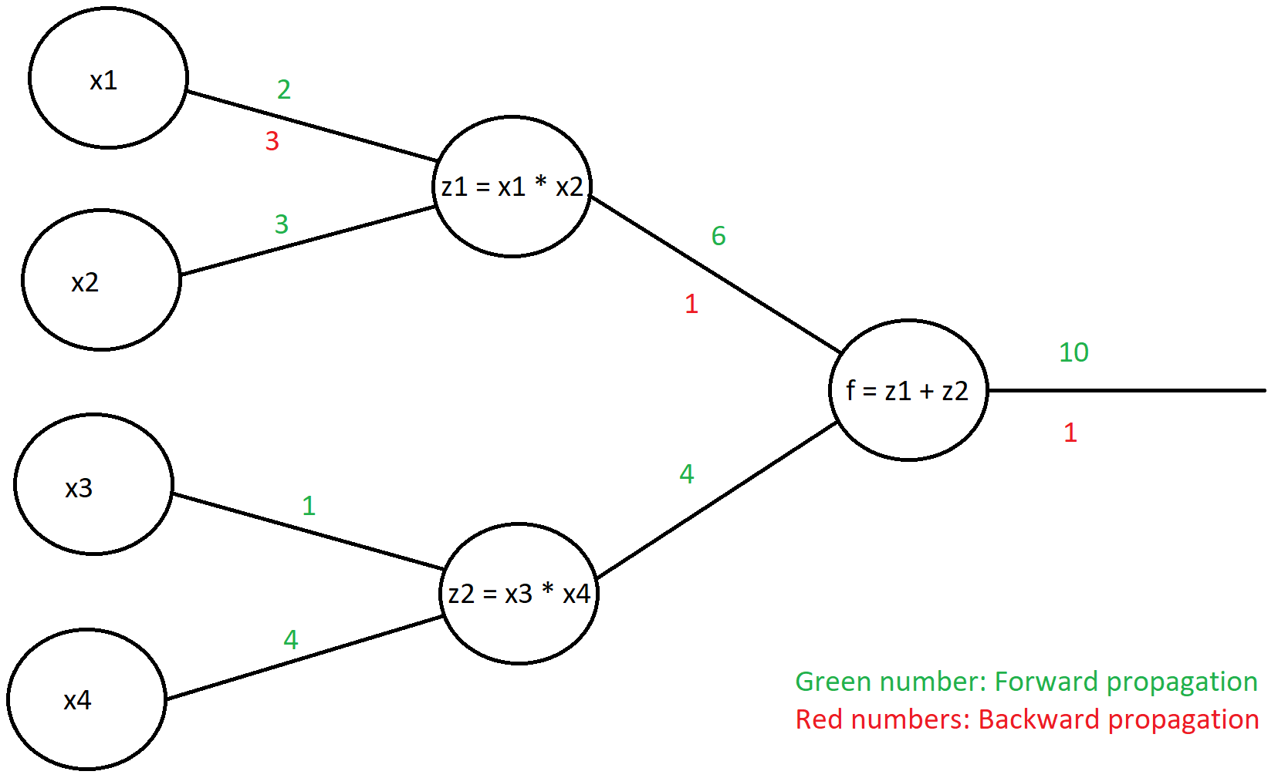

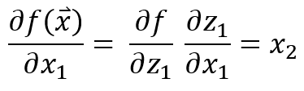
Graphs

Slide 6
Defining a tensor in TensorFlow
The main types of tensors are:
  tf.Variable / tf.get_variable
  tf.constant
  tf.placeholder
Attributes (some of them):
  Shape
  dtype
  name
Notes:
Tf.Variable -> often use a the weight matrix
Tf.constant -> a constant
Tf.placeholder -> use for feeding traning data and labels into the graphs

Slide 7




Example of a tensors

Slide 8
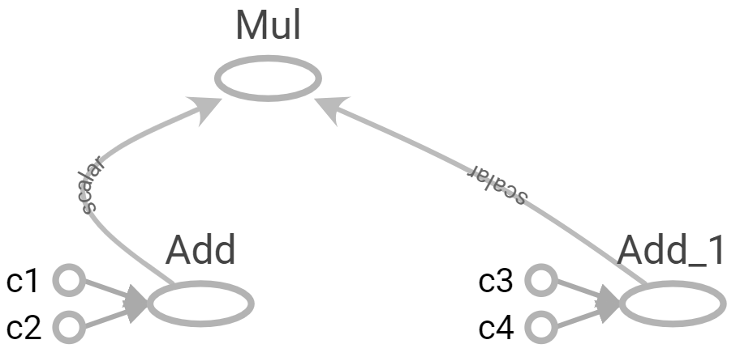
The graph
The TensorFlow graph is a definition, not any computation.
The computational graph is a series of TensorFlow operations arranged into a graph. The graph is composed of two types of objects:
  Operation: Nodes in the graph
  Tensors: The edges in the graph

Slide 9
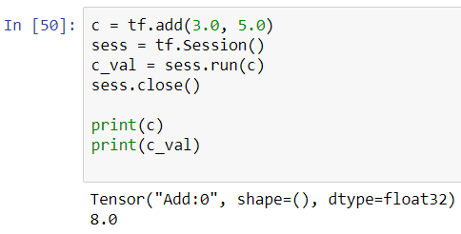
Executing the tf.Graph: tf.Session
We have seen that variables and constants are handles to elements in the computational graph only.
We execute the graph using a tf.Session

Slide 10


Creating variables
We can define variables two ways:
preferred

Slide 11
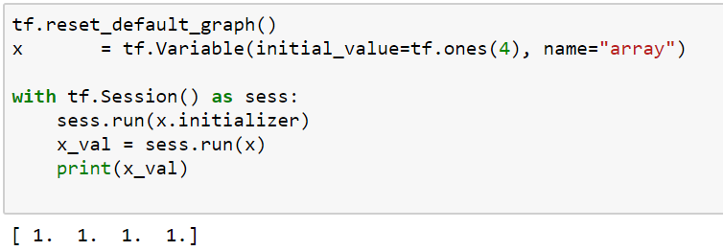
Initializing variables
The variables to be used in the graph have to be either:
  Initialized
  Restored

Slide 12
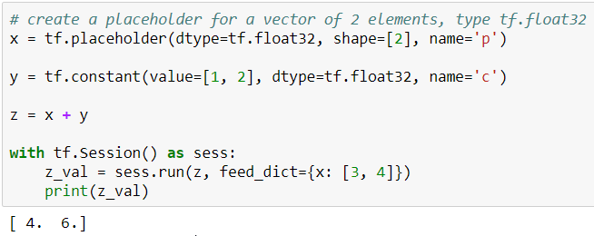
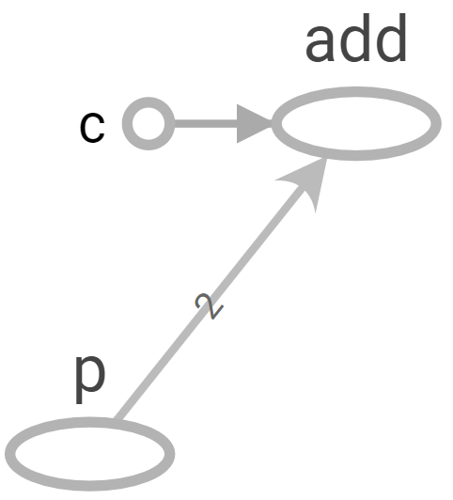
tf.placeholder

Slide 13
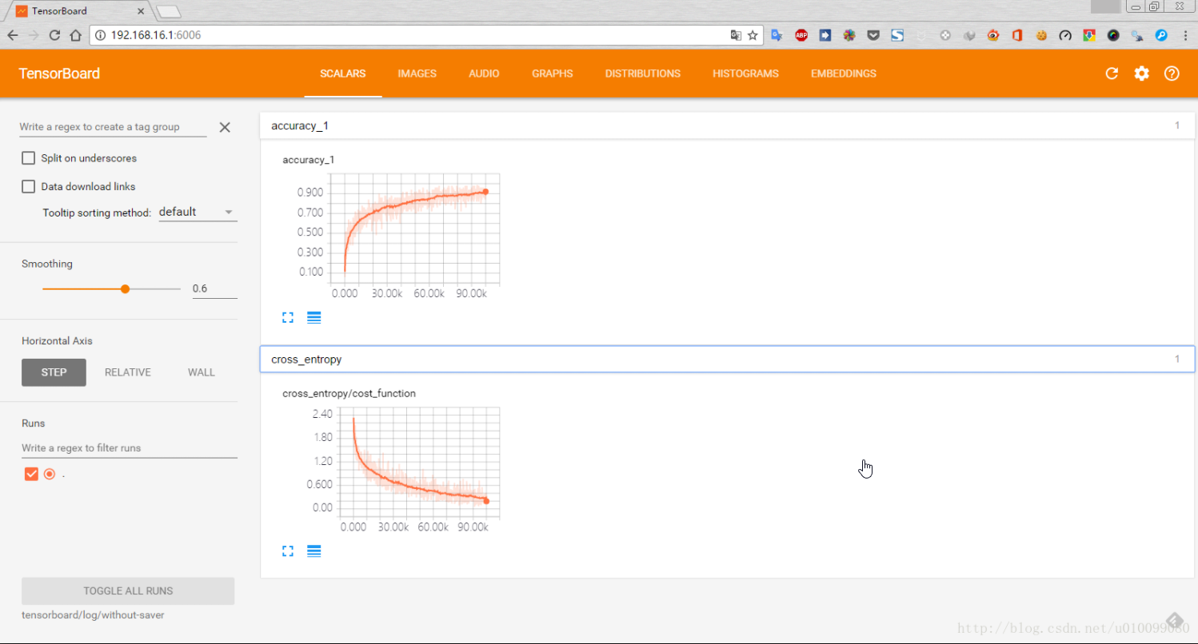
Tensorboard: Visualizing learning

Slide 14
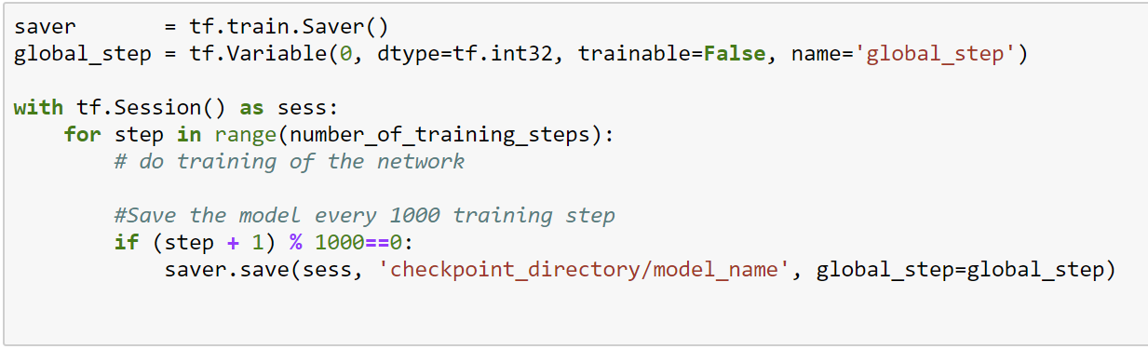
tf.train.saver.save()
How to save our model every 1000 iteration.

Slide 15
Progress
TensorFlow
Convolutional neural networks
Generalization
Recurrent neural networks
Deep reinforcement learning

Slide 16
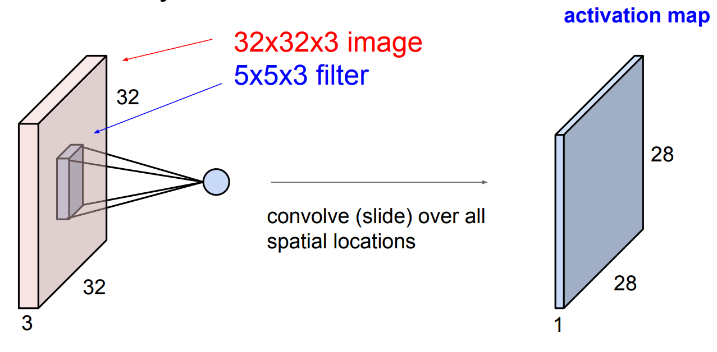
Convolutional layer

Slide 17
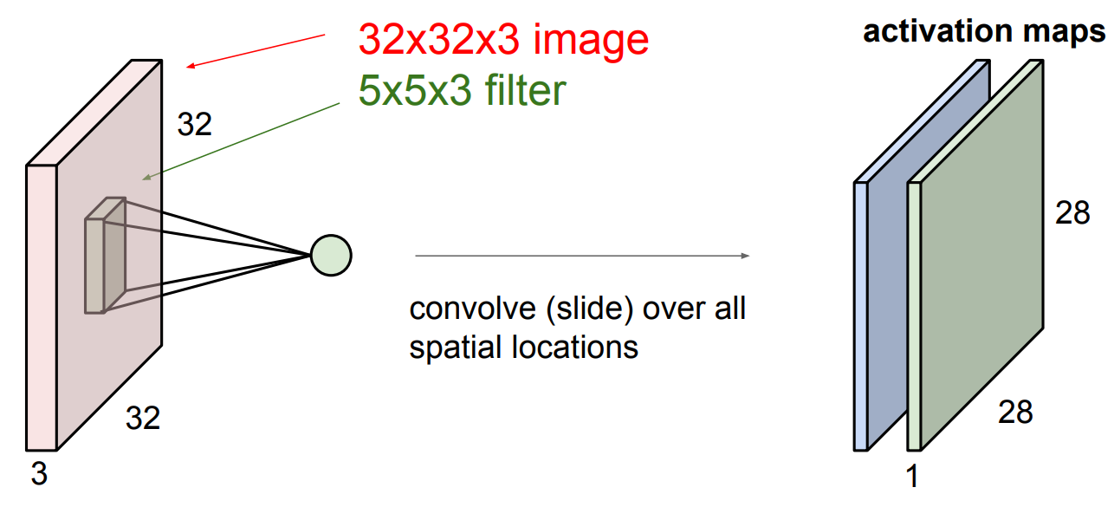
Convolutional layer

Slide 18
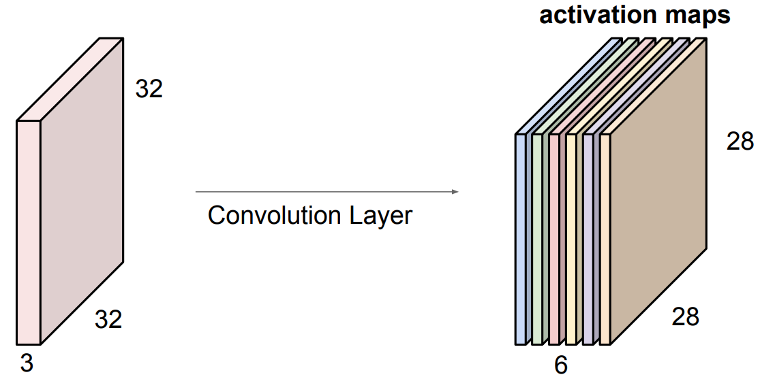
Convolutional layer
If we filter the input volume 6 times using a 5x5x3 filter, we get a output volume with 6 channels (depth)

Slide 19
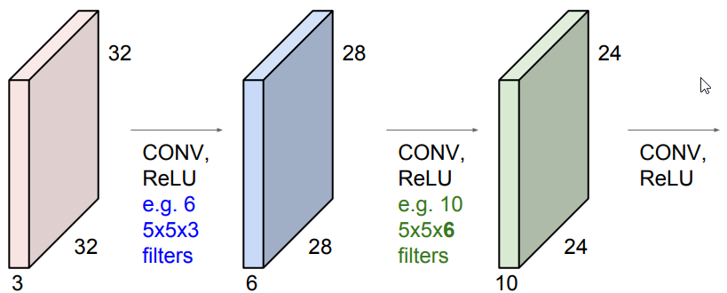
Activations
We use an activation function separately on all elements of the output volume

Slide 20
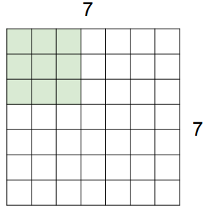
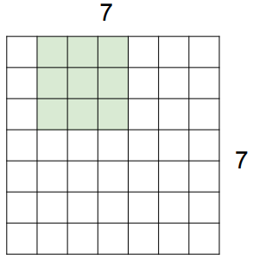
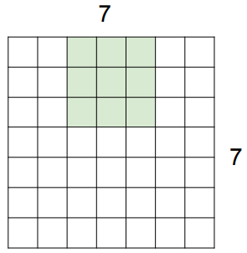
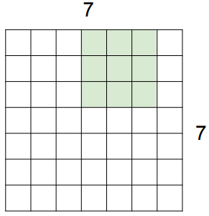
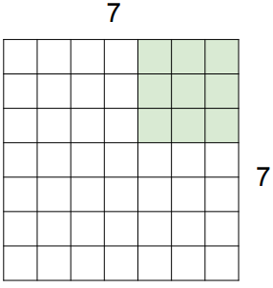
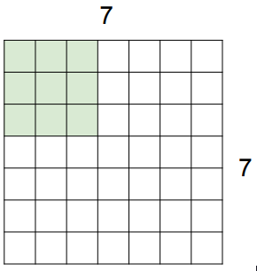
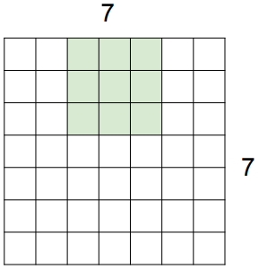

Stride
Stride is the spatial step length in the convolution operation.
Example: Input volume 7x7x1, kernel (filter) size 3x3x1
The stride is an important parameter for determining the spatial size of the output volume
Stride 1
Stride 2

Slide 21
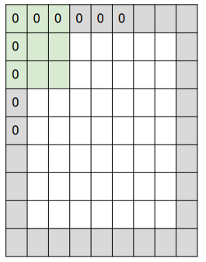
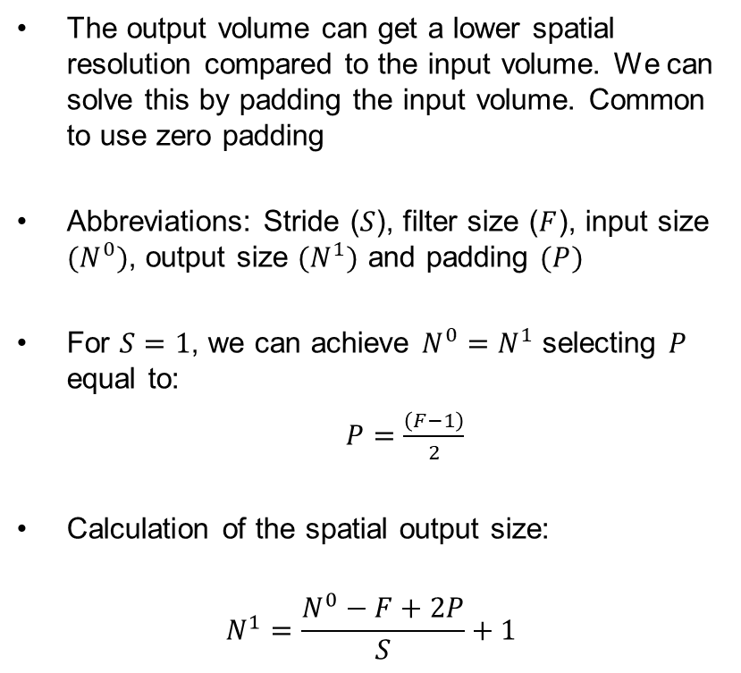
Padding
The output volume can get a lower spatial resolution compared to the input volume. We can solve this by padding the input volume. Common to use zero padding
Abbreviations: Stride ($S$), filter size ($F$), input size ${(N}^{0})$, output size ${(N}^{1})$ and padding $(P)$
For $S=1$, we can achieve $N^{0}=N^{1}$ selecting $P$ equal to:
  $P=\frac{\left(F−1\right)}{2}$
Calculation of the spatial output size:
$$N^{1}=\frac{N^{0}−F+2P}{S}+1$$

Slide 22
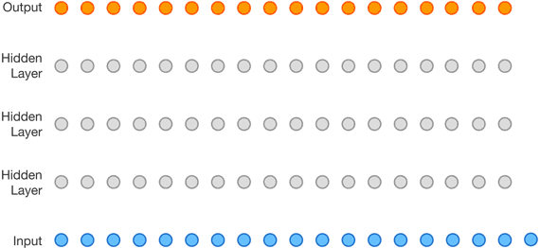
How large area influence the end result?
With a convolutional network the receptive field increase with each layer
3 inputs influence each node in the first hidden layer

Slide 23
How large area influence the end result?
With a convolutional network the receptive field increase with each layer
3 inputs influence each node in the first hidden layer
5 influence the next

Slide 24
How large area influence the end result?
With a convolutional network the receptive field increase with each layer
3 inputs influence each node in the first hidden layer
5 influence the next
7 influence the next

Slide 25
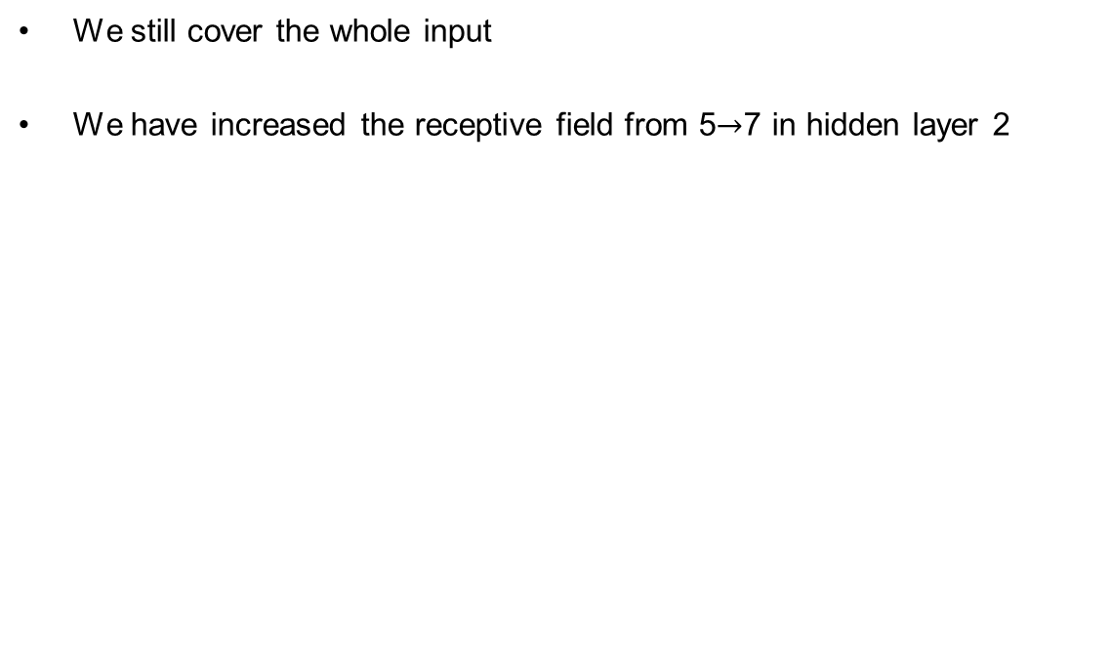
The effect of strided convolutions
We still cover the whole input
We have increased the receptive field from 5 7 in hidden layer 2

Slide 26
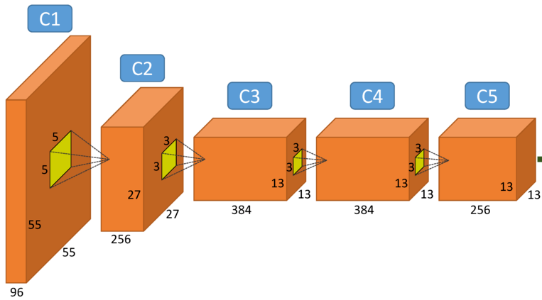
With strides, spatial dimensions will become smaller
Usually some of the of the network capacity is preserved through an increasing number of channels

Slide 27
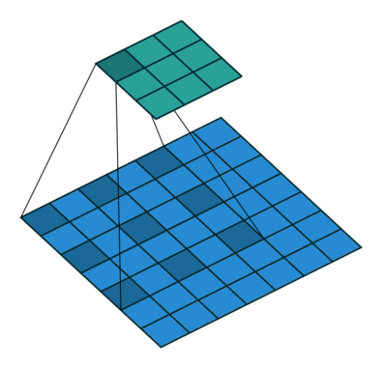
Dilated convolutions
Skipping values in the kernel
Same as filling the kernel with every other value as zero
Still cover all inputs
Larger kernel with no extra parameters

Slide 28
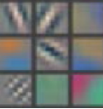
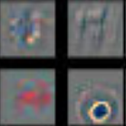
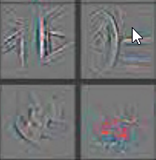
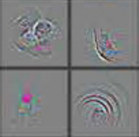
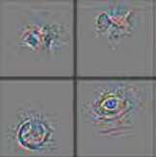
Visualizing and Understanding deeper layers
Looking at the filer coefficient directly at deeper layer is not meaningful.
Visualization with Deconvnet
Layer 1
Layer 2
Layer 3
Layer 4
Layer 5
Zeiler M.D., Fergus R. (2014) Visualizing and Understanding Convolutional Networks

Slide 29
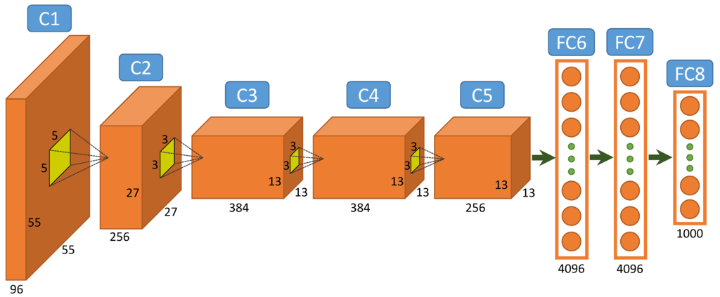
Hierarchical learning
A convolution neural network is built up as a hierarchy were the complexity (abstraction) is increased by depth.
A hierarchical structure is parameter efficient

Slide 30
Progress
TensorFlow
Convolutional neural networks
Generalization
Recurrent neural networks
Deep reinforcement learning

Slide 31

Notation
Formalization supervised learning:
  Input: $x$
  Output: $y$
  Target function: $f :𝒳\overset{→}{ } 𝒴$
  Data: $\left(x_{1},y_{1}\right), \left(x_{2},y_{2}\right)⋅⋅⋅ ,\left(x_{N},y_{N}\right)$
  Hypothesis: $h :𝒳\overset{→}{ } 𝒴$
  Example:
  Hypothesis set: $y=w_{1}x+w_{0}$
  A hypothesis: $y=2x+1$

Slide 32
More notation
In-sample (colored): Training data available to find your solution.
Out-of-sample (gray): Data from the real world, the hypothesis will be used for.
Final hypothesis:
Target hypothesis:
Generalization: Difference between the in-sample error and the out-of-sample error
Notes:
In-sample. The training data you have available to find a good hypothesis

Slide 33
What is the expected out-of-sample error?
For a randomly selected hypothesis
The closest error approximation is the in-sample error

Slide 34



What is training?
A general view of training:
  Training is a search through possible hypothesis
  Use in-sample data to find the best hypothesis
$$h_{1}$$
$$h_{2}$$
$$h_{3}$$

Slide 35



What is the effect of choosing the best hypothesis?
Smaller in-sample error
Increasing the probability that the result is a coincidence
The expected out-of-sample error is greater or equal to the in-sample error
$$h_{1}$$
$$h_{2}$$
$$h_{3}$$

Slide 36

Capacity of the model (hypothesis set)
The model restrict the number of hypothesis you can find
Model capacity is a reference to how many possible hypothesis you have
A linear model has a set of all linear functions as its hypothesis

Slide 37

Measuring capacity
Vapnik-Chervonenkis (VC) dimension
  Denoted: $d_{VC}(ℋ)$
  Definition:
    The maximum number of points that can be arrange such that $ℋ$ can shatter them.

Slide 38
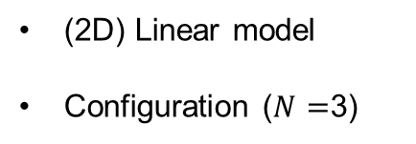


Example VC dimension
(2D) Linear model
Configuration ($N=$3)
$$x_{2}$$
$$x_{1}$$

Slide 39
Splitting of data
Training set (60%)
  Used to train our model
Validation set (20%)
  Used to select the best hypothesis
Test set (20%)
  Used to get a representative out-of-sample error

Slide 40
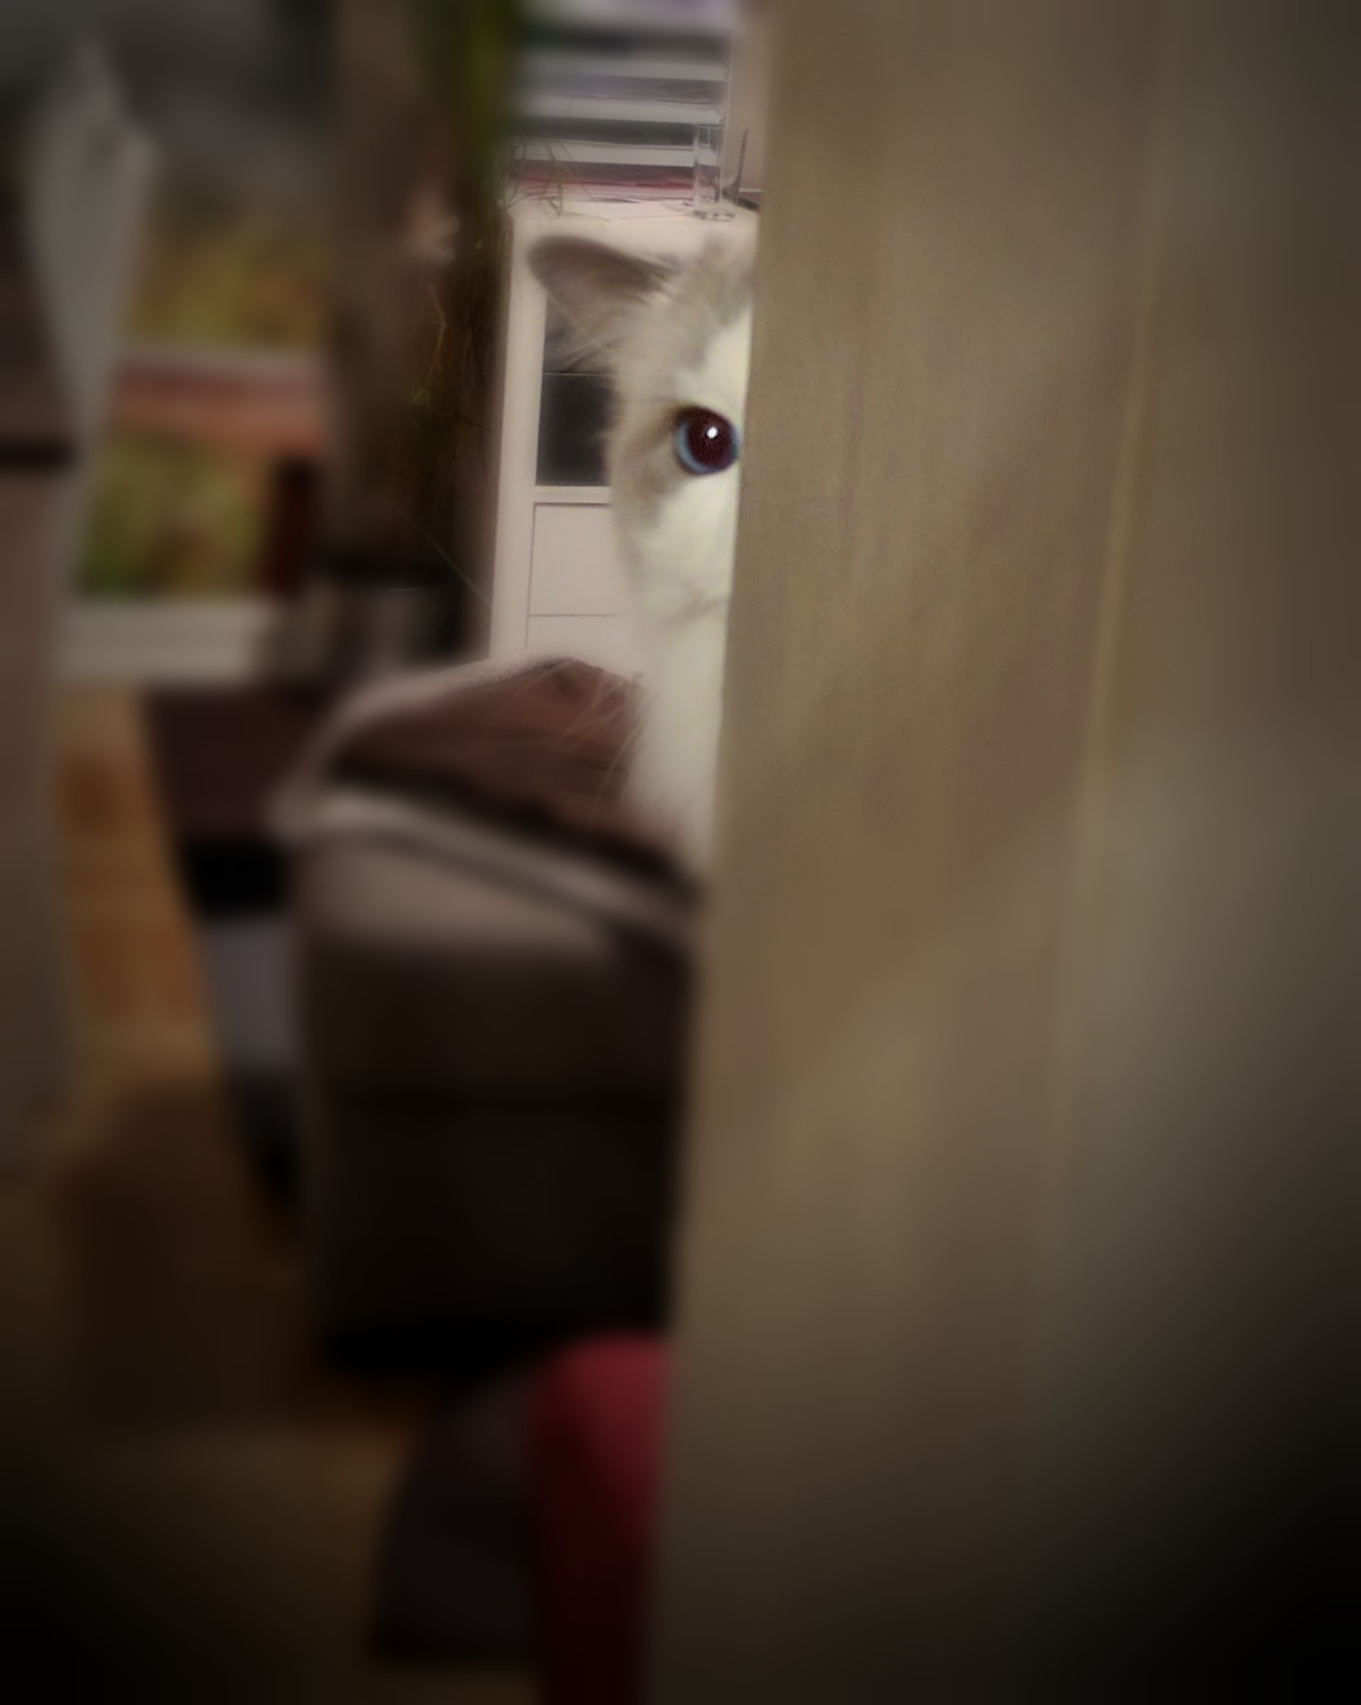
Important! No peeking
Keep a dataset that you don’t look at until evaluation (test set)
The test set should be as different from your training set as you expect the real world to be

Slide 41
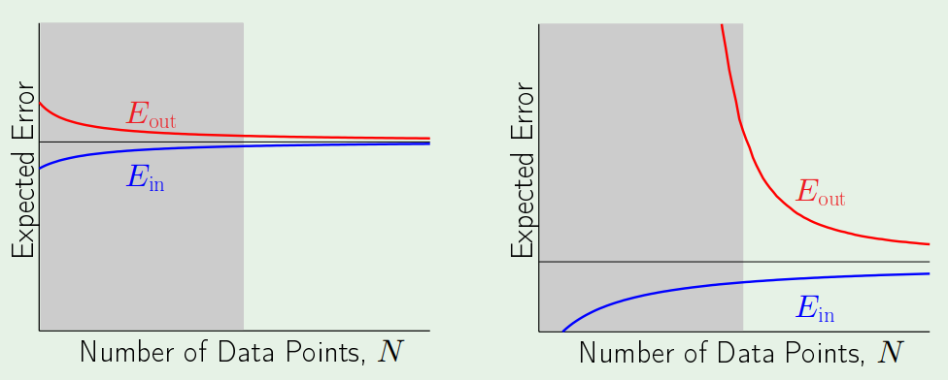
Learning curves
Simple hypothesis
Complex hypothesis

Slide 42
Progress
TensorFlow
Convolutional neural networks
Generalization
Recurrent neural networks
Deep reinforcement learning

Slide 43
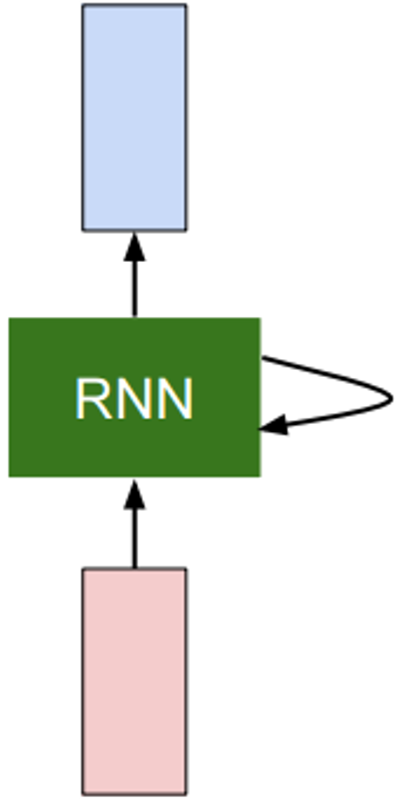


Recurrent Neural Network (RNN)
Takes a new input
Manipulate the state
Reuse weights
Gives a new output
$$y_{t}$$
$$x_{t}$$

Slide 44
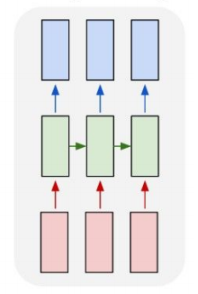












Recurrent Neural Network (RNN)
Unrolled view
$x_{t}$: The input vector:
$h_{t}$: The hidden state of the RNN
$y_{t}$: The output vector:
$$y_{t}$$
$$y_{1}$$
$$y_{2}$$
$$y_{3}$$
$$h_{1}$$
$$h_{2}$$
$$h_{3}$$
$$x_{t}$$
$$x_{1}$$
$$x_{2}$$
$$x_{3}$$

Slide 45

(Vanilla) Recurrent Neural Network
Input vector: $x_{t}$
Hidden state vector: $h_{t}$
Output vector: $y_{t}$
Weight matrices: $W_{hh}$, $W_{hx}, W_{hy}$
General form:
$$h_{t}=f_{w}\left(h_{t−1},x_{t}\right)$$
Vanilla RNN:
$$h_{t}=\tanh\left(W_{hh}h_{t−1}+W_{hx}x_{t}+b\right)$$
$$y_{t}=W_{hy}h_{t}$$
$$y_{t}$$
$$x_{t}$$

Slide 46
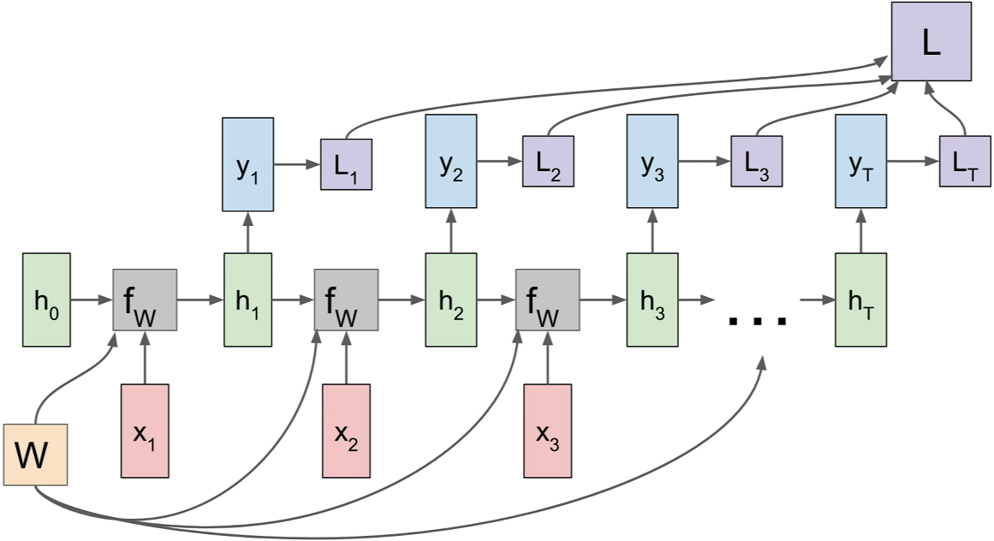
RNN: Computational Graph

Slide 47
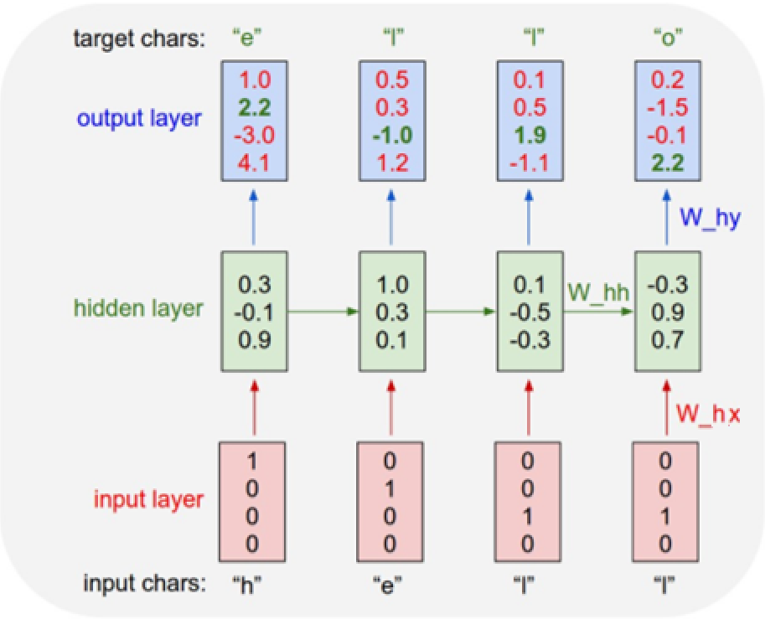

RNN: Predicting the next character
Task: Predicting the next character
Training sequence: “hello”
Vocabulary:
  [h, e, l, o]
Encoding: Onehot
Model:
$$h_{t}=\tanh\left(W_{hh}h_{t−1}+W_{hx}x_{t}+b\right)$$
$$y_{t}=W_{hy}h_{t}$$

Slide 48
Input-output structure of RNN’s
One-to-one
one-to-many
many-to-one
Many-to-many
many-to-many (encoder-decoder)

Slide 49
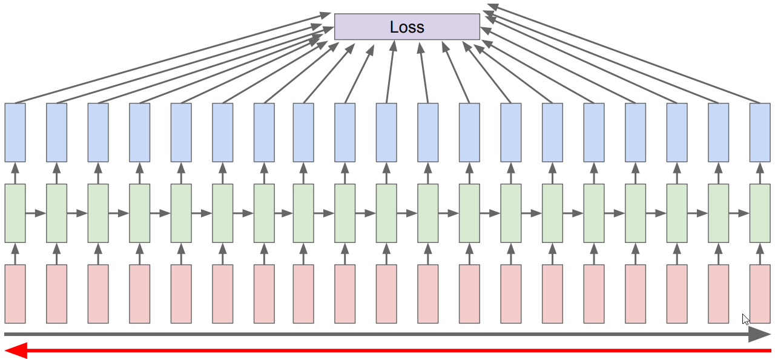
Vanishing gradients - “less of a problem”
In contrast to feed-forward networks, RNNs will not stop learning in spite of vanishing gradients.
The network gets “fresh” inputs each step, so the weights will be updated.
The challenge is to learning long range dependencies. This can be improved using more advanced architectures.
Outputs at time step t is mostly effected by the close previous state.

Slide 50
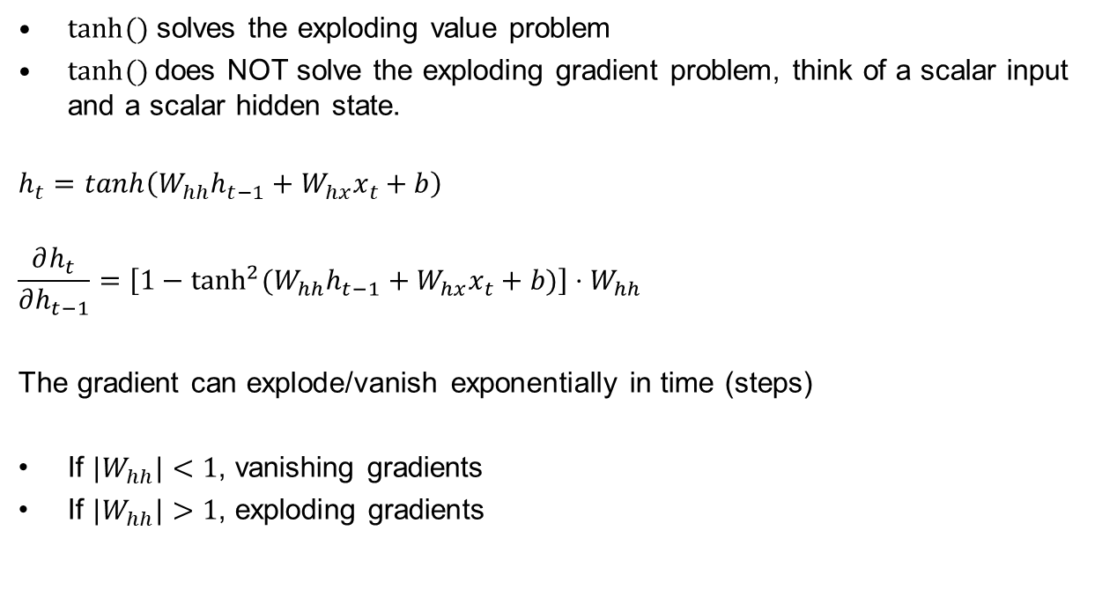
Exploding or vanishing gradients
$tanh⁡()$ solves the exploding value problem
$tanh⁡()$does NOT solve the exploding gradient problem, think of a scalar input and a scalar hidden state.
$$h_{t}=\tanh\left(W_{hh}h_{t−1}+W_{hx}x_{t}+b\right)$$
$$\frac{∂h_{t}}{∂h_{t−1}}=\left[1−\tanh^{2}{(W_{hh}h_{t−1}+W_{hx}x_{t}+b)}\right]{⋅W}_{hh}$$
The gradient can explode/vanish exponentially in time (steps)
If ${|W}_{hh}|<1$, vanishing gradients
If ${|W}_{hh}|>1$, exploding gradients

Slide 51
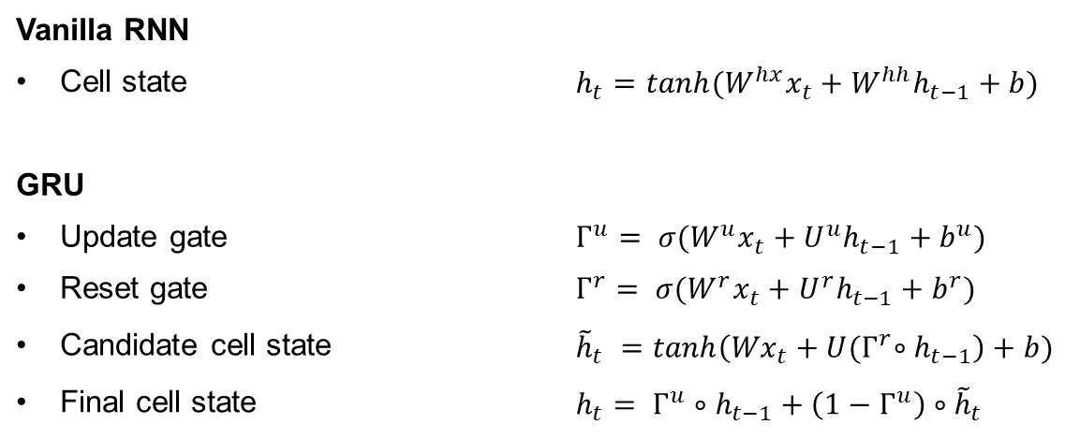
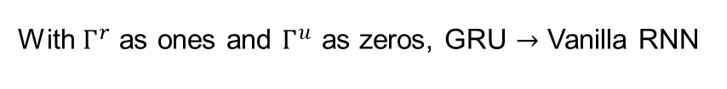
Gated Recurrent Unit (GRU)
GRU is adding or removing to the state, not “transforming the state”
Vanilla RNN
Cell state | $$h_{t}=tanh({W^{hx}x}_{t}+W^{hh}h_{t−1}+b)$$
GRU
Update gate | $$Γ^{u}= σ({W^{u}x}_{t}+{U^{u}h}_{t−1}+b^{u})$$
Reset gate | $$Γ^{r}= σ({W^{r}x}_{t}+{U^{r}h}_{t−1}+b^{r})$$
Candidate cell state | $${\tilde{h}}_{t} =tanh\left({Wx}_{t}+{U{(Γ}^{r}∘h}_{t−1}\right)+b)$$
Final cell state | $h_{t}= Γ^{u}∘h_{t−1}+\left(1−Γ^{u}\right)∘{\tilde{h}}_{t}$
With $Γ^{r}$ as ones and $Γ^{u}$ as zeros, GRU Vanilla RNN
Notes:
The gates can be sees as continuous “binary” gates. They are between 0 and 1
The Reset gate have the opportunity to remove all old information.
The cell memory contains values between -1 and 1.
The update gate chooses how much of the new memory content that should be considered.
Why does GRU work

Slide 52
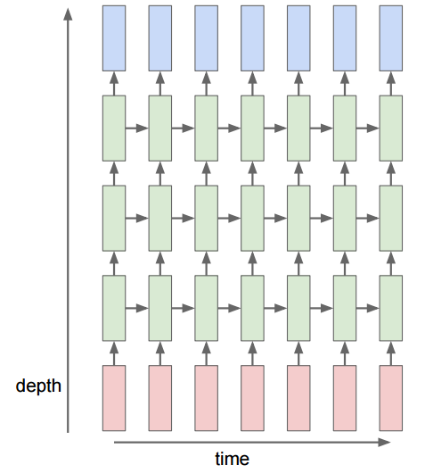
Multi-layer Recurrent Neural Networks
Multi-layer RNN can be used to enhance model complexity
Similar as for feed forward neural networks, stacking layers creates higher level feature representation
Normally, 2 or 3 layer deep, not as deep as conv nets
More complex relationships in time

Slide 53
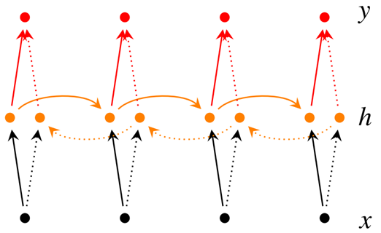

Bidirectional recurrent neural network
The blocks can be vanilla, LSTM and GRU recurrent units
Real time vs post processing
$${\vec{h}}_{t}=f\left({\vec{W}}_{hx}x_{t}+{\vec{W}}_{hh}{\vec{h}}_{t−1}\right)$$
$${\overset{⃖}{h}}_{t}=f\left({\overset{⃖}{W}}_{hx}x_{t}+{\overset{⃖}{W}}_{hh}{\overset{⃖}{h}}_{t+1}\right)$$
$$y_{t}=g(W_{hy} \left[{\vec{h}}_{t},{\overset{⃖}{h}}_{t}\right]+b)$$

Slide 54
Progress
TensorFlow
Convolutional neural networks
Generalization
Recurrent neural networks
Deep reinforcement learning

Slide 55

Branches of Machine Learning

Slide 56

Reinforcement learning
Reinforcement Learning ~ Science of decision making
In RL an agent learns from the experiences it gains by interacting with the environment.
The goal is to maximize an accumulated reward given by the environment.
An agent interacts with the environment via states, actions and rewards.
RL Course by David Silver
Notes:
In Supervised Learning we cannot affect the environment.

Slide 57
Reinforcement learning
What makes reinforcement learning different from other machine learning paradigms?
  There is no supervisor, only a reward signal
  Feedback is delayed, not instantaneous
  Time really matters (sequential, non i.i.d data)
  Agent’s actions affect the subsequent data it receives

Slide 58

Mountain Car
Objective:
  Get to the goal
State variables:
  Position and velocity
Actions:
  Motor: Left, Neutral, right
Reward:
  (-1) for each time step

Slide 59


History (trajectory) and State
History / trajectory :
  $H_{t}={τ_{t}= O}_{1}, A_{1}, R_{1}, O_{2}, A_{2}, R_{2},…, O_{t}, A_{t}, R_{t}$
Full observatory:
  Agent direct observe the environment state.
  $O_{t}= S_{t}^{e}=S_{t}^{a}$
State:
  The state is a summary (of the actions and observations) that determines what happens next given an action.
  $S_{t}=f(H_{t})$
Partially observability:
  The agent indirectly observes the environment.
  Robot with a camera

Slide 60


Markov Property
Definition:
  A state $S_{t}$ is Markov if and only if:
  $ℙ\left[S_{t+1} | S_{t}\right]=ℙ\left[S_{t+1} | {S_{1},{ S}_{2},…,S}_{t}\right]$
The state capture all relevant information from the history
The state is sufficient to describe the statistics of the future.

Slide 61

Reward and Return
The reward, $R_{t}$, is a scalar value the agent receives for each step t.
The return, $G_{t}$, is the total discounted accumulated reward form a given time-step t.
  $G_{t}=R_{t}+{γR}_{t+1}+…= \sum_{k=0}^{∞}{γ^{k}}R_{t+k}$
Discount factor:
  We can apply a discord factor, $γ∈\left[0,1\right],$ to weight how we evaluate return.
The agent's goal is to maximize the return
Notes:
Why discount:
To avoid inf returns in cyclic process.
Uncertain of the future

Slide 62

Markov Decision Process (MDP)
The mathematical formulation of the reinforcement learning (RL) problem.
A Markov Decision Process is a tuple,$ℳ=\left\langle S, A, P, R, γ\right\rangle$, where every state has the Markov property.
  S: A finite set of states
  A: A finite set of actions
  P: The transition probability matrix
  $$P_{s_{t}s_{t+1}}^{a}=ℙ\left[S_{t+1}=s_{t+1} | S_{t}=s_{t}, A_{t}=a_{t}\right]$$
  R: Reward function:
  $R_{s}^{a}= 𝔼\left[S_{t}=s_{t}, A_{t}=a_{t}\right]$
$γ$: is a discount factor $γ\text{∈} \text{[}\text{0,1}\text{]}$
Notes:
$γ$ -> How much do we value reward coming soon comparred to at the end.

Slide 63


Objective
Our goal is it find the policy which maximize the accumulated reward:
$G_{t}=R_{t}+{γR}_{t+1}+…= \sum_{k=0}^{∞}{γ^{k}}R_{t+k}$
Due to the randomness of the transition probability and the reward function, we use the expected value in the definition of the optimal policy.
$π_{∗}=\underset{π}{arg max}{𝔼}\left[G_{t}\right]$

Slide 64

Bellman (optimality) equation
Lets define the optimal Q-value (action-value) function,$Q_{∗}$, to be the maximum expected reward given an state, action pair.
$$Q_{∗}\left(s_{t},a_{t}\right)= \max_{π}{𝔼_{π}\left[ G_{t} | A_{t}=a_{t}, S_{t}=s_{t}\right] }$$
The optimal Q-value function, $Q_{∗}$, satisfy the following form of the bellman equation:
$$Q_{∗}\left(s_{t},a_{t}\right)=𝔼\left[ R_{t}+γ\max_{a_{t+1}}{Q_{∗}\left(s_{t+1},a_{t+1}\right)}| A_{t}=a_{t}, S_{t}=s_{t}\right]$$
Note: The optimal policy, $π_{∗}$, is achieved by taking the action with the highest Q-value.
Note: We still need the expectation, as the randomness of the environment is unknown.

Slide 65

Exploration vs Exploitation
“The “$max$” property while sampling new episodes can lead to suboptimal policy”
Exploitation:
  By selecting the action with the highest q-value while sampling new episodes, we can refine our policy efficiently from an already promising region in the state action space.
Exploration:
  To find a new and maybe more promising region within the state action space, we do not want to limit our search in the state action space.
  We introduce a randomness while sampling new episodes.
  With a probability of $ε$ lets choose a random action:
  $$π\left(a | s\right)=\left\{\begin{aligned}a_{∗}=\underset{a∈A}{argmax}{Q(s,a)}, with probabillity 1−ε \\ random action, with probabillity ε\end{aligned}\right.$$

Slide 66

Function approximation
In the Gridworld example, we stored the state-values for each state. What if the state-action space is too large to be stored e.g. continuous?
We approximate the Q-value using a parameterized function e.g. neural network.
$$\hat{Q}\left(s,a, θ\right)≈Q(s,a)$$
We want the function to generalize:
  Similar states should get similar action-values, $\hat{Q}\left(s,a, θ\right)$ can also generalize to unseen states. A table version would just require to much data.
In supervised learning:
  Building a function approximation vs memorizing all images (table).
Notes:
Typically, we want the parametric function to have less parameters than the values in the table.
Practical if $\hat{Q}\left(s,a, θ\right)$ is differentiable w.r.t theta

Slide 67

Solving for the optimal policy:
Q-learning
Goal: Find a Q-function satisfying the Bellman (optimality) equation.
Idea: The Q-value at the last time step is bounded by the true Q-value, the correctness of the Q-value estimates increase with time-steps.
Init: Initialize the weights in the neural network e.g. randomly.
$$Q_{∗}\left(s_{t},a_{t},θ_{i}\right)=𝔼\left[ R_{t}+γ\max_{a_{t+1}}{Q_{∗}\left(s_{t+1},a_{t+1},θ_{i−1}\right)}| A_{t}=a_{t}, S_{t}=s_{t}\right]$$
Reference:
$$y_{i}= 𝔼\left[ R_{t}+γ\max_{a_{t+1}}{Q\left(s_{t+1},a_{t+1}, θ_{i−1}\right)}| A_{t}=a_{t}, S_{t}=s_{t}\right]$$
Loss:
  $$L_{i}(θ_{i})=𝔼_{s_{t}, s_{t+1, }a_{t}, r_{t}\sim D_{i}}\left[{\left(y_{i}−Q\left(s_{t},a_{t}, θ_{i}\right)\right)}^{2}\right]$$
  $D_{i}$ is your dataset with state action pairs $s_{t}, s_{t+1, }a_{t}, r_{t}$
Notes:
Initialize Q to be something, the weights in the function approximation.

Slide 68
Policy based methods
Value function based methods:
  Learning the expected future reward for a given action.
  The policy was to act greedily or epsilon-greedily on the estimated values.
Policy based methods:
  Learning the probability that an action is good directly.
Advantage of Policy based methods:
  We might need a less complex function for approximating the best action compared to estimate the final reward.
  Example: Think of Pong

Slide 69
Policy based methods
Goal:
  The goal is to use experience/samples to try to make a policy better.
Idea:
  If a trajectory achieves a high reward, the actions were good
  If a trajectory achieves a low reward, the actions were bad
  We will use gradients to enforce more of the good actions and less of the bad actions. Hence the method is called Policy Gradients.
Notes:
Example: Pong, it can be difficult to estimate the final score at a given state within the episode. However, I can be much simpler to estimate were to move to be able to hit the ball

Slide 70

Playing games of Pong
Examples of games/episodes
You play a lot of actions and receive an reward at the end
You get a result, WIN! Great, but how do you know which action, caused the victory?
  Well… you don’t

Slide 71
Which action caused the final results?
In a winning series there may be many non-optimal actions
In a losing series there may be good actions
The true effect is found by averaging out the noise, as winnings series tend to have more good action and visa versa

Slide 72
Policy gradients: High variance

Slide 73
Policy gradients: High variance
42

Slide 74
Variance - all choices get the reward
42
42
42
42
42
42
42
42
42
42

Slide 75
Variance - other possible paths
42
42
42
42
42
42
42
42
42
42

Slide 76
Variance - high probability to chose some other path
42
42
42
42
42
42
42
42
42
42
-8

Slide 77
Variance - same actions for same state: now negative
-8
-8
-8
-8
-8
-8
-8
-8

