Slide 1
INF 5890 IT and Management
Governance Frameworks
January 23 2017
Bendik Bygstad, IFI

Slide 2
Learning outcomes
Understand the change from “IT” to “digitalisation” in organisations and society
Appreciate the difference between governance and management
Can use the Weil and Ross governance framework

Slide 3
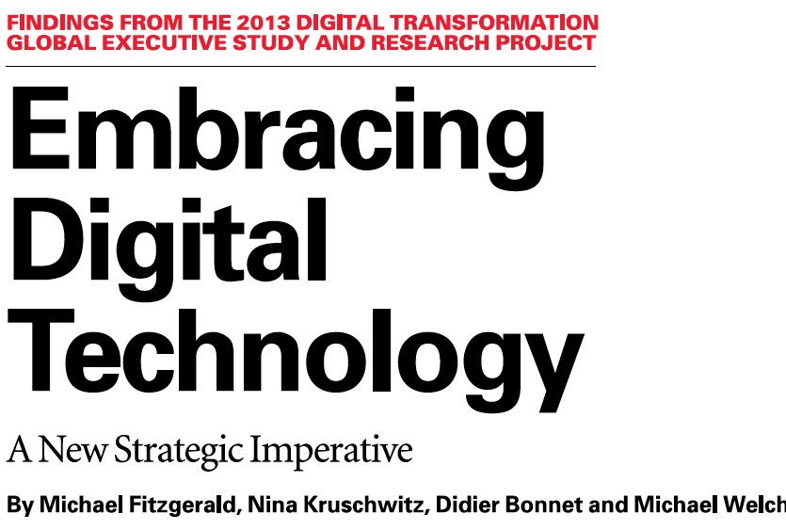

Slide 4
Sloan/Cap Gemini 2013

Slide 5
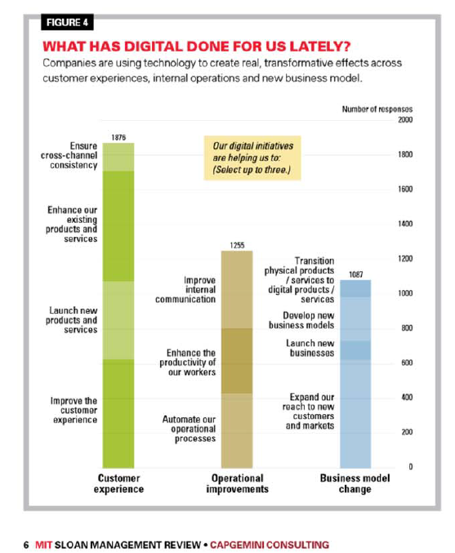

Slide 6
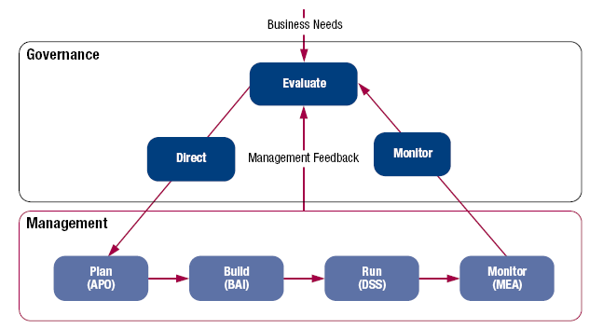
Governance and management
Governance ensures that stakeholders needs, conditions and options are evaluated to determine balanced, agreed-on enterprise objectives to be achieved; setting direction through prioritisation and decision making; and monitoring performance and compliance against agreed-on direction and objectives (EDM).
Management plans, builds, runs and monitors activities in alignment with the direction set by the governance body to achieve the enterprise objectives (PBRM).

Slide 7
IT governance in organizations - models and frameworks
Governance and management
Governing digitalisation processes
Learn to use a framework

Slide 8
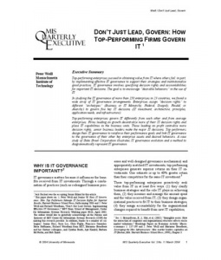
Weill: Don’t just lead, Govern

Slide 9
Five central IT decisions
IT principles
IT architecture
IT infrastructure
Applications and systems
IT Investments

Slide 10
Governance models
Business monarchy
Top management group takes decisions
IT monarchy
CIO takes decisions
Feudalism
Some strong middle managers dominate
Federalism
Decisions are taken jointly by central and local managers
Duopol
A two-part cooperation between IT managers and key business managers
Anarchy
Groups and strong individuals take decisions from local needs

Slide 11
Styringsmatrisen
 | IT- prinsipper | IT- arkitektur | IT infrastruktur-strategier | Virksomhetens applikasjons-behov | IT- investeringer
Forretnings-monarki
IT-monarki
Føydalt
Føderalt
Duopol
Anarki
Vet ikke
Notes:
Jeg er ikke enig i at rekkefølgen på de fem punktene her er den rekkefølgen ting bør besluttes i. Applikasjonsbehovene bør være styrende.

Slide 13
