Slide 1
Introduction & Motivation
INF5071 – Performance in Distributed Systems
September 13, 2010

Slide 2
Overview
About the course
Application and data evolution
Architectures
Machine internals
Network approaches
Case studies

Slide 3
Lecturers
Paul B. Beskow
  email: paulbb @ ifi
  office: Simula
Carsten Griwodz
  email: griff @ ifi
  office: Simula
Pål Halvorsen
  email: paalh @ ifi
  office: Simula

Slide 4
Time and place
Lectures:
Fridays 09.15 – 12.00 (end some time before 12)
Lille Aud.
NB!
The web page states that we will have
group exercises on
Thursdays 09.15 - 10.00, 3B.
However, there will NOT be any weekly exercises, but this hour is assigned for your mandatory assignment
(we will NOT be there – unless said otherwise).

Slide 5
Content: ideas of what to do with respect to performance in distributed systems
architectures
Network
storage
Network
dissemination
distribution
Network
protocols
resource scheduling
Network

Slide 6
Content
Applications and characteristics
(components, requirements, …)
Server examples and resource management
(CPU and memory management)
Storage systems
(management of files, retrieval, …)

Slide 7
Content
Protocols with and without Quality of Service (QoS)
(specific and generic QoS approaches)
Distribution
(use of caches and proxy servers, stream scheduling)
Peer-to-Peer
(various clients, different amount of resources)
Guest lectures?:
(architecture, resource utilization and performance, storage and distribution of data, parallelism, etc.)

Slide 8
Content - student assignment
Mandatory student assignment
(will be presented more in-depth later):
  write a project plan describing your assignment
  write a report describing the results and give a presentation
  (probably mid-late November)
  for example (examples from earlier):
    Transport protocols for various scenarios
    Network emulators
    Comparison of Linux schedulers (cpu, network, disk)
    File system benchmarking (different OSes and file systems)
    Comparison of methods for network performance monitoring (packet train, packet pair, ping, tcpdump library/pcap, …)
    Compare media players (VLC, mplayer, xine, …)
    Virtualization
    …
  it has to be something in the context of performance!!!

Slide 9
Goals
Understand means for enhancing performance
  architectures
  operating systems
  protocols
  distribution mechanisms
  caching/replication
  …
…AND…
…be able to evaluate any combination of these mechanisms

Slide 10
Exam
Prerequisite:
approved report and presentation of student assignment
Oral exam (early December):
  all transparencies from lectures
  Note: we do NOT have a book, and you probably do not want to read all the articles the slides are made from!
   come to the lectures…
  content of your own student assignment

Slide 11
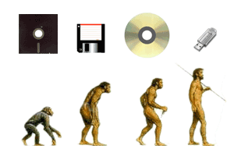

Evolution

Slide 12


Discrete Data to Continuous Media Data
3D streaming is coming …

Slide 13
Evolution of (continuous) media streams:
Television (Broadcast)
time
channels
sender
receiver(s)
analog or digital
traditionally, one program per channel
  analog use frequency division multiplexing only
  digital may additionally use time division multiplexing
  inside one frequency (several programs per channel)

Slide 14
Evolution of (continuous) media streams:
Near Video-on-Demand (NVoD)
time
channels
sender
receiver(s)
analog or digital broadcasting
one program over multiple channels
time-slotted emission of the program

Slide 15
Evolution of (continuous) media streams:
(True) Video-on-Demand (VoD)
time
movies
sender
receiver(s)
digital uni- or multicasting
control channels

Slide 16
Evolution of (continuous) media streams:
“Cyber Vision”
time
sender
digital uni- or multicasting
control channels
variable non-linear “media”, e.g.,
  - games, virtual reality, …
receiver(s)

Slide 17
Evolution & Requirements:
File download and Web browsing
Internet
Packet loss | Not acceptable
Bandwidth demand | Low (?)
Accepted delay | Medium – High (?)

Slide 18
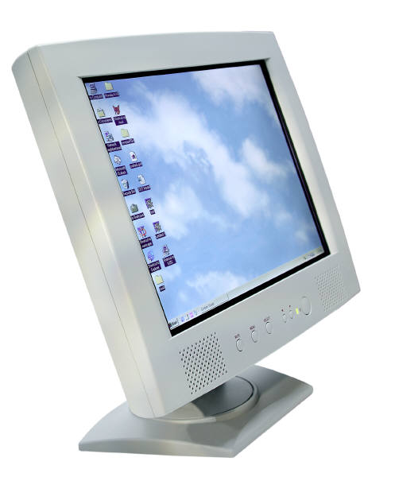

Evolution & Requirements:
Textual commands and textual chat
Internet
Packet loss | Not acceptable
Bandwidth demand | Low
Accepted delay | Human reading speed

Slide 19
Evolution & Requirements:
Live and on-Demand Streaming
Packet loss | Acceptable (some)
Bandwidth demand | High
Accepted delay | Medium
Internet

Slide 20
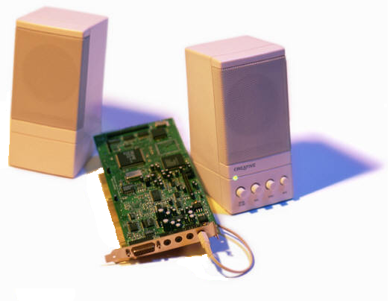


Evolution & Requirements:
AV chat and AV conferencing
Packet loss | Acceptable (some)
Bandwidth demand | High
Accepted delay | Low - Medium
Internet

Slide 21
Evolution & Requirements:
Haptic Interaction
Internet
Packet loss | Acceptable
Bandwidth demand | Low
Accepted delay | Human reaction time

Slide 22
Evolution & Requirements:
A distributed system must support all
Internet

Slide 23
Different Views on Requirements
Application / user
  QoS – time sensitivity?
  resource capabilities –
  high bandwidth, low latency, low loss, …
  best possible perception
Business / service providers
  scalability
  reliability
  money

Slide 24
Components
Servers
End-systems
  PCs
  TV sets with set-top boxes
  PDAs
  Phones
  …
Intermediate nodes
  routers
  proxy cache servers
Networks
  backbone
  local networks

Slide 25
Technical Challenges
Servers (and proxy caches)
  storage
    continuous media streams, e.g.:
      4000 movies * 90 minutes * 10 Mbps (DVD) = 27.0 TB
      15 Mbps = 40.5 TB
      36 Mbps (BluRay) = 97.2 TB
      2000 CDs * 74 minutes * 1.4 Mbps = 1.4 TB
    metrological data, physics data, …
    web data – people put everything out nowadays

Slide 26
Technical Challenges
Servers (and proxy caches)
  I/O
    many concurrent clients
    real-time retrieval
    continuous playout
      DVD (~4Mbps, max 10.08Mbps)
      HDTV (~15Mbps, BlueRay ~36Mbps)
    current examples of capabilities
      disks:
        mechanical: e.g., Seagate X15 - ~400 Mbps
        SSD: e.g., MTRON Pro 7000 – ~1.2 Gbps
      network: Gb Ethernet (1 and 10 Gbps)
      bus(ses):
        PCI 64-bit, 133Mhz (8 Gbps)
        PCI-Express (2 Gbps each direction/lane, 32x = 64 Gbps)
  computing in real-time
    encryption
    adaptation
    transcoding
    …

Slide 27
Technical Challenges
User end system
  real-time processing of data
  (e.g., 1000 MIPS for an MPEG-II decoder)
  storage of media/web files (rarely over 10 GB for a 2 hour movie)
  request/response delay (< 150 ms for videophones)
  high data rates, e.g., MPEG-II DVD quality:
    max. total video data rate of ~10 Mbps
    average transport stream of 4 – 8 Mbps (video, audio, headers, error protection)
    max. user rate of ~11 Mbps (all included like control signals)
  more challenging if client contributes and share its resources with the rest of the system in a P2P manner
Network
  real-time transport of media data
  high rate downloads
  TCP fairness
  mobility
  …
Thus, we will mostly concentrate on
server – and network mechanisms

Slide 28
Traditional
Distributed Architectures

Slide 29
Client-Server
Traditional distributed computing
Successful architecture, and will continue to be so (adding proxy servers)
Tremendous engineering necessary to make server farms scalable and robust
local distribution
network
backbone
network
local distribution
network
local distribution
network

Slide 30
Server Hierarchy
completeness of
available content
Intermediate nodes or
proxy servers may offload the main master server
Popularity of data:
not all are equally popular – most request directed to only a few
Straight forward hierarchy:
  popular data replicated and kept close to clients
  locality vs.
  communication vs.
  node costs
master servers
regional
servers
local servers
end-systems

Slide 31
Peer-to-Peer (P2P)
Really an old idea - a distributed system architecture
  No centralized control
  Nodes are symmetric in function
  All participating and sharing resources
Typically, many nodes, but unreliable and heterogeneous
local distribution
network
backbone
network
local distribution
network
local distribution
network
Notes:
P2P is an old idea, but now it has been popularized by systems like Napster and Gnutella:
machines act as both server and client at the same time
share resources (data, CPU cycles, storage, bandwidth, …)
edge services (move data closer to clients, e.g., stored at other close by clients)

Slide 32
Topologies
Client / server
  easy to build and maintain
  severe scalability problems
Hierarchical
  complex
  potential good performance and scalability
  consistency challenge
  cost vs. performance tradeoff
P2P
  complex
  low-cost (for content provider!!)
  heterogeneous and unreliable nodes
We will in later lectures look at different issues for all these

Slide 33
Traditional
Server Machine Internals

Slide 34
General OS Structure and Retrieval Data Path
application
user space
kernel space
file system
communication
system

Slide 35
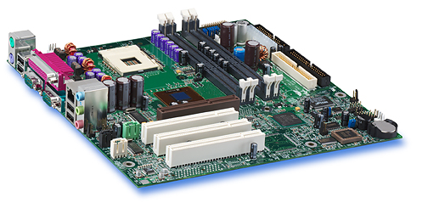
Example:
Intel Hub Architecture (850 Chipset) – I
Intel D850MD Motherboard:
RDRAM connectors
CPU socket
RDRAM
interface
system bus
hub interface
Memory
Controller Hub
PCI
bus
I/O Controller Hub
PCI connectors

Slide 36
Example:
Intel Hub Architecture (850 Chipset) – II
Note:
these transfers only show data movement between sub-systems and not the commands themselves. Additionally, data touching operations within a sub-system will require that data is moved from memory and to the CPU, e.g.:
- checksum calculation - encryption
- data encoding - forward error correction
application
Pentium 4
Processor
file system
communication
system
registers
disk
network card
cache(s)
system bus
(64-bit, 400/533 MHz
→~24-32 Gbps)
RDRAM
file system
memory
controller
hub
communication system
RAM interface
(two 64-bit, 200 MHz
→ ~24 Gbps)
RDRAM
RDRAM
application
RDRAM
hub interface
(four 8-bit, 66 MHz
→ 2 Gbps)
I/O
controller
hub
PCI slots
network card
PCI bus
(32-bit, 33 MHz
→ 1 Gbps)
PCI slots
PCI slots
disk
Notes:
Talk about bottlenecks

Slide 37
Example:
IBM POWER 4
application
POWER 4 chip
Note:
Again, data touching operations add movement operations
CPU
CPU
file system
communication
system
L1
L1
core interface switch
disk
network card
L2
fabric controller
(chip-chip fabric + multi-chip module)
(four 64-bit, 400 MHz → ~95 Gbps)
(eight 32-bit, 400 MHz → ~95 Gbps)
(four 64-bit, 400 MHz → ~95 Gbps)
L3
memory
controller
RAM
file system
GX
controller
L3 controller
RAM
communication system
RAM
application
GX bus
(two 32-bit, 600 MHz → ~35 Gbps)
PCI busses
(32/64-bit, 33/66 MHz → 1-4 Gbps)
PCI slots
network card
remote I/O
(RIO)
bridge
PCI
host bridge
PCI-PCI
bridge
PCI slots
disk
PCI
host bridge
PCI-PCI
bridge
RIO bus
(two 8-bit, 500 MHz → ~7 Gbps)
Notes:
Fabric controller:
Multichip modules can connect 4 ”POWER 4 chips” → ”4 chip, 2-way SMP”
Multichip modules can again be connected up to 4 times giving a maximum of 4x4 chip, 2way SMPs → 32-way SMP using the chip-chip fabric
Memory access penalty of up to 10% in the multi-multichipmodule configuration

Slide 38
Example:
IBM POWER 4
POWER 4 chip
POWER 4 chip
POWER 4 chip
CPU
CPU
CPU
CPU
CPU
CPU
L1
L1
L1
L1
L1
L1
core interface switch
core interface switch
L2
L2
core interface switch
fabric controller
fabric controller
L3
memory
controller
RAM
L3
memory
controller
RAM
L2
GX
controller
L3
controller
RAM
GX
controller
L3
controller
RAM
RAM
RAM
fabric controller
(chip-chip fabric + multi-chip module)
L3
memory
controller
RAM
GX
controller
L3 controller
POWER 4 chip
POWER 4 chip
RAM
CPU
CPU
CPU
CPU
L1
L1
L1
L1
RAM
core interface switch
core interface switch
L2
L2
fabric controller
fabric controller
GX
controller
L3
controller
L3
memory
controller
RAM
GX
controller
L3
controller
L3
memory
controller
RAM
RAM
RAM
RAM
RAM
Multichip modules in fabric controller can connect
4 chips into a 4 chip, 2-way SMP → 8-way MP
Notes:
Fabric controller:
Multichip modules can connect 4 ”POWER 4 chips” → ”4 chip, 2-way SMP”
Multichip modules can again be connected up to 4 times giving a maximum of 4x4 chip, 2way SMPs → 32-way SMP using the chip-chip fabric
Memory access penalty of up to 10% in the multi-multichipmodule configuration

Slide 39
Example:
IBM POWER 4
POWER 4 chip
POWER 4 chip
POWER 4 chip
POWER 4 chip
POWER 4 chip
CPU
POWER 4 chip
CPU
CPU
CPU
CPU
L1
CPU
CPU
CPU
L1
L1
CPU
L1
L1
L1
L1
L1
core interface switch
CPU
core interface switch
CPU
CPU
core interface switch
L1
core interface switch
L2
L1
L2
L1
L1
L2
fabric controller
L2
fabric controller
fabric controller
fabric controller
core interface switch
core interface switch
GX
controller
L3
controller
L3
memory
controller
RAM
GX
controller
L3
controller
L3
memory
controller
RAM
GX
controller
L3
controller
L3
memory
controller
RAM
GX
controller
L3
controller
L3
memory
controller
RAM
RAM
RAM
RAM
RAM
L2
L2
RAM
RAM
RAM
RAM
fabric controller
fabric controller
GX
controller
L3
controller
L3
memory
controller
RAM
POWER 4 chip
GX
controller
L3
controller
L3
memory
controller
RAM
POWER 4 chip
POWER 4 chip
RAM
CPU
CPU
POWER 4 chip
RAM
CPU
CPU
CPU
CPU
L1
L1
CPU
CPU
L1
L1
L1
L1
RAM
core interface switch
L1
L1
RAM
core interface switch
core interface switch
L2
core interface switch
L2
L2
fabric controller
L2
fabric controller
fabric controller
fabric controller
GX
controller
L3
controller
L3
memory
controller
RAM
GX
controller
L3
controller
L3
memory
controller
RAM
GX
controller
L3
controller
L3
memory
controller
RAM
GX
controller
L3
controller
L3
memory
controller
RAM
RAM
RAM
RAM
RAM
RAM
RAM
RAM
RAM
POWER 4 chip
POWER 4 chip
POWER 4 chip
POWER 4 chip
POWER 4 chip
CPU
POWER 4 chip
CPU
CPU
CPU
CPU
L1
CPU
CPU
CPU
L1
L1
CPU
L1
L1
L1
L1
L1
core interface switch
CPU
core interface switch
CPU
CPU
core interface switch
L2
core interface switch
L2
L2
L1
L2
fabric controller
L1
fabric controller
L1
L1
fabric controller
fabric controller
core interface switch
core interface switch
GX
controller
L3
controller
L3
memory
controller
RAM
GX
controller
L3
controller
L3
memory
controller
RAM
GX
controller
L3
controller
L3
memory
controller
RAM
GX
controller
L3
controller
L3
memory
controller
RAM
RAM
RAM
RAM
RAM
L2
L2
RAM
RAM
RAM
RAM
fabric controller
fabric controller
L3
memory
controller
RAM
POWER 4 chip
L3
memory
controller
RAM
POWER 4 chip
GX
controller
L3
controller
GX
controller
L3
controller
POWER 4 chip
CPU
CPU
POWER 4 chip
CPU
CPU
CPU
CPU
L1
L1
CPU
CPU
RAM
L1
L1
L1
L1
RAM
core interface switch
L1
L1
RAM
core interface switch
core interface switch
RAM
L2
core interface switch
L2
L2
fabric controller
L2
fabric controller
fabric controller
fabric controller
GX
controller
L3
controller
L3
memory
controller
RAM
GX
controller
L3
controller
L3
memory
controller
RAM
GX
controller
L3
controller
L3
memory
controller
RAM
GX
controller
L3
controller
L3
memory
controller
RAM
RAM
RAM
RAM
RAM
RAM
RAM
RAM
RAM
Chip-chip fabric in fabric controller can connect 4 multi-chips into a
4x4 chip, 2-way SMP → 32-way MP
Notes:
Fabric controller:
Multichip modules can connect 4 ”POWER 4 chips” → ”4 chip, 2-way SMP”
Multichip modules can again be connected up to 4 times giving a maximum of 4x4 chip, 2way SMPs → 32-way SMP using the chip-chip fabric
Memory access penalty of up to 10% in the multi-multichipmodule configuration

Slide 40
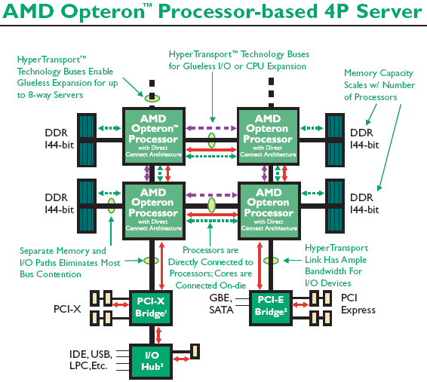
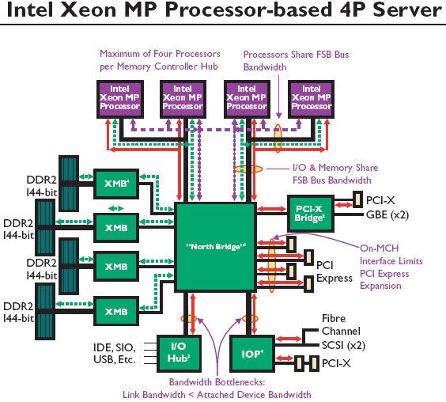
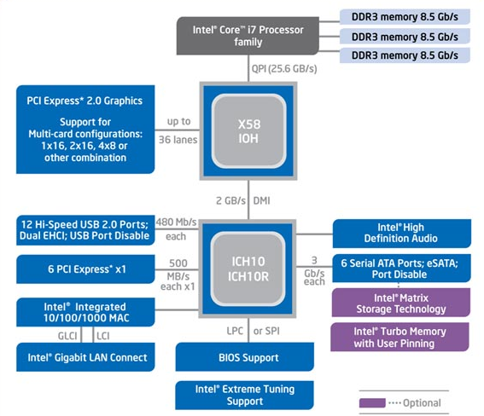

Example:
AMD Opteron & Intel Xeon/Nehalem
Intel Xeon MP Processor-based 4P
application
file system
communication
system
disk
network card
Intel Nehalem
Know your hardware –
different configuration may have different bottlenecks

Slide 41
Server Internals Challenges
Data retrieval from disk and push to network for many users
Important resources:
  memory
  busses
  CPU
  storage (disk) system
  communication (NIC) system
Much can be done to optimize resource utilization, e.g., scheduling, placement, caching/prefetching, admission control, merging concurrent users, …
We will in later lectures look at several of these

Slide 42
Network Approaches

Slide 43
Network Architecture Approaches
WAN backbones
  SONET
  ATM
Local distribution network
  ADSL (asymmetric digital subscriber line)
  FTTC (fiber to the curb)
  FTTH (fiber to the home)
  HFC (hybrid fiber coax) (=cable modem)
  E-PON (Ethernet passive optical network)
  …
Has to be aware of different capabilities
  loss rate
  bandwidth
  possible asymmetric links
  distance
  load
  ….
ATM/SONET
backbone
network
wireless
ADSL
telephone
cable

Slide 44



Network Challenges
Distribution in LANs is more or less solved:
OVERPROVISIONING works
  established in studio business
  established in small area (hotel/hospital/plane/…) businesses
Network

Slide 45
Network Challenges
WANs are not so easy
  overprovisioning of resources will NOT work
  no central control of delivery system
  too much data
  too many users
  too many different systems
Different applications and data types have different requirements and behavior
What kind of services offered is somewhat dependent on the used protocols
We will in later lectures look at different protocols and mechanisms

Slide 46
Case Studies:
Application Characteristics

Slide 47
iTVP
Country-wide IP TV and VoD
in Poland
  live & VoD
  hierarchical structure with caching
    origin server
    regional content centers (RCC)
    (receiving data from content providers)
    a number of proxy caches (P/C) below
    (handling requests from users)
  different quality levels of the video – up to 700 Kbps
  observations over several months

Slide 48
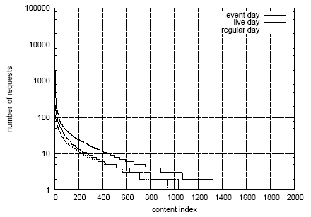
iTVP: Popularity Distribution
Popularity of media objects according to Zipf,
i.e., most accesses are for a few number of objects
The object popularity decreases as time goes
During a 24-hour period
  up to 1500 objects accessed
  ~1200 accesses
  for the most popular

Slide 49
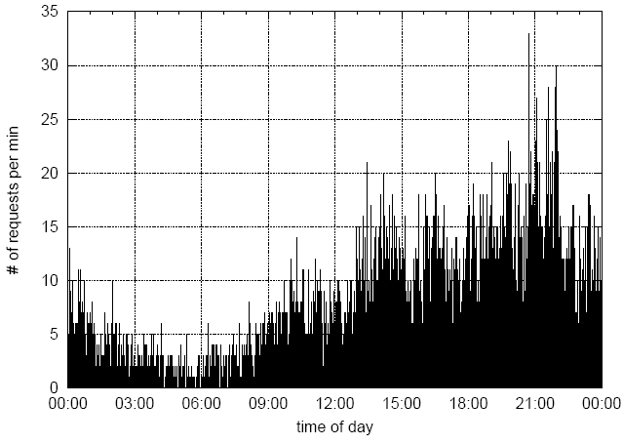
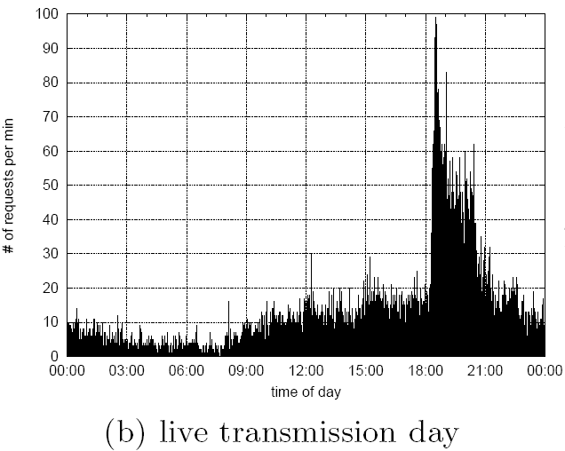
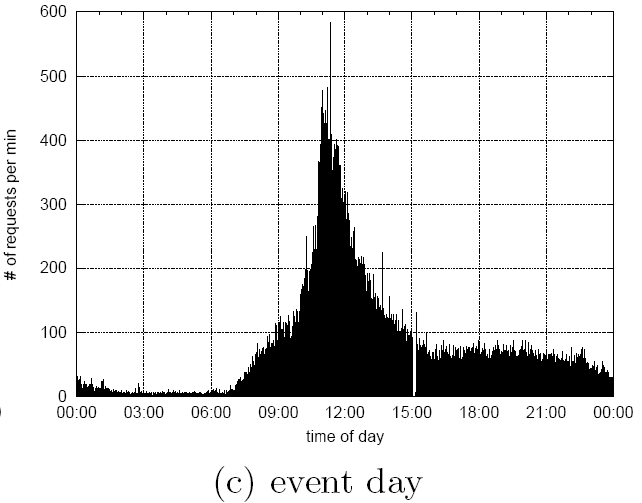
iTVP: Access Patterns
Regular days
  low in the morning, high in the evening
  typical 30 requests per minute
  the most popular items had an average of 300 accesses per day
  an average total of 11.500 accesses per day
Live transmissions
  higher request rate
  an average total of 18.500 accesses per day
  20% accesses to the most popular content
Event transmissions
  several hundreds accesses per minute during event transmission
  an average total of 100.000+ accesses per day
  50% accesses to the most popular content

Slide 50
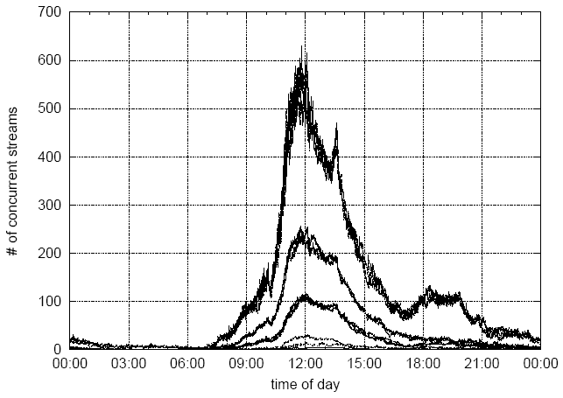
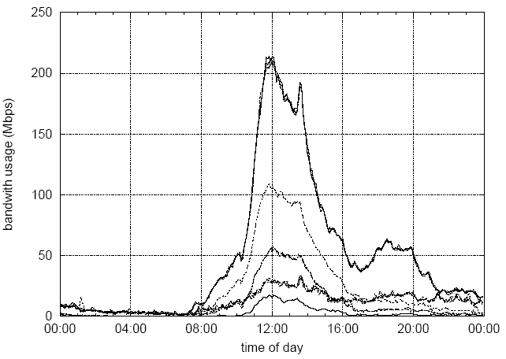
iTVP: Concurrency and Bandwidth
The number of concurrent users vary,
e.g., for a single proxy cache
  event: up to 600
  regular: usually less than 20
Transfers between nodes are on the
order of several Mbps, e.g.,
  event:
    single proxy: up to 200 Mbps
    whole system: up to 1.8 Gbps
  regular:
    single proxy: around 60 Mbps
    whole system: up to 400 Mbps

Slide 51
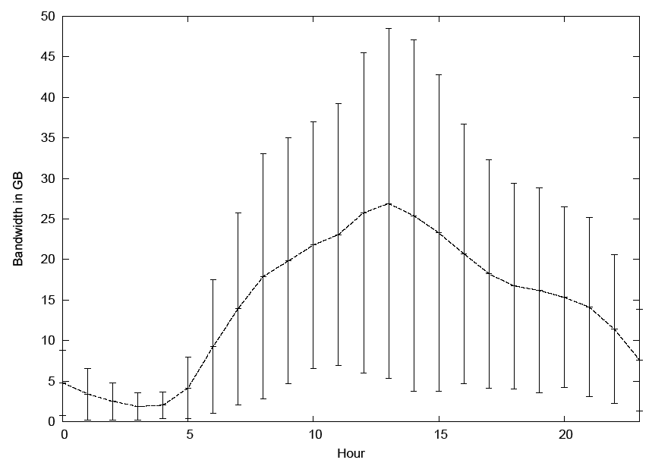
Verdens Gang (VG) TV: News-on-Demand
Client-server
Microsoft Media Server protocol (over UDP, TCP or HTTP)
From a 2-year log of client accesses for news videos
Johnsen et. al. found
  Approximated Zipf distributed
  popularity, but more articles are
  popular
  Access pattern dependent on
  time of day and day of week
  Large bandwidth requirements,
  i.e., several GBs per hour
600
500
weekdays
400
Number of concurrent access
300
average
200
weekend
100
0:00
6:00
12:00
18:00
24:00
Time of day

Slide 52

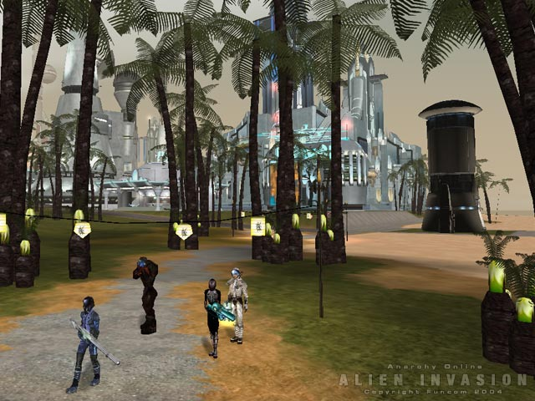

Funcom’s Anarchy Online
World-wide massive multiplayer
online roleplaying game
  client-server
    point-to-point TCP connections
    virtual world divided into many regions
    one or more regions are managed by one machine

Slide 53
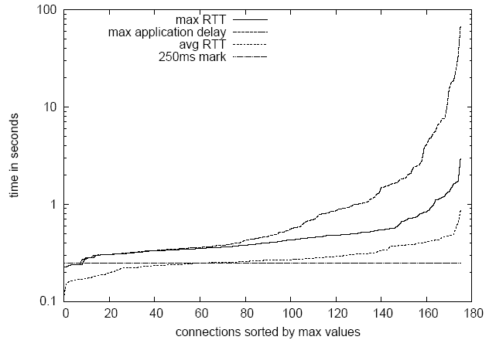
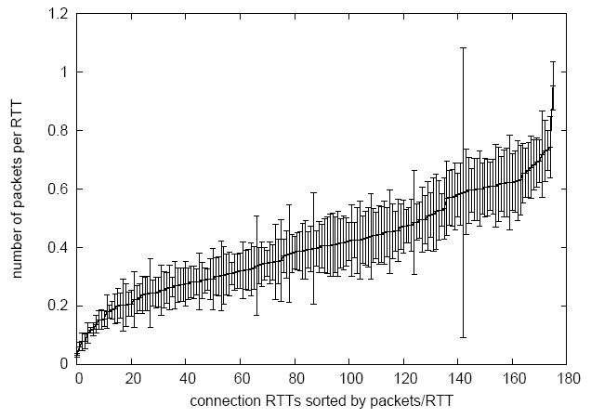
Funcom’s Anarchy Online
For a given region in a one hour trace we found
  ~175 players (from three continents??)
  average layer 3 RTT somewhat
  above 250 ms
   OK
  a worst-case application delay
  of 67 s (!)
   loss results in a players nightmare
  less than 4 packets per second
  small packets: ~120 B
   thin streams

Slide 54
Application Characteristics
Movie-on-Demand and live video streaming
  Access pattern according to Zipf
  high rates, many and large packets
  many concurrent users
  (Blockbuster online – 2.2 million users)
  extreme peeks
  (Move Networks says to have supported 7.000.000 million concurrent users)
  timely, continuous delivery
News-on-Demand streaming
  daily periodic access pattern – close to Zipf
  similar to other video streaming
…

Slide 55
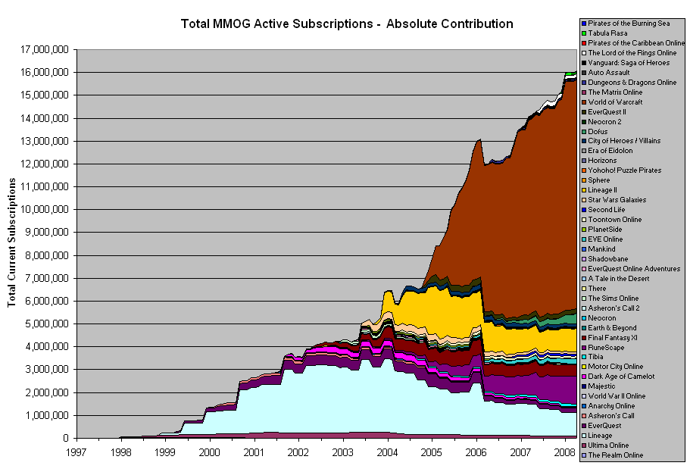
Application Characteristics
Games
  low rates, few and small packets, especially MMOGs:
    < 10 packets per second
    ~ 100 bytes payload per packet
  interactive
  low latency delivery
  (100 – 1000 ms)
  many concurrent
  users
    MMOGs in total –
    > 16 million
    WoW –
    > 9 million

Slide 56
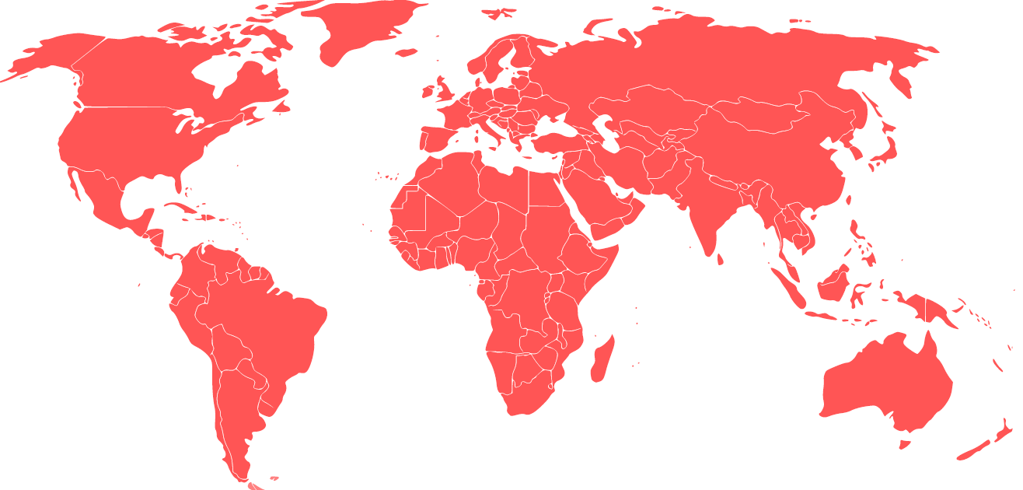

Picture Today!
performance??

Slide 57



Failing to meet the Technical Challenges…
… results in low quality pictures,
video artifacts, hiccups, etc.
giving annoyed users!

Slide 58

Failing to meet the Technical Challenges…
… influence the game experience
giving annoyed users – latency can kill!

Slide 59
Summary
Assumptions:
  overprovisioning of resources will NOT (always) work
Systems:
  need for interoperability – not from a single source
  need for co-operative distribution systems
Huge amounts of data:
  billions of web-pages (at least 22 billion, google: 1 trillion, indexable web pages August 2009)
  billions of downloadable articles
  thousands of movies (estimated 65000 in 1995!! H/Bollywood = ca. 500/1000 per year)
  data from TV-series, sport clips, news, live events, …
  games and virtual worlds
  music
  home made media data shared on the Internet
  …

Slide 60
Summary
Applications and challenges in a distributed system
  different requirements
  different architectures
  different devices
  different capabilities
  …
  and it keeps growing!!!!
Performance issues are important…!!!!

Slide 61
Some References
AMD, http://multicore.amd.com/en/Products
Intel, http://www.intel.com
MPEG.org, http://www.mpeg.org/MPEG/DVD
http://www.cs.uiowa.edu/~asignori/web-size/
http://www.mmogchart.com
Tendler, J.M., Dodson, S., Fields, S.: “IBM e-server: POWER 4 System Microarchitecture”, Technical white paper, 2001
Ewa Kusmierek et. al.: “iTVP: Large Scale Content Distribution for Live and On-Demand Video Services”, in MMCN07
Frank T. Johnsen et. al.: “Analysis of Server Workload and Client Interactions in a NoD Streaming System”, in ISM2006
Carsten Griwodz et. al.: “The Fun of Using TCP for an MMORPG”, in NOSSDAV 2006
…

