Slide 1
Protocols
INF5071 – Performance in Distributed Systems
October 01, 2010

Slide 2
On–demand Streaming Applications
Stable bandwidth problem

Slide 3

UDP
The classical solution
  Send data at playout speed
  Write loss-tolerant audio-video codecs
  Ignore all kinds of loss, or use FEC
Problem
  Does not back off at bandwidth bottlenecks
  TCP connections suffer
Approach is no longer accepted
University of Oslo
INF5071, Carsten Griwodz & Pål Halvorsen

Slide 4
TCP Congestion Control
TCP congestion control is based on the notion
that the network is a “black box” –
congestion indicated by a loss
Sufficient for best-effort applications, but losses might severely hurt traffic like audio and video streams
→ congestion indication can enable features like
quality adaptation
University of Oslo
INF5071, Carsten Griwodz & Pål Halvorsen

Slide 5
Comparison of Non-QoS Philosophies
Pro UDP | Pro TCP
Scalable due to multicast | Proxies, caches and reflectors are beneficial anyway, can replace multicast
 | ISPs dislike multicast
Faster only one end-to-end delay for packet delivery | Existing optimization is for TCP routers, firewall, OS network stacks
Application controls retransmission | No need to handle retransmissions
Scalable codecs are needed anyway | Lossless codecs don’t need additional loss resistance
Small buffers possible if loss is handled gracefully
TCP-friendliness can be implemented (end-to-end) variations of the algorithm possible | TCP-friendly without additional work
 | Works through firewalls
One-fits-all protocol possible on-demand, quasi-broadcasting, conferencing | Most applications are on-demand

Slide 6
Using Standard Protocols
Over UDP | Over TCP | Alternative Transport
RTP Real Time Protocol IETF std, supported by ITU-T & Industry | RTP in RTSP over TCP standardized worst-case fallback firewall-friendly | SCTP Stream Control Transmission Protocol IETF RFC, supported by telephone industry
RLM TCP-friendly, needs fine-grained layered video | "Progressive Download" or "HTTP Streaming" application-level prefetching and buffering trivial, cheap, firewall-friendly | DCCP Datagram Congestion Control Protocol IETF RFC, driven by TCP-friendliness researchers
SR-RTP TCP-friendly with RTP/UDP needs special encoding (OpenDivX)
VDP Video Datagram Protocol Research, for Vosaic | Priority Progress Streaming needs special encoding needs special routers for ’multicast’ | PRTP-ECN Partially reliable transport protocol using ECN Research, Univ. Karlstad
MSP Media Streaming Protocol Research, UIUC
University of Oslo
INF5071, Carsten Griwodz & Pål Halvorsen

Slide 7
Real-time Transport Protocol (RTP)
Real-time Transport Protocol (RTP)
  RFC 1889
  Designed for requirements of real-time data transport
  NOT real-time
  NOT a transport protocol
Two Components:
  Real-Time Transport Protocol (RTP)
  RTP Control Protocol (RTCP)
Provides end-to-end transport functions
  Scalable in multicast scenarios
  Media independent
  Mixer and translator support
  RTCP for QoS feedback and session information
University of Oslo
INF5071, Carsten Griwodz & Pål Halvorsen

Slide 8
RTP Quality Adaptation
Application
Application
Encoding
Decoding
Encoding
Decoding
RTP
RTCP
RTCP
RTP
UDP
UDP
Component interoperations for control of quality
Evaluation of sender and receiver reports
Modification of encoding schemes and parameters
Adaptation of transmission rates
Hook for possible retransmissions (outside RTP)
University of Oslo
INF5071, Carsten Griwodz & Pål Halvorsen

Slide 9
Loss-Delay Adjustment Algorithm
LDA
  An algorithm to stream with RTP in a TCP-friendly way
  use RTCP receiver reports (RR)
    RTCP sends RR periodically
Application
Application
Encoding
Decoding
Encoding
Decoding
RTP
RTCP
RTCP
RTP
UDP
UDP
University of Oslo
INF5071, Carsten Griwodz & Pål Halvorsen

Slide 10
Loss-Delay Adjustment Algorithm
LDA
  An algorithm to stream with RTP in a TCP-friendly way
  use RTCP receiver reports (RR)
    RTCP sends RR periodically
  works like TCP's AIMD
    but RRs are rare
    can't adapt every time
  step one: find the bottleneck bandwidth b
  use packet size and gaps size
Sender
Receiver
University of Oslo
INF5071, Carsten Griwodz & Pål Halvorsen

Slide 11
Loss-Delay Adjustment Algorithm
LDA
  An algorithm to stream with RTP in a TCP-friendly way
  use RTCP receiver reports (RR)
    RTCP sends RR periodically
  works like TCP's AIMD
    but RRs are rare
    can't adapt every time
  no loss:
    use "AIR" – additive increase rate
    but never more than 1 packet/RTT
  loss:
    RTCP counts losses l
    guess 3 of those losses in one RTT:
current rate
newrate
University of Oslo
INF5071, Carsten Griwodz & Pål Halvorsen

Slide 12
Progressive Download
In-band in long-running HTTP response
  Plain file for the web server
  Even simpler than FTP
  No user interactions – start, stop, ...
If packet loss is ...
  ... low – rate control by back-pressure from client
  ... high – client’s problem
Applicability
  Theoretical
    For very low-bit-rate codecs
    For very loss-intolerant codecs
  Practical
    All low-volume web servers
University of Oslo
INF5071, Carsten Griwodz & Pål Halvorsen

Slide 13


Progressive Download
Web server
Backpressure !
Decoder
Receive buffer
TCP Stack
TCP Stack
Can recreate timing from media file
Accepts buffer underruns
Serves requested files as quickly as possible
Network (uncongested)

Slide 14
Progressive Download
Web server
Retransmission Timeout
Decoder
Receive buffer
TCP Stack
TCP Stack
Network (congested)

Slide 15




Progressive Download
Web server
Decoder
Receive buffer
Network (uncongested)
TCP Stack
TCP Stack
University of Oslo
INF5071, Carsten Griwodz & Pål Halvorsen
Backpressure !
Can recreate timing from media file
Accepts buffer underruns
Serves requested files as quickly as possible

Slide 16
INSERT
Towsley Wang paper

Slide 17
Coding for Adaptive Streaming: MPEG-1
International Standard: Moving Pictures Expert Group
  Compression of audio and video for playback (1.5 Mbit/s)
  Real-time decoding
Sequence of I-, P-, and B-Frames
B-Frames
bi-directionally
coded
I-Frames
“intra-coded”
P-Frames
predictive coded
University of Oslo
INF5071, Carsten Griwodz & Pål Halvorsen

Slide 18
Coding ...: MPEG-1
Frames can be dropped
  In a controlled manner
  Frame dropping does not violate dependancies
  Example: B-frame dropping in MPEG-1
University of Oslo
INF5071, Carsten Griwodz & Pål Halvorsen

Slide 19
Coding ...: hierarchical layer coding
University of Oslo
INF5071, Carsten Griwodz & Pål Halvorsen

Slide 20
Coding ...: hierarchical layer coding
University of Oslo
INF5071, Carsten Griwodz & Pål Halvorsen

Slide 21
Coding ...: hierarchical layer coding

Slide 22
Receiver-driven Layered Multicast (RLM)
Requires
  IP multicast
  layered video codec
Operation
  Each video layer is one IP multicast group
  Receivers join the base layer and extension layers
  If they experience loss, they drop layers (leave IP multicast groups)
  To add layers, they perform "join experiments“
Advantages
  Receiver-only decision
  Congestion affects only sub-tree quality
  Multicast trees are pruned, sub-trees have only necessary traffic

Slide 23

Receiver-driven Layered Multicast (RLM)

Slide 24

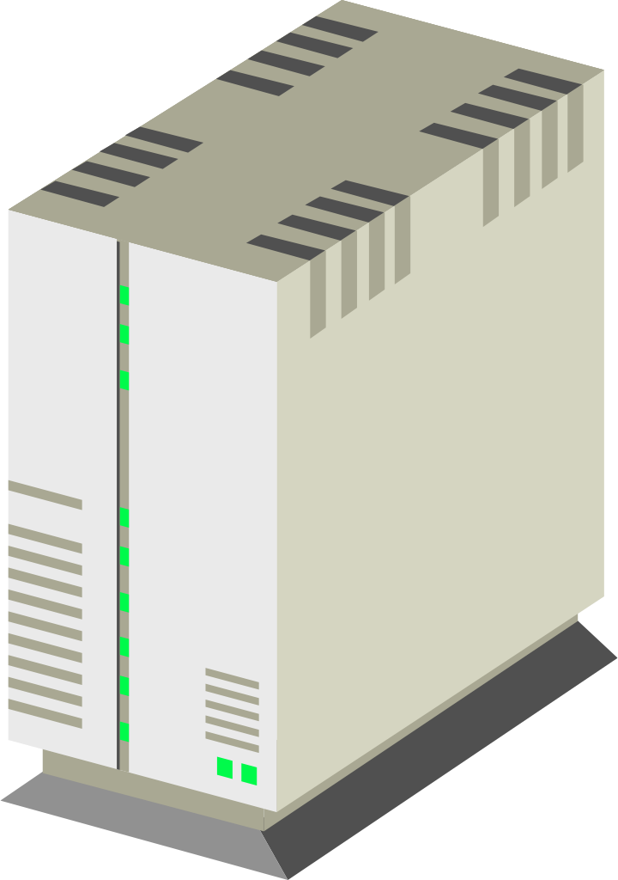
Receiver-driven Layered Multicast (RLM)
University of Oslo
INF5071, Carsten Griwodz & Pål Halvorsen

Slide 25
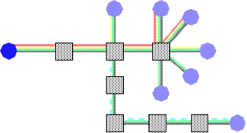
Receiver-driven Layered Multicast (RLM)
Layer size considerations
  Adaptations are in steps of 1 layer
  Big layers
    Join experiments have huge impact
    Quality changes are very visible
  Small layers
    Many addresses are used
    Multicast routing effort is high
    Fair share is hard to achieve (don’t release bandwidth quickly enough)
  Exponential layer sizes
    Bad enough
    Best possible mix
Other problems
  Synchronization problems
  PIM-SM removes sub-trees quickly
    Join and leave operations are very slow
INF5070 – media storage and distribution systems
2003 Carsten Griwodz & Pål Halvorsen

Slide 26
Receiver-driven Layered Multicast (RLM)
INF5070 – media storage and distribution systems
2003 Carsten Griwodz & Pål Halvorsen

Slide 27







DAVVI
Unmodified TCP
All modern codecs possible
  Have used MPEG-2, H.264+MP3
  Needs new container format
Divide a video into segments
  2 seconds are good
Encode segments several times
  At different quality levels
playout time
quality
University of Oslo
INF5071, Carsten Griwodz & Pål Halvorsen

Slide 28

DAVVI
For load-balancing and scaling multiple servers
Downloads segments
A tracker manages information about segment locations
The user contacts the tracker
for segment locations
User sends HTTP GET requests to download video segments
Not so unlike Move Networks and Microsoft SmoothHD
  Just faster ☺
University of Oslo
INF5071, Carsten Griwodz & Pål Halvorsen

Slide 29
Priority Progress Streaming
Unmodified TCP (other transports conceivable)
Unmodified MPEG-1 video-in (other encoding formats conceivable)
Real-time video processing
  Convert MPEG to Spatially Scalable MPEG (SPEG) – 10-25% overhead
  Packetize SPEG to separate by frame and by SNR quality step
    More variations conceivable: color, resolution
  Assign priorities to SPEG packets
    Dynamic utility curves indicate preference for frame or SNR dropping
  Write SPEG packets in real-time into reordering priority progress queue
Queues are long
  Much longer than TCP max window
  Dynamic adjustment allows fast start and dynamic growth
  With longer queues
    Total delay is increased
    High priority packets win more often
University of Oslo
INF5071, Carsten Griwodz & Pål Halvorsen

Slide 30
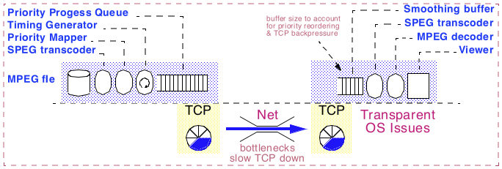
Priority Progress Streaming
MPEG file
Packets to send
High priority
Medium priority
To TCP
Low priority
Priority Progress Queue
University of Oslo
INF5071, Carsten Griwodz & Pål Halvorsen

Slide 31
Paceline
Web server
NOW!
the application
notices congestion
Decoder
User space
Kernel
Receive buffer
Network (congested)
TCP Stack
TCP Stack
University of Oslo
INF5071, Carsten Griwodz & Pål Halvorsen
Backpresure !

Slide 32
Paceline
Try to estimate how full the TCP buffer is
consider
  number of bytes in flight at each RTT: cwnd
  so: cwnd must be approx. bandwidth/RTT
approach
  recreate TCP ACK-mechanism in user space
  send application-layer ACKs (P-ACKs)
  estimate RTT
  estimate bandwidth
  don't feed TCP faster than bandwidth/RTT
  slow down rate adaptation by computing
  estimate cwnd development with pressure
University of Oslo
INF5071, Carsten Griwodz & Pål Halvorsen

Slide 33
Selective Retransmission–RTP (SR−RTP)
Features
  Relies on a layered video codec
  Supports selective retransmission
  Uses congestion control to choose number of video layers
Congestion Manager
  Determines the permitted send rate at the sender
  Uses TCP-friendly algorithm for rate computation
Knowledge about encoding
  Required at sender to select video layers to send
  Required at receiver to
    decode at correct rate
    send NACKs
University of Oslo
INF5071, Carsten Griwodz & Pål Halvorsen
Notes:
Scalable reliable...?

Slide 34


Selective Retransmission–RTP (SR−RTP)
MPEG-4 server
Transmission schedule of
a layered video
Decoder
Update allowed
Bandwidth
for stream
RTCP report
Includes loss information
Smoothing buffer
SR-RTP
RTCP
SR-RTP
RTCP
Congestion
Manager
UDP Stack
Retransmission demand
UDP Stack
Forwarding to the
Congestion Manager
Network
University of Oslo
INF5071, Carsten Griwodz & Pål Halvorsen

Slide 35
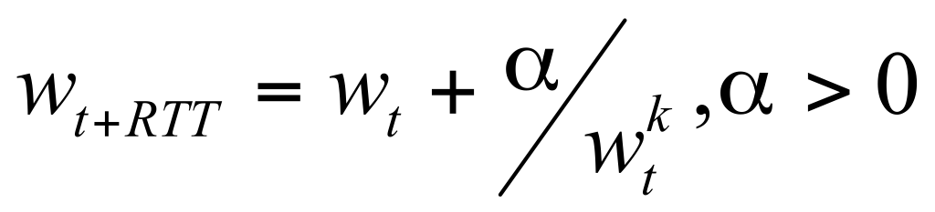
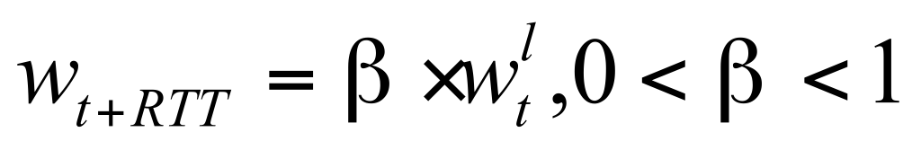
Selective Retransmission–RTP (SR−RTP)
Binomial Congestion Control
  Provides a generalization of TCP AIMD
  Congestion window size w_{t} depends on losses per RTT
  TCP’s AIMD: α = 1, β = .5, k = 0 and l = 1
  k + l = 1: binomial congestion control is TCP friendly
Increase
Decrease
Nick Feamster and Hari Balakrishnan
University of Oslo
INF5071, Carsten Griwodz & Pål Halvorsen

Slide 36
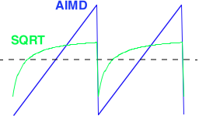
Selective Retransmission–RTP (SR−RTP)
SQRT
  Special case of binomial congestion control
  k=0.5, l=0.5
  Name because w^{0.5} = sqrt(w)
Effect of SQRT
  Average bandwidth is like TCP’s
  Maximum is lower
  SQRT covers a step function with
  less steps
AIMD
SQRT
University of Oslo
INF5071, Carsten Griwodz & Pål Halvorsen

Slide 37
On-demand streaming applications
Smoothness is key
  Use a lot of buffering
  Don’t surprise the application
  Consume a limited amount of buffers
  Try to make congestion control as smooth as possible
Adaptive applications
  Can by improved by this
Next time: Interactive applications and QoS
University of Oslo
INF5071, Carsten Griwodz & Pål Halvorsen

Slide 38
Some References
Dorgham Sisalem, Henning Schulzrinne: "The Loss-Delay Based Adjustment Algorithm: A TCP-Friendly Adaptation Scheme", Network and Operating Systems Support for Digital Audio and Video (NOSSDAV), July 1998
Charles Krasic, Jonathan Walpole, Wu-chi Feng: "Quality-Adaptive Media Streaming by Priority Drop", Network and Operating Systems Support for Digital Audio and Video (NOSSDAV), June 2003
Charles Krasic, Jonathan Walpole: "Priority-Progress Streaming for Quality-Adaptive Multimedia", ACM Multimedia Doctoral Symposium, Ottawa, Canada, October 2001
Kurose, J.F., Ross, K.W.: “Computer Networking – A Top-Down Approach Featuring the Internet”, 2nd ed. Addison-Wesley, 2003
The RFC repository maintained by the IETF Secretariat can be found at http://www.ietf.org/rfc.html
The following RFCs might be interesting with respect to this lecture:
    RFC 793: Transmission Control Protocol
    RFC 2988: Computing TCP's Retransmission Timer
    RFC 768: User Datagram Protocol
    RFC 2481: A Proposal to add Explicit Congestion Notification (ECN) to IP
    RFC 1889: RTP: A Transport Protocol for Real-Time Applications
    RFC 1890: RTP Profile for Audio and Video Conferences with Minimal Control
    RFC 2960: Stream Control Transmission Protocol
    RFC 2326: Real Time Streaming Protocol
    …
University of Oslo
INF5071, Carsten Griwodz & Pål Halvorsen

