Slide 1
Introduction, Motivation & Assignment 1
INF5071 – Performance in Distributed Systems
August 27, 2012

Slide 2
The course
Course content
The course looks at performance issues in distributed systems including server architectures, data placement, scheduling, high performance file systems, resource handling in operating systems, and protocols and mechanisms for distribution and delivery of data. There will be a strong focus on applications that require time dependent delivery. The practical work in the course will improve the understanding of system architectures, operating system improvements and hardware support that are meant in particular for dedicated servers and distribution systems.
Learning outcomes
The students will learn about demands and solutions with respect to performance in distributed systems. They will learn and gain experience in designing and performing experiments. Students will learn about and experiment with algorithms and architectures. They will get practical experience in evaluating and improving performance. Students and teachers will present and discuss results.

Slide 3

Time and place
When:
Mondays 10.15 – … max. 14.00 (Wednesdays 14 – 15)
  Within this period of time, we are flexible – we very often do not use the entire time-slot…
  Visit the home page as we will announce changes here
Where:
Ole-Johan Dahls House
Seminar room 2423 - Java

Slide 4
(New) Format
Traditional lectures (INF5071) Interactive discussions (INF507x)
4 selected topics during the semester – subject to your grade
  assignment 1: TCP protocol simulations – simulation
  assignment 2: TCP protocol emulations – emulation
  assignment 3: HTTP streaming – real-world experiment
  assignment 4: Distributed processing, Hadoop (MapReduce) – real-world experiment
several discussion topics
guest lectures by industry people
(ComoYo (Telenor), Microsoft, Funcom, Dolphine, …)

Slide 5
Evaluation – Grades
No written or oral exam!!!
Present experiment results and deliver reports
  perform experiments in 2-person groups
  the report should
    be maximum 4 pages following the ACM format:
    http://www.acm.org/sigs/publications/proceedings-templates
    contain problem statement, experiment setup, description of the used metrics, presentation and discussion of the results and conclusions
    (you may read and cite related papers, but this is no requirement)
  the first 2 reports may be submitted for feedback
  at the end of the course, the 4 reports will be evaluated to give you a grade ("mappe-evaluering")
    note that the report can be modified for the final delivery (26. November)

Slide 6


Lecturers, or better discussion leaders…
Carsten Griwodz
  email: griff @ ifi
  office: Simula
Pål Halvorsen
  email: paalh @ ifi
  office: Simula
And guests …

Slide 7
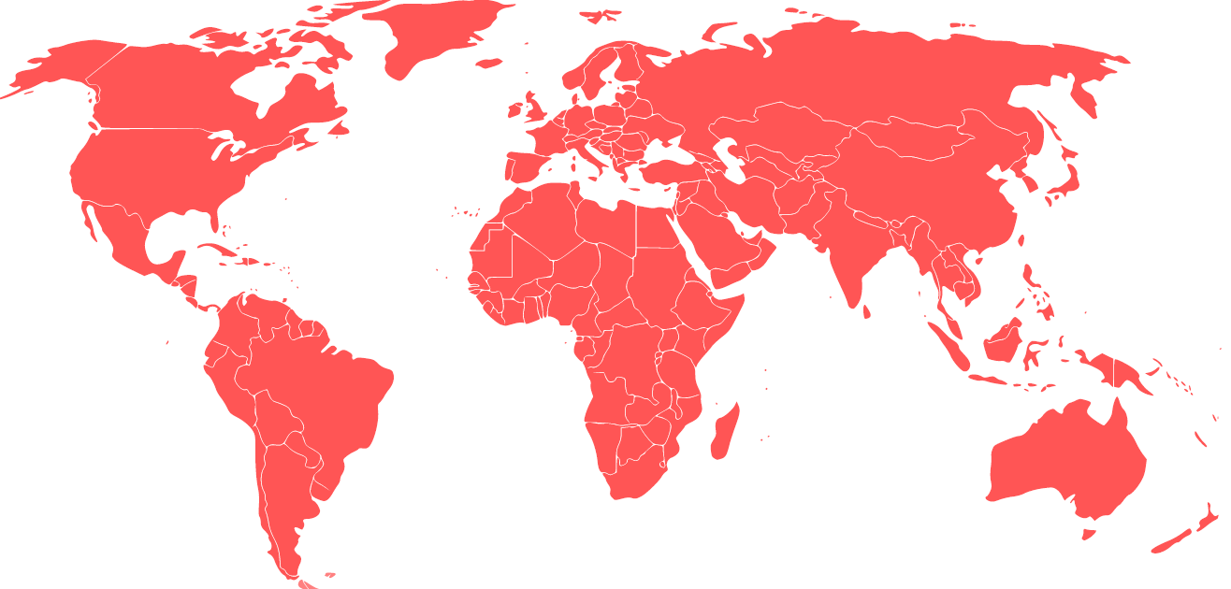

Why is PERFORMANCE important?
Huge amounts of data:
billions of web-pages (google: 1 trillion, indexable web pages August 2009)
billions of downloadable articles
thousands of movies (estimated 65000 in 1995!! H/Bollywood = ca. 500/1000 per year)
data from TV-series, sport clips, news, live events, …
games and virtual worlds
music
home made media data shared on the Internet
…
performance??
Challenges in a distributed system
different requirements
different architectures
different devices
different capabilities
…
and it keeps growing!!!!

Slide 8
Failing to meet the Technical Challenges…
…results in
delayed or aborted transactions
long response times
…
→ annoyed users!

Slide 9

Failing to meet the Technical Challenges…
… results in low quality pictures,
video artifacts, hiccups, etc.
→ annoyed users!

Slide 10

Failing to meet the Technical Challenges…
… influence the game experience – latency can kill!
→ annoyed users

Slide 11
Data transport
INF5071 – Performance in Distributed Systems

Slide 12
QoS vs. Non-QoS Approaches
Internet with network QoS support
  Application must specify their needs
  Internet infrastructure must change – negotiation of QoS parameters
  Routers need more features
    Keep QoS-related information
    Identify packets as QoS-worthy or not
    Treat packets differently keep routing consistent
Internet without network QoS support
  Internet applications must cope with networking problems
    Application itself or middleware
    "Cope with" means either …
      … “adapt to” which must deal with TCP-like service variations
      … “don’t care about” which is considered “unfair” and cannot work with TCP

Slide 13
UDP vs. TCP
Logs from CAIDA – The
Cooperative Association for Internet Data Analysis
packets
% of TCP traffic
bytes

Slide 14
TCP Friendliness:
The definition of good Internet behavior
TCP Congestion Control
TCP limits sending rate as a function of perceived network congestion
  little traffic – increase sending rate
  much traffic – reduce sending rate
Congestion algorithm has three major “components”:
  additive-increase, multiplicative-decrease (AIMD)
  slow-start
  reaction to timeout events

Slide 15
TCP Congestion Control
sender
receiver
Initially, the CONGESTION WINDOW
is 1 MSS (message segment size)
round 1
Then, the size increases by 1 for each
received ACK (until threshold ssthresh is reached or an ACK is missing)
sent packets
per round
(congestion window)
round 2
16
round 3
8
4
round 4
2
1
time

Slide 16
TCP Congestion Control
Normally, the threshold is 65 K
Losing a single packet (TCP Tahoe):
threshold drops to halve CONGESTION WINDOW
CONGESTION WINDOW back to 1
sent packets
per round
(congestion window)
Losing a single packet (TCP Reno):
threshold drops to halve CONGESTION WINDOW
CONGESTION WINDOW back to new threshold
80
75
70
65
ssthresh
16
60
55
50%
50
45
40
35
ssthresh
8
30
25
20
4
15
2
10
1
5
time

Slide 17
TCP Congestion Control
Slow Start
TCP will always return to a slow start when a packet loss is detected by timeout (instead of duplicate ACKs). That means that it starts from scratch with only one segment per RTT, then 2, then 4, etc.
sent packets
per round
(congestion window)
80
Multiplicative decrease
75
Congestion avoidance
phase
70
65
ssthresh
60
55
50
45
40
Slow-start phase
35
ssthresh
30
Additive Increase
One more segments sent after 1 RTT without loss in congestion avoidance phase
25
20
15
Multiplicative Decrease
Performed when loss is detected in slow-phase and in congestion avoidance phase
10
5
time

Slide 18
TCP Congestion Control Alternatives?
Original TCP
  not in use
TCP Tahoe
TCP Reno
TCP New-Reno
  standard TCP headers
TCP SACK (Selective Acknowledgements)
TCP FACK (Forward Acknowledgements)
  must use a TCP option
  RFC 2018 “TCP Selective Acknowledgment Options”
TCP Vegas
TCP Hybla
TCP BIC
TCP CUBIC
Compound TCP
TCP Westwood (+)
  use bandwidth estimate for congestion events
FAST TCP
H-TCP
Data Center TCP
High Speed TCP
HSTCP-LP
TCP-Illinois
TCP-LP
Scalable TCP
TCP Veno
YeAH-TCP
TCP-FIT

Slide 19
Goodput: Driver for TCP research
Lossy transfer with small delays (link: 500kbps, 105ms delay):

Slide 20
TCP Westwood+
Very recent
Developed for wireless networks with many losses
  Losses in wireless networks are often non-congestion losses: corruption losses
Side effect
  Less unfair against long round-trip times
Implemented in Linux
  With SACK extensions
Procedure
  TCP Westwood uses ACK packets
  provide a bandwidth estimate
“Faster recovery”
  After loss indication by a triple-ACK go into faster recovery
    Use bandwidth estimate to set new congestion window size and new slow start threshold

Slide 21
TCP Westwood+
sender
receiver
b_{k} = estimate number of bytes
sent in this RTT.
Uses average difference of
time (sent) and time (ack’d)
for every packet
for this RTT
l_{k} = estimate bytes that can be
sent per time unit (e.g., second)
uses a low pass filter (aging) to
estimate longer-term development of
bytes per RTT
new RTTmin
ssthresh = in case of loss,
multiply l_{k} with the minimum RTT to get a minimum of bytes that have been supported per RTT.
Divide by segment size to get
number of segments/RTT that should
be supportable.
b_{k+1} = estimate number of bytes
sent in this RTT.
Uses average difference of
time (sent) and time (ack’d)
for every packet
for this RTT
7
6
5
Westwood
ssthresh
4
3
Reno ssthresh
2
DUPACKs
1
time
Notes:
Developed for wireless networks with many losses
Losses in wireless networks are often non-congestion losses: corruption losses
TCP Westwood assumption
Immediately before the loss, TCPW was very close to its fair share. Therefore, on triple ACKs and DUPACKs, a state of congestion is reached and the previously used bandwidth is used for the congestion window size (not halving!)

Slide 22
TCP Westwood+
Smaller difference between streams having short and long RTTs
200
50 ms Reno
150
Sequence number in segments/100
50 ms Westwood
100
50
200 ms Reno
200 ms Westwood
0
0
50
100
150
200
Time (sec)
(approximation of a perf. eval. figure)

Slide 23
Effect of TCP variants on latency

Slide 24
TCP congestion control
Many variants…
  aimed different target scenarios
  different approaches to calculate the window
  …
Large variances between different schemes
Assignment 1
  network simulation
  compare TCP New Reno and TCP CUBIC
  change different parameters: queue lengths, number of concurrent connections over the bottleneck link
  answer the question of how the throughput and RTT change with these parameters
  write a 4 page report and present your results in 2 weeks

