Slide 1
Lecture 1 – Introduction to cryptography
TEK4500
25.08.2020
Håkon Jacobsen
hakon.jacobsen@its.uio.no

Slide 2
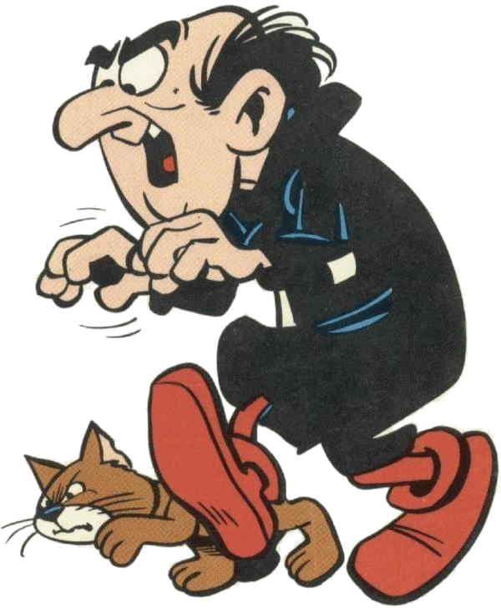
What is cryptography?
Internet
Alice
Bob
M
Adversary

Slide 3
What is cryptography?
Internet
Alice
Bob
M
Adversary

Slide 4
What is cryptography?
Internet
Alice
Bob
M
Adversary
Security goals:
Data privacy: adversary should not be able to read message M

Slide 5
What is cryptography?
Internet
Alice
Bob
M
M'
Adversary
Security goals:
Data privacy: adversary should not be able to read message M
Data integrity: adversary should not be able to modify message M
Data authenticity: message M really originated from Alice

Slide 6
Ideal solution: secure channels
But how to build?
Internet
Alice
Bob
M
Course done!
Adversary
Security goals:
Data privacy: adversary should not be able to read message M ✓
Data integrity: adversary should not be able to modify message M ✓
Data authenticity: message M really originated from Alice ✓

Slide 7
Creating secure channels: encryption schemes
Internet
Alice
Bob
K
K
$$ℰ$$
C
$$𝒟$$
M
M / $⊥$
Adversary
$𝓔$ : encryption algorithm (public)
$𝓓$ : decryption algorithm (public)
/ decryption
K : encryption key (secret)

Slide 8
Creating secure channels: encryption schemes
Internet
Alice
Bob
K_{e}
K_{d}
$$ℰ$$
C
$$𝒟$$
M
M / $⊥$
Adversary
$𝓔$ : encryption algorithm (public) K_{e} : encryption key (public)
$𝓓$ : decryption algorithm (public) K_{d} : decryption key (secret)

Slide 9
Basic goals of cryptography
 | Message privacy | Message integrity / authentication
Symmetric keys | Symmetric encryption | Message authentication codes (MAC)
Asymmetric keys | Asymmetric encryption (a.k.a. public-key encryption) | Digital signatures

Slide 10
Basic goals of cryptography
 | Message privacy | Message integrity / authentication
Symmetric keys | Symmetric encryption | Message authentication codes (MAC)
Asymmetric keys | Asymmetric encryption (a.k.a. public-key encryption) | Digital signatures

Slide 11
Some notation
$∈−$ "element in"
$3∈\{1,2,3,4,5\}$
$7∉\{1,2,3,4,5\}$
${\left\{0,1\right\}}^{n} −$ set of all bitstrings of length $n$
$000, 010, 110∈{\left\{0,1\right\}}^{3}$
${\left\{0,1\right\}}^{∗}−$ set of all bitstrings of finite length
$1, 1001, 10, 10001101000001∈{\left\{0,1\right\}}^{∗}$
$F :𝒳→𝒴−$ function from set $𝒳$ to set $𝒴$
$F :{\left\{0,1\right\}}^{5}→{\left\{0,1\right\}}^{3}$
$G :\left\{A,B,C,D\right\}→\left\{0,1,2,…\right\}$
$∀−$ "for all"
"$∀X∈{\left\{0,1\right\}}^{4}…" =$"for all bitstrings of length 4…"
$∃−$ "there exists"
$"∃X∈\{0,1,2, …\} . X > 13"$
$𝒳×𝒴−$ set of pairs $(X,Y)$ with $X∈𝒳$ and $Y∈𝒴$
$X←5−$ "assign value 5 to $X$"
$X\underset{←}{\$}𝒳−$ "assign $X$ a random value from set $𝒳$"
…independent, and uniformily distributed…

Slide 12
Symmetric encryption – syntax
$$Π=\left(ℰ, 𝒟\right)$$
$$𝒦={\left\{0,1\right\}}^{128} ℳ={\left\{0,1\right\}}^{∗} 𝒞={\left\{0,1\right\}}^{∗}$$
Correctness requirement:
$$∀K∈K, ∀M∈M:$$
$$𝒟\left(K, ℰ\left(K, M\right)\right)=M$$
Valid encryption scheme:
$$ℰ_{K}\left(M\right)=M \\ 𝒟_{K}\left(C\right)=C$$
$$ℰ :𝒦×ℳ→𝒞$$
$$𝒦={\left\{0,1\right\}}^{128} ℳ=\left\{A,B,…, Z\right\} 𝒞=\left\{A,B,…, Z\right\}$$
$$ℰ\left(K, M\right)=ℰ_{K}\left(K\right)=C$$
$$𝒦={\left\{0,1\right\}}^{128} ℳ=\left\{YES, NO\right\} 𝒞= {\left\{0,1\right\}}^{∗}$$
$$𝒟:𝒦×𝒞→ℳ$$
$$𝒦=\left\{1,…,p\right\} ℳ=\left\{A,B,…,Z\right\} 𝒞={\left\{0,1\right\}}^{∗}$$
$$𝒟\left(K, C\right)=𝒟_{K}\left(C\right)=M$$

Slide 13
Symmetric encryption – security
$$Π=\left(ℰ, 𝒟\right)$$
$$𝒦={\left\{0,1\right\}}^{128} ℳ={\left\{0,1\right\}}^{∗} 𝒞={\left\{0,1\right\}}^{∗}$$
Correctness requirement:
$$∀K∈K, ∀M∈M:$$
$$𝒟\left(K, ℰ\left(K, M\right)\right)=M$$
Possible privacy security goals:
Hard to recover $K$ from $C$
Hard to recover $M$ from $C$
Hard to learn any bit of $M$ from $C$
Hard to learn parity of $M$ from $C$
…
$$ℰ :𝒦×ℳ→𝒞$$
$$𝒦={\left\{0,1\right\}}^{128} ℳ=\left\{A,B,…, Z\right\} 𝒞=\left\{A,B,…, Z\right\}$$
$$ℰ\left(K, M\right)=ℰ_{K}\left(K\right)=C$$
$$𝒦={\left\{0,1\right\}}^{128} ℳ=\left\{YES, NO\right\} 𝒞= {\left\{0,1\right\}}^{∗}$$
$$𝒟:𝒦×𝒞→ℳ$$
$$𝒦=\left\{1,…,p\right\} ℳ=\left\{A,B,…,Z\right\} 𝒞={\left\{0,1\right\}}^{∗}$$
$$𝒟\left(K, C\right)=𝒟_{K}\left(C\right)=M$$

Slide 14
Historical encryption algorithms

Slide 15
Ceasar cipher
a b c d e f g h i j k l m n o p q r s t u v w x y z
a b c d e f g h i j k l m n o p q r s t u v w x y z
…
a
in the far distance a helicopter skimmed down between the roofs, hovered for an instant like a bluebottle, and darted away again with a curving flight. It was the police patrol, snooping into people's windows
lq wkh idu glvwdqfh d kholfrswhu vnlpphg grzq ehwzhhq wkh urriv, kryhuhg iru dq lqvwdqw olnh d eoxherwwoh, dqg gduwhg dzdb djdlq zlwk d fxuylqj ioljkw. Lw zdv wkh srolfh sdwuro, vqrrslqj lqwr shrsoh'v zlqgrzv

Slide 16
Ceasar cipher (ROT-13)
a b c d e f g h i j k l m n o p q r s t u v w x y z
a b c d e f g h i j k l m n o p q r s t u v w x y z
in the far distance a helicopter skimmed down between the roofs, hovered for an instant like a bluebottle, and darted away again with a curving flight. It was the police patrol, snooping into people's windows
va gur sne qvfgnapr n uryvpbcgre fxvzzrq qbja orgjrra gur ebbsf,
ubirerq sbe na vafgnag yvxr n oyhrobggyr, naq qnegrq njnl ntnva jvgu n pheivat syvtug. Vg jnf gur cbyvpr cngeby, fabbcvat vagb crbcyr'f jvaqbjf

Slide 17
Ceasar cipher
a ↔ 0
b ↔ 1
c ↔ 2
d ↔ 3
e ↔ 4
⁞
z ↔ 25
$$C←M+3 (\operatorname{mod}{26})$$

Slide 18
ROT-13
a ↔ 0
b ↔ 1
c ↔ 2
d ↔ 3
e ↔ 4
⁞
z ↔ 25
$$C←M+13 (\operatorname{mod}{26})$$
$$M←C−13 (\operatorname{mod}{26})$$
$$𝒦=\{ \}$$
$$ℰ :𝒦×ℳ→𝒞$$
$$ℳ=\{0,1,2,…, 25\}$$
$$𝒟 :𝒦×𝒞→ℳ$$
$$𝒞=\{0,1,2,…, 25\}$$

Slide 19
ROT-K
a ↔ 0
b ↔ 1
c ↔ 2
d ↔ 3
e ↔ 4
⁞
z ↔ 25
$$C←M+K (\operatorname{mod}{26})$$
$$𝒦=\{0,1,2,…, 25\}$$
$$ℰ :𝒦×ℳ→𝒞$$
$$ℳ=\{0,1,2,…, 25\}$$
$$𝒟 :𝒦×𝒞→ℳ$$
$$𝒞=\{0,1,2,…, 25\}$$

Slide 20
Attacking ROT-K
$$K$$ | $$M$$
0 | va gur sne qvfgnapr n uryvpbcgre.…
1 | wb hvs tof rwghobqs o vszwqcdhsf …
2 | xc iwt upg sxhipcrt p wtaxrdeitg …
3 | yd jxu vqh tyijqdsu q xubysefjuh …
$$⋮$$
12 | hm sgd ezq chrszmbd z gdkhbnosdq
13 | in the far distance a helicopter…
14 | jo uif gbs ejtubodf b ifmjdpqufs…
25 | uz ftq rmd puefmzoq m tqxuoabfqd…
$$\left|𝒦\right|=26$$
$C$ = va gur sne qvfgnapr n uryvpbcgre…

Slide 21
Substitution cipher
a b c d e f g h i j k l m n o p q r s t u v w x y z
↕ ↕ ↕ ↕ … ↕
s x d y w q f m j k o i l g z b e n t u c p a r v h
$\left|𝒦\right|=$
$$26!$$
$$≈{10}^{26}≈2^{88}$$
in the far distance a helicopter skimmed down between the roofs, hovered for an instant like a bluebottle, and darted away again with a curving flight. It was the police patrol, snooping into people's windows
jg umw qsn yjtusgdw s mwijdzbuwn tojllwy yzag xwuawwg umw nzzqt, mzpwnwy qzn sg jgtusgu ijow s xicwxzuuiw, sgy ysnuwy sasv sfsjg ajum s dcnpjgf qijfmu. ju ast umw bzijdw bsunzi, tgzzbjgf jguz bwzbiw't ajgyzat

Slide 22
Substitution cipher – formal syntax
$Σ=\{a,b,c,…, z\}$
$ℳ=Σ^{∗}$
$𝒞=Σ^{∗}$
$𝒦=all permutations on Σ$
$π∈𝒦$
$M=feed$
$C= ℰ\left(π, M\right)=π\left(f\right)π\left(e\right)π\left(e\right)π\left(d\right)=uppz$
$𝒟\left(π, C\right)=π^{−1}\left(u\right)π^{−1}\left(p\right)π^{−1}\left(p\right)π^{−1}\left(z\right)=feed$
$$ℰ :𝒦×ℳ→𝒞$$
$$𝒟 :𝒦×𝒞→ℳ$$
$$=\{π :Σ→Σ ∣π a permutation\}$$
$$σ$$ | $$a$$ | $$b$$ | $$c$$ | $$d$$ | $$e$$ | $$f$$ | $$g$$ | $$h$$ | $$…$$
$$π(σ)$$ | $$o$$ | $$y$$ | $$e$$ | $$z$$ | $$p$$ | $$u$$ | $$g$$ | $$t$$ | $$…$$

Slide 23
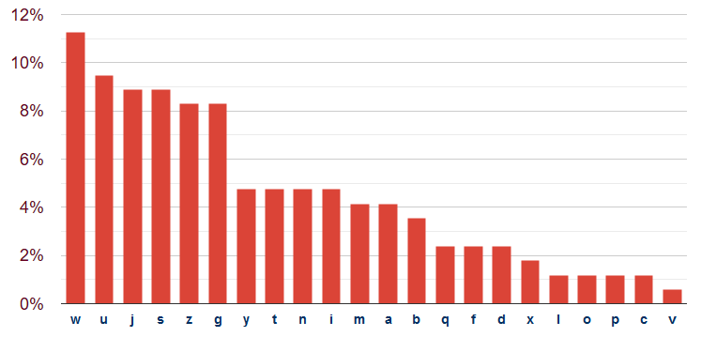
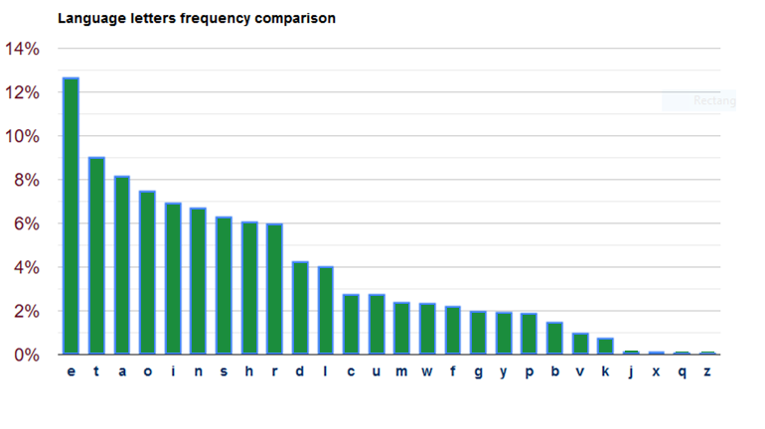
Attacking the substitution cipher
$\left|𝒦\right|=$
jg umw qsn yjtusgdw s mwijdzbuwn tojllwy yzag xwuawwg umw nzzqt, mzpwnwy qzn sg jgtusgu ijow s xicwxzuuiw, sgy ysnuwy sasv sfsjg ajum s dcnpjgf qijfmu. ju ast umw bzijdw bsunzi, tgzzbjgf jguz bwzbiw't ajgyzat
$$26!$$
$$≈{10}^{26}≈2^{88}$$

Slide 24
Attacking the substitution cipher
$\left|𝒦\right|=$
jg ume qsn yjtusgde s meijdzbuen tojlley yzag xeuaeeg ume nzzqt, mzpeney qzn sg jgtusgu ijoe s xicexzuuie, sgy ysnuey sasv sfsjg ajum s dcnpjgf qijfmu. ju ast ume bzijde bsunzi, tgzzbjgf jguz bezbie't ajgyzat
$$26!$$
$$≈{10}^{26}≈2^{88}$$
✗
✓

Slide 25
Attacking the substitution cipher
$\left|𝒦\right|=$
jg tme qsn yjttsgde s meijdzbten tojlley yzag xetaeeg tme nzzqt, mzpeney qzn sg jgttsgt ijoe s xicexzttie, sgy ysntey sasv sfsjg ajtm s dcnpjgf qijfmt. jt ast tme bzijde bstnzi, tgzzbjgf jgtz bezbie't ajgyzat
$$26!$$
$$≈{10}^{26}≈2^{88}$$
✗
✗
✓
✓

Slide 26
Attacking the substitution cipher
$\left|𝒦\right|=$
jg tme qan yjttagde a meijdzbten tojlley yzag xetaeeg tme nzzqt, mzpeney qzn ag jgttagt ijoe a xicexzttie, agy yantey aaav afajg ajtm a dcnpjgf qijfmt. jt aat tme bzijde batnzi, tgzzbjgf jgtz bezbie't ajgyzat
$$26!$$
$$≈{10}^{26}≈2^{88}$$
✗
✗
✗
✓
✓
✓

Slide 27
Attacking the substitution cipher
$\left|𝒦\right|=$
ig tme qan yittagde a meiidzbten toilley yzag xetaeeg tme nzzqt, mzpeney qzn ag igttagt iioe a xicexzttie, agy yantey aaav afaig aitm a dcnpigf qiifmt. it aat tme bziide batnzi, tgzzbigf igtz bezbie't aigyzat
$$26!$$
$$≈{10}^{26}≈2^{88}$$
✗
✗
✗
✗
✓
✓
✓
✓

Slide 28
Attacking the substitution cipher
$\left|𝒦\right|=$
ig tme qan yittagde a meiidobten toilley yoag xetaeeg tme nooqt, mopeney qon ag igttagt iioe a xicexottie, agy yantey aaav afaig aitm a dcnpigf qiifmt. it aat tme boiide batnoi, tgoobigf igto beobie't aigyoat
$$26!$$
$$≈{10}^{26}≈2^{88}$$
✗
✗
✗
✗
✗
✓
✓
✓
✓
✓

Slide 29
Attacking the substitution cipher
$\left|𝒦\right|=$
in tme qan yittande a meiidobten toilley yoan xetaeen tme nooqt, mopeney qon an inttant iioe a xicexottie, any yantey aaav afain aitm a dcnpinf qiifmt. it aat tme boiide batnoi, tnoobinf into beobie't ainyoat
$$26!$$
$$≈{10}^{26}≈2^{88}$$
✗
✗
✗
✗
✗
✗
✓
✓
✓
✓
✓
✓

Slide 30
Attacking the substitution cipher
$\left|𝒦\right|=$
in tme qan yistande a meiidobten soilley yoan xetaeen tme nooqs, mopeney qon an instant iioe a xicexottie, any yantey aaav afain aitm a dcnpinf qiifmt. it aas tme boiide batnoi, tnoobinf into beobie's ainyoas
$$26!$$
$$≈{10}^{26}≈2^{88}$$
✗
✗
✗
✗
✗
✗
✗
✓
✓
✓
✓
✓
✓
✓

Slide 31
Attacking the substitution cipher
$\left|𝒦\right|=$
in the qan distande a heiidobter soilled down xetween the rooqs, hopered qor an instant iioe a xicexottie, and danted awav afain with a dcrpinf qiifht. it was tme boiide batroi, tnoobinf into beobie's windows
$$26!$$
$$≈{10}^{26}≈2^{88}$$
✗
✗
✗
✗
✗
✗
✗
✗
✗
✗
✗
✓
✓
✓
✓
✓
✓
✓
✓
✓
✓
✓
Notes:
https://planetcalc.com/8047/

Slide 32
Conclusions
Key space must be large enough
Ciphertext should not reveal letter frequency of the message
Is this enough?

Slide 33
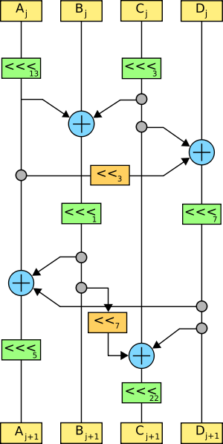
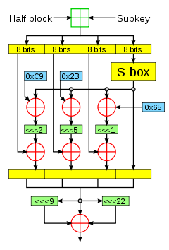
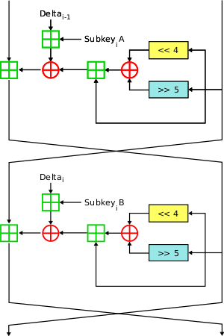
Historical approach to crypto development
build → break → fix → break → fix → break → fix ...

Slide 34
Modern approach
Trying to make cryptography more a science than an art
Focus on formal definitions of security (and insecurity)
Clearly stated assumptions
Analysis supported by mathematical proofs
... but old fashioned cryptanalysis continues to be very important!

Slide 35
The one-time-pad (OTP)
$𝒦 ={\left\{0,1\right\}}^{n}$
$$ℳ={\left\{0,1\right\}}^{n}$$
$$𝒞 ={\left\{0,1\right\}}^{n}$$
$$ℰ :𝒦×ℳ→𝒞$$
$$𝒟 :𝒦×𝒞→ℳ$$
$$ℰ\left(K, M\right)=K⊕M$$
$$𝒟\left(K, C\right)=K⊕C$$
$$0101100100$$
$$⊕1110001101 \\ −−−−−−−−− \\ = 1011101001$$
$$M$$
$$1011101001$$
$$⊕1110001101 \\ −−−−−−−−− \\ = 0101100100$$
$$C$$
$$K$$
$$K$$
$$C$$
$$M$$

Slide 36
The one-time-pad (OTP)
$𝒦 ={\left\{0,1\right\}}^{n}$
$$ℳ={\left\{0,1\right\}}^{n}$$
$$𝒞 ={\left\{0,1\right\}}^{n}$$
$$ℰ :𝒦×ℳ→𝒞$$
$$𝒟 :𝒦×𝒞→ℳ$$
$$ℰ\left(K, M\right)=K⊕M$$
$$𝒟\left(K, C\right)=K⊕C$$
Theorem: The OTP encryption scheme has one-time perfect privacy
Definition (Shannon 1949): An encryption scheme has one-time perfect privacy if for any two $M_{1}, M_{2}∈ℳ$ and any $C∈𝒞$
$$Pr\left[ℰ_{K}\left(M_{1}\right)=C\right]=Pr\left[ℰ_{K}\left(M_{2}\right)=C\right]$$
(probability taken over the random choice $K\underset{←}{\$}𝒦$ and the random coins used by $ℰ$ (if any))
Notes:
Why is this significant?

Slide 37
(One-time) perfect secrecy
From adversary's POV the ciphertext is uniformily distributed over $𝒞$
$C$ cannot give any information about $M$!
$$Prob$$ | $$K$$ | $$C=K⊕101$$
$$1/8$$ | $$000$$ | $$101$$
$$1/8$$ | $$001$$ | $$100$$
$$1/8$$ | $$010$$ | $$111$$
$$1/8$$ | $$011$$ | $$110$$
$$1/8$$ | $$100$$ | $$001$$
$$1/8$$ | $$101$$ | $$000$$
$$1/8$$ | $$110$$ | $$011$$
$$1/8$$ | $$111$$ | $$010$$
$$Prob$$ | $$K$$ | $$C=K⊕001$$
$$1/8$$ | $$000$$ | $$001$$
$$1/8$$ | $$001$$ | $$000$$
$$1/8$$ | $$010$$ | $$011$$
$$1/8$$ | $$011$$ | $$010$$
$$1/8$$ | $$100$$ | $$101$$
$$1/8$$ | $$101$$ | $$100$$
$$1/8$$ | $$110$$ | $$111$$
$$1/8$$ | $$111$$ | $$110$$

Slide 38
Proof of OTP one-time perfect privacy
Theorem: The OTP encryption scheme has one-time perfect privacy
Definition: An encryption scheme has one-time perfect privacy if for any $M_{1}, M_{2}∈ℳ$ and any $C∈𝒞$
$$Pr\left[ℰ_{K}\left(M_{1}\right)=C\right]=Pr\left[ℰ_{K}\left(M_{2}\right)=C\right]$$
with probability taken over the random choice $K\underset{←}{\$}𝒦$ and the random coins used by $ℰ$ (if any))
Fix: $M_{1}, M_{2}, C∈{\left\{0,1\right\}}^{n}$
Need to show: $\operatorname{Pr}\left[K⊕M_{1}=C\right]=\operatorname{Pr}\left[K⊕M_{2}=C\right]$
$$=\frac{1}{2^{n}}$$
$$\operatorname{Pr}\left[K⊕M_{1}=C\right]$$
$$=Pr\left[K=M_{1}⊕C\right]$$
$$=Pr\left[K=Z_{1}\right]$$
$$=\frac{1}{2^{n}}$$
$$\operatorname{Pr}\left[K⊕M_{2}=C\right]=$$
$$\operatorname{Pr}\left[K=M_{2}⊕C\right]$$
$$=Pr\left[K=Z_{2}\right]$$
QED

Slide 39
One-time pad – perfect?
OTP gives perfect privacy…for one message
What happens if you reuse the same key for two messages?
$C_{1}$, $C_{2}$, $C_{1}≠C_{2}$
$C_{1}⊕C_{2}=\left(K⊕M_{1}\right)⊕\left(K⊕M_{2}\right)=M_{1}⊕M_{2}$
Key is as long as the message
What happens if it is shorter?
Key management becomes very difficult
Sort of defeats the purpose
Nothing special about XOR: ROT-K also has one-time perfect privacy
Why doesn't this contradict what we saw earlier about ROT-K?
Theorem: No encryption scheme can have perfect secrecy if $\left|𝒦\right|<\left|ℳ\right|$

Slide 40
Outline of course
 | Message privacy | Message integrity / authentication
Symmetric keys | Symmetric encryption | Message authentication codes (MAC)
Asymmetric keys | Asymmetric encryption (a.k.a. public-key encryption) | Digital signatures

Slide 41
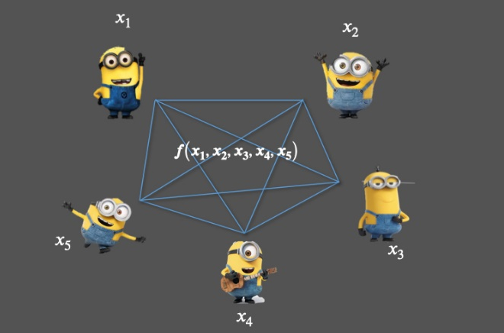
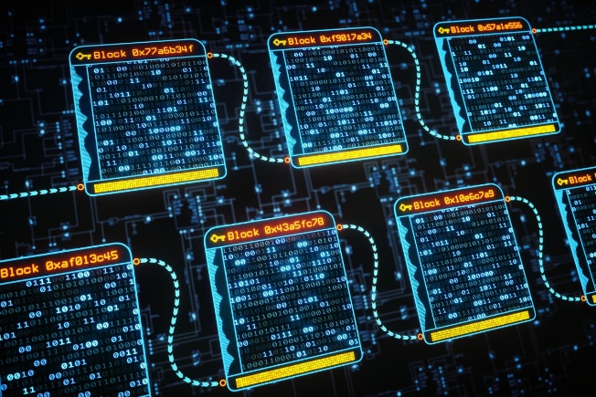
Much more to cryptography
Zero-knowledge proofs
Fully-homomorphic encryption
Multi-party computation
Blockchain
Password?
I know it
Welcome!
$$Enc\left(K, M_{1}+M_{2}\right)=Enc\left(K,M_{1}\right)+Enc\left(K, M_{2}\right)$$

Slide 42
The security pyramid
IN 5280 – Security by design
IN 5540 – Privacy by design
IN 5290 – Ethical hacking
User
Secure
systems
TEK 5510 – Security in operating systems and software
Communication
protocols
TEK 5520 – Cyber security of industrial systems
TEK 4500 – Introduction to cryptography
TEK 5550 – Advanced topics in cryptograpy
Cryptographic mechanisms

Slide 43
Modular arithmetic and
discrete probability

Slide 44
Modular arithmetic
$$−4$$
$$−3$$
$$−2$$
$$−1$$
$$0$$
$$1$$
$$2$$
$$3$$
$$4$$
$$5$$
$$6$$
$$7$$
$$8$$
$$9$$

Slide 45
Modular arithmetic
$$−4$$
$$−3$$
$$−2$$
$$−1$$
$$0$$
$$1$$
$$2$$
$$3$$
$$4$$
$$5$$
$$6$$
$$7$$
$$8$$
$$9$$

Slide 46
Modular arithmetic
$$14$$
$$13$$
$$5$$
$$4$$
$$12$$
$$15$$
$$3$$
$$6$$
$$16$$
$$7$$
$$2$$
$$11$$
$$20$$
$$8$$
$$17$$
$$1$$
$$10$$
$$19$$
$$−4$$
$$−3$$
$$−2$$
$$−1$$
$$0$$
$$9$$
$$18$$

Slide 47
Modular arithmetic
$$14$$
$$13$$
$$5$$
$$4$$
$$−4$$
$$12$$
$$15$$
$$3$$
$$6$$
$$−3$$
$$7$$
$$−2$$
$$2$$
$$16$$
$$11$$
$$20$$
$$−1$$
$$8$$
$$17$$
$$1$$
$$10$$
$$19$$
$$0$$
$$9$$
$$18$$

Slide 48
Modular arithmetic
$$14$$
$$13$$
$$5$$
$$4$$
$$1+3=4$$
$$−4$$
$$12$$
$$5+8=13$$
$$≡4 mod⁡9$$
$$15$$
$$3$$
$$6$$
$$−3$$
$$5⋅4=20≡2 mod⁡9$$
$$−2$$
$$2−5=−3≡6 mod⁡9$$
$$16$$
$$7$$
$$2$$
$$11$$
$$20$$
$$2^{10}=1024≡7 mod⁡9$$
$$−1$$
$$8$$
$$17$$
$$1$$
$$10$$
$$158$$
$$=153+r$$
$$≡r\operatorname{mod}{9≡5 mod⁡9}$$
$$19$$
$$0$$
$$9$$
$$r<9$$
$$18$$
$$9→18→27→36→…→153→162$$

Slide 49
Modular arithmetic
$$14$$
$$13$$
$$5$$
$$4$$
$$1+3=4$$
$$−4$$
$$12$$
$$5+8=13$$
$$≡4 mod⁡9$$
$$15$$
$$3$$
$$6$$
$$−3$$
$$5⋅4=20≡2 mod⁡9$$
$$−2$$
$$2−5=−3≡6 mod⁡9$$
$$16$$
$$7$$
$$2$$
$$11$$
$$20$$
$$2^{10}=1024≡7 mod⁡9$$
$$−1$$
$$8$$
$$17$$
Definition: $r≡n mod m$
is the unique integer $0≤r<m$ such that
$$n=q⋅m+r$$
$$1$$
$$10$$
$$19$$
$$0$$
$$9$$
$$18$$

Slide 50
Discrete probability
$𝒳−$ a finite set (e.g. $𝒳={\left\{0,1\right\}}^{n}$)
Examples:
$𝒳={\left\{0,1\right\}}^{2} Pr\left[00\right]=1/2 \operatorname{Pr}\left[01\right]=1/8 \operatorname{Pr}\left[10\right]=1/4 \operatorname{Pr}\left[11\right]=1/8$
Unform distribution: for all $X∈𝒳: \operatorname{Pr}\left[X\right]=1/\left|𝒳\right|$
Point distribution at $X_{0}$: $\operatorname{Pr}\left[X_{0}\right]=1$ $∀X≠X_{0}:$ $\operatorname{Pr}\left[X\right]=0$
Definition: A probability distribution over $𝒳$ is a function $\operatorname{Pr}{ :𝒳→[0,1]}$ such that
$$\sum_{X∈𝒳}{\operatorname{Pr}\left[X\right]=1}$$

Slide 51
Discrete probability
A subset $A⊆𝒳$ is called an event and $\operatorname{Pr}\left[A\right]=\sum_{X∈A }{\operatorname{Pr}\left[X\right] }$
Example: $𝒳={\left\{0,1\right\}}^{8}$
$A=\left\{all X in 𝒳 such that lsb_{2}\left(X\right)=11 \right\}⊂𝒳$
With the uniform distribution over $𝒳$, what is $\operatorname{Pr}\left[A\right]?$
Union bound: For events $A$ and $B$ in $𝒳$:
$\operatorname{Pr}\left[A∪B\right]≤\operatorname{Pr}\left[A\right]+\operatorname{Pr}\left[B\right]$
Events $A$ and $B$ are independent if $\operatorname{Pr}\left[A and B\right]=\operatorname{Pr}\left[A\right]⋅\operatorname{Pr}\left[B\right]$
$$\operatorname{Pr}\left[A\right]=1/4$$
$$A$$
$$𝒳$$
$$B$$

Slide 52
Randomized algorithms
Inputs
Outputs
Deterministic algorithm: $y←A(x)$
Randomized algorithm:
$y←A(x;r)$ where $r\underset{←}{\$}{\left\{0,1\right\}}^{n}$
$y\underset{←}{\$}A(x)$
$$x$$
$$A(x)$$
$$x$$
$$A(x)$$
$$x′$$
$$A(x)$$

