Slide 1
Lecture 10 – Public-key encryption, IND-CPA/CCA, ElGamal, RSA
TEK4500
27.10.2020
Håkon Jacobsen
hakon.jacobsen@its.uio.no

Slide 2
Basic goals of cryptography
 | Message privacy | Message integrity / authentication
Symmetric keys | Symmetric encryption | Message authentication codes (MAC)
Asymmetric keys | Asymmetric encryption (a.k.a. public-key encryption) | Digital signatures
(Key exchange)

Slide 3
Basic goals of cryptography
 | Message privacy | Message integrity / authentication
Symmetric keys | Symmetric encryption | Message authentication codes (MAC)
Asymmetric keys | Asymmetric encryption (a.k.a. public-key encryption) | Digital signatures
(Key exchange)

Slide 4
Creating secure channels: encryption schemes
Internet
Alice
Bob
K
K
$$ℰ$$
C
$$𝒟$$
M
M / $⊥$
Adversary
$𝓔$ : encryption algorithm (public)
$𝓓$ : decryption algorithm (public)
K: encryption /decryption key (secret)

Slide 5
Creating secure channels: encryption schemes
Internet
Alice
Bob
K_{e}
K_{d}
$$ℰ$$
C
$$𝒟$$
M
M / $⊥$
Adversary
$𝓔$ : encryption algorithm (public)
$𝓓$ : decryption algorithm (public)
K_{e} : encryption key (public)
K_{d} : decryption key (private)

Slide 6
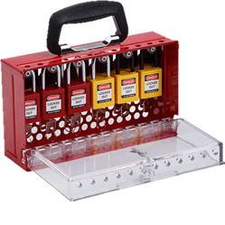
Public-key encryption

Slide 7
Public-key encryption – syntax
A public-key encryption scheme is a tuple $Σ=\left(KeyGen, Enc, Dec\right)$ of algorithms
$$Enc :𝒫𝒦×ℳ→𝒞$$
$$Dec :𝒮𝒦×𝒞→ℳ∪\left\{⊥\right\}$$
$$\left(sk, pk\right)\underset{←}{\$}KeyGen$$
$$Enc\left(pk, M\right)={Enc}_{pk}\left(M\right)=C$$
$$Dec\left(sk, C\right)={Dec}_{SK}\left(C\right)=M/⊥$$
$𝒮𝒦$ – private key space
$𝒫𝒦$ – public key space
$ℳ$ – message space
$𝒞$ – ciphertext space
Correctness: for all $\left(sk,pk\right)←KeyGen$:
$$Dec\left(sk, Enc\left(pk, M\right)\right)=M$$
$$KeyGen$$
$$\$$$
$pk$
$sk$
$\left(sk,pk\right)$
$$Enc$$
$$\$$$
$$C$$
$$Dec$$
$$M$$
$$M / \left\{⊥\right\}$$
Adversary

Slide 8
Public-key encryption – security: IND-CPA
Challenger
$$Exp_{Σ}^{ind–cpa}\left(A\right)$$
$b\underset{←}{\$}\left\{0,1\right\}$ $\left(sk,pk\right)\underset{←}{\$}Σ.KeyGen$ $M_{0}^{∗},M_{1}^{∗}←A(pk)$ // find stage if $\left|M_{0}^{∗}\right|≠\left|M_{1}^{∗}\right|$ then return $⊥$ $C^{∗}←Σ.Enc\left(pk, M_{b}^{∗}\right)$ $b^{′}←A\left({pk,C}^{∗}\right)$ // guess stage $return b^{′}\overset{?}{=}b$
find stage
$$pk$$
$C^{∗}$ was an
encryption of $M_{1}$
$$\left(sk,pk\right)←KeyGen$$
Test me on $M_{0}^{∗}, M_{1}^{∗}$
guess stage
Definition: The IND-CPA-advantage of an adversary $A$ is
$${Adv}_{Σ}^{ind­–cpa}\left(A\right)=\left|2⋅Pr\left[Exp_{Σ}^{ind–cpa}\left(A\right)⇒true\right]−1\right|$$

Slide 9
IND-CCA attack: mail-decryption example

Slide 10
Public-key encryption – security: IND-CCA
Challenger
$$Exp_{Σ}^{ind–cca}\left(A\right)$$
$b\underset{←}{\$}\left\{0,1\right\}$ $\left(sk,pk\right)\underset{←}{\$}Σ.KeyGen$ $M_{0}^{∗},M_{1}^{∗}←A^{𝒟_{sk}\left(⋅\right)}(pk)$ // find stage if $\left|M_{0}^{∗}\right|≠\left|M_{1}^{∗}\right|$ then return $⊥$ $C^{∗}←Σ.Enc\left(pk, M_{b}^{∗}\right)$ $b^{′}←A^{𝒟_{sk}\left(⋅\right)}\left({pk,C}^{∗}\right)$ // guess stage $return b^{′}\overset{?}{=}b$ $$𝒟_{sk}\left(C\right)$$ --------------------------------- if $C=C^{∗}$ the // cheating! return $⊥$ return $Σ.Dec\left(sk, C\right)$
$$pk$$
$C^{∗}$ was an
encryption of $M_{1}$
find stage
$$\left(sk,pk\right)←KeyGen$$
$$C_{1}, C_{2},…$$
$$Dec(sk, ⋅)$$
$$M_{1}, M_{2},…$$
Test me on $M_{0}^{∗}, M_{1}^{∗}$
$$C_{1}, C_{2},…$$
$$Dec(sk, ⋅)$$
guess stage
$$M_{1}, M_{2},…$$
Definition: The IND-CCA-advantage of an adversary $A$ is
$${Adv}_{Σ}^{ind­–cca}\left(A\right)=\left|2⋅Pr\left[Exp_{Σ}^{ind–cca}\left(A\right)⇒true\right]−1\right|$$

Slide 11
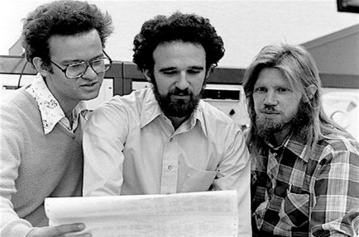
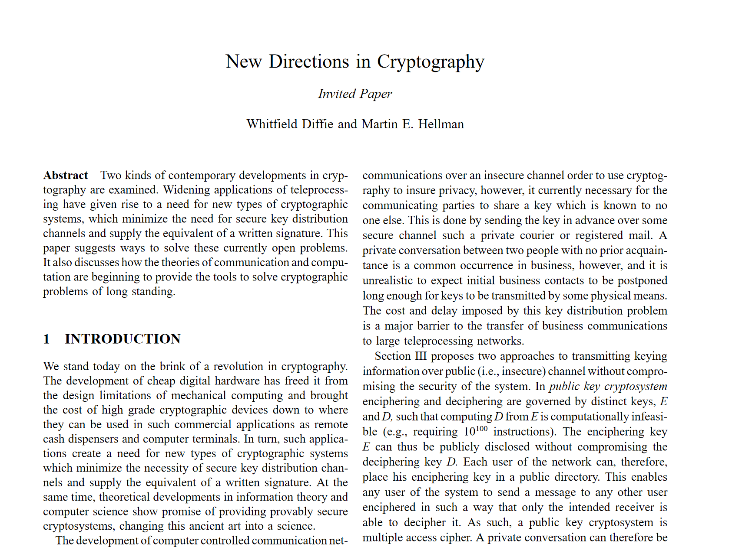
Diffie-Hellman key exchange
Discovered in the 1970's
Allows two parties to establish a shared secret without ever having met
Diffie & Hellman paper also introduced the idea of:
Public-key encryption
But didn't figure out how to do it
1978: ElGamal encryption scheme
Digital signatures
But didn't figure out how to do it
Ralph Merkle
Whitfield Diffie
Martin Hellman

Slide 12
ElGamal
$$G=〈g〉$$
$$A$$
$$B$$
$$b\underset{←}{\$}\left\{1, …, \left|G\right|\right\}$$
$$a\underset{←}{\$}\left\{1, …, \left|G\right|\right\}$$
$$B←g^{b}$$
$$A←g^{a}$$
$$Z←B^{a}=g^{ab}$$
$$Z←A^{b}=g^{ab}$$

Slide 13
ElGamal
$$G=〈g〉$$
$$b\underset{←}{\$}\left\{1, …, \left|G\right|\right\}$$
$$B$$
$$B←g^{b}$$
$$A$$
$$a\underset{←}{\$}\left\{1, …, \left|G\right|\right\}$$
$$A←g^{a}$$
$$Z←B^{a}=g^{ab}$$
$$Z←A^{b}=g^{ab}$$

Slide 14
ElGamal
$$G=〈g〉$$
$$b\underset{←}{\$}\left\{1, …, \left|G\right|\right\}$$
$$B$$
$$B←g^{b}$$
$$A,C$$
$$a\underset{←}{\$}\left\{1, …, \left|G\right|\right\}$$
$$A←g^{a}$$
$$Z←B^{a}=g^{ab}$$
$$Z←A^{b}=g^{ab}$$
$$C←Σ.Enc\left(Z, M\right)$$
$$Σ=\left(KeyGen,Enc,Dec\right)$$
$$Σ. Enc :G×ℳ→𝒞$$
$$Σ.Dec :G×𝒞→ℳ$$

Slide 15
ElGamal
$$G=〈g〉$$
$$b\underset{←}{\$}\left\{1, …, \left|G\right|\right\}$$
$$B$$
$$B←g^{b}$$
$$A,C$$
$$a\underset{←}{\$}\left\{1, …, \left|G\right|\right\}$$
$$A←g^{a}$$
$$Z←B^{a}=g^{ab}$$
$$Z←A^{b}=g^{ab}$$
$$C←Σ.Enc\left(Z, M\right)$$
$$M←Σ.Dec\left(Z, C\right)$$
$$Σ=\left(KeyGen,Enc,Dec\right)$$
$$Σ. Enc :G×ℳ→𝒞$$
$$Σ.Dec :G×𝒞→ℳ$$

Slide 16
ElGamal
$$KeyGen$$
$$G=〈g〉$$
$$sk=$$
$$b\underset{←}{\$}\left\{1, …, \left|G\right|\right\}$$
$$B$$
$$pk=$$
$$B←g^{b}$$
return $\left(sk,pk\right)$
$$A,C$$
$$a\underset{←}{\$}\left\{1, …, \left|G\right|\right\}$$
$$A←g^{a}$$
$$Z←B^{a}=g^{ab}$$
$$Z←A^{b}=g^{ab}$$
$$C←Σ.Enc\left(Z, M\right)$$
$$M←Σ. Dec\left(Z, C\right)$$
$$Σ=\left(KeyGen,Enc,Dec\right)$$
$$Σ. Enc :G×ℳ→𝒞$$
$$Σ.Dec :G×𝒞→ℳ$$

Slide 17
ElGamal
$$KeyGen$$
$$G=〈g〉$$
$$sk=$$
$$b\underset{←}{\$}\left\{1, …, \left|G\right|\right\}$$
$$B$$
$$pk=$$
$$B←g^{b}$$
return $\left(sk,pk\right)$
$$A,C$$
$$Enc\left(pk, M\right)$$
$$a\underset{←}{\$}\left\{1, …, \left|G\right|\right\}$$
$$A←g^{a}$$
$$Z←B^{a}=g^{ab}$$
$$Z←A^{b}=g^{ab}$$
$$C←Σ.Enc\left(Z, M\right)$$
$$M←Σ. Dec\left(Z, C\right)$$
return $\left(A,C\right)$
$$Σ=\left(KeyGen,Enc,Dec\right)$$
$$Σ. Enc :G×ℳ→𝒞$$
$$Σ.Dec :G×𝒞→ℳ$$

Slide 18
ElGamal
$$ElGamal.Enc :$$
$$G×ℳ→$$
$$G×𝒞$$
$$KeyGen$$
$$G=〈g〉$$
$$sk=$$
$$b\underset{←}{\$}\left\{1, …, \left|G\right|\right\}$$
$$ElGamal.Dec :$$
$$Z_{p}×G×𝒞→$$
$$ℳ$$
$$B$$
$$pk=$$
$$B←g^{b}$$
return $\left(sk,pk\right)$
$$A,C$$
$$Enc\left(pk, M\right)$$
$$a\underset{←}{\$}\left\{1, …, \left|G\right|\right\}$$
$$Dec\left(sk, C\right)$$
$$A←g^{a}$$
$$Z←B^{a}=g^{ab}$$
$$Z←A^{b}=g^{ab}$$
$$C←Σ.Enc\left(Z, M\right)$$
$$M←Σ. Dec\left(Z, C\right)$$
return $\left(A,C\right)$
$$Σ=\left(KeyGen,Enc,Dec\right)$$
return $M$
$$Σ. Enc :G×ℳ→𝒞$$
$$Σ.Dec :G×𝒞→ℳ$$

Slide 19
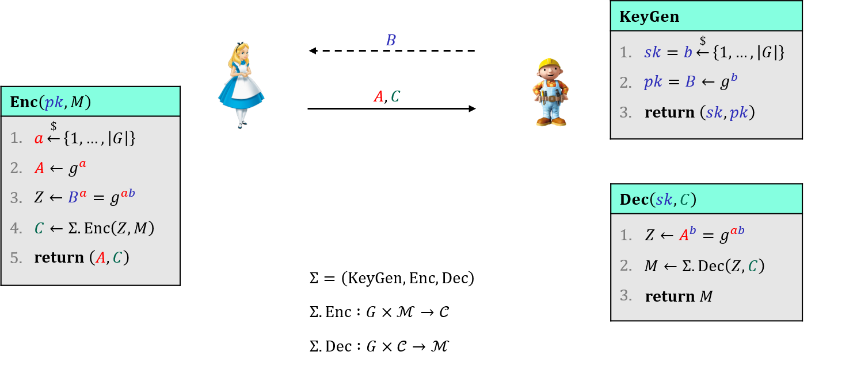
ElGamal – IND-CPA security
Clearly DLOG and DH must be hard
Clearly $Σ$ must be secure (IND-CPA? IND-CCA?)
But is this enough?
No: $Σ$ only guarantees security if its keys are independent and uniformly distributed (in the group $G$)
but $g^{ab}$ isn't uniformly distributed in $G$!

Slide 20
Decisional Diffie-Hellman (DDH) problem
Challenger
$$Exp_{G,g}^{ddh}\left(A\right)$$
$b\underset{←}{\$}\left\{0,1\right\}$ $x,y,z\underset{←}{\$}\left\{1,2,…,\left|G\right|\right\}$ $X←g^{x}$ $Y←g^{y}$ $Z_{1}←g^{xy}$ $Z_{0}←g^{z}$ $b^{′}←A\left(X,Y,Z_{b}\right)$ return $b^{′}\overset{?}{=}b$
I think $Z_{b}$ was a real DH value
Public: $G=\left\langle g\right\rangle$
$$x,y,z\underset{←}{\$}\left\{1,2,…,\left|G\right|\right\}$$
$$X←g^{x}$$
$$Y←g^{y}$$
$$Z_{1}←g^{xy}$$
$$Z_{0}←g^{z}$$
$$X,Y, Z_{b}$$
Adversary wins if it can distinguish a real DH value $g^{xy}$ from a random group element $g^{z}$
Definition: The DDH-advantage of an adversary $A$ is
$${Adv}_{G,g}^{ddh}\left(A\right)=\left|2⋅\operatorname{Pr}\left[Exp_{G,g}^{ddh}\left(A\right) ⇒true\right]−1\right|$$

Slide 21
DLOG vs. DH vs. DDH
$$Exp_{G,g}^{dlog}\left(A\right)$$
$x\underset{←}{\$}\left\{1,2,…,\left|G\right|\right\}$ $X←g^{x}$ $x^{′}←A\left(X\right)$ return $x\overset{?}{=}x$
$$Exp_{G,g}^{dh}\left(A\right)$$
$x,y\underset{←}{\$}\left\{1,2,…,\left|G\right|\right\}$ $X←g^{x}$ $Y←g^{y}$ $z←A\left(X,Y\right)$ return $g^{z}\overset{?}{=}g^{xy}$
$$Exp_{G,g}^{ddh}\left(A\right)$$
$b\underset{←}{\$}\left\{0,1\right\}$ $x,y,z\underset{←}{\$}\left\{1,2,…,\left|G\right|\right\}$ $X←g^{x}$ $Y←g^{y}$ $Z_{1}←g^{xy}$ $Z_{0}←g^{z}$ $b^{′}←A\left(X,Y,Z_{b}\right)$ return $b^{′}\overset{?}{=}b$
DLOG security $⟸$ DH security
$⟸$ DDH security
DLOG security $\overset{?}{⟹}$ DH security
$⟹$ DDH security

Slide 22
ElGamal – IND-CPA security: proof idea
Theorem: For any IND-CPA adversy $A$ against ElGamal, there are adversaries $B$ and $C$such that
$$Adv_{ElGamal}^{ind–cpa}\left(A\right)≤2⋅Adv_{G,g}^{ddh}\left(B\right)+Adv_{Σ}^{ind–cpa}\left(C\right)$$
$$KeyGen$$
$$B$$
$$sk=b\underset{←}{\$}\left\{1, …, \left|G\right|\right\}$$
$$pk=B←g^{b}$$
$$Enc\left(pk, M\right)$$
$$A,C$$
return $\left(sk,pk\right)$
$$a\underset{←}{\$}\left\{1, …, \left|G\right|\right\}$$
$$A←g^{a}$$
$$Z←B^{a}=g^{ab}$$
$$Dec\left(sk, C\right)$$
$$C←Σ.Enc\left(Z, M\right)$$
$$Z←A^{b}=g^{ab}$$
return $\left(A,C\right)$
$$M←Σ. Dec\left(Z, C\right)$$
$$Σ=\left(KeyGen,Enc,Dec\right)$$
return $M$
$$Σ. Enc :G×ℳ→𝒞$$
$$Σ.Dec :G×𝒞→ℳ$$

Slide 23
ElGamal – IND-CPA security: proof idea
Theorem: For any IND-CPA adversy $A$ against ElGamal, there are adversaries $B$ and $C$such that
$$Adv_{ElGamal}^{ind–cpa}\left(A\right)≤2⋅Adv_{G,g}^{ddh}\left(B\right)+Adv_{Σ}^{ind–cpa}\left(C\right)$$
$$KeyGen$$
$$B$$
$$sk=b\underset{←}{\$}\left\{1, …, \left|G\right|\right\}$$
$$pk=B←g^{b}$$
$$Enc\left(pk, M\right)$$
$$A,C$$
return $\left(sk,pk\right)$
$$a\underset{←}{\$}\left\{1, …, \left|G\right|\right\}$$
$$A←g^{a}$$
$$Z←g^{z}$$
can't tell due to
DDH-security
$$Dec\left(sk, C\right)$$
$$C←Σ.Enc\left(Z, M\right)$$
$$Z←g^{z}$$
return $\left(A,C\right)$
$$M←Σ. Dec\left(Z, C\right)$$
$$Σ=\left(KeyGen,Enc,Dec\right)$$
return $M$
$$Σ. Enc :G×ℳ→𝒞$$
$$Σ.Dec :G×𝒞→ℳ$$

Slide 24
ElGamal – IND-CPA security: proof idea
Theorem: For any IND-CPA adversy $A$ against ElGamal, there are adversaries $B$ and $C$such that
$$Adv_{ElGamal}^{ind–cpa}\left(A\right)≤2⋅Adv_{G,g}^{ddh}\left(B\right)+Adv_{Σ}^{ind–cpa}\left(C\right)$$
$$KeyGen$$
$$B$$
$$sk=b\underset{←}{\$}\left\{1, …, \left|G\right|\right\}$$
$$pk=B←g^{b}$$
$$Enc\left(pk, M\right)$$
$$A,C$$
return $\left(sk,pk\right)$
$$a\underset{←}{\$}\left\{1, …, \left|G\right|\right\}$$
$$A←g^{a}$$
$$Z←g^{z}$$
can't tell due to
DDH-security
$$Dec\left(sk, C\right)$$
$$C←Σ.Enc\left(Z, M\right)$$
$$Z←g^{z}$$
return $\left(A,C\right)$
$$M←Σ. Dec\left(Z, C\right)$$
$$Σ=\left(KeyGen,Enc,Dec\right)$$
return $M$
$$Σ. Enc :G×ℳ→𝒞$$
$$Σ.Dec :G×𝒞→ℳ$$

Slide 25
ElGamal – IND-CPA security: proof idea
Theorem: For any IND-CPA adversy $A$ against ElGamal, there are adversaries $B$ and $C$such that
$$Adv_{ElGamal}^{ind–cpa}\left(A\right)≤2⋅Adv_{G,g}^{ddh}\left(B\right)+Adv_{Σ}^{ind–cpa}\left(C\right)$$
$$KeyGen$$
$$B$$
$$sk=b\underset{←}{\$}\left\{1, …, \left|G\right|\right\}$$
$$pk=B←g^{b}$$
$$Enc\left(pk, M\right)$$
$$A,C$$
return $\left(sk,pk\right)$
$$a\underset{←}{\$}\left\{1, …, \left|G\right|\right\}$$
$$A←g^{a}$$
$$Z\underset{←}{\$}G$$
$$Dec\left(sk, C\right)$$
$$C←Σ.Enc\left(Z, M\right)$$
$$Z\underset{←}{\$}G$$
return $\left(A,C\right)$
$$M←Σ. Dec\left(Z, C\right)$$
$$Σ=\left(KeyGen,Enc,Dec\right)$$
return $M$
$$Σ. Enc :G×ℳ→𝒞$$
$$Σ.Dec :G×𝒞→ℳ$$

Slide 26
ElGamal – IND-CPA security: proof idea
Theorem: For any IND-CPA adversy $A$ against ElGamal, there are adversaries $B$ and $C$such that
$$Adv_{ElGamal}^{ind–cpa}\left(A\right)≤2⋅Adv_{G,g}^{ddh}\left(B\right)+Adv_{Σ}^{ind–cpa}\left(C\right)$$
$$KeyGen$$
$$B$$
$$sk=b\underset{←}{\$}\left\{1, …, \left|G\right|\right\}$$
$$pk=B←g^{b}$$
$$Enc\left(pk, M\right)$$
$$A,C$$
return $\left(sk,pk\right)$
$$a\underset{←}{\$}\left\{1, …, \left|G\right|\right\}$$
$$A←g^{a}$$
$$Z\underset{←}{\$}G$$
secure by IND-CPA
$$Dec\left(sk, C\right)$$
$$C←Σ.Enc\left(Z, M\right)$$
$$Z\underset{←}{\$}G$$
return $\left(A,C\right)$
$$M←Σ. Dec\left(Z, C\right)$$
$$Σ=\left(KeyGen,Enc,Dec\right)$$
return $M$
$$Σ. Enc :G×ℳ→𝒞$$
$$Σ.Dec :G×𝒞→ℳ$$

Slide 27
ElGamal – IND-CPA security: proof idea
Theorem: For any IND-CPA adversy $A$ against ElGamal, there are adversaries $B$ and $C$such that
$$Adv_{ElGamal}^{ind–cpa}\left(A\right)≤2⋅Adv_{G,g}^{ddh}\left(B\right)+Adv_{Σ}^{ind–cpa}\left(C\right)$$
$$KeyGen$$
$$B$$
$$sk=b\underset{←}{\$}\left\{1, …, \left|G\right|\right\}$$
$$pk=B←g^{b}$$
$$Enc\left(pk, M\right)$$
$$A,C$$
return $\left(sk,pk\right)$
$$a\underset{←}{\$}\left\{1, …, \left|G\right|\right\}$$
$$A←g^{a}$$
$$Z\underset{←}{\$}G$$
secure by IND-CPA
$$Dec\left(sk, C\right)$$
$$C←Σ.Enc\left(Z, M\right)$$
$$Z\underset{←}{\$}G$$
return $\left(A,C\right)$
$$M←Σ. Dec\left(Z, C\right)$$
$$Σ=\left(KeyGen,Enc,Dec\right)$$
return $M$
$$Σ. Enc :G×ℳ→𝒞$$
$$Σ.Dec :G×𝒞→ℳ$$

Slide 28
Hashed ElGamal
$$ElGamal.Enc :$$
$$G×ℳ→$$
$$G×𝒞$$
$$KeyGen$$
$$G=〈g〉$$
$$sk=$$
$$b\underset{←}{\$}\left\{1, …, \left|G\right|\right\}$$
$$ElGamal.Dec :$$
$$Z_{p}×G×𝒞→$$
$$ℳ$$
$$B$$
$$pk=$$
$$B←g^{b}$$
return $\left(sk,pk\right)$
$$A,C$$
$$Enc\left(pk, M\right)$$
$$a\underset{←}{\$}\left\{1, …, \left|G\right|\right\}$$
$$Dec\left(sk, C\right)$$
$$A←g^{a}$$
$$Z←B^{a}=g^{ab}$$
$$Z←A^{b}=g^{ab}$$
$$C←Σ.Enc\left(Z, M\right)$$
$$M←Σ. Dec\left(Z, C\right)$$
return $\left(A,C\right)$
$$Σ=\left(KeyGen,Enc,Dec\right)$$
return $M$
$$Σ. Enc :G×ℳ→𝒞$$
$$Σ.Dec :G×𝒞→ℳ$$

Slide 29
Hashed ElGamal
$$ElGamal.Enc :$$
$$G×ℳ→$$
$$G×𝒞$$
$$KeyGen$$
$$G=〈g〉$$
$$sk=$$
$$b\underset{←}{\$}\left\{1, …, \left|G\right|\right\}$$
$$ElGamal.Dec :$$
$$Z_{p}×G×𝒞→$$
$$ℳ$$
$$B$$
$$pk=$$
$$B←g^{b}$$
return $\left(sk,pk\right)$
$$A,C$$
$$Enc\left(pk, M\right)$$
$$a\underset{←}{\$}\left\{1, …, \left|G\right|\right\}$$
$$Dec\left(sk, C\right)$$
$$A←g^{a}$$
$$Z←B^{a}=g^{ab}$$
$$H:G→{\left\{0,1\right\}}^{k}$$
$$Z←A^{b}=g^{ab}$$
$$C←Σ.Enc\left(Z, M\right)$$
$$M←Σ. Dec\left(Z, C\right)$$
return $\left(A,C\right)$
$$Σ=\left(KeyGen,Enc,Dec\right)$$
return $M$
$$Σ. Enc :{\left\{0,1\right\}}^{k}×ℳ→𝒞$$
$$Σ.Dec :{\left\{0,1\right\}}^{k}×𝒞→ℳ$$

Slide 30
Hashed ElGamal
$$ElGamal.Enc :$$
$$G×ℳ→$$
$$G×𝒞$$
$$KeyGen$$
$$G=〈g〉$$
$$sk=$$
$$b\underset{←}{\$}\left\{1, …, \left|G\right|\right\}$$
$$ElGamal.Dec :$$
$$Z_{p}×G×𝒞→$$
$$ℳ$$
$$B$$
$$pk=$$
$$B←g^{b}$$
return $\left(sk,pk\right)$
$$A,C$$
$$Enc\left(pk, M\right)$$
$$a\underset{←}{\$}\left\{1, …, \left|G\right|\right\}$$
$$Dec\left(sk, C\right)$$
$$A←g^{a}$$
$$K←H\left(B^{a}\right)=H\left(g^{ab}\right)$$
$$H:G→{\left\{0,1\right\}}^{k}$$
$$K←H\left(A^{b}\right)=H\left(g^{ab}\right)$$
$$C←Σ.Enc\left(Z, M\right)$$
$$M←Σ. Dec\left(Z, C\right)$$
return $\left(A,C\right)$
$$Σ=\left(KeyGen,Enc,Dec\right)$$
return $M$
$$Σ. Enc :{\left\{0,1\right\}}^{k}×ℳ→𝒞$$
$$Σ.Dec :{\left\{0,1\right\}}^{k}×𝒞→ℳ$$

Slide 31
$$C=M^{e} \left(\operatorname{mod}{n}\right)$$
The RSA encryption scheme

Slide 32
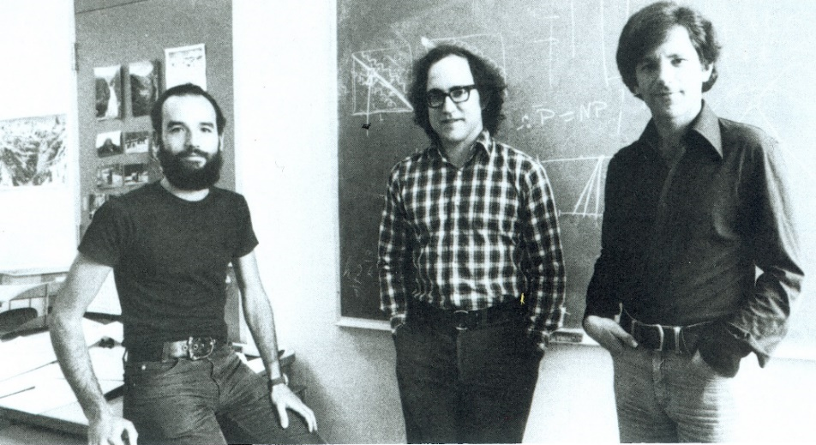
RSA
Designed by Rivest, Shamir and Adleman in 1977
One year before ElGamal
Used both for public key encryption and digital signatures
Adi Shamir
Ron Rivest
Leonard Adleman

Slide 33
The group $\left(Z_{n}^{∗},⋅\right)$
$$Z_{p}=\left\{0, 1, …, p−1\right\}$$
$\left(Z_{p}, ⋅\right)$ is not a group!
Not invertible | Invertible
$$2, 4, 5, 6, 8$$ | $$1, 3, 7, 9$$
$$Z_{p}^{∗}=\left\{1, …, p−1\right\}$$
$\left(Z_{p}^{∗}, ⋅\right)$ is a group!
$$Z_{10}^{+}=\left\{1, 2, 3, 4, 5, 6, 7, 8, 9\right\}$$
$$2⋅1=2 \operatorname{mod}{10}$$
$$Z_{n}=\left\{0, 1, …, n−1\right\}$$
$\left(Z_{n}, ⋅\right)$ is not a group!
$$2⋅2=4 \operatorname{mod}{10}$$
$$2⋅3=6 \operatorname{mod}{10}$$
$$1⋅1=1 \operatorname{mod}{10}$$
$$Z_{n}^{∗}≠\left\{1, …, n−1\right\}$$
$\left(Z_{n}^{+}, ⋅\right)$ is also not a group!
$$2⋅4=8 \operatorname{mod}{10}$$
$$3⋅7=21=1 \operatorname{mod}{10}$$
$$2⋅5=0 \operatorname{mod}{10}$$
$$Z_{n}^{+}$$
$$2⋅6=2 \operatorname{mod}{10}$$
$$9⋅9=81=1 \operatorname{mod}{10}$$
$$\overset{theorem}{=} \left\{a∈Z_{n} ∣ \gcd\left(a,n\right)=1\right\}$$
$$2⋅7=4 \operatorname{mod}{10}$$
$$Z_{n}^{∗}=invertible elements in Z_{n}$$
$$2⋅8=6 \operatorname{mod}{10}$$
$$2=2$$
$$2⋅9=8 \operatorname{mod}{10}$$
$$4=2⋅2$$
$\left(Z_{n}^{∗}, ⋅\right)$ is a group!
$$5=5$$
$$10=2⋅5$$
$$6=2⋅3$$
Proof: let $d=\gcd\left(a,n\right)$
$a$ invertible
$d=1$
$$8=2⋅2⋅2$$
$⟹$ $∃b∈Z_{n}$ such that $ab=1\operatorname{mod}{n}$
$⟹$ $∃k:$ $ab=1+kn$
$⟹$ $ab−kn=1$
$⟹$ $d\left(a^{′}b−kn′\right)=1$
$⟹$ $d=1$
$⟹$ Claim: $∃s,t∈Z$ such that $sa+tn=d=1$
$⟹$ $sa=1−tn$
$⟹$ $sa=1\operatorname{mod}{n}$
$⟹$ $a$ is invertible

Slide 34
Euler's $φ\left(n\right)$ function
$φ\left(n\right)\overset{def}{=}\left|Z_{n}^{∗}\right|$
$φ\left(p\right)=p−1$
$φ\left(p⋅q\right)=$
Note: $φ\left(n\right)≈n−2\sqrt{n}≈n$
i.e.: almost all integers are invertible for large $p$, $q$
$$=\left|\left\{a∈Z_{n} ∣ \gcd\left(a,n\right)=1\right\}\right|$$
$$q−1$$
$1⋅p$,
$2⋅p$,
$3⋅p$,
$$⋯ (q−1)⋅p$$
$1⋅q$,
$2⋅q$,
$3⋅q$,
$$⋯ (p−1)⋅q$$
$$\left(p−1\right)⋅\left(q−1\right)$$
$$p−1$$
$$p⋅q$$
$$φ\left(pq\right)=$$
$$\#numbers less than pq$$
$−$
$\#numbers less than pq with gcd\left(x,pq\right)≠1$
$$=(pq−1)$$
$$− (q−1+p−1)$$
$$=pq−q−p+1$$
$$=\left(p−1\right)⋅\left(q−1\right)$$
$$n$$ | $$1$$ | 2 | 3 | 4 | 5 | 6 | 7 | 8 | 9 | 10 | 11 | 12 | 13 | 14 | 15
$$φ\left(n\right)$$ | $$1$$ | 1 | 2 | 2 | 4 | 2 | 6 | 4 | 6 | 4 | 10 | 4 | 12 | 6 | 8

Slide 35
Euler’s Theorem
$\left(Z_{p}^{∗},⋅\right)$: $\left|Z_{p}^{∗}\right|=p−1$ $e=1$
$\left(Z_{n}^{∗},⋅\right)$: $\left|Z_{n}^{∗}\right|=φ\left(n\right)$ $e=1$
Theorem: if $\left(G,∘\right)$ is a finite group, then for all $g∈G$:
$$g^{\left|G\right|}=e$$
Fermat’s theorem: if $p$ is prime, then for all $a≠0 \left(\operatorname{mod}{p}\right)$:
$a^{p−1}≡1 \left(\operatorname{mod}{p}\right)$
Euler’s theorem: for all positive integers $n$, if $\gcd\left(a,n\right)=1$ then
$a^{φ\left(n\right)}≡1 \left(\operatorname{mod}{n}\right)$

Slide 36
Textbook RSA
$$𝒫𝒦$$
$$ℳ$$
$$𝒞$$
$$KeyGen$$
$p,q\underset{←}{\$}$ two random prime numbers $n←p⋅q$ $φ\left(n\right)=\left(p−1\right)\left(q−1\right)$ choose $e$ such that $\gcd\left(e, φ\left(n\right)\right)=1$ $d←e^{−1} \operatorname{mod}{φ\left(n\right)}$ $sk←d$ $pk←\left(n,e\right)$ return $(sk, pk)$
$$RSA.Enc :$$
$$Z^{+}×Z_{φ\left(n\right)}^{∗}×Z_{n}^{∗}→$$
$$Z_{n}^{∗}$$
$$RSA.Dec:$$
$$Z_{φ\left(n\right)}^{∗}×Z_{n}^{∗}→$$
$$Z_{n}^{∗}$$
$$𝒮𝒦$$
$$𝒞$$
$$ℳ$$
$$pk$$
$$Enc\left(pk=\left(n,e\right), M∈Z_{n}^{∗}\right)$$
$C←M^{e} \operatorname{mod}{n}$ return $C$
$$C$$
$$Dec\left(sk=d, C∈Z_{n}^{∗}\right)$$
$M←C^{d} \operatorname{mod}{n}$ return $M$
Common choices of $e$: $3, 17,$ $65 537$
${11}_{2}$ ${10001}_{2}$ $1 0000 0000 0000 {0001}_{2}$

Slide 37
Textbook RSA – correctness
Theorem: if $\left(G,∘\right)$ is a finite group, then for all $g∈G$:
$$g^{\left|G\right|}=e$$
$$KeyGen$$
$p,q\underset{←}{\$}$ two random prime numbers $n←p⋅q$ $φ\left(n\right)=\left(p−1\right)\left(q−1\right)$ choose $e$ such that $\gcd\left(e, φ\left(n\right)\right)=1$ $d←e^{−1} \operatorname{mod}{φ\left(n\right)}$ $sk←d$ $pk←\left(n,e\right)$ return $(sk, pk)$
Euler’s theorem: for all $a∈Z_{n}^{∗}$
$a^{φ\left(n\right)}≡1 \left(\operatorname{mod}{n}\right)$
Corollary I: $g^{i}=g^{i\operatorname{mod}\left|G\right|}=a^{i\operatorname{mod}{φ\left(n\right)} }$
$$Dec\left(sk, Enc\left(pk, M\right)\right)=M$$
$$Enc\left(pk=\left(n,e\right), M∈Z_{n}^{∗}\right)$$
$C←M^{e} \operatorname{mod}{n}$ return $C$
$$d=e^{−1}\operatorname{mod}{φ\left(n\right) ⟺} ed=1\operatorname{mod}{φ\left(n\right)}$$
$$=M^{ed\operatorname{mod}{φ\left(n\right)}}$$
$$C^{d}=M^{ed}$$
$$=M^{1}$$
$$=M\operatorname{mod}{n}$$
$$Dec\left(sk=d, C∈Z_{n}^{∗}\right)$$
$M←C^{d} \operatorname{mod}{n}$ return $M$
Fact: RSA also works for $M∈Z_{n}$
Notes:
p = 11
q = 17
n = p * q
Zn = Integers(n)
phi = euler_phi(n)
Zphi = Integers(phi)
e = Zphi(3)
d = e^-1
mod(e * d, phi)
M = Zn(123)
C = M^e
C^d

Slide 38
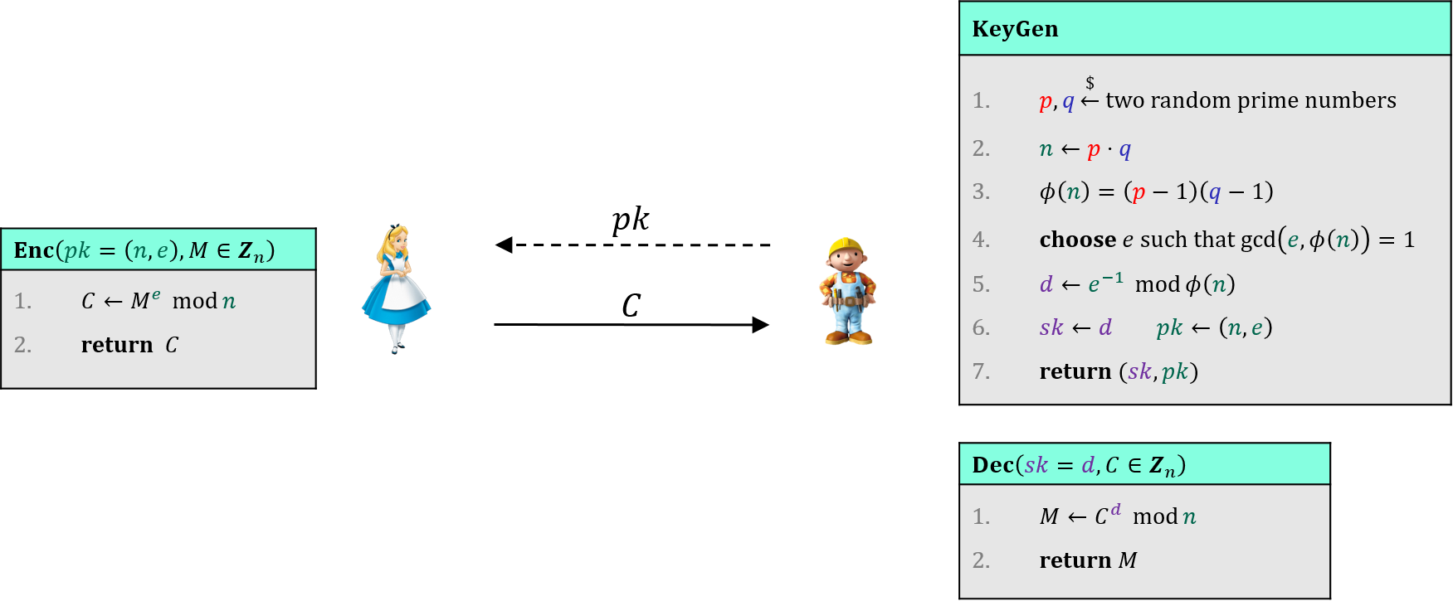
Textbook RSA – security
Textbook RSA is not IND-CPA secure!
Deterministic
Malleable
Many other attacks as well*
Textbook RSA is not an encryption scheme!
So what is it? Answer: a one-way (trapdoor) permutation
* https://crypto.stackexchange.com/questions/20085/which-attacks-are-possible-against-raw-textbook-rsa

Slide 39
The RSA-problem
RSA-problem: given $pk=(e,n)$ and $C=M^{e}\operatorname{mod}{n}$ find $M$
RSA-assumption: the RSA-problem is hard for large random primes $p,q$ ($≈1024$ bits each)
Easy is $d$ is known: simply compute $C^{d}\operatorname{mod}{n}$
Easy if $φ\left(n\right)$ is known: simply compute $1/e=e^{−1}=d\operatorname{mod}{φ\left(n\right)}$ and do the above
Easy if $p$ and $q$ are known: compute $φ\left(n\right)=\left(p−1\right)⋅(q−1)$ and do the above
Hence: RSA-assumption $⟹$ must be hard to find $d$, $φ\left(n\right)$ and $p,q$ given $e, n$ (factoring problem)
What about the converse: factoring is hard $⟹$ RSA-problem is hard? Open problem!
Note: given $φ(n)$ and $n$ $⟹$ easy to find $p$ and $q$ (exercise)
$$RSA.{Enc}_{pk} : Z_{n}^{∗}→Z_{n}^{∗}$$
$$RSA.{Enc}_{pk} : M↦M^{e} \operatorname{mod}{n}$$

Slide 40
How hard is factoring?
In practice factoring is only known way to break RSA
Factoring $n=pq$ believed to be hard for large $p$ and $q$
Naïve $Factor\left(n\right)$:
$3$ divides $n?$ return $3⋅Factor\left(n/3\right)$
$5$ divides $n?$ return $5⋅Factor\left(n/5\right)$
$7$ divides $n?$ return $7⋅Factor\left(n/7\right)$
$⋮$
$\left\lfloor \sqrt{n}\right\rfloor$ divides $n?$ return $\left\lfloor \sqrt{n}\right\rfloor ⋅Factor\left(n/\left\lfloor \sqrt{n}\right\rfloor \right)$
Return $n$
Very inefficient: $n≈2^{k} ⟹ π\left(n\right)≈\frac{2^{k}}{\ln{2^{k}}}≈\frac{2^{k}}{k}$
Much faster factoring algorithms known: current record 829-bit number (Heninger et al.'20)
Algorithm | Time to factor $n≈2^{k}$
Naive | $$≈𝒪\left(2^{k}\right)$$
Quadratic sieve | $$≈𝒪\left(e^{c\sqrt{k}\sqrt{\ln{k}}}\right)$$
Number field sieve | $$≈𝒪\left(e^{1.92\sqrt[3]{k}⋅\sqrt[1.5]{\ln{k}}}\right)$$

Slide 41
RSA in practice
Textbook RSA is deterministic $⟹$ cannot be IND-CPA secure
How to achieve IND-CPA?
pad message with random data before applying RSA function
PKCS#1v1.5
RSA-OAEP
RSA encryption not used much in practice anymore
Mostly key transport: message is a random 256-bit key used in a subsequent symmetric encryption scheme
RSA digital signatures still very common
256 bits
$$M$$
$$Pad$$
$$r || M$$
$$X↦X^{e}\operatorname{mod}{n}$$
$$C$$
2048 bits

Slide 42
Summary
Public-key encryption security goals: IND-CPA and IND-CCA
ElGamal
Public-key encryption from Diffie-Hellman key exchange
IND-CPA secure if the DDH assumption holds in the group and the symmetric encryption scheme is (one-time) IND-CPA secure
Hashed-ElGamal: hash the derived Diffie-Hellman key to obtain a symmetric key $K∈{\left\{0,1\right\}}^{k}$
DDH assumption can be weakened to DH assumption (but stronger requirement on hash function)
RSA
Not a public-key encryption scheme directly
Can (with random padding) be used to create a IND-CPA secure public-key encryption scheme
Must be hard: RSA-problem and factoring problem

