Slide 1
Lecture 11 – Digital signatures, UF-CMA,
RSA, Schnorr, PKI
TEK4500
03.11.2020
Håkon Jacobsen
hakon.jacobsen@its.uio.no

Slide 2
Basic goals of cryptography
 | Message privacy | Message integrity / authentication
Symmetric keys | Symmetric encryption | Message authentication codes (MAC)
Asymmetric keys | Asymmetric encryption (a.k.a. public-key encryption) | Digital signatures
(Key exchange)

Slide 3

What is cryptography?
Internet
Alice
Bob
M
M'
Adversary
Security goals:
Data privacy: adversary should not be able to read message M
Data integrity: adversary should not be able to modify message M
Data authenticity: message M really originated from Alice

Slide 4


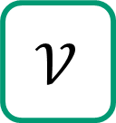

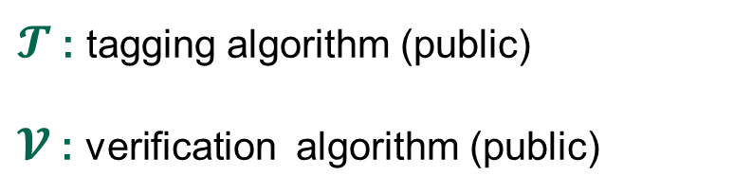
Achieving integrity: MACs
Internet
Alice
Bob
K
K
$$𝒯$$
T
M, T
$$𝒱$$
M
M / $⊥$
Adversary
$𝓣$ : tagging algorithm (public)
$𝓥$ : verification algorithm (public)
K : tagging / verification key (secret)

Slide 5

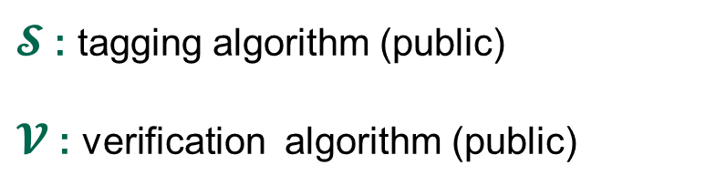
Achieving integrity: digital signatures
Internet
Alice
Bob
sk
vk
$$𝒮$$
σ
M, σ
$$𝒱$$
M
M / $⊥$
Adversary
$𝓢$ : tagging algorithm (public)
$𝓥$ : verification algorithm (public)
sk : signing key (secret)
vk : verification key (public)

Slide 6
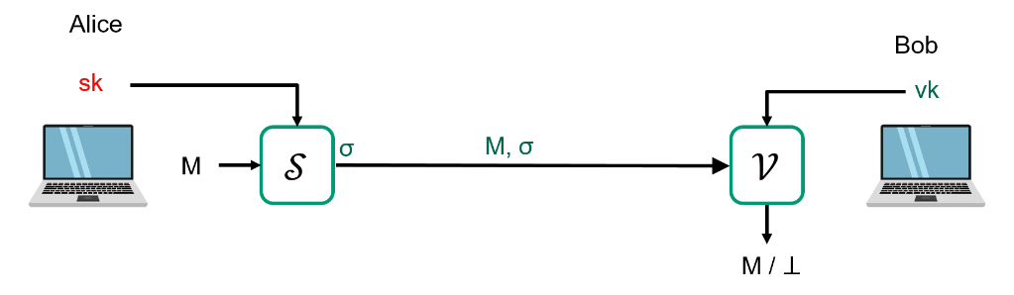
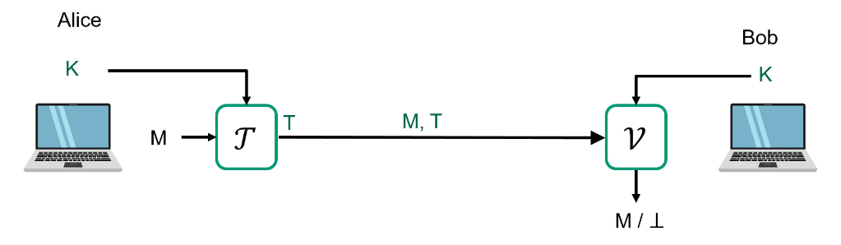

Digital signatures vs. MACs
Digital signatures can be verified by anyone
MACs can only be verified by party sharing
the same key
Non-repudiation: Alice cannot deny having created $σ$
  But she can deny having created $T$ (since Bob could have done it)
Digital signature
MAC

Slide 7
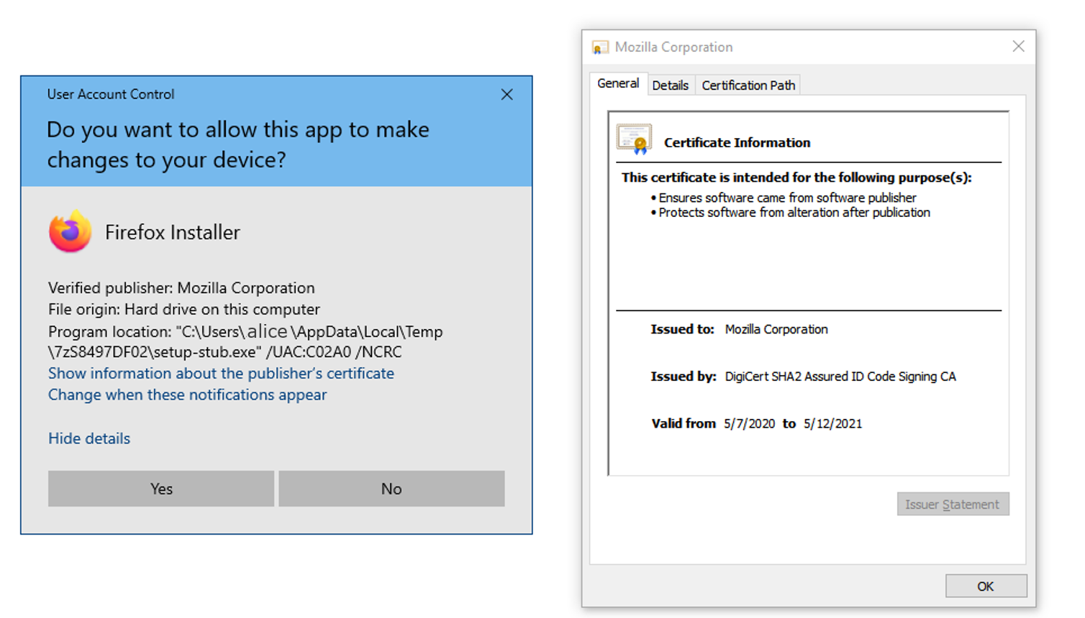
Applications of digital signatures
Electronic document signing
HTTPS / TLS certificates
Software installation
Email sender authentication
Bitcoin

Slide 8
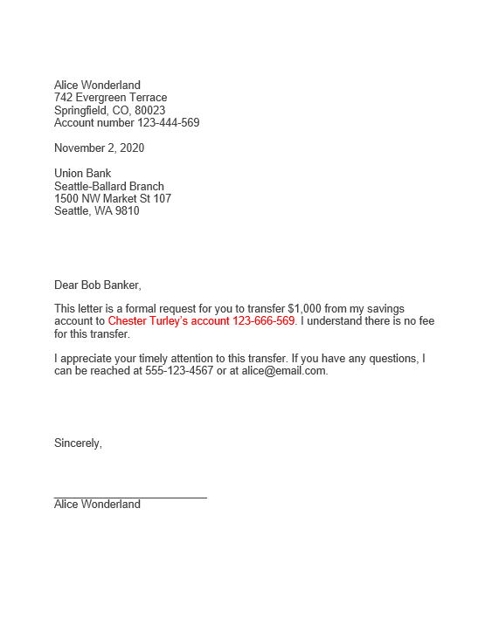
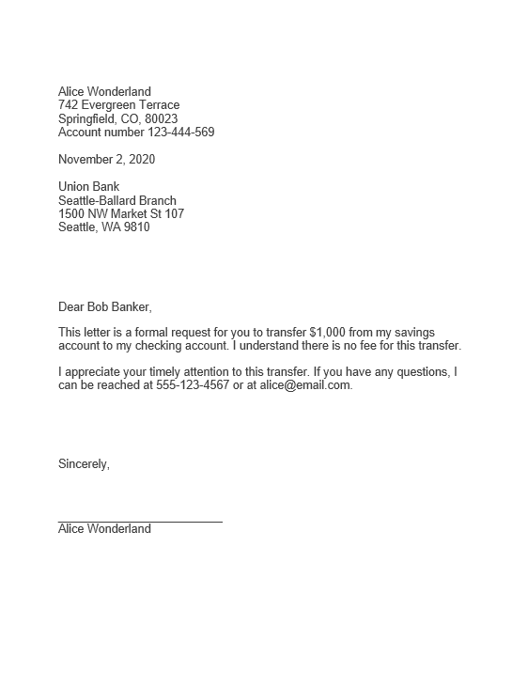

Signing electronically
110100101010000111111001010110
10101110101001010101011101010111001010100100111000101011111100101000001011010010111 100000101100001
scan
1101101
110100101010000111111001010110
10101110101001010001111101110111001010100100111000101011111100101000001011010010111 100000101100001
1101101

Slide 9
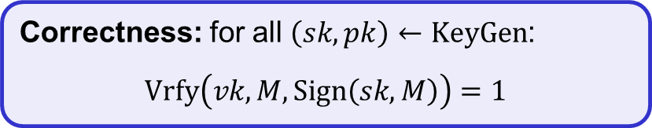















Digital signatures – syntax
A digital signature scheme is a tuple of algorithms $Σ=(KeyGen, Sign, Vrfy)$
$$KeyGen :( )→𝒮𝒦×𝒱𝒦$$
$$Sign :𝒮𝒦×ℳ→𝒮$$
$$Vrfy :𝒱𝒦×ℳ×𝒮→\{0,1\}$$
$$Sign\left(sk, M\right)={Sign}_{sk}\left(M\right)=σ$$
$$Vrfy\left(vk, M,σ\right)={Vrfy}_{vk}\left(M,σ\right)=1/0$$
Correctness: for all $\left(sk,pk\right)←KeyGen$:
$$Vrfy\left(vk, M, Sign\left(sk, M\right)\right)=1$$
$$KeyGen$$
$$\$$$
$sk$
$vk$
$\left(sk,vk\right)$
$$Sign$$
$$σ$$
$$M, σ$$
$$Vrfy$$
$$M$$
$$1/0$$
Adversary
9

Slide 10

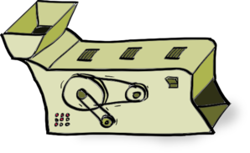
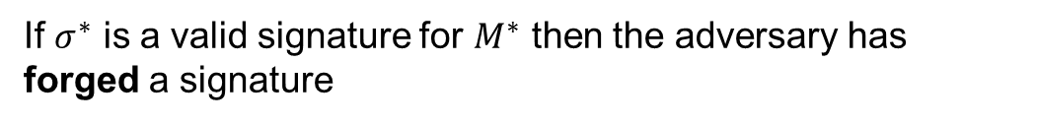
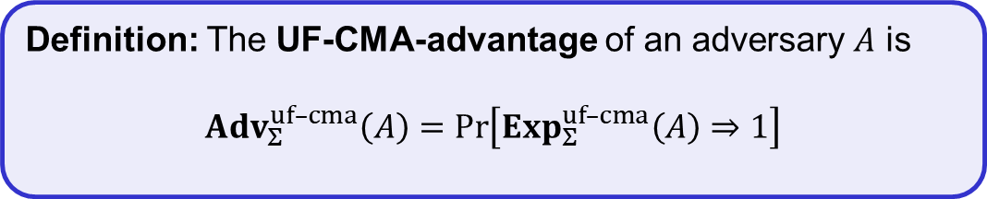

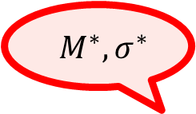
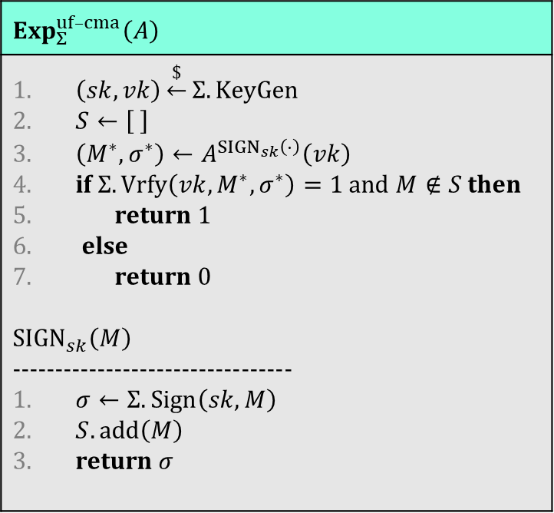


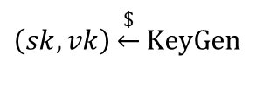

Digital signatures – security: UF-CMA
$$Exp_{Σ}^{uf–cma}\left(A\right)$$
$\left(sk,vk\right)\underset{←}{\$}Σ.KeyGen$ $S←\left[ \right]$ $\left(M^{∗}, σ^{∗}\right)←A^{{SIGN}_{sk}\left(⋅\right)}\left(vk\right)$ if $Σ.Vrfy\left(vk, M^{∗}, σ^{∗}\right)=1$ and $M∉S$ then return 1 else return 0 $${SIGN}_{sk}\left(M\right)$$ --------------------------------- $σ←Σ.Sign\left(sk, M\right)$ $S.add\left(M\right)$ return $σ$
Challenger
$${ M}^{∗}, σ^{∗}$$
$$vk$$
$$\left(sk,vk\right)\underset{←}{\$}KeyGen$$
$$Sign(sk, ⋅)$$
$$M_{1},M_{2}, …$$
$$σ_{1},σ_{2}, …$$
If $σ^{∗}$ is a valid signature for $M^{∗}$ then the adversary has forged a signature
Definition: The UF-CMA-advantage of an adversary $A$ is
$${Adv}_{Σ}^{uf–cma}\left(A\right)=\operatorname{Pr}\left[Exp_{Σ}^{uf–cma}\left(A\right)⇒1\right]$$

Slide 11




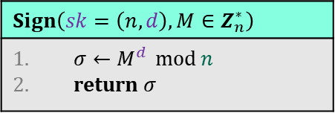
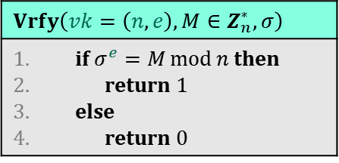


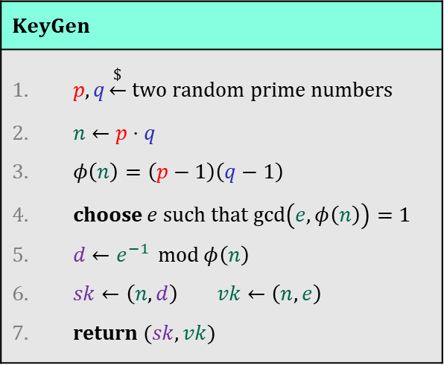









Textbook RSA signatures
$$𝒮𝒦$$
$$ℳ$$
$$𝒮$$
$$Z^{+}×Z_{φ\left(n\right)}^{∗}×Z_{n}^{∗}→$$
$$Z_{n}^{∗}$$
$$KeyGen$$
$p,q\underset{←}{\$}$ two random prime numbers $n←p⋅q$ $φ\left(n\right)=\left(p−1\right)\left(q−1\right)$ choose $e$ such that $\gcd\left(e, φ\left(n\right)\right)=1$ $d←e^{−1} \operatorname{mod}{φ\left(n\right)}$ $sk←\left(n,d\right)$ $vk←\left(n,e\right)$ return $(sk, vk)$
$$RSA.Sign:$$
$$RSA.Vrfy:$$
$$Z^{+}×Z_{φ\left(n\right)}^{∗}×Z_{n}^{∗}×Z_{n}^{∗}→\left\{1,0\right\}$$
$$𝒫𝒦$$
$$ℳ$$
$$𝒮$$
$$vk$$
$$Vrfy\left(vk=\left(n,e\right), M∈Z_{n}^{∗},σ\right)$$
if $σ^{e}=M\operatorname{mod}{n}$ then return $1$ else return 0
$$M,σ$$
$$Sign\left(sk=\left(n,d\right), M∈Z_{n}^{∗}\right)$$
$σ←M^{d} \operatorname{mod}{n}$ return $σ$

Slide 12

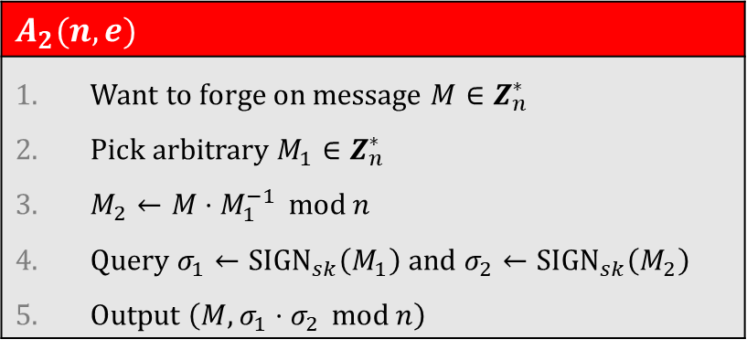

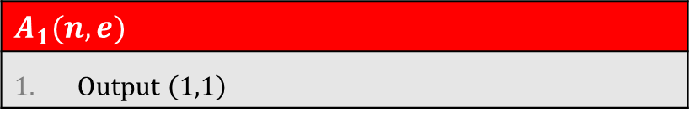
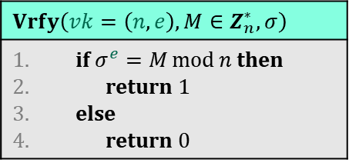


Textbook RSA signatures: attacks
$$KeyGen$$
$p,q\underset{←}{\$}$ two random prime numbers $n←p⋅q$ $φ\left(n\right)=\left(p−1\right)\left(q−1\right)$ choose $e$ such that $\gcd\left(e, φ\left(n\right)\right)=1$ $d←e^{−1} \operatorname{mod}{φ\left(n\right)}$ $sk←\left(n,d\right)$ $vk←\left(n,e\right)$ return $(sk, vk)$
$$A_{1}(n, e)$$
Output $\left(1,1\right)$
$$1^{e}\overset{?}{=} 1\operatorname{mod}{n}$$
Yes! $⟹{Adv}_{RSA}^{uf–cma}\left(A_{1}\right)=1$
$$A_{2}(n, e)$$
Want to forge on message $M∈Z_{n}^{∗}$ Pick arbitrary $M_{1}∈Z_{n}^{∗}$ $M_{2}←M⋅M_{1}^{−1} \operatorname{mod}{n}$ Query $σ_{1}←{SIGN}_{sk}\left(M_{1}\right)$ and $σ_{2}←{SIGN}_{sk}\left(M_{2}\right)$ Output $\left(M, σ_{1}⋅σ_{2} \operatorname{mod}{n}\right)$
$$Sign\left(sk=\left(n,d\right), M∈Z_{n}^{∗}\right)$$
$σ←M^{d} \operatorname{mod}{n}$ return $σ$
$$Vrfy\left(vk=\left(n,e\right), M∈Z_{n}^{∗},σ\right)$$
if $σ^{e}=M\operatorname{mod}{n}$ then return $1$ else return 0
$${\left(σ_{1}⋅σ_{2}\right)}^{e}\overset{?}{=} M\operatorname{mod}{n}$$
Yes! $⟹{Adv}_{RSA}^{uf–cma}\left(A_{2}\right)=1$
$${\left(M_{1}^{d}⋅M_{2}^{d}\right)}^{e}=M_{1}^{ed}⋅M_{2}^{ed}=M_{1}⋅M_{2}=M_{1}⋅M⋅M_{1}^{−1}=M\operatorname{mod}{n}$$
RSA correctness
Notes:
Additional problem: want to sign elements in {0,1}*

Slide 13



Textbook RSA signatures
$$𝒮𝒦$$
$$ℳ$$
$$𝒮$$
$$Z^{+}×Z_{φ\left(n\right)}^{∗}×Z_{n}^{∗}→$$
$$Z_{n}^{∗}$$
$$KeyGen$$
$p,q\underset{←}{\$}$ two random prime numbers $n←p⋅q$ $φ\left(n\right)=\left(p−1\right)\left(q−1\right)$ choose $e$ such that $\gcd\left(e, φ\left(n\right)\right)=1$ $d←e^{−1} \operatorname{mod}{φ\left(n\right)}$ $sk←\left(n,d\right)$ $vk←\left(n,e\right)$ return $(sk, vk)$
$$RSA.Sign:$$
$$RSA.Vrfy:$$
$$Z^{+}×Z_{φ\left(n\right)}^{∗}×Z_{n}^{∗}×Z_{n}^{∗}→\left\{1,0\right\}$$
$$𝒫𝒦$$
$$ℳ$$
$$𝒮$$
$$vk$$
$$Vrfy\left(vk=\left(n,e\right), M∈Z_{n}^{∗},σ\right)$$
if $σ^{e}=M\operatorname{mod}{n}$ then return $1$ else return 0
$$M,σ$$
$$H :{\left\{0,1\right\}}^{∗}→Z_{n}^{∗}$$
$$Sign\left(sk=\left(n,d\right), M∈Z_{n}^{∗}\right)$$
$σ←M^{d} \operatorname{mod}{n}$ return $σ$

Slide 14
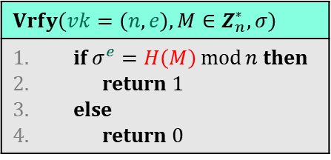
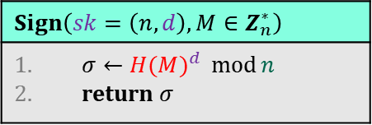
Textbook RSA signatures
$$𝒮𝒦$$
$$ℳ$$
$$𝒮$$
$$Z^{+}×Z_{φ\left(n\right)}^{∗}×Z_{n}^{∗}→$$
$$Z_{n}^{∗}$$
$$KeyGen$$
$p,q\underset{←}{\$}$ two random prime numbers $n←p⋅q$ $φ\left(n\right)=\left(p−1\right)\left(q−1\right)$ choose $e$ such that $\gcd\left(e, φ\left(n\right)\right)=1$ $d←e^{−1} \operatorname{mod}{φ\left(n\right)}$ $sk←\left(n,d\right)$ $vk←\left(n,e\right)$ return $(sk, vk)$
$$RSA.Sign:$$
$$RSA.Vrfy:$$
$$Z^{+}×Z_{φ\left(n\right)}^{∗}×Z_{n}^{∗}×Z_{n}^{∗}→\left\{1,0\right\}$$
$$𝒫𝒦$$
$$ℳ$$
$$𝒮$$
$$vk$$
$$Vrfy\left(vk=\left(n,e\right), M∈Z_{n}^{∗},σ\right)$$
if $σ^{e}=H\left(M\right)\operatorname{mod}{n}$ then return $1$ else return 0
$$M,σ$$
$$H :{\left\{0,1\right\}}^{∗}→Z_{n}^{∗}$$
$$Sign\left(sk=\left(n,d\right), M∈Z_{n}^{∗}\right)$$
$σ←{H(M)}^{d} \operatorname{mod}{n}$ return $σ$

Slide 15






Hash-then sign paradigm
$$𝒮𝒦$$
$$ℳ$$
$$𝒮$$
$$Z^{+}×Z_{φ\left(n\right)}^{∗}×{\left\{0,1\right\}}^{∗}→Z_{n}^{∗}$$
$$KeyGen$$
$p,q\underset{←}{\$}$ two random prime numbers $n←p⋅q$ $φ\left(n\right)=\left(p−1\right)\left(q−1\right)$ choose $e$ such that $\gcd\left(e, φ\left(n\right)\right)=1$ $d←e^{−1} \operatorname{mod}{φ\left(n\right)}$ $sk←\left(n,d\right)$ $vk←\left(n,e\right)$ return $(sk, vk)$
$$RSA.Sign:$$
$$RSA.Vrfy:$$
$$Z^{+}×Z_{φ\left(n\right)}^{∗}×{\left\{0,1\right\}}^{∗}×Z_{n}^{∗}→\left\{1,0\right\}$$
$$𝒫𝒦$$
$$ℳ$$
$$𝒮$$
$$vk$$
$$Vrfy\left(vk=\left(n,e\right), M∈Z_{n}^{∗},σ\right)$$
if $σ^{e}=H\left(M\right)\operatorname{mod}{n}$ then return $1$ else return 0
$$M,σ$$
$$H :{\left\{0,1\right\}}^{∗}→Z_{n}^{∗}$$
$$Sign\left(sk=\left(n,d\right), M∈Z_{n}^{∗}\right)$$
$σ←{H(M)}^{d} \operatorname{mod}{n}$ return $σ$

Slide 16


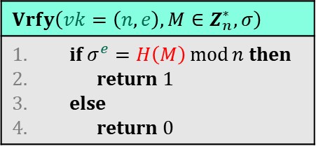


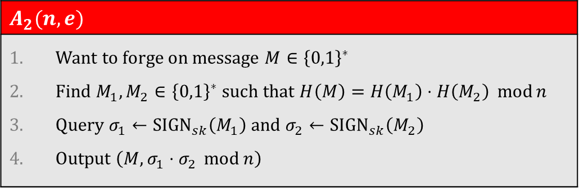

Hashed RSA signatures
$$KeyGen$$
$p,q\underset{←}{\$}$ two random prime numbers $n←p⋅q$ $φ\left(n\right)=\left(p−1\right)\left(q−1\right)$ choose $e$ such that $\gcd\left(e, φ\left(n\right)\right)=1$ $d←e^{−1} \operatorname{mod}{φ\left(n\right)}$ $sk←\left(n,d\right)$ $vk←\left(n,e\right)$ return $(sk, vk)$
$$A_{1}(n, e)$$
Output $\left(1,1\right)$
$$1^{e}\overset{?}{=} H\left(1\right)\operatorname{mod}{n}$$
No! $⟹{Adv}_{RSA}^{uf–cma}\left(A_{1}\right)≈0$
$$A_{2}(n, e)$$
Want to forge on message $M∈{\left\{0,1\right\}}^{∗}$ Find $M_{1},M_{2}∈{\left\{0,1\right\}}^{∗}$ such that $H\left(M\right)=H\left(M_{1}\right)⋅H\left(M_{2}\right) \operatorname{mod}{n}$ Query $σ_{1}←{SIGN}_{sk}\left(M_{1}\right)$ and $σ_{2}←{SIGN}_{sk}\left(M_{2}\right)$ Output $\left(M, σ_{1}⋅σ_{2} \operatorname{mod}{n}\right)$
$$Sign\left(sk=\left(n,d\right), M∈Z_{n}^{∗}\right)$$
$σ←{H(M)}^{d} \operatorname{mod}{n}$ return $σ$
Hard to find!
$$Vrfy\left(vk=\left(n,e\right), M∈Z_{n}^{∗},σ\right)$$
if $σ^{e}=H\left(M\right)\operatorname{mod}{n}$ then return $1$ else return 0
$${\left(σ_{1}⋅σ_{2}\right)}^{e}\overset{?}{=} H\left(M\right)\operatorname{mod}{n}$$
No! $⟹{Adv}_{RSA}^{uf–cma}\left(A_{2}\right)≈0$
$${\left(H{\left(M_{1}\right)}^{d}⋅H{\left(M_{2}\right)}^{d}\right)}^{e}=H\left(M_{1}\right)⋅H\left(M_{2}\right)=H\left(M\right)\operatorname{mod}{n}$$
Notes:
Other problem: want to sign elements in {0,1}*

Slide 17
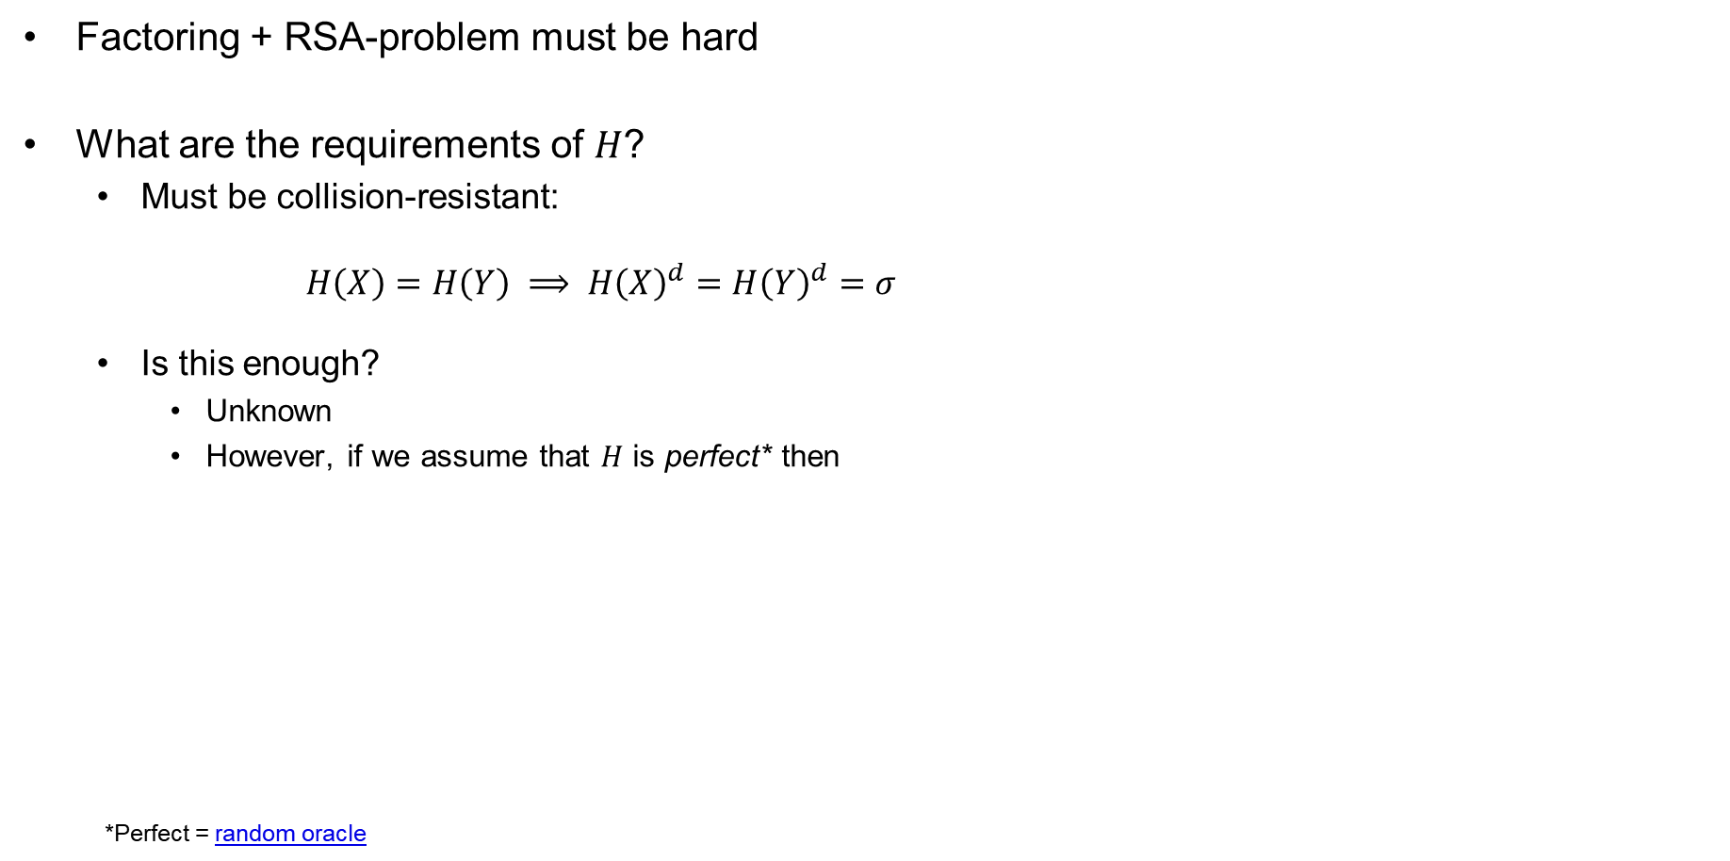
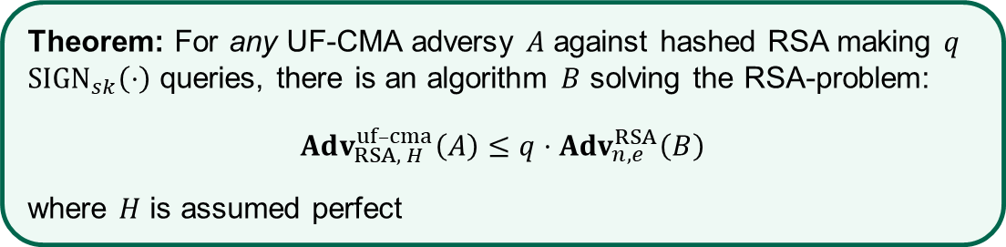
Hashed RSA – security
Factoring + RSA-problem must be hard
What are the requirements of $H$?
  Must be collision-resistant:
  $H\left(X\right)=H\left(Y\right) ⟹ H{\left(X\right)}^{d}=H{\left(Y\right)}^{d}=σ$
  Is this enough?
    Unknown
    However, if we assume that $H$ is perfect* then
  *Perfect = random oracle
$$KeyGen$$
$p,q\underset{←}{\$}$ two random prime numbers $n←p⋅q$ $φ\left(n\right)=\left(p−1\right)\left(q−1\right)$ choose $e$ such that $\gcd\left(e, φ\left(n\right)\right)=1$ $d←e^{−1} \operatorname{mod}{φ\left(n\right)}$ $sk←\left(n,d\right)$ $vk←\left(n,e\right)$ return $(sk, vk)$
Theorem: For any UF-CMA adversy $A$ against hashed RSA making $q$ ${SIGN}_{sk}\left(⋅\right)$ queries, there is an algorithm $B$ solving the RSA-problem:
$$Adv_{RSA, H}^{uf–cma}\left(A\right)≤q⋅Adv_{n,e}^{RSA}\left(B\right)$$
where $H$ is assumed perfect
$$Sign\left(sk=\left(n,d\right), M∈Z_{n}^{∗}\right)$$
$σ←{H(M)}^{d} \operatorname{mod}{n}$ return $σ$
$$Vrfy\left(vk=\left(n,e\right), M∈Z_{n}^{∗},σ\right)$$
if $σ^{e}=H\left(M\right)\operatorname{mod}{n}$ then return $1$ else return 0

Slide 18
Discrete logarithm based signatures

Slide 19
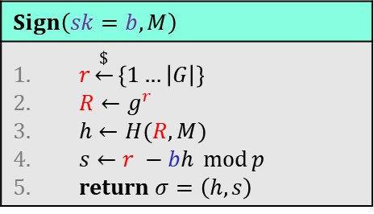



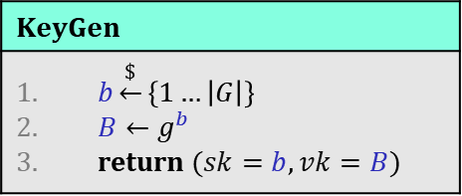





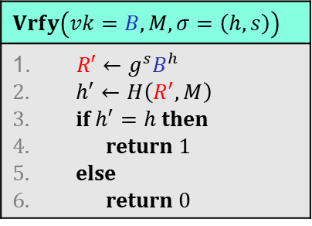


Discrete-log-based signatures: Schnorr
$$G=\left\langle g\right\rangle$$
$$H :G×{\left\{0,1\right\}}^{∗}→Z_{p}^{∗}$$
$$KeyGen$$
$b\underset{←}{\$}\left\{1…\left|G\right|\right\}$ $B←g^{b}$ return $(sk=b, vk=B)$
$$vk$$
$$Vrfy\left(vk=B, M,σ=\left(h,s\right)\right)$$
$R′←g^{s}B^{h}$ $h^{′}←H\left(R^{′}, M\right)$ if $h^{′}=h$ then return 1 else return 0
$$M,σ$$
$$Sign\left(sk=b, M\right)$$
$r\underset{←}{\$}\left\{1…\left|G\right|\right\}$ $R←g^{r}$ $h←H(R, M)$ $s←r −bh \operatorname{mod}{p}$ return $σ=\left(h,s\right)$
Correctness: $Vrfy\left(vk, M, Sign\left(sk, M\right)\right)=1$
$$h^{′}=H\left(R^{′},M\right)$$
$$=H\left(g^{s}B^{h}, M\right)$$
$$=H\left(g^{r−bh}g^{bh}, M\right)$$
$$=H\left(g^{r−bh+bh}, M\right)$$
$$=H\left(g^{r},M\right)$$
$$=H\left(R,M\right)=h$$

Slide 20



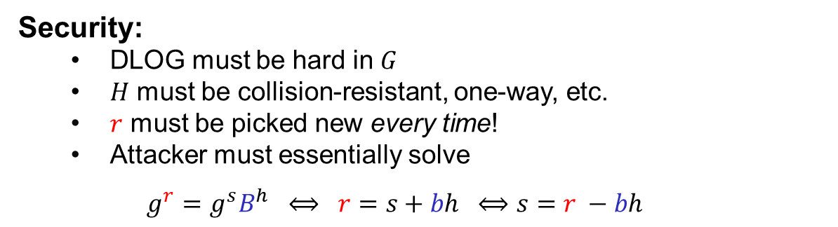

Discrete-log-based signatures: Schnorr – security
$$G=\left\langle g\right\rangle$$
$$H :G×{\left\{0,1\right\}}^{∗}→Z_{p}^{∗}$$
$$KeyGen$$
$b\underset{←}{\$}\left\{1…\left|G\right|\right\}$ $B←g^{b}$ return $(sk=b, vk=B)$
$$vk$$
$$Vrfy\left(vk=B, M,σ=\left(h,s\right)\right)$$
$R′←g^{s}B^{h}$ $h^{′}←H\left(R^{′}, M\right)$ if $h^{′}=h$ then return 1 else return 0
$$M,σ$$
$$Sign\left(sk=b, M\right)$$
$r\underset{←}{\$}\left\{1…\left|G\right|\right\}$ $R←g^{r}$ $h←H(R, M)$ $s←r −bh \operatorname{mod}{p}$ return $σ=\left(h,s\right)$
Security:
  DLOG must be hard in $G$
  $H$ must be collision-resistant, one-way, etc.
  $r$ must be picked new every time!
  Attacker must essentially solve
  $g^{r}=g^{s}B^{h} ⟺ r=s+bh ⟺s=r −bh$
$$σ =\left(h,s \right)$$
$$σ′=\left(h′,s′\right)$$
$$⟹ s−s^{′}=(r−bh)−(r−bh^{′})$$
$$=\left(h^{′}−h\right)⋅b$$
$$⟹b=\left(s−s^{′}\right)⋅{\left(h^{′}−h\right)}^{−1} \operatorname{mod}{p}$$

Slide 21
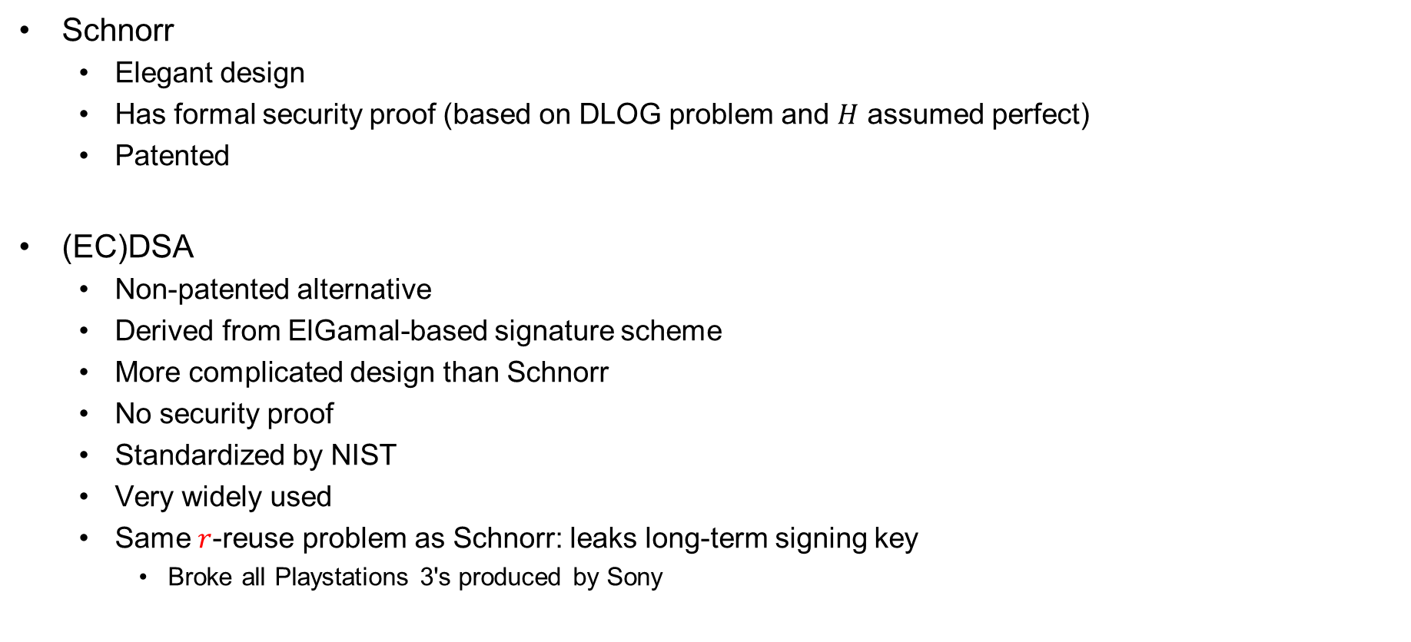
Discrete-log-based signatures: (EC)DSA
Schnorr
  Elegant design
  Has formal security proof (based on DLOG problem and $H$ assumed perfect)
  Patented
(EC)DSA
  Non-patented alternative
  Derived from ElGamal-based signature scheme
  More complicated design than Schnorr
  No security proof
  Standardized by NIST
  Very widely used
  Same $r$-reuse problem as Schnorr: leaks long-term signing key
    Broke all Playstations 3's produced by Sony

Slide 22
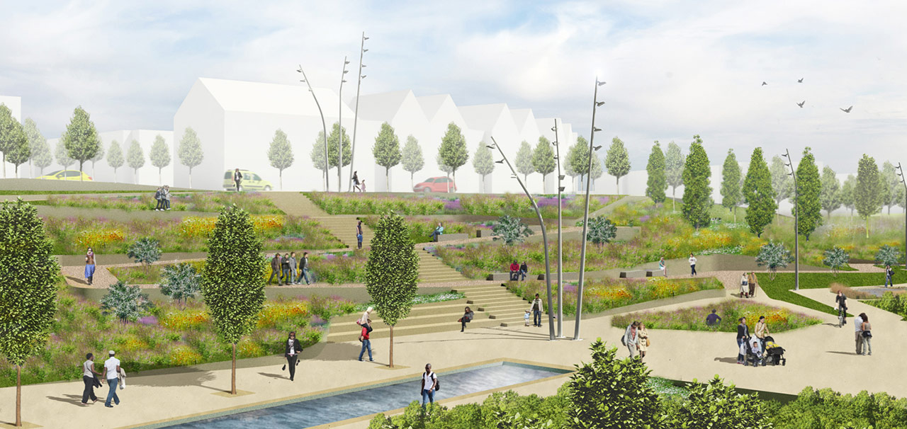
Public-key infrastructure (PKI)

Slide 23




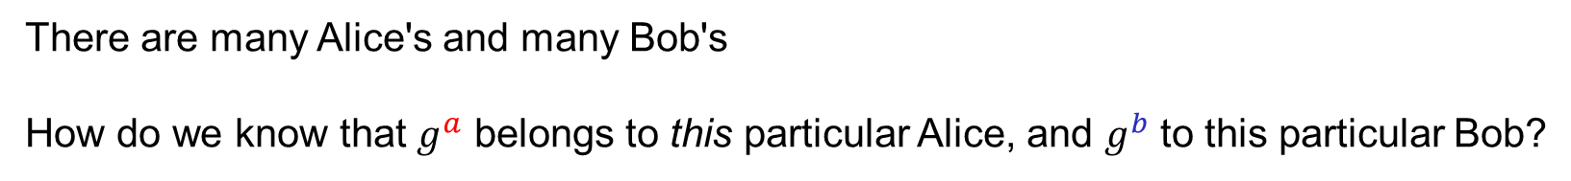
What are identities?
"Alice",
$$g^{a}$$
"Bob",
$$g^{b}$$
$${K←g}^{ab}$$
$${K←g}^{ab}$$
There are many Alice's and many Bob's
How do we know that $g^{a}$ belongs to this particular Alice, and $g^{b}$ to this particular Bob?
Need to bind public keys to entities

Slide 24

Identities on the internet
www.bob.com
"Alice",
$$g^{a}$$
"Bob",
$$g^{b}$$
www.bob.com,
$${K←g}^{ab}$$
$${K←g}^{ab}$$
There are many Alice's and many Bob's
How do we know that $g^{a}$ belongs to this particular Alice, and $g^{b}$ to this particular Bob?
Need to bind public keys to entities
– on the internet: bind public keys to domain names

Slide 25


Identities on the internet
www.evil.com
$$g^{a}$$
www.bob.com,
$$g^{b}$$
need proof these belong together
$$b\underset{←}{\$}\left\{1, …, \left|G\right|\right\}$$
$${K←g}^{ab}$$
$${K←g}^{ab}$$
There are many Alice's and many Bob's
How do we know that $g^{a}$ belongs to this particular Alice, and $g^{b}$ to this particular Bob?
Need to bind public keys to entities
– on the internet: bind public keys to domain names

Slide 26









Authenticated key exchange
$$\left(sk_{B},vk_{B}\right)$$
www.bob.com
$$g^{a}$$
$$g^{b}$$
www.bob.com,
$$,vk_{B}$$
if $Vrfy\left(vk_{B},…,σ\right)=1$
$$σ$$
$${K←g}^{ab}$$
$${K←g}^{ab}$$
else
abort
But why should we trust this $vk_{B}$?
Could have been created by the adversary itself

Slide 27

Digital certificates
Digital certificate: a way of binding a public key to an entity
A certificate consists of:
  The public key of the entity
  A bunch of information identifying the entity
    Name
    Address
    Occupation
    URL
    Email-address
    Phone number
    …
  A digital signature on all the above by a certificate authority (CA)

Slide 28
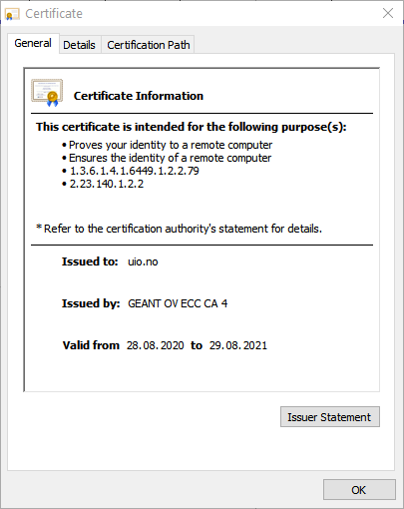
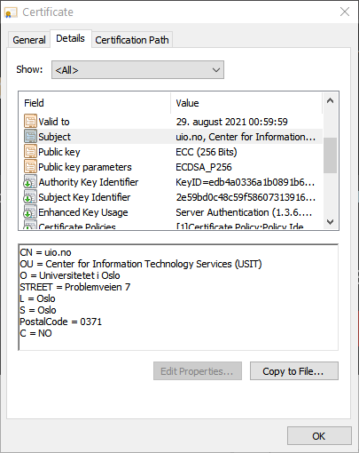
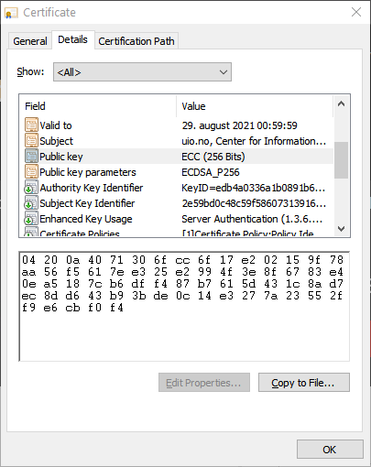
Digital certificates

Slide 29

Certificate authorities (CA)
CA: an issuer of digital certificates
Acts as a trusted third-party, certifying (i.e., signing)
the public keys of other entities
  Verifies the identity of a claimed public-key owner
The basis of a public-key infrastructure (PKI)
Certificate
Authority

Slide 30













HTTPS / TLS + PKI
$$\left(sk_{B},vk_{B}\right)$$
www.bob.com
$$vk_{{CA}_{1}}$$
$$g^{a}$$
if $Vrfy\left(vk_{B},…,σ\right)=1$
www.bob.com,
$$g^{b}$$
and $Vrfy\left(vk_{{CA}_{1}},…,σ\right)=1$
$$σ$$
$$vk_{B}$$
$${K←g}^{ab}$$
$$σ$$
$$vk_{{CA}_{1}}$$
$${K←g}^{ab}$$
else
abort

Slide 31
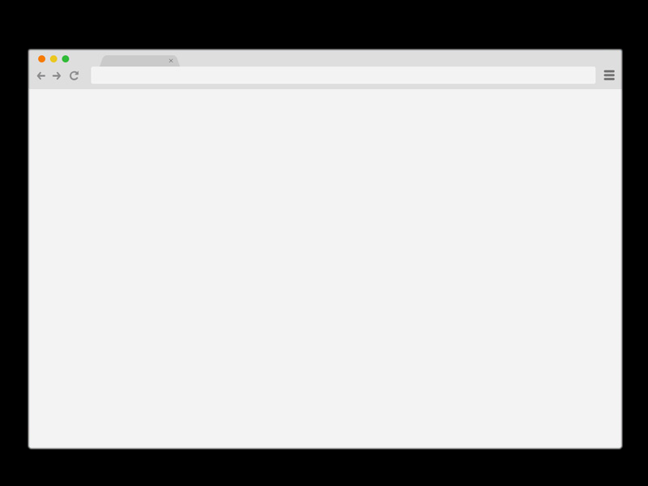




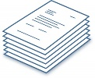



How to get a signed certificate?
4
www.bob.com
www.bob.com
2
$$vk_{B}$$
0x349a5
3
“Put 0x349a5 on your page”
1
Check
5
$$\left(sk_{B},vk_{B}\right)←KeyGen$$
Other validation methods also possible:
Confirmation emails
DNS entries
Physical verification
Passport or driver's license
6
$$←Sign\left(sk_{dc}, vk_{B}, \right)$$
7

Slide 32
HTTPS / TLS + PKI
$$\left(sk_{B},vk_{B}\right)$$
www.bob.com
$$vk_{{CA}_{1}}$$
$$g^{a}$$
if $Vrfy\left(vk_{B},…,σ\right)=1$
www.bob.com,
$$g^{b}$$
and $Vrfy\left(vk_{{CA}_{1}},…,σ\right)=1$
$$σ$$
$$vk_{B}$$
$${K←g}^{ab}$$
$$σ$$
$$vk_{{CA}_{1}}$$
$${K←g}^{ab}$$
else
abort

Slide 33






Root CAs
Root CAs: CAs that sign other CAs' public keys
  + only a few root CAs need to be trusted by end-users
  + root CAs can distribute the signing + verification load to smaller CAs
  - single point of failure
  Root CAs for the internet: a few large multinational corporations
  ; private key must be very heavily guarded
CA signing key

Slide 34
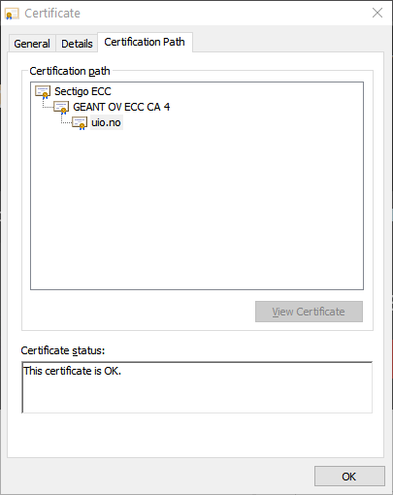
Certificate chains

Slide 35








HTTPS / TLS + PKI
$$\left(sk_{B},vk_{B}\right)$$
www.bob.com
$$vk_{{CA}_{1}}$$
$$vk_{{CA}_{2}}$$
$$g^{a}$$
if $Vrfy\left(vk_{B},…,σ\right)=1$
www.bob.com,
$$g^{b}$$
and $Vrfy\left(vk_{{CA}_{1}},…,σ\right)=1$
$$σ$$
$$vk_{B}$$
and $Vrfy\left(vk_{{CA}_{2}},…,σ\right)=1$
$${K←g}^{ab}$$
$$σ$$
$$vk_{{CA}_{1}}$$
$${K←g}^{ab}$$
else
abort
$$σ$$
$$vk_{{CA}_{2}}$$

Slide 36




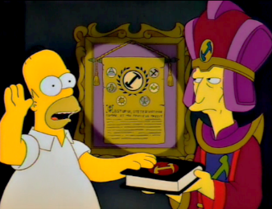
How to become an internet root CA?
Need to prove yourself (trust)worthy to browser and OS vendors
  Microsoft Root Certificate Program
  Mozilla CA Certificate Program
  Apple Root Certificate Program
Lot's of auditing and paperwork
Many formal technical and non-technical security requirements
  CA/Browser forum
  Baseline Requirements v1.7.3

Slide 37
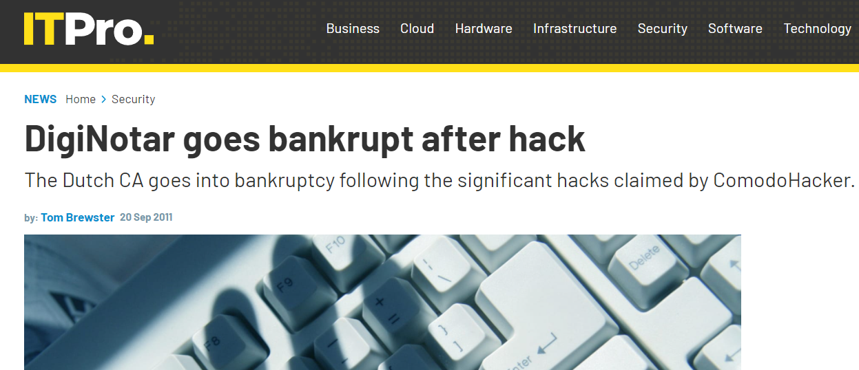
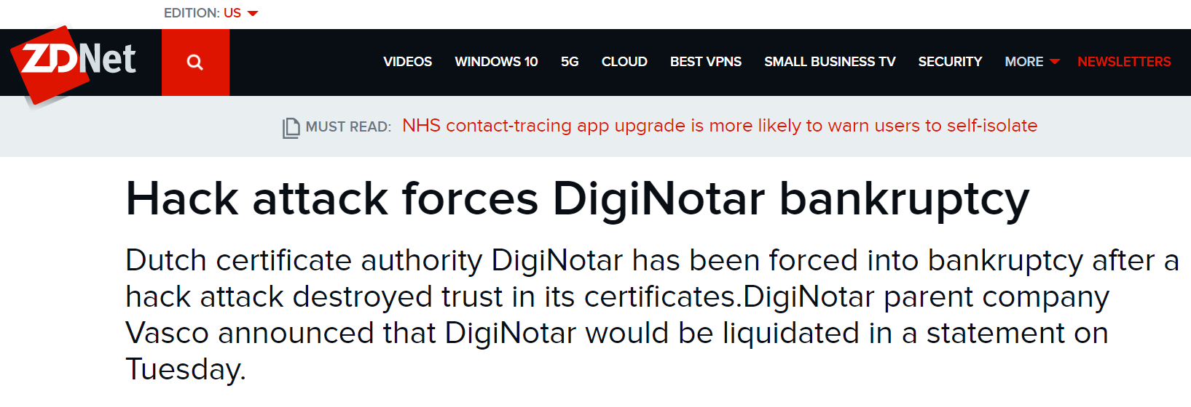
DigiNotar
Dutch root CA
Lost control of their private signing key in 2011
Fraudulent certificates issued for Gmail, Yahoo!, Mozilla, WordPress, …
30 000 Iranian Gmail users targeted

Slide 38
Other PKIs exist
Organization PKIs

Slide 39
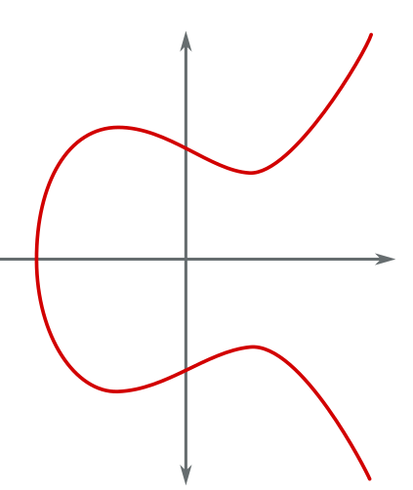





$$P$$
$$y^{2}=x^{3}+ax+b$$
$$a,b,x,y∈R$$
$$Q$$
$$P+Q$$
End of Part II
(Asymmetric crypto)

Slide 40
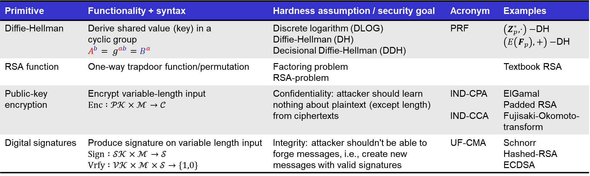
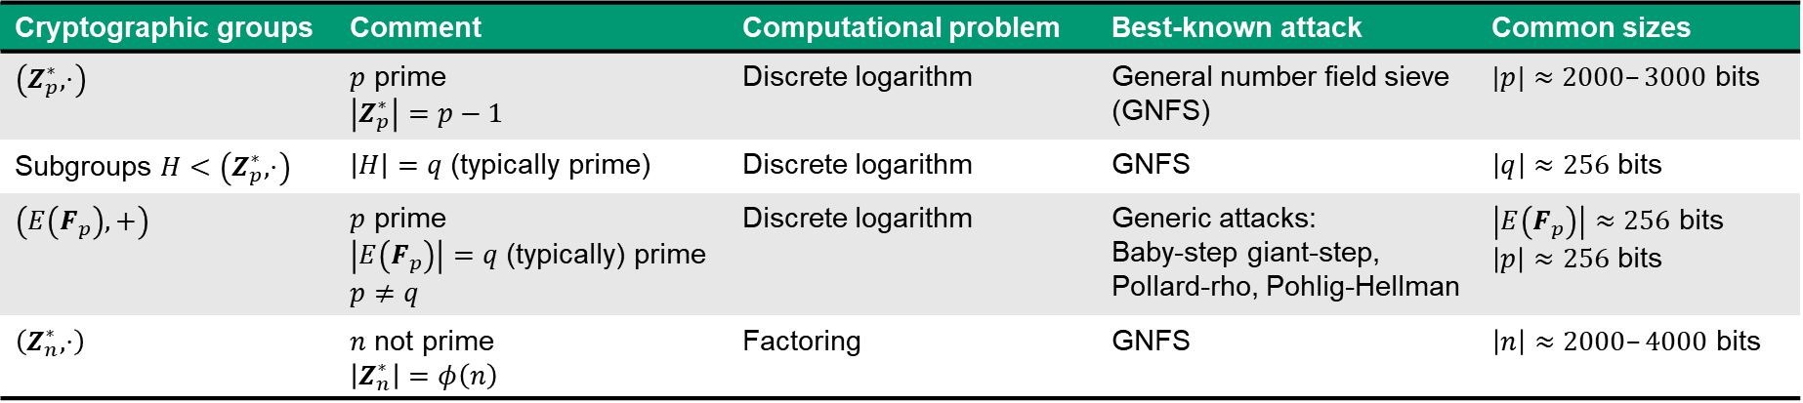
Summary of asymmetric cryptography
Primitive | Functionality + syntax | Hardness assumption / security goal | Acronym | Examples
Diffie-Hellman | Derive shared value (key) in a cyclic group $${A^{b}= g}^{ab}=B^{a}$$ | Discrete logarithm (DLOG) Diffie-Hellman (DH) Decisional Diffie-Hellman (DDH) | PRF | $\left(Z_{p}^{∗},⋅\right)−$DH $\left(E\left(F_{p}\right),+\right)−$DH
RSA function | One-way trapdoor function/permutation | Factoring problem RSA-problem |  | Textbook RSA
Public-key encryption | Encrypt variable-length input $$Enc :𝒫𝒦×ℳ→𝒞$$ | Confidentiality: attacker should learn nothing about plaintext (except length) from ciphertexts | IND-CPA IND-CCA | ElGamal Padded RSA Fujisaki-Okomoto-transform
Digital signatures | Produce signature on variable length input $$Sign :𝒮𝒦×ℳ→𝒮$$ $$Vrfy :𝒱𝒦×ℳ×𝒮→\left\{1,0\right\}$$ | Integrity: attacker shouldn't be able to forge messages, i.e., create new messages with valid signatures | UF-CMA | Schnorr Hashed-RSA ECDSA
Cryptographic groups | Comment | Computational problem | Best-known attack | Common sizes
$$\left(Z_{p}^{∗},⋅\right)$$ | $p$ prime $$\left|Z_{p}^{∗}\right|=p−1$$ | Discrete logarithm | General number field sieve (GNFS) | $|p|≈2000–3000$ bits
Subgroups $H<\left(Z_{p}^{∗},⋅\right)$ | $\left|H\right|=q$ (typically prime) | Discrete logarithm | GNFS | $\left|q\right|≈256$ bits
$$\left(E\left(F_{p}\right),+\right)$$ | $p$ prime $\left|E\left(F_{p}\right)\right|=q$ (typically) prime $p≠q$ | Discrete logarithm | Generic attacks: Baby-step giant-step, Pollard-rho, Pohlig-Hellman | $\left|E\left(F_{p}\right)\right|≈256$ bits $\left|p\right|≈256$ bits
$$\left(Z_{n}^{∗},⋅\right)$$ | $n$ not prime $$\left|Z_{n}^{∗}\right|=φ\left(n\right)$$ | Factoring | GNFS | $\left|n\right|≈2000–4000$ bits

Slide 41

Next week
Quantum computers

