Slide 1
Lecture 12 – Quantum computers,
Shor’s algorithm, post-quantum cryptography
TEK4500
10.11.2020
Håkon Jacobsen
hakon.jacobsen@its.uio.no

Slide 2
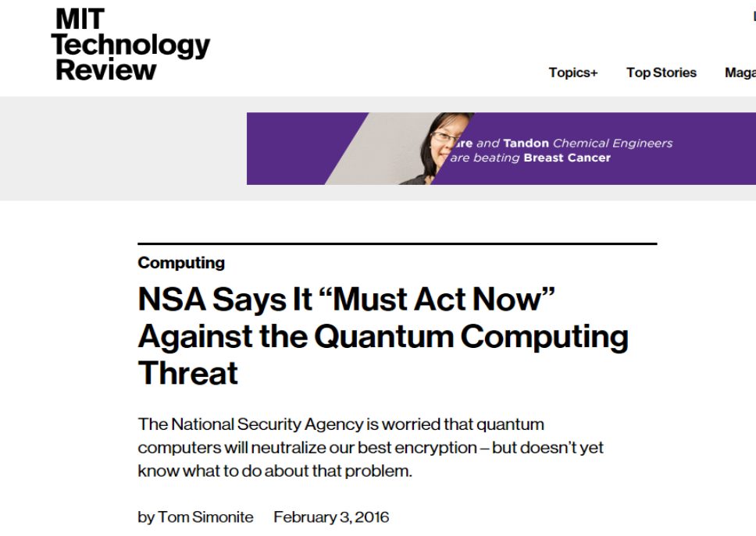

Slide 3
Quantum computing – the starting point

Slide 4
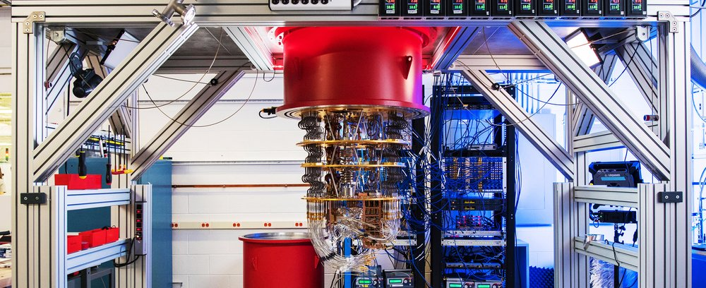
Elements of (quantum) computing
Three elements of all computations: data, operations, results
Quantum computation
  Data = qubit
  Operation = quantum gate
  Results = measurements

Slide 5
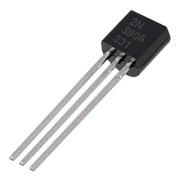
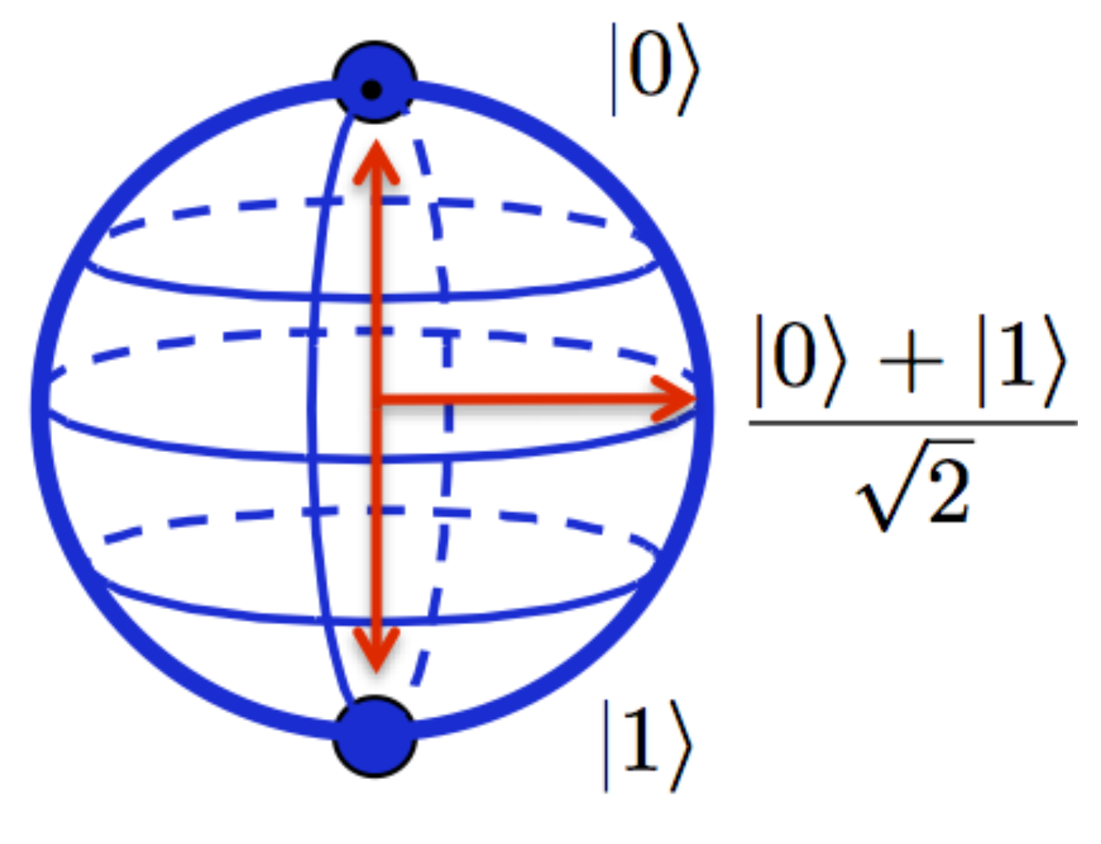

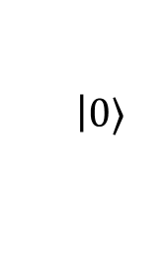







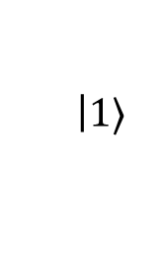

Qubits
Classical bit:
Qubit:
  Can be in a superposition of two basic states $|0〉$ and $|1〉$
  But we can never observe $α$ and $β$ directly!
  Must measure $|ψ〉$ to obtain its value $⟹$ state randomly collapses to either $|0〉$ or $|1〉$
  What's the probability of observing $|0〉$ or $|1〉$?
$$0$$
$$1$$
$$|ψ〉=α$$
$$\left|0\right.〉$$
$$+ β$$
$$\left|1\right.〉$$
$$α,β∈C$$
$${\left|α\right|}^{2}+{\left|β\right|}^{2}=1$$
$$\operatorname{Pr}\left[measure |ψ〉⇒|0〉\right]={\left|α\right|}^{2}$$
$$\operatorname{Pr}\left[measure |ψ〉⇒|1〉\right]={\left|β\right|}^{2}$$

Slide 6
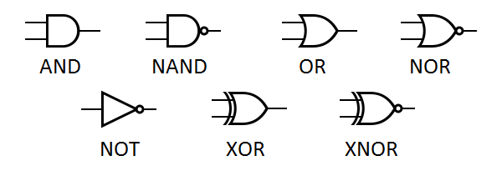
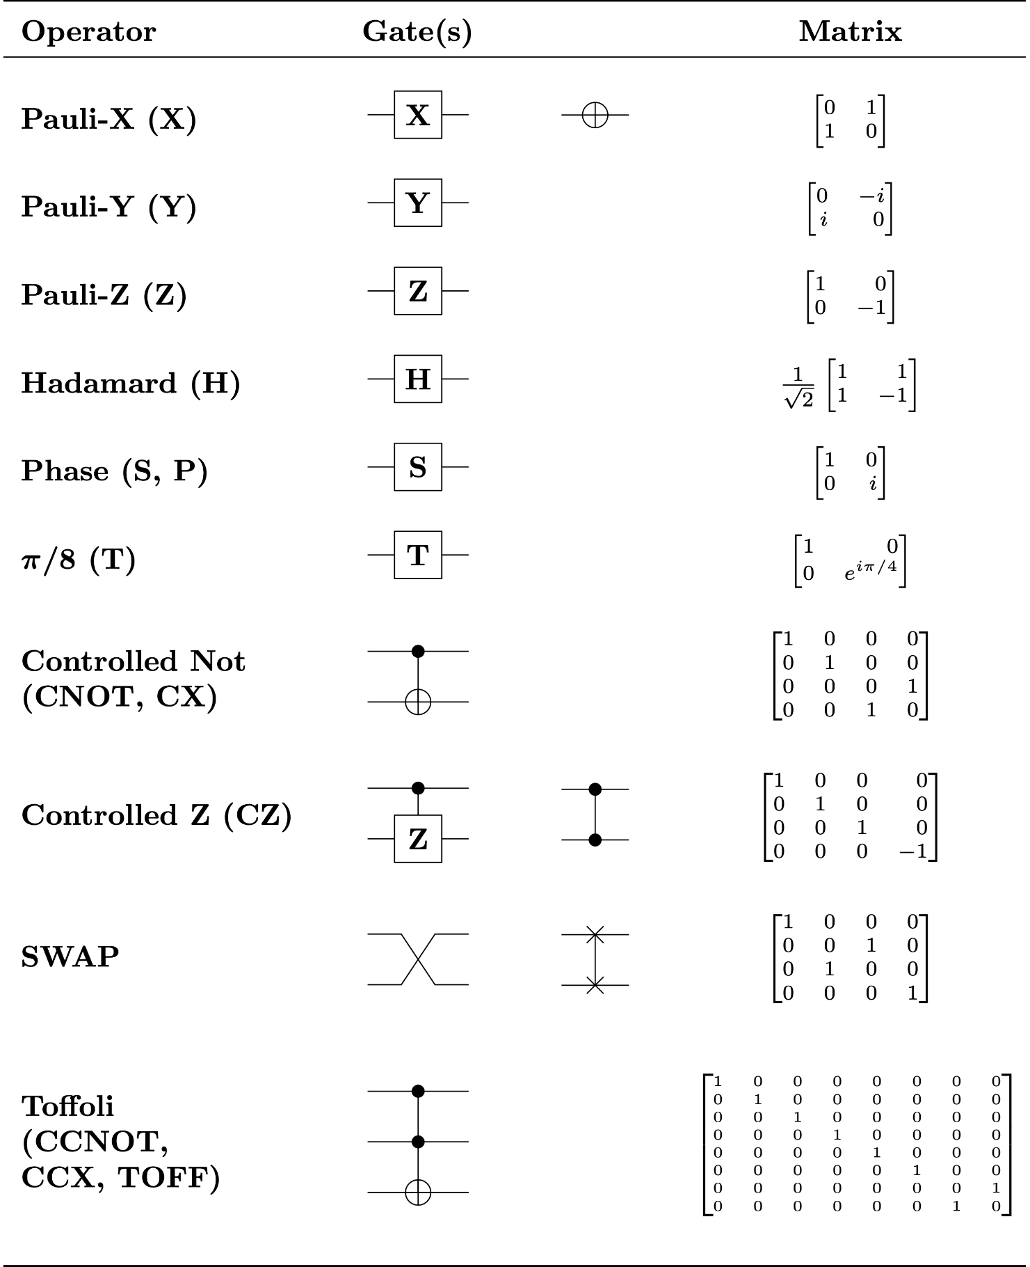
Quantum computation – quantum gates
Classic bits are transformed using logical gates
Qubits are transformed using
quantum gates
$$|ψ〉=α|0〉+β|1〉 ↦ |ψ′〉=α′|0〉+β′|1〉$$

Slide 7
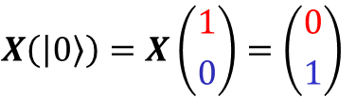
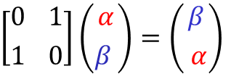


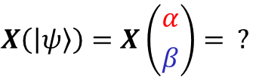


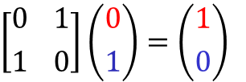

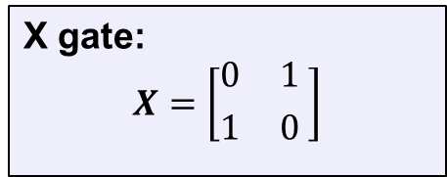
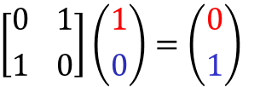

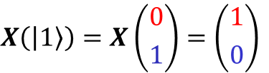

(Quantum) NOT-gate (or X gate)
$$|0〉 \underset{↦}{X} |1〉$$
$$|ψ〉=α|0〉+β|1〉$$
$$|1〉 \underset{↦}{X} |0〉$$
X gate:
$$X=\left[{0 \atop 1}{ 1 \atop 0 }\right]$$
$$|0〉=\left({1 \atop 0}\right)$$
$$|ψ〉=\left({α \atop β}\right)$$
$$α|0〉+β|1〉 \underset{↦}{X} β|0〉+α|1〉$$
$$|1〉=\left({0 \atop 1}\right)$$
$$X\left(|0〉\right)=X\left({1 \atop 0}\right)=\left({0 \atop 1}\right)$$
$$X\left(|1〉\right)=X\left({0 \atop 1}\right)=\left({1 \atop 0}\right)$$
$$X\left(|ψ〉\right)=X\left({α \atop β}\right)= ?$$
$$\left[{0 \atop 1}{ 1 \atop 0}\right]\left({1 \atop 0}\right)=\left({0 \atop 1}\right)$$
$$\left[{0 \atop 1}{ 1 \atop 0}\right]\left({0 \atop 1}\right)=\left({1 \atop 0}\right)$$
$$\left[{0 \atop 1}{ 1 \atop 0}\right]\left({α \atop β }\right)=\left({β \atop α}\right)$$

Slide 8
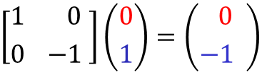

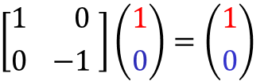

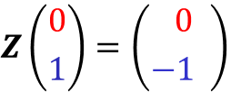
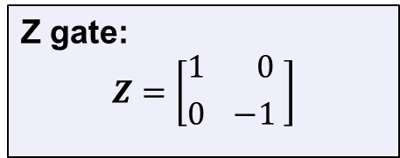
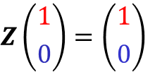
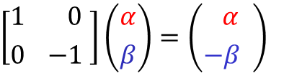

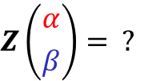
The Z gate
$$|0〉 \underset{↦}{Z} |0〉$$
$$|ψ〉=α|0〉+β|1〉$$
$$|1〉 \underset{↦}{Z} −|1〉$$
Z gate:
$$Z=\left[{1 \atop 0}{ 0 \atop −1 }\right]$$
$$|0〉=\left({1 \atop 0}\right)$$
$$|ψ〉=\left({α \atop β}\right)$$
$$α|0〉+β|1〉 \underset{↦}{Z} α|0〉−β|1〉$$
$$|1〉=\left({0 \atop 1}\right)$$
$$Z\left({1 \atop 0}\right)=\left({1 \atop 0}\right)$$
$$Z\left({0 \atop 1}\right)=\left({ 0 \atop −1 }\right)$$
$$Z\left({α \atop β}\right)= ?$$
$$\left[{1 \atop 0}{ 0 \atop −1 }\right]\left({1 \atop 0}\right)=\left({1 \atop 0}\right)$$
$$\left[{1 \atop 0}{ 0 \atop −1 }\right]\left({0 \atop 1}\right)=\left({ 0 \atop −1 }\right)$$
$$\left[{1 \atop 0}{ 0 \atop −1 }\right]\left({α \atop β}\right)=\left({ α \atop −β }\right)$$

Slide 9
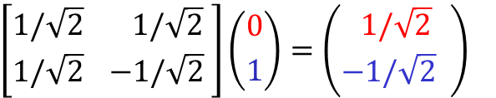
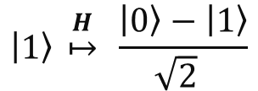
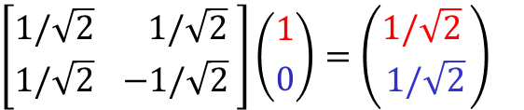
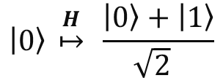
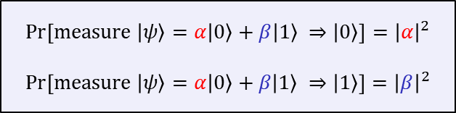
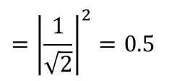

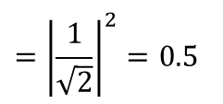

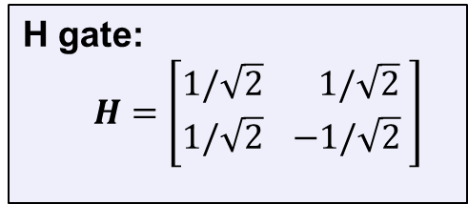
The Hadamard or H gate
$$|0〉 \underset{↦}{H} \frac{|0〉+|1〉}{\sqrt{2} }$$
$$\operatorname{Pr}\left[measure |ψ〉=α|0〉+β|1〉 ⇒|0〉\right]={\left|α\right|}^{2}$$
$$\operatorname{Pr}\left[measure |ψ〉=α|0〉+β|1〉 ⇒|1〉\right]={\left|β\right|}^{2}$$
$$|1〉 \underset{↦}{H} \frac{|0〉−|1〉}{\sqrt{2} }$$
$$={\left|\frac{1}{\sqrt{2}}\right|}^{2}=0.5$$
$$\operatorname{Pr}\left[measure H|0〉⇒|0〉\right]$$
H gate:
$$H=\left[{1/\sqrt{2} \atop 1/\sqrt{2}}{ 1/\sqrt{2} \atop −1/\sqrt{2} }\right]$$
$$={\left|\frac{1}{\sqrt{2}}\right|}^{2}=0.5$$
$$\operatorname{Pr}\left[measure H|1〉⇒|1〉\right]$$
The Hadamard gate allows us to create random bits!
$$\left[{1/\sqrt{2} \atop 1/\sqrt{2}}{ 1/\sqrt{2} \atop −1/\sqrt{2} }\right]\left({1 \atop 0}\right)=\left({1/\sqrt{2} \atop 1/\sqrt{2}}\right)$$
$$\left[{1/\sqrt{2} \atop 1/\sqrt{2}}{ 1/\sqrt{2} \atop −1/\sqrt{2} }\right]\left({0 \atop 1}\right)=\left({ 1/\sqrt{2} \atop −1/\sqrt{2} }\right)$$

Slide 10

Many other gates

Slide 11

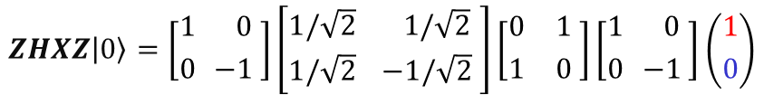










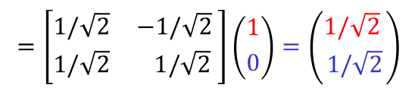
Quantum gates
Turns out all quantum gates can be described by matrices
  In fact, very special matrices: unitary matrices
  … and only unitary matrices! (fact of nature)
Quantum operations are linear and can be combined
$$|0〉 \underset{↦}{X} |1〉$$
$$X=\left[{0 \atop 1}{ 1 \atop 0 }\right]$$
$$|1〉 \underset{↦}{X} |0〉$$
$$|0〉 \underset{↦}{Z} |0〉$$
$$Z=\left[{1 \atop 0}{ 0 \atop −1 }\right]$$
$$|ψ_{0}〉 \underset{↦}{Z} |ψ_{1}〉\underset{↦}{X} |ψ_{2}〉\underset{↦}{H} |ψ_{3}〉\underset{↦}{Z} |ψ_{4}〉$$
$$|1〉 \underset{↦}{Z} |−1〉$$
$$ZHXZ|ψ_{0}〉=|ψ_{4}〉$$
$$ZHXZ|0〉=\left[{1 \atop 0}{ 0 \atop −1 }\right]\left[{1/\sqrt{2} \atop 1/\sqrt{2}}{ 1/\sqrt{2} \atop −1/\sqrt{2} }\right]\left[{0 \atop 1}{ 1 \atop 0 }\right]\left[{1 \atop 0}{ 0 \atop −1 }\right]\left({1 \atop 0}\right)$$
$$|0〉 \underset{↦}{H} \frac{|0〉+|1〉}{\sqrt{2} }$$
$$H=\left[{1/\sqrt{2} \atop 1/\sqrt{2}}{ 1/\sqrt{2} \atop −1/\sqrt{2} }\right]$$
$$|1〉 \underset{↦}{H} \frac{|0〉−|1〉}{\sqrt{2} }$$
$$=\left[{1/\sqrt{2} \atop 1/\sqrt{2}}{ −1/\sqrt{2} \atop 1/\sqrt{2} }\right]\left({1 \atop 0}\right)=\left({1/\sqrt{2} \atop 1/\sqrt{2}}\right)$$

Slide 12
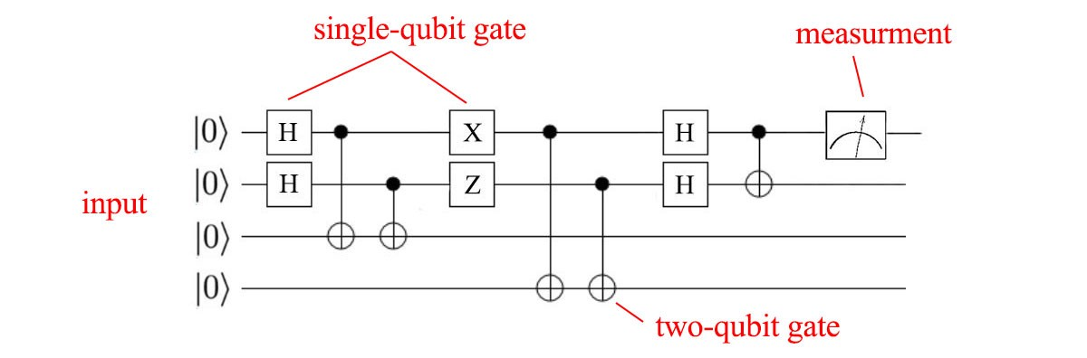

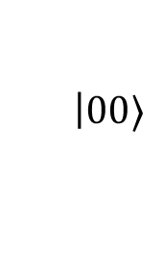





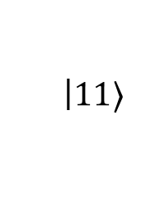
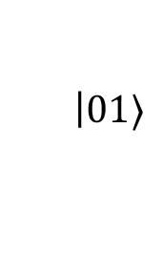
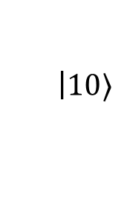
Quantum computers – multiple qubits
A quantum computer consists of multiple qubits
Can apply quantum gates to a subset of qubits in a multi-qubit state
$$|ψ_{0}ψ_{1}〉=α$$
$$\left|00\right.〉$$
$$+ β$$
$$\left|01\right.〉$$
$$+ γ$$
$$\left|10\right.〉$$
$$+ δ$$
$$\left|11\right.〉$$
$$α,β,γ,δ∈C$$
$${\left|α\right|}^{2}+{\left|β\right|}^{2}+{\left|γ\right|}^{2}+{\left|δ\right|}^{2}=1$$

Slide 13
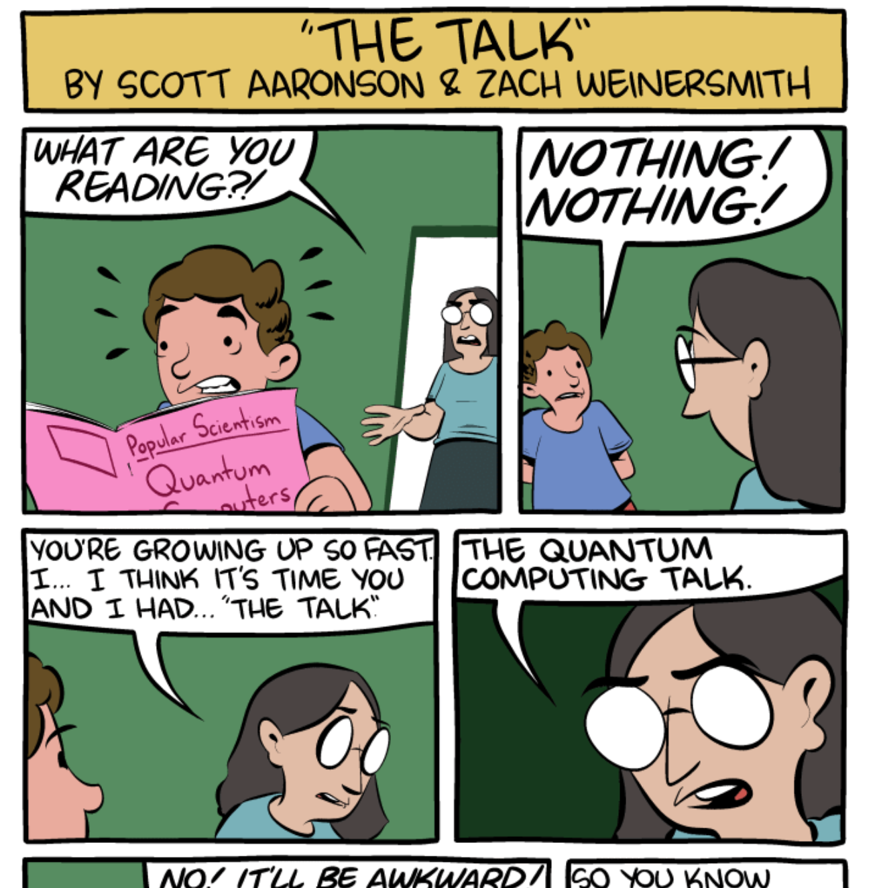
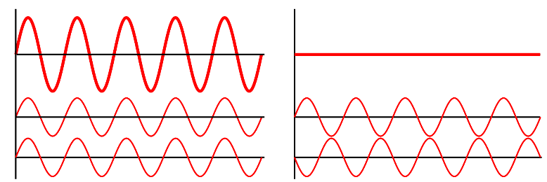

What makes quantum computation special?
Warning: a quantum computer does not
simply "try out all solutions in parallel"
The magic comes from allowing complex
(or even just negative real) superposition amplitudes
Can carefully choreograph computations so that
wrong answers "cancel" out their amplitudes, while
correct answers "combine" (quantum interference)
  increases probability of measuring correct result
  only a few problems allow this choreography; speed up not possible for all computations
https://www.smbc-comics.com/comic/the-talk-3
$$|ψ〉=α|0〉+β|1〉$$

Slide 14
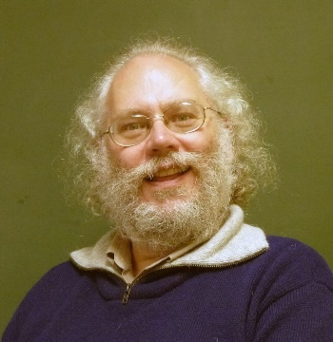
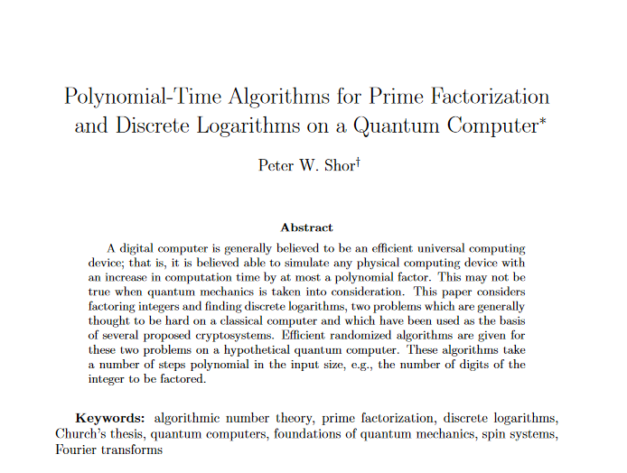
Shor's algorithm
1994

Slide 15



Factoring to order-finding
$$2, 4, 8, 16, 32, 64, 128, 256, 512, 1024, …$$
$$2, 4, 8, 1, 2, 4, 8, 1, 2, 4, 8, 1, 2…$$
$$\operatorname{mod}{15}$$
$$2, 4, 8, 16, 11, 1, 2, 4, 8, 16, 11, 1, 2…$$
$$\operatorname{mod}{21}$$
these sequences are periodic

Slide 16
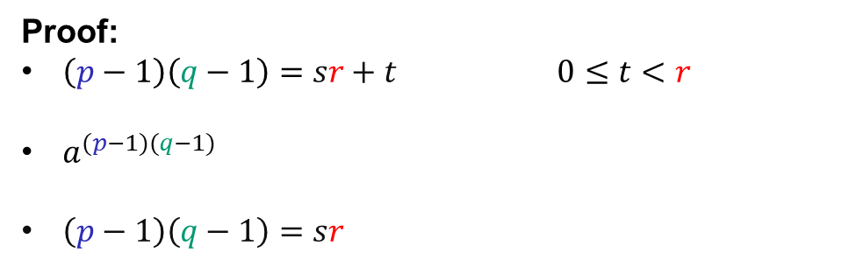









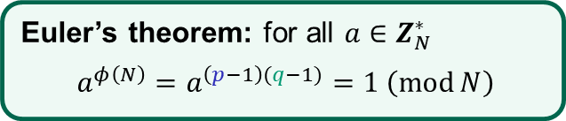





Factoring to order-finding
$$N=pq$$
$$\left| \right|=$$
$$=1$$
$$\left\langle a\right\rangle$$
$$r$$
$a^{1},a^{2},$ $a^{3}, …,a^{r},a^{1},a^{2}…$
$$\left(\operatorname{mod}{N}\right)$$
order of $a$
= the smallest positive $r$ such that $a^{r}=1 \left(\operatorname{mod}{N}\right)$
Euler’s theorem: for all $a∈Z_{N}^{∗}$
$$a^{φ\left(N\right)}=a^{\left(p−1\right)(q−1)}=1 \left(\operatorname{mod}{N}\right)$$
Fact: $r$ must divide $\left(p−1\right)\left(q−1\right)$
Proof:
$\left(p−1\right)\left(q−1\right)=sr+t$ $0≤t<r$
$a^{(p−1)(q−1)}$
$\left(p−1\right)\left(q−1\right)=sr$
$$=a^{sr+t}=a^{sr}a^{t}$$
$$={\left(a^{r}\right)}^{s}a^{t}$$
$$=1⋅a^{t}$$
$$=1\operatorname{mod}{N}$$
$⟹ t=0$ (since $r$ is the smallest)
Q.E.D.
Conclusion: learn $r$ $⟹$ we learn a factor of $(p−1)(q−1)$
repeat with a different $a$ $⟹$ learn another factor of $\left(p−1\right)\left(q−1\right)$ (with high prob.)
eventually we learn full $\left(p−1\right)\left(q−1\right)$ $⟹$ can find $p$ and $q$ (Problem set 10)

Slide 17










Factoring to order-finding
$$N=pq$$
$$=1$$
$a^{1},a^{2},$ $a^{3}, …,a^{r},a^{1},a^{2}…$
$$\left(\operatorname{mod}{N}\right)$$
order of $a$
= the smallest positive $r$ such that $a^{r}=1 \left(\operatorname{mod}{N}\right)$
how likely is this for random $a∈Z_{N}^{∗}$?
Answer: very! (prob. $≥0.5$)
Suppose: $r$ is even
and $a^{r/2}≠±1$
$$x^{2}−1=(x+1)(x−1)$$
Then: $a^{r}−1={\left(a^{r/2}\right)}^{2}−1$
$$=\left(a^{r/2}+1\right)\left(a^{r/2}−1\right)$$
$$=0 \operatorname{mod}{N}$$
$⟹ N$ divides $\left(a^{r/2}+1\right)\left(a^{r/2}−1\right)$
Then: $N$ does not divide $\left(a^{r/2}+1\right)$ or $\left(a^{r/2}−1\right)$
$⟹p$ divides $\left(a^{r/2}+1\right)$ and $q$ divides $\left(a^{r/2}−1\right)$
Then: $\gcd\left(a^{r/2}+1,N\right)=p$
…or vice versa
…and $\gcd\left(a^{r/2}−1,N\right)=q$

Slide 18
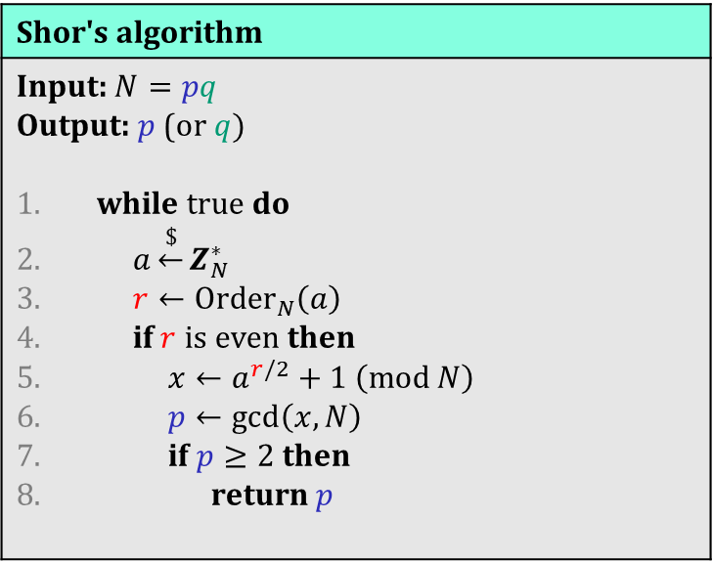
Shor's algorithm
Shor's algorithm
Input: $N=pq$ Output: $p$ (or $q)$ while true do $a\underset{←}{\$}Z_{N}^{∗}$ $r←{Order}_{N}\left(a\right)$ if $r$ is even then $x←a^{r/2}+1 \left(\operatorname{mod}{N}\right)$ $p←\gcd\left(x,N\right)$ if $p≥2$ then return $p$
This is where the quantum magic happens!
// how to find?

Slide 19
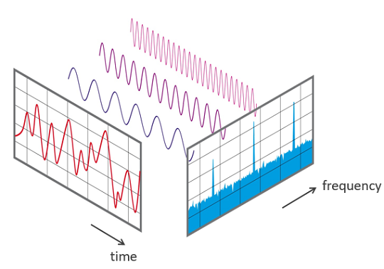

Shor’s algorithm
To factor $N$: find order of $a$ in $Z_{N}^{∗}$
Problem: $r$ can be very large
  Classical solutions take exponential time
Note: the function $f\left(i\right)=a^{i}\operatorname{mod}{N}$ is periodic:
$f\left(i+kr\right)=a^{i+kr}=a^{i}\operatorname{mod}{N}=f(i)$
  finding signal frequencies $⟺$ finding signal period
Key ingredient of Shor's algorithm:
quantum Fourier transform (QFT)
Fourier transform
Notes:
How to find period classically?
Brute-force: takes 2^n time
Create random a^r, a^r' and look for collisions: time 2^n/2

Slide 20
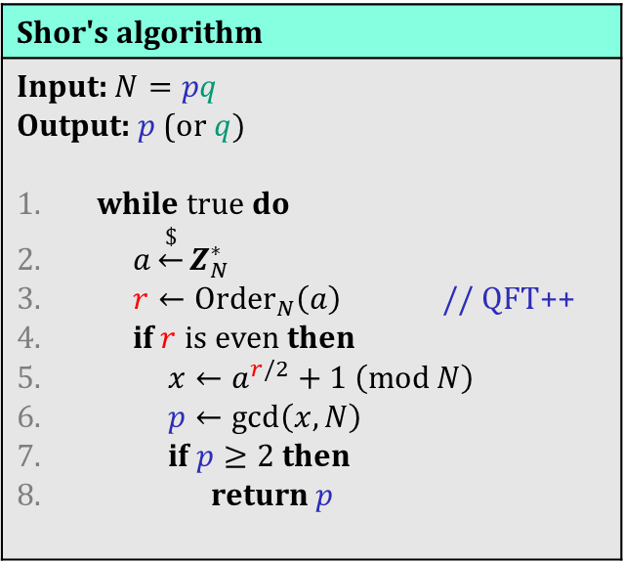
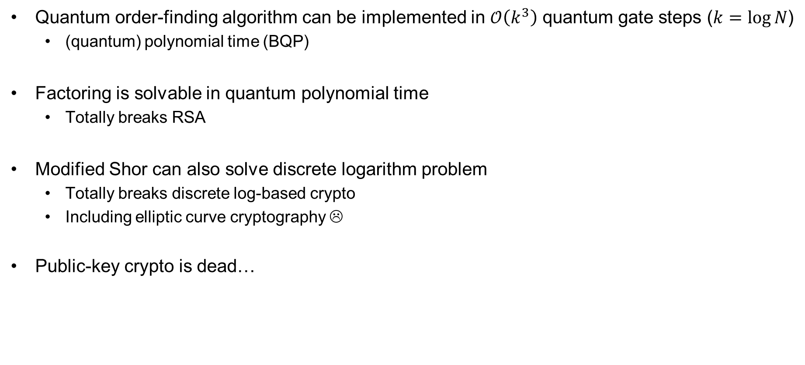
Consequences of Shor’s algorithm
Quantum order-finding algorithm can be implemented in $𝒪\left(k^{3}\right)$ quantum gate steps ($k=\log{N}$)
  (quantum) polynomial time (BQP)
Factoring is solvable in quantum polynomial time
  Totally breaks RSA
Modified Shor can also solve discrete logarithm problem
  Totally breaks discrete log-based crypto
  Including elliptic curve cryptography ☹
Public-key crypto is dead…
Shor's algorithm
Input: $N=pq$ Output: $p$ (or $q)$ while true do $a\underset{←}{\$}Z_{N}^{∗}$ $r←{Order}_{N}\left(a\right)$ // QFT++ if $r$ is even then $x←a^{r/2}+1 \left(\operatorname{mod}{N}\right)$ $p←\gcd\left(x,N\right)$ if $p≥2$ then return $p$

Slide 21

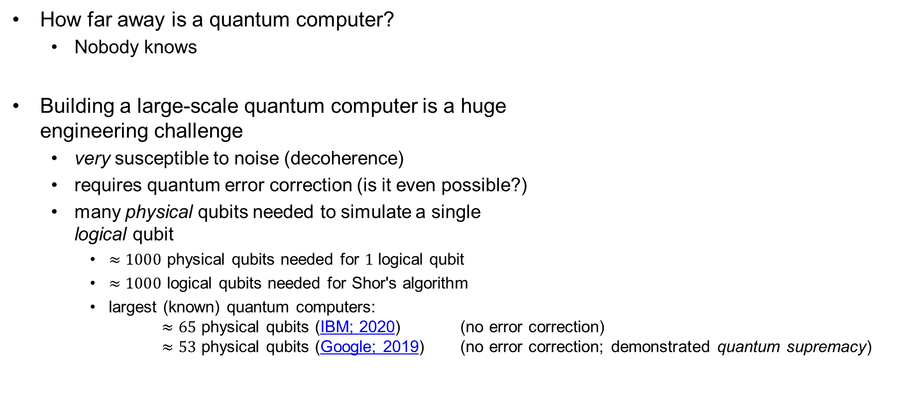
The quantum menace
How far away is a quantum computer?
  Nobody knows
Building a large-scale quantum computer is a huge
engineering challenge
  very susceptible to noise (decoherence)
  requires quantum error correction (is it even possible?)
  many physical qubits needed to simulate a single
  logical qubit
    $≈1000$ physical qubits needed for $1$ logical qubit
    $≈1000$ logical qubits needed for Shor's algorithm
    largest (known) quantum computers:
    $≈65$ physical qubits (IBM; 2020) (no error correction)
    $≈53$ physical qubits (Google; 2019) (no error correction; demonstrated quantum supremacy)

Slide 22

Dealing with quantum computers
Symmetric cryptography
  Grover's algorithm: solves $𝒪\left(2^{n}\right)$ problems in $𝒪\left(2^{n/2}\right)$ quantum steps
  Solution: double key-lengths ($128→256)$
Quantum cryptography
  Use quantum mechanics to build cryptography
Post-quantum cryptography
  Classical algorithms believed to withstand quantum attacks

Slide 23
Post-quantum cryptography
Public-key cryptography based on problems other than factoring and discrete logarithms
Top candidates:
  Lattice-based cryptography
  Code-based cryptography
  Multivariate cryptography
  Hash-based cryptography
  Isogeny-based cryptography

Slide 24

The NIST post-quantum competition
Public competition to standardize
post-quantum schemes
  Public-key encryption
  Digital signatures
Started in 2017
  Round 1: 69 submissions
  Round 2: 26 candidates selected
  Round 3: 15 candidates selected (current)
Winner(s) expected in about a year
Algorithm (public-key encryption) | Problem
Classic McEliece | Code-based
CRYSTALS-KYBER | Lattice-based
NTRU | Lattice-based
SABER | Lattice-based
BIKE | Code-based
FrodoKEM | Lattice-based
HQC | Code-based
NTRU Prime | Lattice-based
SIKE | Isogeny-based
Algorithm (digital signatures) | Problem
CRYSTALS-DILITHIUM | Lattice-based
FALCON | Lattice-based
Rainbow | Multivariate-based
GeMSS | Multivariate-based
Picnic | ZKP
SPHINCS+ | Hash-based

Slide 25


Lattice-based cryptography
Very versatile computational problems
  Public-key encryption
  Digital signatures
  Hash functions
  Fully homomorphic encryption
  Key exchange
Leads to efficient and compact schemes
Based on hardness of problems in algebraic number theory
  Believed to be hard also for quantum computers
Shortest vector problem
Closest vector problem

Slide 26

Lattice-based cryptography
https://cr.yp.to/talks/2017.12.28/slides-dan+nadia+tanja-20171228-latticehacks-16x9.pdf

Slide 27





Hash-based signatures
$$Σ.KeyGen$$
$$Σ.\text{Sig}\text{n}$$
$$Σ.\text{Vrfy}$$
$$H$$
$$+$$
SHA-256
$$=$$

Slide 28





















Hash-based signatures – Lamport's 1-time signature scheme
$$𝒮𝒦={\left\{0,1\right\}}^{512}$$
$$𝒱𝒦={\left\{0,1\right\}}^{512}$$
$$ℳ=\left\{0,1\right\}$$
$$𝒮={\left\{0,1\right\}}^{256}$$
$sk$
$$\left(M,σ\right)$$
$x_{0}$
$x_{1}$
$σ$
$$\text{Sign}\left(sk, 0\right)=x_{0}$$
$$Vrfy\left(vk, 0, σ\right)=(H\left(σ\right)\overset{?}{=}y_{0})$$
$$H$$
$$H$$
$$H$$
$$Vrfy\left(vk, 1, σ\right)=(H\left(σ\right)\overset{?}{=}y_{1})$$
$$\text{S}\text{ig}\text{n}\left(sk, 1\right)=x_{1}$$
$y_{0}$
$y_{1}$
$y′$
$vk$
$$y^{′}\overset{?}{=}y_{M}$$

Slide 29






















































Lamport OTS – signing more bits
$n=4$
$$ℳ={\left\{0,1\right\}}^{n}$$
$$Sign\left(sk, 0110\right)$$
$sk=sk || sk || sk || sk$
$sk$
$sk$
$sk$
$sk$
$x_{0} x_{1} x_{1} x_{0}$
$x_{0}$
$x_{1}$
$x_{0}$
$x_{1}$
$x_{0}$
$x_{1}$
$x_{0}$
$x_{1}$
$$H$$
$$H$$
$$H$$
$$H$$
$$H$$
$$H$$
$$H$$
$$H$$
$$Vrfy\left(vk, 0110,σσσσ\right)$$
$σ$
$σ$
$σ$
$σ$
$y_{0}$
$y_{1}$
$y_{0}$
$y_{1}$
$y_{0}$
$y_{1}$
$y_{0}$
$y_{1}$
$$H$$
$$H$$
$$H$$
$$H$$
$vk$
$vk$
$vk$
$vk$
$vk=vk || vk || vk || vk$
$y^{′}$
$y^{′}$
$y^{′}$
$y^{′}$
$y^{′}\overset{?}{=}y_{0}$
$y^{′}\overset{?}{=}y_{0}$
$y^{′}\overset{?}{=}y_{0}$
$y^{′}\overset{?}{=}y_{0}$

Slide 30



Lamport OTS – security
Theorem: If is $H$ one-way then Lamport is one-time UF-CMA secure.
Detailed: For any one-time UF-CMA attacker $A$ against Lamport, there is an algorithm $B$ such that
$$Adv_{Lamport }^{ot–uf–cma}\left(A\right)≤Adv_{H}^{ow}\left(B\right)$$
$sk$
$x_{0}$
$x_{1}$
$σ$
$$\text{Sign}\left(sk, 0\right)=x_{0}$$
$$H$$
$$H$$
$$H$$
Trying to forge message $1$
$y_{0}$
$y_{1}$
$y′$
$vk$
$$y^{′}\overset{?}{=}y_{1}$$

Slide 31










When we say one-time we mean it
$sk= sk || sk || sk || sk$
$\left(x_{0},x_{1}\right) \left(x_{0},x_{1}\right) \left(x_{0},x_{1}\right) \left(x_{0},x_{1}\right)$
$M=0111$
$$\text{Sign}$$
$σ=x_{0}x_{1}x_{1}x_{1}$
$M′=1000$
$$\text{Sign}$$
$σ=x_{1}x_{0}x_{0}x_{0}$
$M=1100$
$σ=x_{1}x_{1}x_{0}x_{0}$

Slide 32






















From 1 to $N$ signatures
$$sk$$
$$sk_{\text{ots}}^{1}$$
$$sk_{\text{ots}}^{2}$$
$${sk}_{\text{ots}}^{3}$$
$$sk_{\text{ots}}^{4}$$
$${sk}_{\text{ots}}^{5}$$
$${sk}_{\text{ots}}^{6}$$
$$sk_{\text{ots}}^{7}$$
$${sk}_{\text{ots}}^{8}$$
$$vk_{\text{ots}}^{1}$$
$$vk_{\text{ots}}^{2}$$
$$vk_{\text{ots}}^{3}$$
$${vk}_{\text{ots}}^{4}$$
$${vk}_{\text{ots}}^{5}$$
$$vk_{\text{ots}}^{6}$$
$$vk_{\text{ots}}^{7}$$
$$vk_{\text{ots}}^{8}$$
$$vk$$
$$Sign\left(sk_{ots}^{1}, M_{1}\right)=σ_{1}$$
$$Sign\left(sk_{ots}^{2}, M_{2}\right)=σ_{2}$$
$$⋯$$
$$Sign\left(sk_{ots}^{8}, M_{8}\right)=σ_{8}$$

Slide 33



From 1 to $N$ signatures
$$sk$$
$$, i$$
$$sk_{\text{ots}}^{1}$$
$$sk_{\text{ots}}^{2}$$
$${sk}_{\text{ots}}^{3}$$
$$sk_{\text{ots}}^{4}$$
$${sk}_{\text{ots}}^{5}$$
$${sk}_{\text{ots}}^{6}$$
$$sk_{\text{ots}}^{7}$$
$${sk}_{\text{ots}}^{8}$$
$$vk_{\text{ots}}^{1}$$
$$vk_{\text{ots}}^{2}$$
$$vk_{\text{ots}}^{3}$$
$${vk}_{\text{ots}}^{4}$$
$${vk}_{\text{ots}}^{5}$$
$$vk_{\text{ots}}^{6}$$
$$vk_{\text{ots}}^{7}$$
$$vk_{\text{ots}}^{8}$$
$$vk$$
$$Sign\left(sk_{ots}^{1}, M_{1}\right)=σ_{1}$$
$$Sign\left(sk_{ots}^{2}, M_{2}\right)=σ_{2}$$
$$⋯$$
$$Sign\left(sk_{ots}^{8}, M_{8}\right)=σ_{8}$$
$i$++
$i$++
$i$++

Slide 34
$N$-signaturer fra OTS
Kan signere $N$ meldinger
Privat nøkkel: $N⋅\left|sk_{ots}\right|+\log{N} bits$
Offentlig nøkkel: $N⋅\left|pk_{ots}\right| bits$
Signatur: $\left|σ_{ots}\right|+\log{N} bits$
Må lagre tilstand i privatnøkkel (teller $i$)

Slide 35



















Merkle-trees
$$vk$$
$$H$$
$$\left|pk\right|=N⋅\left|pk_{ots}\right|$$
$$\left|pk\right|=\left|H\right|$$
$$H$$
$$H$$
$$H$$
$$H$$
$$H$$
$$H$$
$${vk}_{\text{ots}}^{1}$$
$$vk_{\text{ots}}^{2}$$
$${vk}_{\text{ots}}^{3}$$
$$vk_{\text{ots}}^{4}$$
$$vk_{\text{ots}}^{5}$$
$$vk_{\text{ots}}^{6}$$
$${vk}_{\text{ots}}^{7}$$
$$vk_{\text{ots}}^{8}$$
$${sk}_{\text{ots}}^{1}$$
$$sk_{\text{ots}}^{2}$$
$$sk_{\text{ots}}^{3}$$
$${sk}_{\text{ots}}^{4}$$
$$sk_{\text{ots}}^{5}$$
$$sk_{\text{ots}}^{6}$$
$$sk_{\text{ots}}^{7}$$
$${sk}_{\text{ots}}^{8}$$

Slide 36









Merkle-trees – signing
$$\text{Sign}\left(sk, M\right)$$
$$\text{= }\text{Sign}\left(sk_{\text{ots}}^{4}, M\right)$$
$$+ vk_{\text{ots}}^{4}$$
$$+ \text{authentication} \text{path} \text{for} pk_{\text{ots}}^{4}$$
$i$++
$$vk$$
$$H$$
$$H$$
$$H$$
$$H$$
$$H$$
$$H$$
$$H$$
$${vk}_{\text{ots}}^{1}$$
$$vk_{\text{ots}}^{2}$$
$${vk}_{\text{ots}}^{3}$$
$$vk_{\text{ots}}^{4}$$
$$vk_{\text{ots}}^{5}$$
$$vk_{\text{ots}}^{6}$$
$${vk}_{\text{ots}}^{7}$$
$$vk_{\text{ots}}^{8}$$
$${sk}_{\text{ots}}^{1}$$
$$sk_{\text{ots}}^{2}$$
$$sk_{\text{ots}}^{3}$$
$${sk}_{\text{ots}}^{4}$$
$$sk_{\text{ots}}^{5}$$
$$sk_{\text{ots}}^{6}$$
$$sk_{\text{ots}}^{7}$$
$${sk}_{\text{ots}}^{8}$$

Slide 37





Merkle-trees – verification
$$\text{Vrfy}\left(vk, M, { (σ}_{\text{ots}}, vk_{\text{ots}}^{4}, \text{auth} \text{path}) \right)$$
$$σ$$
$$σ$$
$$vk^{′}$$
$$H$$
$$H$$
$$H$$
$\text{Vrfy}\left(vk_{\text{ots}}^{i}, M, σ_{\text{ots}}\right)\overset{?}{=}\text{VALID}$
$$2. {vk}^{′}\overset{?}{=}vk$$
$$vk_{\text{ots}}^{4}$$

Slide 38






Merkle-signaturer
Can sign $2^{h}$ messages
Signing key: $N⋅\left|sk_{ots}\right| +h bits$
Verification key: $\left|H\right| bits$
Signatures: $\left|σ_{ots}\right|+2⋅\left|pk_{ots}\right|+(h−1)⋅\left|H\right| bits$
Need to store state (counter $i$)
$H=SHA256 h=20$
$$\left|sk\right|=276 bits$$
$\left|vk\right|=256 bits$
$\left|σ\right|≈3k bytes$

Slide 39












Hierarchical hashing
$$vk$$
$$\#\text{OTS} \text{signing} \text{keys}$$
$$2^{h} \text{OTS} \text{verif}\text{. }\text{keys}$$
$$2^{h}$$
SPHINCS+ $≈$
$$2^{h} \text{OTS} \text{verif}\text{. }\text{keys}$$
$$2^{2h}$$
$$d \text{layers}$$
$$2^{h} \text{OTS} \text{verif}\text{. }\text{keys}$$
$$2^{3h}$$
$$⋯$$
$$⋯$$
$$2^{h} \text{OTS} \text{verif}\text{. }\text{keys}$$
$$2^{dh}$$

Slide 40
Learn more about post-quantum cryptography?
Want to learn more about post-quantum cryptography?
Sign up for TEK5550 - Advanced Topics in Cryptology next spring!

Slide 41
End of course

Slide 42
Next week
Summary lecture
Nothing planned; tell me want you want me to repeat/explain further
Exam
  Digital home exam
  Wednesday November 25
  4 hours (possibly +0.5)
  Format: single PDF file made available on Inspera and Canvas (similar to midterm)
  Answers are typed directly into Inspera (no PDF upload); will create forms that mirrors problems in exam PDF
  NO collaboration is allowed
  Students may be picked out for conversations to prove ownership of answer

