Slide 1
Lecture 13 – Course recap
TEK4500
17.11.2020
Håkon Jacobsen
hakon.jacobsen@its.uio.no

Slide 2
What is cryptography?
Internet
Alice
Bob
M
Adversary
Security goals:
Data privacy: adversary should not be able to read message M

Slide 3
What is cryptography?
Internet
Alice
Bob
M
M'
Adversary
Security goals:
Data privacy: adversary should not be able to read message M
Data integrity: adversary should not be able to modify message M
Data authenticity: message M really originated from Alice

Slide 4
Ideal solution: secure channels
But how to build?
Internet
Alice
Bob
M
Adversary
Security goals:
Data privacy: adversary should not be able to read message M ✓
Data integrity: adversary should not be able to modify message M ✓
Data authenticity: message M really originated from Alice ✓

Slide 5
Creating secure channels: encryption schemes
Internet
Alice
Bob
K
K
$$ℰ$$
C
$$𝒟$$
M
M / $⊥$
Adversary
$𝓔$ : encryption algorithm (public)
$𝓓$ : decryption algorithm (public)
/ decryption
K : encryption key (secret)

Slide 6
Creating secure channels: encryption schemes
Internet
Alice
Bob
K_{e}
K_{d}
$$ℰ$$
C
$$𝒟$$
M
M / $⊥$
Adversary
$𝓔$ : encryption algorithm (public) K_{e} : encryption key (public)
$𝓓$ : decryption algorithm (public) K_{d} : decryption key (secret)

Slide 7
Basic goals of cryptography
IND-CPA, IND$-CPA IND-CCA
UF-CMA
AE
 | Message privacy | Message integrity / authentication
Symmetric keys | Symmetric encryption | Message authentication codes (MAC)
Asymmetric keys | Asymmetric encryption (a.k.a. public-key encryption) | Digital signatures
(Key exchange)
IND-CPA, IND-CCA
UF-CMA
Unkeyed primitives
Hash functions
Collision resistance, one-wayness

Slide 8
Basic goals of cryptography
Encrypt-then-MAC
AES-GCM
AES-CCM
AES-OCB
AES-CTR, AES-CTR$
AES-CBC$
CBC-MAC, CMAC,
PRF
 | Message privacy | Message integrity / authentication
Symmetric keys | Symmetric encryption | Message authentication codes (MAC)
Asymmetric keys | Asymmetric encryption (a.k.a. public-key encryption) | Digital signatures
Diffie-Hellman
(Key exchange)
ElGamal, Padded RSA
Schnorr, ECDSA, Hashed RSA
Unkeyed primitives
Hash functions
SHA2-256, SHA2-512
SHA3-256, SHA3-512

Slide 9
Constructions and relations
GCM++, CCM, OCB++
CTR
Symmetric-key encryption
PRF
AE
AEAD
CBC$
EtM
Feistel
PRP
MAC schemes
CBC-MAC, CMAC, PMAC
Protocols
TLS, SSH, IPsec, What's App
Davies-Mayer
HMAC
ElGamal
Hash functions
Public-key encryption
Lamport-Merkle
ElGamal
Key exchange
Merkle- Damgård
Schnorr, ECDSA
Diffie-Hellman
Digital signatures
RSA++
One-Way Trapdoor functions
RSA

Slide 10
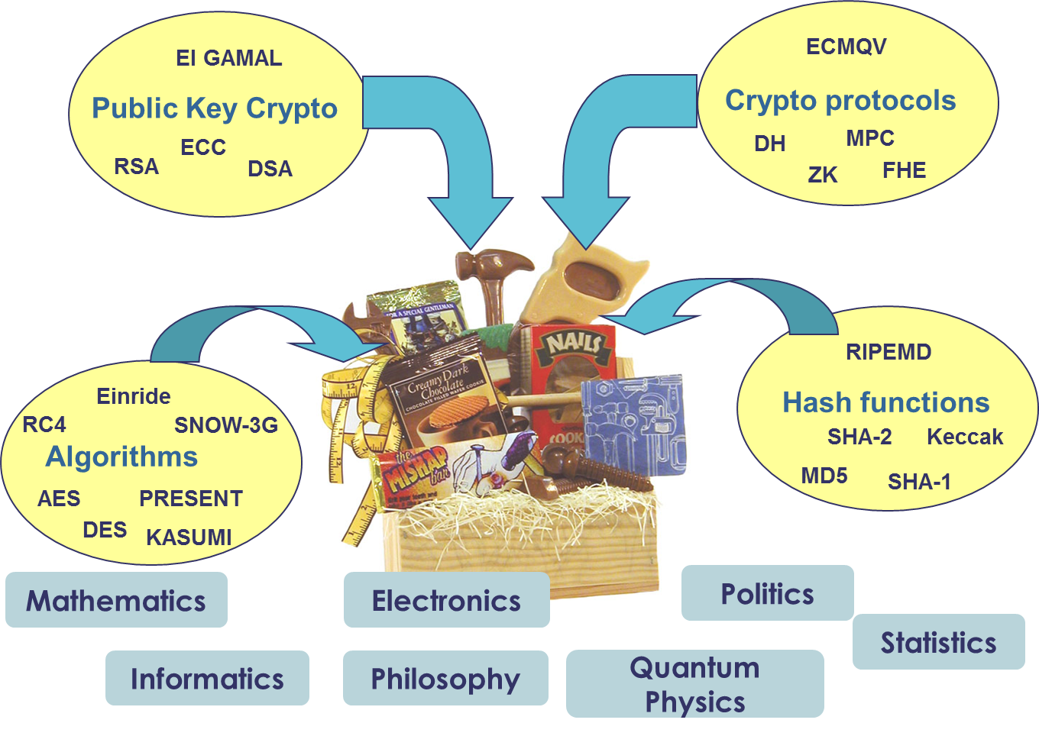
The crypto toolbox

Slide 11
Exam
Digital home exam
Wednesday November 25, 09:00-13:30 (4.5 hours)
Format: single PDF file made available on Inspera and Canvas (similar to midterm)
Answers are typed directly into Inspera (no PDF upload); will create forms that mirrors problems in exam PDF
NO collaboration is allowed
Students may be picked out for conversations to prove ownership of answer
I will be available on Zoom for questions (you can also send emails)

