Slide 1
Lecture 2 – Block ciphers, PRFs/PRPs,
DES, AES
TEK4500
01.09.2020
Håkon Jacobsen
hakon.jacobsen@its.uio.no

Slide 2

Ideal solution: secure channels
Internet
Alice
Bob
M
Adversary
Security goals:
Data privacy: adversary should not be able to read message M ✓
Data integrity: adversary should not be able to modify message M ✓
Data authenticity: message M really originated from Alice ✓

Slide 3

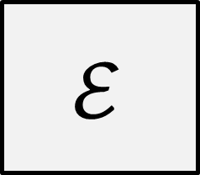


Encryption schemes
Plaintext
$$ℳ$$
$$ℰ$$
$$𝒦$$
Key
Ciphertext
$$𝒞$$

Slide 4





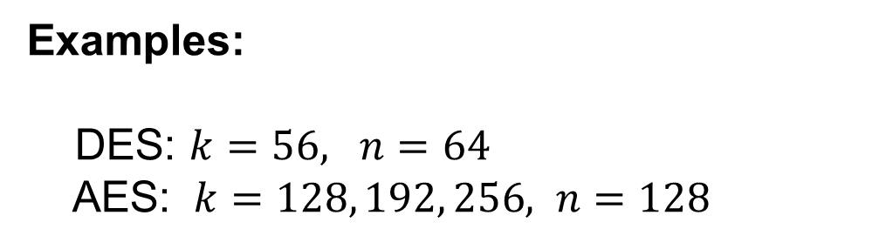


Block ciphers
$$k=80, 128, 192, 256$$
$${\left\{0,1\right\}}^{n}$$
Plaintext
$$n=64, 128, 256$$
$$128$$
$$ℰ$$
$${\left\{0,1\right\}}^{k}$$
Key
$$128$$
Examples:
DES: $k=56, n=64$
AES: $k=128, 192, 256, n=128$
Ciphertext
$${\left\{0,1\right\}}^{n}$$

Slide 5


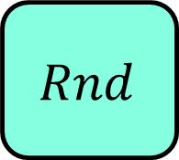






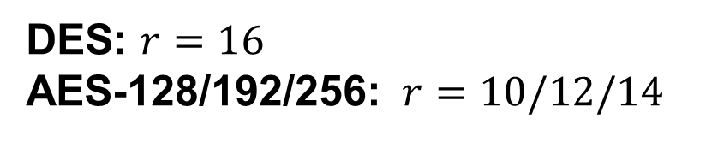



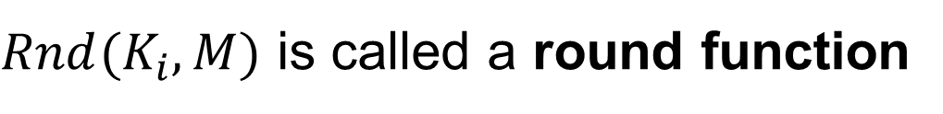
Block ciphers
$$K$$
Key expansion
$$K_{1}$$
$$K_{2}$$
$$K_{3}$$
$$K_{r}$$
$$Rnd$$
$$Rnd$$
$$Rnd$$
$$Rnd$$
$$M$$
$$⋯$$
$$C$$
$Rnd(K_{i}, M)$ is called a round function
DES: $r=16$
AES-128/192/256: $r=10/12/14$

Slide 6







Block cipher applications (1)
Encryption of messages of 128 bits (block length)
However: we usually want to encrypt messages of arbitrary length!
  Splitting the message into multiple 128 bit blocks (like above) is not secure!
  Need to use them in a proper mode-of-operation (covered later in the course)
Correct viewpoint: block ciphers are not encryption schemes!
  Block ciphers are primitives used to construct other things
$$K$$
$$K$$
$$Y_{1}, { Y}_{2},…, { Y}_{t}$$
$$Y_{i}←E_{K}(M_{i})$$
$$M_{i}←E_{K}^{−1}(Y_{i})$$

Slide 7
Block cipher applications (2)
The “work horse” of crypto
Can be used to build:
  Encryption of arbitrary length messages (including stream ciphers)
  Message authentication codes
  Authenticated encryption
  Hash functions
  (Cryptographically secure) pseudorandom generators
  Key derivation functions

Slide 8
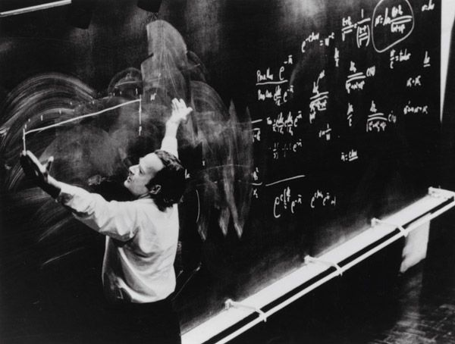
Defining block ciphers

Slide 9
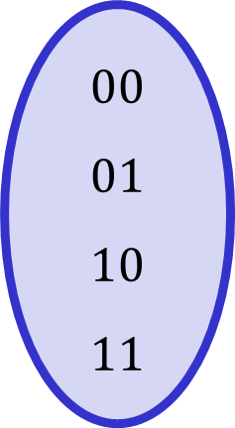
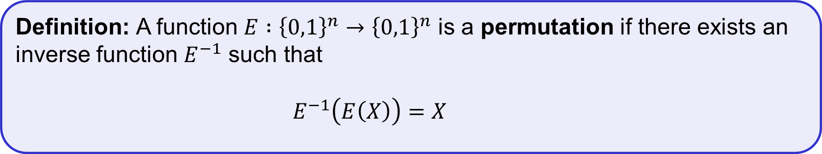
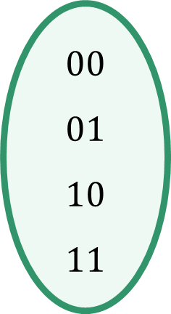
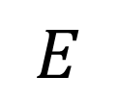
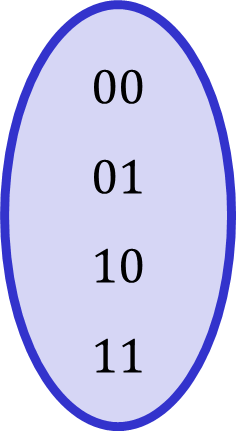
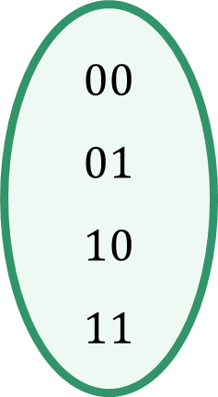
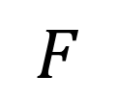
Permutations
Definition: A function $E :{\left\{0,1\right\}}^{n}→{\left\{0,1\right\}}^{n}$ is a permutation if there exists an inverse function $E^{−1}$ such that
$E^{−1}\left(E\left(X\right)\right)=X$
$$E$$
$$F$$
$$00 \\ 01 \\ 10 \\ 11$$
$$00 \\ 01 \\ 10 \\ 11$$
$$00 \\ 01 \\ 10 \\ 11$$
$$00 \\ 01 \\ 10 \\ 11$$
Permutation
Not a permutation

Slide 10
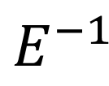
Permutations
Definition: A function $E :{\left\{0,1\right\}}^{n}→{\left\{0,1\right\}}^{n}$ is a permutation if there exists an inverse function $E^{−1}$ such that
$E^{−1}\left(E\left(X\right)\right)=X$
$$E^{−1}$$
$$F$$
$$00 \\ 01 \\ 10 \\ 11$$
$$00 \\ 01 \\ 10 \\ 11$$
$$00 \\ 01 \\ 10 \\ 11$$
$$00 \\ 01 \\ 10 \\ 11$$
Permutation
Not a permutation

Slide 11
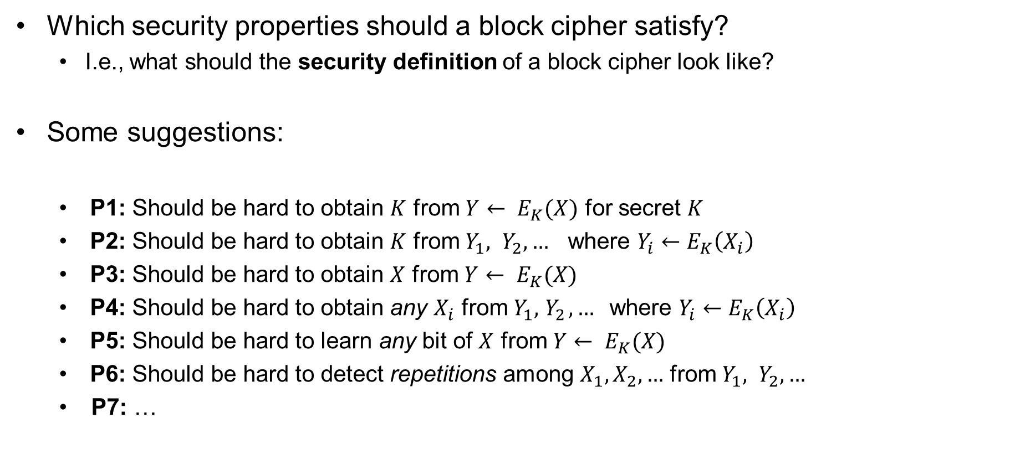
Block cipher security
Which security properties should a block cipher satisfy?
  I.e., what should the security definition of a block cipher look like?
Some suggestions:
  P1: Should be hard to obtain $K$ from ${Y← E}_{K}(X)$ for secret $K$
  P2: Should be hard to obtain $K$ from $Y_{1}, Y_{2}, …$ where $Y_{i}←E_{K}\left(X_{i}\right)$
  P3: Should be hard to obtain $X$ from ${Y← E}_{K}(X)$
  P4: Should be hard to obtain any $X_{i}$ from $Y_{1}, { Y}_{2}, …$where $Y_{i}←E_{K}\left(X_{i}\right)$
  P5: Should be hard to learn any bit of $X$ from ${Y← E}_{K}(X)$
  P6: Should be hard to detect repetitions among $X_{1},X_{2},…$ from $Y_{1}, Y_{2}, …$
  P7: …

Slide 12
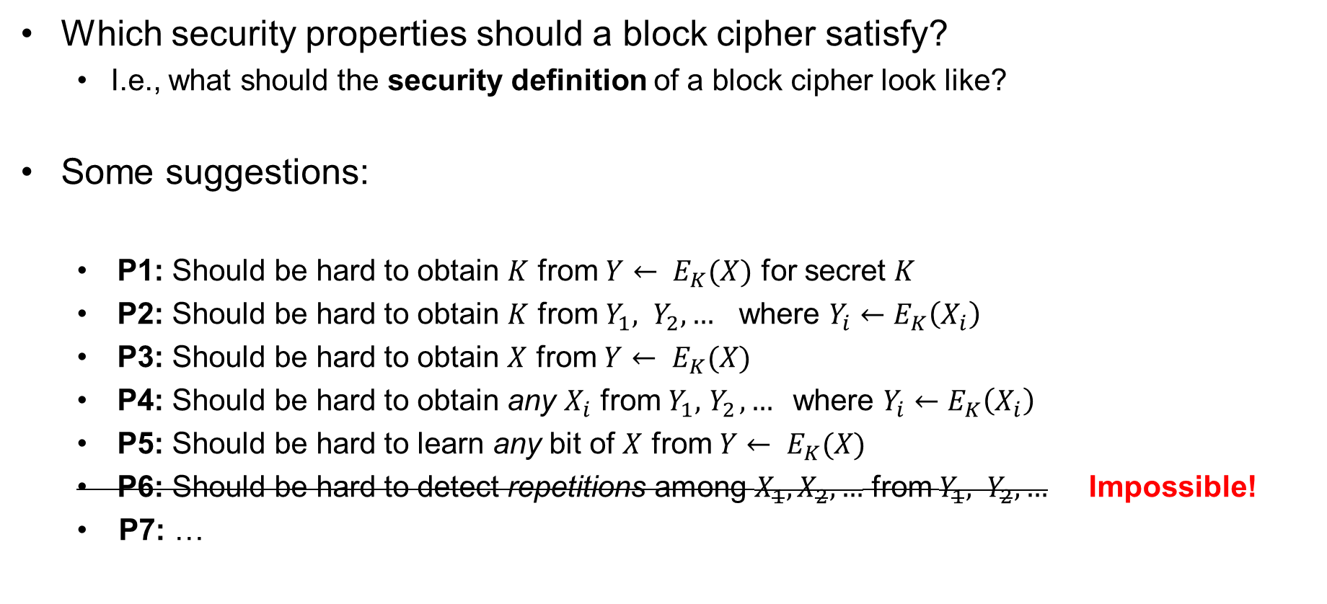
Block cipher security
Which security properties should a block cipher satisfy?
  I.e., what should the security definition of a block cipher look like?
Some suggestions:
  P1: Should be hard to obtain $K$ from ${Y← E}_{K}(X)$ for secret $K$
  P2: Should be hard to obtain $K$ from $Y_{1}, Y_{2}, …$ where $Y_{i}←E_{K}\left(X_{i}\right)$
  P3: Should be hard to obtain $X$ from ${Y← E}_{K}(X)$
  P4: Should be hard to obtain any $X_{i}$ from $Y_{1}, { Y}_{2}, …$where $Y_{i}←E_{K}\left(X_{i}\right)$
  P5: Should be hard to learn any bit of $X$ from ${Y← E}_{K}(X)$
  P6: Should be hard to detect repetitions among $X_{1},X_{2},…$ from $Y_{1}, Y_{2}, …$ Impossible!
  P7: …
Not good enough!

Slide 13
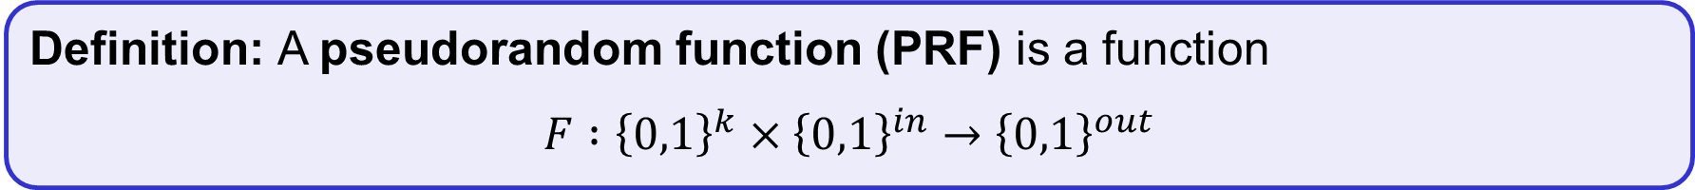

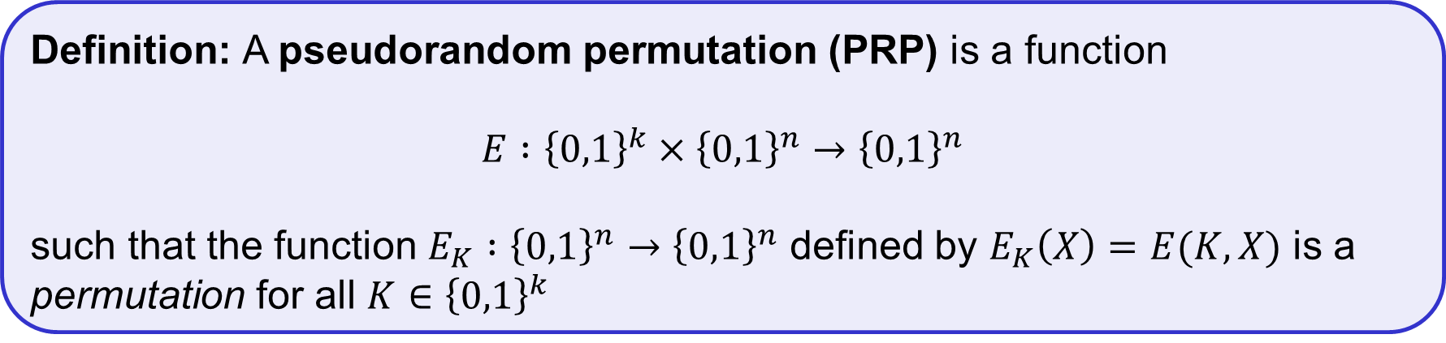
Pseudorandom functions (PRFs) and permutations (PRP)
$k, in, out$ are called the key-length, input-length, and output-length of $F$
Think of a PRF as a family of functions:
  For each $K∈{\left\{0,1\right\}}^{k}$ we get a function $F_{K} :{\left\{0,1\right\}}^{in}→{\left\{0,1\right\}}^{out}$ defined by $F_{K}\left(X\right)=F(K, X)$
Definition: A pseudorandom function (PRF) is a function
$$F :{\left\{0,1\right\}}^{k}×{\left\{0,1\right\}}^{in}→{\left\{0,1\right\}}^{out}$$
PRP = block cipher!
also: all PRPs are PRFs
(but not the other way around)
Definition: A pseudorandom permutation (PRP) is a function
$$E :{\left\{0,1\right\}}^{k}×{\left\{0,1\right\}}^{n}→{\left\{0,1\right\}}^{n}$$
such that the function $E_{K} :{\left\{0,1\right\}}^{n}→{\left\{0,1\right\}}^{n}$ defined by $E_{K}\left(X\right)=E(K, X)$ is a permutation for all $K∈{\left\{0,1\right\}}^{k}$

Slide 14
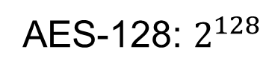

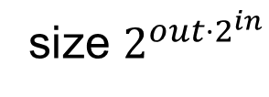
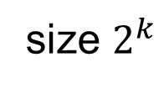
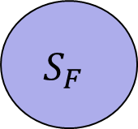
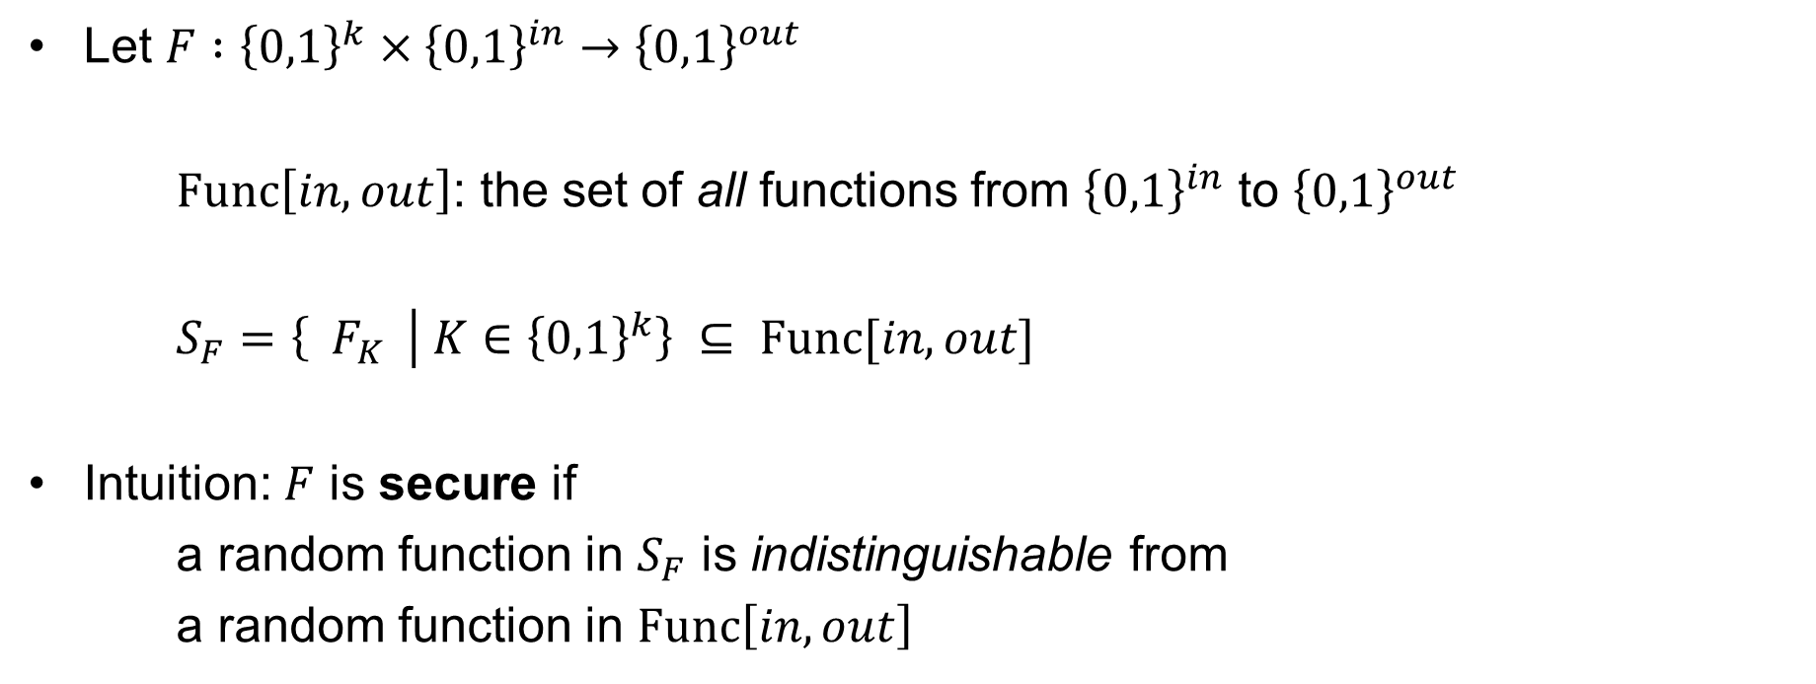

Secure PRFs
Let $F :{\left\{0,1\right\}}^{k}×{\left\{0,1\right\}}^{in}→{\left\{0,1\right\}}^{out}$
$Func\left[in, out\right]$: the set of all functions from ${\left\{0,1\right\}}^{in}$ to ${\left\{0,1\right\}}^{out}$
$S_{F}=\left\{{ F}_{K} | K∈{\left\{0,1\right\}}^{k}\right\} ⊆ Func[in, out]$
Intuition: $F$ is secure if
a random function in $S_{F}$ is indistinguishable from
a random function in $Func\left[in, out\right]$
$$Func\left[in, out\right]$$
$$S_{F}$$
size $2^{{out⋅2}^{in}}$
size $2^{k}$
AES-128: $2^{128}$
$${\left(2^{128}\right)}^{2^{128}}$$

Slide 15



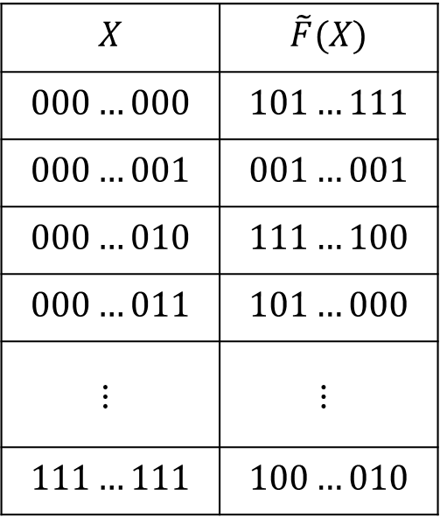
Random functions
Let $\tilde{F}∈Func\left[in, out\right]$
$$X$$ | $$\tilde{F}(X)$$
$$000…000$$ | $$101…111$$
$$000…001$$ | $$001…001$$
$$000…010$$ | $$111…100$$
$$000…011$$ | $$101…000$$
$$⋮$$ | $$⋮$$
$$111…111$$ | $$100…010$$
$$2^{in}$$
$$out$$
Notes:
Used to functions defined through rules: f(x) = 2 * x or f(x) = x^2 or f(x) = sin(x)

Slide 16
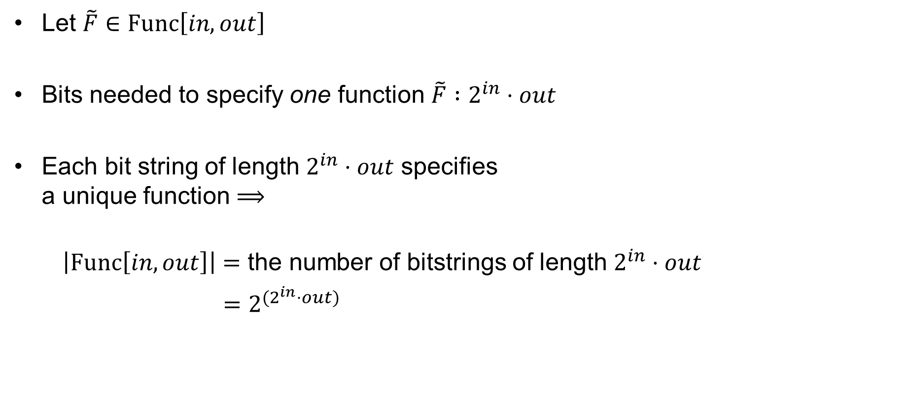

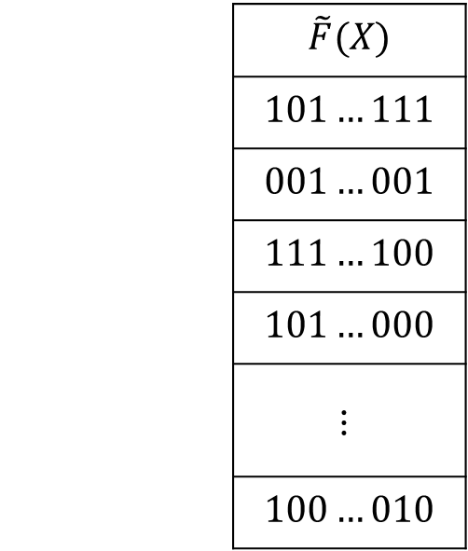
Random functions
Let $\tilde{F}∈Func\left[in, out\right]$
Bits needed to specify one function $\tilde{F} :2^{in}⋅out$
Each bit string of length $2^{in}⋅out$ specifies
a unique function $⟹$
$\left|Func\left[in, out\right]\right|=$ the number of bitstrings of length $2^{in}⋅out$
$=2^{(2^{in}⋅out)}$
 | $$\tilde{F}(X)$$
 | $$101…111$$
 | $$001…001$$
 | $$111…100$$
 | $$101…000$$
 | $$⋮$$
 | $$100…010$$
$$2^{in}$$
$$out$$

Slide 17
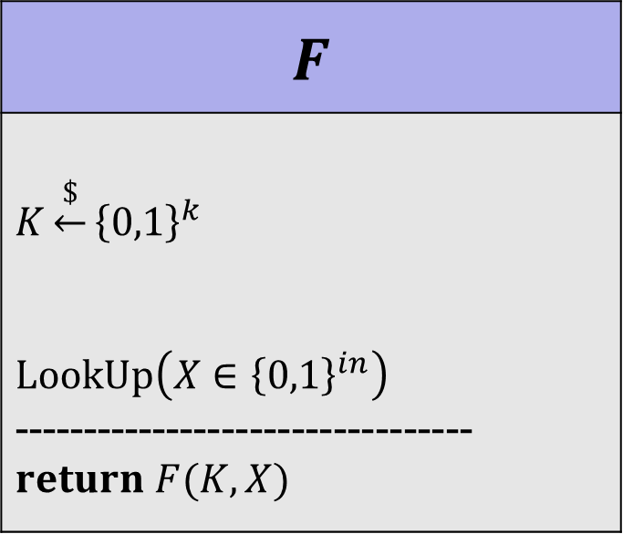
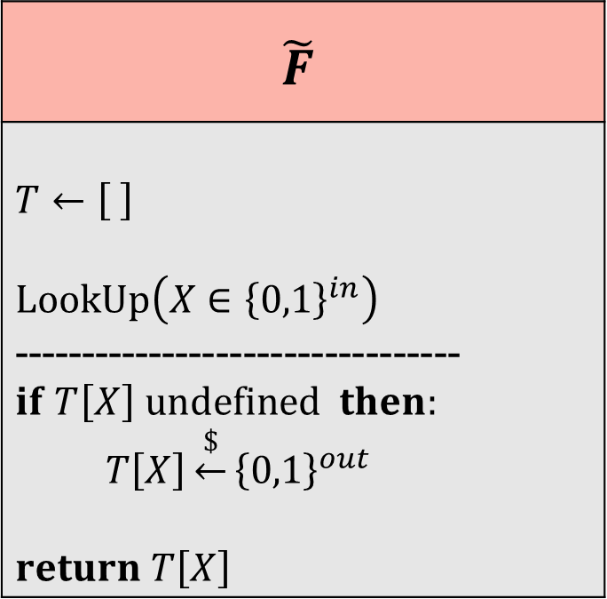

Random functions – alternate view
$$\tilde{F}$$
$$T←\left[ \right]$$ $$LookUp\left(X∈{\left\{0,1\right\}}^{in}\right)$$ --------------------------------- $$if T\left[X\right] undefined then:$$ $T\left[X\right]\underset{←}{\$}{\left\{0,1\right\}}^{out}$ $return T\left[X\right]$
$$F$$
$$K\underset{←}{\$}{\left\{0,1\right\}}^{k}$$ $$LookUp\left(X∈{\left\{0,1\right\}}^{in}\right)$$ ---------------------------------$return F(K, X)$
PRF security
$$≈$$

Slide 18



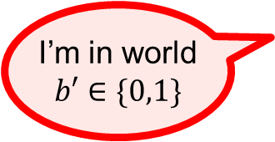

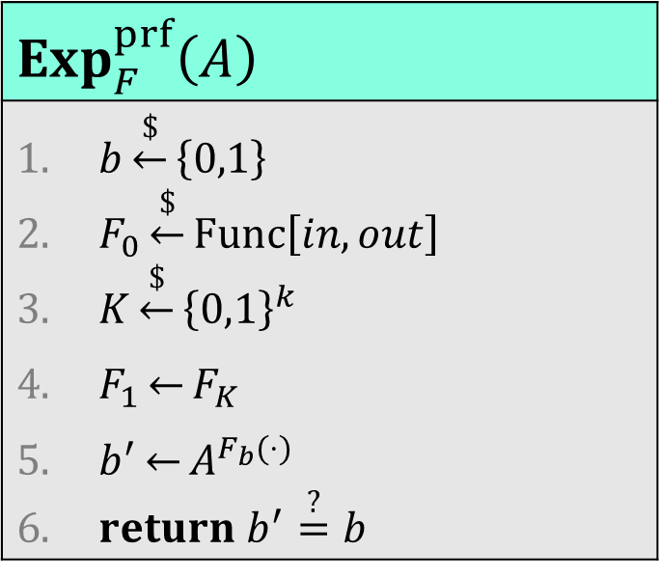
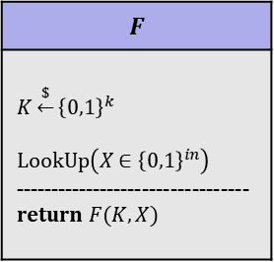
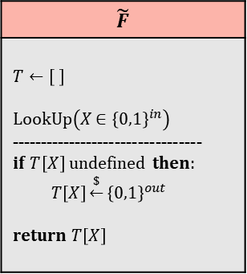
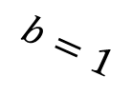

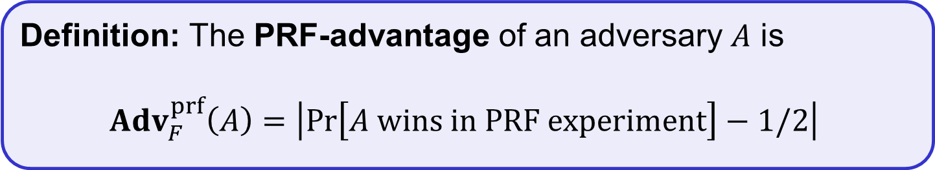


PRF security definition
$$Exp_{F}^{prf}\left(A\right)$$
$b\underset{←}{\$}\left\{0,1\right\}$ $F_{0}\underset{←}{\$}Func\left[in, out\right]$ $K\underset{←}{\$}{\left\{0,1\right\}}^{k}$ $F_{1}\underset{←}{}F_{K}$ $b^{′}\underset{←}{}A^{F_{b}(⋅)}$ $return b^{′}\overset{?}{=}b$
$$b=0$$
$$b=1$$
$$A=$$
$$\tilde{F}$$
$$T←\left[ \right]$$ $$LookUp\left(X∈{\left\{0,1\right\}}^{in}\right)$$ --------------------------------- $$if T\left[X\right] undefined then:$$ $T\left[X\right]\underset{←}{\$}{\left\{0,1\right\}}^{out}$ $return T\left[X\right]$
$$F$$
$$K\underset{←}{\$}{\left\{0,1\right\}}^{k}$$ $$LookUp\left(X∈{\left\{0,1\right\}}^{in}\right)$$ ---------------------------------$return F(K, X)$
$$X_{1} \\ X_{2} \\ ⋮$$
$$Y_{1}$$
$$Y_{2} \\ ⋮$$
I’m in world
$$b′∈\{0,1\}$$
Definition: The PRF-advantage of an adversary $A$ is
$${Adv}_{F}^{prf}\left(A\right)=\left|\operatorname{Pr}\left[A wins in PRF­­­ experiment\right]−1/2\right|$$

Slide 19
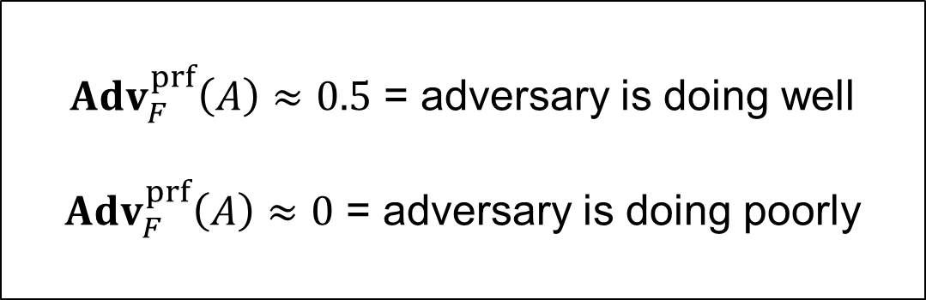
PRF security definition
$$Exp_{F}^{prf}\left(A\right)$$
$b\underset{←}{\$}\left\{0,1\right\}$ $F_{0}\underset{←}{\$}Func\left[in, out\right]$ $K\underset{←}{\$}{\left\{0,1\right\}}^{k}$ $F_{1}\underset{←}{}F_{K}$ $b^{′}\underset{←}{}A^{F_{b}(⋅)}$ $return b^{′}\overset{?}{=}b$
$$b=0$$
$$b=1$$
$$A=$$
$$\tilde{F}$$
$$T←\left[ \right]$$ $$LookUp\left(X∈{\left\{0,1\right\}}^{in}\right)$$ --------------------------------- $$if T\left[X\right] undefined then:$$ $T\left[X\right]\underset{←}{\$}{\left\{0,1\right\}}^{out}$ $return T\left[X\right]$
$$F$$
$$K\underset{←}{\$}{\left\{0,1\right\}}^{k}$$ $$LookUp\left(X∈{\left\{0,1\right\}}^{in}\right)$$ ---------------------------------$return F(K, X)$
$$X_{1} \\ X_{2} \\ ⋮$$
$$Y_{1}$$
$$Y_{2} \\ ⋮$$
${Adv}_{F}^{prf}\left(A\right)≈0.5$ = adversary is doing well
${Adv}_{F}^{prf}\left(A\right)≈0$ = adversary is doing poorly
I’m in world
$$b′∈\{0,1\}$$
Definition: The PRF-advantage of an adversary $A$ is
$${Adv}_{F}^{prf}\left(A\right)=\left|\operatorname{Pr}\left[A wins in PRF­­­ experiment\right]−1/2\right|$$

Slide 20
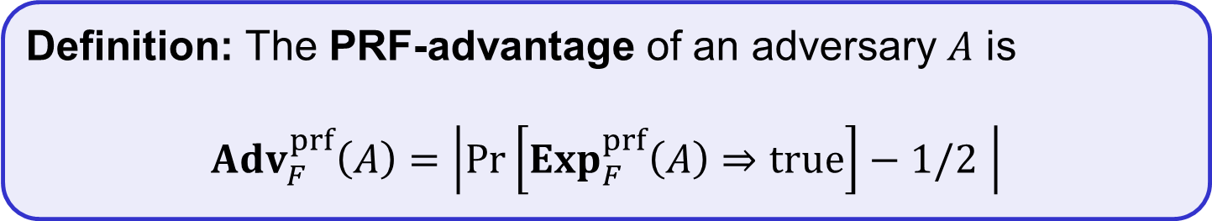
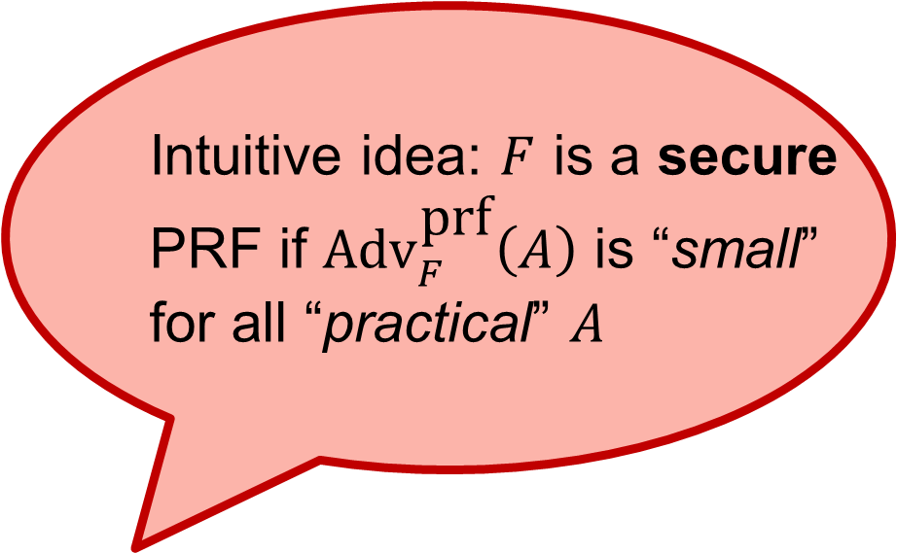
PRF security definition
$$Exp_{F}^{prf}\left(A\right)$$
$b\underset{←}{\$}\left\{0,1\right\}$ $F_{0}\underset{←}{\$}Func\left[in, out\right]$ $K\underset{←}{\$}{\left\{0,1\right\}}^{k}$ $F_{1}\underset{←}{}F_{K}$ $b^{′}\underset{←}{}A^{F_{b}(⋅)}$ $return b^{′}\overset{?}{=}b$
Intuitive idea: $F$ is a secure
PRF if ${\text{Adv}}_{F}^{\text{p}\text{rf}}\left(A\right)$ is “small”
for all “practical” $A$
Definition: The PRF-advantage of an adversary $A$ is
$${Adv}_{F}^{prf}\left(A\right)=\left|\operatorname{Pr}\left[{Exp}_{F}^{prf}\left(A\right)⇒true\right]−1/2 \right|$$

Slide 21
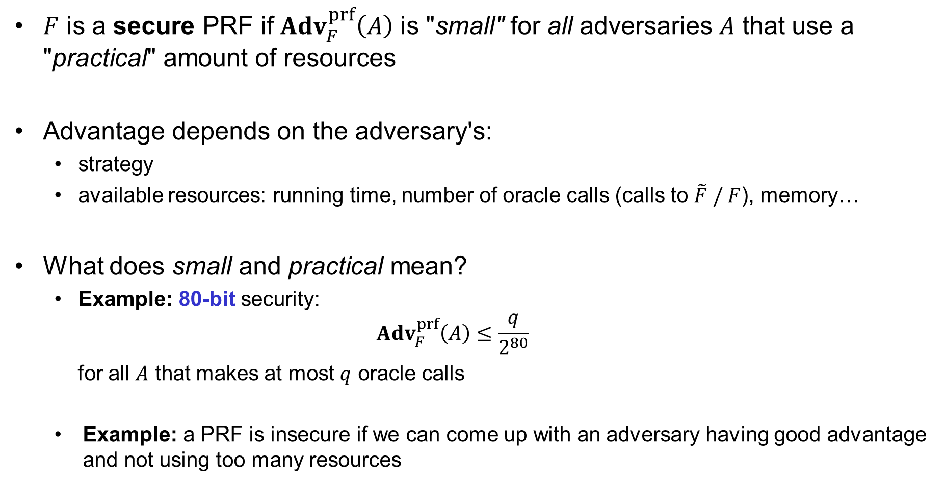
Understanding "advantage"
$F$ is a secure PRF if ${Adv}_{F}^{prf}\left(A\right)$ is "small" for all adversaries $A$ that use a "practical" amount of resources
Advantage depends on the adversary's:
  strategy
  available resources: running time, number of oracle calls (calls to $\tilde{F} / F$), memory…
What does small and practical mean?
  Example: 80-bit security:
  ${Adv}_{F}^{prf}\left(A\right)≤\frac{q}{2^{80}}$
  for all $A$ that makes at most $q$ oracle calls
  Example: a PRF is insecure if we can come up with an adversary having good advantage and not using too many resources

Slide 22
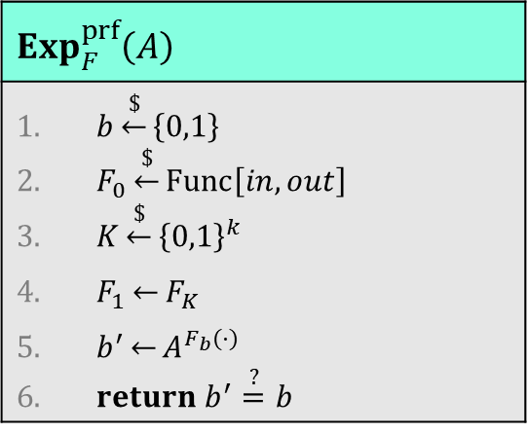



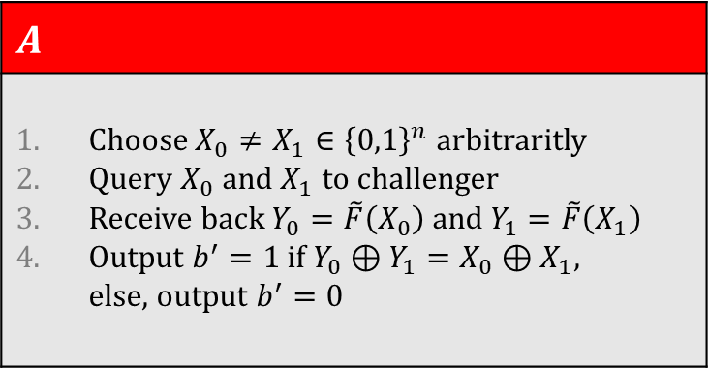
Example
Let $F :{\left\{0,1\right\}}^{n}×{\left\{0,1\right\}}^{n}→{\left\{0,1\right\}}^{n}$ be defined by $F\left(K, X\right)=K⊕X$
Claim: $F$ is not a secure PRF
$$Exp_{F}^{prf}\left(A\right)$$
$b\underset{←}{\$}\left\{0,1\right\}$ $F_{0}\underset{←}{\$}Func\left[in, out\right]$ $K\underset{←}{\$}{\left\{0,1\right\}}^{k}$ $F_{1}\underset{←}{}F_{K}$ $b^{′}\underset{←}{}A^{F_{b}(⋅)}$ $return b^{′}\overset{?}{=}b$
$$A$$
Choose $X_{0}≠X_{1}∈{\left\{0,1\right\}}^{n}$ arbitraritly Query $X_{0}$ and $X_{1}$ to challenger Receive back $Y_{0}=\tilde{F}\left(X_{0}\right)$ and $Y_{1}=\tilde{F}\left(X_{1}\right)$ Output $b^{′}=1$ if $Y_{0}⊕Y_{1}=X_{0}⊕X_{1},$ else, output $b^{′}=0$
$$\operatorname{Pr}\left[{Exp}_{F}^{prf}\left(A\right)⇒true\right]$$
$$= \operatorname{Pr}\left[b^{′}=b\right]$$
$$= \operatorname{Pr}\left[b^{′}=1 ∣ b=1\right]⋅\operatorname{Pr}\left[ b=1\right]+\operatorname{Pr}\left[b^{′}=0 ∣ b=0\right]⋅\operatorname{Pr}\left[ b=0\right]$$
$$= \operatorname{Pr}\left[b^{′}=1 ∣ b=1\right]⋅1/2 +\operatorname{Pr}\left[b^{′}=0 ∣ b=0\right]⋅1/ 2$$
$$= Pr\left[Y_{0}⊕Y_{1}=X_{0}⊕X_{1}∣b=1\right]{⋅1/2} +\operatorname{Pr}\left[b^{′}=0 ∣ b=0\right]⋅1/ 2$$
$$= 1⋅1/2 +\operatorname{Pr}\left[b^{′}=0 ∣ b=0\right]⋅1/ 2$$

Slide 23
Example
Let $F :{\left\{0,1\right\}}^{n}×{\left\{0,1\right\}}^{n}→{\left\{0,1\right\}}^{n}$ be defined by $F\left(K, X\right)=K⊕X$
Claim: $F$ is not a secure PRF
$$Exp_{F}^{prf}\left(A\right)$$
$b\underset{←}{\$}\left\{0,1\right\}$ $F_{0}\underset{←}{\$}Func\left[in, out\right]$ $K\underset{←}{\$}{\left\{0,1\right\}}^{k}$ $F_{1}\underset{←}{}F_{K}$ $b^{′}\underset{←}{}A^{F_{b}(⋅)}$ $return b^{′}\overset{?}{=}b$
$$A$$
Choose $X_{0}≠X_{1}∈{\left\{0,1\right\}}^{n}$ arbitraritly Query $X_{0}$ and $X_{1}$ to challenger Receive back $Y_{0}=\tilde{F}\left(X_{0}\right)$ and $Y_{1}=\tilde{F}\left(X_{1}\right)$ Output $b^{′}=1$ if $Y_{0}⊕Y_{1}=X_{0}⊕X_{1},$ else, output $b^{′}=0$
$$\operatorname{Pr}\left[{Exp}_{F}^{prf}\left(A\right)⇒true\right]$$
$$= \operatorname{Pr}\left[b^{′}=b\right]$$
$$= \operatorname{Pr}\left[b^{′}=1 ∣ b=1\right]⋅\operatorname{Pr}\left[ b=1\right]+\operatorname{Pr}\left[b^{′}=0 ∣ b=0\right]⋅\operatorname{Pr}\left[ b=0\right]$$
$$= \operatorname{Pr}\left[b^{′}=1 ∣ b=1\right]⋅1/2 +\operatorname{Pr}\left[b^{′}=0 ∣ b=0\right]⋅1/ 2$$
$$= Pr\left[Y_{0}⊕Y_{1}=X_{0}⊕X_{1}∣b=1\right]{⋅1/2} +\operatorname{Pr}\left[b^{′}=0 ∣ b=0\right]⋅1/ 2$$
$$=1⋅1/2 +(1 − \operatorname{Pr}\left[b^{′}=1 ∣ b=0\right])⋅1/ 2$$

Slide 24
Example
Let $F :{\left\{0,1\right\}}^{n}×{\left\{0,1\right\}}^{n}→{\left\{0,1\right\}}^{n}$ be defined by $F\left(K, X\right)=K⊕X$
Claim: $F$ is not a secure PRF
$$Exp_{F}^{prf}\left(A\right)$$
$b\underset{←}{\$}\left\{0,1\right\}$ $F_{0}\underset{←}{\$}Func\left[in, out\right]$ $K\underset{←}{\$}{\left\{0,1\right\}}^{k}$ $F_{1}\underset{←}{}F_{K}$ $b^{′}\underset{←}{}A^{F_{b}(⋅)}$ $return b^{′}\overset{?}{=}b$
$$A$$
Choose $X_{0}≠X_{1}∈{\left\{0,1\right\}}^{n}$ arbitraritly Query $X_{0}$ and $X_{1}$ to challenger Receive back $Y_{0}=\tilde{F}\left(X_{0}\right)$ and $Y_{1}=\tilde{F}\left(X_{1}\right)$ Output $b^{′}=1$ if $Y_{0}⊕Y_{1}=X_{0}⊕X_{1},$ else, output $b^{′}=0$
$$\operatorname{Pr}\left[{Exp}_{F}^{prf}\left(A\right)⇒true\right]$$
$$= \operatorname{Pr}\left[b^{′}=b\right]$$
$$= \operatorname{Pr}\left[b^{′}=1 ∣ b=1\right]⋅\operatorname{Pr}\left[ b=1\right]+\operatorname{Pr}\left[b^{′}=0 ∣ b=0\right]⋅\operatorname{Pr}\left[ b=0\right]$$
$$= \operatorname{Pr}\left[b^{′}=1 ∣ b=1\right]⋅1/2 +\operatorname{Pr}\left[b^{′}=0 ∣ b=0\right]⋅1/ 2$$
$$= Pr\left[Y_{0}⊕Y_{1}=X_{0}⊕X_{1}∣b=1\right]{⋅1/2} +\operatorname{Pr}\left[b^{′}=0 ∣ b=0\right]⋅1/ 2$$
$$=1⋅1/2 +(1 − \operatorname{Pr}\left[Y_{0}⊕Y_{1}=X_{0}⊕X_{1} ∣ b=0\right])⋅1/ 2$$

Slide 25
Example
Let $F :{\left\{0,1\right\}}^{n}×{\left\{0,1\right\}}^{n}→{\left\{0,1\right\}}^{n}$ be defined by $F\left(K, X\right)=K⊕X$
Claim: $F$ is not a secure PRF
$$Exp_{F}^{prf}\left(A\right)$$
$b\underset{←}{\$}\left\{0,1\right\}$ $F_{0}\underset{←}{\$}Func\left[in, out\right]$ $K\underset{←}{\$}{\left\{0,1\right\}}^{k}$ $F_{1}\underset{←}{}F_{K}$ $b^{′}\underset{←}{}A^{F_{b}(⋅)}$ $return b^{′}\overset{?}{=}b$
$$A$$
Choose $X_{0}≠X_{1}∈{\left\{0,1\right\}}^{n}$ arbitraritly Query $X_{0}$ and $X_{1}$ to challenger Receive back $Y_{0}=\tilde{F}\left(X_{0}\right)$ and $Y_{1}=\tilde{F}\left(X_{1}\right)$ Output $b^{′}=1$ if $Y_{0}⊕Y_{1}=X_{0}⊕X_{1},$ else, output $b^{′}=0$
$$\operatorname{Pr}\left[{Exp}_{F}^{prf}\left(A\right)⇒true\right]$$
$$= \operatorname{Pr}\left[b^{′}=b\right]$$
$$= \operatorname{Pr}\left[b^{′}=1 ∣ b=1\right]⋅\operatorname{Pr}\left[ b=1\right]+\operatorname{Pr}\left[b^{′}=0 ∣ b=0\right]⋅\operatorname{Pr}\left[ b=0\right]$$
$$= \operatorname{Pr}\left[b^{′}=1 ∣ b=1\right]⋅1/2 +\operatorname{Pr}\left[b^{′}=0 ∣ b=0\right]⋅1/ 2$$
$$= Pr\left[Y_{0}⊕Y_{1}=X_{0}⊕X_{1}∣b=1\right]{⋅1/2} +\operatorname{Pr}\left[b^{′}=0 ∣ b=0\right]⋅1/ 2$$
$$=1⋅1/2 +(1 − \operatorname{Pr}\left[Y_{0}=X_{0}⊕X_{1}⊕Y_{1} ∣ b=0\right])⋅1/ 2$$

Slide 26
Example
Let $F :{\left\{0,1\right\}}^{n}×{\left\{0,1\right\}}^{n}→{\left\{0,1\right\}}^{n}$ be defined by $F\left(K, X\right)=K⊕X$
Claim: $F$ is not a secure PRF
$$Exp_{F}^{prf}\left(A\right)$$
$b\underset{←}{\$}\left\{0,1\right\}$ $F_{0}\underset{←}{\$}Func\left[in, out\right]$ $K\underset{←}{\$}{\left\{0,1\right\}}^{k}$ $F_{1}\underset{←}{}F_{K}$ $b^{′}\underset{←}{}A^{F_{b}(⋅)}$ $return b^{′}\overset{?}{=}b$
$$A$$
Choose $X_{0}≠X_{1}∈{\left\{0,1\right\}}^{n}$ arbitraritly Query $X_{0}$ and $X_{1}$ to challenger Receive back $Y_{0}=\tilde{F}\left(X_{0}\right)$ and $Y_{1}=\tilde{F}\left(X_{1}\right)$ Output $b^{′}=1$ if $Y_{0}⊕Y_{1}=X_{0}⊕X_{1},$ else, output $b^{′}=0$
$$\operatorname{Pr}\left[{Exp}_{F}^{prf}\left(A\right)⇒true\right]$$
$$= \operatorname{Pr}\left[b^{′}=b\right]$$
$$= \operatorname{Pr}\left[b^{′}=1 ∣ b=1\right]⋅\operatorname{Pr}\left[ b=1\right]+\operatorname{Pr}\left[b^{′}=0 ∣ b=0\right]⋅\operatorname{Pr}\left[ b=0\right]$$
$$= \operatorname{Pr}\left[b^{′}=1 ∣ b=1\right]⋅1/2 +\operatorname{Pr}\left[b^{′}=0 ∣ b=0\right]⋅1/ 2$$
$$= Pr\left[Y_{0}⊕Y_{1}=X_{0}⊕X_{1}∣b=1\right]{⋅1/2} +\operatorname{Pr}\left[b^{′}=0 ∣ b=0\right]⋅1/ 2$$
$$=1⋅1/2 +(1 − \operatorname{Pr}\left[Y_{0}=Z ∣ b=0\right])⋅1/ 2$$

Slide 27
Example
Let $F :{\left\{0,1\right\}}^{n}×{\left\{0,1\right\}}^{n}→{\left\{0,1\right\}}^{n}$ be defined by $F\left(K, X\right)=K⊕X$
Claim: $F$ is not a secure PRF
$$Exp_{F}^{prf}\left(A\right)$$
$b\underset{←}{\$}\left\{0,1\right\}$ $F_{0}\underset{←}{\$}Func\left[in, out\right]$ $K\underset{←}{\$}{\left\{0,1\right\}}^{k}$ $F_{1}\underset{←}{}F_{K}$ $b^{′}\underset{←}{}A^{F_{b}(⋅)}$ $return b^{′}\overset{?}{=}b$
$$A$$
Choose $X_{0}≠X_{1}∈{\left\{0,1\right\}}^{n}$ arbitraritly Query $X_{0}$ and $X_{1}$ to challenger Receive back $Y_{0}=\tilde{F}\left(X_{0}\right)$ and $Y_{1}=\tilde{F}\left(X_{1}\right)$ Output $b^{′}=1$ if $Y_{0}⊕Y_{1}=X_{0}⊕X_{1},$ else, output $b^{′}=0$
$$\operatorname{Pr}\left[{Exp}_{F}^{prf}\left(A\right)⇒true\right]$$
$$= \operatorname{Pr}\left[b^{′}=b\right]$$
$$= \operatorname{Pr}\left[b^{′}=1 ∣ b=1\right]⋅\operatorname{Pr}\left[ b=1\right]+\operatorname{Pr}\left[b^{′}=0 ∣ b=0\right]⋅\operatorname{Pr}\left[ b=0\right]$$
$$= \operatorname{Pr}\left[b^{′}=1 ∣ b=1\right]⋅1/2 +\operatorname{Pr}\left[b^{′}=0 ∣ b=0\right]⋅1/ 2$$
$$= Pr\left[Y_{0}⊕Y_{1}=X_{0}⊕X_{1}∣b=1\right]{⋅1/2} +\operatorname{Pr}\left[b^{′}=0 ∣ b=0\right]⋅1/ 2$$
$=1⋅1/2 +\left(1 −2^{−n}\right)⋅1/ 2$

Slide 28
Example
Let $F :{\left\{0,1\right\}}^{n}×{\left\{0,1\right\}}^{n}→{\left\{0,1\right\}}^{n}$ be defined by $F\left(K, X\right)=K⊕X$
Claim: $F$ is not a secure PRF
$$Exp_{F}^{prf}\left(A\right)$$
$b\underset{←}{\$}\left\{0,1\right\}$ $F_{0}\underset{←}{\$}Func\left[in, out\right]$ $K\underset{←}{\$}{\left\{0,1\right\}}^{k}$ $F_{1}\underset{←}{}F_{K}$ $b^{′}\underset{←}{}A^{F_{b}(⋅)}$ $return b^{′}\overset{?}{=}b$
$$A$$
Choose $X_{0}≠X_{1}∈{\left\{0,1\right\}}^{n}$ arbitraritly Query $X_{0}$ and $X_{1}$ to challenger Receive back $Y_{0}=\tilde{F}\left(X_{0}\right)$ and $Y_{1}=\tilde{F}\left(X_{1}\right)$ Output $b^{′}=1$ if $Y_{0}⊕Y_{1}=X_{0}⊕X_{1},$ else, output $b^{′}=0$
$$\operatorname{Pr}\left[{Exp}_{F}^{prf}\left(A\right)⇒true\right]$$
$$= \operatorname{Pr}\left[b^{′}=b\right]$$
$$= \operatorname{Pr}\left[b^{′}=1 ∣ b=1\right]⋅\operatorname{Pr}\left[ b=1\right]+\operatorname{Pr}\left[b^{′}=0 ∣ b=0\right]⋅\operatorname{Pr}\left[ b=0\right]$$
$$= \operatorname{Pr}\left[b^{′}=1 ∣ b=1\right]⋅1/2 +\operatorname{Pr}\left[b^{′}=0 ∣ b=0\right]⋅1/ 2$$
$$= Pr\left[Y_{0}⊕Y_{1}=X_{0}⊕X_{1}∣b=1\right]{⋅1/2} +\operatorname{Pr}\left[b^{′}=0 ∣ b=0\right]⋅1/ 2$$
$$=1 −2^{−n}⋅1/ 2=1−2^{−n+1}$$

Slide 29

Example
Let $F :{\left\{0,1\right\}}^{n}×{\left\{0,1\right\}}^{n}→{\left\{0,1\right\}}^{n}$ be defined by $F\left(K, X\right)=K⊕X$
Claim: $F$ is not a secure PRF
$$Exp_{F}^{prf}\left(A\right)$$
$b\underset{←}{\$}\left\{0,1\right\}$ $F_{0}\underset{←}{\$}Func\left[in, out\right]$ $K\underset{←}{\$}{\left\{0,1\right\}}^{k}$ $F_{1}\underset{←}{}F_{K}$ $b^{′}\underset{←}{}A^{F_{b}(⋅)}$ $return b^{′}\overset{?}{=}b$
$$A$$
Choose $X_{0}≠X_{1}∈{\left\{0,1\right\}}^{n}$ arbitraritly Query $X_{0}$ and $X_{1}$ to challenger Receive back $Y_{0}=\tilde{F}\left(X_{0}\right)$ and $Y_{1}=\tilde{F}\left(X_{1}\right)$ Output $b^{′}=1$ if $Y_{0}⊕Y_{1}=X_{0}⊕X_{1},$ else, output $b^{′}=0$
$$\operatorname{Pr}\left[{Exp}_{F}^{prf}\left(A\right)⇒true\right]$$
$$= \operatorname{Pr}\left[b^{′}=b\right]$$
$$= 1−2^{−n+1}$$
$${Adv}_{F}^{prf}\left(A\right)=\left|\operatorname{Pr}\left[{Exp}_{F}^{prf}\left(A\right)⇒true\right]−1/2 \right|$$
$=\left|1−2^{−n+1}−1/ 2\right|=1\backslash 2 −2^{−n+1}≈1/2$

Slide 30
PRP security definition
$$Exp_{F}^{prf}\left(A\right)$$
$b\underset{←}{\$}\left\{0,1\right\}$ $F_{0}\underset{←}{\$}Func\left[in, out\right]$ $K\underset{←}{\$}{\left\{0,1\right\}}^{k}$ $F_{1}\underset{←}{}F_{K}$ $b^{′}\underset{←}{}A^{F_{b}(⋅)}$ $return b^{′}\overset{?}{=}b$

Slide 31
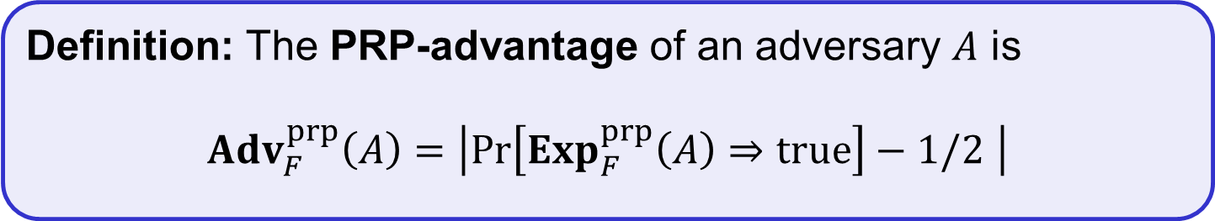
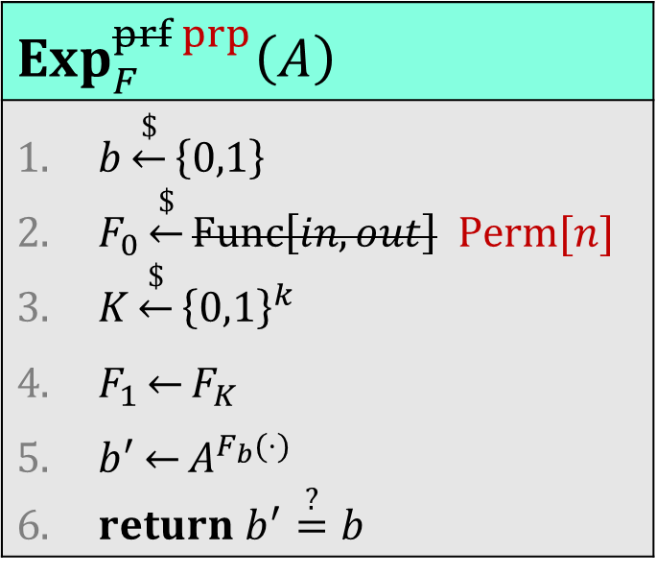

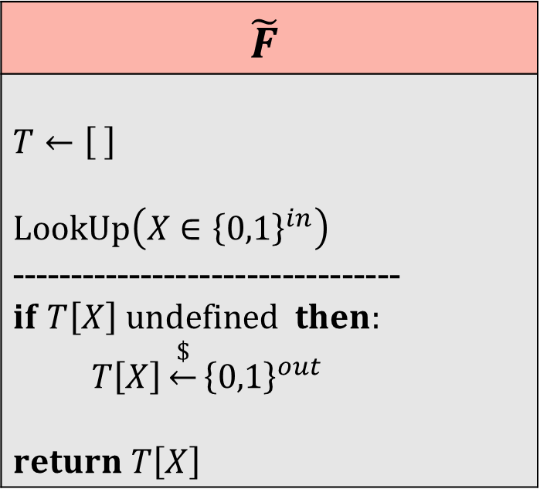
PRP security definition
$$Exp_{F}^{prf prp}\left(A\right)$$
$b\underset{←}{\$}\left\{0,1\right\}$ $F_{0}\underset{←}{\$}Func\left[in, out\right] Perm[n]$ $K\underset{←}{\$}{\left\{0,1\right\}}^{k}$ $F_{1}\underset{←}{}F_{K}$ $b^{′}\underset{←}{}A^{F_{b}(⋅)}$ $return b^{′}\overset{?}{=}b$
$$\tilde{F}$$
$$T←\left[ \right]$$ $$LookUp\left(X∈{\left\{0,1\right\}}^{in}\right)$$ --------------------------------- $$if T\left[X\right] undefined then:$$ $T\left[X\right]\underset{←}{\$}{\left\{0,1\right\}}^{out}$ $return T\left[X\right]$
$$∖T.values$$
Definition: The PRP-advantage of an adversary $A$ is
$${Adv}_{F}^{prp}\left(A\right)=\left|\operatorname{Pr}\left[{Exp}_{F}^{prp}\left(A\right)⇒true\right]−1/2 \right|$$

Slide 32
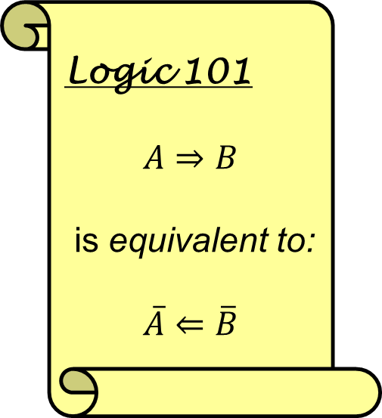
Block cipher security
Logic 101
$$A⇒B$$
is equivalent to:
$$\overline{A}⇐\overline{B}$$
Which security properties should a block cipher satisfy?
  I.e., what should the security definition of a block cipher look like?
Some suggestions:
  P1: Should be hard to obtain $K$ from ${Y← E}_{K}(X)$ for secret $K$
  P2: Should be hard to obtain $K$ from $Y_{1}, Y_{2}, …$ where $Y_{i}←E_{K}\left(X_{i}\right)$
  P3: Should be hard to obtain $X$ from ${Y← E}_{K}(X)$
  P4: Should be hard to obtain any $X_{i}$ from $Y_{1}, { Y}_{2}, …$where $Y_{i}←E_{K}\left(X_{i}\right)$
  P5: Should be hard to learn any bit of $X$ from ${Y← E}_{K}(X)$
  P6: Should be hard to detect repetitions among $X_{1},X_{2},…$ from $Y_{1}, Y_{2}, …$ Impossible!
  P7: …
$E$ is PRF/PRP secure $⟹$ $E$ has properties P1 – P5
Not good enough!
$E$ is not PRF/PRP secure $⟸$ $E$ has does not have properties P1 – P5

Slide 33
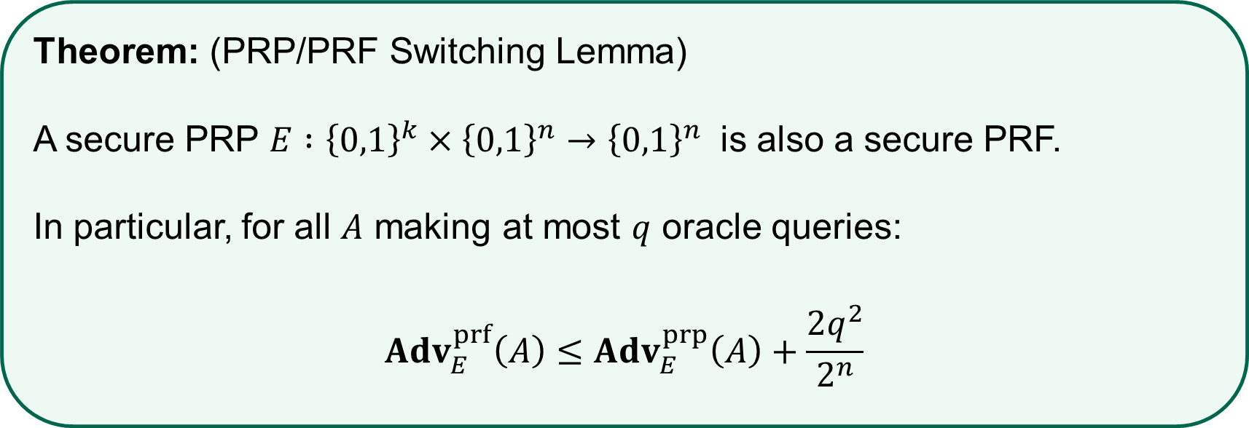
PRP security $⟹$ PRF security
Theorem: (PRP/PRF Switching Lemma)
A secure PRP $E :{\left\{0,1\right\}}^{k}×{\left\{0,1\right\}}^{n}→{\left\{0,1\right\}}^{n}$ is also a secure PRF.
In particular, for all $A$ making at most $q$ oracle queries:
$${Adv}_{E}^{prf}\left(A\right)≤{Adv}_{E}^{prp}\left(A\right)+\frac{{2q}^{2}}{2^{n}}$$

Slide 34
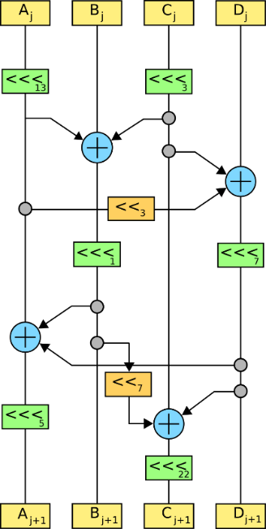

Constructing block ciphers

Slide 35


PRPs from PRFs – the Feistel construction
Let $F :{{\left\{0,1\right\}}^{k}×\left\{0,1\right\}}^{n/2}→{\left\{0,1\right\}}^{n/2}$ be a PRF
  not a permutation!
Function $E\left(K,X\right)={Feistel}_{F}^{\left(4\right)}(K, X)$ is a PRP
  Called a Feistel network/construction
  $E :{\left\{0,1\right\}}^{4k}×{\left\{0,1\right\}}^{n}→{\left\{0,1\right\}}^{n}$
More or less DES:
$DES≈{Feistel}_{F}^{\left(16\right)} :{\left\{0,1\right\}}^{56}×{\left\{0,1\right\}}^{64}→{\left\{0,1\right\}}^{64}$
(56-bit key is expanded to 16 48-bit roundkeys)

Slide 36



Feistel network security – theory
Theorem: (Luby & Rackoff '86)
If $F :{{\left\{0,1\right\}}^{k}×\left\{0,1\right\}}^{n/2}→{\left\{0,1\right\}}^{n/2}$ is a secure PRF
$⟹$ 3-round Feistel $E :{\left\{0,1\right\}}^{3k}×{\left\{0,1\right\}}^{n}→{\left\{0,1\right\}}^{n}$
is a secure PRP
$$3$$
$$3$$

Slide 37

Data Encryption Standard (DES)
1972 – NIST calls for a block cipher standard
1974 – Horst Feistel at IBM designs Lucifer
  Key-length: 128 bits; block-length: 128 bits
Lucifer evolves into DES
  Input from the NSA
  Key-length: 56 bits; block-length: 64 bits
  #Rounds: 16
1976 – Lucifer (now DES) is standardized
Widely implemented
1997 – Broken by exhaustive search
2001 – Replaced by AES

Slide 38
Principles for designing block ciphers
C. Shannon, “Communication Theory of Secrecy Systems”(1949):
  Diffusion: plaintext spread over large parts of the ciphertext
  Confusion: a complex relation between plaintext, key and ciphertext

Slide 39








DES
$$K$$
$$F:{\left\{0,1\right\}}^{48}×{\left\{0,1\right\}}^{32}→{\left\{0,1\right\}}^{32}$$
Key expansion
$$M$$
…
$$C$$
$$K_{1}$$
$$K_{16}$$
64 bits
64 bits
16-round Feistel network
…
$$IP$$
$$IP^{−1}$$

Slide 40




DES round function
$$F(K_{i}, X)$$
S-box: function ${\left\{0,1\right\}}^{6}→{\left\{0,1\right\}}^{4},$
Implemented as a look-up table

Slide 41

DES properties
Easy to implement in hardware
Not as efficient in software
Many design decisions still unclear
  Design criteria classified for many years
  Controversy around NSA influence
  Initial S-boxes were changed
  Switching to 56-bit keys (from 128 bits) probably to allow NSA to decrypt
Not secure since key space and block length too small $⟹$ replacement needed

Slide 42
Advanced Encryption Standard

Slide 43





Substitution-permutation networks

Slide 44












AES-128
128
$$K$$
128
128
128
128
$$K_{0}$$
$$K_{1}$$
$$K_{2}$$
$$K_{9}$$
$$K_{10}$$
input
output
SubBytes
ShiftRow
MixColumn
SubBytes
ShiftRow
MixColumn
SubBytes
ShiftRow
$$⊕$$
$$⊕$$
$$⊕$$
$$⋯$$
$$⊕$$
$$⊕$$
10 rounds

Slide 45



AES round function
SubBytes
ShiftRow
MixColumn

Slide 46
AES round
$$a_{0,0}$$ | $$a_{0,1}$$ | $$a_{0,2}$$ | $$a_{0,3}$$
$$a_{1,0}$$ | $$a_{1,1}$$ | $$a_{1,2}$$ | $$a_{1,3}$$
$$a_{2,0}$$ | $$a_{2,1}$$ | $$a_{2,2}$$ | $$a_{2,3}$$
$$a_{3,0}$$ | $$a_{3,1}$$ | $$a_{3,2}$$ | $$a_{3,3}$$
SubBytes | $$b_{i,j}=S[a_{i,j}]$$
ShiftRows | $$\left[\begin{matrix}c_{0,j} \\ c_{1,j} \\ \begin{matrix}c_{2,j} \\ c_{3,j}\end{matrix}\end{matrix}\right]=\left[\begin{matrix}b_{0,j} \\ b_{1,j−1} \\ \begin{matrix}b_{2,j−2} \\ b_{3,j−3}\end{matrix}\end{matrix}\right]$$
MixColumns | $$\left[\begin{matrix}d_{0,j} \\ d_{1,j} \\ \begin{matrix}d_{2,j} \\ d_{3,j}\end{matrix}\end{matrix}\right]=\left[\begin{matrix}\begin{matrix}02 & 03 \\ 01 & 02\end{matrix} & \begin{matrix}01 & 01 \\ 03 & 01\end{matrix} \\ \begin{matrix}01 & 01 \\ 03 & 01\end{matrix} & \begin{matrix}02 & 03 \\ 01 & 02\end{matrix}\end{matrix}\right]\left[\begin{matrix}c_{0,j} \\ c_{1,j} \\ \begin{matrix}c_{2,j} \\ c_{3,j}\end{matrix}\end{matrix}\right]$$
AddRoundKey | $$\left[\begin{matrix}e_{0,j} \\ e_{1,j} \\ \begin{matrix}e_{2,j} \\ e_{3,j}\end{matrix}\end{matrix}\right]=\left[\begin{matrix}d_{0,j} \\ d_{1,j} \\ \begin{matrix}d_{2,j} \\ d_{3,j}\end{matrix}\end{matrix}\right]⊕\left[\begin{matrix}k_{0,j} \\ k_{1,j} \\ \begin{matrix}k_{2,j} \\ k_{3,j}\end{matrix}\end{matrix}\right]$$
$$\left[\begin{matrix}e_{0,j} \\ e_{1,j} \\ \begin{matrix}e_{2,j} \\ e_{3,j}\end{matrix}\end{matrix}\right]=\left[\begin{matrix}\begin{matrix}02 & 03 \\ 01 & 02\end{matrix} & \begin{matrix}01 & 01 \\ 03 & 01\end{matrix} \\ \begin{matrix}01 & 01 \\ 03 & 01\end{matrix} & \begin{matrix}02 & 03 \\ 01 & 02\end{matrix}\end{matrix}\right]\left[\begin{aligned}S[a_{0,j}] \\ S[a_{1,j−1}] \\ S[a_{2,j−2}] \\ S[a_{3,j−3}]\end{aligned}\right]⊕\left[\begin{matrix}k_{0,j} \\ k_{1,j} \\ \begin{matrix}k_{2,j} \\ k_{3,j}\end{matrix}\end{matrix}\right]$$
$$=\left(\left[\begin{aligned}02 \\ 01 \\ 01 \\ 03\end{aligned}\right]∙S[a_{0,j}]\right)⊕\left(\left[\begin{aligned}03 \\ 02 \\ 01 \\ 01\end{aligned}\right]∙S\left[a_{1,j−1}\right]\right)$$
$$⊕\left(\left[\begin{aligned}01 \\ 03 \\ 02 \\ 01\end{aligned}\right]∙S[a_{2,j−2}]\right)⊕\left(\left[\begin{aligned}01 \\ 01 \\ 03 \\ 02\end{aligned}\right]∙S[a_{3,j−3}]\right)⊕\left[\begin{matrix}k_{0,j} \\ k_{1,j} \\ \begin{matrix}k_{2,j} \\ k_{3,j}\end{matrix}\end{matrix}\right]$$
$$T_{0}\left[x\right]=\left(\left[\begin{aligned}02 \\ 01 \\ 01 \\ 03\end{aligned}\right]∙S\left[x\right]\right)$$ | $$T_{1}\left[x\right]=\left(\left[\begin{aligned}03 \\ 02 \\ 01 \\ 01\end{aligned}\right]∙S\left[x\right]\right)$$ | $$T_{2}\left[x\right]=\left(\left[\begin{aligned}01 \\ 03 \\ 02 \\ 01\end{aligned}\right]∙S\left[x\right]\right)$$ | $$T_{3}\left[x\right]=\left(\left[\begin{aligned}01 \\ 01 \\ 03 \\ 02\end{aligned}\right]∙S\left[x\right]\right)$$

Slide 47

AES round
$$a_{0,0}$$ | $$a_{0,1}$$ | $$a_{0,2}$$ | $$a_{0,3}$$
$$a_{1,0}$$ | $$a_{1,1}$$ | $$a_{1,2}$$ | $$a_{1,3}$$
$$a_{2,0}$$ | $$a_{2,1}$$ | $$a_{2,2}$$ | $$a_{2,3}$$
$$a_{3,0}$$ | $$a_{3,1}$$ | $$a_{3,2}$$ | $$a_{3,3}$$
SubBytes | $$b_{i,j}=S[a_{i,j}]$$
ShiftRows | $$\left[\begin{matrix}c_{0,j} \\ c_{1,j} \\ \begin{matrix}c_{2,j} \\ c_{3,j}\end{matrix}\end{matrix}\right]=\left[\begin{matrix}b_{0,j} \\ b_{1,j−1} \\ \begin{matrix}b_{2,j−2} \\ b_{3,j−3}\end{matrix}\end{matrix}\right]$$
MixColumns | $$\left[\begin{matrix}d_{0,j} \\ d_{1,j} \\ \begin{matrix}d_{2,j} \\ d_{3,j}\end{matrix}\end{matrix}\right]=\left[\begin{matrix}\begin{matrix}02 & 03 \\ 01 & 02\end{matrix} & \begin{matrix}01 & 01 \\ 03 & 01\end{matrix} \\ \begin{matrix}01 & 01 \\ 03 & 01\end{matrix} & \begin{matrix}02 & 03 \\ 01 & 02\end{matrix}\end{matrix}\right]\left[\begin{matrix}c_{0,j} \\ c_{1,j} \\ \begin{matrix}c_{2,j} \\ c_{3,j}\end{matrix}\end{matrix}\right]$$
AddRoundKey | $$\left[\begin{matrix}e_{0,j} \\ e_{1,j} \\ \begin{matrix}e_{2,j} \\ e_{3,j}\end{matrix}\end{matrix}\right]=\left[\begin{matrix}d_{0,j} \\ d_{1,j} \\ \begin{matrix}d_{2,j} \\ d_{3,j}\end{matrix}\end{matrix}\right]⊕\left[\begin{matrix}k_{0,j} \\ k_{1,j} \\ \begin{matrix}k_{2,j} \\ k_{3,j}\end{matrix}\end{matrix}\right]$$
$$\left[\begin{matrix}e_{0,j} \\ e_{1,j} \\ \begin{matrix}e_{2,j} \\ e_{3,j}\end{matrix}\end{matrix}\right]=T_{0}\left[a_{0,j}\right]⊕T_{1}\left[a_{1,j−1}\right]$$
$⊕T_{2}\left[a_{2,j−2}\right]⊕T_{3}\left[a_{3,j−3}\right]⊕\left[\begin{matrix}k_{0,j} \\ k_{1,j} \\ \begin{matrix}k_{2,j} \\ k_{3,j}\end{matrix}\end{matrix}\right]$
$$T_{0}\left[x\right]=\left(\left[\begin{aligned}02 \\ 01 \\ 01 \\ 03\end{aligned}\right]∙S\left[x\right]\right)$$ | $$T_{1}\left[x\right]=\left(\left[\begin{aligned}03 \\ 02 \\ 01 \\ 01\end{aligned}\right]∙S\left[x\right]\right)$$ | $$T_{2}\left[x\right]=\left(\left[\begin{aligned}01 \\ 03 \\ 02 \\ 01\end{aligned}\right]∙S\left[x\right]\right)$$ | $$T_{3}\left[x\right]=\left(\left[\begin{aligned}01 \\ 01 \\ 03 \\ 02\end{aligned}\right]∙S\left[x\right]\right)$$

Slide 48
AES performance
AES is reasonably efficient in software
  T-table implementation very fast
  (but not secure!)
  Hard to implement fast and constant-time
Intel introduced dedicated AES instructions into their CPUs (AES-NI):
  aesenc, aesenclast: do one round of AES in one cycle
  aeskeygenassist: do AES key expansion
  aesdec, aesdeclast: do one round of AES decryption in one cycle
  aesimc: do AES inverser MixColumns
  Now standard in all modern CPUs
 | Throughput
AES-128 (in software) | 265 MB/s
AES-128 (w/AES-NI) | 3.45 GB/s

Slide 49


Attacking block ciphers

Slide 50
Attacks on block ciphers
Brute force attacks: search through every possible key in key space
  Generic: works for all block ciphers
  Not practical for large key spaces
Advanced attacks: try to exploit the concrete details of the block cipher
  Differential cryptanalysis ('90, but known by the designers of DES + NSA since mid '70 )
  Linear cryptanalysis ('92)
  AES designed to resist both
Implementation attacks: vulnerabilities due to implementation characteristics
  Power draw
  Timing
  Cache misses

Slide 51
Summary
Block ciphers are very important primitives (building blocks) – but they are not encryption schemes!
Correct abstraction: block ciphers = PRPs
Right security notion for PRFs/PRPs:
indistinguishability from random function/permutation
Concrete block cipher designs: DES and AES

